Slide 1
AgriGuard: Crop Disease Detection
Frontier Tech Leaders Programme Global Cohort 1
Student Name : Andisha Saliha HAMEEDI
Date: 12.11.2023

Slide 2
Outline
Frontier Tech Leaders Programme Global Cohort 1
Concept note and implementation plan:
Background
Objectives
SDG Relation
Data
Data Collection
Exploratory Data Analysis (EDA) and Feature Engineering
Model Selection and Training
Model Evaluation and Hyperparameter Tuning
Model Refinement and Testing
Results
Deployment
Future Work

Slide 3
Concept note and implementation plan
Frontier Tech Leaders Programme Global Cohort 1

Slide 4
Background
Frontier Tech Leaders Programme Global Cohort 1
Agriculture plays a crucial role in sustaining human life, and the health of crops is essential for food security. Crop diseases pose a significant threat to agricultural productivity, leading to yield losses and economic challenges for farmers. Detecting and diagnosing these diseases early can help implement timely interventions, reducing losses and ensuring food production. In this context, leveraging machine learning for crop disease detection has emerged as a promising solution.

Slide 5
Frontier Tech Leaders Programme Global Cohort 1
Importance of the Problem Being Solved: Crop diseases can result in devastating consequences, affecting not only the livelihoods of farmers but also global food supply. Traditional methods of disease detection often rely on manual inspection, which is time-consuming and may not provide early detection. Machine learning models offer the potential to automate and enhance this process, enabling quick and accurate identification of crop diseases. By doing so, farmers can take prompt action to mitigate the impact, such as applying targeted treatments or preventive measures. This project aims to leverage the power of machine learning to revolutionize crop disease detection, contributing to sustainable agriculture and global food security.

Slide 6
Objectives
Frontier Tech Leaders Programme Global Cohort 1
1.Early Detection of Crop
2. Accurate Disease Classification
3. User-Friendly Interface
4. Scalability
5. Integration with Agricultural Practice.
6. Performance Optimization

Slide 7
Machine Learning Model Aims
1. Image Recognition: Train the model to recognize patterns and visual cues indicative of various crop diseases by analyzing images of affected plants.
2. Classification Accuracy: Achieve a high level of accuracy in classifying and diagnosing crop diseases to provide reliable information to farmers.
3. Adaptability: Develop a model that can adapt to new diseases and variations in symptoms, ensuring its relevance and effectiveness over time.
4. Interpretability: Ensure that the model's decision-making process is interpretable and transparent, allowing farmers to understand why a particular diagnosis was made.

Slide 8
SDG Relation
Frontier Tech Leaders Programme Global Cohort 1
Zero Hunger (SDG 2): The project directly aligns with SDG 2 by addressing the challenge of crop losses and enhancing food security in developing countries. By reducing crop losses through early disease detection and management, AgriGuard contributes to achieving the goal of zero hunger, ensuring that people have access to sufficient, safe, and nutritious food

Slide 9
Data
Frontier Tech Leaders Programme Global Cohort 1

Slide 10
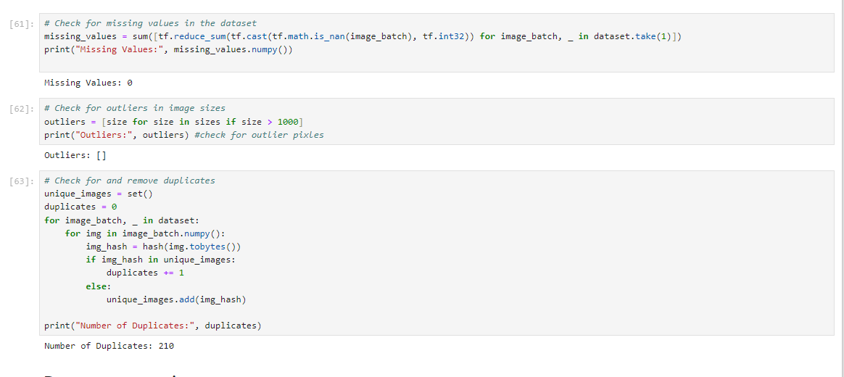
Data Collection
Frontier Tech Leaders Programme Global Cohort 1
The dataset primarily consist of images capturing the visual characteristics of crops, including both healthy and diseased states. The images are in commonly used formats such as JPEG.
Powerful sources for agricultural data: PlantVillage

Slide 11
Exploratory Data Analysis (EDA) and Feature Engineering
Frontier Tech Leaders Programme Global Cohort 1
Exploratory Data Analysis (EDA):
1. Class Distribution Visualization: Extracted class names from the dataset and visualized a sample of images along with their corresponding class labels.
2. Dataset Information and Distribution Analysis: Examined the structure of the dataset by printing information about the first few batches.
3. Visualized the distribution of image sizes in a histogram.
3. Image Segmentation Features Exploration:
4. Defined a function for extracting color difference features through image segmentation.

Slide 12
Feature Engineering:
1. Dataset Partitioning: Created a function to split the dataset into training, validation, and test sets.
2. Shuffled the dataset to introduce randomness: Proper dataset partitioning is essential for training, validation, and evaluation of machine learning models. Shuffling helps prevent any order-related biases during training.
3. Data Preprocessing: Resized and rescaled images using Keras preprocessing layers.
4. Applied data augmentation techniques (random flips and rotations) to increase dataset variability. Resizing ensures uniformity in input dimensions, and rescaling normalizes pixel values. Data augmentation enhances model generalization by exposing it to diverse transformations during training.
5. Image Segmentation Features Integration: Utilized the SLIC algorithm for image segmentation and calculated color differences.
Rationale Behind Feature Engineering:
these feature engineering techniques are tailored to address specific challenges in plant disease detection. Image segmentation hones in on relevant disease-related patterns, data augmentation fosters model robustness, and resizing/rescaling ensures standardized inputs. Together, these strategies aim to enhance the model's ability to accurately classify healthy and diseased plant leaves, promoting improved performance and generalization.

Slide 13
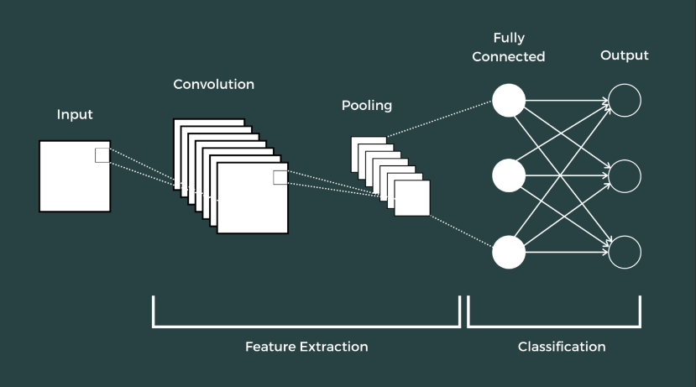
Model
Frontier Tech Leaders Programme Global Cohort 1

Slide 14
Model Selection and Training
Frontier Tech Leaders Programme Global Cohort 1
Convolutional Neural Networks (CNNs) are particularly well-suited for image classification tasks due to their inherent architecture, which is designed to effectively capture and leverage spatial hierarchies of features present in images. Here's a brief explanation of why CNNs excel in image classification:
Strengths: Weaknesses:
Hierarchical Feature Learning 1. Data Requirements
Translation Invariance 2. Computational Cost
Parameter Sharing
Pooling Layers
Adaptability to Image Sizes
Spatial Hierarchy

Slide 15
Model Training
Input Data: The input data is a batch of images, each with dimensions (IMAGE_SIZE, IMAGE_SIZE, CHANNELS).
Preprocessing (resize_and_rescale): The input images undergo preprocessing, which involves resizing and rescaling operations. This step ensures that all input images have the same dimensions and intensity range.
Convolutional Layers: The first layer is a Convolutional layer with 32 filters (kernels) of size (3, 3). These filters slide (convolve) across the input image, capturing local patterns or features. Activation function ReLU is applied elementwise to introduce non-linearity. This layer extracts 32 feature maps from the input image.
Max Pooling Layers
Flattening Layer
Dense (Fully Connected) Layers
Output

Slide 16
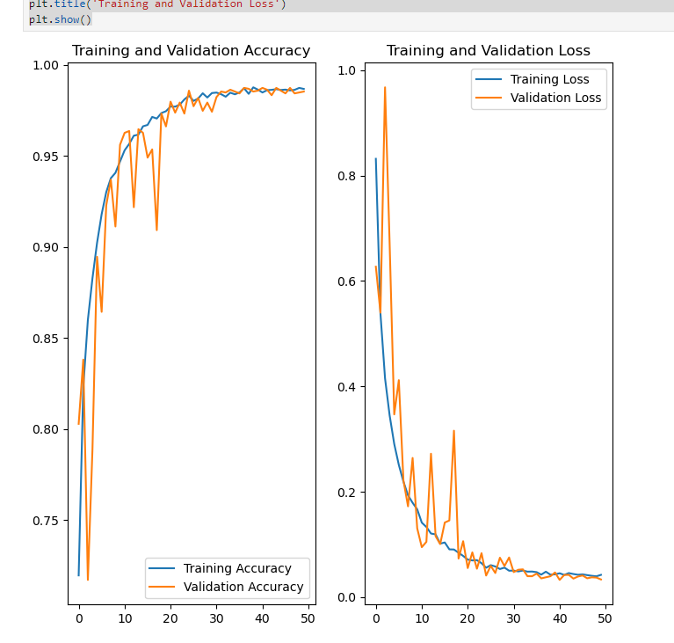
Model Evaluation and Hyperparameter Tuning
Frontier Tech Leaders Programme Global Cohort 1
1.Evaluation Metrics and Visualizations:
Training and Validation Loss/Accuracy: The code plots training and validation accuracy and loss over epochs, providing insights into the model's learning behavior.
Testing Evaluation: The model is evaluated on the test dataset using model.evaluate(test_dataset), and the results are stored in the scores variable.
2. Highlight the Model's Performance:
Accuracy and Loss Plots:

Slide 17
Details on Hyperparameter Tuning:
Model Architecture: The model architecture consists of convolutional layers with batch normalization, max-pooling, and dense layers. A dropout layer is included for regularization.
Learning Rate Scheduler: The learning rate is scheduled using LearningRateScheduler. Initially set at 0.001, it undergoes a decay of 0.9 per epoch.
Loss Function: Sparse categorical crossentropy is chosen as the loss function, suitable for multi-class classification tasks.
Impact on Model Performance:
The learning rate schedule helps in dynamic adjustment of the learning rate during training. A carefully chosen schedule can contribute to faster convergence and better generalization. The impact of the specific decay rate and schedule should be observed in the accuracy and loss plots over epochs.
In summary, the project demonstrates a comprehensive approach to model evaluation, including visualizations of training dynamics and assessment on a separate test dataset. Hyperparameter tuning involves adjusting the learning rate dynamically, employing data augmentation, and choosing a suitable model architecture. The impact of these decisions is observed through the model's performance metrics and visualizations.

Slide 18
Model Refinement and Testing
Frontier Tech Leaders Programme Global Cohort 1
In the initial model evaluation phase, the performance of the model was assessed using key metrics and visualizations. The following summary highlights the key findings and areas identified for improvement:
1.Training Metrics: During the training phase (as shown in the code), the model achieved a training accuracy of approximately 99.48% after 30 epochs. This high accuracy indicates that the model learned well from the training data.
2.Validation Metrics: The validation accuracy reached around 100% after 30 epochs, suggesting that the model performed exceptionally well on the validation set. However, it's essential to consider potential overfitting, especially if there is a significant gap between training and validation performance.
3. Loss Curves: The loss curves for both training and validation sets were plotted. While the training loss steadily decreased, indicating learning, the validation loss also exhibited a decreasing trend. However, close attention should be paid to potential overfitting or instability in the later epochs.
4. Accuracy Curves: Accuracy curves for training and validation sets were also plotted. The increasing trend in both curves indicates that the model was learning the features of the dataset. However, close examination of the curves for signs of overfitting is crucial.

Slide 19
Results
Frontier Tech Leaders Programme Global Cohort 1

Slide 20
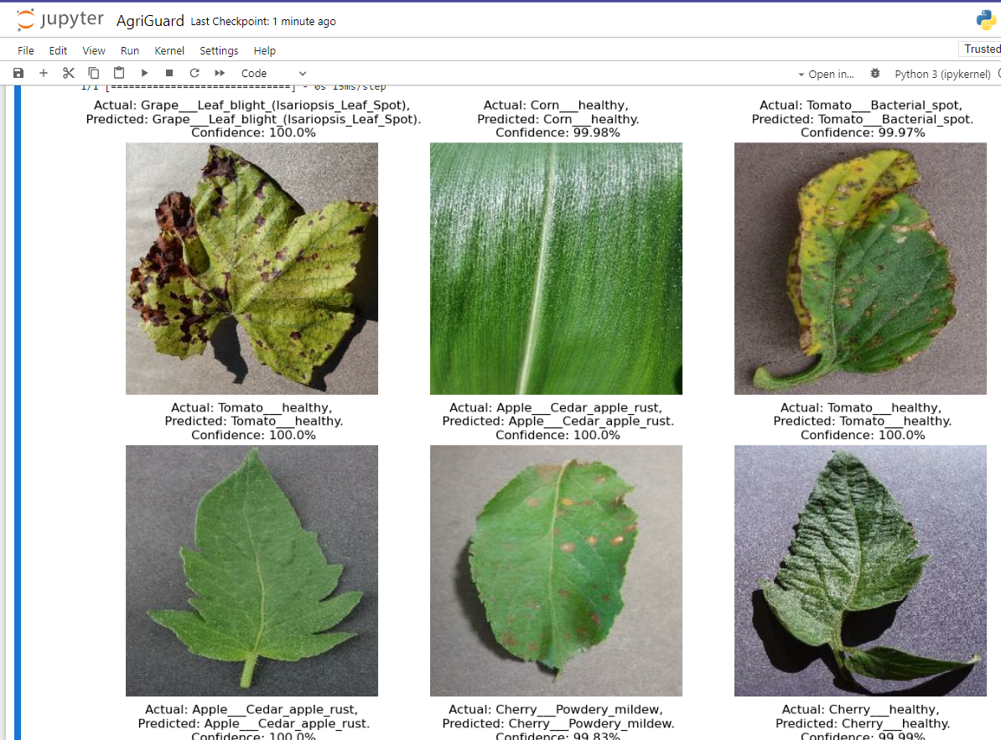
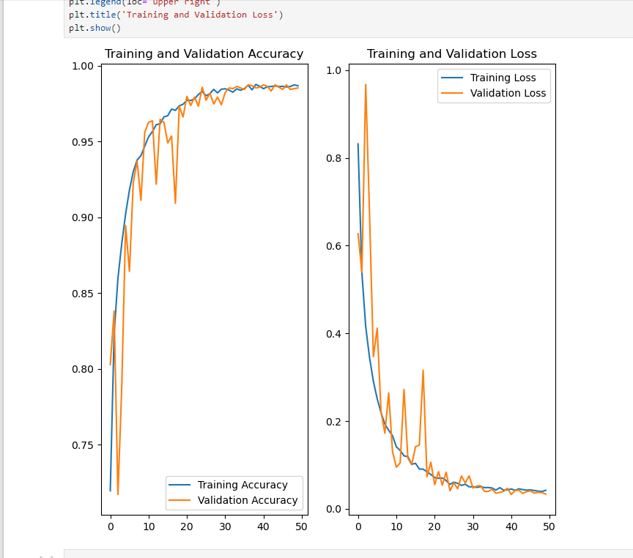
Evaluation Results
Frontier Tech Leaders Programme Global Cohort 1

Slide 21
Deployment
Frontier Tech Leaders Programme Global Cohort 1
GCP Account and Project Creation
GCP Bucket Creation and Model Upload
Google Cloud SDK Installation and Authentication
Real-World Deployment Considerations

Slide 22
Future Work
Frontier Tech Leaders Programme Global Cohort 1
Future improvements may involve advanced model architectures, diverse data sources, and features that provide more context or granularity to the crop disease detection system. Additionally, considering the practical usability and feedback from stakeholders is essential for successful deployment in real-world scenarios.

Slide 23
References
Frontier Tech Leaders Programme Global Cohort 1
https://github.com/codebasics/potato-disease-classification/blob/main/training/potato-disease-classification-model-using-image-data-generator.ipynb
Published in: 2018 Fourth International Conference on Computing Communication Control and Automation (ICCUBEA)
Date of Conference: 16-18 August 2018
Date Added to IEEE Xplore: 25 April 2019
ISBN Information:
INSPEC Accession Number: 18617937
DOI: 10.1109/ICCUBEA.2018.8697390
Publisher: IEEE
Conference Location: Pune, India
Published in: February 2018, Pages 311-318Journal/Conference: Computers, Materials & Continua In this paper, convolutional neural network models were developed to perform plant disease detection and diagnosis using simple leaves images of healthy and diseased plants, through deep learning methodologies.

Slide 24


Thank you!
Frontier Tech Leaders Programme Global Cohort 1

