Slide 1
Prediction of Terrorism incidents in West Africa
Frontier Tech Leaders Programme Global Cohort 1
Abdoul Faride Bassirou Alzouma
09/12/2023

Slide 2
Outline
Frontier Tech Leaders Programme Global Cohort 1
Concept note and implementation plan:
Background
Objectives
SDG Relation
Data
Data Collection
Exploratory Data Analysis (EDA) and Feature Engineering
Model Selection and Training
Model Evaluation and Hyperparameter Tuning
Model Refinement and Testing
Results
Deployment
Future Work

Slide 3
Concept note and implementation plan
Frontier Tech Leaders Programme Global Cohort 1

Slide 4
Background
Frontier Tech Leaders Programme Global Cohort 1
Terrorism persists in West Africa, posing substantial social, economic, and security challenges. The lack of localized and reliable prediction models impedes preventative interventions, worsening the impact on communities and impeding efforts toward sustainable development.
The project's main goal is to create a prediction model that forecasts terrorist attacks in West Africa by using machine learning techniques.

Slide 5
Background
Frontier Tech Leaders Programme Global Cohort 1
The project tackles the complex problem of terrorism in West Africa, considering historical tensions and socio-economic disparities. Advocating for a machine learning approach, it aims to enhance prediction accuracy, adaptability, and holistic analysis, contributing to a robust strategy for effectively addressing and mitigating the impact of terrorism in the region.

Slide 6
Background
Frontier Tech Leaders Programme Global Cohort 1
Solving the problem of terrorism in West Africa is crucial due to its far-reaching impact on security, social stability, and economic development. Developing reliable prediction models tailored to the local context is essential for proactive interventions, minimizing harm to communities, and promoting sustainable development in the region.

Slide 7
Objectives
Frontier Tech Leaders Programme Global Cohort 1
Create a machine learning model to predict terrorism incidents in West Africa accurately, considering historical tensions and socio-economic factors.
Improve the model's adaptability to changing threats, ensuring it learns continuously in evolving contexts.
Analyze terrorism patterns comprehensively by using diverse datasets covering social, economic, and geopolitical dynamics in the region.
Establish an early warning system for timely intervention, reducing the impact of potential terrorism threats on communities.
Optimize resource allocation by identifying high-risk areas, contributing to both security measures and sustainable development.
Provide data-driven insights to empower stakeholders like policymakers, security agencies, and humanitarian organizations for more effective decision-making.
Contribute to developing a comprehensive strategy for predicting, preventing, and mitigating the impact of terrorism in West Africa.

Slide 8
Objectives
Frontier Tech Leaders Programme Global Cohort 1
The machine learning model aims to predict the probability of a terrorism attack in West Africa based on factors like location and time. Additionally, it will assess the likelihood of an attack's success, contributing to a comprehensive understanding of potential incidents and their outcomes.

Slide 9
SDG Relation
Frontier Tech Leaders Programme Global Cohort 1
SDG 16: Peace, Justice, and Strong Institutions
By tackling the important problem of terrorism and seeking to improve security protocols and lessen the effects of terrorism on communities in West Africa, the project helps to advance inclusive, peaceful societies.

Slide 10
SDG Relation
Frontier Tech Leaders Programme Global Cohort 1
SDG 1: No Poverty and SDG 8: Decent Work and Economic Growth
Addressing terrorism's socio-economic repercussions, the project aims to reduce poverty by promoting sustainable development initiatives and economic growth, aligning with the goals of poverty eradication and decent work.

Slide 11
SDG Relation
Frontier Tech Leaders Programme Global Cohort 1
SDG 17: Partnerships for the Goals
Collaborative efforts involving stakeholders such as policymakers, security agencies, and humanitarian organizations align with SDG 17, emphasizing the importance of partnerships to achieve sustainable development.

Slide 12
Data
Frontier Tech Leaders Programme Global Cohort 1

Slide 13
Data Collection
Frontier Tech Leaders Programme Global Cohort 1
The primary data source for this project is the "Global Terrorism Database" (GTD), which is available on Kaggle. The GTD is a comprehensive and widely used dataset that records terrorist incidents worldwide. It provides detailed information on various aspects of each incident, including the location, date, attack type, target type, casualties, and additional contextual factors.
The data contains around 180000 records, with 135 features providing a rich source for analysis.

Slide 14
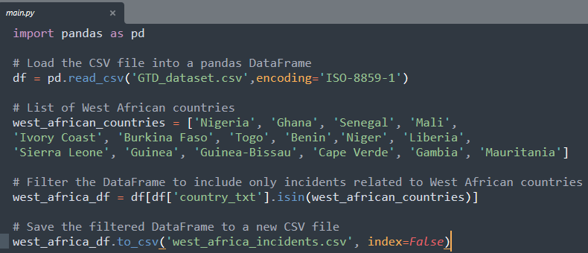
Data Collection
Frontier Tech Leaders Programme Global Cohort 1
Extracting only west Africa countries relational terrorist attacks from the Global Terrorism Database dataset.
Pandas library has been used for extraction.

Slide 15
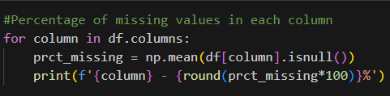
Data Collection
Frontier Tech Leaders Programme Global Cohort 1
Looking for the percentage missing values in every column by using isnull() and sum()
Then every column that have 25% and more of missing values get dropped
Drop Unnecessary columns for the analysis.

Slide 16
Exploratory Data Analysis (EDA) and Feature Engineering
Frontier Tech Leaders Programme Global Cohort 1
Relevant data, including time, place, and socioeconomic indicators, have been chosen and converted to numerical representations in order to create features for this project.
Through this procedure, the data was transformed into a machine-learning-friendly format, allowing the model to assess and forecast terrorist attacks in West Africa with more accuracy.

Slide 17
Exploratory Data Analysis (EDA) and Feature Engineering
Frontier Tech Leaders Programme Global Cohort 1
The rationale behind feature engineering decisions in this project is to capture key aspects influencing terrorism incidents, transforming qualitative information like location and time into numerical features for the machine learning model. This approach enhances the model's ability to discern patterns and relationships critical for accurate predictions in the West African context.

Slide 18
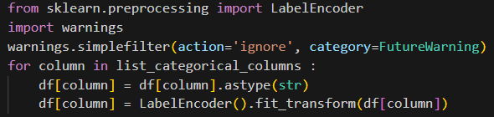
Exploratory Data Analysis (EDA) and Feature Engineering
Frontier Tech Leaders Programme Global Cohort 1
In this project, scaling is applied to ensure consistency in numerical feature magnitudes, normalization is used to bring features within a standard range, and encoding converts categorical variables like terrorist group name into numerical formats.

Slide 19
Model
Frontier Tech Leaders Programme Global Cohort 1

Slide 20
Model Selection and Training
Frontier Tech Leaders Programme Global Cohort 1
The reason for choosing an XGBoost (Extreme Gradient Boosting) model for this project lies in its ability to handle complex relationships within the data, adapt to changing contexts, and provide high predictive accuracy.

Slide 21
Model Selection and Training
Frontier Tech Leaders Programme Global Cohort 1
Strengths
XGBoost is particularly good at identifying complex patterns, adjusting to shifting circumstances, and offering a high degree of predicted accuracy. It works well for complicated, multidimensional problems like terrorism incident prediction because of its ensemble nature, which leverages the skills of several weak learners.

Slide 22
Model Selection and Training
Frontier Tech Leaders Programme Global Cohort 1
Weaknesses
On the other hand, the intricacy of XGBoost might result in more processing demands and longer training durations. Furthermore, the ensemble structure of the model may make it difficult to read, requiring a trade-off between interpretability and accuracy.

Slide 23
Model Selection and Training
Frontier Tech Leaders Programme Global Cohort 1
For training the XGBoost model, the dataset is divided into 80% of training set and 20% of testing set. Hyperparameters are tuned using grid search technique with cross-validation to enhance performance, and the model has been trained until convergence on the training data.
The number of cross-validation folds has been set to 5 and as an appropriate metric accuracy has been chosen over precision and recall.

Slide 24
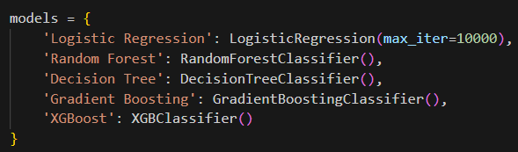
Model Selection and Training
Frontier Tech Leaders Programme Global Cohort 1
Models chosen to train and make comparison

Slide 25
Model Evaluation and Hyperparameter Tuning
Frontier Tech Leaders Programme Global Cohort 1
All the chosen models have been evaluated by using key metrics such as: accurary,precision and F1.
Every model’s accuracy on training and testing set have been observed.

Slide 26
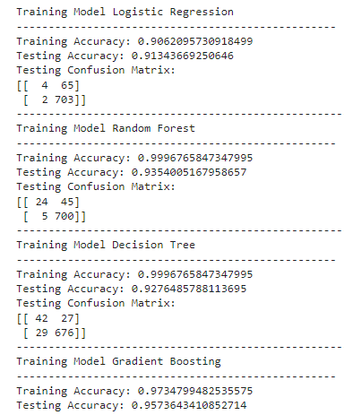
Model Evaluation and Hyperparameter Tuning
Frontier Tech Leaders Programme Global Cohort 1
Each model’s performance on training and testing set.

Slide 27
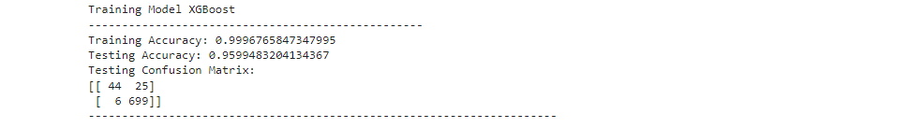
Model Evaluation and Hyperparameter Tuning
Frontier Tech Leaders Programme Global Cohort 1
For the predictions the best model chosen is XGB due to his shown high performance.

Slide 28
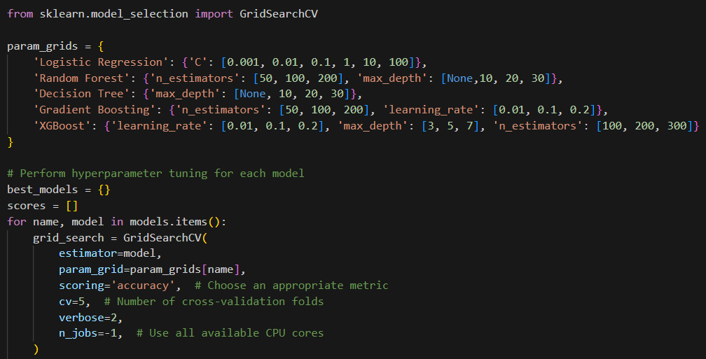
Model Evaluation and Hyperparameter Tuning
Frontier Tech Leaders Programme Global Cohort 1
GridSearchCV from Scite-Learn library has been used during the hyperparameter tuning for each model with a cross-validation folds set to 5.

Slide 29
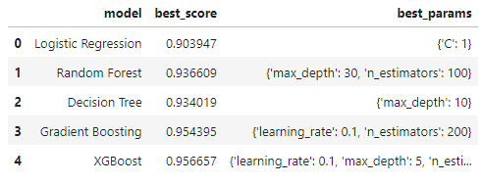
Model Evaluation and Hyperparameter Tuning
Frontier Tech Leaders Programme Global Cohort 1
After Hyperparameter tuning each one of model’s best score and best parameters have been founded.

Slide 30

Model Evaluation and Hyperparameter Tuning
Frontier Tech Leaders Programme Global Cohort 1
After finding the best parameters and best score for each model, the test set has been used to evaluated the accuracy for each model
The Selected XGB model gets an improvement of around 1.5% after hyperparameter tuning.

Slide 31
Model Refinement and Testing
Frontier Tech Leaders Programme Global Cohort 1
In the model refinement section, Hyperparameter technique with cross-validation have been chosen to refine the model. Refinement techniques have been applied to all the models in order to find better parameters for each model.

Slide 32
Model Refinement and Testing
Frontier Tech Leaders Programme Global Cohort 1
The final XGBoost model is tested on a different, never-before-seen test dataset during the test submission step in order to gauge its performance on fresh data. In order to verify the model's efficacy in forecasting terrorist attacks in West Africa, this phase involves assessing critical metrics like accuracy, precision, recall, and F1-score.

Slide 33
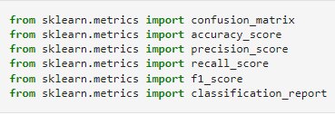
Model Refinement and Testing
Frontier Tech Leaders Programme Global Cohort 1
The metrics used :

Slide 34
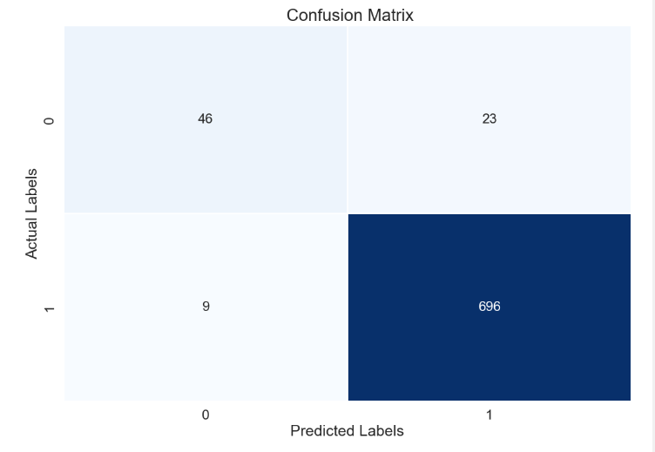
Model Refinement and Testing
Frontier Tech Leaders Programme Global Cohort 1
The confusion matrix of XGB model

Slide 35
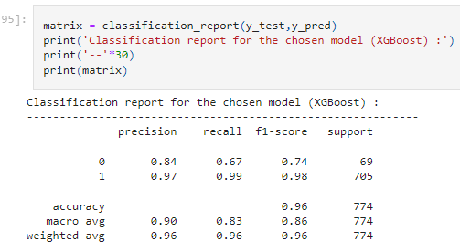
Model Refinement and Testing
Frontier Tech Leaders Programme Global Cohort 1
The model’s report

Slide 36
Results
Frontier Tech Leaders Programme Global Cohort 1

Slide 37
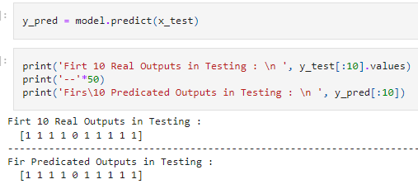
Evaluation Results
Frontier Tech Leaders Programme Global Cohort 1
10 First prediction on the test dataset
1 is for succeeded terrorist attack
0 is for failed terrorist attack

Slide 38
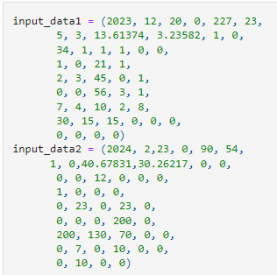
Evaluation Results
Frontier Tech Leaders Programme Global Cohort 1
We create two records of terrorist attack, one as succeeded and other one as failed terrorist attack and give it to the model in order to see his prediction

Slide 39
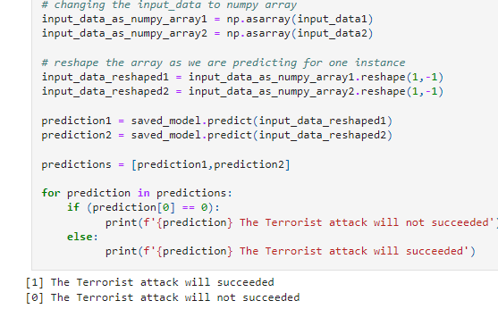
Evaluation Results
Frontier Tech Leaders Programme Global Cohort 1
We get the result we are expected

Slide 40
Deployment
Frontier Tech Leaders Programme Global Cohort 1
During the deployment stage, the production environment will be integrated with the trained XGBoost model, enabling it to make predictions on incoming data in real-time.
This will include configuring API endpoints, making sure the new system works with the old one, and putting in place any security precautions that are required. Updating the model and keeping an eye on it are necessary to keep it working well over time.

Slide 41
Deployment
Frontier Tech Leaders Programme Global Cohort 1
An entire Full Stack (Frontend and Backend) web application will be developed by integrating inside our prediction model. React framework will be used to create an interactive frontend and also a warning system will be implemented in the application for early intervention.

Slide 42
Future Work
Frontier Tech Leaders Programme Global Cohort 1
Enhanced Feature Engineering
We plan to explore more sophisticated feature engineering techniques to capture a broader range of factors influencing terrorism incidents, potentially improving the model's predictive capabilities.
Dynamic Model Updating
Provide a system for dynamic model updating so that it may adjust to shifting circumstances and threat environments, maintaining the model's efficacy over time.

Slide 43
Future Work
Frontier Tech Leaders Programme Global Cohort 1
Collaboration and Knowledge Sharing
Promote cooperation with data scientists, terrorist studies professionals, and regional experts to obtain important insights and improve the model based on a more thorough comprehension of the West African context.
Global Collaboration
Explore opportunities for collaboration with international organizations, research institutions, and other regions facing similar challenges to share knowledge, data, and methodologies, fostering a global approach to addressing terrorism.

Slide 44
References
Frontier Tech Leaders Programme Global Cohort 1
RASCHKA, Sebastian et MIRJALILI, Vahid. Python machine learning: Machine learning and deep learning with Python, scikit-learn, and TensorFlow 2. Packt Publishing Ltd, 2019.
GÉRON, Aurélien. Hands-on machine learning with Scikit-Learn, Keras, and TensorFlow. " O'Reilly Media, Inc.", 2022.
HUAMANÍ, Enrique Lee, ALVA, Mantari Alicia, et ROMAN-GONZALEZ, Avid. Machine learning techniques to visualize and predict terrorist attacks worldwide using the global terrorism database. International Journal of Advanced Computer Science and Applications, 2020, vol. 11, no 4.
DEMIR, Mustafa, GULER, Ahmet, et OZER, Murat. Predictors of successful terrorism incidents. Behavioral Sciences of Terrorism and Political Aggression, 2022, p. 1-29..
https://www.wearecapicua.com/blog/machine-learning-reactjs

Slide 45


Thank you!
Frontier Tech Leaders Programme Global Cohort 1

