Slide 1
Prediction of Terrorism Incidents in West Africa
Frontier Tech Leaders Programme Global Cohort 1
Abdoul Faride Bassirou Alzouma
16/12/2023

Slide 2
Outline
Frontier Tech Leaders Programme Global Cohort 1
Concept note and implementation plan:
Background
Objectives
SDG Relation
Data
Methodology
Results
Deployment
Future Work

Slide 3
Concept note and implementation plan
Frontier Tech Leaders Programme Global Cohort 1

Slide 4
Background
Frontier Tech Leaders Programme Global Cohort 1
The project intends to develop a machine learning model that takes historical tensions and socioeconomic factors into account. Terrorism is a major issue in West Africa, yet there are no good prediction models, making proactive measures difficult. The project tackles this gap by providing early warnings and improving resource allocation, contributing to regional stability and aligning with UN Sustainable Development Goals.

Slide 5
SDG Relation
Frontier Tech Leaders Programme Global Cohort 1
The project is directly related to the United Nations Sustainable Development Goal 16: Peace, Justice, and Strong Institutions. It contributes to boosting regional security, fostering early warning systems, and integrating with the broader SDG framework for sustainable development by establishing a machine learning model for forecasting terrorism attacks in West Africa.

Slide 6
Objectives
Frontier Tech Leaders Programme Global Cohort 1
Develop a precise machine learning model to predict terrorism incidents in West Africa, considering historical tensions and socio-economic factors.
Enhance the model's adaptability to changing threats, ensuring continuous learning in evolving contexts.
Analyze terrorism patterns comprehensively using diverse datasets covering social, economic, and geopolitical dynamics in the region.
Establish an early warning system for timely intervention, reducing the impact of potential terrorism threats on communities.
Optimize resource allocation by identifying high-risk areas, contributing to both security measures and sustainable development.
Provide data-driven insights to empower stakeholders such as policymakers, security agencies, and humanitarian organizations for more effective decision-making.
Contribute to the development of a comprehensive strategy for predicting, preventing, and mitigating the impact of terrorism in West Africa.

Slide 7
Data
Frontier Tech Leaders Programme Global Cohort 1
The primary data source is Kaggle's "Global Terrorism Database" (GTD), a commonly used dataset that records global terrorism incidents. The GTD provides detailed information on incident details, including location, date, attack type, target type, casualties, and contextual elements, with roughly 180,000 records and 135 attributes, creating a solid platform for analysis.

Slide 8
Methodology
Frontier Tech Leaders Programme Global Cohort 1
For this project, the chosen methodology involves using a machine learning approach to predict if a terrorism incident is succeeded or failed in West Africa region. The specific AI method employed is ensemble learning, incorporating algorithms such as Logistic Regression, Random Forest, Decision Tree, Gradient Boosting, and XGBoost.

Slide 9
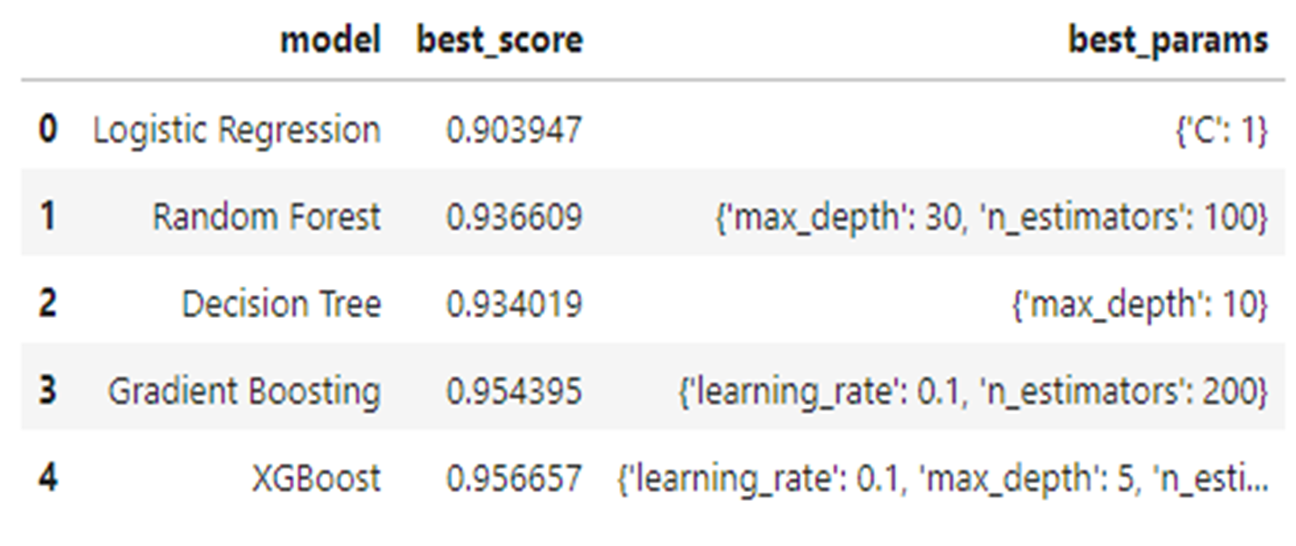
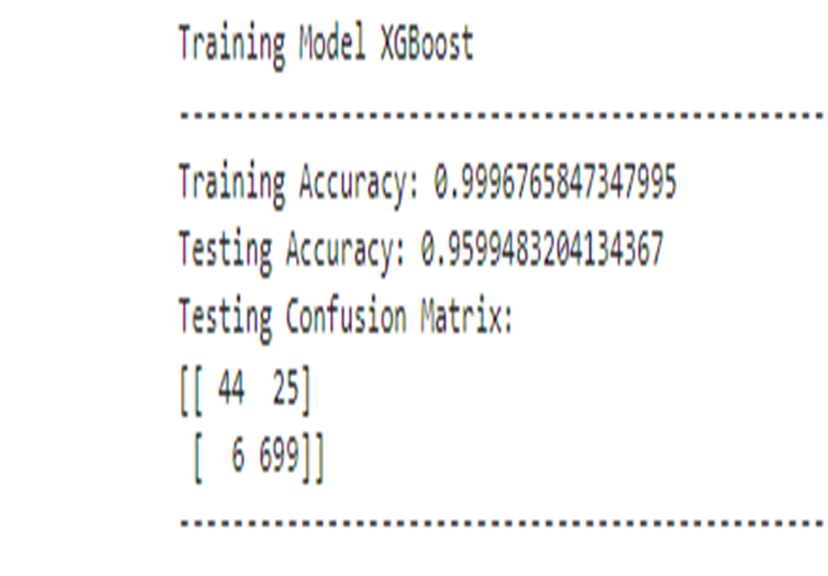
Evaluation Results
Frontier Tech Leaders Programme Global Cohort 1

Slide 10
Deployment
Frontier Tech Leaders Programme Global Cohort 1
By incorporating our prediction model, I am creating a comprehensive Full Stack (Frontend and Backend) web application. The React framework is used to develop an interactive frontend, and an early intervention warning system will be included in the application.

Slide 11
Future Work
Frontier Tech Leaders Programme Global Cohort 1
I plan to explore more sophisticated feature engineering techniques to capture a broader range of factors influencing terrorism incidents, potentially improving the model's predictive capabilities.
Explore opportunities for collaboration with international organizations, research institutions, and other regions facing similar challenges to share knowledge, data, and methodologies, fostering a global approach to addressing terrorism.

Slide 12
References
Frontier Tech Leaders Programme Global Cohort 1
RASCHKA, Sebastian et MIRJALILI, Vahid. Python machine learning: Machine learning and deep learning with Python, scikit-learn, and TensorFlow 2. Packt Publishing Ltd, 2019.
GÉRON, Aurélien. Hands-on machine learning with Scikit-Learn, Keras, and TensorFlow. " O'Reilly Media, Inc.", 2022.
HUAMANÍ, Enrique Lee, ALVA, Mantari Alicia, et ROMAN-GONZALEZ, Avid. Machine learning techniques to visualize and predict terrorist attacks worldwide using the global terrorism database. International Journal of Advanced Computer Science and Applications, 2020, vol. 11, no 4.
DEMIR, Mustafa, GULER, Ahmet, et OZER, Murat. Predictors of successful terrorism incidents. Behavioral Sciences of Terrorism and Political Aggression, 2022, p. 1-29..
https://www.wearecapicua.com/blog/machine-learning-reactjs

Slide 13


Thank you!
Frontier Tech Leaders Programme Global Cohort 1

