Slide 1

Chronic Diseases Prediction system using Machine Learning Techniques
Frontier Tech Leaders Programme Global Cohort 1
Mariam Kili Bechir
12-12-2023

Slide 2
Outline
Frontier Tech Leaders Programme Global Cohort 1
Concept note and implementation plan:
Background
Objectives
SDG Relation
Data
Data Collection
Exploratory Data Analysis (EDA) and Feature Engineering
Model Selection and Training
Model Evaluation and Hyperparameter Tuning
Model Refinement and Testing
Results
Deployment
Future Work

Slide 3
Concept note and implementation plan
Frontier Tech Leaders Programme Global Cohort 1

Slide 4
Background
Frontier Tech Leaders Programme Global Cohort 1
Overview
Enhance chronic disease prediction using machine learning techniques
Developing predictive models for common chronic diseases such as diabetes, heart diseases, and Parkinson's.
Contribute to SDGs, and proactively manage health conditions.
Brief background
Chronic diseases pose a global health threat, especially in regions with limited access to advanced healthcare
Leveraging AI and Machine Learning in healthcare for early detection
Importance of the problem being solved
Effective intervention.
Promoting well-being and reducing global health disparities
Identifying individuals at risk early

Slide 5
Objectives
Frontier Tech Leaders Programme Global Cohort 1
Develop ML models for the prediction of common chronic diseases such as diabetes, heart diseases, and Parkinson’s.
Assess the potential of machine learning to improve early detection, intervention, and management of chronic diseases.
Contribute to the United Nations Sustainable Development Goals (SDGs) for healthcare improvement by developing and implementing machine learning-based chronic disease prediction systems.
ML Predict the probability of an individual developing a chronic disease based on their demographic and clinical data.

Slide 6

SDG Relation
Frontier Tech Leaders Programme Global Cohort 1
Predict diseases that cause a health challenge
Ensuring healthy lives for all
Improved global health healthcare systems
Access of good quality health services

Slide 7

Data
Frontier Tech Leaders Programme Global Cohort 1

Slide 8
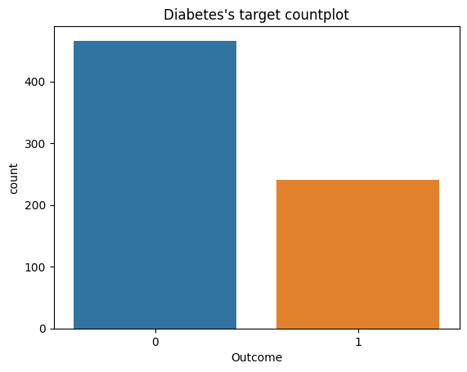
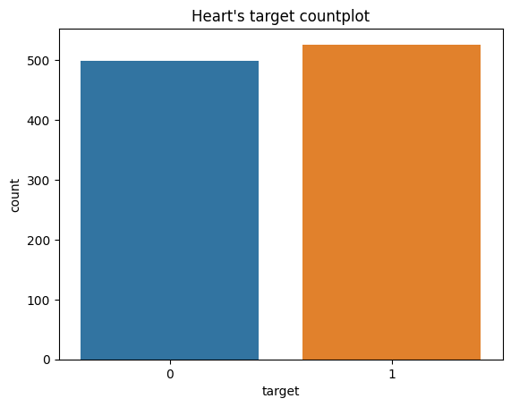
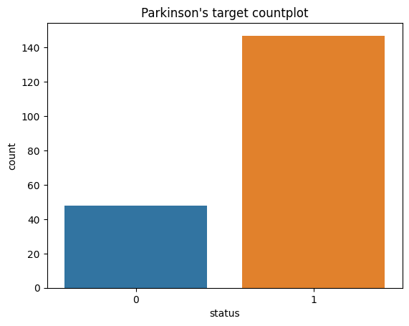
Data Collection
Frontier Tech Leaders Programme Global Cohort 1
Source of the datasets: 3 datasets was collected from Kaggle
Preprocessing steps during data collection: matplotlib, seaborn, pandas profiling
Data cleaning: no missing values, duplicated values removed
Diabetes: 768 rows × 9 columns heart: 1025 rows × 14 columns Parkinson: 195 rows × 24 columns

Slide 9
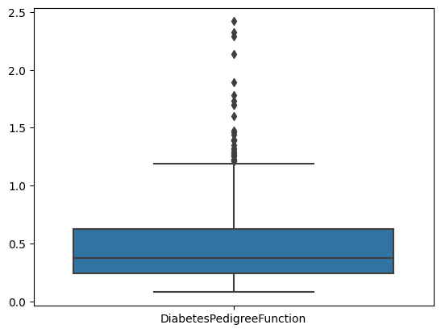
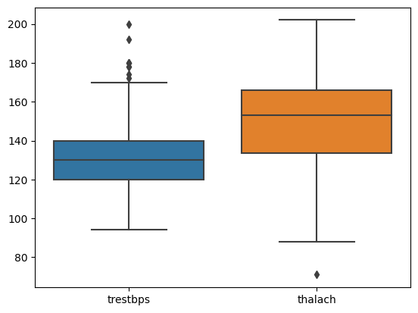
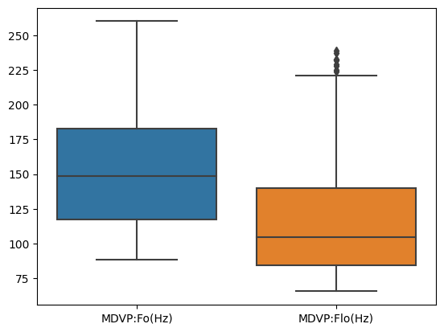
Exploratory Data Analysis (EDA) and Feature Engineering
Frontier Tech Leaders Programme Global Cohort 1
Handling Outliers
Balance the data using oversampling and smote techniques
Normalization techniques used: MinMaxscaler(), StandardScaler()

Slide 10

Model
Frontier Tech Leaders Programme Global Cohort 1

Slide 11
Model Selection and Training
Frontier Tech Leaders Programme Global Cohort 1
1- Logistic Regression:
simple and computationally efficient. robust to overfitting. May not perform well with highly non-linear data.
2- SVM:
computationally height, effective in high-dimensional spaces, versatile due to different kernel functions, resistant to overfitting, can be challenging to choose kernel.
3- k-Nearest Neighbors (KNN)
non-parametric and flexible algorithm, intuitive and easy .. However, it’s computationally expensive during prediction, especially with large datasets and also sensitive to irrelevant or redundant features.
4- Random Forest:
Robust, less prone to overfitting compared to individual decision trees. It can handle a large number of features and provides feature importance scores. More expensive.
6- GradientBoosting :
A powerful boosting algorithm, trains the model sequentially and each new model tries to correct the previous model, less sensitive to outliers
5- XGBoost :
better predictive performance, robust to outliers. Efficient and scalable algorithm. it can prone to overfitting, especially with insufficient regularization and requires tuning of hyperparameters.

Slide 12
Model Evaluation and Hyperparameter Tuning
Frontier Tech Leaders Programme Global Cohort 1
Use of hyperparameterTuning Gridsearch techniquewith cv=5 for each model
Result of hyperparameter Tuning on Heart dataset
 | model | Before HyperParameter | After Hyperparamter | best_parameters
0 | Logistic_regression | 78% | 86% | C= 1.623, max_iter= 300
1 | Random_forest | 98.53% | 87% | max_depth=3, max_leaf_nodes= 9
3 | SVM | 81% | 100% | C= 1000, gamma= 0.001, kernel= ‘rbf'
4 | XG_Boost | 99% | 98% | max_depth=9, max_leaf_nodes=3
5 | KNN | 73% | 97% | metric= 'manhattan', 'n_neighbors’=11

Slide 13
Model Evaluation and Hyperparameter Tuning
Frontier Tech Leaders Programme Global Cohort 1
Use of hyperparameterTuning Gridsearch techniquewith cv=5 for each model
Models Result of hyperparameter Tuning on Diabetes dataset
 | model | Before HyperParameter | After Hyperparamter | best_parameters
0 | Logistic_regression | 75.32% | 84% | C= 0.001, max_iter= 100, solver=‘lbfgs’
1 | KNN | 82.46% | 87% | metric= 'manhattan', 'n_neighbors’=7
3 | SVM | 83.77% | 84.5% | C= 1, kernel= ‘linear'
4 | Random Forest | 86.36% | 88.5% | max_depth=10, n_estimators=10
5 | XG_Boost | 86.36% | 89% | max_depth=6, max_leaf_nodes=3
6 | GrandientBoosting | 89.61% | 88% | Learning_rate=0.2, max_depth=3

Slide 14
Model Evaluation and Hyperparameter Tuning
Frontier Tech Leaders Programme Global Cohort 1
Use of hyperparameterTuning Gridsearch techniquewith cv=5 for each model
Result of hyperparameter Tuning on Parkinson dataset
 | model | Before HyperParameter | After Hyperparamter | best_parameters
0 | Logistic_regression | 84.74% | 82.55% | C= 545.55, max_iter= 300
1 | Random_forest | 100% | 90.22% | max_depth=10, n_estimators= 10
3 | SVM | 91.48% | 95% | C= 100, gamma= 1, kernel= ‘rbf'
4 | XG_Boost | 98.3% | 92.77% | max_depth=6, max_leaf_nodes=3
5 | KNN | 96.6% | 91.48% | metric= 'manhattan', 'n_neighbors’=7

Slide 15
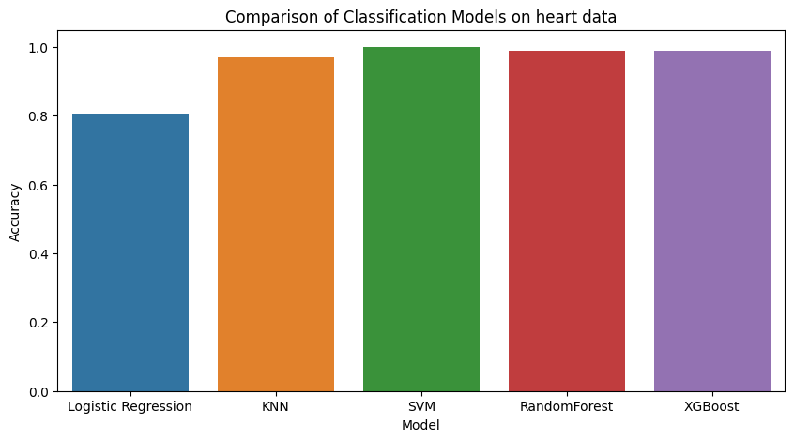
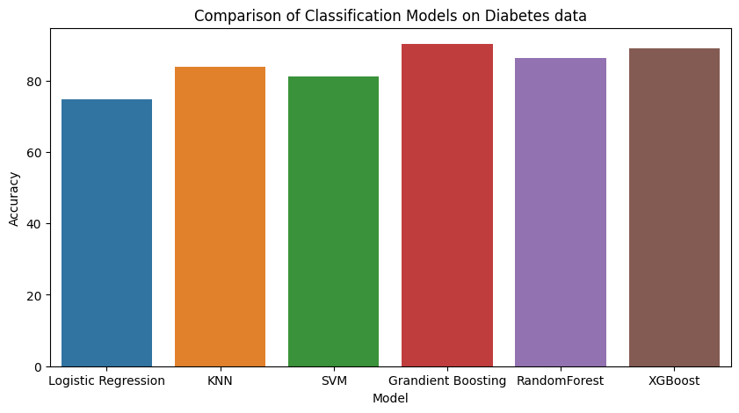
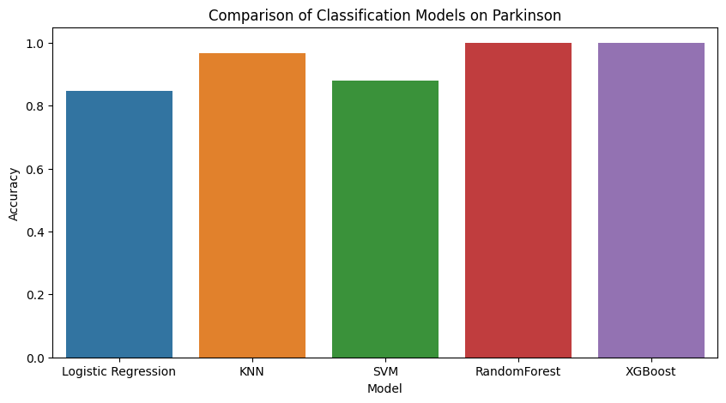
Models comparison
Frontier Tech Leaders Programme Global Cohort 1

Slide 16
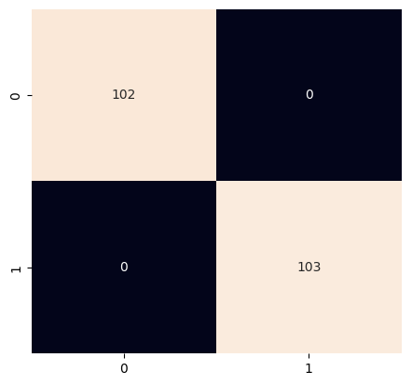
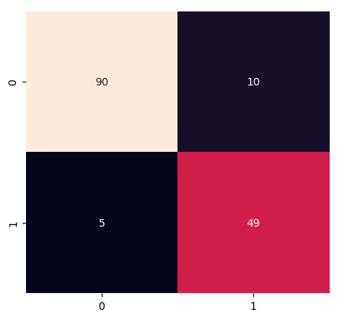
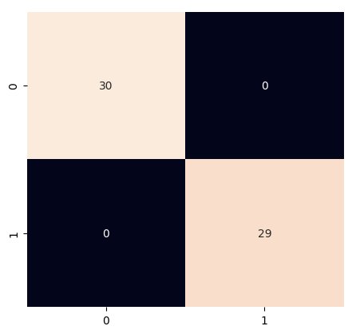
Model Refinement and Testing
Frontier Tech Leaders Programme Global Cohort 1
Techniques used for model improvement: Hyperparameter Tuning, standardization and MinMaxScaler feature normalization techniques are used, Oversampling and SMOTE balancing techniques, Gradient Boosting for Diabetes dataset,
Confusion Matrix:
1-confusion_matrix with SVM for heart dataset
2-confusion matrix with GB for diabetes dataset
3- confusion matrix with RandomForest for Parkinson dataset

Slide 17

Results
Frontier Tech Leaders Programme Global Cohort 1

Slide 18
Models Refinement Results-Evaluation Results
Frontier Tech Leaders Programme Global Cohort 1
Disease type | Selected Model | Scores
 |  | Training score | Test Score
Heart disease | SVM | 100% | 100%
Diabetes | Gradient Boosting | 97.87% | 90.25%
Parkinson | RandomForest | 100% | 100%

Slide 19
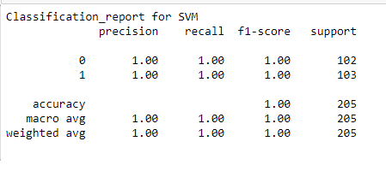
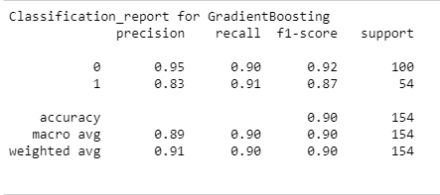
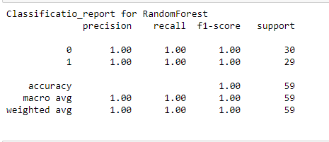
Evaluation Results
Frontier Tech Leaders Programme Global Cohort 1

Slide 20
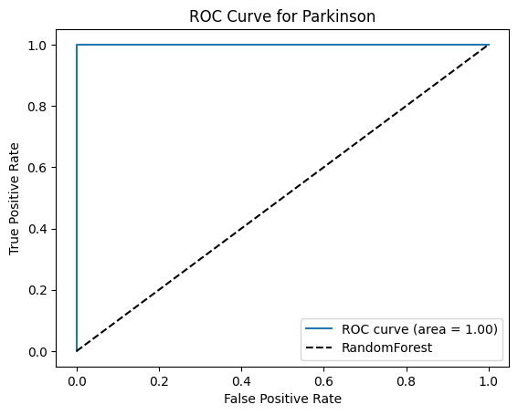
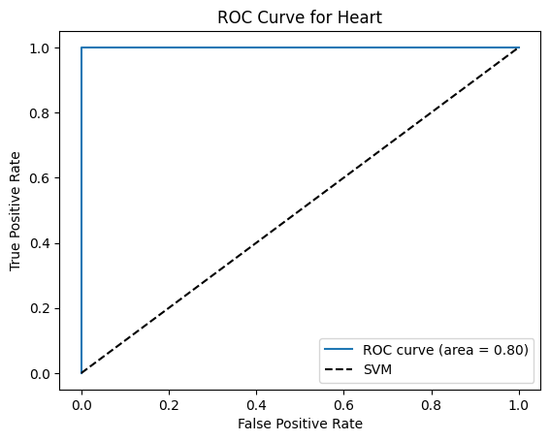
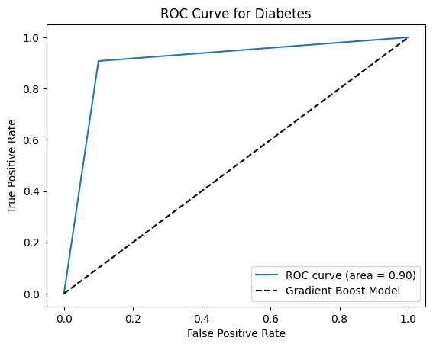
Evaluation Results
Frontier Tech Leaders Programme Global Cohort 1

Slide 21
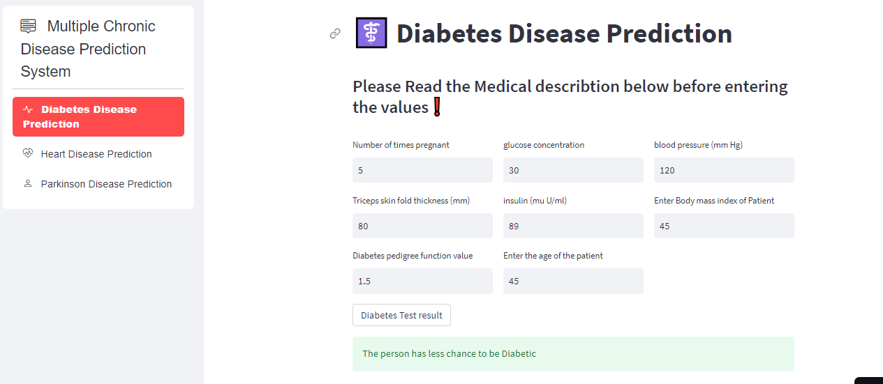
Deployment
Frontier Tech Leaders Programme Global Cohort 1
Libraries used: Model deployed on Streamlit cloud: https://capstoneprojectchronicdisease-4t9vcgbfqw3botzprmyfbt.streamlit.app/

Slide 22
Future Work
Frontier Tech Leaders Programme Global Cohort 1
This application can be a more large application, we can build others models for more diseases like Malaria, Kidney, covid etc,
This means developping the same app on large datasets to predict more diseases.
We can also add different types of diseases such as infectious diseases for prediction.
Improve diabetes model for the good use of this app to predict chronic diseases

Slide 23
References
Frontier Tech Leaders Programme Global Cohort 1
1- D. Hamid, S. S. Ullah, J. Iqbal, S. Hussain, C. A. U. Hassan, and F. Umar, ‘A Machine Learning in Binary and Multiclassification Results on Imbalanced Heart Disease Data Stream’, J Sens, vol. 2022, 2022, doi: 10.1155/2022/8400622.
2- https://en.wikipedia.org/wiki/Sustainable_Development_Goal_3
3-https://www.un.org/sustainabledevelopment/health/
4-https://www.google.com/url?sa=i&url=https%3A%2F%2Fwww.dimins.com%2Fblog%2F2022%2F06%2F13%2Fbig-data-healthcare%2F&psig=AOvVaw1a3o-FR8Ewbof_NTEvPkou&ust=1702123866255000&source=images&cd=vfe&opi=89978449&ved=0CBEQjRxqFwoTCIjihdrn_4IDFQAAAAAdAAAAABAI
5- https://unicsoft.com/wp-content/uploads/2022/07/ML_Model_1140.png
6- M. ÇOLAK, T. TÜMER SİVRİ, N. PERVAN AKMAN, A. BERKOL, and Y. EKİCİ, “Disease prognosis using machine learning algorithms based on new clinical dataset,” Communications Faculty of Sciences University of Ankara Series A2-A3 Physical Sciences and Engineering, vol. 65, no. 1, pp. 52–68, Jun. 2023, doi: 10.33769/aupse.1215962.
7- T. H. H. Aldhyani, A. S. Alshebami, and M. Y. Alzahrani, ‘Soft Clustering for Enhancing the Diagnosis of Chronic Diseases over Machine Learning Algorithms’, J Healthc Eng, vol. 2020, 2020, doi: 10.1155/2020/4984967.

Slide 24


Thank you!
Frontier Tech Leaders Programme Global Cohort 1

