Slide 1

Chronic Diseases Prediction system using Machine Learning Techniques
Frontier Tech Leaders Programme Global Cohort 1
Mariam Kili Bechir
15-12-2023

Slide 2
Outline
Frontier Tech Leaders Programme Global Cohort 1
Concept note and implementation plan:
Background
Objectives
SDG Relation
Data
Methodology
Results
Deployment
Future Work

Slide 3
Concept note and implementation plan
Frontier Tech Leaders Programme Global Cohort 1

Slide 4
Background
Frontier Tech Leaders Programme Global Cohort 1
Overview
Enhance chronic disease prediction using machine learning techniques
Developing predictive models for common chronic diseases such as diabetes, heart diseases, and Parkinson's.
Contribute to SDGs, and proactively manage health conditions.
Brief background
Chronic diseases pose a global health threat, especially in regions with limited access to advanced healthcare
Leveraging AI and Machine Learning in healthcare for early detection
Importance of the problem being solved
Effective intervention.
Promoting well-being and reducing global health disparities
Identifying individuals at risk early

Slide 5

SDG Relation
Frontier Tech Leaders Programme Global Cohort 1
Predict diseases that cause a health challenge
Ensuring healthy lives for all
Improved global healthcare systems
Access of good quality health services

Slide 6
Objectives
Frontier Tech Leaders Programme Global Cohort 1
Develop ML models for the prediction of common chronic diseases such as diabetes, heart diseases, and Parkinson’s.
Assess the potential of machine learning to improve early detection, intervention, and management of chronic diseases.
Contribute to the United Nations Sustainable Development Goals (SDGs) for healthcare improvement by developing and implementing machine learning-based chronic disease prediction systems.
ML Predict the probability of an individual developing a chronic disease based on their demographic and clinical data.

Slide 7
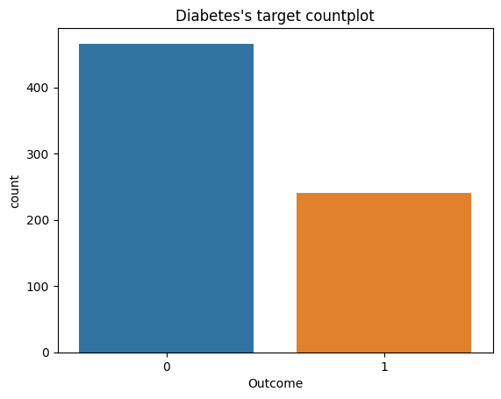
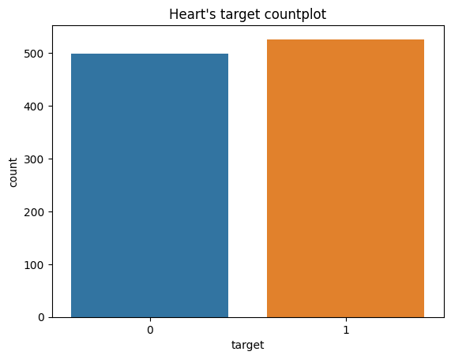
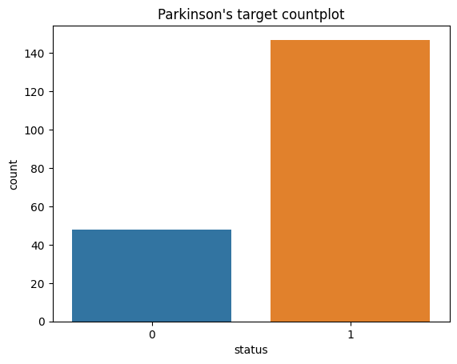
Data
Frontier Tech Leaders Programme Global Cohort 1
Source of the datasets: 3 datasets was collected from Kaggle
Preprocessing steps during data collection: matplotlib, seaborn, pandas profiling
Data cleaning: no missing values, duplicated values removed, outliers removed
Diabetes: 768 rows × 9 columns heart: 1025 rows × 14 columns Parkinson: 195 rows × 24 columns

Slide 8
Methodology
Frontier Tech Leaders Programme Global Cohort 1
Models Training: Logistic Regression, Support Vector Machine, Knearest Neighbors techniques
Sampling techniques: Balance the data using oversampling and smote techniques
Normalization: techniques used: MinMaxscaler(), StandardScaler()
Models optimization: hyperparameterTuning Gridsearch technique with cv=5 for each model
Use of ensemble techniques: RandomForestClassifer, XGBoost Classifier, Gradient Boosting ensemble to get strong Models

Slide 9
Models Results
Frontier Tech Leaders Programme Global Cohort 1
Disease type | Selected Model | Scores
 |  | Training score | Test Score
Heart disease | SVM | 100% | 100%
Diabetes | Gradient Boosting | 97.87% | 90.25%
Parkinson | RandomForest | 100% | 100%

Slide 10
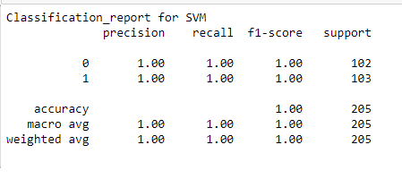
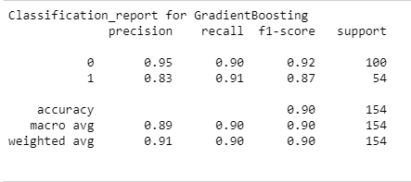
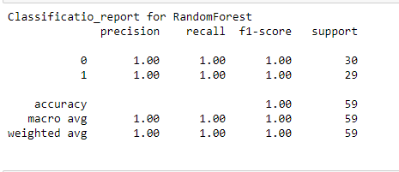
Evaluation Results
Frontier Tech Leaders Programme Global Cohort 1

Slide 11
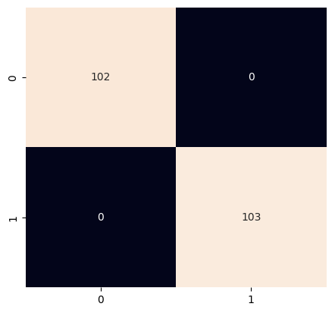
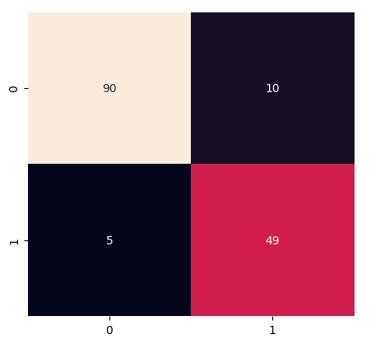
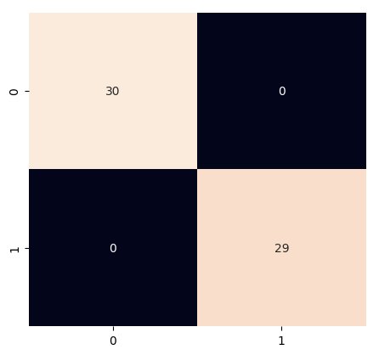
Confusion Matrix
Frontier Tech Leaders Programme Global Cohort 1
1-confusion_matrix with SVM for heart dataset
2-confusion matrix with GB for diabetes dataset
3- confusion matrix with RandomForest for Parkinson dataset

Slide 12
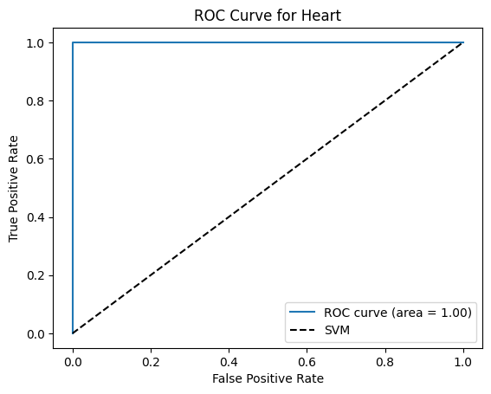
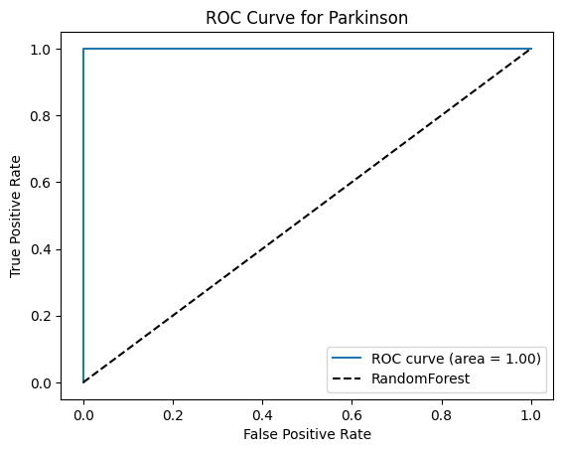
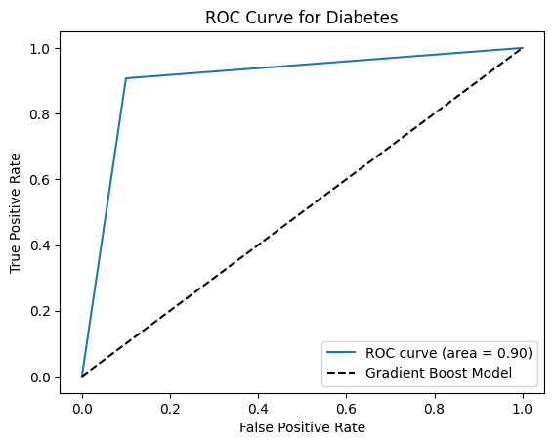
ROC-AUC Results
Frontier Tech Leaders Programme Global Cohort 1

Slide 13
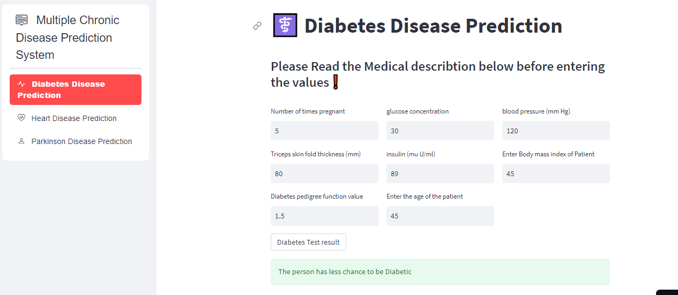
Deployment
Frontier Tech Leaders Programme Global Cohort 1
In this project, ‘Joblib’ is used for models’ serialization, Environment settings, python version 3.8, host codes on github
Libraries and API used: Streamlit
Model deployed on Streamlit cloud: https://capstoneprojectchronicdisease-4t9vcgbfqw3botzprmyfbt.streamlit.app/

Slide 14
Future Work
Frontier Tech Leaders Programme Global Cohort 1
Develop the app on large datasets to predict more diseases like Malaria, Kidney, covid etc,
We can also add different types of diseases such as infectious diseases for prediction.
Improve diabetes model for the good use of this app to predict chronic diseases
Use Cloud services such as AWS, Google Cloup Service for more configuration in deployment

Slide 15
References
Frontier Tech Leaders Programme Global Cohort 1
1- D. Hamid, S. S. Ullah, J. Iqbal, S. Hussain, C. A. U. Hassan, and F. Umar, ‘A Machine Learning in Binary and Multiclassification Results on Imbalanced Heart Disease Data Stream’, J Sens, vol. 2022, 2022, doi: 10.1155/2022/8400622.
2- https://en.wikipedia.org/wiki/Sustainable_Development_Goal_3
3-https://www.un.org/sustainabledevelopment/health/
4- https://unicsoft.com/wp-content/uploads/2022/07/ML_Model_1140.png
5- M. ÇOLAK, T. TÜMER SİVRİ, N. PERVAN AKMAN, A. BERKOL, and Y. EKİCİ, “Disease prognosis using machine learning algorithms based on new clinical dataset,” Communications Faculty of Sciences University of Ankara Series A2-A3 Physical Sciences and Engineering, vol. 65, no. 1, pp. 52–68, Jun. 2023, doi: 10.33769/aupse.1215962.
6- T. H. H. Aldhyani, A. S. Alshebami, and M. Y. Alzahrani, ‘Soft Clustering for Enhancing the Diagnosis of Chronic Diseases over Machine Learning Algorithms’, J Healthc Eng, vol. 2020, 2020, doi: 10.1155/2020/4984967.

Slide 16


Thank you!
Frontier Tech Leaders Programme Global Cohort 1

