Slide 1
Predicting and Clustering Urban Waste Generation: A Key to Sustainable Waste
Frontier Tech Leaders Programme Global Cohort 1
Shuaib Mursal Ibrahim
December 12, 2023

Slide 2
Outline
Frontier Tech Leaders Programme Global Cohort 1
Concept note and implementation plan:
Background
Objectives
SDG Relation
Data
Data Collection
Exploratory Data Analysis (EDA) and Feature Engineering
Model Selection and Training
Model Evaluation and Hyperparameter Tuning
Model Refinement and Testing
Results
Deployment
Future Work

Slide 3
Concept note and implementation plan
Frontier Tech Leaders Programme Global Cohort 1

Slide 4
Background
Frontier Tech Leaders Programme Global Cohort 1
The growing populations and consumption patterns in cities worldwide are increasing urban waste generation, posing a significant challenge for sustainable city planning and environmental management.

Slide 5
Con…
Frontier Tech Leaders Programme Global Cohort 1
As cities expand and populations grow, the volume of municipal solid waste (MSW) generated continues to surge, straining existing waste management systems and threatening environmental sustainability which also has significant economic, and social challenges.

Slide 6
Con…
Frontier Tech Leaders Programme Global Cohort 1
Conventional approaches often rely on generic waste collection schedules and disposal methods, failing to account for the complex factors that influence urban waste generation patterns. This outdated approach leads to inefficient resource allocation, increased waste management costs, and environmental concerns.

Slide 7
Con…
Frontier Tech Leaders Programme Global Cohort 1
The goal of this project is to leverage machine learning techniques to forecast the quantity of waste generated by urban areas, and categorize urban areas based on waste generation patterns.

Slide 8
Objectives
Frontier Tech Leaders Programme Global Cohort 1
To reach the forementioned goal, the project has the following specific objectives
Identify and analyze the primary factors influencing urban waste generation patterns.
Develop a robust data-driven approach for predicting urban waste generation.
Employ clustering algorithms to identify distinct groups of urban areas based on waste generation characteristics.

Slide 9
Con…
Frontier Tech Leaders Programme Global Cohort 1
The project utilizes the following machine learning models to achieve its objectives
Linear Regression Model (LRM)
Artificial Neurol Network (ANN)
K-Means Clustering

Slide 10
SDG Relation
Frontier Tech Leaders Programme Global Cohort 1
The project directly aligns with several United Nations Sustainable Development Goals (SDGs), contributing to global efforts for a more sustainable and resilient future. These SDGs include:

Slide 11
SDG Relation
Frontier Tech Leaders Programme Global Cohort 1
SDG 11: Sustainable Cities and Communities:
By optimizing waste management strategies, the project supports the creation of more sustainable and resilient urban environments (Target 11.6).

Slide 12
SDG Relation
Frontier Tech Leaders Programme Global Cohort 1
SDG 15: Life on Land:
The project aids in reducing the environmental impact on land by promoting sustainable waste management practices, mitigating the negative effects of waste on ecosystems and biodiversity (Targets 15.3 and 15.9).

Slide 13
Data
Frontier Tech Leaders Programme Global Cohort 1

Slide 14
Data Collection
Frontier Tech Leaders Programme Global Cohort 1
The dataset used in this project is the World Bank's "What a Waste 2.0: A Global Snapshot of Solid Waste Management to 2050" dataset. This dataset provides comprehensive data on solid waste management from 217 countries, covering various aspects such as waste generation, collection, treatment, and disposal

Slide 15
Data Collection
Frontier Tech Leaders Programme Global Cohort 1
Missing values for the numerical variables were imputed using appropriate KNN.
The extent of missing values in each variable was assessed using descriptive statistics. For variables with a relatively low proportion of missing values (less than 50%) were imputed.

Slide 16
Data Collection
Frontier Tech Leaders Programme Global Cohort 1
Variables with a high proportion of missing values (greater than 50%) were dropped from the dataset, as imputing such a large number of missing values could significantly distort the data distribution.
For the categorical variables, categories were capitalized for consistency. Fewer categories were combined into a single category then mode imputation were applied for the missing values.

Slide 17
Data Collection
Frontier Tech Leaders Programme Global Cohort 1
Outliers were identified using statistical techniques such as boxplots and interquartile ranges (IQRs). Outliers were considered to be values that fell outside the IQR range. Detected outliers were trimmed to -+1.5*IQR to prevent them from unduly influencing the machine learning models.

Slide 18
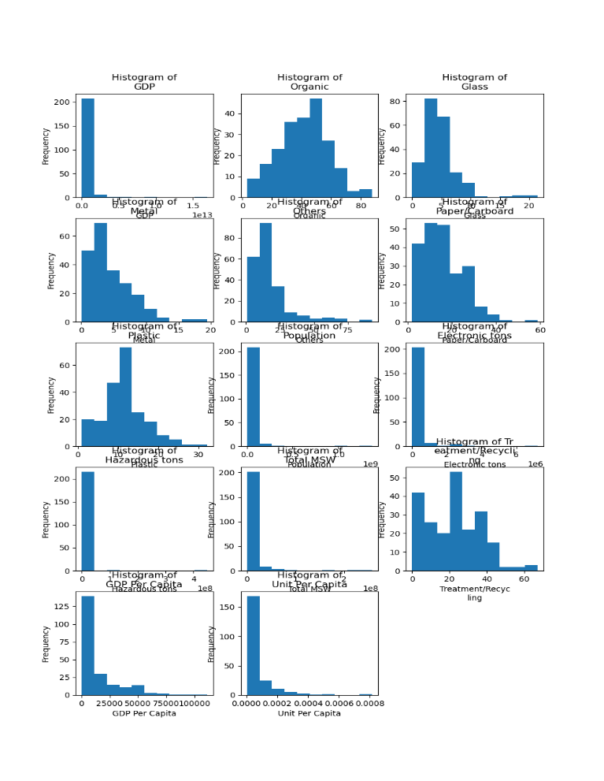
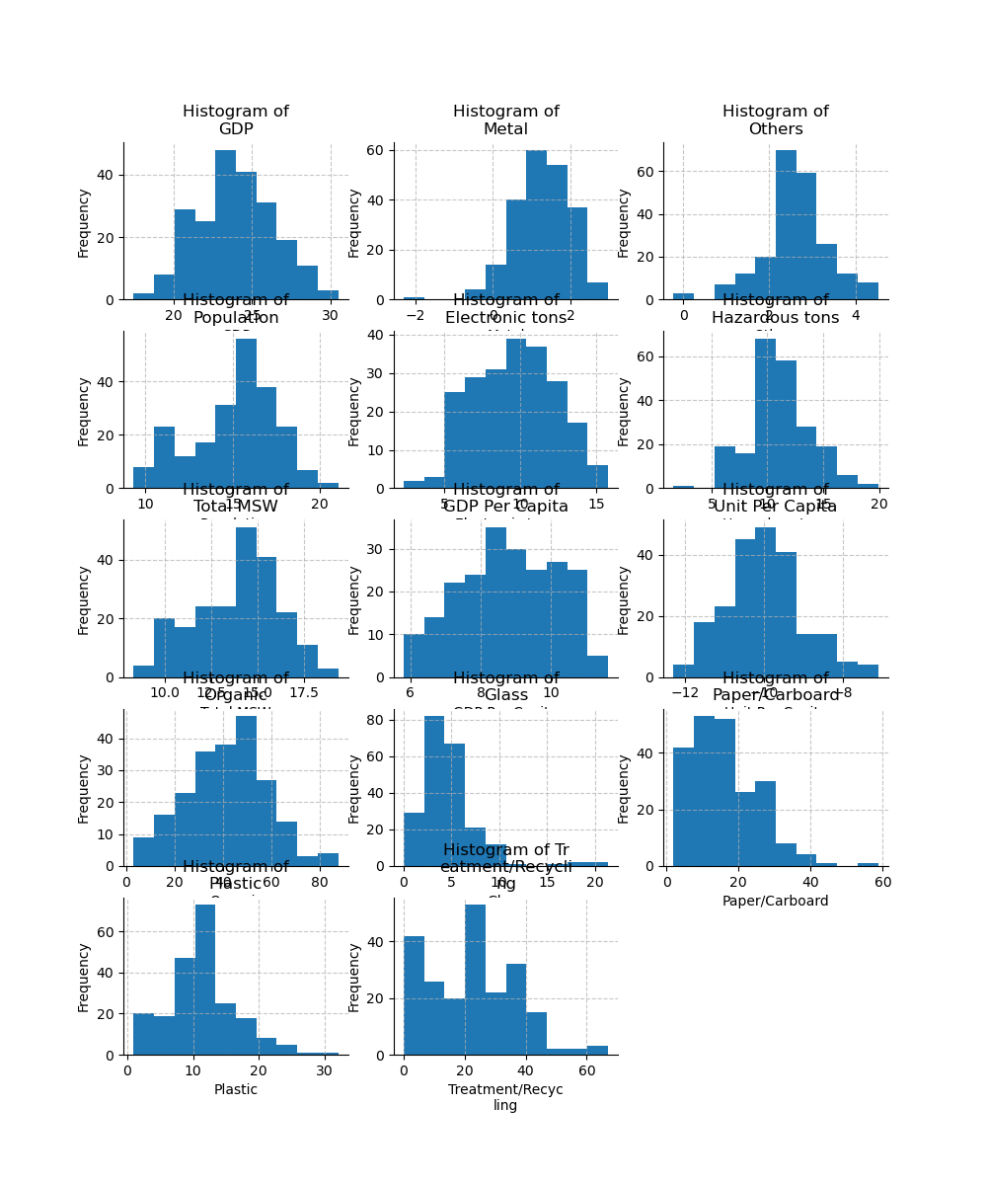
Exploratory Data Analysis (EDA) & Feature Engineering
Frontier Tech Leaders Programme Global Cohort 1

Slide 19
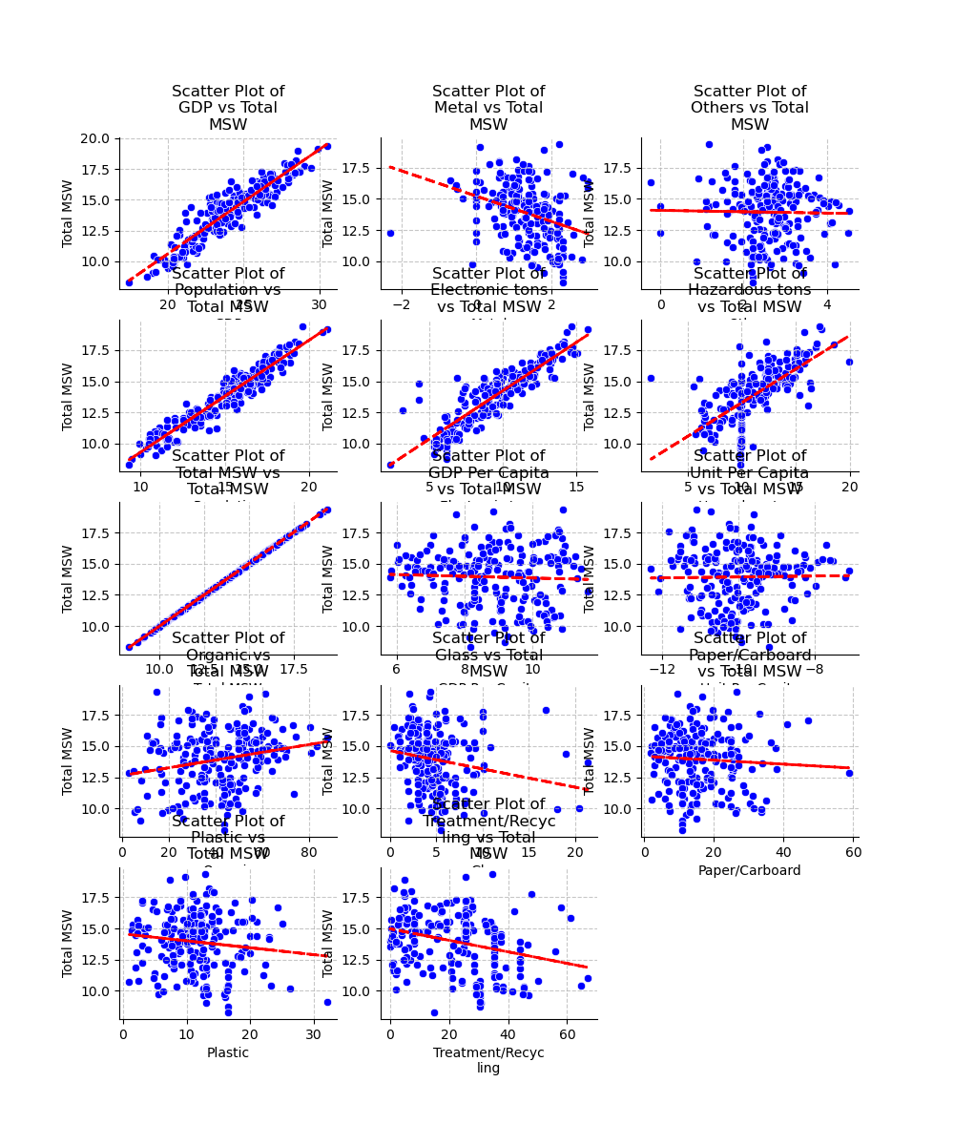
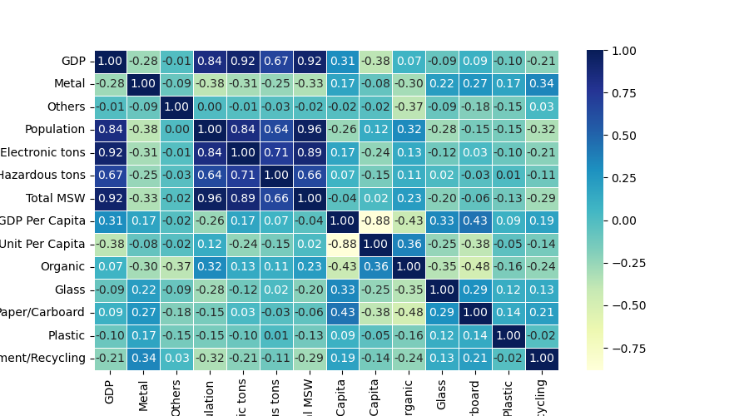
Exploratory Data Analysis (EDA) & Feature Engineering
Frontier Tech Leaders Programme Global Cohort 1

Slide 20
Exploratory Data Analysis (EDA) & Feature Engineering
Frontier Tech Leaders Programme Global Cohort 1
GDP and population are two crucial factors influencing waste generation patterns. Based on these two features, two features were engineered.
GDP per Capita: Created a new feature by dividing the total waste generation by the population.
Unit per GDP Unit: Created a new feature by dividing the total waste generation by the GDP. environmental impact of economic activities.
Notes:
Per Capita: This feature represents the average waste generated per person, providing a more normalized measure of waste generation relative to population size.
Rationale: This feature helps account for the varying population sizes across countries, allowing for a more equitable comparison of waste generation patterns.
Per Unit GDP: This feature represents the waste generated per unit of economic activity, providing insights into the waste intensity of different economies.
Rationale: This feature helps assess the relationship between economic growth and waste generation, indicating the

Slide 21
Exploratory Data Analysis (EDA) & Feature Engineering
Frontier Tech Leaders Programme Global Cohort 1
Before building the models, the data were normalized by standardizing the variables

Slide 22
Model
Frontier Tech Leaders Programme Global Cohort 1

Slide 23
Model Selection & Training
Frontier Tech Leaders Programme Global Cohort 1
Multiple regression is a suitable choice when the goal is to predict a continuous numerical variable (waste generation) from a set of independent variables (GDP, population, etc.). It allows for understanding the linear relationship between the independent variables and the dependent variable.

Slide 24
Model Selection & Training
Frontier Tech Leaders Programme Global Cohort 1
ANNs are powerful models capable of capturing complex nonlinear relationships between variables. They are well-suited for handling large datasets and extracting hidden patterns.

Slide 25
Model Selection & Training
Frontier Tech Leaders Programme Global Cohort 1
K-means clustering is an unsupervised learning algorithm that groups similar data points into clusters. It is useful for exploratory data analysis and identifying patterns in the data.

Slide 26
Model Selection & Training
Frontier Tech Leaders Programme Global Cohort 1
Model | Strengths | Weaknesses
Regression Analysis | Simple, interpretable, can handle missing data | May not capture complex nonlinear relationships
ANNs | High accuracy, can capture complex nonlinear relationships | Requires large amounts of data, computationally expensive
K-means clustering | Simple, efficient, easy to interpret | Sensitive to initial centroids, may stuck in local minima

Slide 27
Model Selection & Training
Frontier Tech Leaders Programme Global Cohort 1
The data was split int training and test data. 80% of the data was used as a training set, while 20% used as testing set.
For the LRM 5-fold cross validation was used, while for the ANN model 20% of the training dataset was used as cross validation.

Slide 28
Model Evaluation & Hyperparameter Tuning
Frontier Tech Leaders Programme Global Cohort 1
Mean squared error (MSE), Mean absolute error (MAE), and R-squared were used as the evaluation metrics for the LRM and ANN model. For the K-means clustering model, the most important thing is determining the number of cluster. Elbow method was used to determine the appropriate number of clusters.

Slide 29
Model Evaluation & Hyperparameter Tuning
Frontier Tech Leaders Programme Global Cohort 1
In the artificial neural network (ANN) model, several hyperparameters were optimized. These parameters included the learning rate, the number of hidden layers, the number of neurons per layer, the dropout rate, and the optimizer. After optimizing these parameters, a configuration with a single hidden layer, 8 neurons per layer, a learning rate of 0.01, and the SGD optimizer was identified as optimal based on the Mean Squared Error (MSE) and Mean Absolute Error (MAE) metrics.

Slide 30
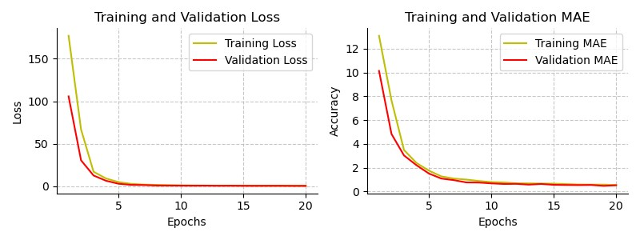
Model Evaluation & Hyperparameter Tuning
Frontier Tech Leaders Programme Global Cohort 1

Slide 31
Model Refinement & Testing
Frontier Tech Leaders Programme Global Cohort 1
The model refinement phase plays a crucial role in the machine learning workflow, shifting the focus from model construction to performance optimization. While the initial model exhibited errors, subsequent iterations combining hyperparameter tuning and feature engineering yielded optimal results based on established evaluation metrics.

Slide 32
Model Refinement & Testing
Frontier Tech Leaders Programme Global Cohort 1
For instance, the linear regression model achieved a perfect fit to the data, while the ANN model initially displayed significantly higher errors in MSE, MAE, and R-squared. This aligns with the known tendency of linear regression models to improve fit with increasing feature count. After a thorough data examination, less significant features were eliminated, leading to satisfactory results for both models

Slide 33
Results
Frontier Tech Leaders Programme Global Cohort 1

Slide 34
Results: LRM & ANN Models
Frontier Tech Leaders Programme Global Cohort 1
Dataset Type | Linear Regression Model |  |  | Artificial Neurol Network Model
 | Evaluation Metrics
 | MSE | MAE | R-squared | MSE | MAE | R-squared
Training | 0.198 | 0.319 | 0.961 | 0.443 | 0.526 | 0.913
Validation | 0.217 | 0.342 | 0.953 | 0.427 | 0.470 | -
Testing | 0.188 | 0.324 | 0.961 | 0.272 | 0.417 | 0.944

Slide 35
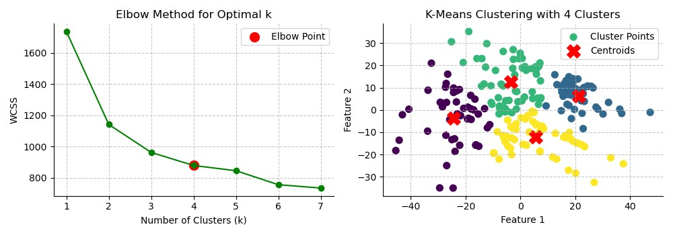
Results: K-Means Clustering
Frontier Tech Leaders Programme Global Cohort 1

Slide 36
Results: K-Means Clustering
Frontier Tech Leaders Programme Global Cohort 1
Variables | Cluster 1 | Cluster 2 | Cluster 3 | Cluster 4
GDP | 23.562 | 24.817 | 24.458 | 23.129
Metal | 1.572 | 0.939 | 1.204 | 1.332
Population | 13.997 | 16.458 | 15.309 | 14.899
Electronic tons | 9.038 | 10.633 | 10.040 | 8.925
Hazardous tons | 11.036 | 11.813 | 11.465 | 10.688
Organic | 22.399 | 57.243 | 32.468 | 52.584
Glass | 5.187 | 3.285 | 5.444 | 4.162
Treatment/Recycling | 37.636 | 6.694 | 13.263 | 30.310
Info System | 1.000 | 1.000 | 1.000 | 1.000
Agency | 1.000 | 1.000 | 1.000 | 1.000
Law | 1.000 | 1.000 | 1.000 | 1.000
PPP | 1.000 | 1.000 | 1.000 | 1.000

Slide 37
Results: K-Means Clustering
Frontier Tech Leaders Programme Global Cohort 1
This clustering analysis identifies four distinct waste management profiles among countries. Cluster 1 features nations with low GDP and population, showing a strong commitment to glass waste recycling. Cluster 2 includes countries with high GDP and population, producing substantial electronic and hazardous waste, highlighting opportunities for improved recycling. Cluster 3 represents nations with moderate GDP and population, maintaining a balanced waste distribution and a moderate recycling emphasis. Lastly, Cluster 4 encompasses countries with low GDP and a moderate population, adopting a middle-ground approach to waste management with a focus on recycling. These insights can inform targeted interventions and collaborative efforts to enhance global sustainable waste practices.

Slide 38
Results: K-Means Clustering
Frontier Tech Leaders Programme Global Cohort 1
Distances between clusters
Cluster | 1 | 2 | 3 | 4
1 | 0.000 | 46.754 | 26.420 | 31.048
2 | 46.754 | 0.000 | 25.749 | 24.253
3 | 26.420 | 25.749 | 0.000 | 26.435
4 | 31.048 | 24.253 | 26.435 | 0.000

Slide 39
Results: K-Means Clustering
Frontier Tech Leaders Programme Global Cohort 1
Inter-cluster analysis reveals nuanced relationships. Cluster 2 and 4 share the most similarities, followed by 2 and 3, and 3 and 4. Cluster 3 and 1 are moderately similar, while 1 and 4 are notably different. These findings inform differentiated approaches and collaborative efforts to improve global waste management.

Slide 40
Future Work
Frontier Tech Leaders Programme Global Cohort 1
Explore additional features: Include factors like infrastructure development, urbanization rates, etc.
Consider geographical context: Account for location, climate, and proximity to recycling facilities.
Experiment with advanced ML models: Try gradient boosting, random forests, or advanced neural networks for better prediction accuracy.
Enhance clustering analysis: Explore hierarchical clustering, density-based clustering, and compare with K-means results.

Slide 41


Thank you!
Frontier Tech Leaders Programme Global Cohort 1

