Slide 1
Smart Energy Distribution
Frontier Tech Leaders Programme Global Cohort 1
Hilassoun A. Roland SANOU
12/12/2023

Slide 2
How to use this template
Frontier Tech Leaders Programme Global Cohort 1
Download the file
Change the name into "Name_Surname_Draft_Presentation"
Do not move the text boxes, keep your text and visuals inside the boxes
Do not change the colors and font type
If you need to change the font size make it consistent and don't use different sizes in one page (biggest 28, smallest 16). Titles always should be 44.
You can duplicate a page if you need more than one pages
Add high quality pictures and their sources. Keep it inside the boxes.
Key color - #2B2551​
Supporting color 1 - #FFC837 ​
Supporting color 2 - #4CA3AA ​
Supporting color 3 - #FFFFFF​
Supporting color 4 - #FF577D
Remove this page before uploading the presentation to your Github repository!

Slide 3
Outline
Frontier Tech Leaders Programme Global Cohort 1
Concept note and implementation plan:
Background
Objectives
SDG Relation
Data
Data Collection
Exploratory Data Analysis (EDA) and Feature Engineering
Model Selection and Training
Model Evaluation and Hyperparameter Tuning
Model Refinement and Testing
Results
Deployment
Future Work

Slide 4
Concept note and implementation plan
Frontier Tech Leaders Programme Global Cohort 1

Slide 5
Background
Frontier Tech Leaders Programme Global Cohort 1
Our project is based on Smart grid technology. It aims to provide a ML solutions to avoid energy wastage and provide an efficient distribution of energy.
This idea came from the constat that in some developing countries like mine(Burkina Faso), we faced a lot of energy problems such bad repartition of energy, lack of energy ressource to covert the demand...
Traditional energy systems often struggle to adapt to dynamic fluctuations in demand, leading to inefficiencies, wastage, and an increased carbon footprint.

Slide 6
Objectives
Frontier Tech Leaders Programme Global Cohort 1
Project objectives are:
Collect data related to energy distribution from Smart Grid technology
Develop a ML model based on data to provide output on the stability of smart grid
Use outputs to make decision on energy repartition between customer
Principally, machine learning aims to use data then determine the stability of the Smart Grid.

Slide 7
SDG Relation
Frontier Tech Leaders Programme Global Cohort 1
By accurately forecasting energy demand and dynamically balancing energy distribution, the project supports the efficient utilization of energy resources, contributing to the goal of ensuring access to affordable, reliable, sustainable, and modern energy for all. Balancing energy distribution based on real-time data allows for better integration of renewable energy sources, reducing reliance on non-renewable sources.
It answered to SDGs7(affordable and clean energy), SDGs11(sustainable cities and communities) and SDGs13(climat action)

Slide 8
Data
Frontier Tech Leaders Programme Global Cohort 1

Slide 9
Data Collection
Frontier Tech Leaders Programme Global Cohort 1
The original dataset contains 10,000 observations. The augmented version has then 60,000 observations. It also contains 12 primary predictive features and two dependent variables. https://www.kaggle.com/code/mineshjethva/power-grid-stability-with-deep-learning/input
For the prepocessing and data cleaning step:
-dataset loading
-dataset observation with( isna, info and describe functions)
-Fortunately, we did not have missing value. Dataset behave very nicely.

Slide 10
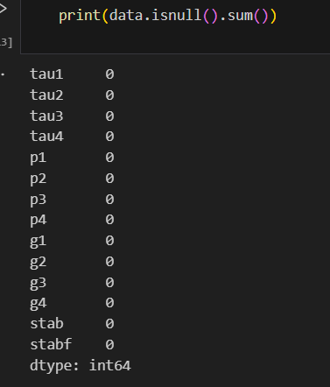
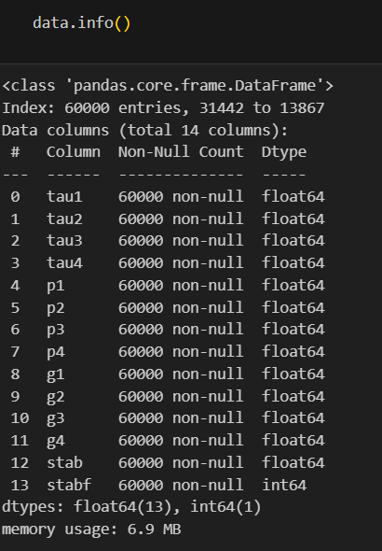
Data Collection

Slide 11
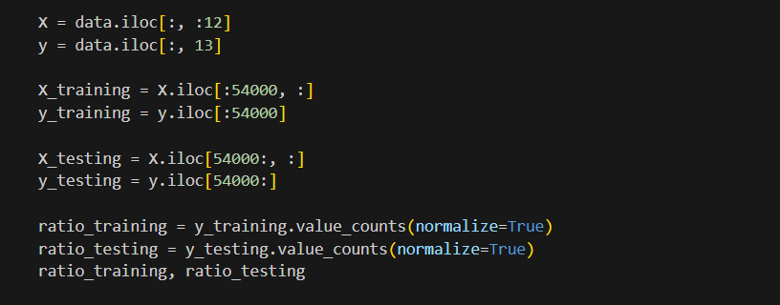
Exploratory Data Analysis (EDA) and Feature Engineering
Frontier Tech Leaders Programme Global Cohort 1
Our dataset contains 60000 observations. We have divided it into 54000 for training and 6000 for test. Out of our 12 features, stab column has been determined as our target feature.

Slide 12
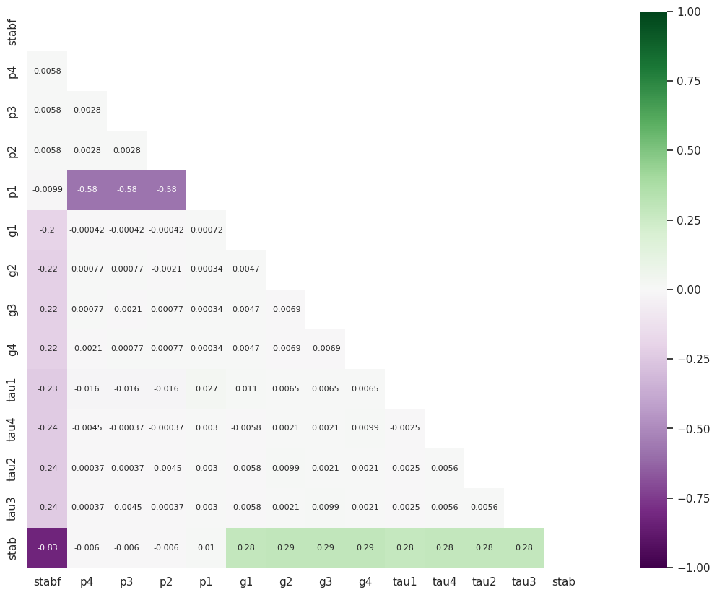
Exploratory Data Analysis (EDA) and Feature Engineering
We had 2 columns stab and stabf that providing the same output about the smart grid stability. Dropping stabf for using only using stab as target feature. After checking the correlation between features.

Slide 13
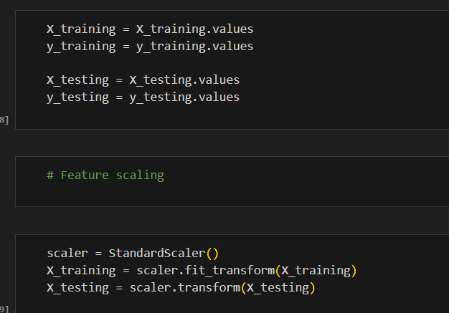
Exploratory Data Analysis (EDA) and Feature Engineering
After splitting our dataset into test and training part, we scale and normalize X_training and X_testing

Slide 14
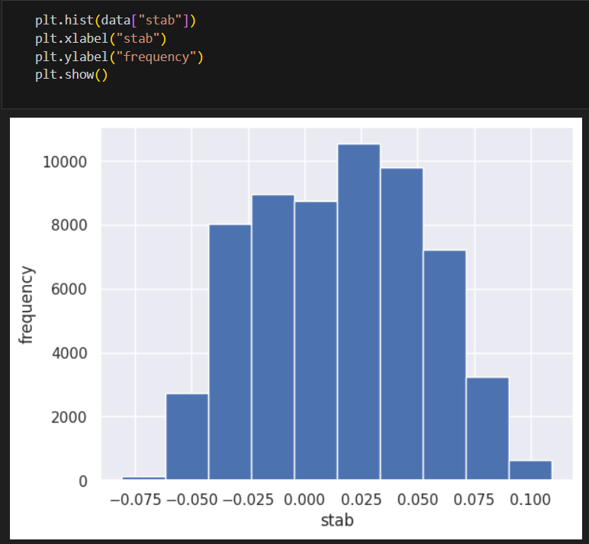
Exploratory Data Analysis (EDA) and Feature Engineering

Slide 15
Model
Frontier Tech Leaders Programme Global Cohort 1

Slide 16
Model Selection and Training
Frontier Tech Leaders Programme Global Cohort 1
We had 2 models with great accuracy: Classification model (XGBClassifier) and Deep Learning (ANN Sequential model). We prefered used the deep learning model for its high accuracy result.
Deep Learning, ANN architectures performed better than simpler ones. By augmenting the dataset, the model could performe so much better. It would though be up to a smart grid operator to confirm if the accuracy level obtained with deep learning would suffice in practical terms (live network);
Please provide comparison of models

Slide 17
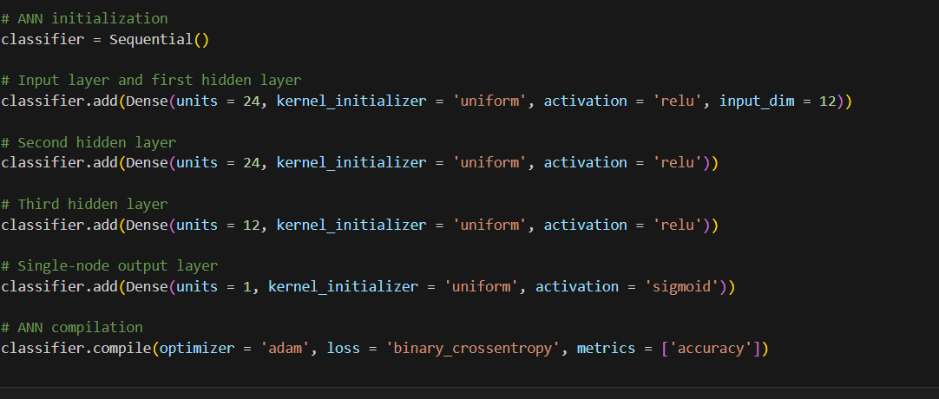
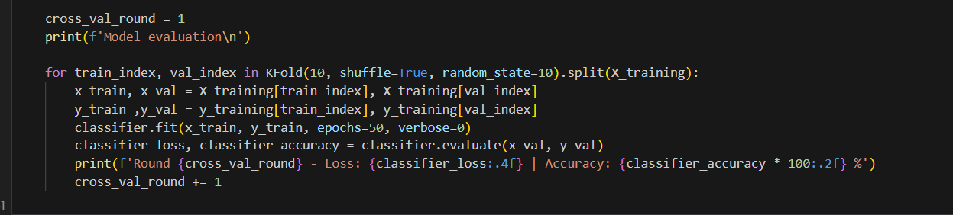
Deep Learning Model

Slide 18
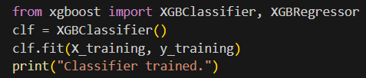
Classification Model

Slide 19
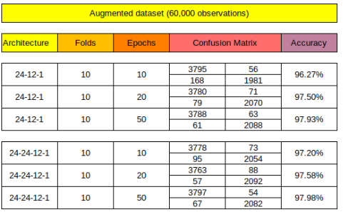
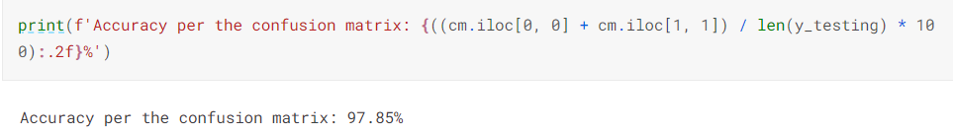
Model Evaluation and Hyperparameter Tuning
Frontier Tech Leaders Programme Global Cohort 1
For our deep learning model

Slide 20
Model Refinement and Testing
Frontier Tech Leaders Programme Global Cohort 1
After fitting the different test data we analyze the output and try to play with parameters such to get better accuracy.
The type of our dataset is so well designed that we could not feel any significant change.

Slide 21
Results
Frontier Tech Leaders Programme Global Cohort 1

Slide 22
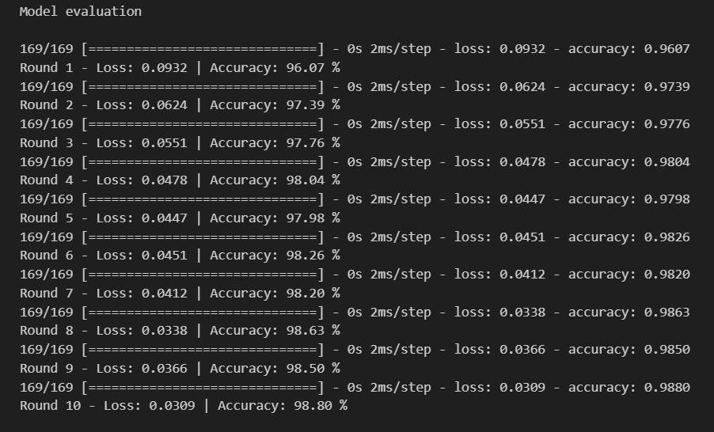
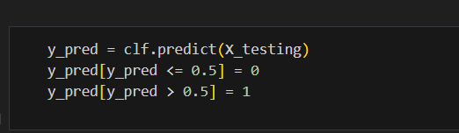
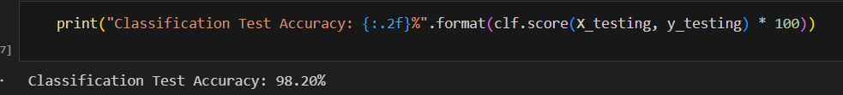

Classification Results vs Deep Learning Results

Slide 23
Deployment
Frontier Tech Leaders Programme Global Cohort 1
Overview of the deployment phase
Model serialization, serving, and API integration
(You can fill this part after deployment submission)

Slide 24
Future Work
Frontier Tech Leaders Programme Global Cohort 1
Test the model on real life
Work a better dataset which take weather, real-time production features

Slide 25
References
Frontier Tech Leaders Programme Global Cohort 1
https://www.kaggle.com/code/mineshjethva/power-grid-stability-with-deep-learning/notebook
https://medium.com/@rithpansanga/optimizing-xgboost-a-guide-to-hyperparameter-tuning-77b6e48e289d
https://www.kaggle.com/code/lucidlenn/data-analysis-and-classification-using-xgboost
https://www.kaggle.com/code/gcdatkin/smart-grid-stability-prediction/notebook

Slide 26


Thank you!
Frontier Tech Leaders Programme Global Cohort 1

