Slide 1
﻿Deepfake Video Detection Using InceptionResnet-V2
Frontier Tech Leaders Programme Global Cohort 1
Farmanuddin Farman
10/12/2023

Slide 2
Outline
Frontier Tech Leaders Programme Global Cohort 1
Concept note and implementation plan:
Background
Objectives
SDG Relation
Data
Data Collection
Exploratory Data Analysis (EDA) and Feature Engineering
Model Selection and Training
Model Evaluation and Hyperparameter Tuning
Model Refinement and Testing
Results
Deployment
Future Work

Slide 3
Concept note and implementation plan
Frontier Tech Leaders Programme Global Cohort 1

Slide 4
Background
Frontier Tech Leaders Programme Global Cohort 1
Project aims to develop a robust deepfake detection model using Convolutional Neural Networks (CNNs).
Deepfakes, AI-driven videos, create realistic yet fake scenes in videos.[1]
Deepfake potential to spread misinformation, manipulate public opinion, harm reputations, pose security threats, individual privacy, and organizational credibility.

Slide 5
Objectives
Frontier Tech Leaders Programme Global Cohort 1
Project objectives:
To achieve a high level of accuracy in detecting deepfake videos.
Implementing transfer learning strategy.
Ensuring the model's resilience against diverse deepfake generation techniques.
Machine learning model aims to achieve:
Detecting Real and Fake Videos.
Accuracy above 85% on test dataset.

Slide 6
SDG Relation
Frontier Tech Leaders Programme Global Cohort 1
Goal 9 of SDG: Industry, Innovation, and Infrastructure: By creating advanced tools to detect deepfakes, we contribute to the development of innovative technologies that can safeguard against malicious uses of AI.
Goal 16 of SDG: Peace, Justice, and Strong Institutions: Deepfake detection plays a role in maintaining the integrity of information, supporting justice, and preventing the spread of misinformation.

Slide 7
Data
Frontier Tech Leaders Programme Global Cohort 1

Slide 8
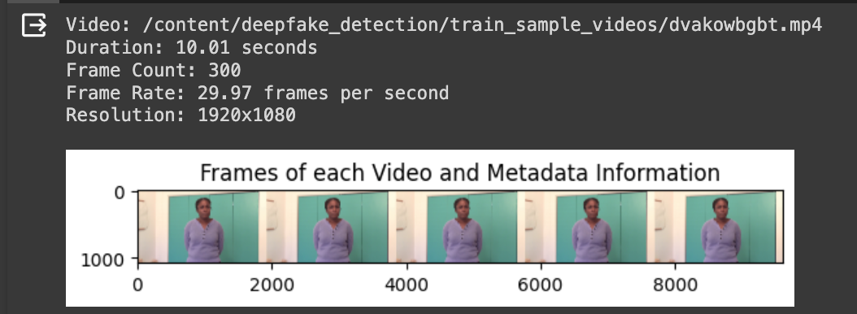
Data Collection
Frontier Tech Leaders Programme Global Cohort 1
﻿Famous Kaggle competition dataset, known as deepfake detection challenge (DFDC). [2]
Dataset was downloaded through Kaggle API, We analyzed the first five videos.

Slide 9
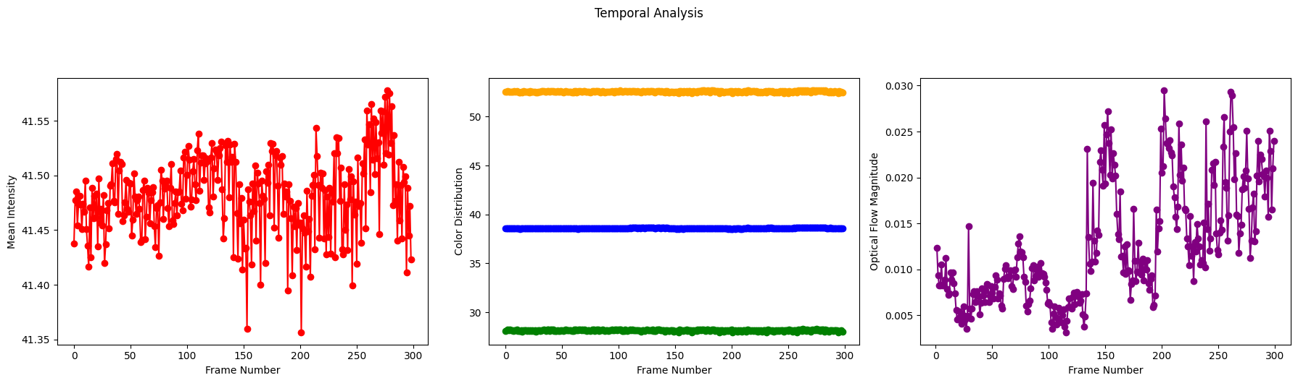
Exploratory Data Analysis (EDA) and Feature Engineering
Frontier Tech Leaders Programme Global Cohort 1
Data Inspection: Analyzed the Data, Duration of the video(10.01 second), frame numbers(300) per video, and resolution.
Temporal Analysis: We analyzed the videos how certain features or properties change over time, calculated mean intensity, color distribution, and optical flow.

Slide 10
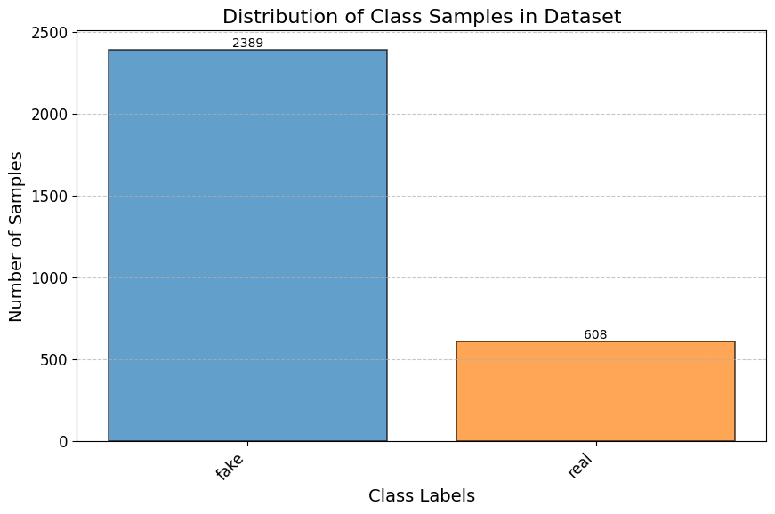
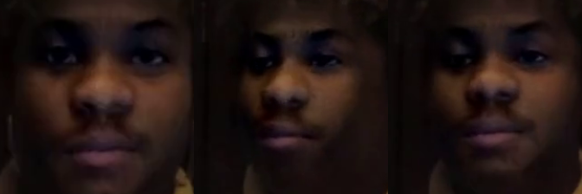
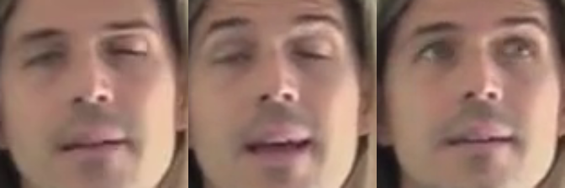
Exploratory Data Analysis (EDA) and Feature Engineering
Frontier Tech Leaders Programme Global Cohort 1
Used OpenCV to capture frame from videos, first three frames of Fake and Real Folder.

Slide 11
Exploratory Data Analysis (EDA) and Feature Engineering
Data Augmentation: A technique that transforms the features of the input data to increase its diversity, reduce overfitting, and improve the model's performance.
The train_data.classes array, being composed of integer values (0 or 1), is already encoded.
Output: (array([0, 0, 0, ..., 1, 1, 1], dtype=int32))

Slide 12
Model
Frontier Tech Leaders Programme Global Cohort 1

Slide 13
Model Selection and Training
Frontier Tech Leaders Programme Global Cohort 1
InceptionResNetV2: InceptionResNetV2 is a deep and sophisticated architecture, capturing complicated features in images.
InceptionRestNetv2 has pre-trained weights: provide convergence and better performance.
Weaknesses: Computational Intensity, Overfitting Risk

Slide 14
Model Selection and Training
Hyperparameters and Training Configuration:
Optimizer: Adam
Loss Function: Binary Cross-Entropy
Metrics: Accuracy

Slide 15
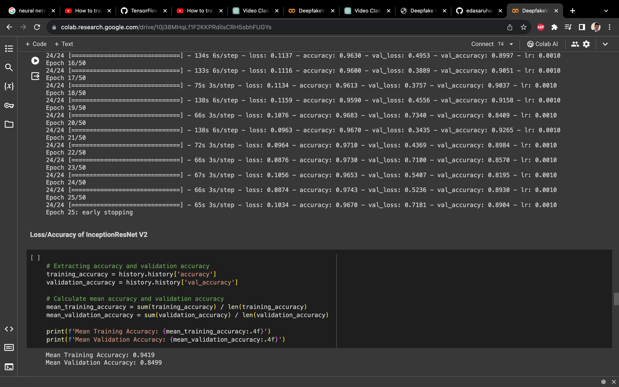
Model Evaluation and Hyperparameter Tuning
Frontier Tech Leaders Programme Global Cohort 1
Evaluation metrics and visualizations: Early stopping regularization technique is used during the training of a model. Got val_accuracy of 0.86% and accuracy of 0.96% on 15th epoch (early stopping).

Slide 16
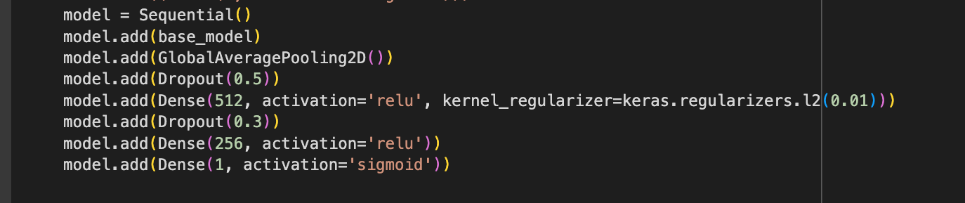
Model Evaluation and Hyperparameter Tuning
Hyperparameter tuning:
Dropout Rates:
Original Setting: Dropout rates of 0.5 and 0.3.
Impact: Mitigates overfitting during training.
Regularization:
Original Setting: L2 regularization with a coefficient of 0.01.
Impact: Controls overfitting by penalizing large weights.

Slide 17
Model Refinement and Testing
Frontier Tech Leaders Programme Global Cohort 1
Refinement phase: We unfroze the last 20 layers, Dropout layers were introduced in the model architecture during both the global average pooling layer and the fully connected layers.
L2 regularization with a coefficient of 0.01 was applied to the first dense layer.
Test submission phase: The trained model was loaded from the checkpoint file, and its performance was evaluated on the test dataset.
Various metrics were computed to assess the model's effectiveness in making predictions on new, unseen data.
Test loss: 0.348
Test Accuracy: 90.37%
Precision: 0.21 and Recall: 0.20

Slide 18
Results
Frontier Tech Leaders Programme Global Cohort 1

Slide 19
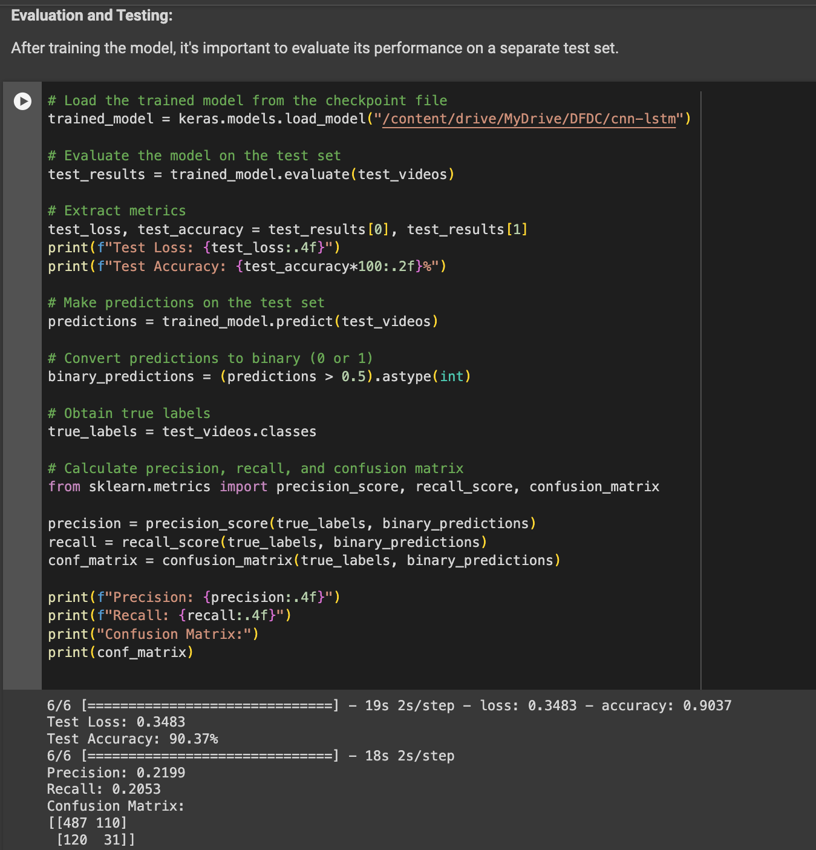
Evaluation Results
Frontier Tech Leaders Programme Global Cohort 1
.

Slide 20
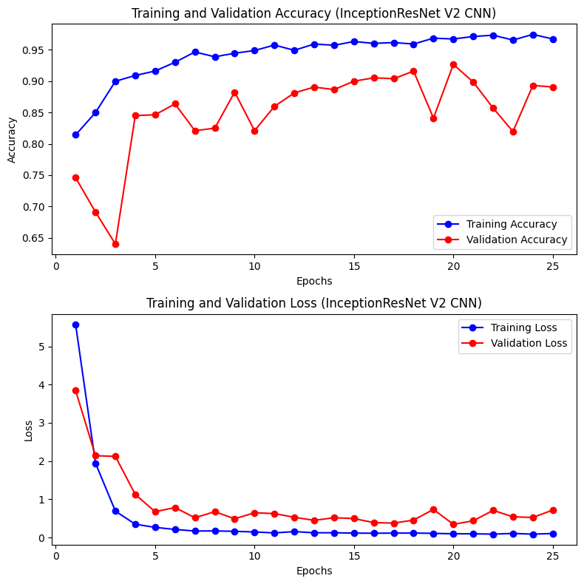
Evaluation Results

Slide 21
Deployment
Frontier Tech Leaders Programme Global Cohort 1
The deployment phase involves making the machine learning model available for use in a real-world or production environment.
The deepfake detection model is deployed using Flask, a micro web framework for Python.
the model is serialized using the Keras load_model function, which saves the model architecture, optimizer, and learned weights.
Users can interact with the model by uploading video files through the web interface.

Slide 22
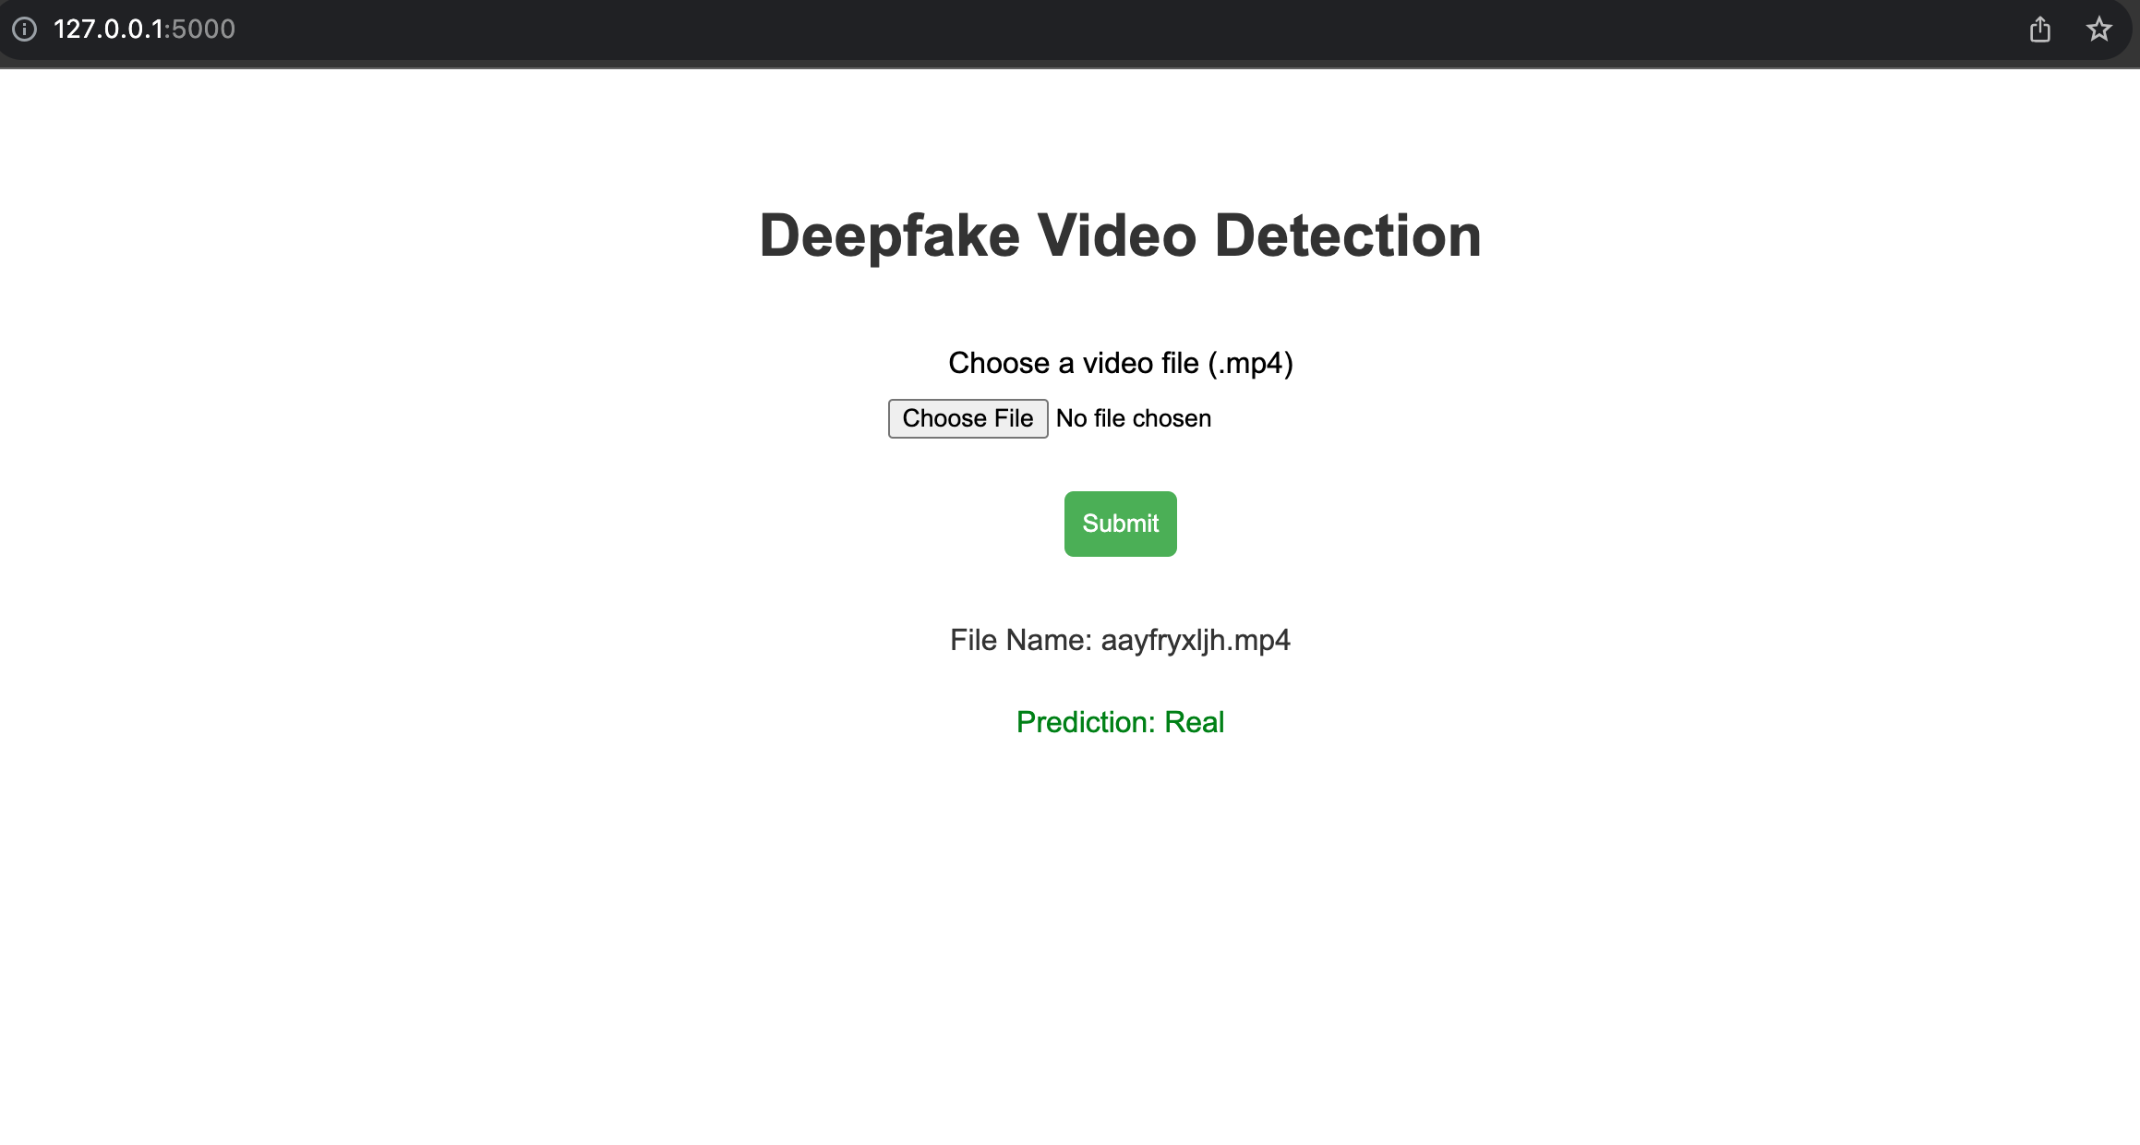
Deployment
/DeploySDG
|-- app.py
|-- savedmodels
|-- uploads
|--venv
|--İndex.html

Slide 23
Future Work
Frontier Tech Leaders Programme Global Cohort 1
Incorporating LSTM layers to capture temporal dependencies and enhance the model's ability to understand sequential information in video data.
Integration of human-in-the-loop approach for improved model validation and decision-making in deepfake detection.

Slide 24
References
Frontier Tech Leaders Programme Global Cohort 1
A. Anand and B. Bianco, The 2021 Innovations Dialogue Conference Report: Deepfakes, Trust and International Security, Geneva, Switzerland: UNIDIR, 2021.
https://www.kaggle.com/competitions/deepfake-detection-challenge/data
Yadav, P., Jaswal, I., Maravi, J., Choudhary, V., & Khanna, G. (2021, September). DeepFake Detection using InceptionResNetV2 and LSTM. In International Conference on Emerging Technologies: AI, IoT, and CPS for Science Technology Applications.

Slide 25


Thank you!
Frontier Tech Leaders Programme Global Cohort 1

