Slide 1
Flood Prediction Model for Resilient Communities in Sierra Leone.
Frontier Tech Leaders Programme Global Cohort 1
Steven Daniel
December 2023

Slide 2
Outline
Frontier Tech Leaders Programme Global Cohort 1
Concept note and implementation plan:
Background
Objectives
SDG Relation
Data
Methodology
Results
Deployment
Future Work

Slide 3
Concept note and implementation plan
Frontier Tech Leaders Programme Global Cohort 1

Slide 4
Background
Frontier Tech Leaders Programme Global Cohort 1
Project overview: The project focuses on developing a flood prediction model for Sierra Leone a country that frequently battling with incident of flooding that has led to the loss of lives and destruction of properties.
The primary goal is to facilitate swift measures for mitigating the impact on communities and critical infrastructure.
Background: Sierra Leone grapples with recurring challenges, especially during the rainy seasons, where devastating floods wreak havoc on vulnerable communities and critical infrastructure. marked by severe flooding incidents, notably the catastrophic mudslide and flooding on August 14, 2017, claiming over 400 lives, left hundreds injured, with an additional 600 people missing and leaving over 3,000 people homeless.
Importance of the problem being solved: Project is important to lessen the devastating effects of flooding on lives, infrastructure, and communities.

Slide 5




SDG Relation
SDG 11 –
Sustainable Cities and Communities
SDG 9 –
Industry, Innovation, and Infrastructure
Swift measures based on accurate predictions can minimize the impact of floods on urban areas, protecting both lives and infrastructure.
Represents a technological innovation that contributes to the advancement of infrastructure resilience.
SDG 1 –
No Poverty (Indirectly related)
SDG 13 – Climate Action
Protecting communities from floods helps safeguard livelihoods, prevent economic loss, and contributes to overall poverty reduction
Mitigating the effects of floods, a consequence intensified by climate change through accurate predictions supports the broader goal of climate resilience

Slide 6
Objectives
Frontier Tech Leaders Programme Global Cohort 1
Aggregate and preprocess data to establish a robust foundation for the flood prediction model
Utilize machine learning algorithms to interpret complex relationships within the dataset, enhancing prediction accuracy and reliability.
Evaluate and select appropriate technologies and tools for data analysis, and machine learning in enhancing the precision and scalability of the flood prediction model
Validate the machine learning model using historical data and optimize parameters for improved performance
Create an intuitive interface for end-users to access and interpret flood predictions

Slide 7
Data
Frontier Tech Leaders Programme Global Cohort 1
Source(s) of the dataset: OpenWeather Map
https://home.openweathermap.org/marketplace/my_orders
https://history.openweathermap.org/storage/52b96426702dd7eed9a4507cd5c11615.csv
Dataset contains 393,773 weather records and 28 columns for Sierra Leone and span January 1, 1979 - December 2, 2023. The following features were selected:
Features | Features | Features | New Features Features
dt (Datetime) | Feels_like | Rain_1h | Rain (combination of rain_1h & Rain_3h)
Timezone | Minimum temperature | Rain_3h
Latitude | Maximum temperature | Clouds_all
Longitude | Pressure
Temperature | Humidity |  | Flood_occurred (binary) Formed by setting a threshold of rainfall
Visibility | Wind speed
Dew_point | Wind_gust

Slide 8
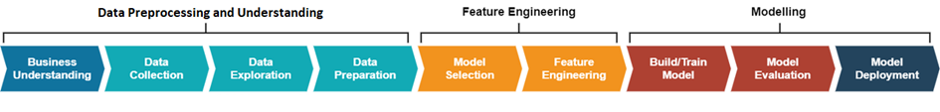
Methodology
Frontier Tech Leaders Programme Global Cohort 1
Feature Selection: Identify the most relevant features that significantly contribute to flood prediction
Algorithm Selection: Choosing appropriate machine learning algorithms based on the nature of the problem. For this project;
Random Forest
Decision Tree.
Model Training: 80% dataset used for training g and 20% for testing.
Model Evaluation: Assess the performance of the trained models using evaluation metrics such as accuracy, precision, recall, F1 score, AUC-ROC Score and refining the model to effectively generalize to unseen data.
Real-time Data Integration: integrated with real-time weather data by developing an API application that fetches data from Open Weather Map.
Model Deployment: serialized using pickle and served through web application built using python’s flask incorporating weather real-time data through API call and returning result of prediction to users.
The project followed SDG AI Lab Standard Framework for a Data Science Project with slight variation and was implemented using machine learning specifically classification algorithms – Random Forest and Decision Tree.
Business Understanding: Understanding of the business problem or opportunity that the project aims to address
Data Collection: collected from Open Weather at https://history.openweathermap.org/storage/52b96426702dd7eed9a4507cd5c11615.csv
Data Processing: Cleaning and EDA including handling missing values, normalizing data, and addressing outliers to ensure the dataset's quality and reliability..

Slide 9
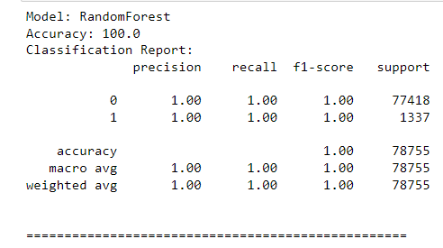
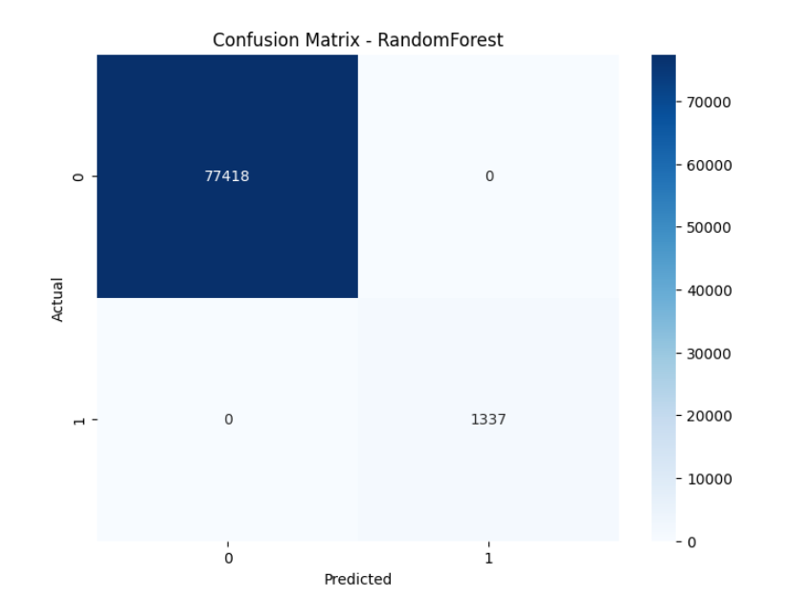
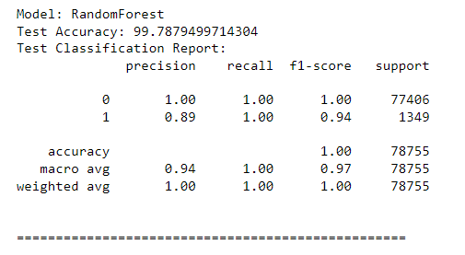
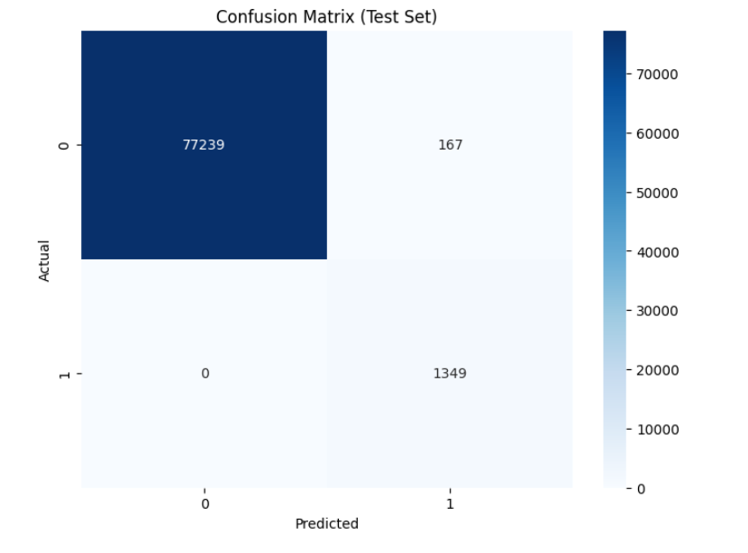
Evaluation Results
Frontier Tech Leaders Programme Global Cohort 1
Training
Test dataset

Slide 10

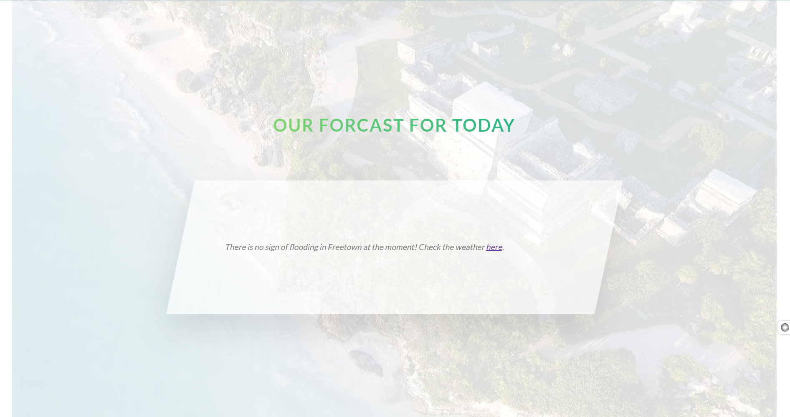
Deployment
Frontier Tech Leaders Programme Global Cohort 1
The purpose of the deployment phase is to make the model available in the real-world for users to make predictions of flood events.
The model was serialized using pickle, served through Flask application
Integrated with OpenWeather API to get Sierra Leone’s real-time weather data for prediction and deployed using www.render.com cloud service.
The application can be accessed through: https://sierra-leone-flood-prediction.onrender.com/

Slide 11
Future Work
Frontier Tech Leaders Programme Global Cohort 1
Refine the model using a dataset of satellite imagery of Sierra Leone.
Perform more hyperparameter tuning to improve accuracy on unseen data
Collaborate with the meteorological agency of Sierra Leone to finetune based on factors that causes flood and history of past flood events and their dataset of weather conditions.
Program the frontend to give users predictions for at least 4 days.
Build an interactive interface to forecasts weather in addition to predicting flood.
Display real-time weather forecasts on frontend in form of charts..

Slide 12
References
Frontier Tech Leaders Programme Global Cohort 1
Mosavi, P. Ozturk, and K.-W. Chau, “Flood Prediction Using Machine Learning Models: Literature Review.”
“Reflections on Sierra Leone’s mudslide disaster - BBC News.” Accessed: Nov. 20, 2023. [Online]. Available: https://www.bbc.com/news/world-africa-40973539
H. Moon, S. Yoon, and Y. Moon, “Urban flood forecasting using a hybrid modeling approach based on a deep learning technique,” Journal of Hydroinformatics, vol. 25, no. 2, pp. 593–610, Mar. 2023, doi: 10.2166/hydro.2023.203.
“OpenWeather Marketplace.” Accessed: Dec. 09, 2023. [Online]. Available: https://home.openweathermap.org/marketplace/my_orders
N. Gauhar, S. Das, and K. S. Moury, “Prediction of Flood in Bangladesh using k-Nearest Neighbors Algorithm,” International Conference on Robotics, Electrical and Signal Processing Techniques, pp. 357–361, 2021, doi: 10.1109/ICREST51555.2021.9331199.
D. K. Behera, M. Das, S. Swetanisha, and P. K. Sethy, “Hybrid model for movie recommendation system using content K-nearest neighbors and restricted Boltzmann machine,” Indonesian Journal of Electrical Engineering and Computer Science, vol. 23, no. 1, pp. 445–452, Jul. 2021, doi: 10.11591/IJEECS.V23.I1.PP445-452.
A. Tella, M. R. Ul Mustafa, A. O. Balogun, C. J. Okolie, I. B. Yamusa, and M. B. Ibrahim, “SPATIAL PREDICTION OF FLOOD IN KUALA LUMPUR CITY OF MALAYSIA USING LOGISTIC REGRESSION,” in International Archives of the Photogrammetry, Remote Sensing and Spatial Information Sciences - ISPRS Archives, International Society for Photogrammetry and Remote Sensing, Feb. 2023, pp. 363–369. doi: 10.5194/isprs-archives-XLVIII-4-W6-2022-363-2023.
A. Sahoo, S. Samantaray, and D. K. Ghose, “Prediction of Flood in Barak River using Hybrid Machine Learning Approaches: A Case Study,” Journal of the Geological Society of India, vol. 97, no. 2, pp. 186–198, Feb. 2021, doi: 10.1007/S12594-021-1650-1/METRICS.
I. M. Hayder et al., “An Intelligent Early Flood Forecasting and Prediction Leveraging Machine and Deep Learning Algorithms with Advanced Alert System,” Processes 2023, Vol. 11, Page 481, vol. 11, no. 2, p. 481, Feb. 2023, doi: 10.3390/PR11020481.

Slide 13
References
Frontier Tech Leaders Programme Global Cohort 1
“Reflections on Sierra Leone’s mudslide disaster - BBC News.” Accessed: Nov. 20, 2023. [Online]. Available: https://www.bbc.com/news/world-africa-40973539
“Sierra Leone: Floods - Emergency Plan of Action (EPoA) DREF n° MDRSL008 Final Report - Sierra Leone | ReliefWeb.” Accessed: Nov. 26, 2023. [Online]. Available: https://reliefweb.int/report/sierra-leone/sierra-leone-floods-emergency-plan-action-epoa-dref-n-mdrsl008-final-report
“Stats SL - Statistics Sierra Leone Hands Over Final Census Results To President Bio.” Accessed: Nov. 26, 2023. [Online]. Available: https://www.statistics.sl/index.php/statistics-sierra-leone-hands-over-final-census-results-to-president-bio.html
“Sierra Leone: Post-Mudslides and Floods Needs Assessment and Recovery Framework | GFDRR.” Accessed: Nov. 26, 2023. [Online]. Available: https://www.gfdrr.org/en/sierra-leone-post-mudslides-and-floods-needs-assessment-and-recovery-framework
“MDRSL008-Sierra Leone Floods-DREF Final Report.”
“SDG AI Lab Data Science Project Framework (Capstone Project).pptx.” Accessed: Nov. 26, 2023. [Online]. Available: https://undp.sharepoint.com/:p:/r/sites/FrontierTechLeadersCommunity/_layouts/15/Doc.aspx?sourcedoc=%7B870D3A35-8B5A-4F52-8726-F9D6CBE9714C%7D&file=SDG%20AI%20Lab%20Data%20Science%20Project%20Framework%20(Capstone%20Project).pptx&action=edit&mobileredirect=true
A. Paul and P. Das, “Flood Prediction Model using Artificial Neural Network,” International Journal of Computer Applications Technology and Research, vol. 3, no. 7, pp. 473–478, 2014, [Online]. Available: www.ijcat.com

Slide 14


Thank you!
Frontier Tech Leaders Programme Global Cohort 1

