Slide 1
Sudanese primary school’s dataset analysis and classification based on facility availability
Frontier Tech Leaders Programme Global Cohort 1
Zainab Elfatih Mohamed Malik
5. Dec 2023

Slide 2
Outlines
Frontier Tech Leaders Programme Global Cohort 1
Overview
Dataset
Exploratory Data Analysis (EDA)
Data Preparation and Feature Engineering
Machine Learning Model
Deployment
Future Work

Slide 3
1. Overview
Frontier Tech Leaders Programme Global Cohort 1

Slide 4


1.1 Background
Frontier Tech Leaders Programme Global Cohort 1
The Sudanese education system faces challenges such as unequal distribution of resources, varying infrastructure standards, and disparities in gender access, all of which contribute to an uneven educational landscape [3][4].
The findings from this project carry the potential to guide stakeholders/government to address specific challenges faced by schools for optimal impact.

Slide 5

1.2 Objectives
Frontier Tech Leaders Programme Global Cohort 1
Assessing the status of primary schools in Sudan
Classifying schools based on facility availability.
To contribute to guiding stakeholders/government to address specific challenges faced by schools for optimal impact.

Slide 6



1.2 SDG Relation
Frontier Tech Leaders Programme Global Cohort 1
This project focuses on analyzing and classifying Sudanese primary schools based on facility availability in the schools, aligning with Sustainable Development Goal 4 (Quality Education), 5 (Gender Equality) and 9 (Industry, Innovation, and Infrastructure)

Slide 7



2. Dataset
Frontier Tech Leaders Programme Global Cohort 1
An impressive collaboration between the Ministry of Education, UNICEF, and OCHA Sudan have been done in 2021 in collecting the school’s data [1].

Slide 8
General info
ID
Capacity
Teachers
Students' female
Classes status
Total number
Permanent
Facilities
School name ar
School name en
State name
State code
Locality name en
Locality name ar
Locality code
Location
Type
Status
Students' male
Student total
Grade 1 to 8 students' number
Need reconstruction
Fence
Feeding
Store
Kindergarten
Electricity
Water
Latrines
Latrines M/F/C

Slide 9
3. Exploratory Data Analysis (EDA)
Frontier Tech Leaders Programme Global Cohort 1

Slide 10
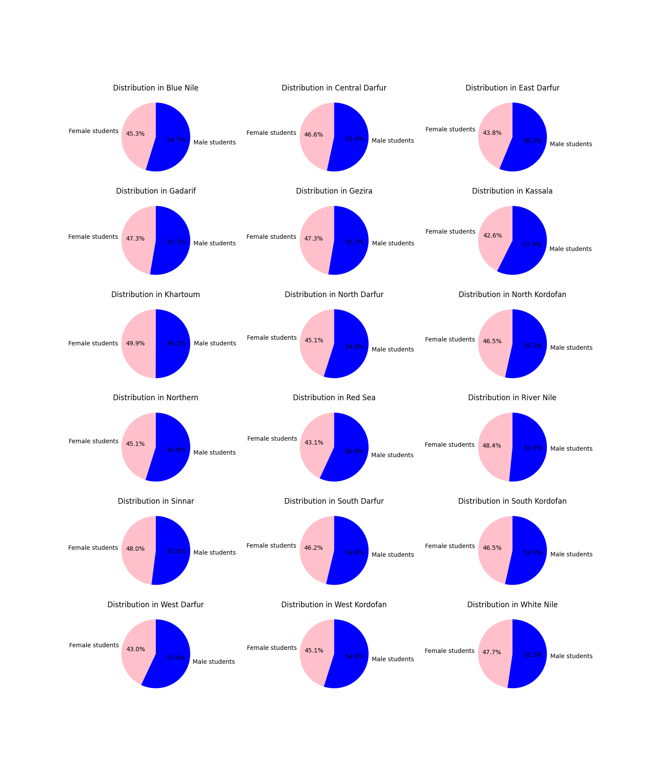
Frontier Tech Leaders Programme Global Cohort 1

Slide 11
Frontier Tech Leaders Programme Global Cohort 1

Slide 12
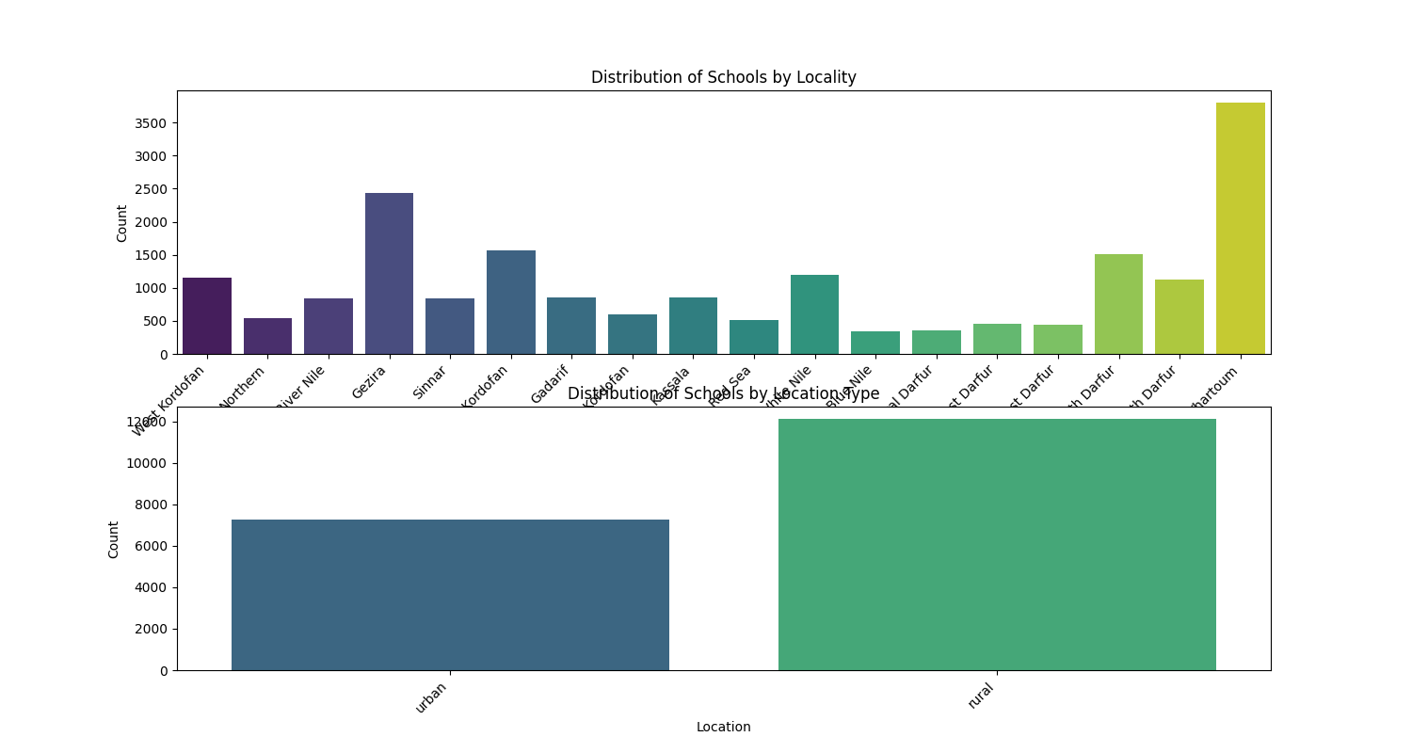
Frontier Tech Leaders Programme Global Cohort 1

Slide 13
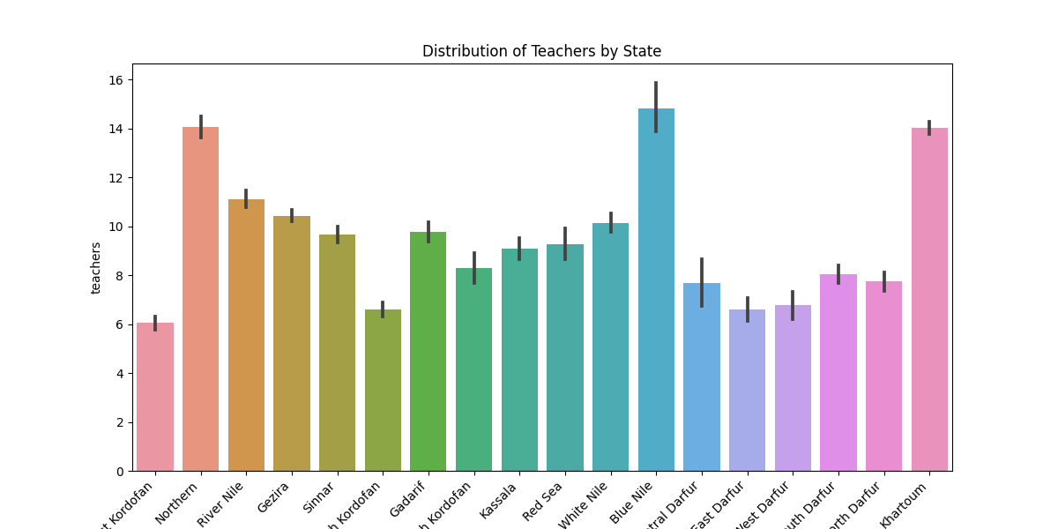
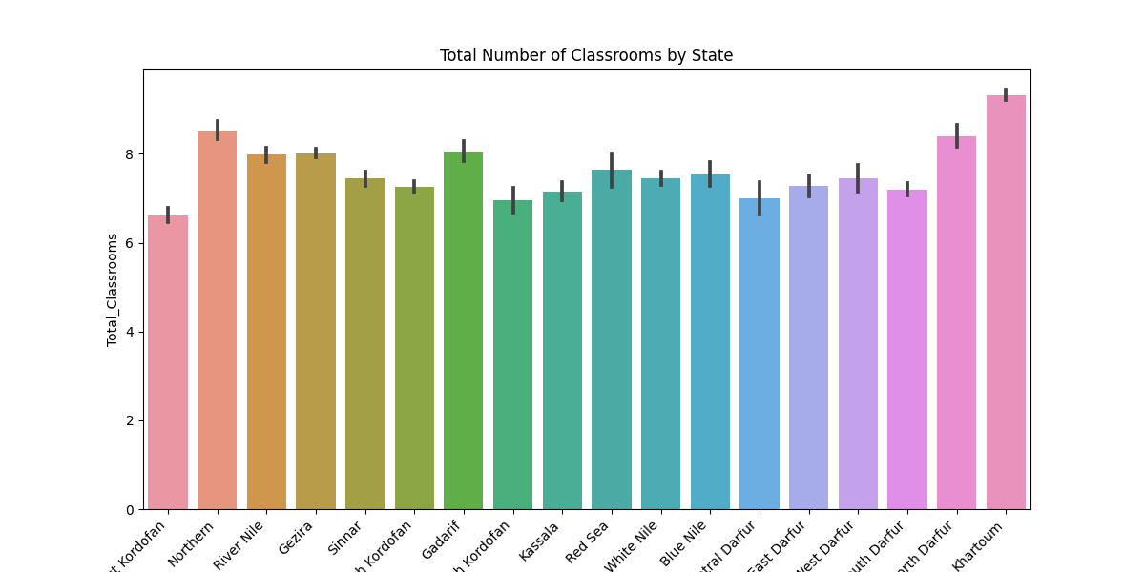
Frontier Tech Leaders Programme Global Cohort 1

Slide 14
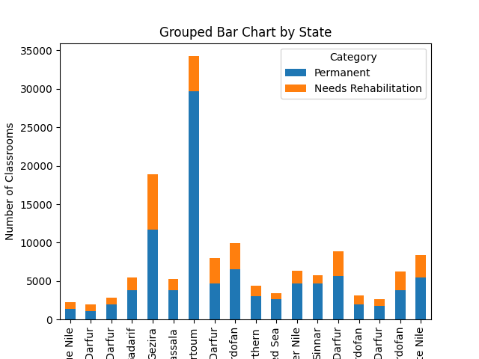
Frontier Tech Leaders Programme Global Cohort 1

Slide 15
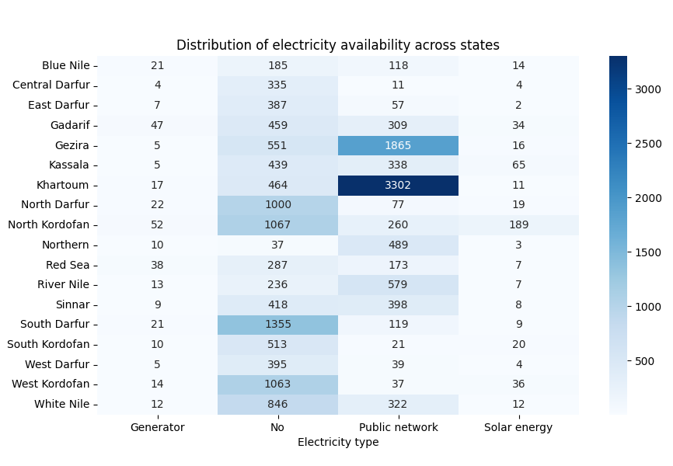
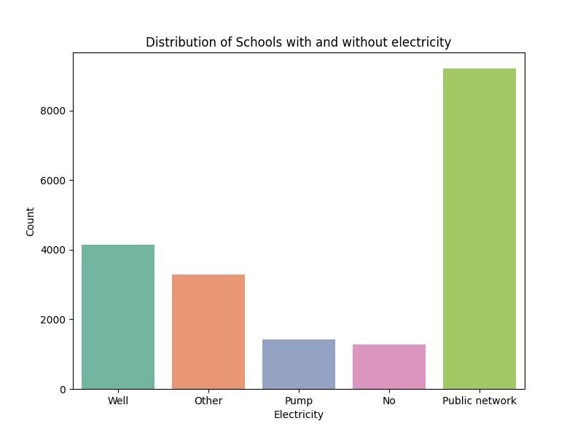
Frontier Tech Leaders Programme Global Cohort 1

Slide 16
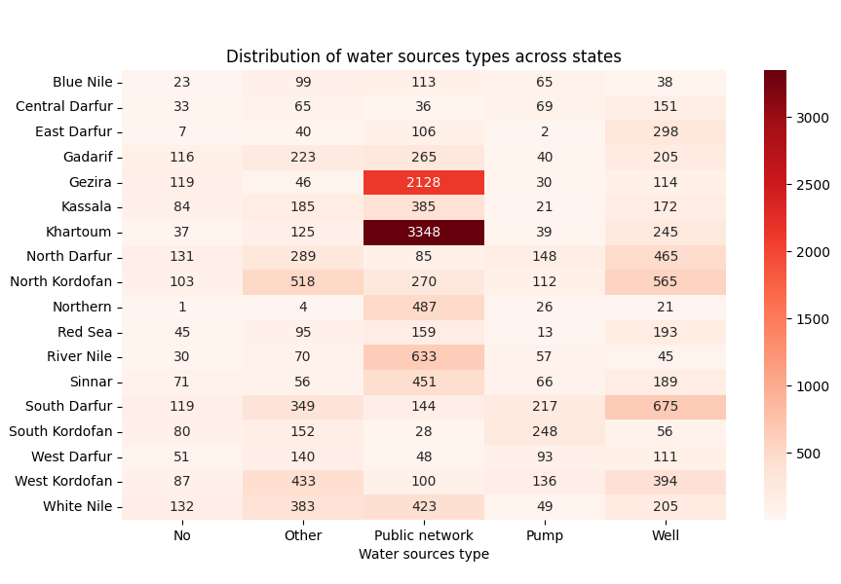
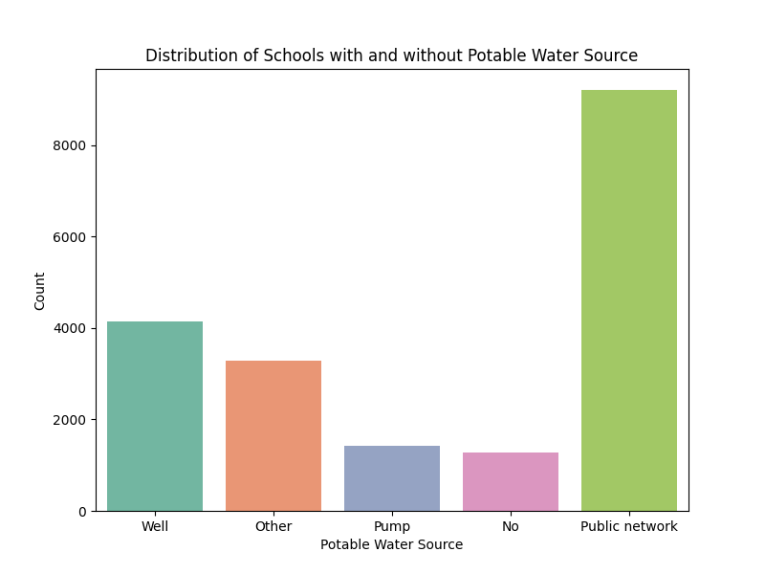
Frontier Tech Leaders Programme Global Cohort 1

Slide 17
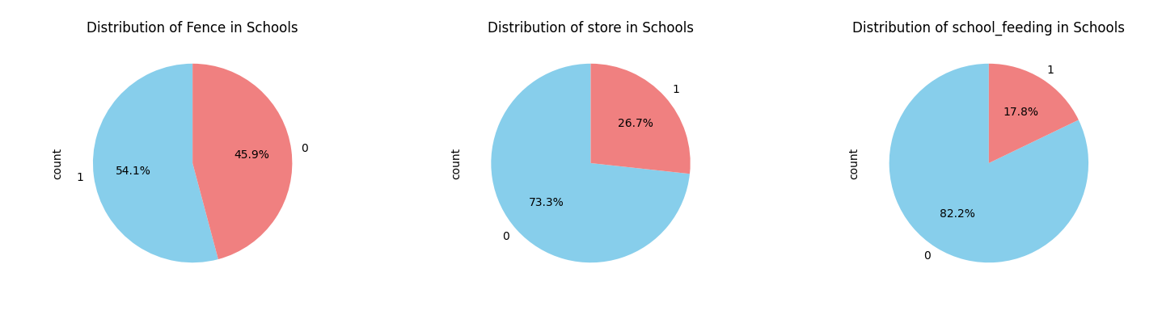
Frontier Tech Leaders Programme Global Cohort 1

Slide 18
4. Data Preparation and Feature Engineering
Frontier Tech Leaders Programme Global Cohort 1

Slide 19
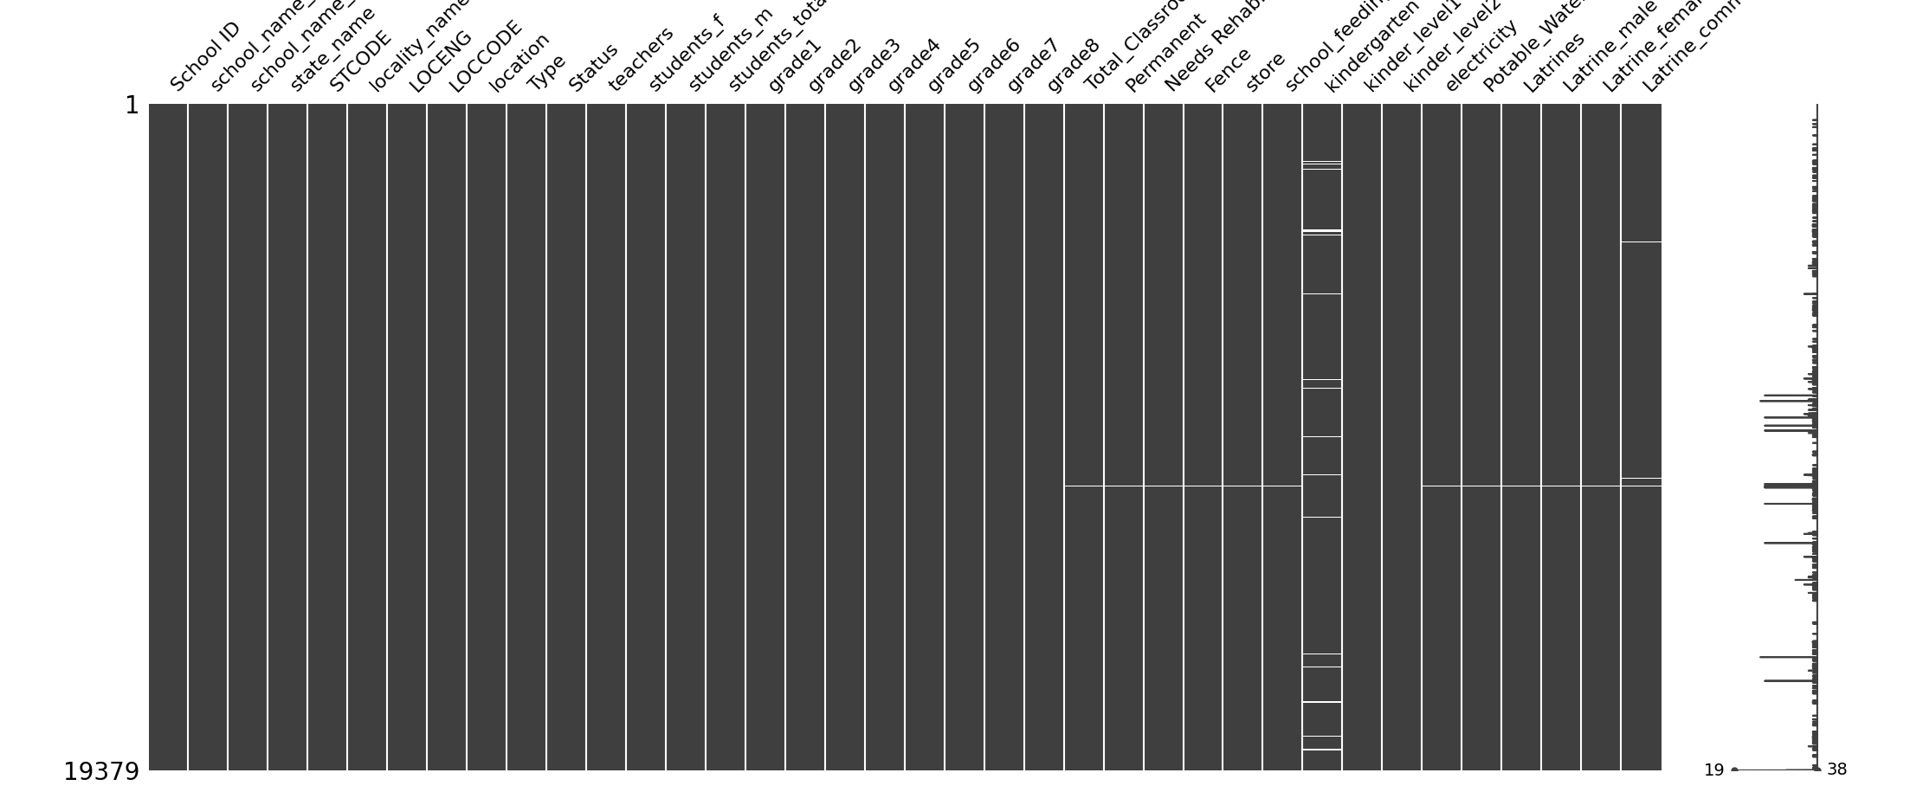
4.1 Missing data
Frontier Tech Leaders Programme Global Cohort 1

Slide 20
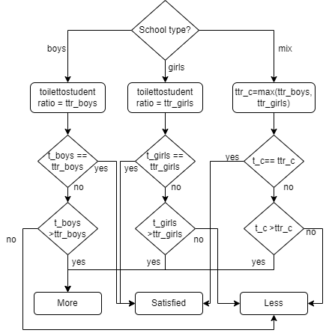
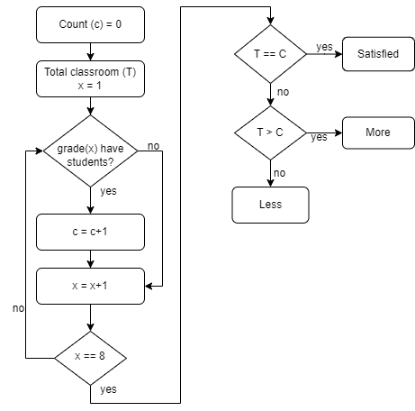
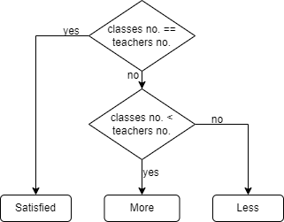
4.2 Creating new features
Frontier Tech Leaders Programme Global Cohort 1
Toilet to Student [2]
Class to student
Class to teacher

Slide 21
4.3 Drop unnecessary features
Frontier Tech Leaders Programme Global Cohort 1
1st and 5th columns written in Arabic, and both have similar information column written in English
School name, state name, location (LOCENG)
School grade1 to grade8 columns

Slide 22

4.4 Convert Categorical Features into Numerical
Frontier Tech Leaders Programme Global Cohort 1
Edit STCODE and LOCCODE columns to be only the numerical part without "SD“
Convert yes,no to 1,0 in columns; Fence, Store, School_feeding, Latrines
Check unique classes in 'location', 'Type', 'Status' , 'electricity', 'Potable_Water_source' columns and convert them to numerical

Slide 23
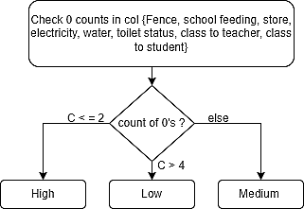
4.6 Labeling
Frontier Tech Leaders Programme Global Cohort 1

Slide 24
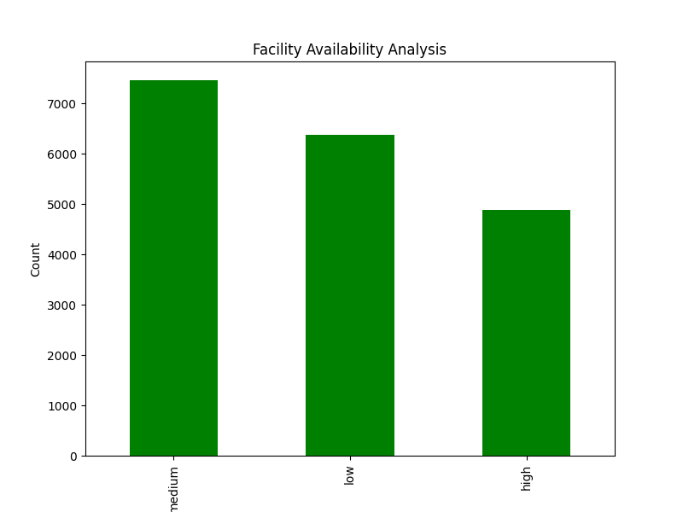
Frontier Tech Leaders Programme Global Cohort 1

Slide 25
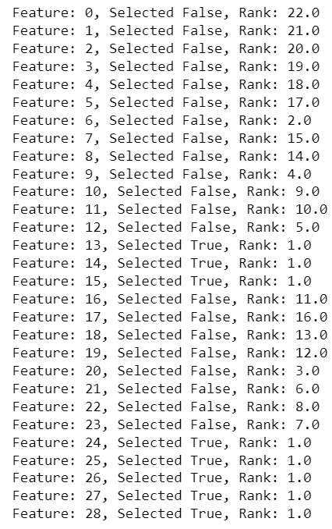
4.7 Prepare Data for Machine Learning Models
Frontier Tech Leaders Programme Global Cohort 1
Determine x, y values.
Standardization using StandardScaler.
Feature importance (29 features, 8 most important have been selected).
Splitting (train/test)

Slide 26
5. Machine Learning Models
Frontier Tech Leaders Programme Global Cohort 1

Slide 27




5.1 Model Selection and Training
Frontier Tech Leaders Programme Global Cohort 1
Model | Hypermeters | Hypermeters values | Performance metrices values | Performance metrices values | Confusion matrix
Naïve bayes | Folds number | 10 | Accuracy | 97
 |  |  | F1 | 98,96,96
 |  |  | precession | 96,95,100
 |  |  | recall | 100.97,92
Random forest | Number of trees in the forest (estimator) | 9 | Accuracy | 100
 |  |  | F1 | 100,100,100
 |  |  | precession | 100,100,100
 |  |  | recall | 100,100,100
KNN | K | 1 | Accuracy | 100
 |  |  | F1 | 100,100,100
 |  |  | precession | 100,100,100
 |  |  | recall | 100,100,100
SVM | Kernel function | Linear | Accuracy | 100
 |  |  | F1 | 100,100,100
 |  |  | precession | 100,100,100
 |  |  | recall | 100,100,100

Slide 28
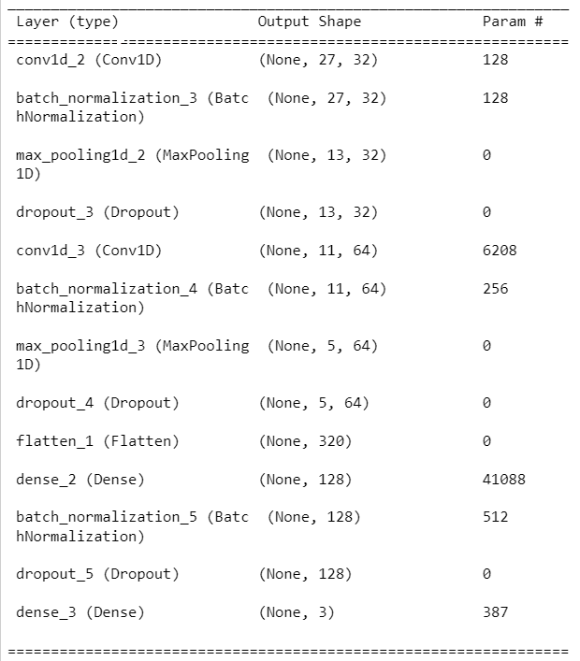

Frontier Tech Leaders Programme Global Cohort 1
Model | Hypermeters | Hypermeters values | Performance metrices values | Performance metrices values | Confusion matrix
CNN | Folds number | 10 | Accuracy | 87
 |  |  | F1 | 88, 83, 92
 |  |  | precession | 86, 89, 88
 |  |  | recall | 91, 78, 97

Slide 29
6. Deployment
Frontier Tech Leaders Programme Global Cohort 1

Slide 30
Deployment
Frontier Tech Leaders Programme Global Cohort 1
Prepare Machine learning model
Deploy using flask
model.ipynb (ML model)
model.pkl (pickle file for ML model)
app.ipynb (flask application)
index.html (template)
data.csv (data to build ML model)

Slide 31
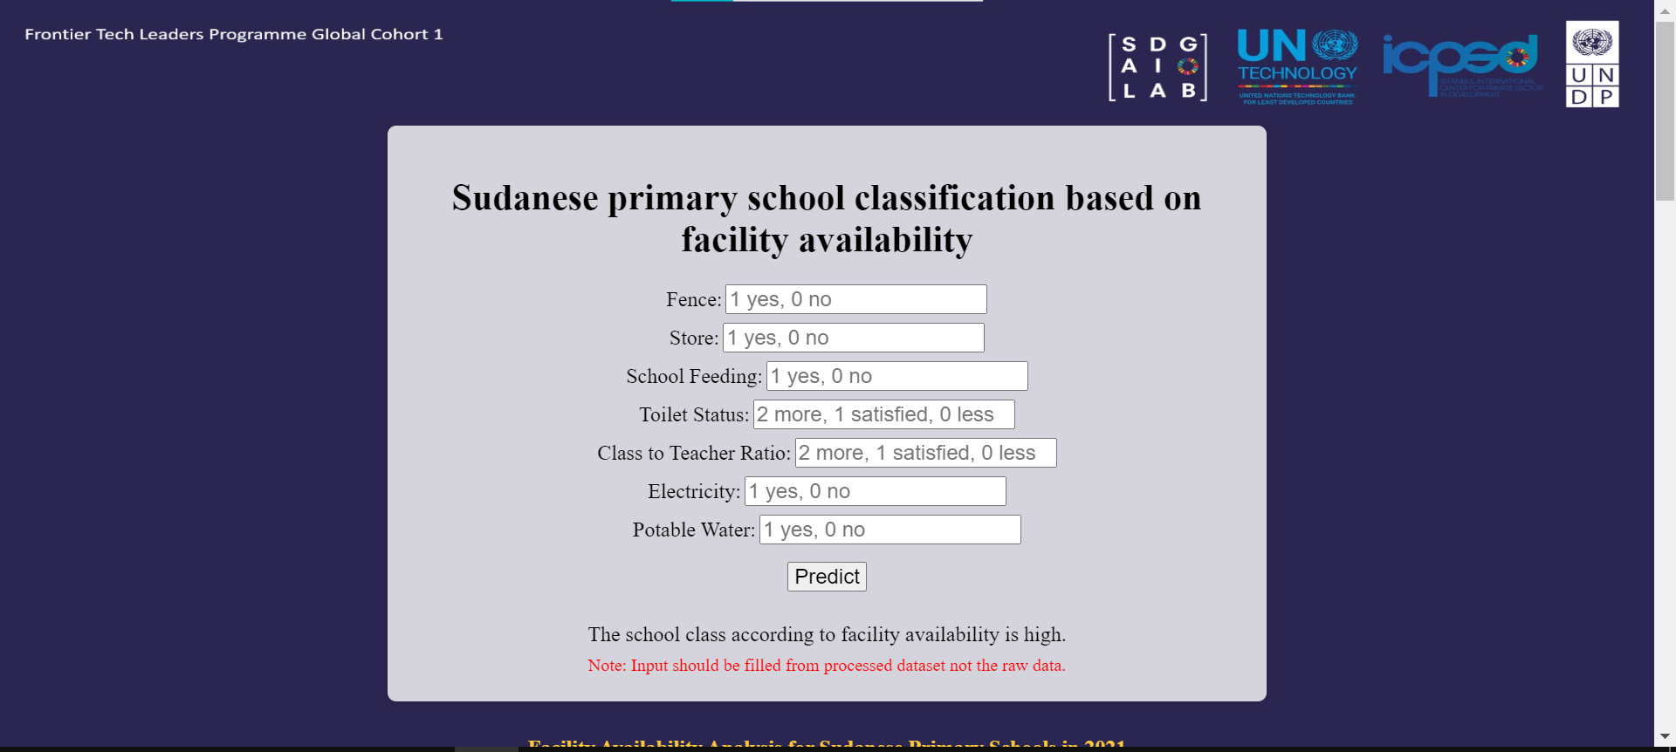
Frontier Tech Leaders Programme Global Cohort 1

Slide 32
7. Future Work
Frontier Tech Leaders Programme Global Cohort 1
Modify the deployment app
Take classrooms that need to reconstruction in consideration

Slide 33
References
Frontier Tech Leaders Programme Global Cohort 1
[1] Sudan schools dataset, https://data.humdata.org/dataset/sudan-schools
[2] UNICEF Sudan - Investment Case - Back to School, Back to Learning (EU), https://www.unicef.org/sudan/media/9711/file/UNICEF%20Sudan%20-%20Investment%20Case%20-%20Back%20to%20School,%20Back%20to%20Learning%20(EU).pdf
[3] United Nations. (2015). Transforming our world: the 2030 Agenda for Sustainable Development. Retrieved from https://sdgs.un.org/2030agenda
[4] World Bank. (2020). World Development Report 2018: Learning to Realize Education's Promise. Retrieved from https://www.worldbank.org/en/publication/wdr2018

Slide 34


Thank you!
Frontier Tech Leaders Programme Global Cohort 1

