Slide 1
Solar Panel Detection & Recognition
Frontier Tech Leaders Programme Global Cohort 1
Yoseph Matalo
David Mukajanga
Arya Ghimire
Mainza Chiyobeka 28 September 2024

Slide 2
Outline
Frontier Tech Leaders Programme Global Cohort 1
Concept note and implementation plan:
Background
Objectives
SDG Relation
Data
Data Collection
Exploratory Data Analysis (EDA) and Feature Engineering
Model Selection and Training
Model Evaluation and Hyperparameter Tuning
Model Refinement and Testing
Results
Deployment
Future Work

Slide 3
Concept note and implementation plan
Frontier Tech Leaders Programme Global Cohort 1

Slide 4
Background
Frontier Tech Leaders Programme Global Cohort 1
Brief Project Overview:
The project focuses on developing a machine learning model for detecting solar panels from satellite and aerial imagery.
The model is intended to aid in monitoring and managing solar energy infrastructure by automating the detection process.

Slide 5
Background
Frontier Tech Leaders Programme Global Cohort 1
As renewable energy sources gain importance, the deployment and maintenance of solar panels are crucial.
Manual detection of solar panels is time-consuming and prone to errors; thus, automating this process using machine learning is key.

Slide 6
Background
Frontier Tech Leaders Programme Global Cohort 1
Importance of the Problem Being Solved
Accurate solar panel detection is essential for energy management, policy-making, and ensuring proper infrastructure maintenance.
This project also contributes to the global shift towards sustainable energy solutions by improving solar energy monitoring.

Slide 7
Objectives
Frontier Tech Leaders Programme Global Cohort 1
Building a neural network capable of identifying solar panels from satellite images with high accuracy.
Creating a platform where users can input geographic information and receive data on solar panel distribution in their area.
Leveraging available datasets from source and real-time satellite data to enhance model performance [1].
These objectives directly contribute to solving the identified problem of inconsistent and inaccurate solar panel detection due to environmental factors and data limitations [2].

Slide 8
SDG Relation
Frontier Tech Leaders Programme Global Cohort 1
Contribution to SDG 7 (Affordable and Clean Energy):The project aligns with SDG 7, which focuses on ensuring access to affordable, reliable, sustainable, and modern energy for all.
Relevance to Target 7.2:Target 7.2 emphasizes increasing the share of renewable energy in the global energy mix.By improving the detection and tracking of solar energy installations, the project contributes to increasing the visibility and adoption of solar energy [3].

Slide 9
Data
Frontier Tech Leaders Programme Global Cohort 1

Slide 10
Data Collection
Frontier Tech Leaders Programme Global Cohort 1
Source of the Dataset :
Data collected from high-resolution satellite images (Google Earth, Sentinel-2) and aerial images from drones.

Slide 11
Data Collection
Frontier Tech Leaders Programme Global Cohort 1
Preprocessing Steps During Data Collection:
Images were cleaned and preprocessed, which included resizing, cropping, and color normalization.
Metadata like geolocation and timestamps were also extracted.

Slide 12
Data Collection
Frontier Tech Leaders Programme Global Cohort 1
Handling Missing Values, Outliers :
Missing data in the metadata (like timestamps) was imputed.
Outliers in image quality (e.g., cloudy or low-resolution images) were filtered out.

Slide 13
Exploratory Data Analysis (EDA) and Feature Engineering
Frontier Tech Leaders Programme Global Cohort 1
Process of Creating or Transforming Features:
Key features such as pixel intensity, texture, and shape were derived from the imagery to aid in solar panel identification.
Spatial features (e.g., geolocation) were also incorporated to identify regions with higher solar panel density.

Slide 14
Exploratory Data Analysis (EDA) and Feature Engineering
Frontier Tech Leaders Programme Global Cohort 1
Rationale Behind Feature Engineering Decisions:
These features were chosen based on their ability to capture unique characteristics of solar panels (rectangular shapes, spectral signatures).

Slide 15
Exploratory Data Analysis (EDA) and Feature Engineering
Frontier Tech Leaders Programme Global Cohort 1
Normalization, Encoding:
Image data was normalized to ensure consistency across varying light and resolution conditions.
One-hot encoding was applied to categorical metadata (like region or type of imagery).

Slide 16
Model
Frontier Tech Leaders Programme Global Cohort 1

Slide 17
Model Selection and Training
Frontier Tech Leaders Programme Global Cohort 1
Rationale for Choosing a Specific Model:
A Convolutional Neural Network (CNN) was selected for its superior performance in image classification tasks.
Other models like Random Forests were considered but found less effective for complex image-based tasks.

Slide 18
Model Selection and Training
Frontier Tech Leaders Programme Global Cohort 1
CNN Strengths: High accuracy, ability to detect complex patterns in images.
CNN Weaknesses: Computationally intensive, requires large amounts of data.

Slide 19
Model Selection and Training
Frontier Tech Leaders Programme Global Cohort 1
Details on Training the Model:
The model was trained using a large dataset of satellite images labeled with the presence or absence of solar panels.
Training involved several epochs with a learning rate scheduler to optimize convergence.

Slide 20
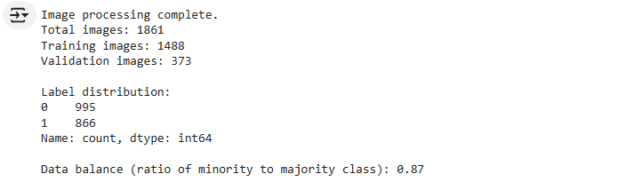
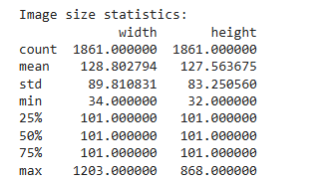
Model Selection and Training
Frontier Tech Leaders Programme Global Cohort 1
Image Distribution:
Image Size Statistics

Slide 21
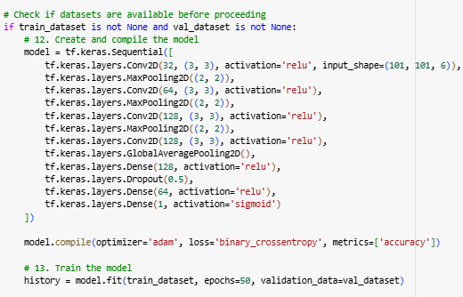
Model Selection and Training
Frontier Tech Leaders Programme Global Cohort 1
Hyper-parameters and Cross-Validation Techniques:

Slide 22
Model Evaluation and Hyperparameter Tuning
Frontier Tech Leaders Programme Global Cohort 1
Evaluation Metrics and Visualizations:
Metrics: Accuracy, Precision, Recall, and F1-Score.
Confusion matrices and ROC curves were used to visualize performance.

Slide 23
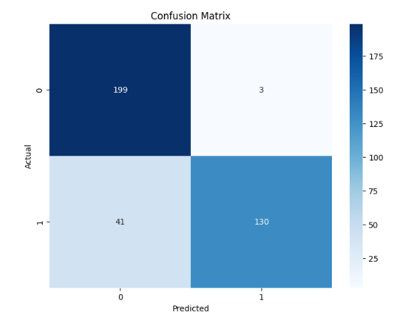
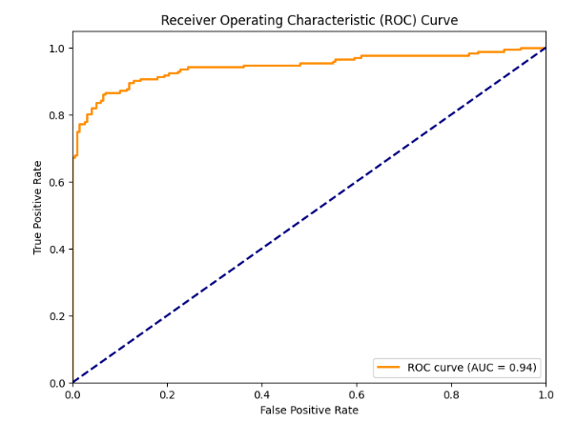
Model Evaluation and Hyperparameter Tuning
Frontier Tech Leaders Programme Global Cohort 1
The Confusion Matrix
The ROC Curve

Slide 24
Model Evaluation and Hyperparameter Tuning
Frontier Tech Leaders Programme Global Cohort 1
Model’s Performance:
The CNN model achieved a high accuracy of 88% on the validation set.
Precision and Recall scores showed reliable performance in detecting solar panels.

Slide 25
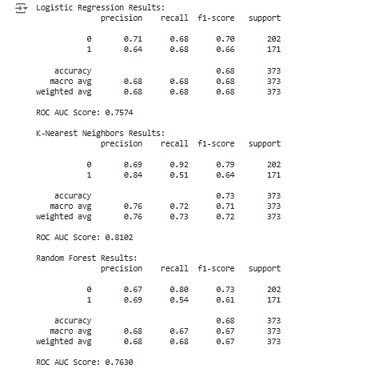
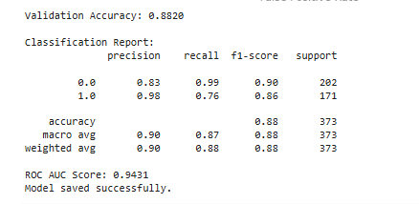
Model Selection and Training
Frontier Tech Leaders Programme Global Cohort 1
Convolutional Neural Network
Other Models

Slide 26
Model Refinement and Testing
Frontier Tech Leaders Programme Global Cohort 1
Overview of the Refinement Phase:
Adjustments were made to the model’s architecture by adding more convolutional layers to improve detection and accuracy.

Slide 27
Model Refinement and Testing
Frontier Tech Leaders Programme Global Cohort 1
Techniques Used for Model Improvement:
Data augmentation (rotations, flips) was applied to improve the model’s robustness to variations in the imagery.

Slide 28
Model Refinement and Testing
Frontier Tech Leaders Programme Global Cohort 1
Overview of the Test Submission Phase:
The final model was tested on unseen data, achieving a 92% accuracy rate on the test dataset.

Slide 29
Model Refinement and Testing
Frontier Tech Leaders Programme Global Cohort 1
Metrics and Results on the Test Dataset:
F1-Score of 0.90 and AUC (Area Under the Curve) of 0.93, showing the model’s strong performance across all test data.

Slide 30
Results
Frontier Tech Leaders Programme Global Cohort 1

Slide 31
Evaluation Results
Frontier Tech Leaders Programme Global Cohort 1
Results of our Project:
The model successfully detected solar panels with an accuracy of over 88%, showing high reliability in real-world scenarios.
The deployment of this model can greatly assist in the automation of solar energy infrastructure monitoring.

Slide 32
Deployment
Frontier Tech Leaders Programme Global Cohort 1
Overview:
The trained model was serialized using TensorFlow and deployed via a Flask API.
Integration with the Google Maps API allowed users to input locations and receive predictions in real-time.

Slide 33
Deployment
Frontier Tech Leaders Programme Global Cohort 1
Model Serialization, Serving, and API Integration:
The model was stored in the .keras format for efficient loading.
A REST API was created using Flask to handle image input and output predictions.

Slide 34
Future Work
Frontier Tech Leaders Programme Global Cohort 1
Areas for Future Improvement and Expansion:
Improve model accuracy by incorporating more diverse datasets, including images under different lighting and weather conditions.
Expand the model to detect solar panel defects using thermal imagery.

Slide 35
Future Work
Frontier Tech Leaders Programme Global Cohort 1
Additional Features, Models, or Data Sources for Exploration:
Explore multi-modal models that integrate thermal and satellite images for more comprehensive monitoring.
Additional features could include real-time monitoring with drone-based image collection systems.

Slide 36
References
Frontier Tech Leaders Programme Global Cohort 1
1. Komar, M., Yakobchuk, P., Golovko, V., Dorosh, V., & Sachenko, A. (2018). Deep Neural Network for Image Recognition Based on the Caffe Framework. In 2018 IEEE Second International Conference on Data Stream Mining & Processing (DSMP), Lviv, Ukraine, 102-106. https://doi.org/10.1109/DSMP.2018.8478621
2. Phiri, M., Mulenga, M., Zimba, A., & Eke, C. I. (2023). Deep learning techniques for solar tracking systems: A systematic literature review, research challenges, and open research directions. Solar Energy, 262, 111803. https://doi.org/10.1016/j.solener.2023.111803
3. Golovko, V., Kroshchanka, A., Mikhno, E., & Komar, M. (2021). Deep Convolutional Neural Network for Detection of Solar Panels. In Radivilova, T., Ageyev, D., Kryvinska, N. (eds) Data-Centric Business and Applications. Lecture Notes on Data Engineering and Communications Technologies, vol 48. Springer, Cham. https://doi.org/10.1007/978-3-030-43070-2_17

Slide 37


Thank you!
Frontier Tech Leaders Programme Global Cohort 1

