Slide 1
ECG Classification based on Time-Frequency Analysis and Deep Learning
Frontier Tech Leaders Programme Global Cohort 1
Mosab Aboidrees Altraifi Yousif
Abdelrahman Mohammed
(Group 12)
Date

Slide 2
Outline
Frontier Tech Leaders Programme Global Cohort 1
Concept note and implementation plan:
Background
Objectives
SDG Relation
Data
Data Collection
Exploratory Data Analysis (EDA) and Feature Engineering
Model Selection and Training
Model Evaluation and Hyperparameter Tuning
Model Refinement and Testing
Results
Deployment
Future Work

Slide 3
Concept note and implementation plan
Frontier Tech Leaders Programme Global Cohort 1

Slide 4
Background
Frontier Tech Leaders Programme Global Cohort 1
ECG signals are essential for diagnosing heart conditions such as arrhythmia (ARR), congestive heart failure (CHF), and normal sinus rhythm (NSR).
Traditional ECG classification relies on manual feature extraction, making it inefficient for real-time diagnostics.
Deep learning and time-frequency analysis offer automated, accurate solutions.

Slide 5
Background
Problem Statement:
Cardiovascular diseases (CVD) are the leading cause of death globally.
ECG signals are widely used to diagnose CVDs, but traditional methods are time-consuming and prone to error.
Solution:
Leverage time-frequency analysis (CWT) and deep learning (CNN) to automatically classify ECG signals.
Use transfer learning to improve model performance and generalization.

Slide 6
Objectives
Frontier Tech Leaders Programme Global Cohort 1
Project Objectives:
Time-Frequency Analysis: Convert raw ECG signals into time-frequency representations using Continuous Wavelet Transform (CWT).
Deep Learning Model: Train a convolutional neural network (CNN) to classify these representations.
Model Refinement: Use hyperparameter tuning, regularization, and cross-validation to optimize the model.
Real-World Deployment: Prepare the model for integration into clinical systems.

Slide 7
SDG Relation
Frontier Tech Leaders Programme Global Cohort 1
Relevance to Sustainable Development Goal (SDG) 3: Good Health and Well-being
This project contributes to SDG 3 by improving the accuracy and speed of diagnosing cardiovascular diseases.
The model can help reduce premature mortality from non-communicable diseases through better diagnostic tools.

Slide 8
Data
Frontier Tech Leaders Programme Global Cohort 1

Slide 9
Data Collection
Frontier Tech Leaders Programme Global Cohort 1
Dataset Overview:
Sources: MIT-BIH Arrhythmia Database, MIT-BIH Normal Sinus Rhythm Database, BIDMC Congestive Heart Failure Database.
Total Samples: 162 ECG recordings (96 ARR, 30 CHF, 36 NSR).
Sampling Rate: 128 Hz.
Format: Stored as .mat files.
Data Collection and Preprocessing:
Raw ECG signals were collected and preprocessed for noise removal.
Standardization of signal length was performed to ensure consistent CWT analysis.
Data was labeled into three categories: ARR, CHF, and NSR.

Slide 10
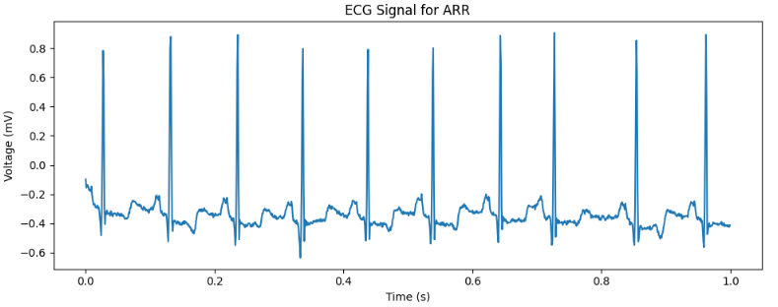
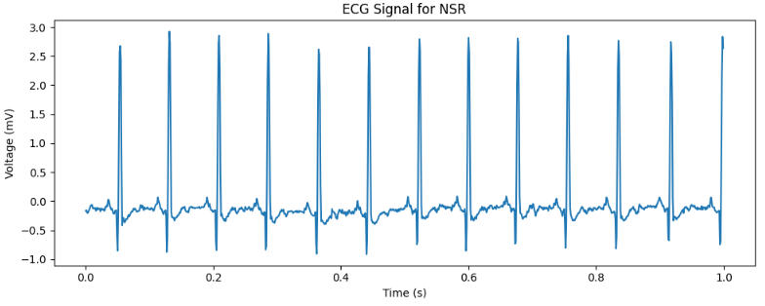
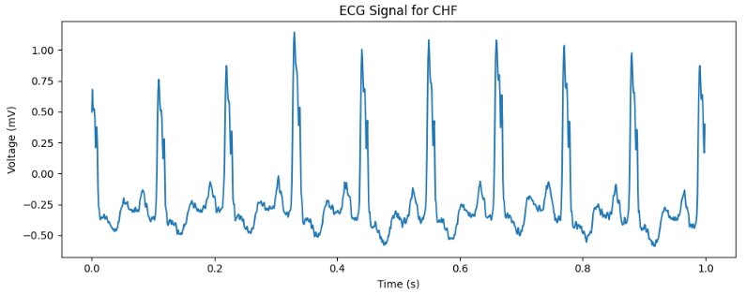
Exploratory Data Analysis (EDA) and Feature Engineering

Slide 11
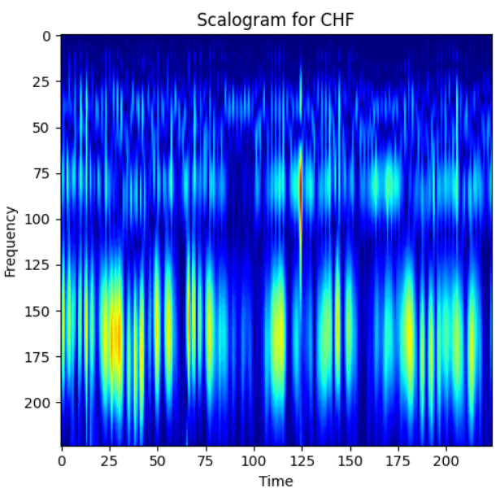
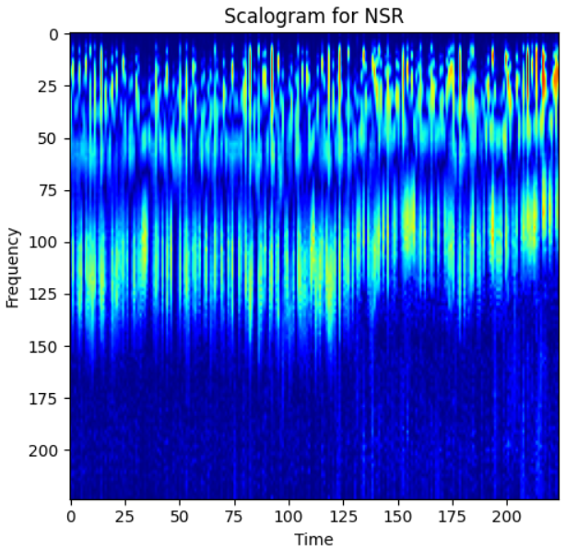
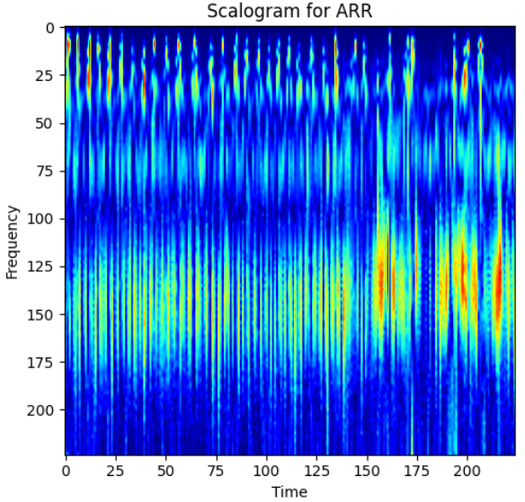
Exploratory Data Analysis (EDA) and Feature Engineering
Frontier Tech Leaders Programme Global Cohort 1
EDA:
Scalograms (time-frequency representations) were created using CWT to capture both time and frequency-domain features.
Feature Engineering:
ECG signals were transformed into scalograms, saved as RGB images (224x224x3) for deep learning model input.

Slide 12
Model
Frontier Tech Leaders Programme Global Cohort 1

Slide 13
Model Selection and Training
Frontier Tech Leaders Programme Global Cohort 1
Training set 80% and testing set 20%.
Layer (Type) | Output Shape | Parameters | Kernel Size | Activation Function | Regularization (L2)
Input Layer (Input) | (None, input_shape) | 0 | N/A | N/A | None
Conv2D (32 filters) | (None, input_shape/2) | 896 | (3, 3) | ReLU | 0.002
MaxPooling2D | (None, input_shape/4) | 0 | (2, 2) | N/A | None
Conv2D (64 filters) | (None, input_shape/8) | 18,496 | (3, 3) | ReLU | 0.002
MaxPooling2D | (None, input_shape/16) | 0 | (2, 2) | N/A | None
Conv2D (128 filters) | (None, input_shape/32) | 73,856 | (3, 3) | ReLU | 0.002
MaxPooling2D | (None, input_shape/64) | 0 | (2, 2) | N/A | None
Flatten | (None, *) | 0 | N/A | N/A | None
Dense (500 units) | (None, 500) | 64,500 | N/A | ReLU | 0.002
Dense (Output layer) | (None, num_classes) | num_classes * 501 | N/A | Softmax | None

Slide 14
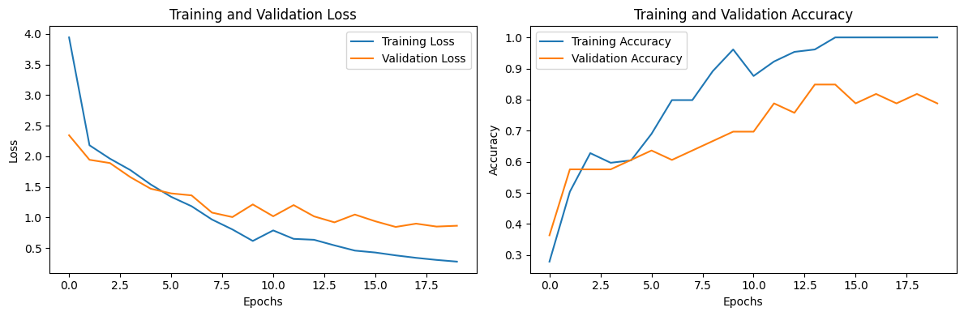
Model Evaluation and Hyperparameter Tuning
Frontier Tech Leaders Programme Global Cohort 1
Training:
Pretrained layers were fine-tuned for ECG classification.
Hyperparameters: Learning rate = 0.001, Batch size = 27, Optimizer = SGDM.

Slide 15
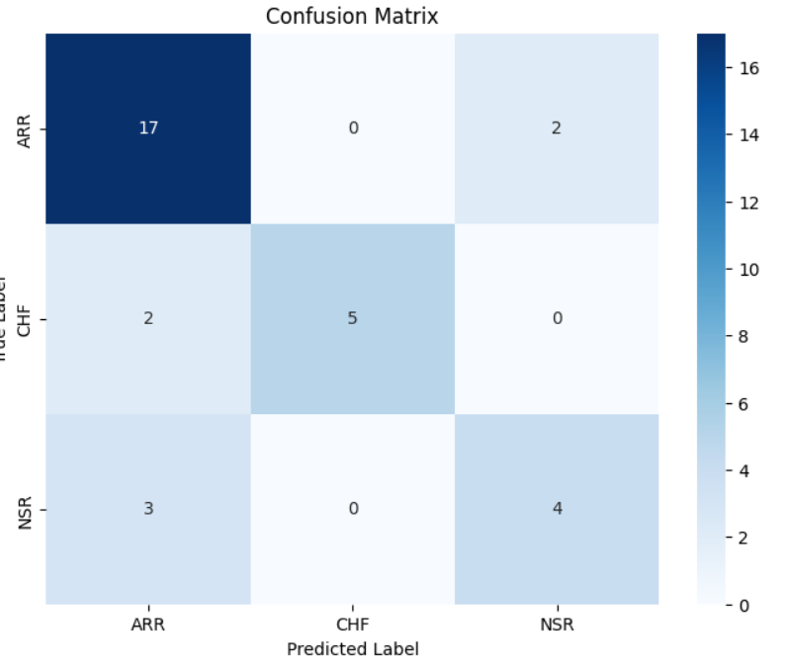
Model Refinement and Testing
Frontier Tech Leaders Programme Global Cohort 1
Refinement:
L2 regularization and adjustments to architecture helped reduce overfitting, to get raining accuracy of 80%

Slide 16
Results
Frontier Tech Leaders Programme Global Cohort 1

Slide 17
Evaluation Results
Frontier Tech Leaders Programme Global Cohort 1
Results Summary:
Challenges:
Class imbalance was a challenge, addressed through stratified sampling and cross-validation.
Overfitting was reduced through regularization and batch size adjustments.
Accuracy | F1 Score | Precision | Recall
78.79% | 78.48% | 79.84% | 78.79%

Slide 18
Deployment
Frontier Tech Leaders Programme Global Cohort 1
Deployment Plans:
The refined model will be integrated into clinical diagnostic systems.
Real-time classification of ECG signals will be enabled, potentially aiding in early detection of heart conditions.
Deployment done with streamlit, and you can access it via this link:
Streamlit (ecgclassification.streamlit.app)

Slide 19
Future Work
Frontier Tech Leaders Programme Global Cohort 1
Next Steps:
Explore more advanced architectures like Efficient Net or ResNet for even better performance.
Expand the dataset and test the model in real-world clinical settings.
Investigate real-time ECG classification and scalability.

Slide 20
References
Frontier Tech Leaders Programme Global Cohort 1
[1] Moody, G. B., and R. G. Mark. "The impact of the MIT-BIH Arrhythmia Database." IEEE Engineering in Medicine and Biology Magazine. Vol. 20, No. 3, May-June 2001, pp. 45–50. (PMID: 11446209)
[2] Goldberger A. L., et al. "PhysioBank, PhysioToolkit, and PhysioNet: Components of a New Research Resource for Complex Physiologic Signals." Circulation, Vol. 101, No. 23, 2000. (doi: 10.1161/01.CIR.101.23.e215)
[3] Zhao, Q., and L. Zhang. "ECG feature extraction and classification using wavelet transform and support vector machines." IEEE International Conference on Neural Networks and Brain, 2005, pp. 1089–1092.
[4] Baim, D. S., et al. "Survival of patients with severe congestive heart failure treated with oral milrinone." Journal of the American College of Cardiology, Vol. 7, No. 3, 1986, pp. 661–670.
[5] Mohonta, S. C., et al. "Electrocardiogram based arrhythmia classification using wavelet transform with deep learning model." Sensing and Bio-Sensing Research, Vol. 37, 2022, p. 100502. (doi: 10.1016/j.sbsr.2022.100502)
[6] Acharya, U. R., et al. "Automated detection of arrhythmias using different intervals of tachycardia ECG segments with convolutional neural network." Computers in Biology and Medicine, Vol. 85, 2017, pp. 138-147. (doi: 10.1016/j.compbiomed.2017.04.012)
[7] Hannun, A. Y., et al. "Cardiologist-level arrhythmia detection and classification in ambulatory electrocardiograms using a deep neural network." Nature Medicine, Vol. 25, 2019, pp. 65–69. (doi: 10.1038/s41591-018-0268-3)

Slide 21


Thank you!
Frontier Tech Leaders Programme Global Cohort 1

