Slide 1
Malnutrition Risk Prediction ML Model
Frontier Tech Leaders Programme Global Cohort 1
Group 13: Lina Ahmed | Linda Mohammed | Maha Abdelfadil | Nada Ali
September 2024

Slide 2
Outline
Frontier Tech Leaders Programme Global Cohort 1
Concept note and implementation plan:
Background
Objectives
SDG Relation
Data
Data Collection
Exploratory Data Analysis (EDA) and Feature Engineering
Model Selection and Training
Model Evaluation and Hyperparameter Tuning
Model Refinement and Testing
Results
Deployment
Future Work

Slide 3
Concept note and implementation plan
Frontier Tech Leaders Programme Global Cohort 1

Slide 4
Background
Frontier Tech Leaders Programme Global Cohort 1
This capstone project focuses on predicting malnutrition risks among children in low income developing countries using machine learning techniques.
By developing a predictive model, the project seeks to identify at-risk children early, enabling timely interventions and ultimately improving child health outcomes.

Slide 5
Objectives
Frontier Tech Leaders Programme Global Cohort 1
Improve early detection of malnutrition risks.
Equip healthcare providers and policymakers with a tool to target interventions more effectively.
Machine learning model aims to contribute to global efforts in reducing child malnutrition and advancing progress towards Sustainable Development Goal 2 (Zero Hunger).

Slide 6
SDG Relation
Frontier Tech Leaders Programme Global Cohort 1
The project aligns with Sustainable Development Goal 2 (Zero Hunger) by aiming to reduce child malnutrition, which is a significant contributor to child mortality and morbidity in these regions.
It also aligns with SDG 3 (Good Health and Well-Being) by aiming to ensure healthy lives for children.

Slide 7
Data
Frontier Tech Leaders Programme Global Cohort 1

Slide 8
Data Collection
Frontier Tech Leaders Programme Global Cohort 1
The project will leverage data from the “Multivariate random forest prediction of poverty and malnutrition prevalence” dataset available on Kaggle.
This dataset, derived from the research paper by Chris Browne, David S. Matteson, Linden McBride, and colleagues, offers a comprehensive repository of social indicators and environmental factors.

Slide 9
Data Collection
Frontier Tech Leaders Programme Global Cohort 1
The paper focus on data from eleven USAID Feed the Future (FTF) priority countries: Bangladesh, Ethiopia, Ghana, Guatemala, Honduras, Kenya, Mali, Nepal, Nigeria, Senegal, and Uganda.
The data was a combination of many sources: DHS malnutrition and asset poverty data, Physical geography covariates, Food price data, Solar-induced chlorophyll fluorescence data, Land surface temperature data, Precipitation data.

Slide 10
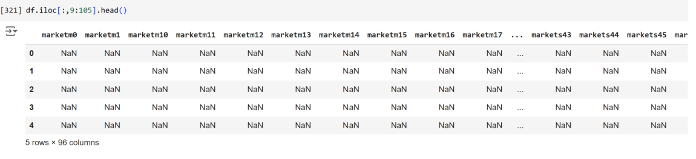
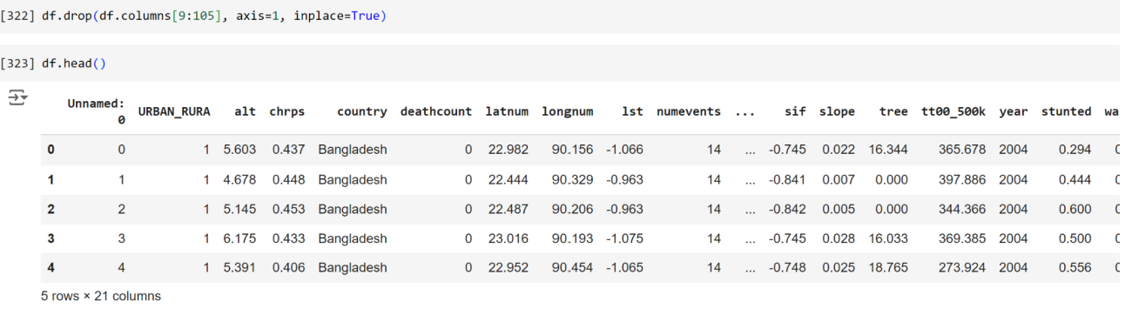
Data Collection | Handling Missing values:
Frontier Tech Leaders Programme Global Cohort 1
Columns with significant missing values were dropped after verifying they were not essential for the model.

Slide 11
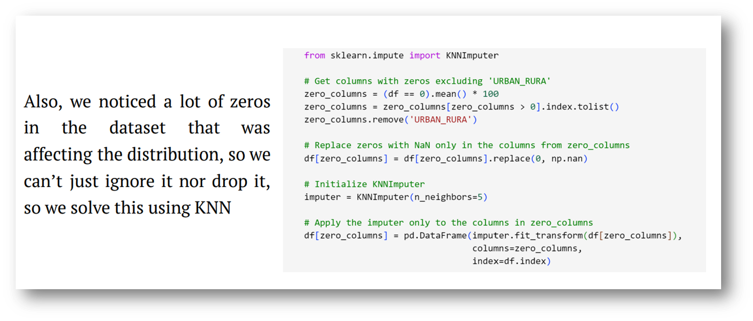
Data Collection | Handling Zeros:
Frontier Tech Leaders Programme Global Cohort 1

Slide 12
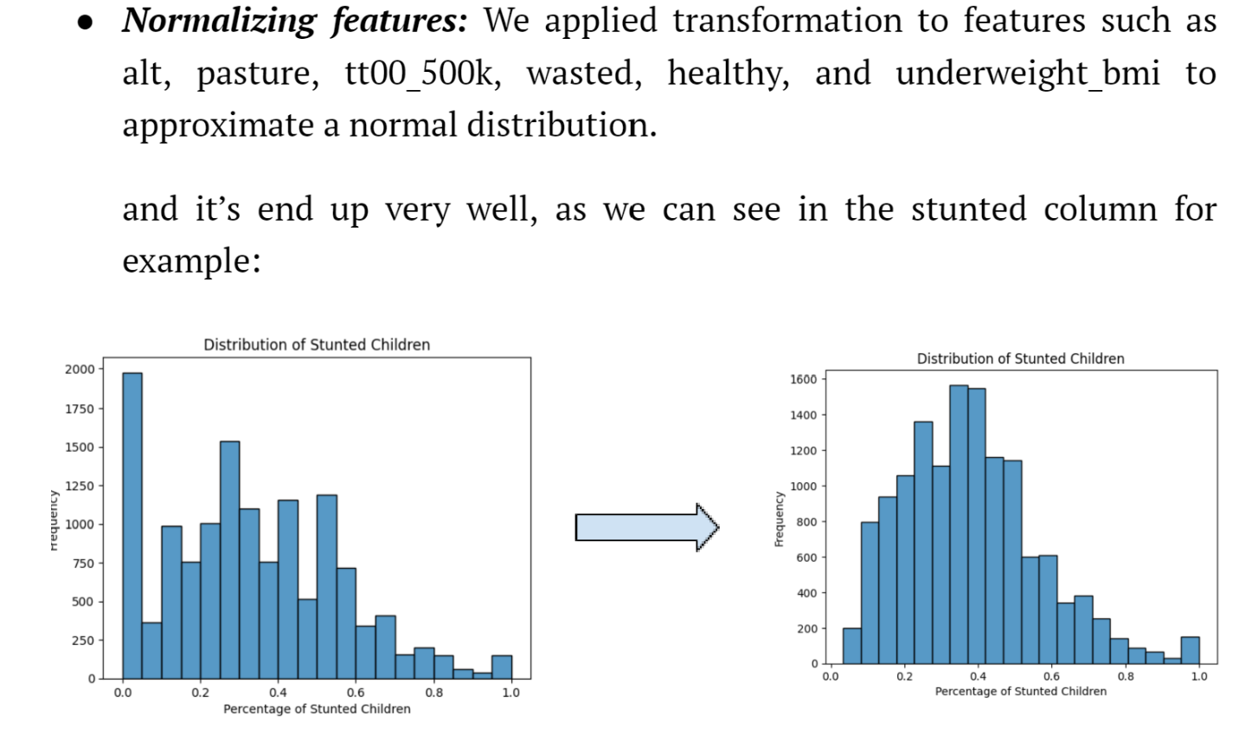
Frontier Tech Leaders Programme Global Cohort 1

Slide 13
Exploratory Data Analysis (EDA) and Feature Engineering
Frontier Tech Leaders Programme Global Cohort 1
In this phase of the project, we aimed to understand the underlying patterns, distributions, and relationships within the dataset. This step guides us to feature engineering and model selection part through:
Distribution of Features
Correlation Analysis
Distribution of Categories

Slide 14
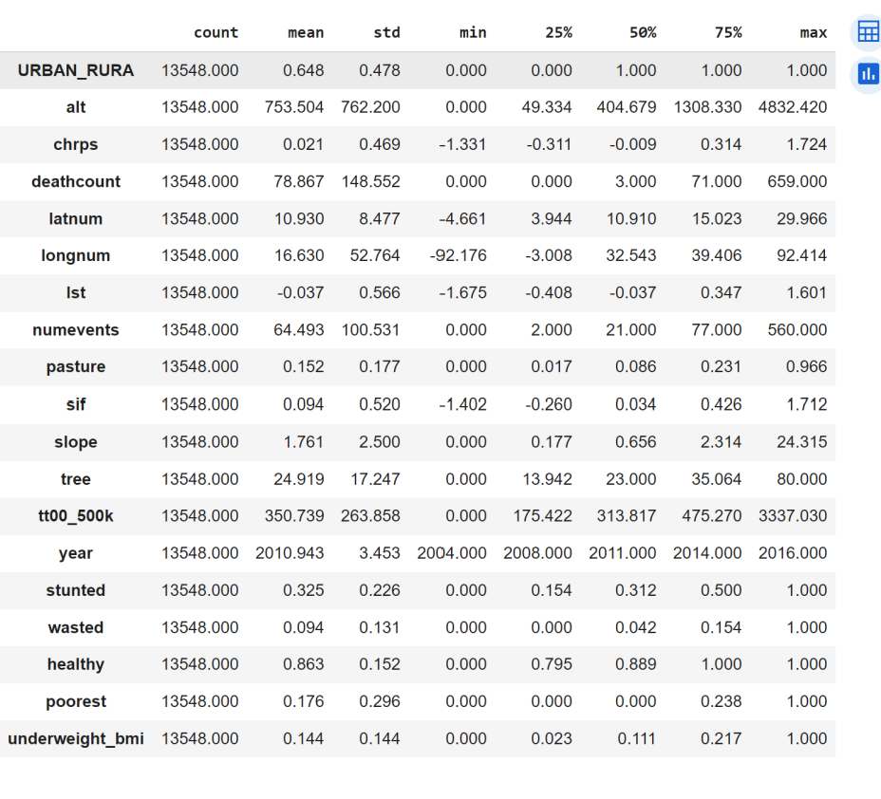
Exploratory Data Analysis (EDA) and Feature Engineering
Frontier Tech Leaders Programme Global Cohort 1
a. Distribution of Features
Features like altitude, pasture, and tree cover displayed right-skewed distributions, indicating that most data points are clustered around lower values.

Slide 15
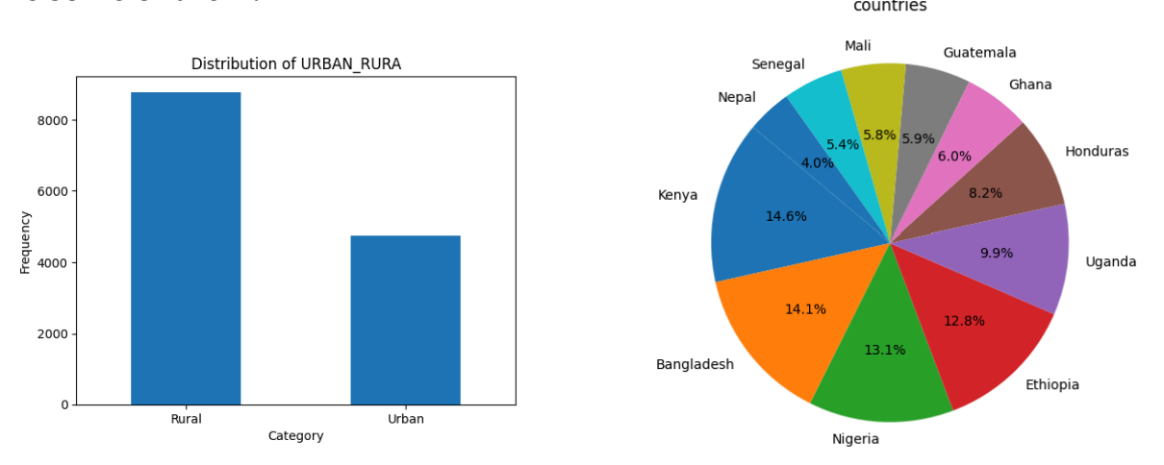
Exploratory Data Analysis (EDA) and Feature Engineering
Distribution of Features
Frontier Tech Leaders Programme Global Cohort 1

Slide 16
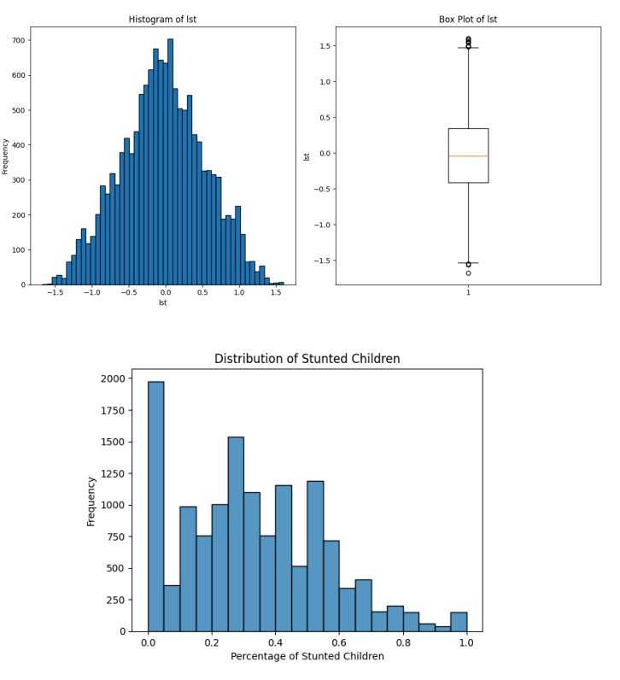
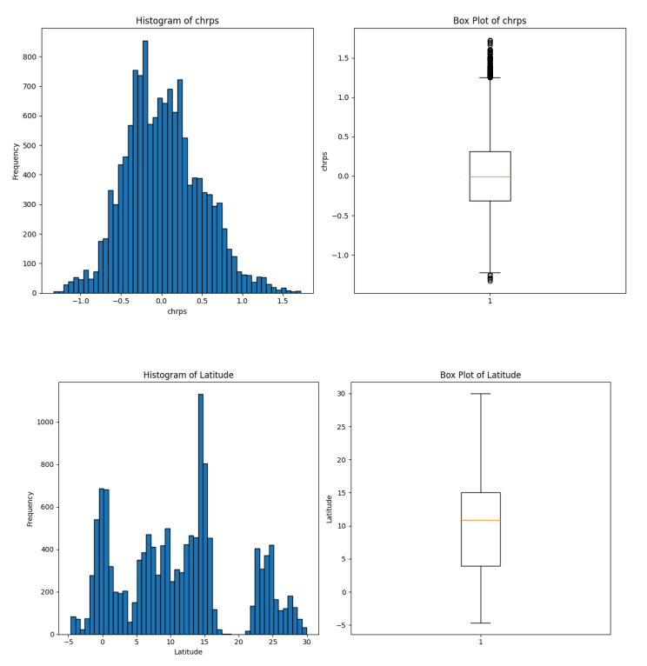
Exploratory Data Analysis (EDA) and Feature Engineering
Distribution of Features
Frontier Tech Leaders Programme Global Cohort 1

Slide 17
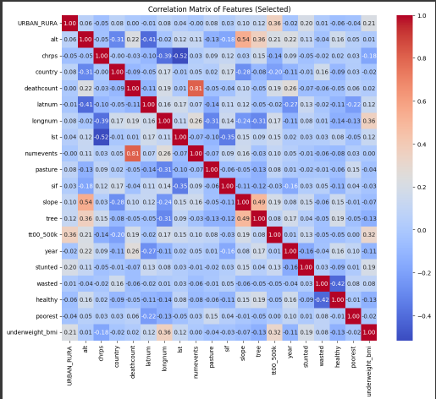
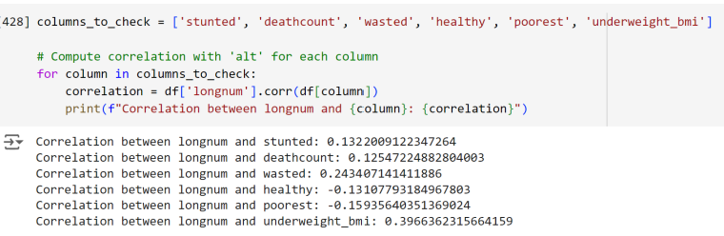
Exploratory Data Analysis (EDA) and Feature Engineering
Frontier Tech Leaders Programme Global Cohort 1
b. Correlation Analysis
We calculated pairwise correlations between numerical features and visualized them using a heatmap.

Slide 18
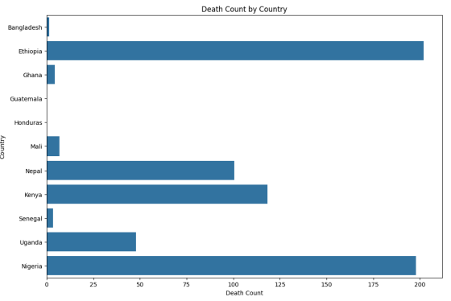
Exploratory Data Analysis (EDA) and Feature Engineering
Frontier Tech Leaders Programme Global Cohort 1
c. Distribution of Categories
To understand how different categories are distributed across countries, we created grouped bar plots and stacked bar plots.
This provide insights into the prevalence of different risk levels within each country.

Slide 19
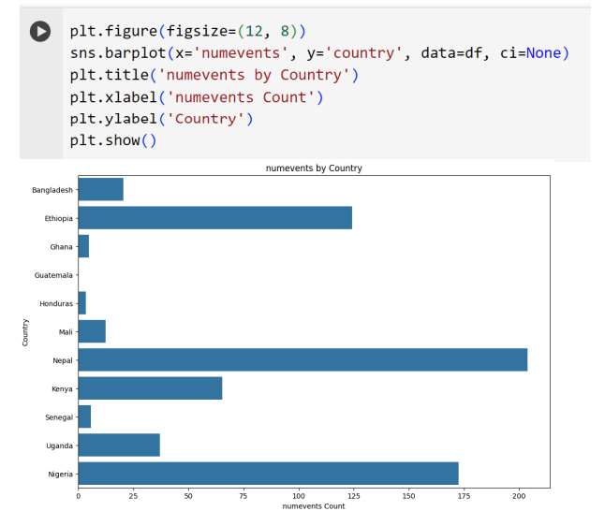
Exploratory Data Analysis (EDA) and Feature Engineering
Frontier Tech Leaders Programme Global Cohort 1
c. Distribution of Categories

Slide 20
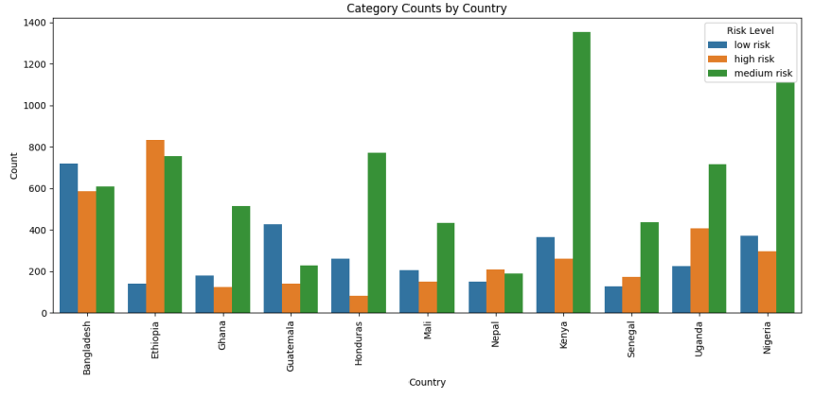
Exploratory Data Analysis (EDA) and Feature Engineering
c. Distribution of Categories
Frontier Tech Leaders Programme Global Cohort 1

Slide 21
Exploratory Data Analysis (EDA) and Feature Engineering
Key Insights from the EDA part
Frontier Tech Leaders Programme Global Cohort 1
Feature Distributions:
Features like altitude, pasture, and tree cover displayed right-skewed distributions, indicating that most data points are clustered around lower values.
Correlation:
There were moderate correlations between some features, such as altitude and tree cover, which can inform feature selection and model interpretation.

Slide 22
Exploratory Data Analysis (EDA) and Feature Engineering
Key Insights from the EDA part
Frontier Tech Leaders Programme Global Cohort 1
Category Distribution:
Visualizations of category distributions by country revealed the geographic spread of risk levels, highlighting areas with higher or lower risk.

Slide 23
Exploratory Data Analysis (EDA) and Feature Engineering | Feature Engineering
Frontier Tech Leaders Programme Global Cohort 1
In the feature engineering phase, we focused on transforming existing features and creating new ones to enhance the predictive power of our model. The objective was to make the features more informative and relevant to the problem of classifying risk levels.

Slide 24
Model
Frontier Tech Leaders Programme Global Cohort 1

Slide 25
Model Selection and Training
Frontier Tech Leaders Programme Global Cohort 1
To assess whether competitive predictions for malnutrition prevalence can be produced without the need for deep learning methods, we chose the Random Forest (RF) model.
Random Forests are widely used in machine learning for their simplicity and ability to handle non-linear relationships in data. They perform well with limited hyperparameter tuning, and by combining multiple decision trees, they improve prediction accuracy.

Slide 26
Model Selection and Training
Frontier Tech Leaders Programme Global Cohort 1
We explore both independent RFs, which predict each malnutrition outcome (e.g., stunted, wasted, and healthy) separately, and multivariate RFs, which jointly estimate multiple outcomes through multi-output regression.

Slide 27
Model Selection and Training
Frontier Tech Leaders Programme Global Cohort 1
RF Strengths:
•Robustness (less prone to overfitting).
•Flexibility (both continuous and categorical data).
•Feature Importance.
RF Weaknesses:
•Black-box nature (Interpretability).
•Computational Complexity (larger datasets or a large number of estimators, especially during training).

Slide 28
Model Selection and Training
Frontier Tech Leaders Programme Global Cohort 1
The dataset was cleaned and transformed to prepare it for training. Categorical features such as the country were ordinally encoded, and numerical features were scaled using StandardScaler.
We split the dataset into training, validation, and test sets to ensure robust evaluation.
The multi-output random forest was used to predict multiple outcomes: stunting, wasting, and being healthy.
A standard RF was implemented using the RandomForestRegressor, and we employed multi-output regression to jointly estimate the target variables.

Slide 29
Model Selection and Training
Frontier Tech Leaders Programme Global Cohort 1
Hyperparameters Used and Cross-Validation Techniques
To optimize the performance, we implemented a grid search to tune key hyperparameters. Specifically, we explored combinations of the following hyperparameters: number of trees in the forest, maximum depth of each tree and minimum number of samples required to split a node.
This allowed us to find the optimal combination of hyperparameters that balanced the bias-variance tradeoff effectively. After careful tuning, the best hyperparameters identified were:
n_estimators = 300
max_depth = 10
min_samples_split = 5

Slide 30
Model Selection and Training
Frontier Tech Leaders Programme Global Cohort 1
Implementation of Other Models and Comparisons
Neural Network:
fully connected 3 layers neural network, including L2 regularization to prevent overfitting with of 64 and 32 neurons in the hidden layers, both using ReLU activation functions and an output layer corresponding to the number of target variables.The model was trained for 100 epochs using the Adam optimizer and mean squared error (MSE) loss function.

Slide 31
Model Selection and Training
Frontier Tech Leaders Programme Global Cohort 1
Implementation of Other Models and Comparisons
2. XGBoost:
We also applied the XGBoost regressor using 100 estimators. XGBoost is a highly efficient gradient boosting algorithm known for its strong performance in various regression tasks. We used XGBoost in a multi-output regression setting, similar to the Random Forest approach.

Slide 32
Model Selection and Training
Frontier Tech Leaders Programme Global Cohort 1
Implementation of Other Models and Comparisons
We compared the performance of each model based on key metrics such as mean squared error (MSE), and R-squared (R²) score. The purpose of this comparison was to evaluate whether simpler ensemble methods like Random Forest could provide competitive results compared to more complex methods like neural networks, without requiring deep learning techniques.
This allowed us to assess which model performed best in terms of both prediction accuracy and generalization to unseen data.

Slide 33
Model Evaluation and Hyperparameter Tuning
Frontier Tech Leaders Programme Global Cohort 1
Evaluation Metrics and Visualizations
For evaluating the model's performance, We used Mean Squared Error (MSE) and R-squared (R²) as the primary metrics. These metrics were chosen to measure the accuracy of the predicted values against the actual outcomes across three health targets: stunted, wasted, and healthy.
The lower the MSE, the better the model is at minimizing prediction errors. Conversely, a higher R² value indicates that the model is explaining more variance in the data.

Slide 34
Model Evaluation and Hyperparameter Tuning
Frontier Tech Leaders Programme Global Cohort 1
Evaluation Metrics and Visualizations
MSE and R² were calculated across all models (MRF, NN, and XGBoost) for both training and test datasets to provide a comparative view of performance.
A scatter plots of actual vs. predicted values for the stunted, wasted and healthy targets were plotted for the MRF model to visually assess how closely predictions matched actual outcomes.

Slide 35
Model Refinement and Testing
Frontier Tech Leaders Programme Global Cohort 1
Overview:
After the initial model training, the refinement phase focused on optimizing the model’s performance. This phase involved evaluating the model's generalization ability on the validation set and tuning it based on insights gained.
Steps such as hyperparameter tuning, feature selection, and handling class imbalances were performed to improve the prediction accuracy of malnutrition risk.

Slide 36
Model Refinement and Testing
Frontier Tech Leaders Programme Global Cohort 1
Refinement Techniques: (reduce Overfitting and enhance generalizability)
Hyperparameter tuning: Optimized Random Forest parameters using grid search (n_estimators=300, max_depth=10, min_samples_split=5).
Cross-validation: Applied k-fold cross-validation (with k=5) to ensure robust evaluation and to prevent the model from being overly dependent on any specific subset of data.
Regularization techniques: techniques such as L2 regularization were considered for alternative models like neural networks.

Slide 37
Model Refinement and Testing
Frontier Tech Leaders Programme Global Cohort 1
Refinement Techniques: (Model Performance)
Data preprocessing improvements: Feature scaling using StandardScaler, power transformations for skewed features, and KNN imputation to fill in missing values (zeros) in the dataset.
Feature Selection: After training the initial model, a correlation matrix was used to identify highly correlated features, which could introduce redundancy and affect model performance.
highly correlated features were removed, and the top 9 features that had the strongest relationship with targets were selected.

Slide 38
Model Refinement and Testing
Frontier Tech Leaders Programme Global Cohort 1
Overview of the Test Submission Phase
The test submission phase involved final evaluation of the model on a previously unseen test dataset to assess real-world performance.
After training the final refined Random Forest model using the best-tuned parameters, predictions were generated on the test set.
These predictions were compared to the actual outcomes to measure the model’s effectiveness in predicting malnutrition risk.

Slide 39
Results
Frontier Tech Leaders Programme Global Cohort 1

Slide 40
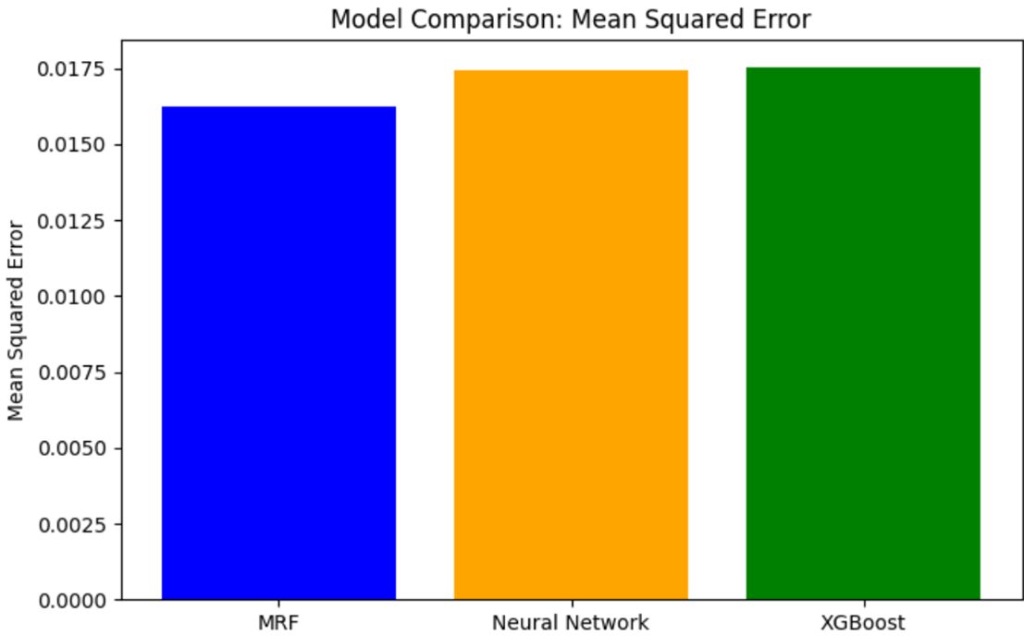
Evaluation Results
Frontier Tech Leaders Programme Global Cohort 1
Mean Square Error (MSE):
MRF Model: 0.016235
NN Model: 0.017414
XGBoost Model: 0.0175

Slide 41
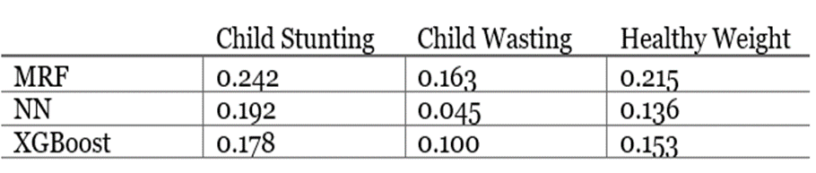
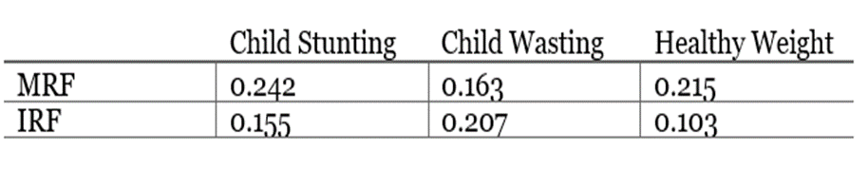
Evaluation Results
Frontier Tech Leaders Programme Global Cohort 1
R² for malnutrition prediction indexed by methodology and prevalence

Slide 42

Evaluation Results
Frontier Tech Leaders Programme Global Cohort 1
R² comparison

Slide 43
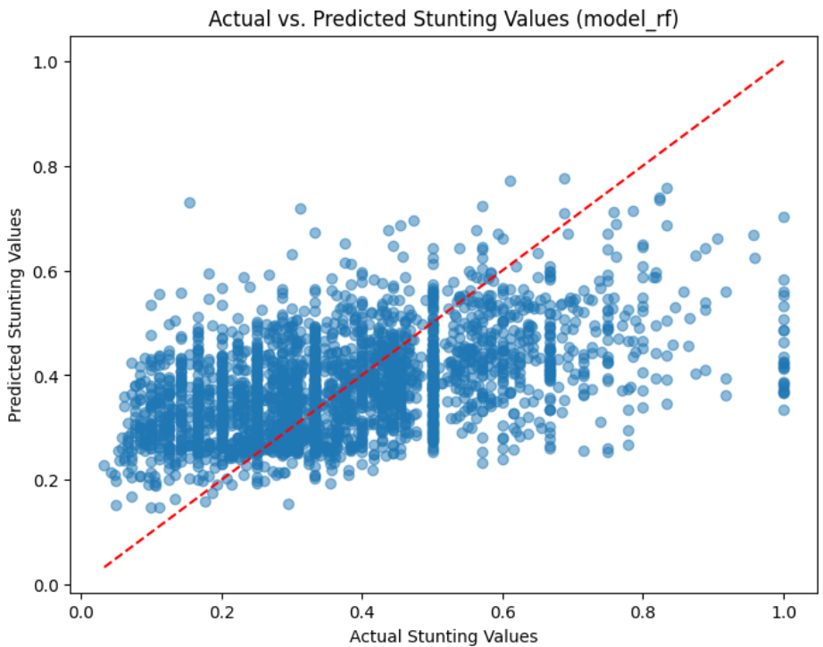
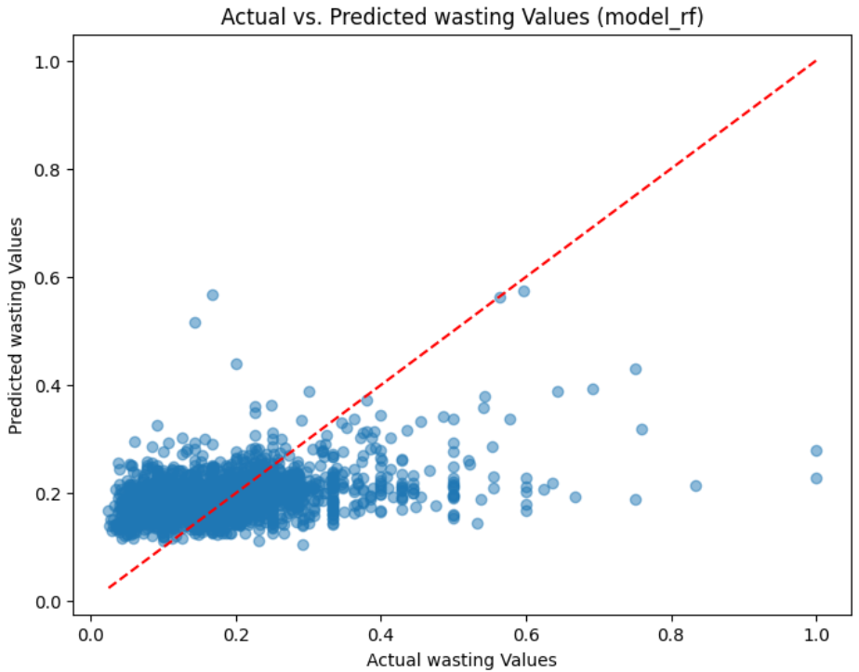
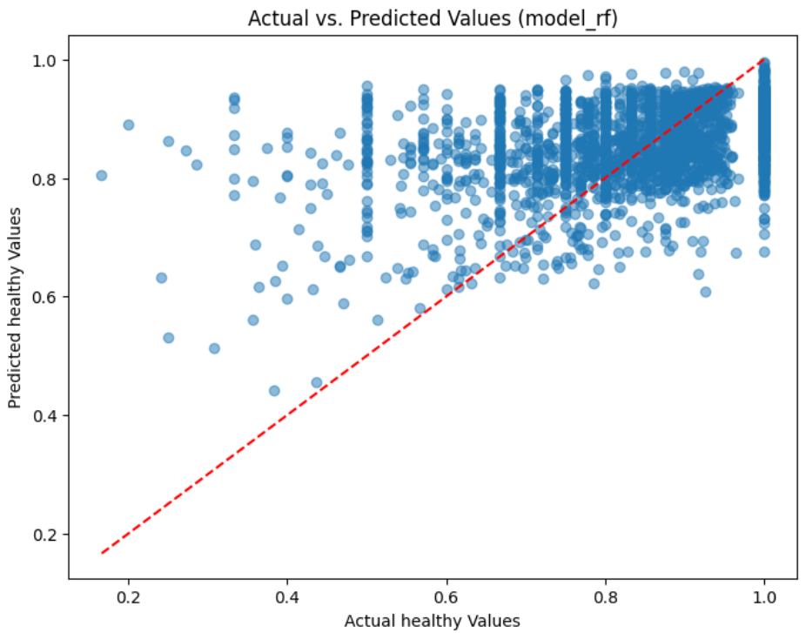
Evaluation Results | Scatter Plot:
Frontier Tech Leaders Programme Global Cohort 1

Slide 44
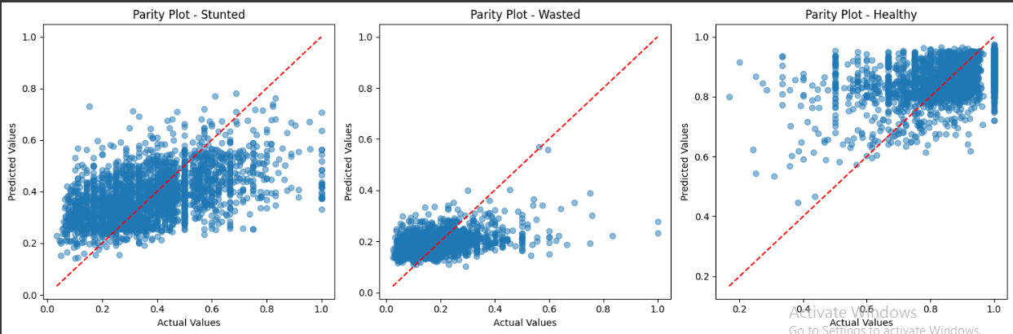
Evaluation Results | Parity Plot:
Frontier Tech Leaders Programme Global Cohort 1

Slide 45
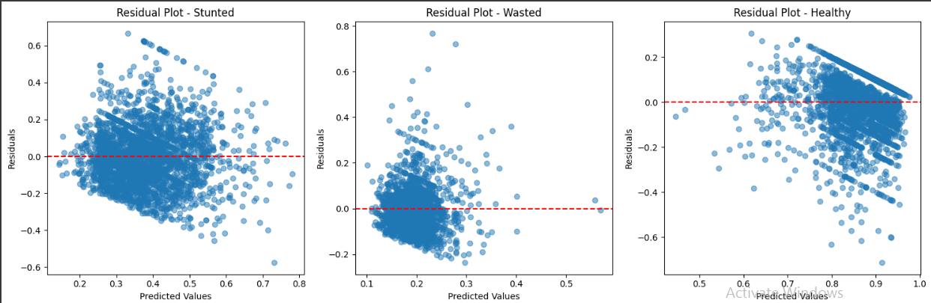
Evaluation Results | Residual Plot:
Frontier Tech Leaders Programme Global Cohort 1

Slide 46
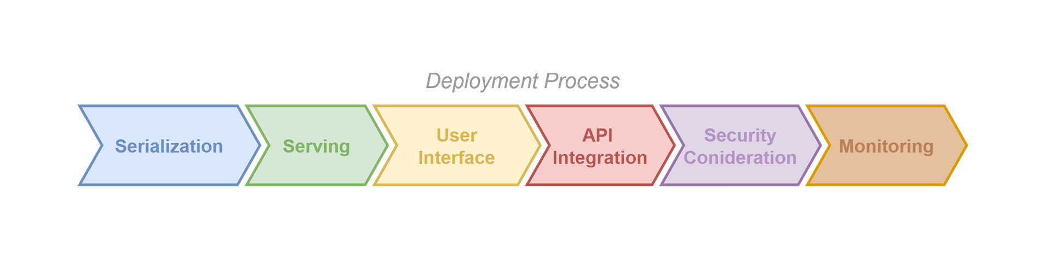
Deployment
Frontier Tech Leaders Programme Global Cohort 1
The deployment phase focuses on preparing the trained machine learning model for real-world or production use.
The is to ensure that the model is reliably accessible to end-user objectives or other systems while maintaining both performance and security.

Slide 47
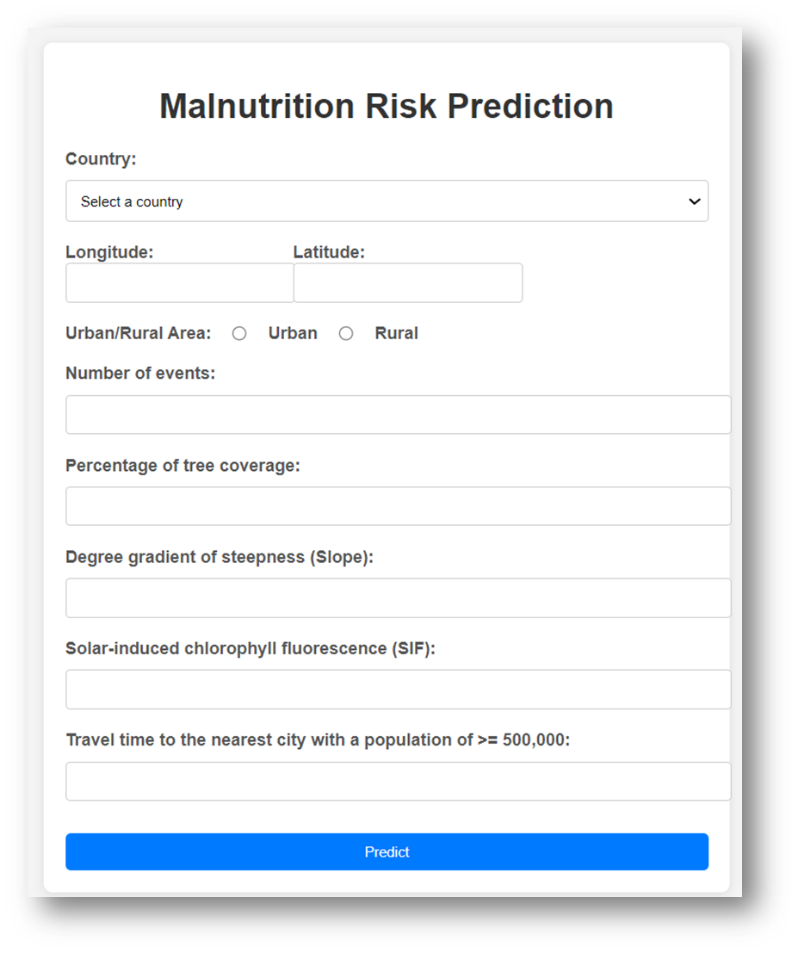
Deployment
Frontier Tech Leaders Programme Global Cohort 1
User Interface

Slide 48
Future Work
Frontier Tech Leaders Programme Global Cohort 1
Collaboration with local governments, NGOs, and community members will be sought to:
Understand their needs and concerns.
Integrate more data features.
Understand More relations between the features.

Slide 49
References
Frontier Tech Leaders Programme Global Cohort 1
Browne, C., Matteson, D. S., McBride, L., et al. (2017) Multivariate random forest prediction of poverty and malnutrition prevalence. Journal of Applied Econometrics Link

Slide 50



Thank you!
Frontier Tech Leaders Programme Global Cohort 1

