Slide 1
Predict and Tracker CO₂ Emissions from Vehicles
Frontier Tech Leaders Programme Global Cohort 3
Team Members
Dukundimana Toussaint
Ziaurrahman Hemat
GAI AWUOU KWAI ALIER
Abdelrazig Mustafa
Date 28th September 2024

Slide 2
Outline
Frontier Tech Leaders Programme Global Cohort 3
Concept note and implementation plan:
Background
Objectives
SDG Relation
Data
Data Collection
Exploratory Data Analysis (EDA) and Feature Engineering
Model Selection and Training
Model Evaluation and Hyperparameter Tuning
Model Refinement and Testing
Results
Deployment
Future Work

Slide 3
Concept note and implementation plan
Frontier Tech Leaders Programme Global Cohort 3
The project aims to address the challenge of high CO2 emissions from vehicles by developing a predictive model to estimate emissions based on various factors and by using geospatial data to identify areas using geospatial data with high emission levels. The goal is to provide targeted recommendations for reducing emissions in specific regions, thereby enhancing mitigation efforts.

Slide 4
Background
Frontier Tech Leaders Programme Global Cohort 3
The transportation sector is one of the largest contributors to global CO2 emissions, which exacerbates climate change. Vehicles, especially those running on fossil fuels, release significant amounts of CO2, contributing to air pollution and climate-related challenges. To tackle this issue, technological solutions like machine learning and geospatial analysis can help in understanding and mitigating the emissions.

Slide 5
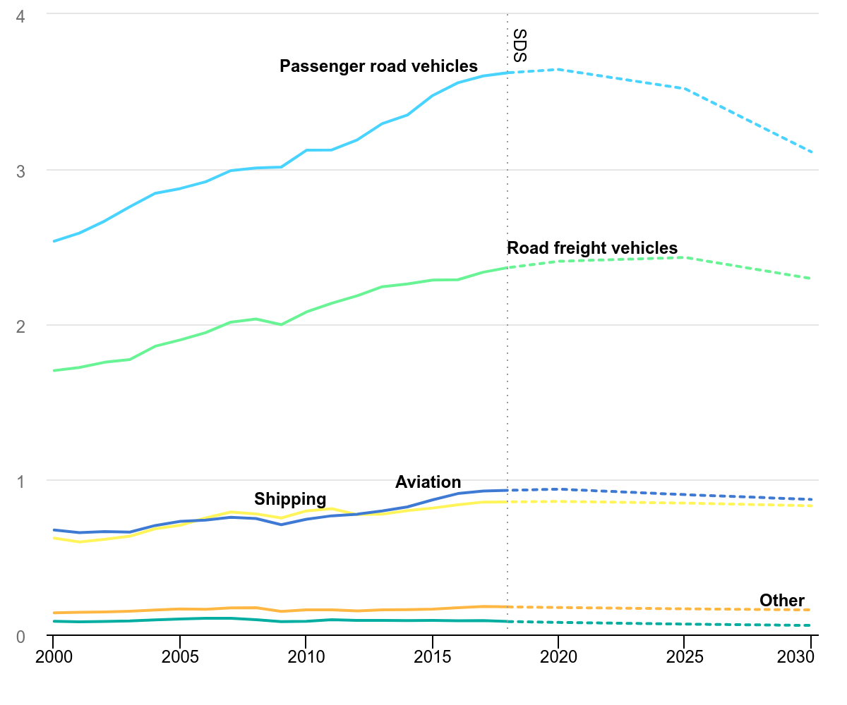
Frontier Tech Leaders Programme Global Cohort 3
The data is sourced from the International Energy Agency (IEA) , this means Road travel accounts for three-quarters of transport emissions. Most of this comes from passenger vehicles — cars and buses — contributing 45.1%. The other 29.4% comes from trucks carrying freight.

Slide 6
Objectives
Frontier Tech Leaders Programme Global Cohort 3
The aim of this project is to leverage data from various sources, including vehicle sensors, to predict CO2 emissions in relation to standard emission benchmarks. By utilizing machine learning algorithms, the project will develop a predictive model that estimates vehicle emissions based on real-time and historical data. Additionally, geospatial analysis will be applied to map emissions across different regions, allowing for the identification of high-emission zones. The ultimate goal is to provide actionable insights for reducing CO2 emissions, promoting sustainable transportation, and aligning with climate action targets set by SDG 13
In this project, Supervised Learning (Regression) will be used to predict vehicle CO2 emissions based on data like engine size and sensor inputs, comparing them to emission standards. Clustering Methods will identify high-emission "danger zones," helping to map regions with excessive emissions. The overall goal is to provide actionable insights for reducing CO2 emissions and promoting sustainable transportation through data-driven strategies.

Slide 7

SDG Relation
Frontier Tech Leaders Programme Global Cohort 3
Our project directly aligns with SDG 13: Climate Action, which aims to combat climate change and its impacts by reducing greenhouse gas emissions. By predicting vehicle CO2 emissions and identifying high-emission zones, this project supports efforts to lower carbon emissions in the transportation sector. The insights from our machine learning and geospatial analysis models will help target high-emission areas, allowing for more effective mitigation strategies and promoting sustainable transportation. This contributes to reducing the overall environmental footprint, a key objective of SDG 13

Slide 8
Data
Frontier Tech Leaders Programme Global Cohort 3

Slide 9
Data Collection
Frontier Tech Leaders Programme Global Cohort 3
The project will utilize the Kaggle dataset link on CO2 emissions by vehicles, which is in CSV
format and includes various features like vehicle make, model, engine size,Cylinders Fuel_Consumption_City Fuel_Consumption_Hwy Fuel_Consumption_Comb Fuel_Consumption_Comb_mpg

Slide 10
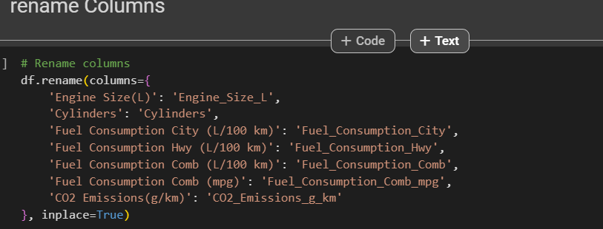
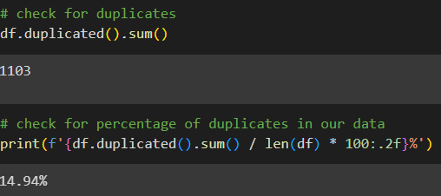
Data Preprocessing
Frontier Tech Leaders Programme Global Cohort 3
rename the columns name of DataFrame
Check the Column Datatype
Checking the Missing Values
Check duplicates
Checking Outliers

Slide 11
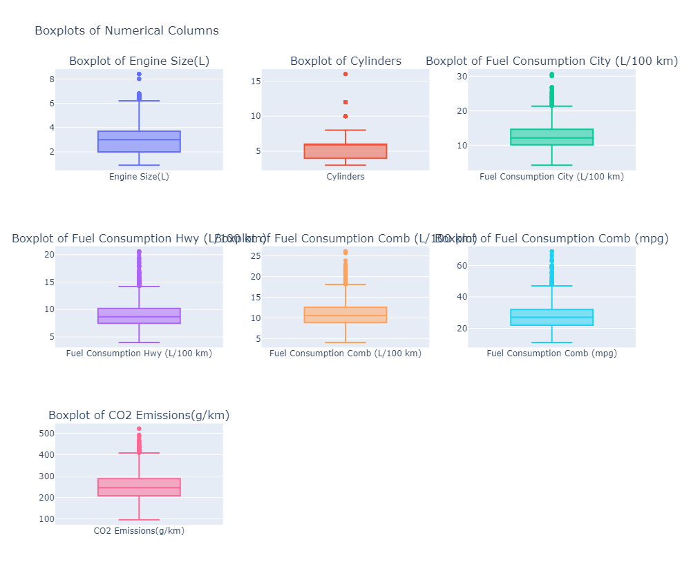
Data Preprocessing
Frontier Tech Leaders Programme Global Cohort 3
Outliers in DataFrame
ouliers

Slide 12
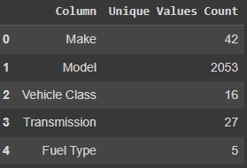
Exploratory Data Analysis (EDA) and Feature Engineering
Frontier Tech Leaders Programme Global Cohort 3
. There are four categorical columns containing numerous values that require feature engineering to facilitate the modeling process and enhance the model's ability to interpret the data effectively
By consolidating the categories, the complexity of the data is reduced, making it easier for modeling and analysis.

Slide 13
Exploratory Data Analysis (EDA)
Feature Engineering
Frontier Tech Leaders Programme Global Cohort 3
Feature Engineering
Car brands are categorized into four types based on their characteristics:
Sports: High-performance brands like Bugatti, Porsche, Maserati, and Lamborghini are grouped due to their focus on speed and luxury.
Premium: Brands such as Audi, BMW, and Mercedes-Benz offer a mix of luxury and advanced technology, targeting higher-end consumers.
Luxury: Brands like Acura, Bentley, and Rolls-Royce are known for superior quality and craftsmanship, appealing to the luxury market.
General: Mass-market brands like Chevrolet, Ford, and Toyota are categorized for their affordability and reliability.
Transforming Vehicle Class Values:
In the DataFrame, the 'Vehicle Class' column is transformed into a new column called 'Vehicle_Class_Type':
Hatchback: Combines 'COMPACT', 'MINICOMPACT', and 'SUBCOMPACT'.
Sedan: Combines 'MID-SIZE', 'TWO-SEATER', 'FULL-SIZE', 'STATION WAGON - SMALL', and 'STATION WAGON - MID-SIZE'.
SUV: Combines 'SUV - SMALL', 'SUV - STANDARD', and 'MINIVAN'.
Truck: Combines 'VAN - CARGO', 'VAN - PASSENGER', 'PICKUP TRUCK - STANDARD', 'SPECIAL PURPOSE VEHICLE', and 'PICKUP TRUCK - SMALL'.

Slide 14
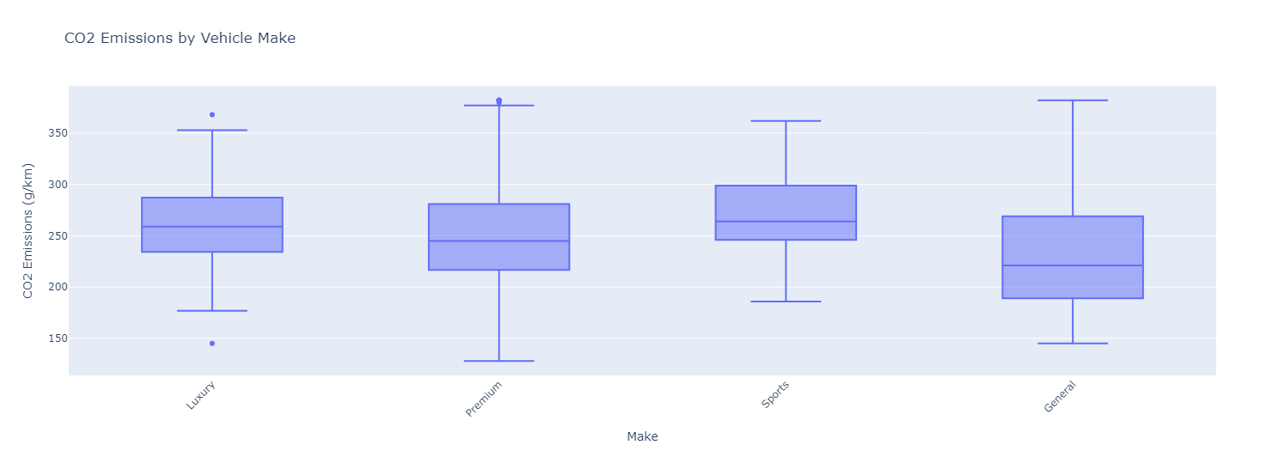
Exploratory Data Analysis (EDA)
Frontier Tech Leaders Programme Global Cohort 3
This shows that Luxury and Sports cars emit alot of C02 emissions

Slide 15
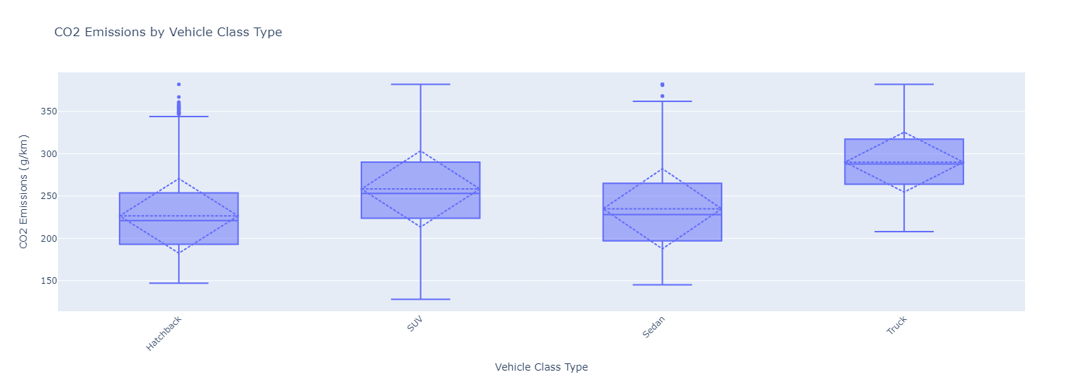
Exploratory Data Analysis (EDA)
Frontier Tech Leaders Programme Global Cohort 3
This graph shows that Truck and A sport utility vehicle (SUV) Emit a lot Co2 Emissions

Slide 16
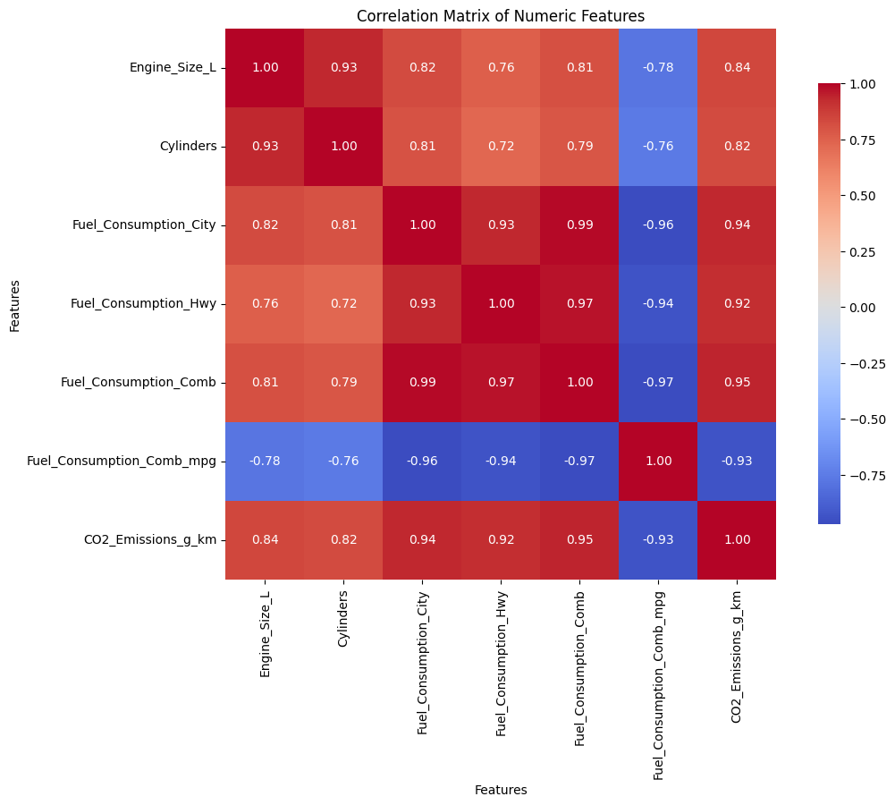
Exploratory Data Analysis (EDA)
Frontier Tech Leaders Programme Global Cohort 3

Slide 17
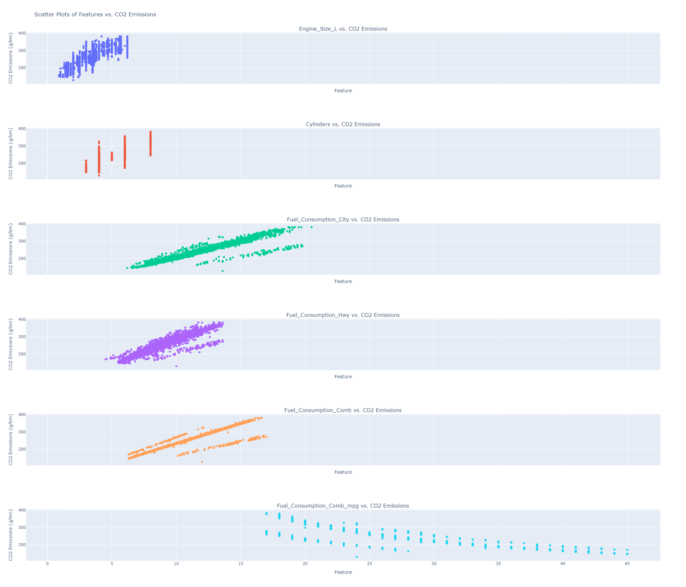
Exploratory Data Analysis (EDA)
Frontier Tech Leaders Programme Global Cohort 3

Slide 18
Exploratory Data Analysis (EDA)
Frontier Tech Leaders Programme Global Cohort 3
Engine Size (0.839): Larger engines lead to higher CO2 emissions due to increased fuel consumption.
Cylinders (0.823): More cylinders are associated with higher
emissions, indicating more powerful and fuel-consuming engines.
Fuel Consumption in City (0.936): Greater fuel consumption in u
rban driving correlates strongly with increased CO2 emissions, highlighting the importance of fuel efficiency in cities.
Fuel Consumption on Highway (0.920): Poor highway fuel efficiency results in higher emissions, emphasizing the need for efficient vehicles at speed.
Combined Fuel Consumption (0.946): A strong positive correlation shows that overall fuel efficiency directly impacts CO2 emissions; more efficient vehicles emit less.
Combined Fuel Consumption (mpg) (-0.935): Higher miles per gallon (mpg) reflects better fuel efficiency, negatively correlating with CO2 emissions—indicating that improved fuel efficiency reduces emissions.

Slide 19
Model
Frontier Tech Leaders Programme Global Cohort 3

Slide 20
Model Selection and Training
Frontier Tech Leaders Programme Global Cohort 3
Chosen Model: XGBRegressor for my modeling approach based on its outstanding performance metrics obtained through LazyPredict.
Strengths:
High Performance:
XGBRegressor is known for its high predictive accuracy, as demonstrated by the excellent performance metrics (low RMSE and high R-Squared value) achieved during evaluation.
Regularization:
It incorporates L1 (Lasso) and L2 (Ridge) regularization techniques, which help prevent overfitting and improve model generalization.
Feature Importance:
XGBRegressor provides insights into feature importance, allowing for better interpretability of model decisions and guiding feature selection.
Handling Missing Values:
XGBoost has the ability to handle missing data internally, which can be advantageous when dealing with real-world datasets that may have incomplete information

Slide 21
Model Selection and Training
Frontier Tech Leaders Programme Global Cohort 3
Weakness:
Sensitivity to Hyperparameters:
XGBRegressor requires careful tuning of hyperparameters to achieve optimal performance. Poor hyperparameter choices can lead to suboptimal models.
Overfitting Potential:
Although it includes regularization, XGBRegressor can still overfit the training data if not properly tuned, especially with deep trees and high learning rates.

Slide 22
Model Selection and Training
Frontier Tech Leaders Programme Global Cohort 3
The XGBRegressor model was trained by first splitting the dataset into a training set (80%) and a test set (20%) using Scikit-Learn. Following the split, we applied data scaling techniques to ensure that all features contributed equally to the modeling process. This approach enhanced the model's performance and reliability, facilitating better convergence during training

Slide 23
Model Selection and Training
Frontier Tech Leaders Programme Global Cohort 3
In tuning the XGBRegressor model, we employed Random Search techniques along with 5-Fold Cross-Validation to efficiently identify optimal hyperparameters.
Hyperparameters Used:
n_estimators: Number of boosting rounds (trees) to be built.
learning_rate: Step size that controls the impact of each tree on the final outcome.
max_depth: Maximum depth of each tree, which helps prevent overfitting by limiting model complexity.
min_child_weight: Minimum sum of instance weight required in a child node, serving as a regularization parameter.
gamma: Minimum loss reduction needed to make a further partition on a leaf node, acting as a pruning mechanism.
Cross-Validation Technique:
We implemented 5-Fold Cross-Validation, which involved splitting the training dataset into five subsets. The model was trained on four of these subsets and validated on the remaining one. This process was repeated for each fold to ensure that every subset served as a validation set at least once

Slide 24
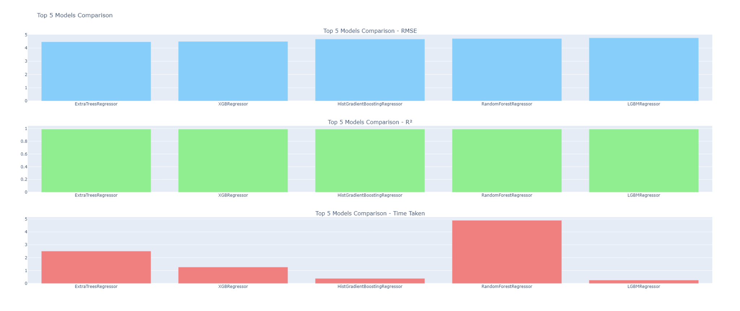
Model Selection and Training
Frontier Tech Leaders Programme Global Cohort 3

Slide 25
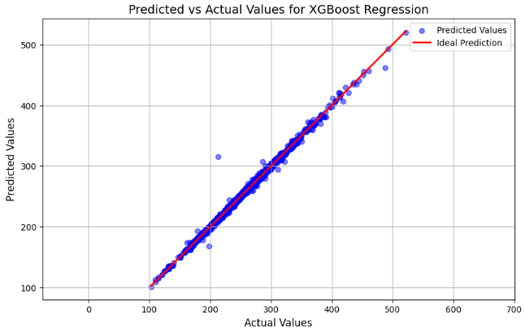
Model Evaluation and Hyperparameter Tuning
Frontier Tech Leaders Programme Global Cohort 3

Slide 26
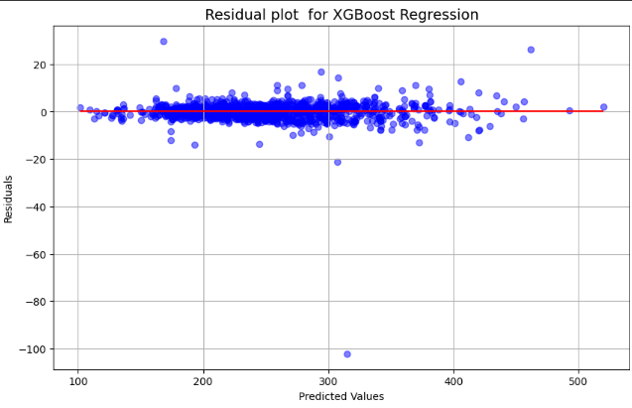
Model Evaluation and Hyperparameter Tuning
Frontier Tech Leaders Programme Global Cohort 3

Slide 27
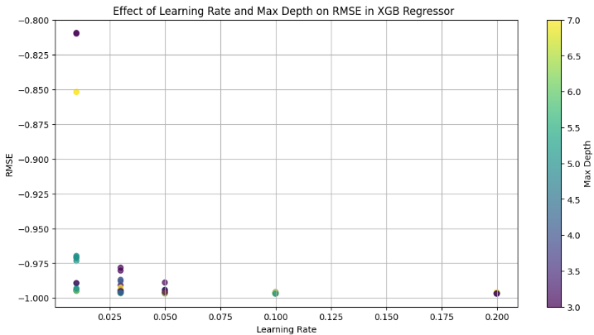
Model Evaluation and Hyperparameter Tuning
Frontier Tech Leaders Programme Global Cohort 3

Slide 28
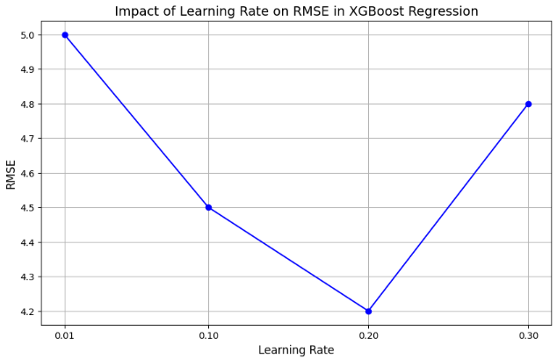
Model Evaluation and Hyperparameter Tuning
Frontier Tech Leaders Programme Global Cohort 3
low Root Mean Squared Error (RMSE) indicates that the model's predictions are close to the actual values, signifying good predictive accuracy

Slide 29
Model Evaluation and Hyperparameter Tuning
Frontier Tech Leaders Programme Global Cohort 3
low Root Mean Squared Error (RMSE) indicates that the model's predictions are close to the actual values, signifying good predictive accuracy

Slide 30
Model Refinement and Testing
Frontier Tech Leaders Programme Global Cohort 3
Hyperparameter Tuning
Feature Engineering
Cross-Validation
Model Selection:The Lazy predict for model selection
In Test Submission the final model is trained on the entire dataset, predictions are generated for the test dataset, and results are formatted and submitted according to requirements. A comparison of actual and predicted values is performed to evaluate the model’s performance visually.
Metrics and Results on the Test Dataset
Root Mean Squared Error (RMSE): 4.3
R-Squared (R²): 0.99

Slide 31
Results
Frontier Tech Leaders Programme Global Cohort 3

Slide 32
Evaluation Results
Frontier Tech Leaders Programme Global Cohort 3
The XGBRegressor demonstrated exceptional performance in predicting car CO2 emissions, providing valuable insights into the impact of vehicle features on emissions and indicate the areas with high co2 emission. The results contribute to efforts aimed at reducing carbon footprints and improving environmental sustainability in the automotive industry.

Slide 33
Evaluation Results
Frontier Tech Leaders Programme Global Cohort 3
The XGBRegressor demonstrated exceptional performance in predicting car CO2 emissions, providing valuable insights into the impact of vehicle features on emissions and indicate the areas with high co2 emission. The results contribute to efforts aimed at reducing carbon footprints and improving environmental sustainability in the automotive industry.

Slide 34
Deployment
Frontier Tech Leaders Programme Global Cohort 3
I utilized Streamlit to create an interactive web application for predicting car CO2 emissions based on regression analysis. The deployment process involved several key steps:
Streamlit Integration: Streamlit was used to develop a user-friendly interface, allowing users to input relevant vehicle specifications and obtain CO2 emission predictions.
Dockerization: I created a Docker image to encapsulate the application and its dependencies. This facilitated seamless deployment on cloud platforms, ensuring consistency across different environments.
Security Measures: To safeguard the application, I implemented a login system requiring user credentials. This added a layer of security, ensuring that only authorized users could access the application.
Model Utilization: The saved XGBRegressor model was integrated into the web app to provide real-time predictions, enhancing user experience by delivering accurate CO2 emission estimates based on their input data.
This deployment approach ensures that the application is not only accessible but also secure and efficient, contributing to the overall goal of promoting environmentally friendly practices in the automotive sector.

Slide 35
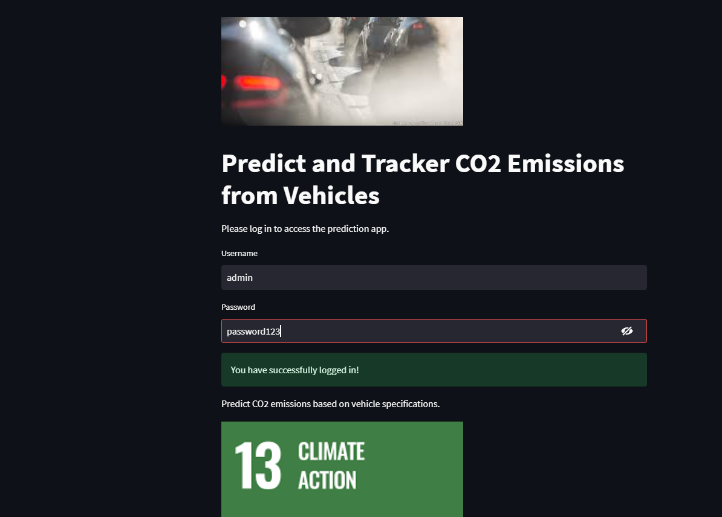
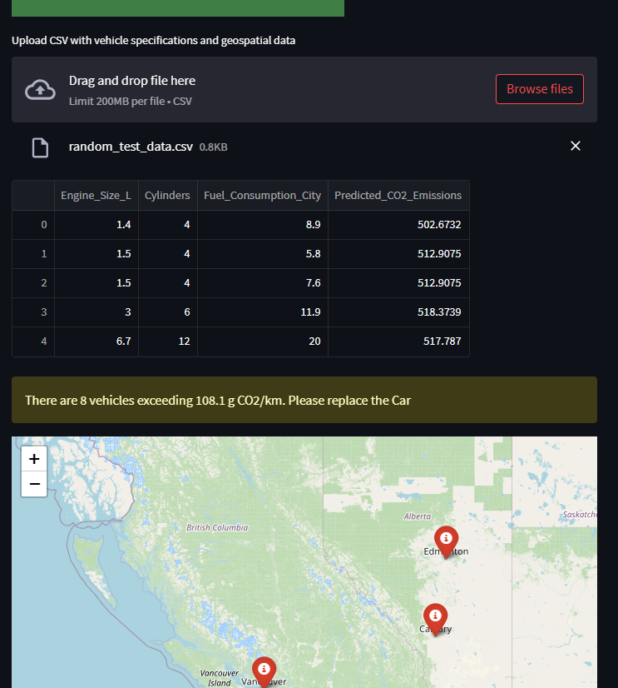
Deployment
Frontier Tech Leaders Programme Global Cohort 3

Slide 36
Future Work
Frontier Tech Leaders Programme Global Cohort 3
Analysis using Geospatial data:Geospatial Data Integration: Collect more geospatial data from various sources, such as government databases, environmental agencies, and satellite imagery, to improve the accuracy of emission predictions
Integrate real-time data on traffic patterns, vehicle types, and fuel usage to provide more dynamic insights into emissions.
Public Dashboard:Build a public-facing dashboard where users can visualize emissions data and receive recommendations for reducing their carbon footprint.

Slide 37
References
Frontier Tech Leaders Programme Global Cohort 3
science Direct
kaggle
IEE explore

Slide 38



Thank you!
Frontier Tech Leaders Programme Global Cohort 3

