Slide 1
Predicting Antimicrobial Resistance Using Machine Learning for Improved Healthcare Outcomes
Frontier Tech Leaders Programme Global Cohort 3
Christian RWIBUTSO HAKIZINKA, Abdullah Amin, Shamsun Nahar, Abdelmola Albadwi
Oct 1, 2024

Slide 2
Outline
Frontier Tech Leaders Programme Global Cohort 3
Concept note and implementation plan:
Background
Objectives
SDG Relation
Data
Data Collection
Exploratory Data Analysis (EDA) and Feature Engineering
Model Selection and Training
Model Evaluation and Hyperparameter Tuning
Model Refinement and Testing
Results
Deployment
Future Work

Slide 3
Concept note and implementation plan
Frontier Tech Leaders Programme Global Cohort 3

Slide 4

Background
Frontier Tech Leaders Programme Global Cohort 3
Overview
Antimicrobial resistance (AMR) is a growing global health threat that reduces the effectiveness of antibiotics, making it harder to treat infections. Our project aims to address the challenge of predicting when bacteria will become resistant to specific antibiotics.
Problem Background
AMR happens when bacteria evolve to survive antibiotic treatments, often due to overuse and misuse of antibiotics. Countries like India, the United States, and China are significantly affected by rising AMR cases, leading to prolonged illnesses, higher healthcare costs, and increased mortality rates.
Importance of the Problem
Without accurate predictions, the misuse of antibiotics continues, worsening resistance. Addressing this issue will improve patient outcomes, limit the spread of resistant bacteria, and support the development of more effective treatment plans.

Slide 5
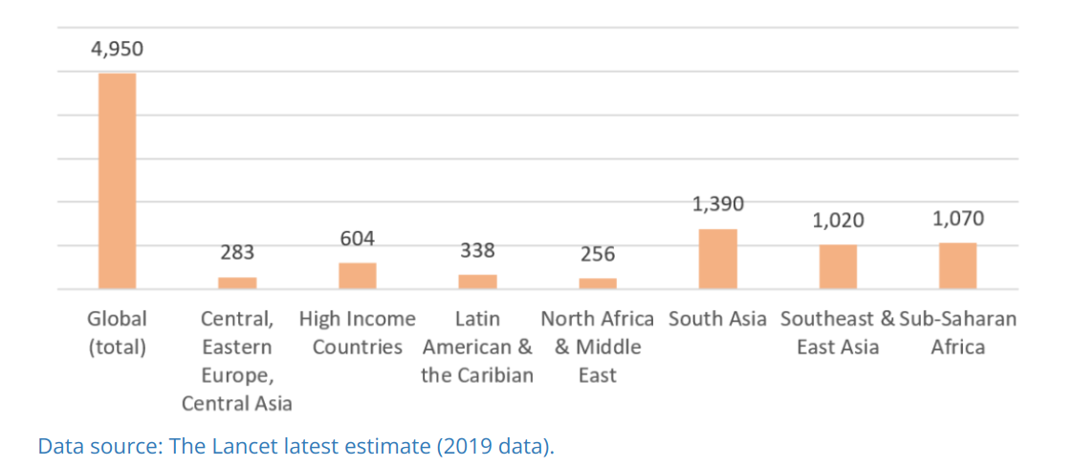
Background
Frontier Tech Leaders Programme Global Cohort 3
Deaths associated with AMR by region (in thousands)
Curbing antimicrobial resistance (AMR) is crucial to achieving our broader goal of ending poverty and ensuring a sustainable, healthy planet. This is a battle we cannot afford to lose!

Slide 6
Objectives
Frontier Tech Leaders Programme Global Cohort 3
Project Goals
Predict bacterial resistance to specific antibiotics using machine learning.
Improve treatment decision-making for healthcare providers.
Help reduce the spread of antimicrobial resistance (AMR) and improve patient outcomes.
Model Aim
Develop an accurate model that identifies resistance patterns in bacteria.
Enable timely and effective treatment selection to combat resistant infections.

Slide 7
SDG Relation
Frontier Tech Leaders Programme Global Cohort 3
SDG 3: Good Health and Well-being
Improves healthcare outcomes by predicting effective treatments for diseases like antimicrobial resistance.
Helps combat drug-resistant pathogens, reducing disease burden globally.
SDG 9: Industry, Innovation, and Infrastructure
Drives innovation in healthcare by applying advanced machine learning techniques for drug development and medical research.
SDG 12: Responsible Consumption and Production
Reduces overuse of antibiotics by predicting drug efficacy, promoting responsible use of medical resources.
SDG 17: Partnerships for the Goals
Fosters collaboration between governments, health institutions, and research bodies through data sharing to address global health challenges.

Slide 8
Data
Frontier Tech Leaders Programme Global Cohort 3

Slide 9
Data Collection
Frontier Tech Leaders Programme Global Cohort 3
The datasets for our project was sourced from reputable institutions such as the World Health Organization (WHO) and various healthcare research centers. These datasets include demographic, clinical, laboratory, and microbiological data essential for understanding antimicrobial resistance (AMR) patterns. During data collection, preprocessing steps was involve integrating data from multiple sources and standardizing formats.
Link: Global Antimicrobial Resistance and Use Surveillance System (GLASS) Dashboard - Publication - WHO AFRO Health Data Hub
Missing which were more than 30% were dropped and there were no outliers in the data

Slide 10
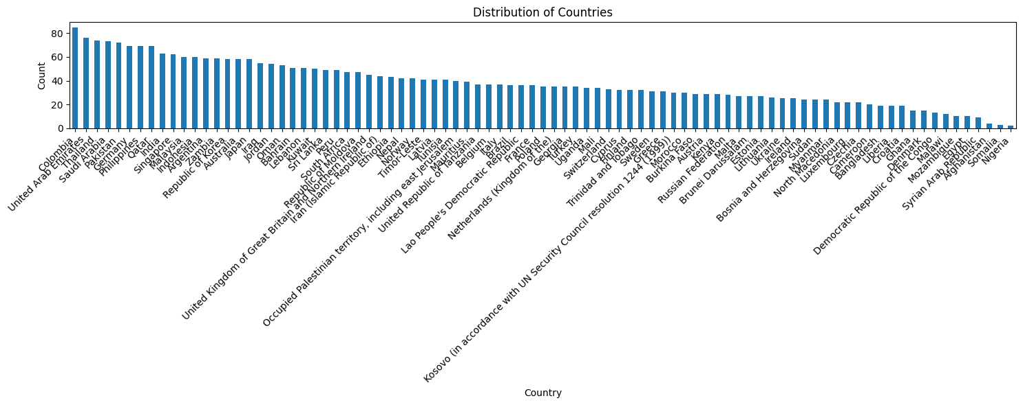
Exploratory Data Analysis (EDA) and Feature Engineering
Frontier Tech Leaders Programme Global Cohort 3
Visualizations: Using histograms, box plots, and scatter plots to understand data distributions and relationships.
Insights: Identifying trends and patterns in the data, such as common resistance patterns and their correlation with specific antibiotics.
Our data consist of data from 110 countries.

Slide 11
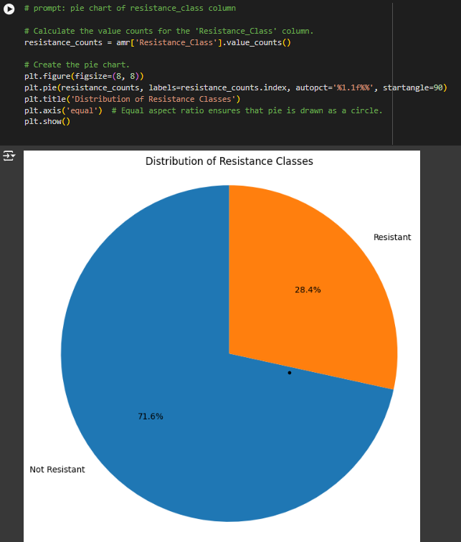
EDA and Feature Engineering
Frontier Tech Leaders Programme Global Cohort 3

Slide 12
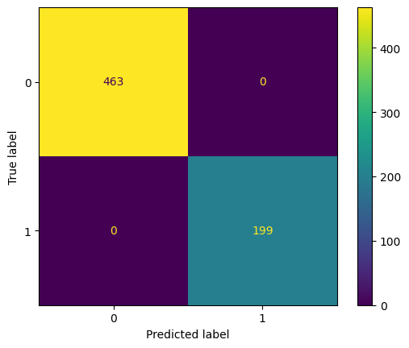
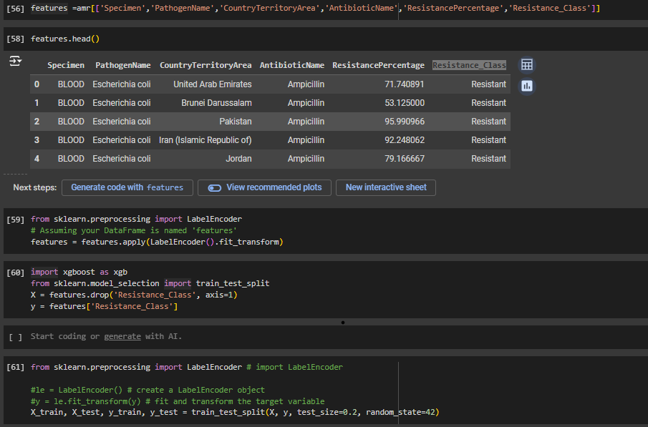
EDA and Feature Engineering
Frontier Tech Leaders Programme Global Cohort 3

Slide 13
Exploratory Data Analysis (EDA) and Feature Engineering
Frontier Tech Leaders Programme Global Cohort 3
Explain the process of creating or transforming features
Rationale behind feature engineering decisions
Describe scaling, normalization, encoding, etc.

Slide 14
Model
Frontier Tech Leaders Programme Global Cohort 3

Slide 15
Model Selection and Training
Frontier Tech Leaders Programme Global Cohort 3
Model Selection
We explored three models:
Random Forest,
Logistic Regression,
XGBoost.
Random Forest offers high accuracy and feature importance but is computationally intensive. Logistic Regression is simple and interpretable, ideal for smaller datasets, while XGBoost provides strong performance and handles complex data effectively.
Why Logistic Regression?
We chose Logistic Regression due to its interpretability, efficiency with small datasets, and good accuracy. Despite its simplicity, it delivers a solid 91% accuracy and ensures stable predictions by minimizing overfitting.

Slide 16
Model Selection and Training
Frontier Tech Leaders Programme Global Cohort 3
Training and Hyperparameters
We trained the model using cross-validation to ensure robust results. Key hyperparameters included regularization strength and class weights to handle imbalanced data effectively.
Model Comparison
Logistic Regression outperformed others in interpretability and efficiency, while XGBoost offered higher complexity handling. Random Forest provided insights into feature importance but required more computational resources.

Slide 17
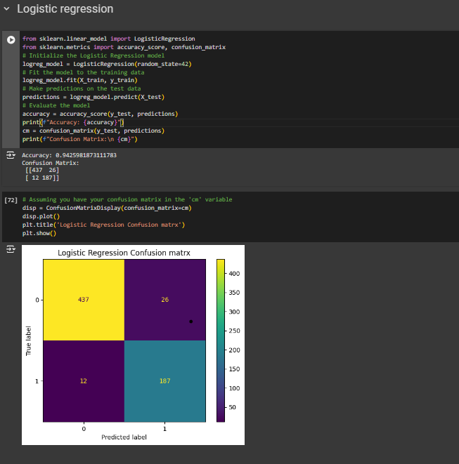
Model Selection and Training
Frontier Tech Leaders Programme Global Cohort 3

Slide 18
Model Evaluation and Hyperparameter Tuning
Frontier Tech Leaders Programme Global Cohort 3
Model Performance
Our Logistic Regression model achieved an accuracy of 91%, with precision, recall, and F1-score metrics highlighting balanced performance across all classes. The model's ROC-AUC score further demonstrated its strong ability to distinguish between resistant and non-resistant bacteria.
Hyperparameter Tuning
We tuned key parameters like regularization strength (C) and class weights to handle class imbalance. This optimization improved recall and reduced false negatives, resulting in better performance in predicting resistant bacteria.
Visualizations
Confusion matrix and ROC curve visualizations were used to illustrate model performance. The ROC curve showed an AUC score of 0.92, confirming the model's strong discriminatory power.

Slide 19
Results
Frontier Tech Leaders Programme Global Cohort 3

Slide 20
Evaluation Results
Frontier Tech Leaders Programme Global Cohort 3

Slide 21
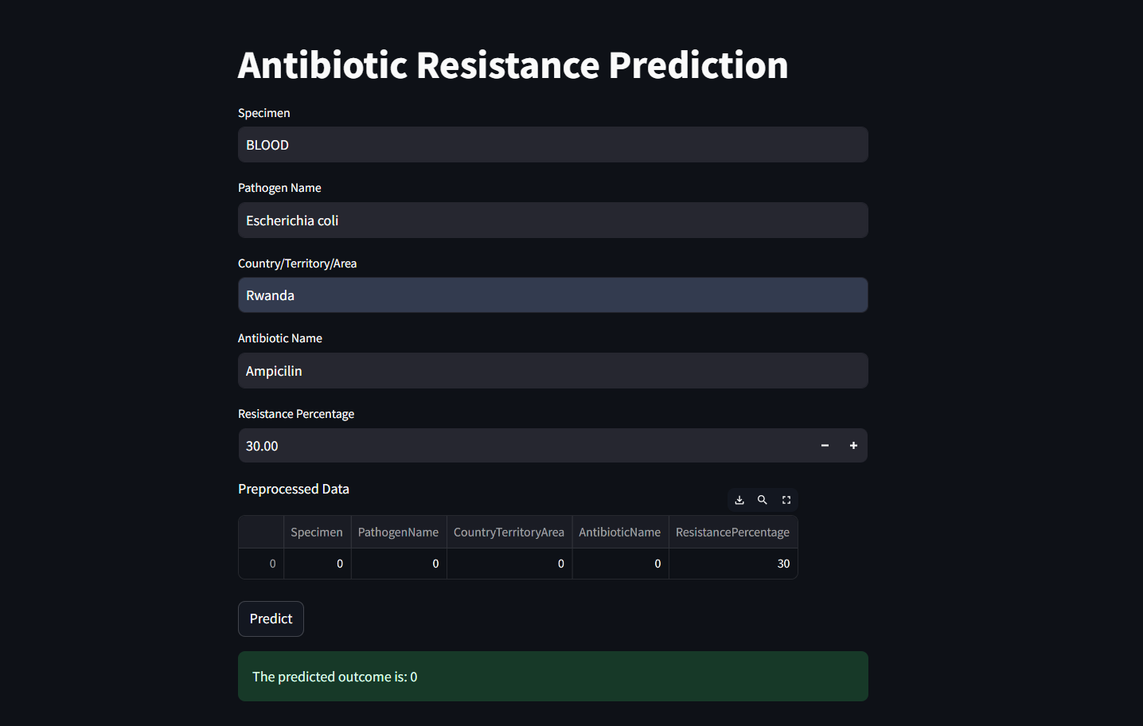
Deployment
Frontier Tech Leaders Programme Global Cohort 3

Slide 22
Future Work
Frontier Tech Leaders Programme Global Cohort 3
To further enhance model accuracy and robustness, future steps will involve expanding the dataset by incorporating more diverse bacterial strains and antibiotic classes. Additionally, we aim to experiment with advanced models like neural networks to capture more complex resistance patterns. Regular model updates and retraining with new data will ensure adaptability to emerging resistance trends.
Upon validation, the model can be deployed in hospital systems to provide real-time predictions of bacterial resistance. This integration will enable healthcare providers to make data-driven decisions, improving patient outcomes and optimizing antibiotic use, thereby reducing the spread of resistant infections.

Slide 23
References
Frontier Tech Leaders Programme Global Cohort 3
Sakagianni, A., Koufopoulou, C., Feretzakis, G., Kalles, D., Verykios, V. S., Myrianthefs, P., & Fildisis, G. (2023). Using Machine Learning to Predict Antimicrobial Resistance―A Literature Review. Journal Name, Volume(Issue), Pages. https://www.ncbi.nlm.nih.gov/pmc/articles/PMC10044642/
Rawson T.M., Ming D., Ahmad R., Moore L.S.P., Holmes A.H. Antimicrobial use, drug-resistant infections and COVID-19. Nat. Rev. Microbiol. 2020;18:409–410. doi: 10.1038/s41579-020-0395-y. [PMC free article] [PubMed] [CrossRef] [Google Scholar]
WHO Regional Office for Europe/European Centre for Disease Prevention and Control . Antimicrobial Resistance Surveillance in Europe 2022–2020 Data. WHO Regional Office for Europe; Copenhagen, Denmark: 2022. [(accessed on 1 August 2022)]. Available online: https://www.ecdc.europa.eu/en/publications-data/antimicrobial-resistance-surveillance-europe-2022-2020-data
Feretzakis G., Loupelis E., Sakagianni A., Skarmoutsou N., Michelidou S., Velentza A., Martsoukou M., Valakis K., Petropoulou S., Koutalas E. A 2-Year Single-Centre Audit on Antibiotic Resistance of Pseudomonas aeruginosa, Acinetobacter baumannii and Klebsiella pneumoniae Strains from an Intensive Care Unit and Other Wards in a General Public Hospital in Greece. Antibiotics. 2019;8:62. doi: 10.3390/antibiotics8020062.

Slide 24



Thank you!
Frontier Tech Leaders Programme Global Cohort 3

