Slide 1
IrrigateIQ
Frontier Tech Leaders Programme Global Cohort 1
Salim Nsimbe
01/10/2024

Slide 2
Outline
Frontier Tech Leaders Programme Global Cohort 1
Concept note and implementation plan:
  Background
  Objectives
  SDG Relation
Data
  Data Collection
  Exploratory Data Analysis (EDA) and Feature Engineering
Model Selection and Training
  Model Evaluation and Hyperparameter Tuning
  Model Refinement and Testing
Results
Deployment
Future Work

Slide 3
Concept note and implementation plan
Frontier Tech Leaders Programme Global Cohort 1

Slide 4
Background
Frontier Tech Leaders Programme Global Cohort 1
Brief project overview
This project focuses on deploying a machine learning model that predicts irrigation frequency for crops. By utilizing data from various sources like soil moisture, weather, and crop type, the model helps optimize the amount of water used for irrigation.The goal is to make the model available to farmers or agricultural systems to enhance decision-making in water management.
Provide brief background
Agriculture is a major consumer of water resources globally, accounting for around 70% of freshwater withdrawals. Efficient water management is critical in areas facing water scarcity and environmental stress. Traditional irrigation methods often rely on guesswork or historical practices, leading to overuse or underuse of water, which can harm crop yields and contribute to resource depletion.The application of machine learning in agriculture has shown promise in solving such problems by using data to make informed decisions. The model in this project, designed to predict the ideal frequency of irrigation, can address inefficiencies and optimize water use in agricultural operations.
Importance of the problem being solved
Water waste,Crop yield impact, Environmental degradation,Sustainability

Slide 5
Objectives
Frontier Tech Leaders Programme Global Cohort 1
Project Objectives:
Optimize Watering: Predict the best irrigation schedule for crops.
Save Water: Reduce water wastage in farming through data-driven predictions.
Boost Crop Yields: Improve crop growth with optimal watering.
Support Sustainable Farming: Promote environmentally friendly and efficient agriculture.
Provide Easy Access: Make predictions available via a user-friendly API for farmers.
Machine Learning Model Objectives:
Real-Time Integration: Adjust recommendations based on live environmental data.
Adapt to Different Conditions: Work across various climates and crop types.
Scalable Solution: Handle both small and large-scale agricultural operations.

Slide 6
SDG Relation
Frontier Tech Leaders Programme Global Cohort 1
SDG 2: Zero Hunger
Efficient irrigation increases agricultural productivity, improves crop yields, and enhances food security.
SDG 6: Clean Water and Sanitation
Optimized irrigation conserves freshwater, promoting sustainable water management in agriculture.
SDG 13: Climate Action
Smart irrigation reduces environmental harm, soil degradation, and lowers agriculture’s carbon footprint.
SDG 9: Industry, Innovation, and Infrastructure
Using AI for irrigation fosters innovation and supports smart, sustainable agricultural infrastructure.
SDG 12: Responsible Consumption and Production
Efficient water use in farming reduces waste and supports sustainable resource consumption.
SDG 15: Life on Land
Proper irrigation protects ecosystems, preserves soil health, and supports sustainable land management.

Slide 7
Data
Frontier Tech Leaders Programme Global Cohort 1

Slide 8
Data Collection
Frontier Tech Leaders Programme Global Cohort 1
Smart Farming Data is dataset from kaggle.com consisting of agricultural data gathered from various farms across California
Using some of the methods in the pandas library I checked for missing values, the lay out of the data, the mean, std, min and max values.
Using the matplotlib.pyplot library I used the boxplot method to find the outlier which were dealt with using the interquartile range formula.

Slide 9
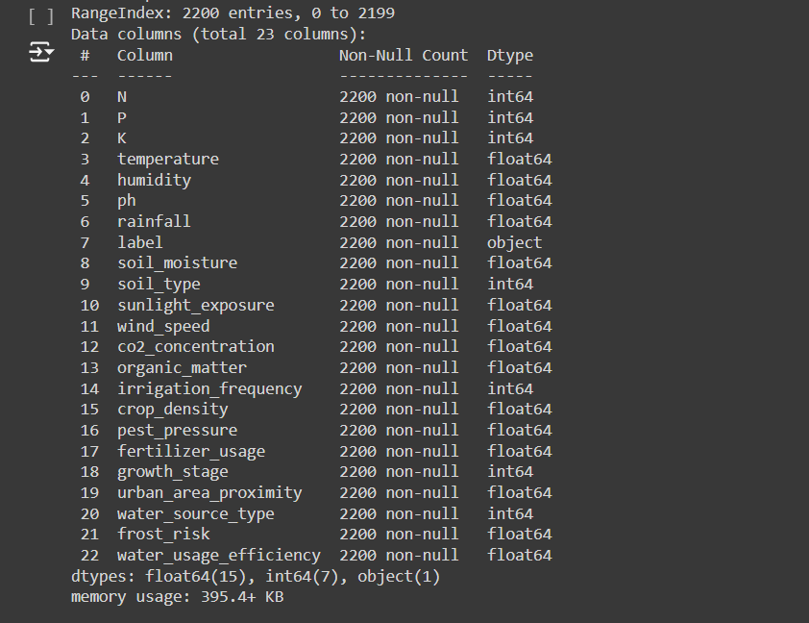
Data Collection
Frontier Tech Leaders Programme Global Cohort 1

Slide 10
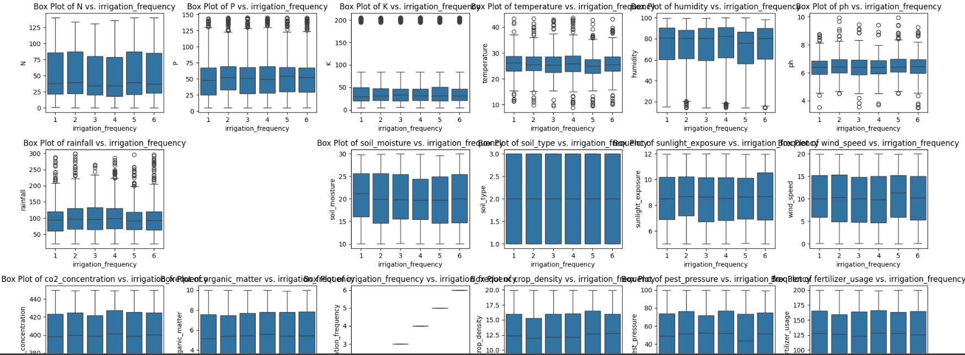
Data Collection

Slide 11
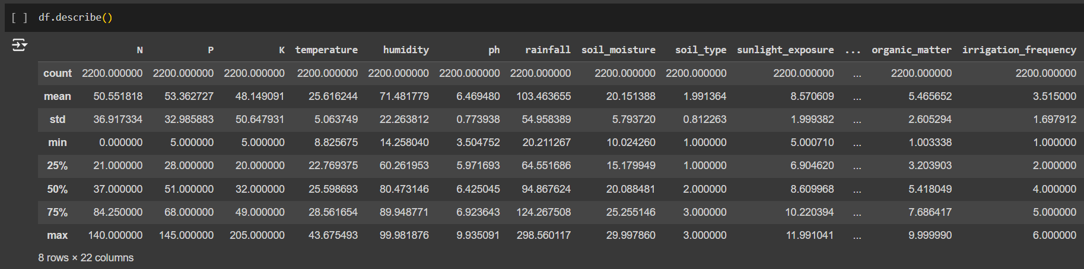
Data Collection

Slide 12
Exploratory Data Analysis (EDA) and Feature Engineering
Frontier Tech Leaders Programme Global Cohort 1
I created only one feature which was the Nutrient Index which is the multiplication of Nitrogen(N), Phosphorus(P) and Potassium(K) divided by 3.
I deemed features that were deleted redundant due to them having close to zero impact to the model and kept features where receiving data on them would on take the usage of a couple of sensors.
I had change some of the categorical data as they manually encoded. This would lead bias where the system would think the distance between certain say loamy and clay is meaningful even if the categories are nominal.

Slide 13
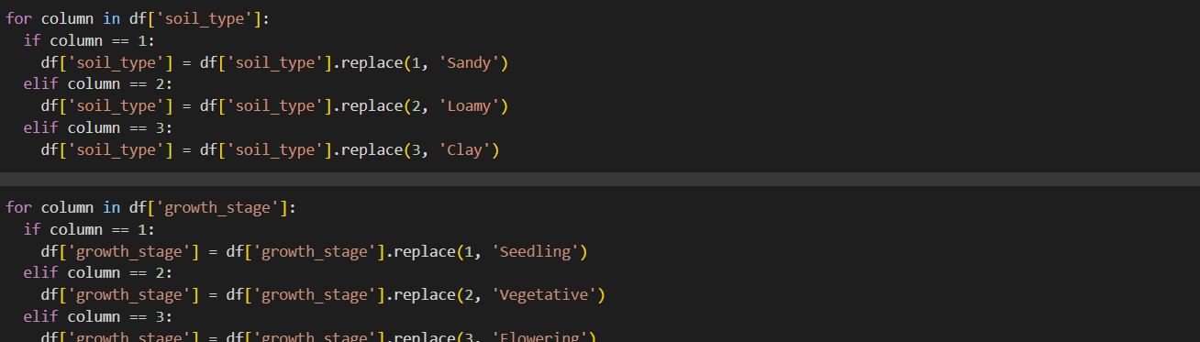
EDA and Feature Engineering

Slide 14
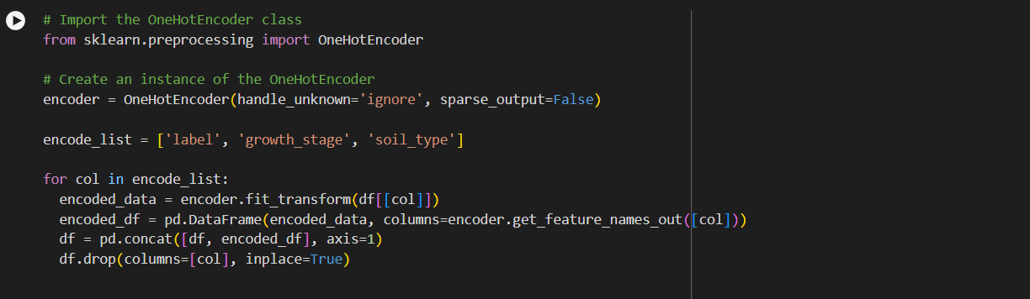
EDA and Feature Engineering

Slide 15
Model
Frontier Tech Leaders Programme Global Cohort 1

Slide 16
Model Selection and Training
Frontier Tech Leaders Programme Global Cohort 1
I run tests on a bunch of models to find the model with the highest accuracy.
During initial tests all models didn’t get an accuracy above 20% on the test set

Slide 17
Model Evaluation and Hyperparameter Tuning
Frontier Tech Leaders Programme Global Cohort 1
Evaluation metrics and visualizations
Highlight the model's performance
Details on any hyperparameter tuning performed and Impact on model performance

Slide 18
Model Refinement and Testing
Frontier Tech Leaders Programme Global Cohort 1
Due to the poor results on the test set. I had an overfitting problem so I created augmented data using gretel.ai.
I deleted some features and cut down the frequency types to three. [3,4,6]
By doing this I made my model predict between 3 different classes. This way I could improve the accuracy.

Slide 19
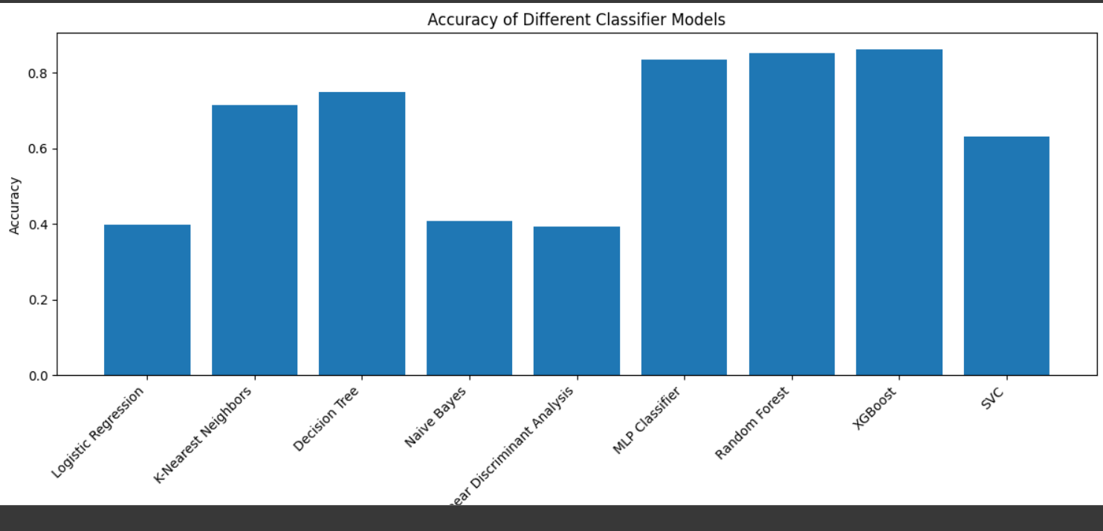
Model Refinement and Test

Slide 20
Results
Frontier Tech Leaders Programme Global Cohort 1

Slide 21
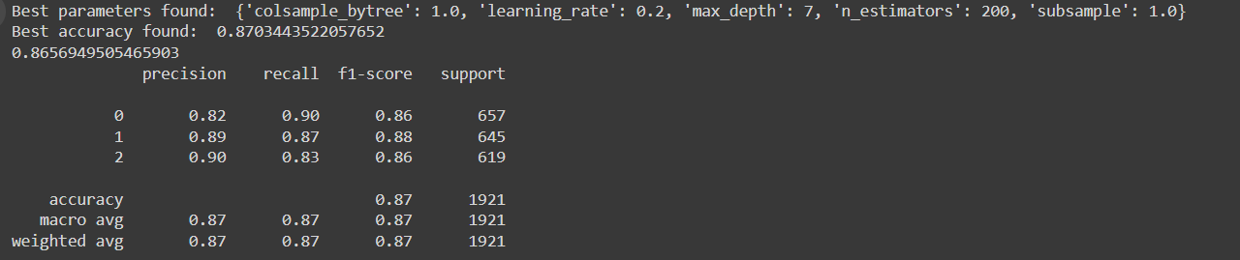
Evaluation Results
Frontier Tech Leaders Programme Global Cohort 1

Slide 22
Deployment
Frontier Tech Leaders Programme Global Cohort 1
The deployment involves setting up a Flask web service to serve the machine learning model for predictions. The environment is containerized using Docker for consistent deployment across various platforms (cloud/on-premise).
The model is serialized using pickle to store it in a binary format for easy loading during inference.The Flask app serves the serialized model through API endpoints, receiving POST requests with input data, running the model, and returning predictions.

Slide 23
Future Work
Frontier Tech Leaders Programme Global Cohort 1
Collecting data from differents part of the world and not limiting it to only California
Explore advanced machine learning techniques (e.g., deep learning, ensemble models) to improve prediction accuracy.
Integrate with IoT sensors for real-time data collection on soil moisture, humidity, and temperature, enabling continuous model updates and recommendations.
Provide multi-language support to cater to farmers across different regions, ensuring broader accessibility.

Slide 24
References
Frontier Tech Leaders Programme Global Cohort 1
https://scikit-learn.org/stable/supervised_learning.html
https://www.youtube.com/@RyanAndMattDataScience

Slide 25



Thank you!
Frontier Tech Leaders Programme Global Cohort 1

