Slide 1
CROP YIELD PREDICTION
Frontier Tech Leaders Programme Global Cohort 1
NISHANT SUBEDI
10/01/2024

Slide 2
Outline
Frontier Tech Leaders Programme Global Cohort 1
Concept note and implementation plan:
Background
Objectives
SDG Relation
Data
Data Collection
Exploratory Data Analysis (EDA) and Feature Engineering
Model Selection and Training
Model Evaluation and Hyperparameter Tuning
Model Refinement and Testing
Results
Deployment
Future Work

Slide 3
Concept note and implementation plan
Frontier Tech Leaders Programme Global Cohort 1

Slide 4
Background
Frontier Tech Leaders Programme Global Cohort 1
Overview: Developing a deep learning model to predict crop yields using soil and weather data.
Traditional methods struggle to capture the complexities of agricultural data for accurate yield forecasting.
Importance: Accurate crop predictions are crucial for optimizing resources, increasing productivity, and enhancing food security.

Slide 5
Objectives
Frontier Tech Leaders Programme Global Cohort 1
Project Objective: Develop an AI-based model for accurate crop yield predictions using soil and weather data.
Model Goals: Improve prediction accuracy, support data-driven decisions for farmers by leveraging deep learning techniques.

Slide 6
SDG Relation
Frontier Tech Leaders Programme Global Cohort 1
The project supports SDG 2 (Zero Hunger) by providing accurate crop yield predictions to improve agricultural productivity.
It helps farmers make informed decisions, contributing to food security and promoting sustainable farming practices.

Slide 7
Data
Frontier Tech Leaders Programme Global Cohort 1

Slide 8
Data Collection
Frontier Tech Leaders Programme Global Cohort 1
Dataset Sources: Data is sourced from Kaggle , weather (temperature, rainfall) and soil data (pesticides used).
Preprocessing Steps: Data cleaning involves renaming columns, handling inconsistencies, and standardizing formats for consistency.
Handling Missing Values/Outliers: Missing values are addressed through imputation techniques, and outliers are identified and handled using statistical methods to ensure data quality.

Slide 9
Exploratory Data Analysis (EDA) and Feature Engineering
Frontier Tech Leaders Programme Global Cohort 1
Feature Creation/Transformation: Features are created through transformations such as log transformations for skewed distributions and aggregating data to enhance temporal analysis.
Rationale: These transformations aim to improve the model's ability to capture complex relationships and enhance predictive accuracy.
Scaling and Normalization: Numerical features are scaled using standardization to ensure all features contribute equally to the model, while categorical variables are encoded using one-hot encoding for better representation.

Slide 10
Model
Frontier Tech Leaders Programme Global Cohort 1

Slide 11
Model Selection and Training
Frontier Tech Leaders Programme Global Cohort 1
Rationale for Choosing a Specific Model: The TensorFlow and Keras deep learning was selected for its ability to capture complex non-linear relationships in the data, enhancing prediction accuracy.
Strengths and Weaknesses: Strengths include flexibility and the capacity to learn from large datasets, while weaknesses involve the need for significant computational resources and potential overfitting.
Details on Training the Model: The model was trained using the Adam optimizer and Mean Squared Error (MSE) loss function, with a validation split to monitor performance.
Hyperparameters Used and Cross-Validation Techniques: Key hyperparameters included learning rate, batch size, and the number of neurons in hidden layers, while K-fold cross-validation was employed to ensure robust performance evaluation.

Slide 12
Model Evaluation and Hyperparameter Tuning
Frontier Tech Leaders Programme Global Cohort 1
Evaluation metrics such as Mean Squared Error (MSE) and R-squared were used to quantify model performance, supplemented by visualizations like loss curves and scatter plots of predicted versus actual values.
The model achieved an MSE of 48.11 and an R-squared of 0.82, indicating strong predictive capability and good fit to the data.
Hyperparameter tuning included adjustments to the learning rate, batch size, and dropout rate, which improved model performance and reduced overfitting.
The impact of hyperparameter tuning resulted in a final MSE of 50.34 and an R-squared of 0.80, demonstrating enhanced generalization to unseen data.

Slide 13
Model Refinement and Testing
Frontier Tech Leaders Programme Global Cohort 1
The refinement phase focused on enhancing the model's accuracy and generalization through techniques like hyperparameter tuning, regularization, and feature selection.
Techniques such as dropout layers and early stopping were implemented to mitigate overfitting and improve model robustness.
The test submission phase involved preparing the test dataset using the same preprocessing steps applied during training, ensuring consistency in input data.
On the test dataset, the model achieved a Mean Squared Error of 50.34 and an R-squared value of 0.80, confirming its effectiveness in predicting crop yields.

Slide 14
Results
Frontier Tech Leaders Programme Global Cohort 1

Slide 15
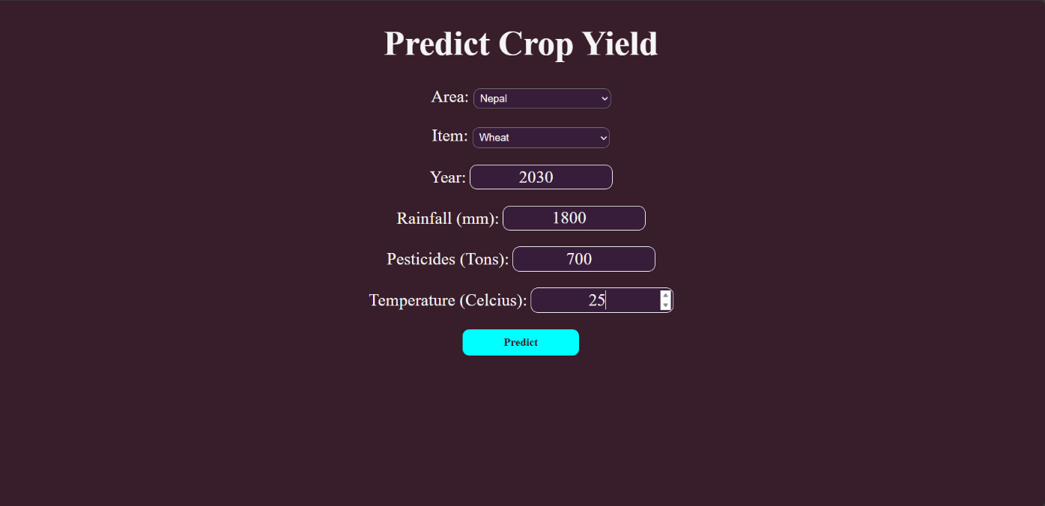
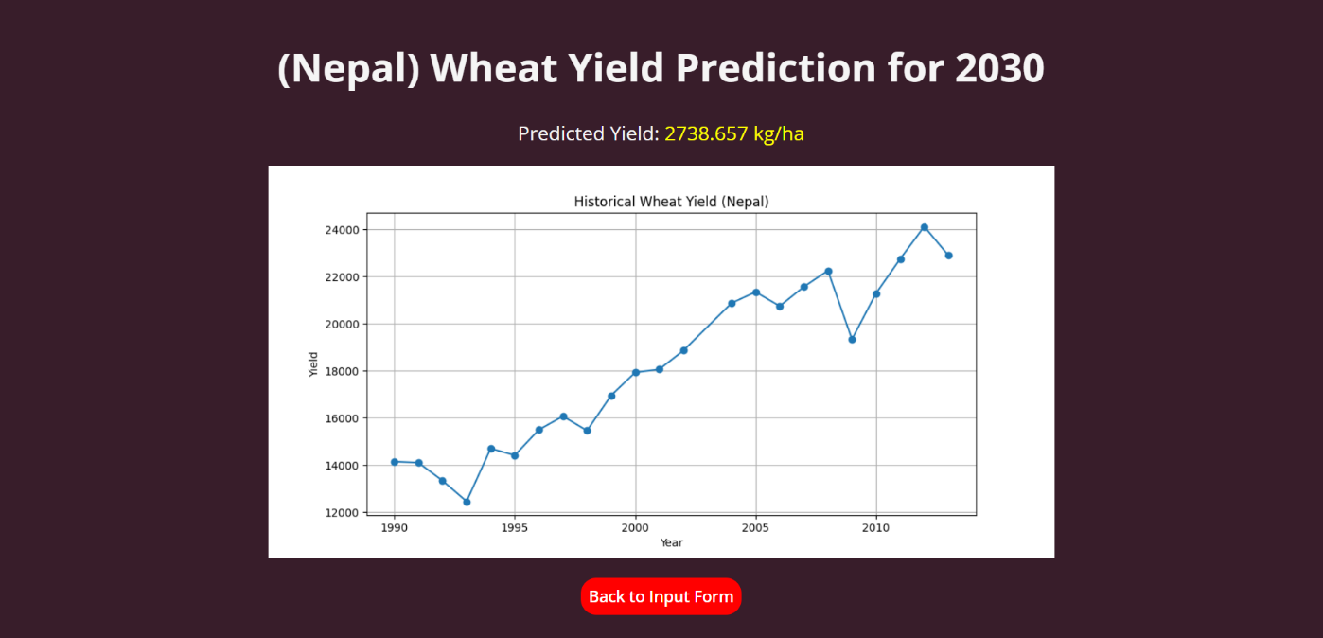
Evaluation Results
Frontier Tech Leaders Programme Global Cohort 1

Slide 16
Deployment
Frontier Tech Leaders Programme Global Cohort 1
The deployment phase involves making the trained machine learning model accessible to end-users through a Django web application, enabling real-time crop yield predictions.
Model serialization was achieved using TensorFlow/Keras for the trained model and Joblib for the preprocessing pipeline, ensuring efficient loading and consistent input handling during predictions.
The Django web application serves the serialized model and preprocessing pipeline, allowing users to input relevant data and receive predictions, with the potential for API integration to enhance accessibility and functionality.

Slide 17
Future Work
Frontier Tech Leaders Programme Global Cohort 1
Future work could focus on enhancing model accuracy through the integration of additional features such as satellite imagery and soil moisture data, which can provide deeper insights into crop yield predictions.
Exploring alternative machine learning models, such as ensemble methods or advanced deep learning architectures, could further improve performance and generalization to different agricultural contexts.
Additionally, expanding data sources to include real-time weather data and historical yield records can enrich the dataset, offering more robust predictions and insights for farmers and agricultural consultants.

Slide 18
References
Frontier Tech Leaders Programme Global Cohort 1
https://www.mdpi.com/2072-4292/14/9/1990
https://journals.plos.org/plosone/article?id=10.1371/journal.pone.0252402
https://link.springer.com/chapter/10.1007/978-981-99-4725-6_77
https://link.springer.com/chapter/10.1007/978-981-99-9707-7_26
https://www.kaggle.com/code/mahmoudmagdyelnahal/crop-yield-prediction-99

Slide 19


Thank you!
Frontier Tech Leaders Programme Global Cohort 1

