Slide 1
Analyzing the Impact of Renewable Energy Adoption on Economic Recovery of Developing Nations
Frontier Tech Leaders Programme Global Cohort 1
Team Member: Madan Ghimire
Date: 04/10/2024

Slide 2
Outline
Frontier Tech Leaders Programme Global Cohort 1
Concept note and implementation plan:
Background
Objectives
SDG Relation
Data
Data Collection
Exploratory Data Analysis (EDA) and Feature Engineering
Model Selection and Training
Model Evaluation and Hyperparameter Tuning
Model Refinement and Testing
Results
Deployment
Future Work

Slide 3
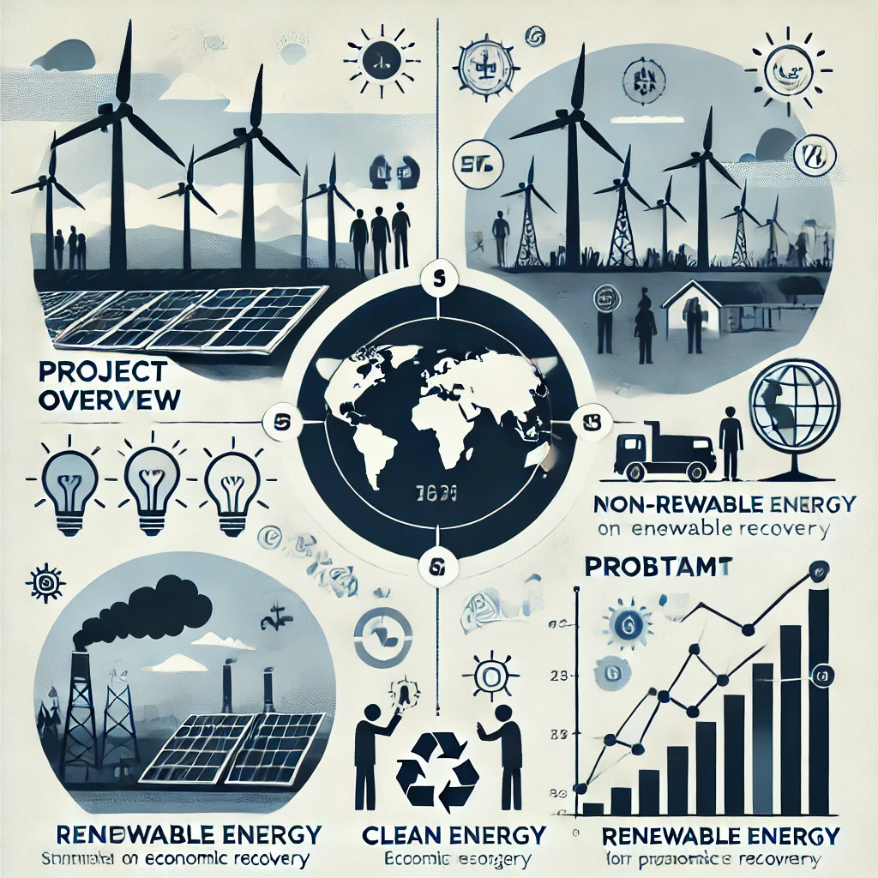
Concept Note and Implementation Plan
Developing nations face significant economic challenges, often exacerbated by limited access to clean, affordable energy, which hinders their economic resilience, poverty reduction efforts, and social protection.
The reliance on non-renewable, costly, and environmentally harmful energy sources restricts economic growth in these regions, making renewable energy adoption crucial for sustainable development.
Notes:
Developing nations face significant economic challenges, often exacerbated by limited access to clean, affordable energy, which hinders their economic resilience, poverty reduction efforts, and social protection.
The reliance on non-renewable, costly, and environmentally harmful energy sources restricts economic growth in these regions, making renewable energy adoption crucial for sustainable development.
Despite global efforts, the current pace of renewable energy adoption is insufficient to address the economic and environmental challenges in developing countries, necessitating a data-driven approach for effective policy formulation.

Slide 4
Objectives
Investigate the relationship between renewable energy adoption and its effects on economic recovery in developing nations.
Provide data-driven insights for policy decisions related to SDG 7 and interconnected SDGs.

Slide 5
SDG Relation
The project addresses SDG 7 and SDG 8:
SDG 7: Focuses on renewable energy’s role in fostering affordable, clean energy.
SDG 8: Explores how renewable energy impacts economic recovery, job creation, and sustained growth.

Slide 6
Data
Data Sources:
World Development Indicators (WDI) from the World Bank.
UNDP Data Futures Platform.
33 years of data of 28 Least Developed Countries.

Slide 7
Data Collection
Preprocessing:
Converted data from text format to numerical format
Formatted data along the time series and alphabetically
ARIMA technique which uses time series forecasting to fill the missing data
An ARIMA model is defined by three parameters: p, d and q.
p: The order of the autoregressive term.
d: The number of differencing operations required to make the time series stationary.
q: The order of the moving average term.

Slide 8
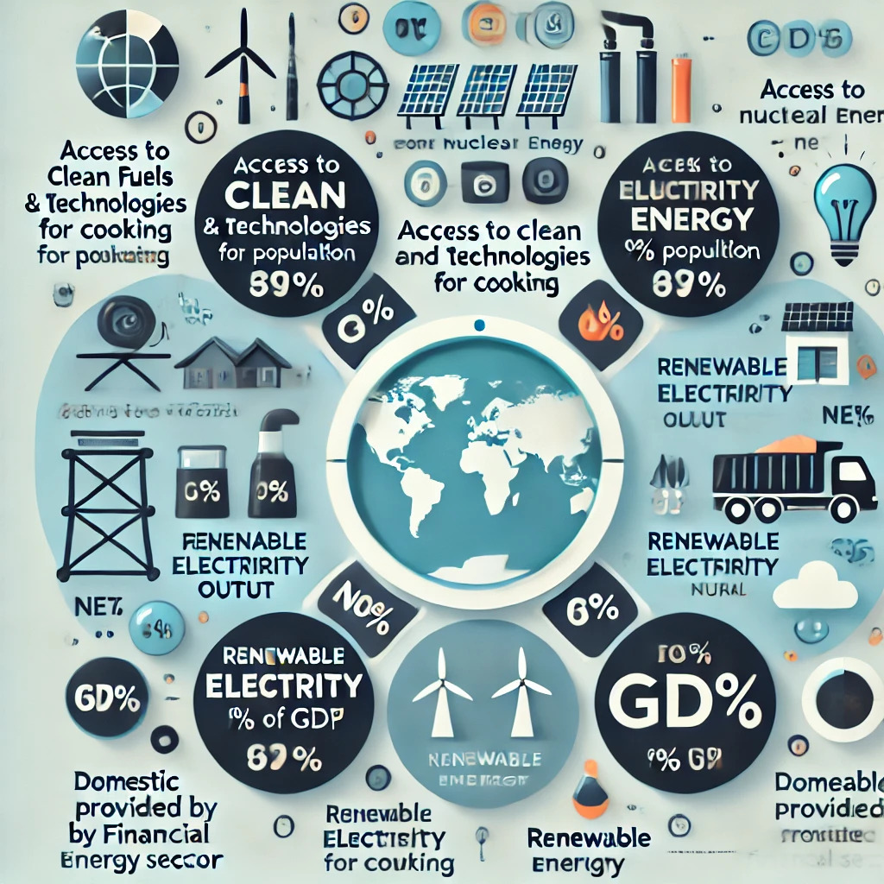
Exploratory Data Analysis (EDA) and Feature Engineering
Rationale: CO2 emissions and energy imports over time.
Feature Engineering: Creating features like renewable energy percentage, electricity trade costs, and debt levels.
Total of 13 features
Dependent Feature = Annual Growth of GDP

Slide 9
Model Selection and Training
Model Selection:
Support Vector Regression (SVR)
K-Nearest Neighbor (KNN)
Random Forest
ANN
Model Training: Using trained dataset developed during data preprocessing

Slide 10
Random Forest Regression
Rationale for Choosing:
Chosen for robustness and handling variance better than a single tree.
Strengths:
• Reduces overfitting through averaging.
• Handles missing data and outliers well.
Weaknesses:
Computationally expensive and hard to interpret.
Training Details:
Trained with 100 estimators, grid search for hyperparameters.
High initial R2 score, but complexity affected interpretability.
Notes:
Weaknesses:
Prone to overfitting without pruning.
Sensitive to small variations in the data.
Training Details:
Trained with MSE criterion; prone to high variance.
Moderate initial R2 accuracy, but poor generalization.

Slide 11
Support Vector Regression (SVR)
Rationale for Choosing:
Selected for its ability to model non-linear relationships using kernel functions.
Strengths:
Effective in high-dimensional spaces, handles non-linear data.
Less prone to overfitting.
Weaknesses:
Requires feature scaling, sensitive to parameter tuning.
Training Details:
Trained with RBF kernel, optimized epsilon and regularization parameter (C).
Notes:
Weaknesses:
Prone to overfitting without pruning.
Sensitive to small variations in the data.
Training Details:
Trained with MSE criterion; prone to high variance.
Moderate initial R2 accuracy, but poor generalization.

Slide 12
Artificial Neural Network (ANN)
Rationale for Choosing:
Chosen for its non-linear modeling ability and adaptability to complex datasets
Strengths:
Captures complex relationships, adaptable to high-dimensional data
Weaknesses:
Black-box model, prone to overfitting.
• Requires large datasets for training.
Training Details:
• Trained with 2 hidden layers, ReLU activation, and MSE loss function.
• Achieved R2 score of 0.71 after 1000 epochs.
Notes:
Weaknesses:
Prone to overfitting without pruning.
Sensitive to small variations in the data.
Training Details:
Trained with MSE criterion; prone to high variance.
Moderate initial R2 accuracy, but poor generalization.

Slide 13
Model Evaluation and Hyperparameter Tuning
Evaluation Metrics:
R2 accuracy

Slide 14
Model Refinement and Testing
Techniques Used:
Feature selection using Feature Importance algorithms
ARIMA for missing data replacement.

Slide 15
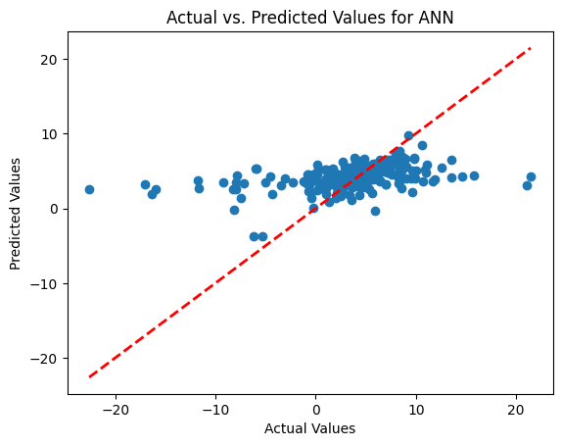
Results
ANN Model Performance: Achieved an MSE score of 0.31 on training
ANN Model R2 score was 0.35 after performing the prediction

Slide 16
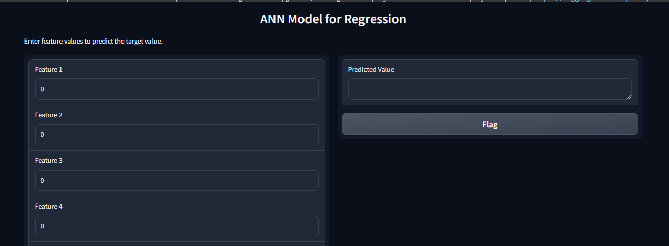
Deployment
Deployment Phase:
• Gradio interface for real-time predictions.
Model serialized using TensorFlow/Keras.

Slide 17
Future Work
Improving data quality and integrating more features.
Addressing biases in the dataset and enhancing model scalability.

Slide 18
References
Frontier Tech Leaders Programme Global Cohort 1
Anon Access all data | Data Futures Exchange
Anon World Development Indicators | DataBank

Slide 19


Thank you!
Frontier Tech Leaders Programme Global Cohort 1

