Slide 1
Prediction of Graduate Admission
Frontier Tech Leaders Programme Global Cohort 3
Bamba GUEYE
01/10/2024

Slide 2
Outline
Frontier Tech Leaders Programme Global Cohort 3
Concept note and implementation plan:
Background
Objectives
SDG Relation
Data
Data Collection
Exploratory Data Analysis (EDA) and Feature Engineering
Model Selection and Training
Model Evaluation and Hyperparameter Tuning
Model Refinement and Testing
Results
Deployment
Future Work

Slide 3
Concept note and implementation plan
Frontier Tech Leaders Programme Global Cohort 3

Slide 4
Background
Frontier Tech Leaders Programme Global Cohort 3
Our project helps graduate students predict university admissions based on their academic profiles, offering personalized guidance to select suitable institutions.
Our project uses machine learning to provide tailored, data-driven guidance for students.
Improves the match between student profiles and university programs.

Slide 5
Objectives
Frontier Tech Leaders Programme Global Cohort 3
Develop an application that helps graduate students identify universities that align with their academic qualifications through a thorough evaluation.
Using machine learning models to predict graduate admissions based on a student's academic profile and select the best-performing models.

Slide 6
SDG Relation
Frontier Tech Leaders Programme Global Cohort 3
Our project, "Prediction of Graduate Admission," directly contributes to Sustainable Development Goal 4 (SDG 4): "Ensure inclusive and equitable quality education and promote lifelong learning opportunities for all."

Slide 7
SDG Relation
Frontier Tech Leaders Programme Global Cohort 3
Promoting Equity in Education
Supporting Lifelong Learning

Slide 8
Data
Frontier Tech Leaders Programme Global Cohort 3

Slide 9
Data Collection
Frontier Tech Leaders Programme Global Cohort 3
Our dataset consists of 500 instances and 9 attributes, sourced from Kaggle. It includes key features like GRE Score, TOEFL Score, CGPA, and Chance of Admit.
The data is in CSV format.

Slide 10
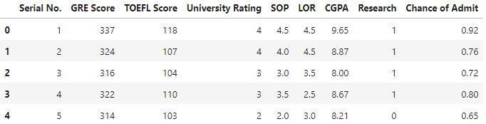
Data Collection
Frontier Tech Leaders Programme Global Cohort 3
Loading CSV Dataset into Pandas Data frame

Slide 11
Data Collection
Frontier Tech Leaders Programme Global Cohort 3
Quick overview of data frame
Quick statistical summary
Check missing values

Slide 12
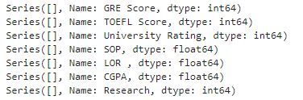
Data Collection
Frontier Tech Leaders Programme Global Cohort 3
Check whether the outliers in our dataset

Slide 13
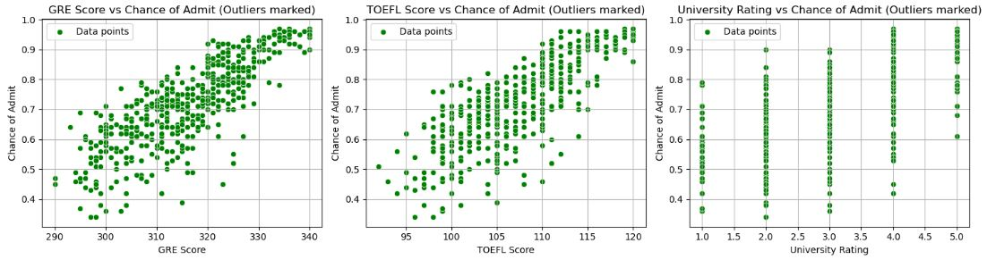
Data Collection
Frontier Tech Leaders Programme Global Cohort 3
Data visualization:

Slide 14
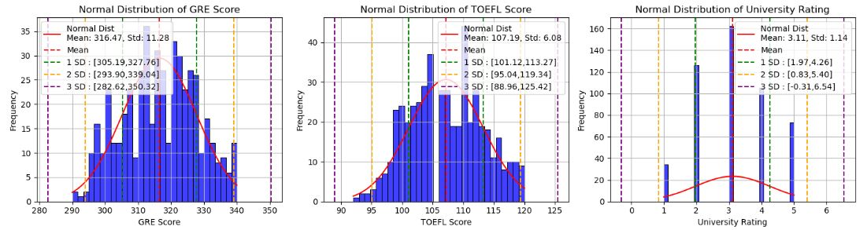
Exploratory Data Analysis (EDA) and Feature Engineering
Frontier Tech Leaders Programme Global Cohort 3
Check the normalization of each feature

Slide 15
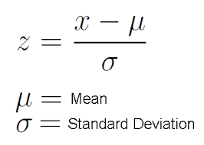
Exploratory Data Analysis (EDA) and Feature Engineering
Frontier Tech Leaders Programme Global Cohort 3
Normalize the dataset using the function StandardScaler()
Enhance the model's performance by incorporating polynomial features.

Slide 16
Model
Frontier Tech Leaders Programme Global Cohort 3

Slide 17
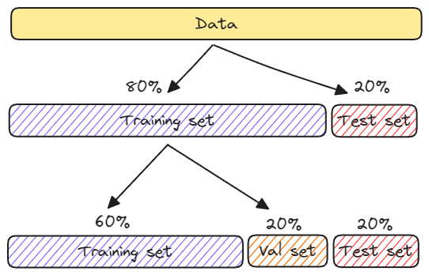
Model Selection and Training
Frontier Tech Leaders Programme Global Cohort 3
Split the dataset into training, cross validation, and test sets

Slide 18
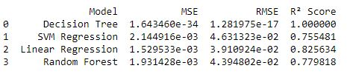
Model Selection and Training
Frontier Tech Leaders Programme Global Cohort 3
Choosing the model among various machine learning algorithms, including Decision Tree, SVM Regression, Linear Regression, and Random Forest

Slide 19
Model Selection and Training
Frontier Tech Leaders Programme Global Cohort 3
Discuss the strengths and weaknesses
Strengths | Weaknesses
Linear regression is straightforward to understand and explain, and can be regularized to avoid overfitting. In addition, linear models can be updated easily with new data using stochastic gradient descent. | Linear regression performs poorly when there are non-linear relationships.

Slide 20
Model Selection and Training
Frontier Tech Leaders Programme Global Cohort 3
Initialize the model using the function of scikit-learn LinearRegression()
Training the model using the function fit() for train_set_scaled, y_train and cross_validation_scaled, y_cross_validation

Slide 21
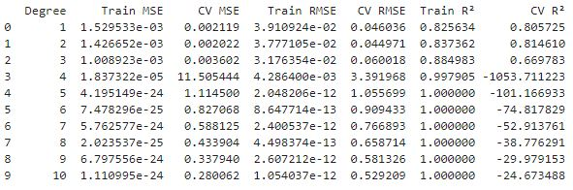
Model Selection and Training
Frontier Tech Leaders Programme Global Cohort 3
Comparison of models

Slide 22
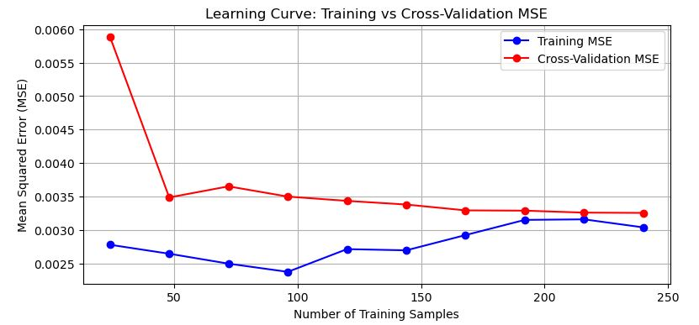
Model Evaluation and Hyperparameter Tuning
Frontier Tech Leaders Programme Global Cohort 3
Evaluation metrics and visualizations

Slide 23
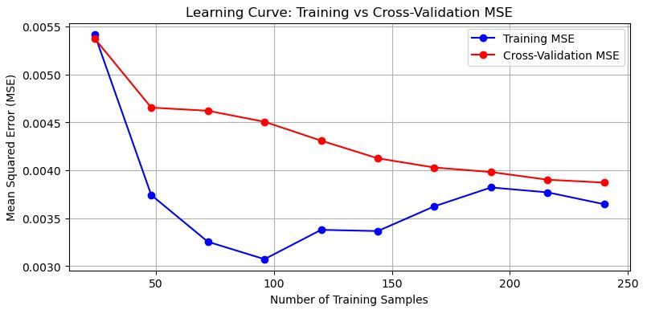
Model Evaluation and Hyperparameter Tuning
Frontier Tech Leaders Programme Global Cohort 3
Tuned the hyperparameters using GridSearchCV to determine the optimal alpha value.

Slide 24

Model Refinement and Testing
Frontier Tech Leaders Programme Global Cohort 3
Experiment with Different Algorithms
Enhance the model’s performance among them
Use Regularization to Prevent Overfitting with Ridge function and tune Hyperparameters with GridSearchCV
Metrics and results on the test dataset

Slide 25
Results
Frontier Tech Leaders Programme Global Cohort 3

Slide 26

Evaluation Results
Frontier Tech Leaders Programme Global Cohort 3
After tuning Hyperparameters and regularization
Before tuning Hyperparameters and regularization

Slide 27
Deployment
Frontier Tech Leaders Programme Global Cohort 3
Test Model in Jupyter Notebook
Build Backend with FastAPI
Build Frontend with Streamlit
Containerize with Docker

Slide 28
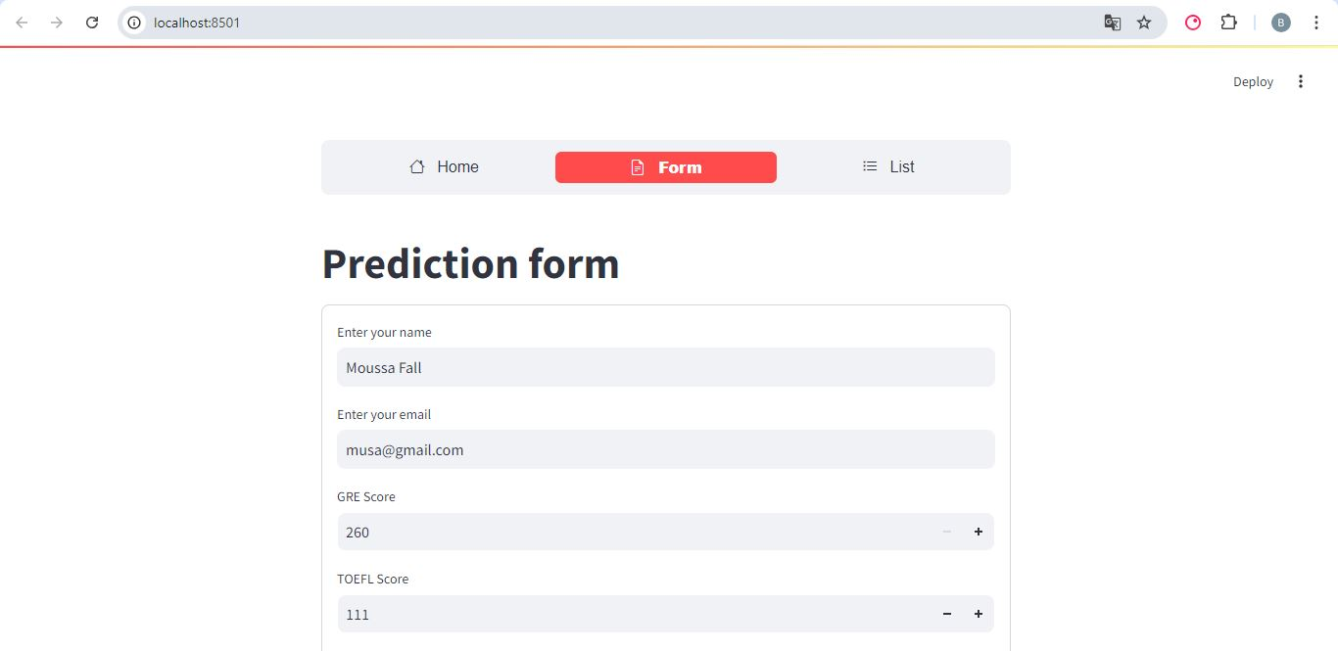
Deployment
Frontier Tech Leaders Programme Global Cohort 3

Slide 29
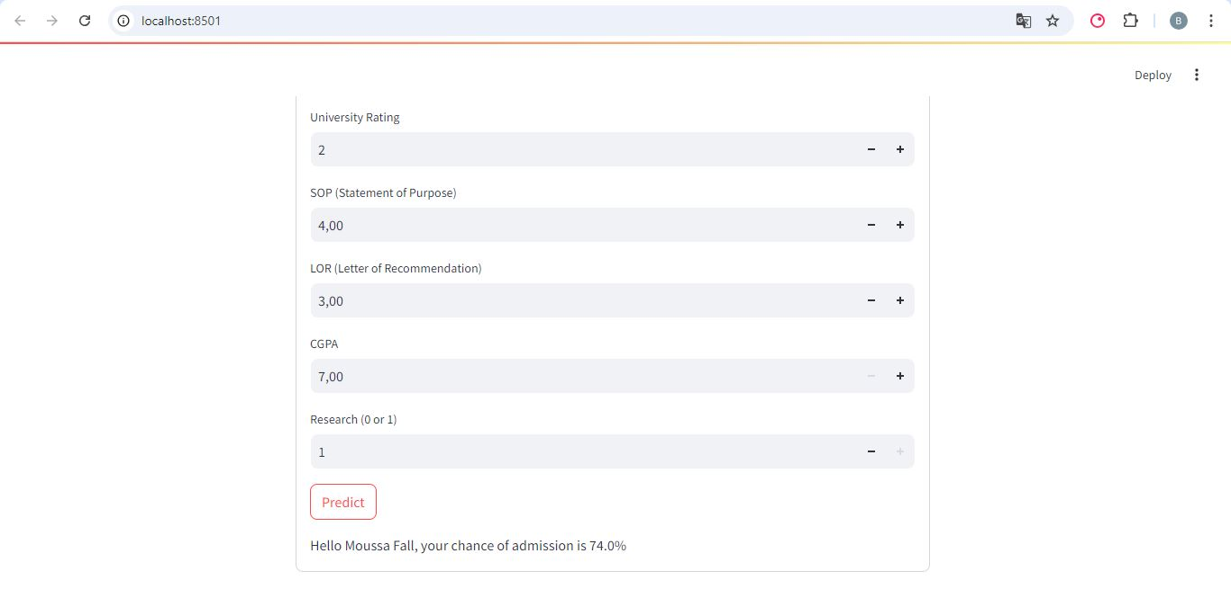
Deployment
Frontier Tech Leaders Programme Global Cohort 3

Slide 30
Future Work
Frontier Tech Leaders Programme Global Cohort 3
Using feature selection to improve the model
Expanding the dataset and introducing more advanced techniques like deep learning
Deployment in cloud (AWS, Azure, etc…)

Slide 31
References
Frontier Tech Leaders Programme Global Cohort 3
• DATASCIENTEST. (n.d.). FastAPI: Le framework Python parfait pour les APIs. Retrieved from https://datascientest.com/fastapi
• Le Data SCIENTIST. (n.d.). Streamlit: Donner une vie à vos modèles de ML. Retrieved from https://ledatascientist.com/streamlit-donner-une-vie-a-vos-modeles-de-ml/
• Dataquest. (n.d.). Real-world Python use cases. Retrieved from https://www.dataquest.io/blog/real-world-python-use-cases/
• HopHR. (n.d.). Limitations of Jupyter Notebook in data science projects: A step-by-step guide. Retrieved from https://www.hophr.com/tutorial-page/limitations-jupyter-notebook-data-science-projects-step-by-step-guide#:~:text=For%20instance%2C%20it%20lacks%20robust,large%20datasets%20or%20complex%20computations

Slide 32


Thank you!
Frontier Tech Leaders Programme Global Cohort 3

