Slide 1
Medical Diagnostic System for Breast Cancer Detection
Frontier Tech Leaders Programme Global Cohort 1
Team Members:
- Mohammed Adil - Dagim Faji
- Ali Soltan Dileyta - Mahdi Abdi Rayaleh
- Kena Teshome - Impundu Joyeux TheveninDate

Slide 2
Outline
Frontier Tech Leaders Programme Global Cohort 1
Concept note and implementation plan:
Background
Objectives
SDG Relation
Data
Data Collection
Exploratory Data Analysis (EDA) and Feature Engineering
Model Selection and Training
Model Evaluation and Hyperparameter Tuning
Model Refinement and Testing
Results
Deployment
Future Work

Slide 3
Concept note and implementation plan
Frontier Tech Leaders Programme Global Cohort 1

Slide 4
Background
Frontier Tech Leaders Programme Global Cohort 1
The Medical Diagnostic System for Breast Cancer leverage the power of machine learning (ML) and deep learning (DL) to create a robust, accurate, and accessible diagnostic tool.
This tool will primarily target healthcare providers but can also be adapted for use by patients in resource-limited settings where access to advanced medical diagnostics is not readily available.

Slide 5
Background
Frontier Tech Leaders Programme Global Cohort 1
Breast cancer remains the most common cancer among women worldwide, with over 2.3 million new cases diagnosed in 2020 alone, according to the World Health Organization (WHO).
Despite advances in medical technology and treatments, breast cancer continues to be a leading cause of death among women globally. Early detection is critical in improving survival rates, as it allows for timely treatment and intervention.

Slide 6
Objectives
Frontier Tech Leaders Programme Global Cohort 1
Image Analysis: Utilize a Convolutional Neural Network (CNN) trained on large datasets of mammography images to classify breast tissue as benign or malignant. The CNN will be fine-tuned for high accuracy, with continuous model evaluation and retraining as more data becomes available.
Symptom Analysis: Develop a chatbot that interacts with users, asking a series of symptom-related questions based on established medical guidelines. The chatbot will analyze the responses to provide a preliminary risk assessment.
Combine the image analysis from the CNN and the symptom analysis from the chatbot into a unified diagnostic tool. This will allow users to upload mammography images and answer diagnostic questions on a single platform, providing a comprehensive assessment.
Develop a user-friendly web application using React and Django, ensuring that the tool is accessible to healthcare providers and potentially patients. The web app will feature a modern, responsive design, making it accessible across various devices, including smartphones and tablets.

Slide 7

SDG Relation
Frontier Tech Leaders Programme Global Cohort 1
Given the wide spread impact of breast cancer, this project aligns with Sustainable Development Goal 3 (Good Health and Well-Being).
aiming to reduce mortality rates through early detection and accessible diagnostic tools.
By integrating advanced ML/DL techniques with user-friendly interfaces, the project aspires to contribute significantly to global breast cancer detection efforts.

Slide 8
Data
Frontier Tech Leaders Programme Global Cohort 1

Slide 9
Data Collection
Frontier Tech Leaders Programme Global Cohort 1
The project utilizes two primary datasets:
The rsna-mammography-768-vl-perlabel: from Kaggle, which provides an image of mammography data labeled as 0 (for benign) and 1 ( for malignant).
CBIS-DDSM: Mass Case Mammograms PNG Dataset: also, from Kaggle, containing labeled images of mammography image samples.

Slide 10
Exploratory Data Analysis (EDA) and Feature Engineering
Frontier Tech Leaders Programme Global Cohort 1
Understanding the Dataset:
List the number of images, split between positive (malignant) and negative (benign).
Discuss the format of the images (resolution, color channels).
Check if there’s any class imbalance, which is typical in medical datasets.

Slide 11
Exploratory Data Analysis (EDA) and Feature Engineering
Frontier Tech Leaders Programme Global Cohort 1
Image Characteristics and Visualizing :
Display random images from both classes (benign and malignant) to give an idea of the visual differences.
Preprocessing the Images:
Convert all the images into tensors.
Resizing all images to 224x224 for a CNN.
Normalize the pixel values to be between 0 and 1 .

Slide 12
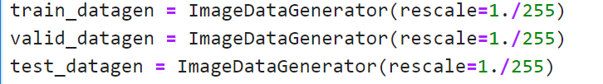
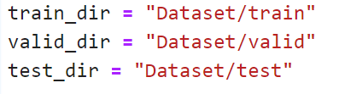
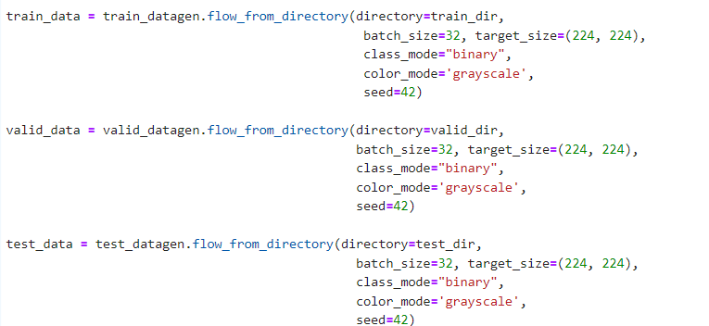
Exploratory Data Analysis (EDA) and Feature Engineering
Frontier Tech Leaders Programme Global Cohort 1
preprocess data:
Setup path to our data directories
import data from directories and turn it into batches

Slide 13
Model
Frontier Tech Leaders Programme Global Cohort 1

Slide 14
Model Selection and Training
Frontier Tech Leaders Programme Global Cohort 1
The project problem is image classification so we used a Convolutional Neural Networks (CNNs) because:
Good at detecting patterns and features in images, videos, and audio signals.
Robust to translation, rotation, and scaling invariance.
End-to-end training, no need for manual feature extraction.
Can handle large amounts of data and achieve high accuracy.

Slide 15
Model Selection and Training
Frontier Tech Leaders Programme Global Cohort 1
Disadvantages of Convolutional Neural Networks (CNNs):
Computationally expensive to train and require a lot of memory.
Can be prone to overfitting if not enough data or proper regularization is used.
Requires large amounts of labeled data.
Interpretability is limited, it’s hard to understand what the network has learned.

Slide 16
Model Selection and Training
Frontier Tech Leaders Programme Global Cohort 1
CNN architecture:
Convolutional Neural Network consists of multiple layers like the input layer, Convolutional layer, Pooling layer, and fully connected layers.
Convolutional Layer
Max Pooling Layer
Dense Layer
Input Layer
Output Layer
Image

Slide 17
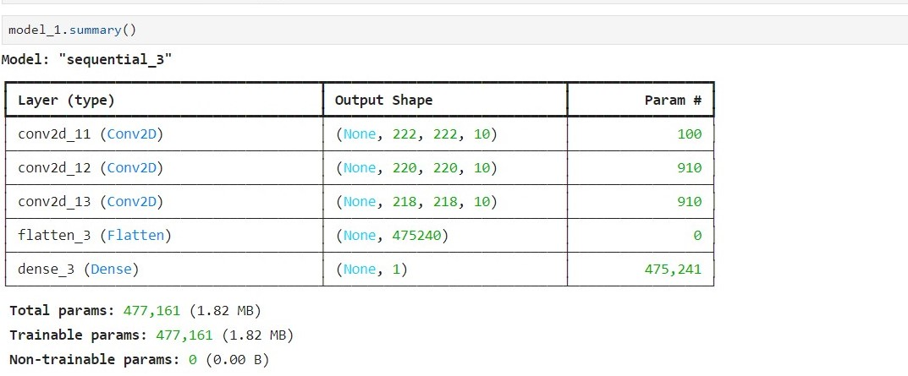
Model Selection and Training
Frontier Tech Leaders Programme Global Cohort 1
Summary of our base model:

Slide 18
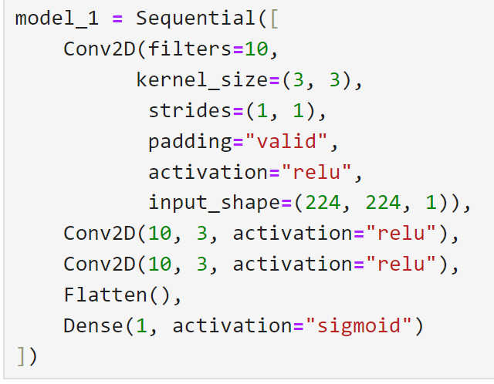
Model Selection and Training
Frontier Tech Leaders Programme Global Cohort 1
Hyperparameters used :
Higher value leads to more complex model
Lower values learn smaller features , higher values learn large features.
The number of steps a filter takes across an image at a time. If “1” a filter moves a cross the image on pixel at a time.
If “same ” pads the target tensor with zeros to preserve the input shape or leaves the tensor as is if “valid”.

Slide 19
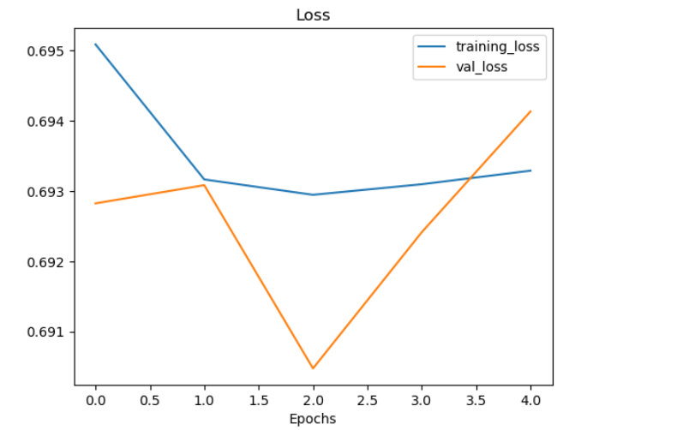
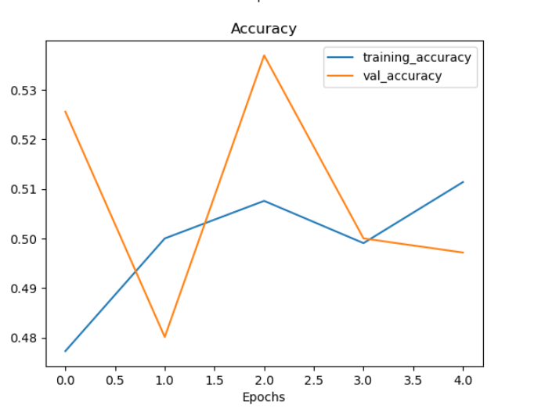
Model Selection and Training
Frontier Tech Leaders Programme Global Cohort 1
First Model Results:

Slide 20
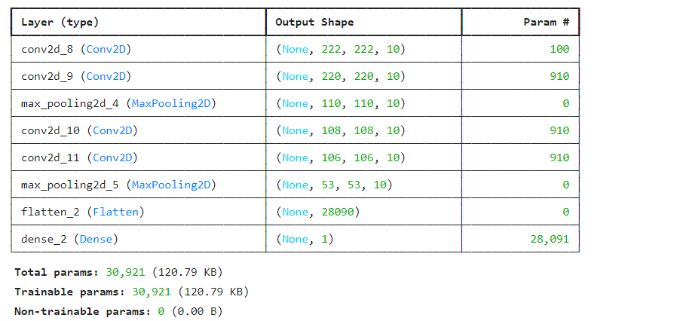
Model Selection and Training
Frontier Tech Leaders Programme Global Cohort 1
Summary of model 2:
Increasing the number of layers and adding a max pooling layer

Slide 21
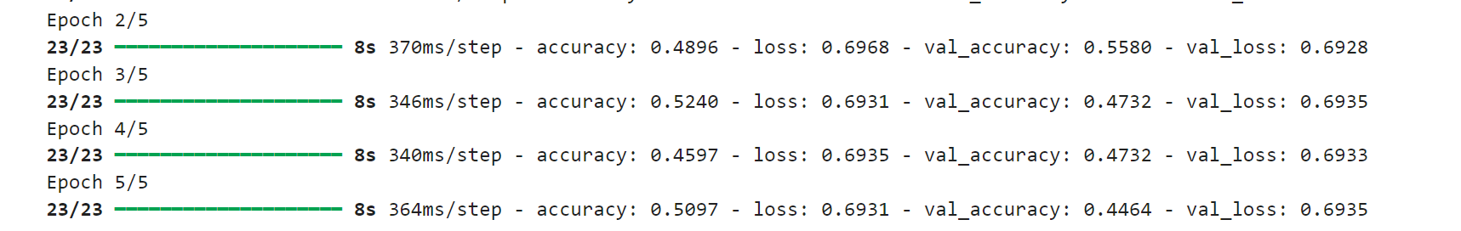
Model Selection and Training
Frontier Tech Leaders Programme Global Cohort 1
No improvement on the accuracy:

Slide 22
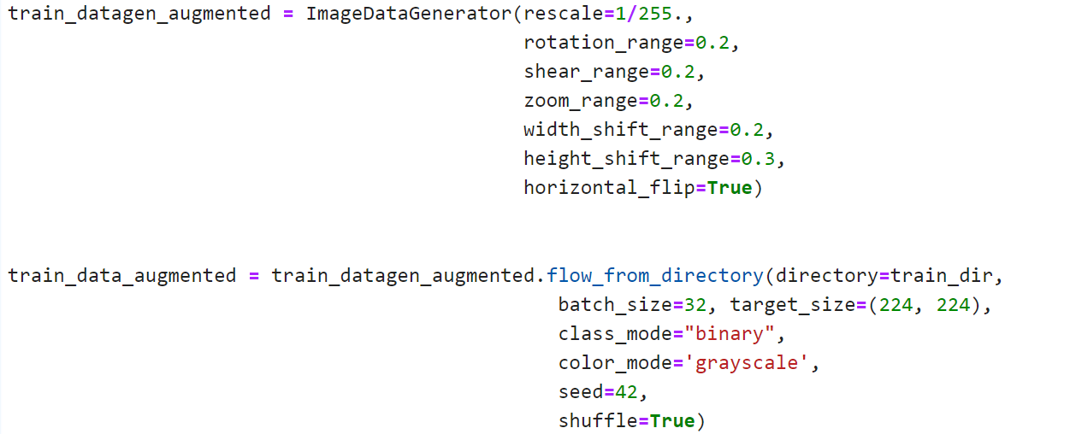
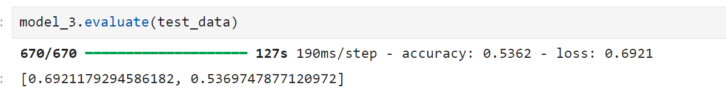
Model Selection and Training
Frontier Tech Leaders Programme Global Cohort 1
Using data augmentation :
Create ImageDataGenerator training instance with data augmentation

Slide 23
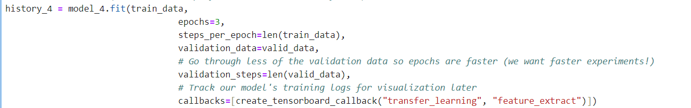
Model Selection and Training
Frontier Tech Leaders Programme Global Cohort 1
Using Transfer Learning :
Create base model with tf.keras.applications
Freeze the base model (so the pre-learned patterns remain)
Use feature extraction:
Notes:
shod

Slide 24
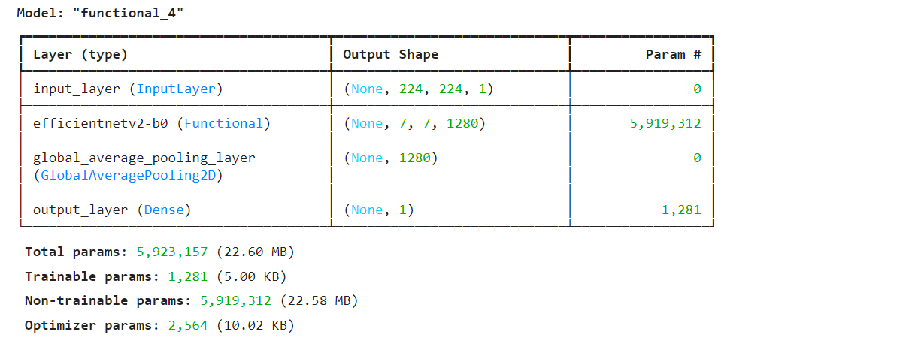
Model Selection and Training
Frontier Tech Leaders Programme Global Cohort 1
Using Transfer Learning :
Summary of the model:
Notes:
shod

Slide 25
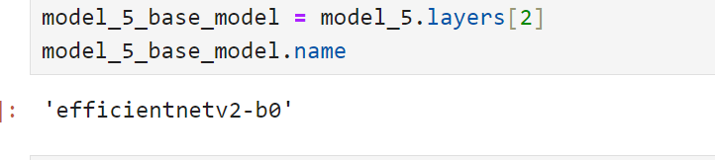

Model Selection and Training
Frontier Tech Leaders Programme Global Cohort 1
Using Transfer Learning (fine_tune):
Create base model with tf.keras.applications
Access the base_model layers of model_5
Make all the layers in model_5_base_model trainable
Freeze all layers except for the last 10
Notes:
shod

Slide 26
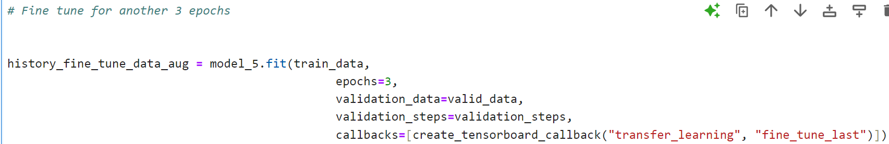
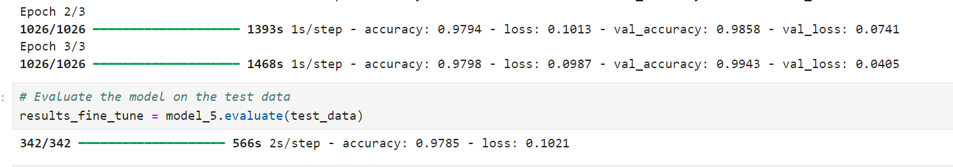
Notes:
shod

Slide 27
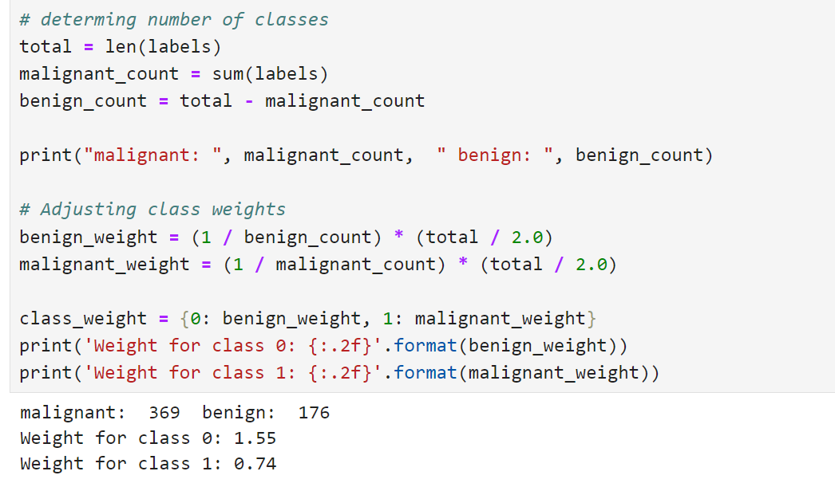
Model Refinement and Testing
Frontier Tech Leaders Programme Global Cohort 1
Modeling with Adjusted Class Weights

Slide 28
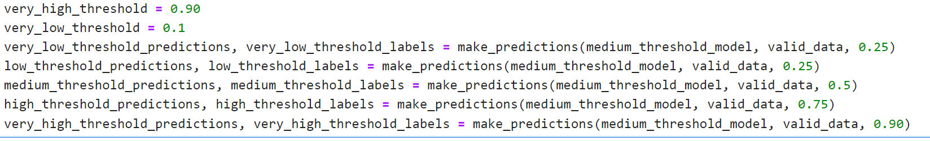
Model Refinement and Testing
Frontier Tech Leaders Programme Global Cohort 1
Making predictions with different thresholds :

Slide 29
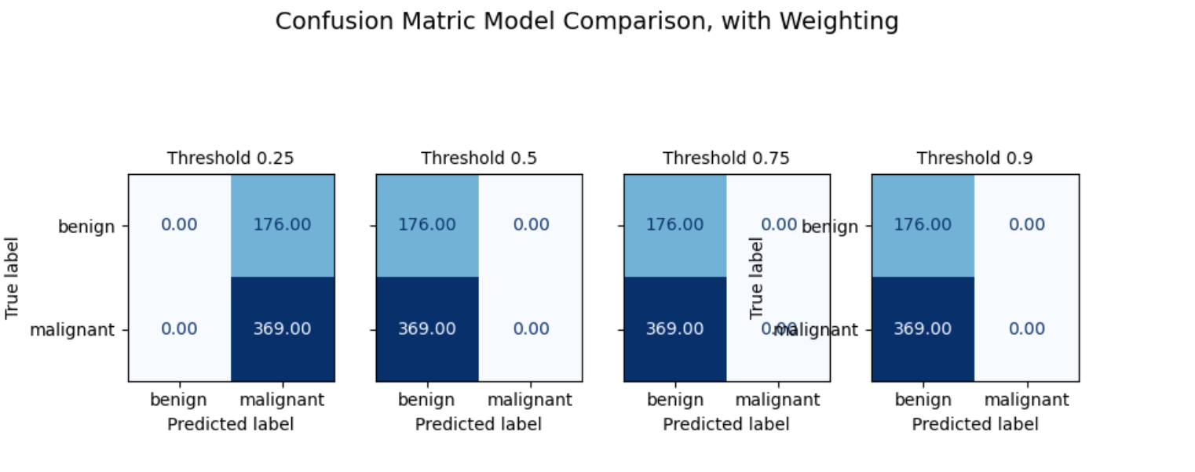
Model Refinement and Testing
Frontier Tech Leaders Programme Global Cohort 1
Generating Confusion Matrices for weighted models

Slide 30
Results
Frontier Tech Leaders Programme Global Cohort 1

Slide 31
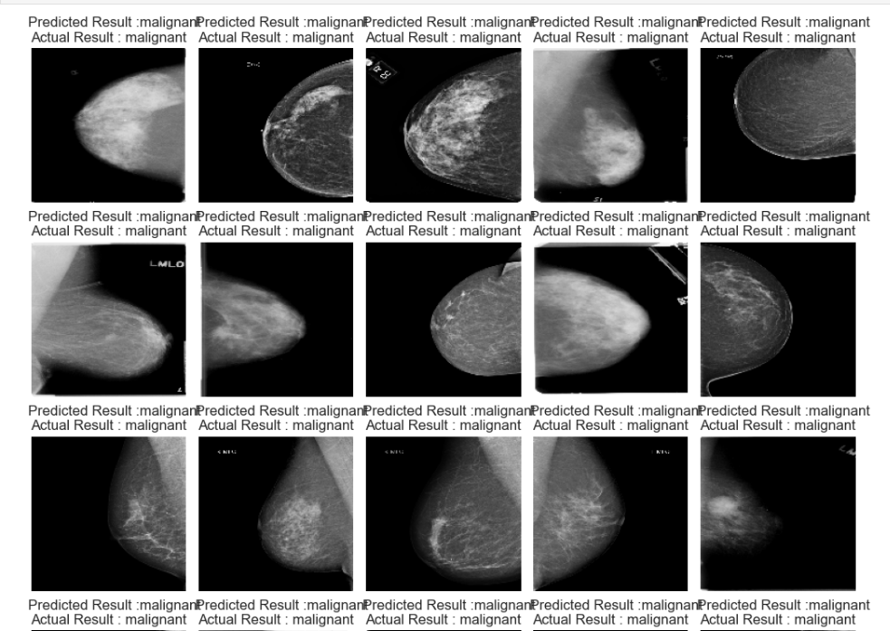
Evaluation Results
Frontier Tech Leaders Programme Global Cohort 1
Correctly Predicted Breast Images

Slide 32
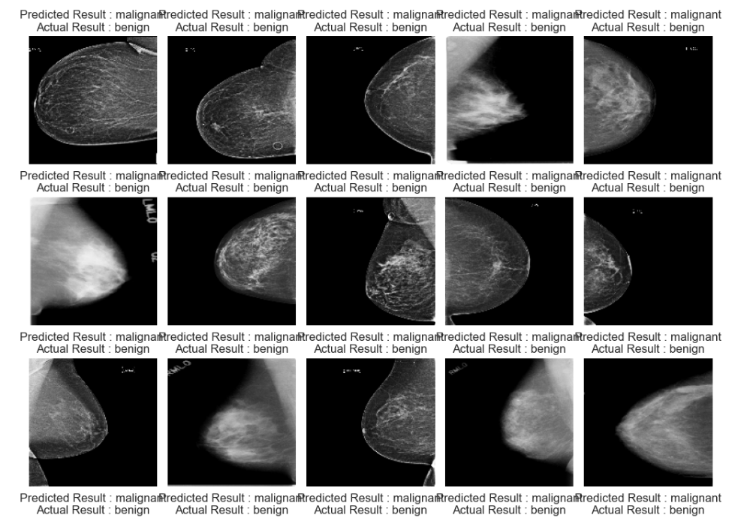
Evaluation Results
Frontier Tech Leaders Programme Global Cohort 1
Incorrectly Predicted Breast Images

Slide 33
Deployment
Frontier Tech Leaders Programme Global Cohort 1
The trained convolutional neural network (CNN) model was serialized using the HDF5 format (model.h5).
Serialization ensures that the model's architecture, weights, and configuration can be restored exactly in the production environment. The model is stored as a .h5 file, which allows for seamless loading and reusability across various platforms without re-training.
The serialized model is served using Django.

Slide 34
Deployment
Frontier Tech Leaders Programme Global Cohort 1
The model.h5 file is loaded in the backend when the web server is initialized. For making predictions, the model is exposed via an API that allows users to send mammography images as input, which are then processed by the model to generate predictions .
TensorFlow was used in the backend to load the pre-trained model for real-time predictions, while React powers the frontend, ensuring a smooth user experience.

Slide 35
Deployment
Frontier Tech Leaders Programme Global Cohort 1
API Integration:
The deployed model is integrated into a RESTful API for prediction services:
• Endpoint: /api/diagnosis/ (POST request)
• Input Format: The API accepts multipart/form-data containing the mammography image file (image field).
• Response Format: The API responds with a JSON object containing the predicted class (Benign or Malignant) and the confidence score of the prediction.

Slide 36
Future Work
Frontier Tech Leaders Programme Global Cohort 1
Our model is biased to predict the majority class Despatie the technique we have used to deal with the imbalance data.
So even with the good model accuracy , the F1 – score is bad. And with believe that due to the type and quality of data we worked with.
As future work suggestion , working with different dataset and different kind of images other than mammography images to predict the breast cancer , to increase f1- score would be better .
improve the chatbot to have a real conversation with the user using NLP and transformers.

Slide 37


Thank you!
Frontier Tech Leaders Programme Global Cohort 1

