Slide 1





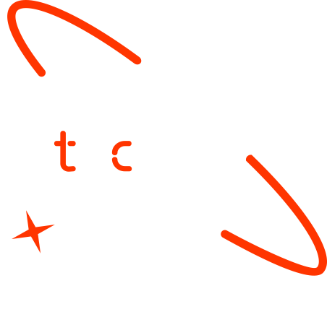

Personalized Learning System for Ethiopian Education
Graduate Name
Mussie Leake Beraki
Liya Tegared Bitew
Yordanos Teku Gutema
Mekdes Birhanu Abera
Dagimawit
Date- Monday, 16 June 2025

Slide 2

Outline
Concept note and implementation plan
Background
Objectives
SDG Relation
Data
Data Collection
Exploratory Data Analysis et Feature Engineering
Model
Model Selection and Training
Model Evaluation and Hyperparameter Tuning
Model Refinement and Testing
Results
Evaluation Results
Deployment
Future Work

Slide 3
Concept note and Implementation Plan
Notes:
FTs like precision agriculture, remote sensing & AI-powered forming equipment can help increase agricultural productivity in LDCs. This can improve fiid security & contribute to the achievement of SDG 2 (Zero Hunger).

Slide 4
Background
In Ethiopia, only a very small percentage of students—approximately 3.2%—successfully pass the Grade 12 University Entrance Examination. This low pass rate highlights significant gaps in access to quality, personalized learning support. Traditional one-size-fits-all approaches often fail to address individual student needs. With the advancement of machine learning, there is a promising opportunity to build intelligent systems that analyze learning behavior and recommend tailored study resources, helping students improve their academic outcomes.
Notes:
FTs like precision agriculture, remote sensing & AI-powered forming equipment can help increase agricultural productivity in LDCs. This can improve fiid security & contribute to the achievement of SDG 2 (Zero Hunger).

Slide 5
Objectives
Develop a machine learning model to recommend personalized learning materials.
Analyze students' learning habits, preferences, and background data.
Improve students' academic performance and preparation for the Grade 12 University Entrance Examination.
Increase the current low pass rate (around 3.2%) by providing tailored academic support.
Lay the foundation for an intelligent, scalable educational recommendation platform.
Notes:
FTs like precision agriculture, remote sensing & AI-powered forming equipment can help increase agricultural productivity in LDCs. This can improve fiid security & contribute to the achievement of SDG 2 (Zero Hunger).

Slide 6

SDG Relation
By analyzing students’ learning patterns and recommending personalized study materials, the system ensures students get the support they need based on their unique needs—not a one-size-fits-all approach.
This makes learning more effective, engaging, and equitable, especially for those who might struggle in traditional classrooms.
As the model is refined and integrated with digital platforms (like mobile apps), it can help students learn anytime, anywhere, supporting lifelong learning
Notes:
FTs like precision agriculture, remote sensing & AI-powered forming equipment can help increase agricultural productivity in LDCs. This can improve fiid security & contribute to the achievement of SDG 2 (Zero Hunger).

Slide 7

SDG Relation
The project demonstrates how machine learning and data science can solve real-world educational problems in Ethiopia.
It encourages innovation in the education system and lays the groundwork for technology-driven infrastructure, such as AI-powered tutoring platforms.
Future integration into mobile apps shows potential to scale efficiently and reach more users with minimal cost
Notes:
FTs like precision agriculture, remote sensing & AI-powered forming equipment can help increase agricultural productivity in LDCs. This can improve fiid security & contribute to the achievement of SDG 2 (Zero Hunger).

Slide 8

SDG Relation
Students in remote or under-resourced areas often lack access to quality teachers and learning materials.
This tool helps level the playing field by offering intelligent academic support based on data, not geography or wealth.
It supports fairer opportunities for all students to succeed on the national university entrance exam, regardless of their background.
Notes:
FTs like precision agriculture, remote sensing & AI-powered forming equipment can help increase agricultural productivity in LDCs. This can improve fiid security & contribute to the achievement of SDG 2 (Zero Hunger).

Slide 9
Data
Notes:
FTs like precision agriculture, remote sensing & AI-powered forming equipment can help increase agricultural productivity in LDCs. This can improve fiid security & contribute to the achievement of SDG 2 (Zero Hunger).

Slide 10
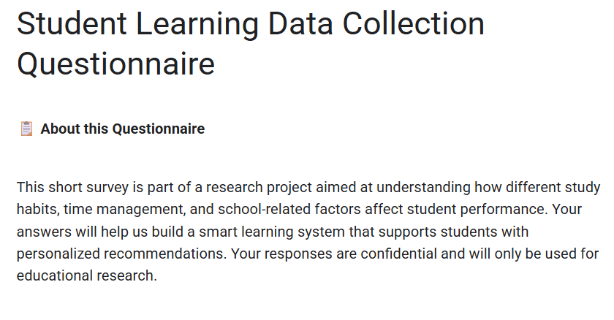
Data Collection
The primary data source for this project will be historical academic records and mock exam
results collected from Grade 12 students across selected Ethiopian high schools. This dataset
includes students’ subject-wise scores, attendance records, demographic details (such as
gender and school type), and self-reported study habits.
Here
Notes:
FTs like precision agriculture, remote sensing & AI-powered forming equipment can help increase agricultural productivity in LDCs. This can improve fiid security & contribute to the achievement of SDG 2 (Zero Hunger).

Slide 11
Exploratory Data Analysis and Feature Engineering
Involved inspecting and cleaning the student dataset to uncover patterns and ensure data quality. Key steps included handling missing values, encoding categorical variables (e.g., mapping internet access and screen time to numeric values), and removing potential data leakage. These engineered features—like cleaned age, time spent on digital entertainment, and type of learning resources—enabled the model to make accurate, personalized predictions about students’ preferred study materials.
Notes:
FTs like precision agriculture, remote sensing & AI-powered forming equipment can help increase agricultural productivity in LDCs. This can improve fiid security & contribute to the achievement of SDG 2 (Zero Hunger).

Slide 12
Model
Notes:
FTs like precision agriculture, remote sensing & AI-powered forming equipment can help increase agricultural productivity in LDCs. This can improve fiid security & contribute to the achievement of SDG 2 (Zero Hunger).

Slide 13
Model Selection and Training
Focused on evaluating different classification algorithms to predict the most effective learning materials for students. Two models—Decision Tree and Random Forest—were tested, with the Random Forest selected for its superior performance. The training process included hyperparameter tuning using GridSearchCV with stratified cross-validation to ensure balanced evaluation. The final model pipeline included data preprocessing (imputation and encoding) and was saved for deployment, along with the selected feature names.
Notes:
FTs like precision agriculture, remote sensing & AI-powered forming equipment can help increase agricultural productivity in LDCs. This can improve fiid security & contribute to the achievement of SDG 2 (Zero Hunger).

Slide 14
Model Evaluation and Hyperparameter Tuning
Model Evaluation and Hyperparameter Tuning used accuracy, F1-score, and balanced accuracy to assess performance. GridSearchCV optimized parameters like n_estimators, max_depth, and min_samples_split using 5-fold stratified cross-validation. Random Forest outperformed Decision Tree, showing higher generalization with minimal overfitting.
Notes:
FTs like precision agriculture, remote sensing & AI-powered forming equipment can help increase agricultural productivity in LDCs. This can improve fiid security & contribute to the achievement of SDG 2 (Zero Hunger).

Slide 15
Model Refinement and Testing
Involved validating the optimized Random Forest model on a held-out test set to ensure robustness. The final model demonstrated consistent performance across metrics, and feature importance analysis confirmed the relevance of selected inputs. Minor preprocessing adjustments were made to align training and inference pipelines.
Notes:
FTs like precision agriculture, remote sensing & AI-powered forming equipment can help increase agricultural productivity in LDCs. This can improve fiid security & contribute to the achievement of SDG 2 (Zero Hunger).

Slide 16
Results
Notes:
FTs like precision agriculture, remote sensing & AI-powered forming equipment can help increase agricultural productivity in LDCs. This can improve fiid security & contribute to the achievement of SDG 2 (Zero Hunger).

Slide 17
Evaluation Results
Results showed that the Random Forest model achieved high accuracy and balanced F1-scores on the test set, indicating reliable prediction across classes. Confusion matrices and classification reports confirmed minimal misclassification, and cross-validation scores validated the model’s generalizability.
Notes:
FTs like precision agriculture, remote sensing & AI-powered forming equipment can help increase agricultural productivity in LDCs. This can improve fiid security & contribute to the achievement of SDG 2 (Zero Hunger).

Slide 18
Deployment
Deployment is partially completed. The backend is fully functional with a working Django REST API that loads the trained model and returns predictions based on user input. While the frontend integration is in progress, the backend can be demonstrated using tools like Postman to showcase real-time prediction results, validating the system's core functionality.
Notes:
FTs like precision agriculture, remote sensing & AI-powered forming equipment can help increase agricultural productivity in LDCs. This can improve fiid security & contribute to the achievement of SDG 2 (Zero Hunger).

Slide 19
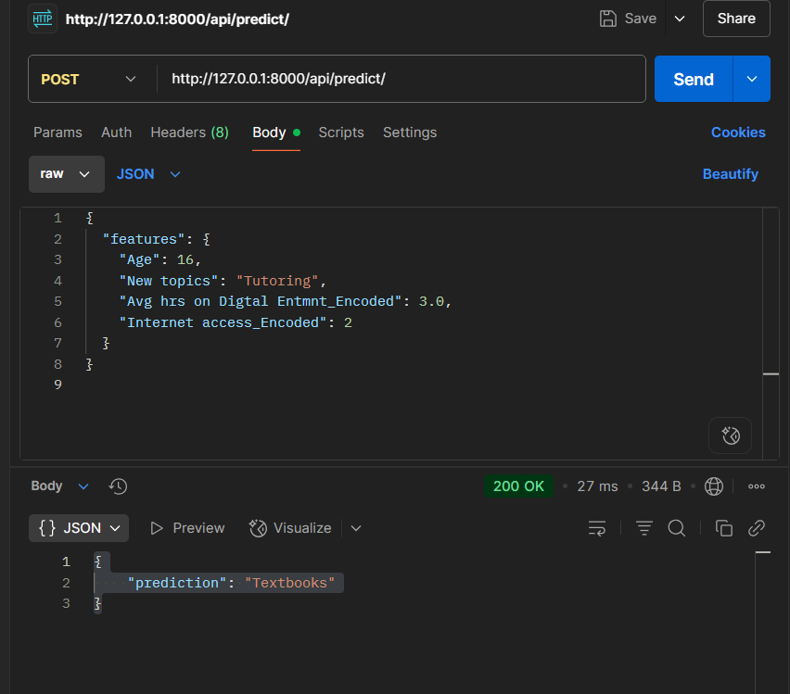
Deployment
Notes:
FTs like precision agriculture, remote sensing & AI-powered forming equipment can help increase agricultural productivity in LDCs. This can improve fiid security & contribute to the achievement of SDG 2 (Zero Hunger).

Slide 20
Future Work
We Plan to developing a more advanced recommendation engine to provide personalized academic guidance based on student behavior and performance trends. Additionally, we plan to extend the platform into a mobile application to increase accessibility and engagement for students across Ethiopia.
Notes:
FTs like precision agriculture, remote sensing & AI-powered forming equipment can help increase agricultural productivity in LDCs. This can improve fiid security & contribute to the achievement of SDG 2 (Zero Hunger).

Slide 21
References
Django Software Foundation. (2024). Django Documentation. https://docs.djangoproject.com/
Raschka, S., & Mirjalili, V. (2022). Python Machine Learning (3rd ed.). Packt Publishing.
Géron, A. (2019). Hands-On Machine Learning with Scikit-Learn, Keras, and TensorFlow (2nd ed.). O'Reilly Media.
Ethiopian Ministry of Education. (2023). Grade 12 National Curriculum Framework.
Notes:
FTs like precision agriculture, remote sensing & AI-powered forming equipment can help increase agricultural productivity in LDCs. This can improve fiid security & contribute to the achievement of SDG 2 (Zero Hunger).

Slide 22

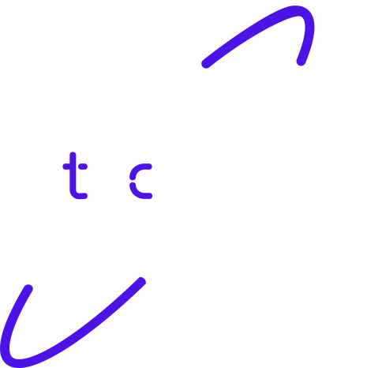
Thank you!

