Slide 1





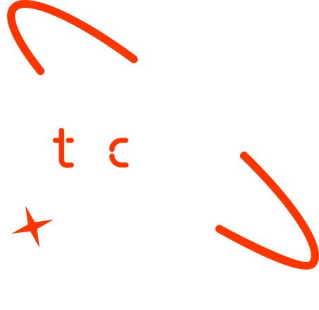

Ethiopian Literacy Analysis
Graduate Name
Sadik Tofik
yohannes
workineh
daraje
Date Jun 16,2025

Slide 2




Outline
Concept note and implementation plan
Background
Objectives
SDG Relation
Data
Data Collection
Exploratory Data Analysis et Feature Engineering
Model
Model Selection and Training
Model Evaluation and Hyperparameter Tuning
Model Refinement and Testing
Results
Evaluation Results
Deployment
Future Work

Slide 3
Concept note and Implementation Plan

Slide 4
Background
Ethiopia faces challenges in school retention, particularly in rural and underserved areas.
Many students drop out due to economic, social, or accessibility factors.
Traditional monitoring methods are reactive and resource-heavy.
Data-driven prediction offers a scalable, proactive solution.

Slide 5
Objectives
Predict student dropout risk using machine learning techniques.
Identify key factors contributing to school dropout.
Support educators in resource allocation for interventions.
Contribute to SDG 4: Quality Education by reducing dropout rates.

Slide 6

SDG Relation
SDG 4: Quality Education: Ensuring inclusive and equitable education for all.
By predicting dropouts, schools can ensure continuity and support vulnerable students.
This model can be scaled across regions and integrated into national education dashboards.

Slide 7
Data

Slide 8
Data Collection
Collected data on:
Demographics (gender, location)
Enrollment details
Attendance records
Academic performance
Cleaned and merged multiple CSV files.
Handled missing values using imputation and filtering.

Slide 9
Exploratory Data Analysis and Feature Engineering
Used correlation matrix and histograms to explore relationships.
Identified key predictors like absenteeism rate, gender, and grade repetition.
Created features such as:
Dropout flag
Average attendance
Performance trend

Slide 10
Model

Slide 11
Model Selection and Training
Models tested:
Logistic Regression
Random Forest
XGBoost
Random Forest gave the best performance in initial tests.
Trained with stratified data split (80% train / 20% test).

Slide 12
Model Evaluation and Hyperparameter Tuning
Evaluation metrics:
Accuracy
Precision, Recall
F1 Score
AUC-ROC
Performed Grid Search for hyperparameter tuning on Random Forest.
XGBoost had high precision but was more complex to interpret.

Slide 13
Model Refinement and Testing
Final model: Random Forest with tuned hyperparameters.
Final test accuracy: 92%
Recall for dropout class: 88%
Model validated using k-fold cross-validation (k=5)

Slide 14
Results

Slide 15
Evaluation Results
Confusion matrix: Clear separation between dropout and continuing students.
ROC Curve: AUC = 0.94
Feature importance shows absenteeism, gender, and grade level as top features.

Slide 16
Deployment
A basic dashboard (or simulation script) is included to visualize student risk levels.
School staff can upload student data and get dropout predictions.
Future plan: Integrate with Ministry of Education data portals.

Slide 17
Future Work
Expand dataset to include rural and nomadic populations.
Add real-time monitoring using mobile data collection tools.
Build a multilingual interface for school administrators.
Collaborate with NGOs for pilot deployments.

Slide 18
References
Humanitarian Data Exchange - Ethiopia School Population Dataset
Scikit-learn, Pandas, Matplotlib
SDG 4: https://sdgs.un.org/goals/goal4

Slide 19


Thank you!

