Slide 1
Biometric Voter Registration System with Facial Recognition
Frontier Tech Leaders Programme Global Cohort 1
Anita Razafindrakotovao
01-07-2024

Slide 2
How to use this template
Frontier Tech Leaders Programme Global Cohort 1
Download the file
Change the name into "Name_Surname_Draft_Presentation"
Do not move the text boxes, keep your text and visuals inside the boxes
Do not change the colors and font type
If you need to change the font size make it consistent and don't use different sizes in one page (biggest 28, smallest 16). Titles always should be 44.
You can duplicate a page if you need more than one pages
Add high quality pictures and their sources. Keep it inside the boxes.
Key color - #2B2551​
Supporting color 1 - #FFC837 ​
Supporting color 2 - #4CA3AA ​
Supporting color 3 - #FFFFFF​
Supporting color 4 - #FF577D
Remove this page before uploading the presentation to your Github repository!

Slide 3
Outline
Frontier Tech Leaders Programme Global Cohort 1
Concept note and implementation plan:
Background
Objectives
SDG Relation
Data
Data Collection
Exploratory Data Analysis (EDA) and Feature Engineering
Model Selection and Training
Model Evaluation and Hyperparameter Tuning
Model Refinement and Testing
Results
Deployment
Future Work

Slide 4
Concept note and implementation plan
Frontier Tech Leaders Programme Global Cohort 1

Slide 5
Background
Frontier Tech Leaders Programme Global Cohort 1
The proposed project centers on implementing a part of technology used in biometric voter registration system which is Facial Recognition.
In many countries, including Madagascar, marginalized communities often face barriers to political participation, leading to unequal representation and decision-making processes. This is due to the population not trusting the electoral system.
By introducing a biometric voter registration system, the electoral process could become more transparent and secure, thereby increasing public trust.

Slide 6
Objectives
Frontier Tech Leaders Programme Global Cohort 1
The main objectives of the project include:
Reduce instances of voter fraud and duplication by implementing a secure biometric system.
Increase voting participation rate by getting voters’ trust.
The machine learning model aims to make a facial recognition of a voter registered on the voters database. The model should be very efficient with high accuracy because errors in the recognition of a voter may lead to very unfortunate results such as the loss of right of a voter.

Slide 7

SDG Relation
Frontier Tech Leaders Programme Global Cohort 1
The project has a relationship with SDG10: Reduced Inequalities. In many countries, marginalized communities often face barriers to political participation, leading to unequal representation and decision-making processes.
By introducing a biometric voter registration system, this project aims to address these inequalities by ensuring that all citizens, regardless of their socio-economic status or background, have equal access to the electoral process.

Slide 8
Data
Frontier Tech Leaders Programme Global Cohort 1

Slide 9
Data Collection
Frontier Tech Leaders Programme Global Cohort 1
The used dataset is called DigiFace-1M dataset which is a collection of over one million diverse synthetic face images for face recognition.
The dataset was downloaded as .zip and it contains 720K images with 10K identities. Each identity has a subfolder labeled by a unique number. For this project we took only 500 identities and each identity has 72 images.
Data folder is then transformed into dataframe of 12528 rows and 3 columns which are the image_path, label (identity folder number) and a randomly generated full name for each identity.

Slide 10
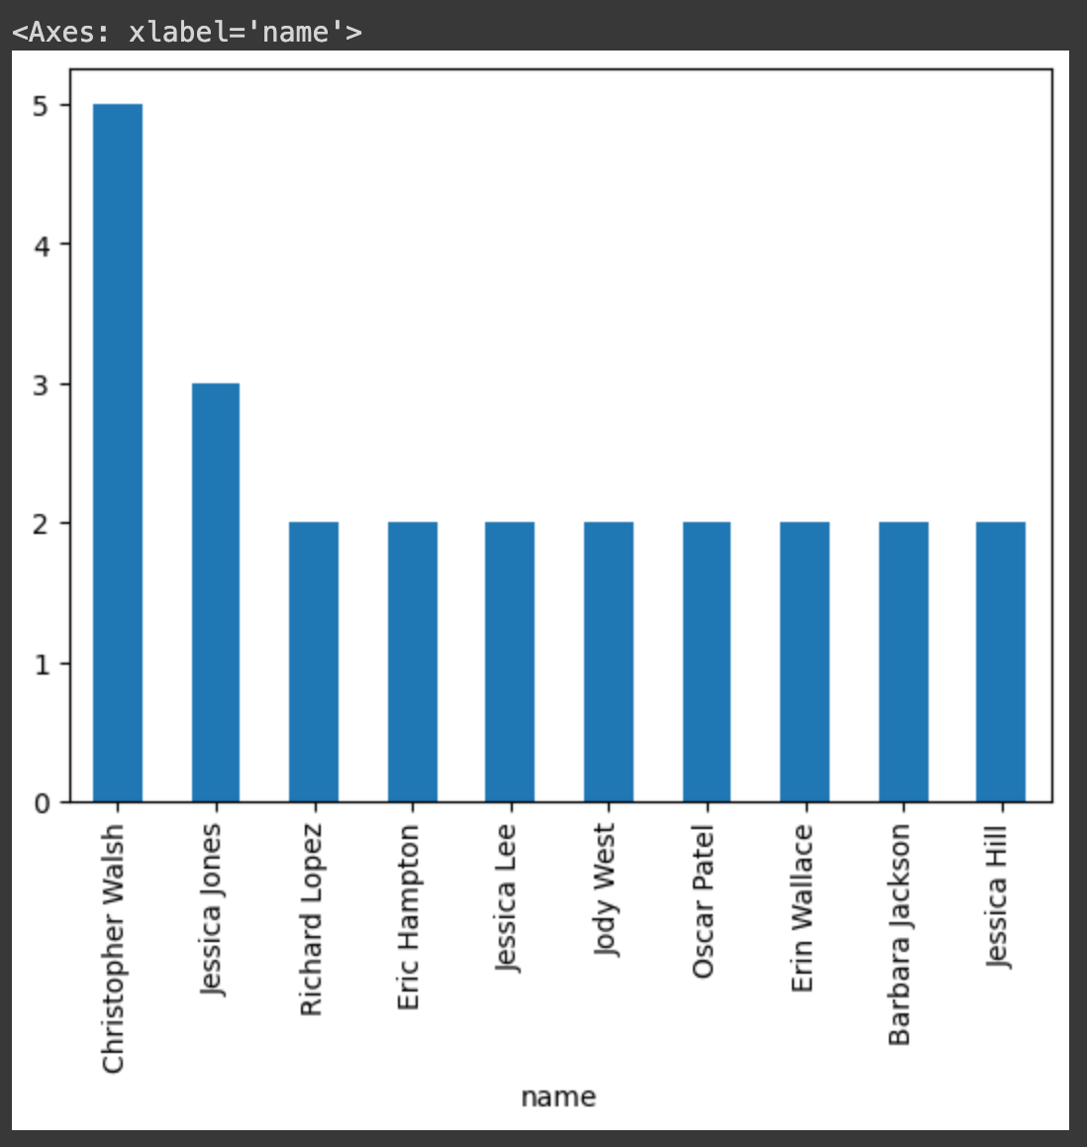
Exploratory Data Analysis (EDA) and Feature Engineering
Frontier Tech Leaders Programme Global Cohort 1
First, each identity has a unique label and a randomly generated name (might be not unique).
An identity is chosen to be labeled positive and the remaining labeled negative. Afterwards the images were moved to the respective folder.
Out of 15328 rows, 4384 were used for training, 3759 for testing and 4385 for validation.

Slide 11
Model
Frontier Tech Leaders Programme Global Cohort 1

Slide 12
Model Selection and Training
Frontier Tech Leaders Programme Global Cohort 1
The selected model is trained with CNN. Convolutional layers are well-suited for image data, providing good feature extraction capabilities.
It is easy to implement due to the relatively small number of layers. However, the risk of overfitting is high for small dataset as the one we used.
Data Augmentation: Applied techniques like rescaling, shear, zoom, and horizontal flip to enhance generalization.
Epochs and Steps: Trained for 8 epochs with 137 steps per epoch to balance between training time and model performance.
Hyperparameters: Conv2D filters: 32, Kernel size: (3, 3), Pool size: (2, 2), Dense units: 128
Activation functions: ReLU for hidden layers, Sigmoid for output layer

Slide 13
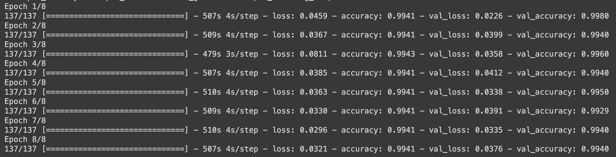
Model Evaluation and Hyperparameter Tuning
Frontier Tech Leaders Programme Global Cohort 1
Metrics:
As metrics of performance, we chose the model accuracy, model loss, and validation accuracy, validation loss.

Slide 14
Model Evaluation and Hyperparameter Tuning
Frontier Tech Leaders Programme Global Cohort 1
The achieved high accuracy on the training set, indicates good learning from the training data.
Also, the continuous reduction in loss values over epochs, reflects the improved model predictions.
Initially epoch value of 10 was used and higher batch size but the model did not learn well so we reduced the steps per epoch also.

Slide 15
Model Refinement and Testing
Frontier Tech Leaders Programme Global Cohort 1
Implemented a function to predict the class of images using the trained classifier.
Created a list of unique test sample names and computed predictions for each class.
Compared the model's predictions to the actual classes to evaluate performance.
Results:
Precision: 0.8034188034188035
Recall: 0.8050847457627118

Slide 16
Results
Frontier Tech Leaders Programme Global Cohort 1

Slide 17
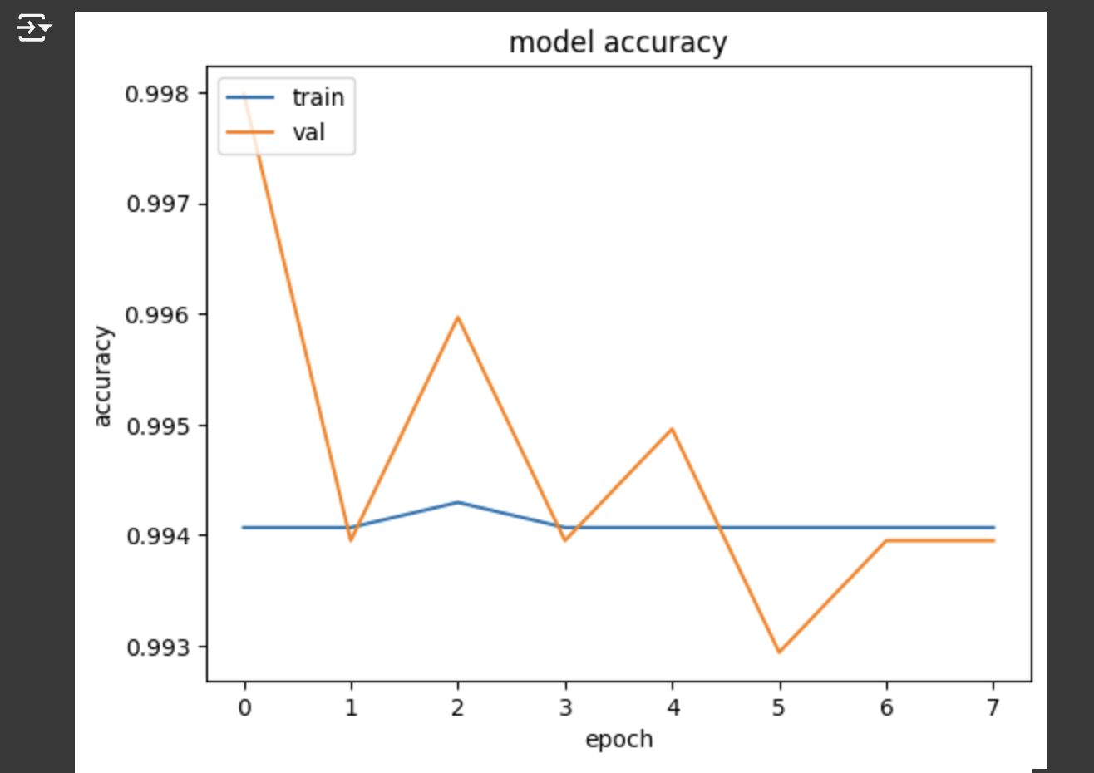
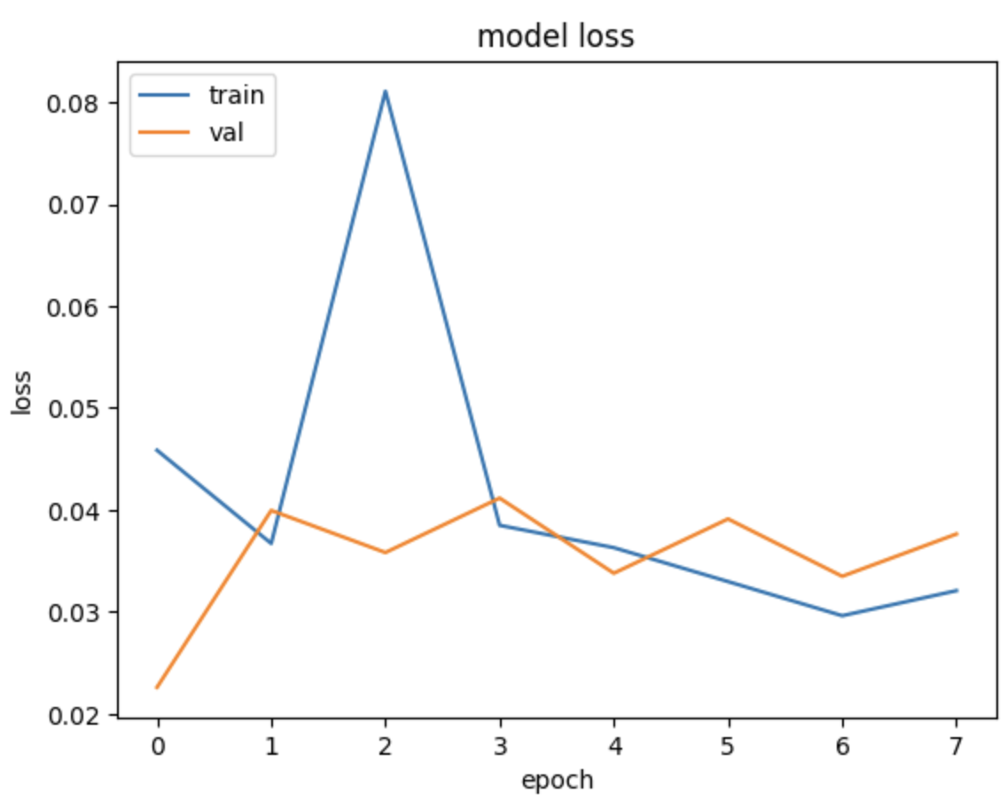
Evaluation Results
Frontier Tech Leaders Programme Global Cohort 1
Model accuracy: 0.9940
Model loss: 0.0321

Slide 18
Deployment
Frontier Tech Leaders Programme Global Cohort 1
Web application or Desktop application for the user interface to Access the model’s API

Slide 19
Future Work
Frontier Tech Leaders Programme Global Cohort 1
Advanced Preprocessing: Implement more sophisticated image preprocessing techniques to handle varying lighting conditions, occlusions
Test model with non synthetic dataset
Develop mobile and web applications to make the system accessible to the user

Slide 20
References
Frontier Tech Leaders Programme Global Cohort 1
DataGen. (2024). From https://datagen.tech/blog/digi-face-1m/
Mohd, F., Satar, S., Mohamed, M., & Hamid, N. (2023). A Secure Online Voting System Using Face Recognition Technology. Malaysian Journal ofComputing and Applied Mathematics, 1-19.
Gwangbin, B., Martin, d., & Tadas, B. (2022). DigiFace-1M: 1Million Digital FAce Images for Face Recognition. Microsoft.

Slide 21


Thank you!
Frontier Tech Leaders Programme Global Cohort 1

