Slide 1
CAPSTONE FINAL PRESENTATION
This Was Not For Me
Detecting gift purchases as a distinct class of noise in e-commerce recommender systems
AI in Marketing Capstone, Group 2 — [Team Member 1] / [Team Member 2] / [Team Member 3]
github.com/edasaruhan/SIC_AI_17_Capstone_Group_2 · 20 September 2026
Every number in this deck is read from committed JSON artefacts · code version 791d9d4
Notes:
Sunumun tek cumlelik iddiasi su: hediye alimlari tavsiye sistemlerinde ayri bir gurultu sinifi ve bunu olcebiliyoruz. Projenin butun sayilari depoya commit edilmis JSON dosyalarindan okunuyor, slaytlara elle yazilmadi. Yirmi bir slayt var: on altisi ana anlati, besi ek. Bir yerde 'bunu nereden biliyorsunuz' sorusu gelirse cevap her zaman bir dosya adi.

Slide 2
THE PROBLEM
A five-star review can describe a taste the buyer does not have
Buyer's own history
a stable, self-chosen taste
+ one gift purchase
reviewed honestly, 5 stars
Model updates the profile
"this user likes that"
Next 10 slots shift
toward the gift's subcategory
Illustrative schematic. No review text is reproduced anywhere in this project's outputs.
The rating is honest.
Nothing is wrong with the review itself — the buyer really did like the item.
The preference signal is not.
The item was chosen for somebody else. It is evidence about a third party.
Nothing in the data marks it.
Purchase-type is not a field. It exists only in free text, if at all.
Recommender research treats noise as accidental — mis-clicks, bots, position bias. A gift is none of those: it is a deliberate, correctly recorded purchase whose preference content belongs to someone who is not in the dataset.
This Was Not For Me · SIC AI 17 Capstone · Group 2
2
Notes:
Buradaki tek mesaj: puan dogru, tercih sinyali yanlis. Kullanici hediyeyi gercekten begenmis olabilir, ama urunu kendisi icin secmemis. Klasik gurultu literaturu kazara olan seyleri konusuyor - yanlis tiklama, bot, konum yanliligi. Hediye bunlarin hicbiri degil: kasitli ve dogru kaydedilmis bir alim, ama tercihi veri kumesinde olmayan birine ait. Sagdaki ucuncu kutu isin zorlugu: veride 'bu hediyedir' diye bir alan yok.

Slide 3
WHY MARKETING SHOULD CARE
The wrong signal does not stay in the model — it becomes spend
+2.0 pts
of the top-10 list is handed to the gift's subcategory
Sequential model × Toys and Games, C0 vs C1, 29,577 test users
0.66
self-purchases before that excess halves
95% CI [0.53, 0.82] · ≈2.4 weeks (approximate)
+4.9 pts
of slots go to gift-only subcategories
Classical model × Toys, waste share C0 − C1, 95% CI [4.76, 5.04] pts
WHERE THE BUDGET LEAKS
Channel | What the contaminated model does | Consequence
On-site recommendations | Reserves slots for a subcategory the customer never buys for themselves | Lower slot productivity; the customer's real next purchase is pushed out
Retargeting / email | Rebuilds the audience around the gift's category | Impressions billed against an interest that does not exist
Lifecycle timing | Reads a December gift peak as a taste shift | Seasonal campaign aimed at the wrong segment
This Was Not For Me · SIC AI 17 Capstone · Group 2
3
Notes:
Bu slayt akademik bulguyu para diline ceviriyor. Sirali modelde tek bir hediye, kullanicinin top-10 listesinin iki puanini hediyenin alt kategorisine ayiriyor; bu fazla, kullanici kendisi icin bir alisveris yaptiktan sonra yariya iniyor. Klasik modelde israf payi daha buyuk: her yuz slottan yaklasik besi yalnizca hediye olarak girilen alt kategorilere gidiyor. Alt tablo uc kanalin her birinde bunun nasil fatura oldugunu gosteriyor. Dikkat: 'israf' bir ust sinir varsayimi - o slotlarin hic donusmedigini olcmedik.

Slide 4
RESEARCH QUESTIONS
Four questions, fixed before the experiment was run
 | Question | How it is answered
RQ1 | How common are gift purchases, and when? | Human-calibrated prevalence per category + month-of-year profile
RQ2 | Does removing gift rows improve prediction of the user's own next purchase? | C1 vs a placebo (C4) that deletes the same NUMBER of random rows
RQ3 | Is it better to delete gifts or to flag them? | C3 (shadow token) against both C1 (delete) and C0 (do nothing)
RQ4 | How long does a recommendation list stay contaminated? | M2 half-life in self-purchases, M1 wasted slot share
The interpretation rule was written down BEFORE any result was seen
A 95 % bootstrap interval that excludes zero in the expected direction → reported as a LOWER BOUND (alt_sınır), because label noise pulls a placebo contrast toward the placebo. An interval containing zero → NOT DETECTABLE (saptanamadı) — never "no effect". An interval excluding zero in the opposite direction → NEGATIVE (negatif), reported as such.
Dated in repo/docs/DECISIONS.md. Thresholds were never edited after a result was seen; the 500 human-labelled rows were never used for tuning.
This Was Not For Me · SIC AI 17 Capstone · Group 2
4
Notes:
Dort soru ve her birinin nasil cevaplandigi. En onemli kisim alttaki kutu: yorum kurali sonuclari gormeden yazildi ve tarihi DECISIONS.md'de duruyor. Uc olasi karar var - alt sinir, saptanamadi, negatif. 'Saptanamadi' asla 'etki yok' demek degil; bunu sunum boyunca ayni dikkatle soyluyoruz. Etiket gurultusu plasebo karsitligini plasebonun lehine cektigi icin pozitif bulgularin hepsi alt sinir olarak raporlaniyor, yani gercek etki en az bu kadar.

Slide 5
HOW IT WAS BUILT
One pipeline: a big model teaches a small one, then the small one labels everything
Amazon Reviews 2023
4 categories · 35,905,069 raw reviews
Teacher: Qwen3-4B-Instruct-2507
prompt v3 · vllm on 2×T4 · 47,200 labels
Human check
500 rows, 5-class schema, 1 annotator
Student: ModernBERT-base
fidelity gate PASS · 4,598,612 rows labelled
RecBole experiment
6 conditions × 2 models × 3 seeds = 72 runs
FROM RAW REVIEWS TO A TRAINABLE CORPUS
Category | Raw reviews | After 5-core | Role in the study
Toys and Games | 16,260,406 | 2,164,018 | High-gift treatment category
Grocery and Gourmet Food | 14,318,520 | 2,434,594 | Low-gift control category
Video Games | 4,624,615 | 368,476 | Detector validation only
All Beauty | 701,528 | 0 | Detector only — 5-core is empty, so no experiment is possible
Filters, in order: verified purchase → at least 5 words of text → de-duplication → 5-core on users and items. Only the two experiment categories were labelled at full scale; the distilled student exists because labelling 4.6 M rows with the teacher was not affordable.
This Was Not For Me · SIC AI 17 Capstone · Group 2
5
Notes:
Boru hattini bir bakista anlatan slayt. Buyuk model dort kategoriden orneklenmis kirk yedi bin review'u etiketliyor; bes yuz satiri insan bagimsiz etiketliyor; sonra damitilmis kucuk model dort buçuk milyon satirin tamamini etiketliyor. Neden damitma? Ogretmen modelle dort bucuk milyon satir etiketlemek Kaggle butcesinde mumkun degildi. Alt tabloda dikkat cekilecek satir All Beauty: bes-cekirdek filtresinden sonra hicbir satir kalmiyor, o yuzden o kategoride deney yapilamiyor - bunu gizlemiyoruz, tabloya yaziyoruz.

Slide 6
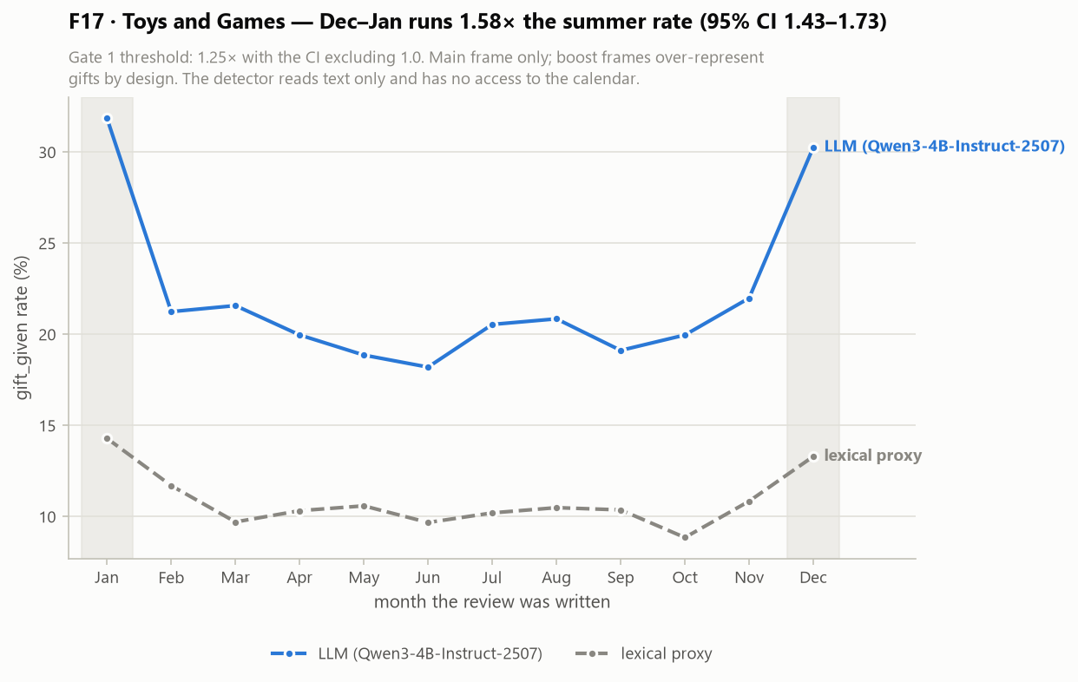
DETECTION · GATE 1
The detector had to earn its use — four criteria, all fixed in advance
GATE 1 — ALL FOUR CATEGORIES
Criterion | Threshold | Toys
1 · December–January vs summer | ≥ 1.25× | 1.58×
2 · Found beyond the keyword proxy | ≥ 1% | 18.0%
3 · Schema health (parse, class mix) | no failure | pass
4 · 200-row trial agreement | ≥ 0.7 | 0.835
VERDICT PER CATEGORY
Toys & Games
PASS 4/4
Grocery & Gourmet Food
PASS 4/4
Video Games
PASS 4/4
All Beauty
PASS 4/4
F17 · Toys and Games: LLM label rate vs the lexical keyword proxy, by month
Seasonality is the criterion a keyword list cannot fake: it is a property of the calendar, not of the wording.
This Was Not For Me · SIC AI 17 Capstone · Group 2
6
Notes:
Dedektorun kullanilabilir olup olmadigina bakan Kapi 1. Dort olcut de kosudan once sabitlendi ve dort kategoride de dorduyle gecti. En ikna edici olcut mevsimsellik: Aralik-Ocak orani yaz aylarinin bir buçuk kati; bir anahtar kelime listesi takvimi taklit edemez. Ikinci olcut de onemli: etiketlerin yuzde on sekizi sozcuksel vekilin hic yakalamadigi satirlardan geliyor, yani model kelime aramanin otesine geciyor. Grafikte iki egri: LLM etiketi ve vekil.

Slide 7
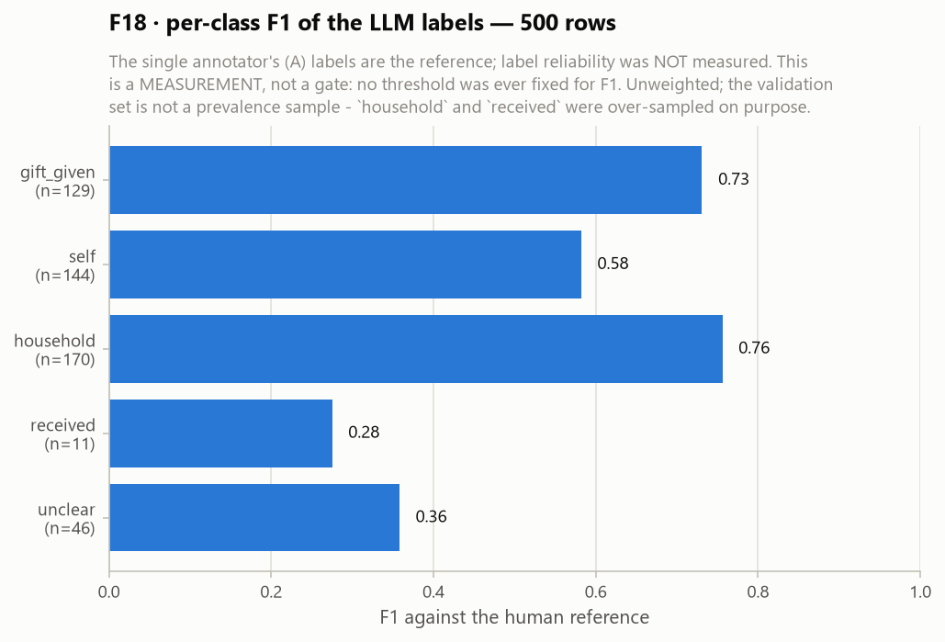
HONESTY SLIDE · WEEK 4
The detector did not meet its own accuracy thresholds. We report that first.
Two pre-registered gates were MISSED
macro-F1 ≥ 0.75 → measured 0.5404 [0.4897, 0.5869]
gift precision ≥ 0.80 → measured 0.68 (recall 0.79, F1 0.7312)
Week-4 verdict recorded in the artefact: INCOMPLETE
Label reliability was never measured
Planned: 3 annotators, Fleiss kappa ≥ 0.6. Actual: 1 annotator, so no agreement statistic exists.
Why the study is still readable
Label noise makes a gift-deletion condition look MORE like its random-deletion placebo, not less. So every effect on the next slides is a lower bound, and the direction cannot be an artefact of a weak detector.
F18 · per-class F1 of the LLM labels against 500 independently human-labelled rows
This Was Not For Me · SIC AI 17 Capstone · Group 2
7
Notes:
Bu slaydi atlamiyoruz, aksine one aliyoruz. Concept note'ta iki esik yazmisiz: makro-F1 en az sifir yetmis bes ve hediye kesinligi en az sifir seksen. Olculen degerler sifir elli dort ve sifir altmis sekiz - ikisi de tutmuyor. Ayrica tek etiketleyici calisti, yani planlanan Fleiss kappa hic olculmedi; Hafta 4'un artefakttaki karari INCOMPLETE. Peki calisma neden hala okunabilir? Cunku etiket gurultusu hediye-silme kosulunu rastgele-silme plasebosuna YAKLASTIRIR; yani bulunan etki gercek etkinin alt siniri. Zayif dedektor bulgunun yonunu uydurmaz, ancak buyuklugunu kucultur.

Slide 8
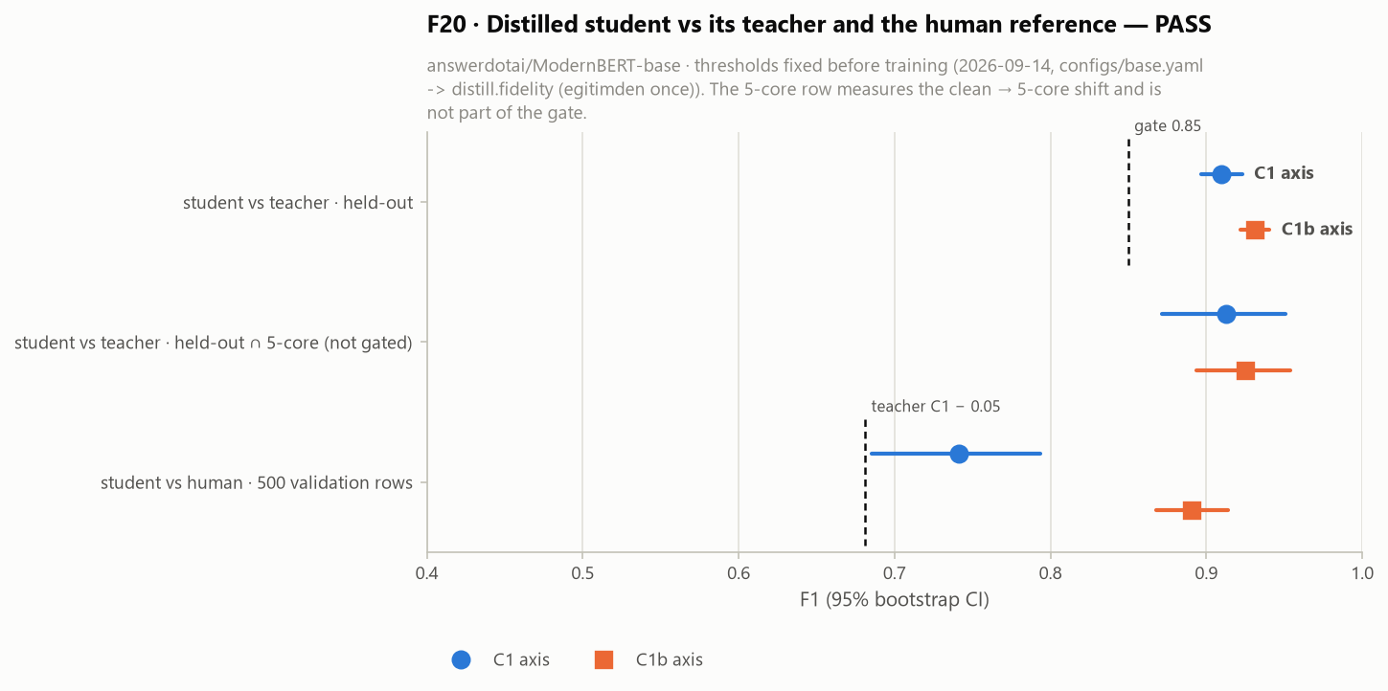
DISTILLATION · FIDELITY GATE
A distilled student reproduced the teacher's labels closely enough to scale
FIDELITY GATE — 3 CRITERIA, FIXED BEFORE TRAINING
Criterion | Threshold | Measured
F1 vs teacher, narrow axis (C1) | ≥ 0.85 | 0.9098
F1 vs teacher, broad axis (C1b) | ≥ 0.85 | 0.9313
Not worse than teacher vs human | drop ≤ 0.05 | 0.7415 vs 0.7312
GATE PASS · 3/3
What this does and does not say
Trained on 41,988 teacher labels, checked on 4,667 held-out rows, then run over 4,598,612 interactions (2,164,018 Toys + 2,434,594 Grocery).
The gate measures agreement with the TEACHER, not correctness. The student inherits the teacher's errors — which is exactly why the accuracy limits on the previous slide still apply at 4.6 M rows.
F20 · student vs teacher on the held-out split
This Was Not For Me · SIC AI 17 Capstone · Group 2
8
Notes:
Dort buçuk milyon satiri ogretmen modelle etiketlemek mumkun olmadigi icin ModernBERT-base'i ogretmenin etiketleriyle egittik. Sadakat kapisi uc olcutle ve egitimden once sabitlendi; uçu de gecti - dar eksende sifir doksan bir, geniş eksende sifir doksan uc F1. Kritik nuans sagdaki son paragraf: bu kapi DOGRULUGU degil OGRETMENE BENZERLIGI olcuyor. Ogrenci ogretmenin hatalarini da devraliyor, yani onceki slayttaki dogruluk siniri dort buçuk milyon satirda da gecerli.

Slide 9
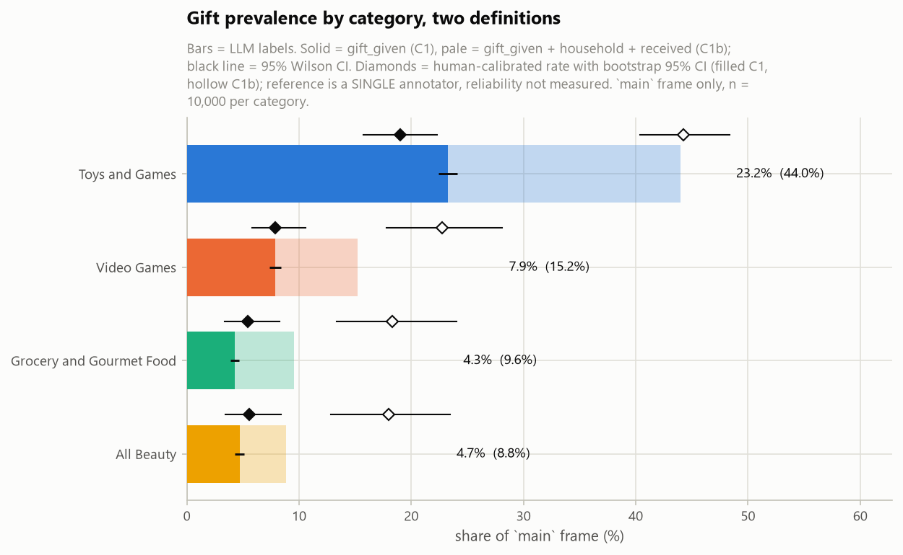
RESULT 1 · PREVALENCE
RQ1 · About one in five Toys reviews is a gift — and every category peaks in December
Category | Calibrated | 95 % CI | Raw LLM
Toys & Games | 19.0% | [15.8, 22.3] | 23.2%
Grocery | 5.4% | [3.4, 8.3] | 4.3%
Video Games | 7.9% | [5.8, 10.6] | 7.9%
All Beauty | 5.5% | [3.4, 8.4] | 4.7%
DECEMBER–JANUARY ÷ SUMMER
Toys & Games 1.58× [1.43, 1.73]
Grocery 1.71× [1.33, 2.23]
Video Games 2.08× [1.74, 2.49]
All Beauty 2.06× [1.61, 2.63]
Calibration maps the LLM's raw rate through the confusion matrix measured on the 500 human rows, so the interval carries the detector's error — this is why Toys moves from 23.2 % to 19.0 %.
F19 · human-calibrated prevalence, narrow (gift_given) axis
This Was Not For Me · SIC AI 17 Capstone · Group 2
9
Notes:
Ilk sonuc: Toys ve Games'te review'larin yaklasik besde biri hediye. Grocery, Video Games ve All Beauty yuzde bes ile sekiz arasinda - Grocery'yi tam da bu yuzden kontrol kategorisi sectik. Sagdaki ham ve kalibre edilmis sutun farkina dikkat: kalibrasyon, LLM'in ham oranini bes yuz insan satirinda olculen karisiklik matrisinden geciriyor, boylece dedektorun hatasi guven araligina giriyor. Toys yuzde yirmi uçten yuzde on dokuza duşuyor. Alt kisimda dort kategorinin de Aralik-Ocak tepesi var.

Slide 10
DESIGN · WHY A PLACEBO
Deleting gifts also deletes data — so the comparison must hold the data loss fixed
C0 · do nothing
all rows kept
C1 · delete gifts
n gift rows removed
C4 · PLACEBO
the same n RANDOM rows removed
C1 vs C0 cannot answer RQ2
Two things change at once: the gift rows are gone AND the training set is smaller. A drop could be the missing rows; a gain could be luck.
C1 vs C4 can
Identical training-set size, identical test pairs, same seeds. The only difference is WHICH rows went. Positive means gift rows were worth less than random rows.
ALL SIX CONDITIONS
C0 | C1 | C4 | C1b | C4b | C3
baseline nothing removed | narrow gift_given removed | placebo for C1 same n, random | broad + household, received | placebo for C1b same n, random | flag, don't delete shadow token
C2 (down-weighting) was specified but not run: RecBole's SASRec loss does not accept per-interaction weights without patching the library, and patching it would have broken the "same code for every condition" rule.
This Was Not For Me · SIC AI 17 Capstone · Group 2
10
Notes:
Deneyin en onemli tasarim karari bu. Hediyeleri silmek ayni zamanda veriyi kuçultuyor, o yuzden C1'i C0 ile karsilastirmak iki seyi ayni anda degistiriyor. Cozum plasebo: C4 ayni SAYIDA rastgele satiri siliyor. Boylece egitim kumesi buyuklugu, test ciftleri ve seed'ler birebir ayni kaliyor; tek fark hangi satirlarin gittigi. Alt satirda alti kosulun tanimi var. C2 yani agirlik azaltma yazildi ama kosulmadi: RecBole'un SASRec kaybi etkilesim basina agirlik almiyor, kutuphaneyi yamamak da 'her kosulda ayni kod' kuralini bozacakti.

Slide 11
VALIDITY
Gate 2 · the setup is valid in all four cells, so the contrasts mean something
Criterion | What it rules out | Toys · SASRec | Toys · BPR | Grocery · SASRec | Grocery · BPR
1 · Every run scored on the same test pairs | Comparing different test sets | PASS | PASS | PASS | PASS
2 · Each condition's item universe ⊆ C0's | A condition inventing items | PASS | PASS | PASS | PASS
3 · Neither placebo is BETTER than C0 | Deletion helping by itself | PASS | PASS | PASS | PASS
4 · C0 seed-to-seed CV < 0.1 | Runs too unstable to compare | PASS · 0.012 | PASS · 0.025 | PASS · 0.005 | PASS · 0.002
CRITERION 3 IN NUMBERS — NEITHER PLACEBO IS BETTER THAN C0 (THE CI'S UPPER END MAY TOUCH ZERO, BUT NEVER RISES ABOVE IT)
Cell | C4 − C0, Recall@10 | C4b − C0, Recall@10
Toys · SASRec | -0.008510 [-0.0092, -0.0079] | -0.022462 [-0.0234, -0.0216]
Toys · BPR | -0.004109 [-0.0046, -0.0036] | -0.010853 [-0.0114, -0.0103]
Grocery · SASRec | -0.000201 [-0.0005, 0.0001] | -0.001638 [-0.0020, -0.0013]
Grocery · BPR | -0.000235 [-0.0005, 0.0000] | -0.001357 [-0.0017, -0.0011]
18 runs per cell, 72 in total. Criterion 1 is enforced by a SHA-256 hash of the test pairs written into every run report — one distinct hash per cell, checked by the gate rather than assumed.
This Was Not For Me · SIC AI 17 Capstone · Group 2
11
Notes:
Kapi 2, sonuclari yorumlamaya hakkimiz olup olmadigini soruyor ve dort hucrede de dort olcutuyle geciyor. En onemli olcut ucuncusu: hicbir plasebo C0'dan IYI olmamali, cunku veri silmek tek basina yardim ediyorsa butun tasarim coker. Alt tabloda bu sayilar var; Toys'ta guven araliklari sifirin acikca altinda, Grocery'de sifira degiyor ama uzerine cikmiyor - kapinin istedigi tam olarak bu. Birinci olcut de varsayim degil: her kosu raporuna test ciftlerinin SHA-256 ozeti yaziliyor ve kapi hucre basina tek bir ozet oldugunu dogruluyor. Dorduncusu C0'in seed'ler arasi degisim katsayisi; hepsi esigin cok altinda. Hucre basina on sekiz, toplam yetmis iki kosu.

Slide 12
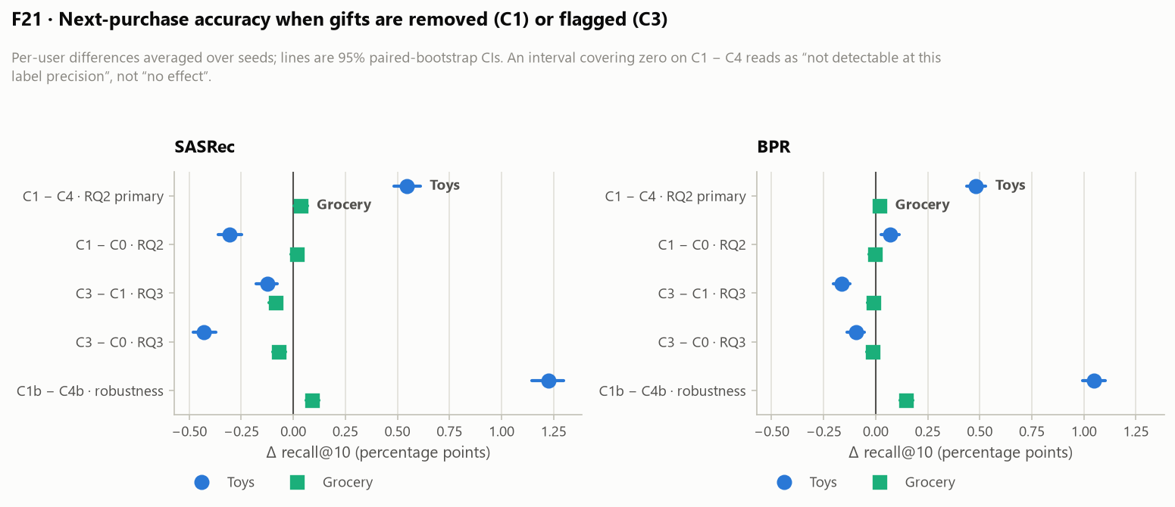
RESULT 2 · THE CORE FINDING
RQ2 · Removing gifts beats removing the same number of random rows
C1 − C4, RECALL@10 (PRIMARY)
Cell | Δ | 95 % CI | Rel. | Rule
Toys · SASRec | +0.005449 | [0.0048, 0.0061] | +15.7% | lower bound
Toys · BPR | +0.004822 | [0.0044, 0.0053] | +40.0% | lower bound
Grocery · SASRec | +0.000360 | [0.0000, 0.0007] | +1.2% | lower bound
Grocery · BPR | +0.000201 | [-0.0001, 0.0005] | +1.4% | not detectable
DOSE–RESPONSE: TOYS − GROCERY
Model | Axis | Δ | 95 % CI
SASRec | C1-C4 | +0.005089 | [0.0044, 0.0058]
SASRec | C1b-C4b | +0.011330 | [0.0106, 0.0121]
BPR | C1-C4 | +0.004621 | [0.0041, 0.0052]
BPR | C1b-C4b | +0.009001 | [0.0084, 0.0096]
F21 · per-cell contrasts with 95 % paired-bootstrap intervals
All four dose–response intervals exclude zero: the effect is larger where gifts are more common. That is the pattern a real mechanism produces.
This Was Not For Me · SIC AI 17 Capstone · Group 2
12
Notes:
Projenin ana bulgusu. Veri kaybi sabit tutuldugunda hediye satirlarini silmek, ayni sayida rastgele satiri silmekten daha iyi bir model biraikiyor: Toys'ta sirali modelde yuzde on alti, klasik modelde yuzde kirk rölatif kazanc. Kontrol kategorisi Grocery'de etki ya cok kuçuk ya saptanamiyor. Alt tablodaki doz-yanit bunun tesaduf olmadiginin en guclu isareti: dort karsilastirmanin dordunde de Toys'un etkisi Grocery'ninkinden istatistiksel olarak buyuk. Hediye ne kadar yaygınsa etki o kadar buyuk - gercek bir mekanizmanin uretecegi desen bu.

Slide 13
RESULT 2B · THE HONEST CAVEAT
But "better than the placebo" is not "better than doing nothing"
The placebo contrast isolates the mechanism. The C1 − C0 contrast is what a practitioner would actually feel.
Cell | C1 − C4 (vs placebo) | Rule | C1 − C0 (vs doing nothing) | Rule | C1b − C4b (broad axis) | Rule
Toys · SASRec | +0.005449 +15.7% | lower bound | -0.003061 -7.1% | negative | +0.012253 +59.3% | lower bound
Toys · BPR | +0.004822 +40.0% | lower bound | +0.000713 +4.4% | positive | +0.010473 +197.4% | lower bound
Grocery · SASRec | +0.000360 +1.2% | lower bound | +0.000159 +0.5% | CI includes zero | +0.000923 +3.2% | lower bound
Grocery · BPR | +0.000201 +1.4% | not detectable | -0.000034 -0.2% | CI includes zero | +0.001472 +11.2% | lower bound
The mechanism is real
C1 − C4 excludes zero in three of four cells, and the dose–response holds. Gift rows carry less usable preference signal than random rows.
The net gain is model-dependent
On Toys, deleting gifts outright helps BPR (+4.4%) but hurts SASRec (-7.1%) — the sequence model loses context with the rows.
Widening the definition widens the gap
C1b − C4b is larger than C1 − C4 in all four cells, which is consistent with household and received purchases carrying the same kind of noise.
This Was Not For Me · SIC AI 17 Capstone · Group 2
13
Notes:
Bu slayt bulguyu abartmamak icin var. Plaseboya karsi kazanmak, hiçbir sey yapmamaya karsi kazanmak demek degil. Ortadaki tabloda C1 eksi C0 sutununa bakin: Toys'ta klasik model kazaniyor ama sirali model KAYBEDIYOR - sirali model silinen satirlarla birlikte baglami da kaybediyor. Yani 'hediyeleri sil' diye bir tavsiye vermiyoruz; 'hediye satirlari daha az tercih sinyali tasiyor' diyoruz. Ucuncu kutu ilginç: geniş eksende fark daha da buyuyor, bu da ev halki ve alinan hediye kategorilerinin ayni tur gurultuyu tasidigiyla tutarli.

Slide 14
RESULT 3 · DELETE OR FLAG?
RQ3 · Flagging with a shadow token was worse than both alternatives
C3 keeps every gift row but replaces the item with a per-subcategory shadow token, so the model can learn "something happened here" without learning the item.
Cell | C3 − C1 (flag vs delete) | Rule | C3 − C0 (flag vs nothing) | Rule
Toys · SASRec | -0.001235 [-0.0018, -0.0008] | negative | -0.004296 [-0.0048, -0.0037] | negative
Toys · BPR | -0.001647 [-0.0020, -0.0012] | negative | -0.000934 [-0.0014, -0.0005] | negative
Grocery · SASRec | -0.000850 [-0.0012, -0.0005] | negative | -0.000691 [-0.0010, -0.0004] | negative
Grocery · BPR | -0.000102 [-0.0004, 0.0002] | CI includes zero | -0.000135 [-0.0004, 0.0001] | CI includes zero
What we found
Negative against deletion in three of four cells, and against doing nothing in three of four. The shadow token adds vocabulary and sequence positions without adding information the model can use.
What we are NOT claiming
That flagging is a bad idea in general. One implementation was tested: a per-subcategory shadow token in the item sequence. Type-aware embeddings, a separate purchase-type channel, or loss re-weighting were not tested.
This Was Not For Me · SIC AI 17 Capstone · Group 2
14
Notes:
Ucuncu soru pratik: silmek mi, isaretlemek mi? Test ettigimiz isaretleme yontemi, hediye satirini tutup urunu alt kategori basina bir golge token'la degistirmek. Sonuç: dort hucrenin uçunde silmekten de, hiçbir sey yapmamaktan da kotu. Golge token modele kullanabilecegi bilgi eklemeden kelime dagarcigi ve sira pozisyonu ekliyor. Sagdaki kutu onemli: 'isaretleme kotu bir fikirdir' demiyoruz - TEK bir uygulamayi test ettik. Tur-farkindali gomme vektorleri ya da ayri bir alim-turu kanali denenmedi.

Slide 15
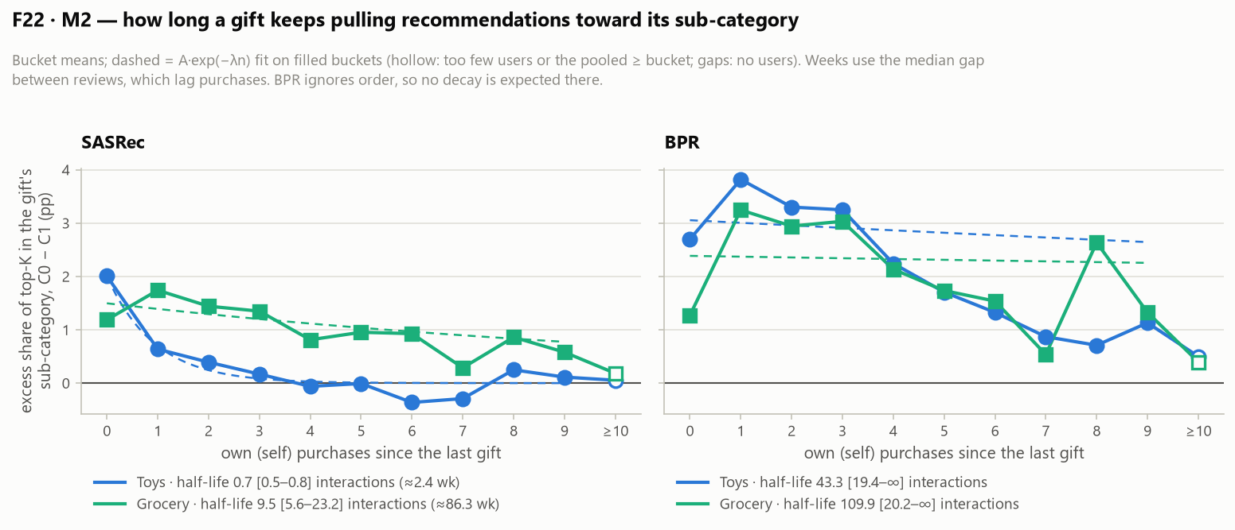
RESULT 4 · HOW LONG IT LASTS
RQ4 · The excess halves after about one self-purchase — roughly two to four weeks
0.66
self-purchase half-life
95 % CI [0.53, 0.82]
≈2.4 wk
approximate calendar time
review date ≠ purchase date
Read it like this
A gift opens +2.0 pts of extra top-10 share for its subcategory. After one purchase the user makes for themselves, less than half of that is left; after four it is gone.
BPR shows decay too, but the pre-registered fit gives no finite half-life: the gift is DILUTED by later purchases rather than forgotten, because BPR never sees order.
F22 · excess top-10 share for the gift's subcategory vs the number of self-purchases after the gift, with the pre-registered exponential fit
This Was Not For Me · SIC AI 17 Capstone · Group 2
15
Notes:
Pazarlama icin en kullanisli sayi bu. Sirali modelde bir hediye, hediyenin alt kategorisine top-10'da iki puan fazla yer aciyor. Kullanici kendisi icin BIR alisveris yaptiktan sonra bu fazlanin yarisindan azi kaliyor, dort alimdan sonra sifirlaniyor. Takvime cevirisi kabaca iki-dort hafta ama bu YAKLASIK, cunku elimizde review tarihi var, alim tarihi yok. BPR'de de azalma var ama onceden kayitli uyum sonlu bir yari omur vermiyor: BPR sirayi gormedigi icin hediye unutulmuyor, yeni alimlar arasinda SEYRELIYOR. Pazarlama dilinde: kirlilik zamanla degil, yeni alimlarla temizleniyor.

Slide 16
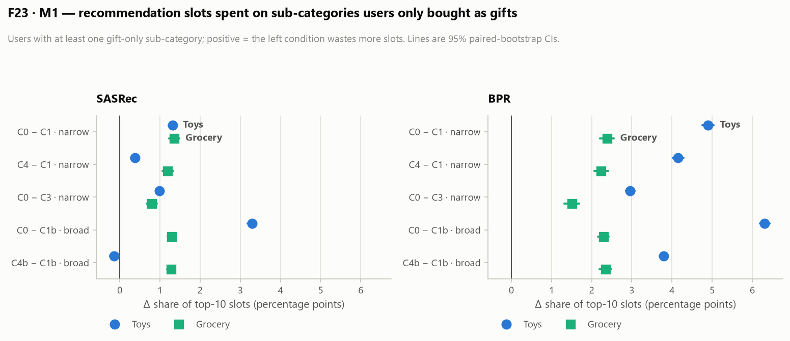
RESULT 4B · WASTED SLOTS
RQ4 · In the classical model, roughly one slot in twenty goes to gift-only interest
Cell | C0 − C1 | C4 − C1 (net of data loss)
Toys · SASRec | +1.3 pts [1.22, 1.41] | +0.4 pts [0.28, 0.47]
Toys · BPR | +4.9 pts [4.76, 5.04] | +4.2 pts [4.02, 4.29]
Grocery · SASRec | +1.4 pts [1.23, 1.48] | +1.2 pts [1.06, 1.33]
Grocery · BPR | +2.4 pts [2.21, 2.56] | +2.2 pts [2.07, 2.41]
What the numbers say
On Toys, 32% of test users have a subcategory they entered only as a gift. The classical model gives 16.3% of their top-10 to it; the gift-free model gives 11.4%.
Holding data loss fixed (C4 − C1) keeps most of that gap in the classical model but almost none of it in the sequential one.
"Waste" is an upper bound by construction: we did not measure whether those slots convert. A customer may later buy in that subcategory for themselves.
F23 · share of top-10 slots drawn from subcategories the user entered only as a gift
This Was Not For Me · SIC AI 17 Capstone · Group 2
16
Notes:
Ikinci pazarlama metrigi: top-10'un yalnizca hediye olarak girilen alt kategorilere giden payi. Toys'ta test kullanicilarinin ucte birinde boyle bir alt kategori var. Klasik model bu kullanicilarin listesinin yuzde on altisini oraya ayiriyor, hediyeleri gormemis model yuzde on birini - yani her yuz slottan bes tanesi hediyenin actigi ilgiye gidiyor. Veri kaybi sabit tutuldugunda klasik modelde bu farkin buyuk kismi kaliyor, sirali modelde neredeyse hiç kalmiyor. Ve dipnot: 'israf' bir ust sinir - o slotlarin hiç donusmedigini olcmedik.

Slide 17
CLOSING
What we claim, what we do not, and what comes next
We claim
• Gift purchases are measurable at scale, and common: 19 % of Toys reviews.
• Gift rows carry less usable preference signal than random rows, with a dose–response across two categories.
• A gift's excess recommendation share halves after about one self-purchase in the sequential model.
• The one flagging method we tested is worse than deleting.
We do not claim
• That the detector is accurate: macro-F1 0.54 against one annotator, both pre-registered gates missed.
• That deleting gifts is a recommended production change — the net effect against doing nothing is model-dependent.
• That this generalises beyond two Amazon categories, two models and English-language reviews.
• That wasted slots are lost revenue; conversion was never measured.
Next, in order of value
• A second and third annotator on the same 500 rows, and the Fleiss κ the design asked for.
• Purchase-type as a model input instead of a deletion rule — the C2 that RecBole would not run.
• A held-out category the detector never saw during prompt development.
• Conversion-linked data, so "waste" becomes a measured cost.
Everything on these slides is reproducible from the repository
python repo/scripts/demo.py — prints every headline number above from the committed JSON artefacts, with no data files and no dependencies beyond the standard library. github.com/edasaruhan/SIC_AI_17_Capstone_Group_2 code version 791d9d4
This Was Not For Me · SIC AI 17 Capstone · Group 2
17
Notes:
Kapanis slaydi uç sutun: ne iddia ediyoruz, ne iddia etmiyoruz, sirada ne var. Ortadaki sutunu hizla geçmeyin - jurinin soracagi her soru orada zaten yazili. Alttaki kutu davetiye: depoyu klonlayip tek komutla butun basliklari basabilirsiniz, veri dosyasi bile gerekmiyor cunku sayilar commit'li JSON'lardan okunuyor. Soru-cevap icin bes ek slayt var: kosul tanimlari, iki kapinin olcutleri, tam karsitlik tablosu, sinirliliklar ve yeniden uretim.

Slide 18
APPENDIX
A1 · The six conditions, exactly as they were run
Condition | Definition | Rows removed | Purpose
C0 | Baseline — the full 5-core training set | none | Reference for every other condition
C1 | Narrow: rows labelled gift_given are deleted from TRAINING | n_gift | RQ2 treatment
C4 | Placebo for C1 — the same NUMBER of rows, chosen at random | n_gift | Separates "which rows" from "how many rows"
C1b | Broad: gift_given + household + received deleted | n_broad | Sensitivity to the label definition
C4b | Placebo for C1b | n_broad | Same, for the broad axis
C3 | Gift rows kept; item replaced by a per-subcategory shadow token | none | RQ3 — flag instead of delete
Only training rows are touched; validation and test rows are identical in every condition, which is what makes the runs comparable — and is also a limitation: a gift sitting in a user's validation row is never removed, so the sequential model still sees it as the last item of the test input. Placebo row selection uses a per-condition seed derived as (base_seed + zlib.crc32(condition_name)) mod 2³¹−1, never Python's hash(), which is randomised per process.
This Was Not For Me · SIC AI 17 Capstone · Group 2
A1
Notes:
Ek slayt: alti kosulun tam tanimi. Vurgulanacak iki sey var. Birincisi yalnizca EGITIM satirlari degisiyor; dogrulama ve test satirlari her kosulda ayni - karsilastirmayi mumkun kilan da bu, ama ayni zamanda bir sinirlilik: kullanicinin dogrulama satirindaki hediye hiç silinmiyor. Ikincisi plasebo satirlarinin seçimi: seed crc32'den turetiliyor, Python'un hash fonksiyonundan degil, cunku o her surecte farkli sonuç verir ve deney yeniden uretilemez olurdu.

Slide 19
APPENDIX
A2 · Both gates in full, with the numbers that decided them
GATE 1 — MAY THE DETECTOR BE USED? (PER CATEGORY)
Criterion | Threshold | Toys | Grocery | Video Games | All Beauty
1 · Dec–Jan ÷ summer ratio | ≥ 1.25× | 1.58× | 1.71× | 2.08× | 2.06×
2 · Rate found beyond keyword proxy | ≥ 1% | 18.0% | 3.1% | 4.9% | 3.3%
3 · Schema health | no failure | pass | pass | pass | pass
4 · 200-row trial agreement | ≥ 0.7 | 0.835 | 0.835 | 0.835 | 0.835
Verdict |  | PASS 4/4 | PASS 4/4 | PASS 4/4 | PASS 4/4
GATE 2 — MAY THE CONTRASTS BE INTERPRETED? (PER CATEGORY × MODEL CELL)
Criterion | Mechanism | Toys · SASRec | Toys · BPR | Grocery · SASRec | Grocery · BPR
1 · Same test pairs everywhere | SHA-256 of the test pairs, written per run | PASS | PASS | PASS | PASS
2 · Item universe ⊆ C0 | Set comparison against C0's item table | PASS | PASS | PASS | PASS
3 · Neither placebo is better than C0 | Paired bootstrap; the CI's lower end must not sit above zero | PASS | PASS | PASS | PASS
4 · C0 seed-to-seed CV < 0.1 | Std ÷ mean of C0's recall@10 over the three seeds | 0.012 | 0.025 | 0.005 | 0.002
Gate 2 checks 18 runs per cell (72 in total) and is re-evaluated from the run reports, not from a cached verdict.
This Was Not For Me · SIC AI 17 Capstone · Group 2
A2
Notes:
Iki kapinin tam hali. Kapi 1 dedektorun kullanilip kullanilamayacagina bakiyor ve kategori basina karar veriyor; Kapi 2 karsitliklarin yorumlanabilir olup olmadigina bakiyor ve hucre basina. Ikisi de kosudan once yazildi. Kapi 2'nin her seferinde kosu raporlarindan yeniden hesaplandigini soylemek onemli - onbellekten bir 'PASS' okumuyoruz.

Slide 20
APPENDIX
A3 · Every contrast, every cell, Recall@10 with 95 % intervals
Contrast | Meaning | Toys · SASRec | Toys · BPR | Grocery · SASRec | Grocery · BPR
C1 − C4 | Delete gifts vs delete the same number at random | +0.005449 [0.0048, 0.0061] lower bound | +0.004822 [0.0044, 0.0053] lower bound | +0.000360 [0.0000, 0.0007] lower bound | +0.000201 [-0.0001, 0.0005] not detectable
C1b − C4b | Same, broad label axis | +0.012253 [0.0114, 0.0130] lower bound | +0.010473 [0.0099, 0.0110] lower bound | +0.000923 [0.0006, 0.0012] lower bound | +0.001472 [0.0012, 0.0018] lower bound
C1 − C0 | Delete gifts vs do nothing | -0.003061 [-0.0036, -0.0025] negative | +0.000713 [0.0003, 0.0011] positive | +0.000159 [-0.0001, 0.0005] CI includes zero | -0.000034 [-0.0003, 0.0003] CI includes zero
C3 − C1 | Flag vs delete | -0.001235 [-0.0018, -0.0008] negative | -0.001647 [-0.0020, -0.0012] negative | -0.000850 [-0.0012, -0.0005] negative | -0.000102 [-0.0004, 0.0002] CI includes zero
C3 − C0 | Flag vs do nothing | -0.004296 [-0.0048, -0.0037] negative | -0.000934 [-0.0014, -0.0005] negative | -0.000691 [-0.0010, -0.0004] negative | -0.000135 [-0.0004, 0.0001] CI includes zero
Paired bootstrap over per-user Recall@10, averaged across seeds 42, 1337, 2024 before resampling; 117,386 test users in Toys, 238,756 in Grocery. Recall@10 replaced NDCG@10 as the primary metric before the runs, because a contaminated list is a coverage problem before it is a ranking problem — the change is dated in DECISIONS.md and NDCG is still reported alongside.
This Was Not For Me · SIC AI 17 Capstone · Group 2
A3
Notes:
Butun karsitliklar tek tabloda; soru-cevapta buraya donebiliriz. Her hucrede uç satir var: fark, guven araligi ve onceden kayitli yorum kurali. Alttaki notta iki teknik detay: eşli bootstrap kullanici basina Recall@10 uzerinde ve seed'ler once ortalandi; ayrica birincil metrik kosulardan ONCE NDCG'den Recall'a degistirildi - tarihi DECISIONS.md'de, NDCG de hala raporlaniyor.

Slide 21
APPENDIX
A4 · The limitations we would raise ourselves
# | Limitation | What it costs the conclusion
1 | Two pre-registered detector gates were missed (macro-F1 0.5404 vs ≥ 0.75; gift precision 0.68 vs ≥ 0.80) | Effects are lower bounds; absolute prevalence is uncertain
2 | The primary metric changed from NDCG@10 to Recall@10 before the runs | Pre-registered, dated, and NDCG is still reported — but it is a change
3 | 1 human annotator; the planned Fleiss κ was never measured | No reliability estimate for the reference labels themselves
4 | C1 deletes rows the detector believes are gifts, including its false positives | The treatment is "delete what the detector flags", not "delete gifts"
5 | Gifts in a user's validation row are never removed | Weakens C1 for the sequential model specifically
6 | Number of epochs actually trained was not recorded for the 72 runs | Now written to every new run report; the old runs cannot be recovered
Ten further limitations are listed in repo/docs/SONUCLAR.md §7, including: two categories and two models only; English-language reviews; review date used as a proxy for purchase date; "waste" measured as slot share rather than conversion; M2 is observational and its n = 0 bucket is structurally different from the others (a post-hoc sensitivity check is reported alongside the pre-registered fit); subcategory taken from item metadata, which is itself incomplete.
This Was Not For Me · SIC AI 17 Capstone · Group 2
A4
Notes:
Sinirliliklari juri sormadan biz soyluyoruz. Ilk uç madde dedektorun dogrulugu ve etiket guvenilirligiyle ilgili ve en agirlari. Dorduncusu ince ama onemli: C1 aslinda 'hediyeleri sil' degil 'dedektorun isaretledigini sil' kosulu. Besincisi sirali modele ozel. Altincisi bir kayit eksikligi ve artik duzeltildi - yeni kosular gerçek epoch sayisini yaziyor, ama gecmis yetmis iki kosu kurtarilamiyor. Geri kalan on madde SONUCLAR.md yedinci bolumde.

Slide 22
APPENDIX
A5 · How to check any number on any slide
Start here
• repo/scripts/demo.py — prints every headline number from the committed JSONs. Standard library only; no data files needed.
• repo/docs/SONUCLAR.md — every result with its interval and its limitation.
• repo/docs/DECISIONS.md — every threshold and definition, with the date it was fixed.
• final-report/final-report.md — the written report, with the source JSON named in each section.
Provenance stamped into every artefact
• prevalence.json — code_version 791d9d4
• gate2.json — code_version 791d9d4
• experiment_stats.json — code_version 791d9d4
• marketing_metrics.json — code_version 3f904a6-dirty
A "-dirty" suffix means the working tree had uncommitted CODE changes when the artefact was written. Runs also carry label_source, reportable and a SHA-256 of the test pairs.
WHAT IS AND IS NOT IN THE REPOSITORY
Committed
Code, configs, 441 tests, every result JSON, every figure, the report and this deck's generator
Deliberately not committed
Review data and model weights (Kaggle datasets are private), the 500 human-labelled rows, any verbatim review text, any personal data
Two virtual environments: .venv for the pipeline (polars 1.44, numpy 2.5) and .venv-recbole for the experiment (numpy < 2, because RecBole 1.2.0 still uses np.float_). Slides were generated by presentation/build_deck.py, which reads the same JSONs — so the deck cannot drift from the artefacts.
This Was Not For Me · SIC AI 17 Capstone · Group 2
A5
Notes:
Son ek slayt: her sayiyi nasil kontrol edeceginizi anlatiyor. Baslangiç noktasi demo betigi - veri dosyasi olmadan, standart kutuphaneyle, commit'li JSON'lardan butun basliklari basiyor. Sagdaki provenans kutusu her artefaktin hangi kod surumuyle uretildigini gosteriyor; 'dirty' eki calisma agacinda commit edilmemis KOD degisikligi vardi demek. Alt tabloda neyin commit edilip neyin edilmedigi var: veri ve model agirliklari kasitli olarak depoda yok. Bu deck'i ureten betik de ayni JSON'lari okuyor, yani slaytlar artefaktlardan sapamaz.

