Slide 1
GrowthPilot AI
Customer operations, explainable inactivity risk, and governed marketing action
Samsung Innovation Campus · Group 7 · Şahin Başcı
Final local evidence package · 9 September 2026
AI-assisted drafting disclosed · Human review required

Slide 2
THE OPERATING PROBLEM
02
Marketing decisions fail when the evidence trail is fragmented
01
Customer context
CRM notes and consent are detached from orders and value.
The bottleneck is not a lack of dashboards.
02
Commercial truth
Inventory, returns and revenue definitions drift across files.
It is the absence of a traceable path from data to a reviewed decision.
03
Paid media
GrowthPilot makes provenance, tenant scope, consent and approval part of that path.
Provider metrics arrive without consistent provenance or identity.
Project problem framing; no commercial outcome is claimed.
AI-assisted drafting disclosed · Human review required

Slide 3
THE PRODUCT
03
One governed workflow connects source data to human action
1 · INGEST
2 · STORE
3 · ANALYZE
4 · REVIEW
5 · ACT
Validated imports
and provider adapters
→
Canonical records
with PostgreSQL RLS
→
Versioned KPIs, RFM
and inactivity scores
→
Explanation, consent
and audience snapshot
→
Approval required
kill switch remains on
Controls that never drop away
Tenant scope · server-side RBAC · checksums · consent · approval · audit
Implemented locally; live provider execution remains disabled.
AI-assisted drafting disclosed · Human review required

Slide 4
DATA AND TARGET
04
The experiment uses time as a guardrail, not a random split
UCI Online Retail II
CC BY 4.0 · DOI 10.24432/C5CG6D
TRAIN
7 cutoffs
20,677 rows
1,067,371
5,942
90 days
VALIDATE
2011-03
3,349 rows
transaction lines
identified customers
future inactivity window
CALIBRATE
2011-06
2,659 rows
TEST
2011-09
2,772 rows
Features use events strictly before each cutoff; every label window is fully observed.
Future inactivity is an operational proxy — not contractual churn and not campaign causality.
UCI Online Retail II profile and temporal split artifacts.
AI-assisted drafting disclosed · Human review required

Slide 5
MODEL EXPLORATION
05
Evidence selected a simpler model than the concept predicted
Validation PR-AUC
Selected for refinement
0.805322
0.805223
0.803517
0.715529
Regularized
logistic regression
0.577187
C = 0.01 improved validation PR-AUC to 0.812223. Sigmoid calibration and the ~10% threshold were then frozen before test access.
LightGBM was not chosen merely because the original concept expected it.
Project-executed validation only · artifacts/ml/model_exploration.json.
AI-assisted drafting disclosed · Human review required

Slide 6
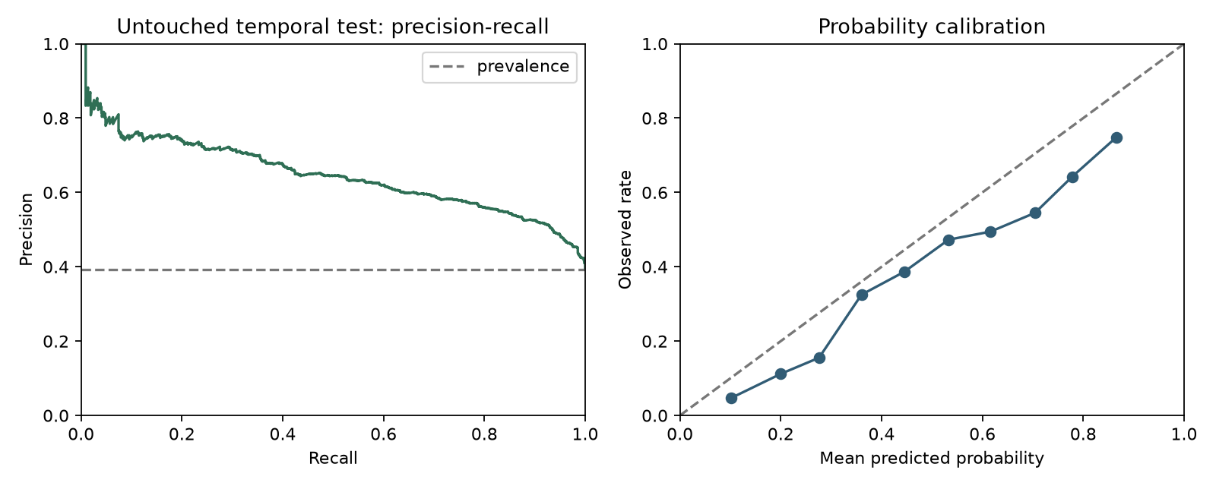
UNTOUCHED FINAL EVALUATION
06
The frozen test shows useful ranking and visible temporal shift
0.647525
0.765878
0.199854
1.904513×
PR-AUC
ROC-AUC
Brier
Top-10% lift
Frozen threshold
302
customers selected
10.8947% of test
Precision 0.735099
Recall 0.203857
F1 0.319195
2,772-row 2011-09-01 holdout · 95% PR-AUC CI [0.618131, 0.678937].
AI-assisted drafting disclosed · Human review required

Slide 7
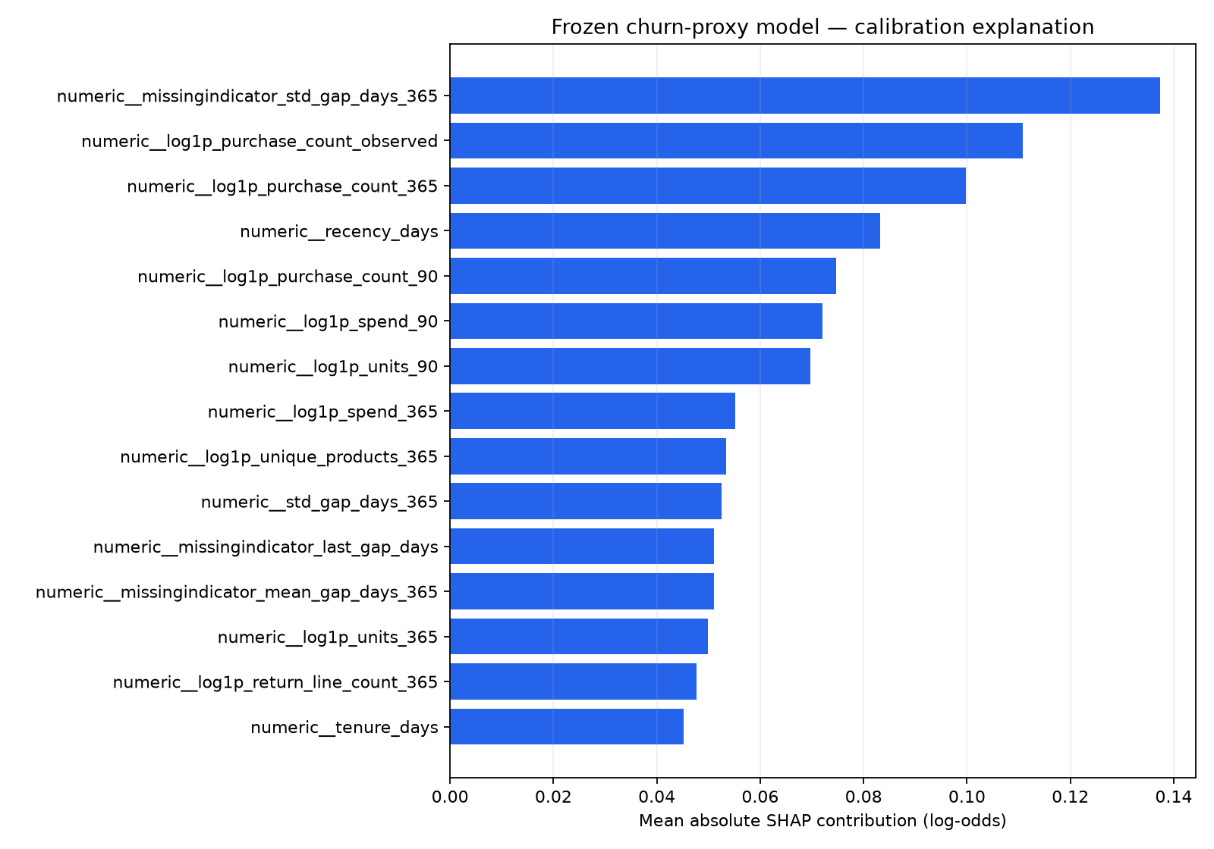
EXPLAINABILITY AND RESPONSIBLE AI
07
A score can inform review, but it never authorizes an action
Validated explanation
Maximum SHAP additivity error
8.88 × 10⁻¹⁶ in calibrated log-odds
1
Current consent
2
Eligible audience snapshot
3
Authorized reviewer
4
Explicit approval
5
Kill switch + budget cap
SHAP explains fitted score formation — not why a customer behaves or what will change them.
Project explanation artifact and implemented consent/approval controls.
AI-assisted drafting disclosed · Human review required

Slide 8
PROJECT LEAD DECISION
08
Local evidence is ready; production proof remains external
Completed locally
External validation still required
✓ Tenant-safe CRM / commerce / imports
○ Live Meta / Google / LLM / OIDC sandboxes
✓ Versioned analytics and model registry
○ Browser accessibility and load validation
✓ Audiences, approvals and audit trail
○ Managed backup / restore rehearsal
✓ Written assignments + final presentation
○ Randomized pilot for incremental impact
Decision requested: audit the local package. Publication, deployment and live spend remain separately gated.
No push · no paid deployment · no live advertising spend.
AI-assisted drafting disclosed · Human review required

