Slide 1





SIC CAPSTONE IDEA PROPOSAL
Patterns we want to examine
Problematic Gaming Early Warning
Gaming frequency and active days
Irregular or extended play
Can early gaming behavior patterns predict a future increase in problematic gaming symptoms?
THE PROBLEM
Consecutive gaming days
Late-night / overnight play where available
Total playtime alone may not reflect changes in gaming behavior over time.
Problematic gaming may depend on patterns of play, not only total hours.
Open research opportunity
Open Play authors explicitly identify irregular, extended, and overnight play as potential early-warning signals for later problematic play.
1

Slide 2






PROPOSED INNOVATIVE SOLUTION
An explainable early-warning model
Based on real gaming behavior, from raw play data to the patterns behind each prediction.
1
2
3
4
Observe
Build Features
Predict
Explain
Use real gaming behavior across time.
Create behavioral features from play patterns.
Estimate later problematic-gaming symptoms.
Use SHAP / feature importance to show what drove the prediction.
Candidate behavioral features
FREQUENCY
REGULARITY
INTENSITY & TIMING
Gaming frequency
Playtime variability
Long sessions
Active gaming days
Consecutive days
Late-night play
EARLY WARNING GOAL
Identify behavioral signals before a later increase in problematic gaming symptoms — then explain which patterns mattered most.
2

Slide 3
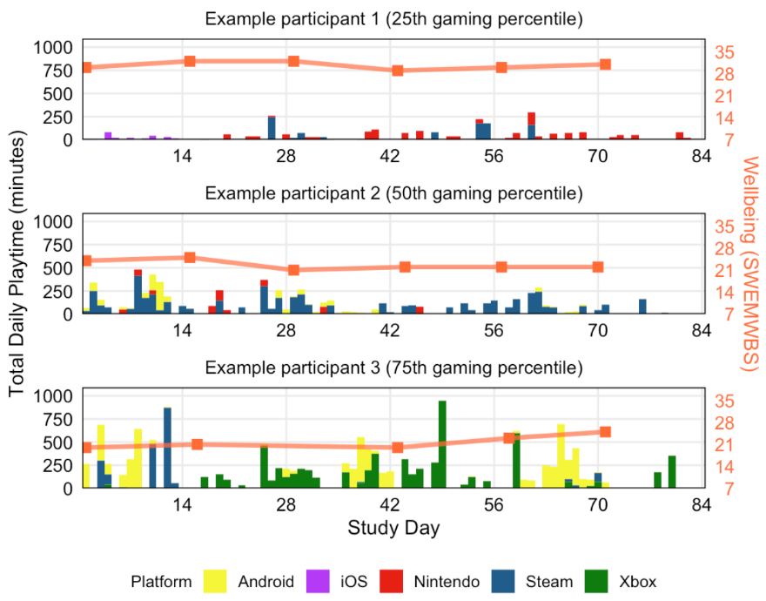


DATASET: OPEN PLAY
Longitudinal, multi-platform gaming data
Linked with psychological measures.
~2,000
participants
5
gaming platforms
2
Gaming Disorder measurements
with real gaming behavior data
Android • iOS • Nintendo • Steam • Xbox
Wave 1 and Wave 6
Target structure
Wave 1
Between waves
Wave 6
Baseline Gaming Disorder symptoms
Real gaming behavior
Later Gaming Disorder symptoms
Baseline
Model input
Prediction target
Example of daily gaming behavior tracked over time
3

