Slide 1
Synthetic Sentries: Safeguarding AI with Next Generation Security Mechanisms

Slide 2
Agenda
Rise of AI and its security implications
Potential vulnerabilities and security risks of AI
Statistics on AI-related security incidents and their impacts
Overview of Synthetic Sentries architecture and its components
How Synthetic Sentries Differ from Traditional Security Measures
AI security use cases
AI Security best practices
Q&A

Slide 3
Rise of Artificial Intelligence(AI) and its security implications
AI has brought significant advancements to many fields, from healthcare, finance, transportation and entertainment. However, these benefits come with serious security risks as well.
AI systems can be targeted by hackers who might manipulate them to make wrong decisions, leading to harmful consequences.
For example, if an AI in a self-driving car is hacked, it could cause accidents. AI can also be used to create fake content, like deepfake videos, which can be used to spread misinformation or harm someone's reputation.

Slide 4
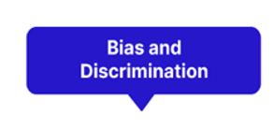


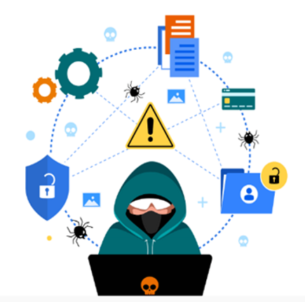
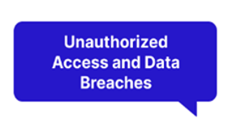



Potential vulnerabilities and security risks of AI

Slide 5
Statistics on AI-related security incidents and their impacts
As per 2023-Gartner report, below are few Statistics on AI-related security incidents and their impacts
S. No | Category | Details
1 | Frequency of AI Security Incidents | - 41% of organizations reported experiencing an AI-related security incident within the past year (Gartner, 2023). - 162% increase in AI security incidents from 2020 to 2023.
2 | Data Breaches | - AI-driven systems involved in 22% of all reported data breaches in 2023. - AI-related data breaches exposed 32% more records than traditional cyber incidents.
3 | Response and Recovery | - Average time to detect and contain AI security incident: 68 days (compared to 49 days for traditional cyber-attacks). - 57% of companies report difficulty in determining the full extent of AI security breaches.
4 | Human Factor | - 48% of AI security incidents involved human error or insider threats. - 70% of organizations report a shortage of skilled professionals to address AI-specific security challenges.
5 | Regulatory Impact | - 35% of organizations faced regulatory scrutiny or fines related to AI security or privacy issues. - 68% of companies increased their AI security budgets in response to new AI regulations.

Slide 6
Statistics on AI-related security incidents and their impacts

Slide 7
Limitations in Current Security Mechanisms to Safeguard AI
Current security tools are designed for traditional IT systems. They often fail to address unique AI vulnerabilities. Example-Incapable of detecting subtle manipulations in the training data. Many security tools rely on predefined rules and signatures.
Limited Visibility into AI Internals- Traditional security mechanisms operate at the network or system level. Lack of insight into AI model internals and data processing.
Inadequate Handling of AI Inputs/Outputs - Struggles to analyze complex AI inputs like images or natural language. Unable to evaluate the safety of AI-generated content.
Lack of Adaptive Learning in Security - Most security tools don't use AI to improve their own performance. Unable to anticipate new threats based on observed patterns.
Insufficient Protection Against Data Poisoning - Traditional security focuses on data integrity, not subtle manipulations. It Struggles to detect malicious data that influences AI learning.
Lack of Standardization in AI Security -No widely accepted standards for AI security best practices. Example: Varied security measures across different AI platforms create vulnerabilities

Slide 8

Synthetic Sentries architecture
To overcome the limitations of existing security mechanisms,Synthetic Sentries are advanced AI-powered security systems designed specifically to protect AI systems,including GenAI.
AI-native: Built to understand and secure AI systems from the inside out
Adaptive: Continuously learns and evolves to counter new threats
Proactive: Anticipates potential attacks before they happen
Synthetic Sentries Layer
Anomaly Detection
Access Control
Threat Intelligence
Intrusion Prevention
Privacy Preservation
Input Layer
Core AI System
Output Layer

Slide 9
Anomaly Detection
Access
Control
Threat Intelligence
Intrusion Prevention
Privacy Preservation
ROLE
ROLE
ROLE
ROLE
ROLE
Watchful guardian
Smart Bouncer
Informed Advisor
Active Defender
Data Protector
Detects unusual patterns or behaviors.
Alerts other components when anything unusual is detected.
Governs user and system access.
Decides who can interact with the AI and how, based on predefined policies and user identities.
Monitors for known and emerging threats from various sources.
Shares this intelligence with the other components.
Actively blocks detected threats and suspicious activities.
Predicts and prevents potential attacks .
Ensures data protection and privacy.
it ensures that sensitive information handled by the AI remains protected.
Inconsistent Results

Slide 10
Synthetic Sentries Vs Traditional Security
S. No | Aspect | Synthetic Sentries | Traditional Security
1 | AI-Specific vs. General Cybersecurity | - Designed specifically for AI system vulnerabilities - Understands the unique ways AI can be attacked or misused | - Focuses on general cybersecurity threats - May not recognize AI-specific issues like model manipulation
2 | Adaptive Learning | - Continuously learns and adapts to new AI behaviours and threats - Uses AI to improve its own security measures | - Often relies on predefined rules and signatures - May require manual updates to address new threats
3 | Integration with AI Systems | - Deeply integrated into the AI system it protects - Can monitor internal AI processes and data flows | - Usually operates as an external layer - Limited visibility into AI's internal operations
4 | Handling of AI Inputs and Outputs | - Can understand and analyse complex AI inputs (e.g., prompts, images) - Monitors AI outputs for unexpected or harmful content | - May struggle with AI-specific inputs and outputs - Often focuses on network traffic and file systems
5 | Privacy Preservation | - Includes specialized techniques for AI data privacy (e.g., federated learning) - Can protect data while still allowing AI to learn from it | - Typically focuses on data encryption and access control - May not support advanced AI privacy needs
6 | Proactive Threat Detection | - Uses predictive models to anticipate potential AI attacks - Can simulate attacks to test AI system resilience | - Often reactive, responding to known threats - May not predict AI-specific attack patterns
7 | Handling of Model Dynamics | - Adapts to changes in AI model behaviour over time - Can secure AI systems that learn and evolve | - Typically assumes static system behaviour - May flag normal AI learning as suspicious activity
8 | Ethical AI Considerations | - Can monitor for biased or unfair AI outputs - Helps ensure responsible AI use | - Typically, doesn't address ethical AI concerns - Focuses solely on technical security aspects

Slide 11
AI security use cases
Endpoint security
Cloud security
Advanced threat hunting
Vulnerability management

Slide 12
AI security use cases
Applications of AI are diverse and continually evolving as AI tools become more advanced and accessible.
The most common use cases of AI security are
Endpoint security
Cloud security
Advanced threat hunting
Vulnerability management

Slide 13
AI security Best Practices
To balance AI’s security risks and benefits, organizations should craft explicit AI security strategies that outline how stakeholders should develop, implement and manage AI systems.
Implementing formal data governance processes
Prioritizing ethics and transparency
Applying security controls to AI systems
Regular monitoring and evaluation

Slide 14
Q & A

