Slide 1
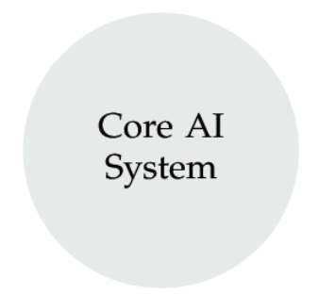
Synthetic Sentries Layer
Anomaly Detection
Access Control
Threat Intelligence
Intrusion Prevention
Privacy Preservation
Input Layer
Output Layer

Slide 2
Synthetic Sentries Layer

Slide 3
Synthetic Sentries Layer
Anomaly Detection
Access Control
Threat Intelligence
Intrusion Prevention
Privacy Preservation
User input
Output Layer

