Slide 1

CSCI 3495
Prompt Engineering
Natural Language Processing & Large Language Models
Week 6, Class 1 · Mon Sep 28, 2026

Slide 2
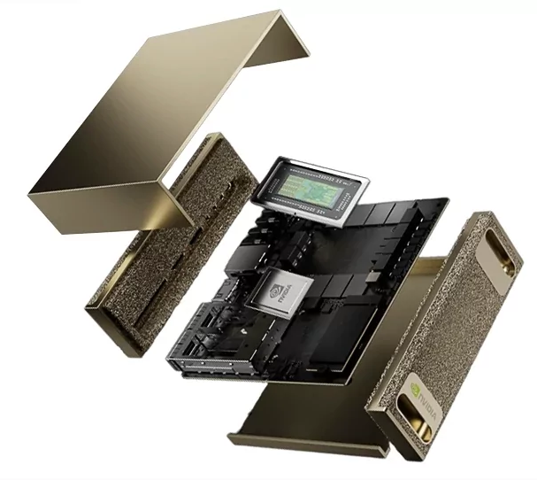
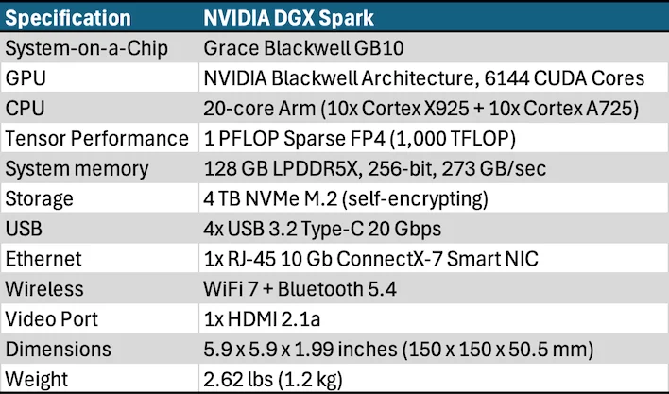
DGX Spark: Our Class Shared PC

Slide 3
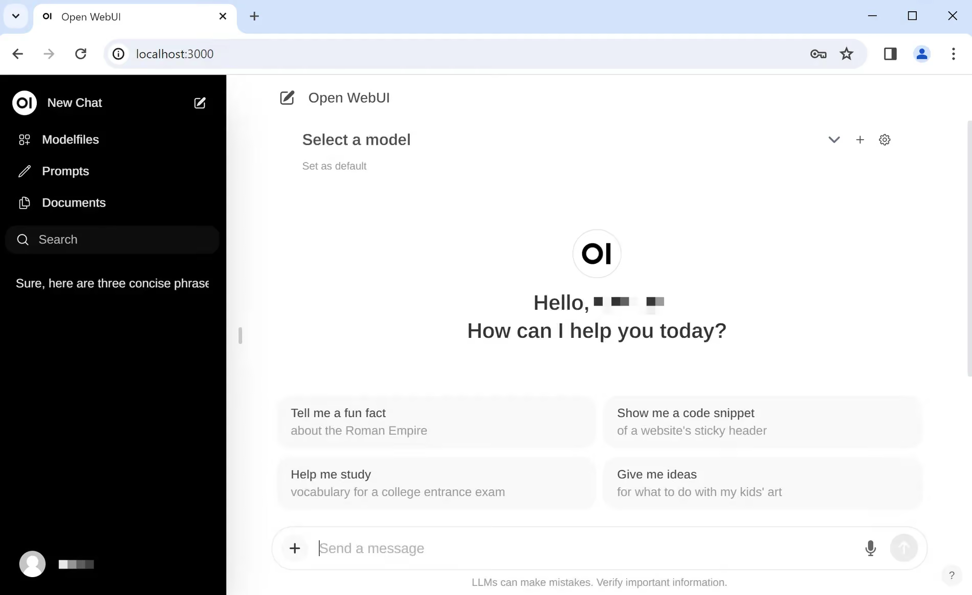
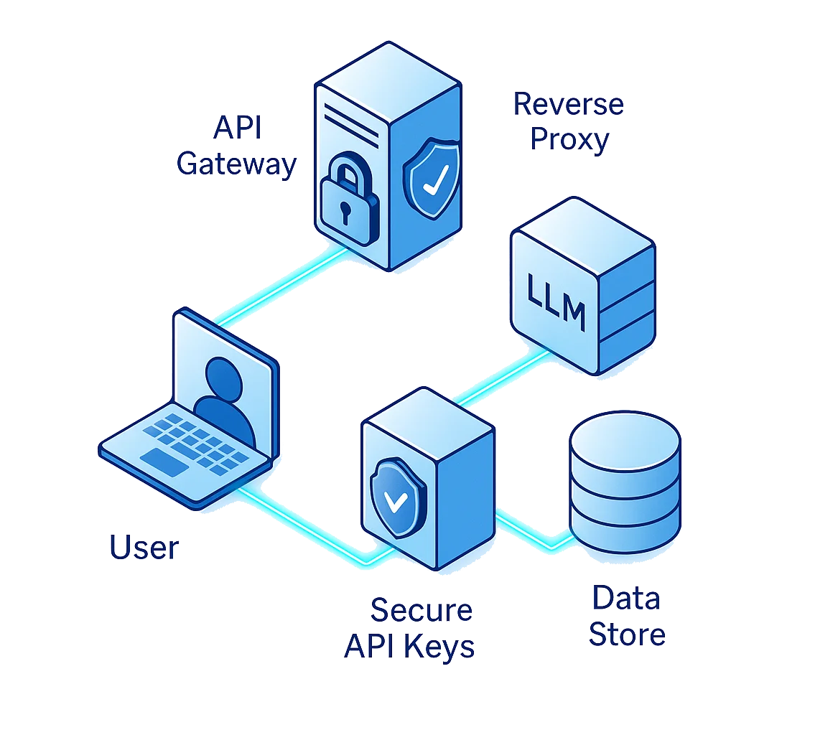

3 Resources Provided
Open WebUI: Open-source LLM Chat Interface
LLM API: Programmatic access to open-source LLMs
Jupyter Notebooks with high-compute GPU/CPU access

Slide 4
Open WebUI
URL: spark.cs.trinity.edu:71
Test using your provide login credentials.
Test credentials:
teststudent@trinity.edu
fYEEENmiRUmsGcnW

Slide 5
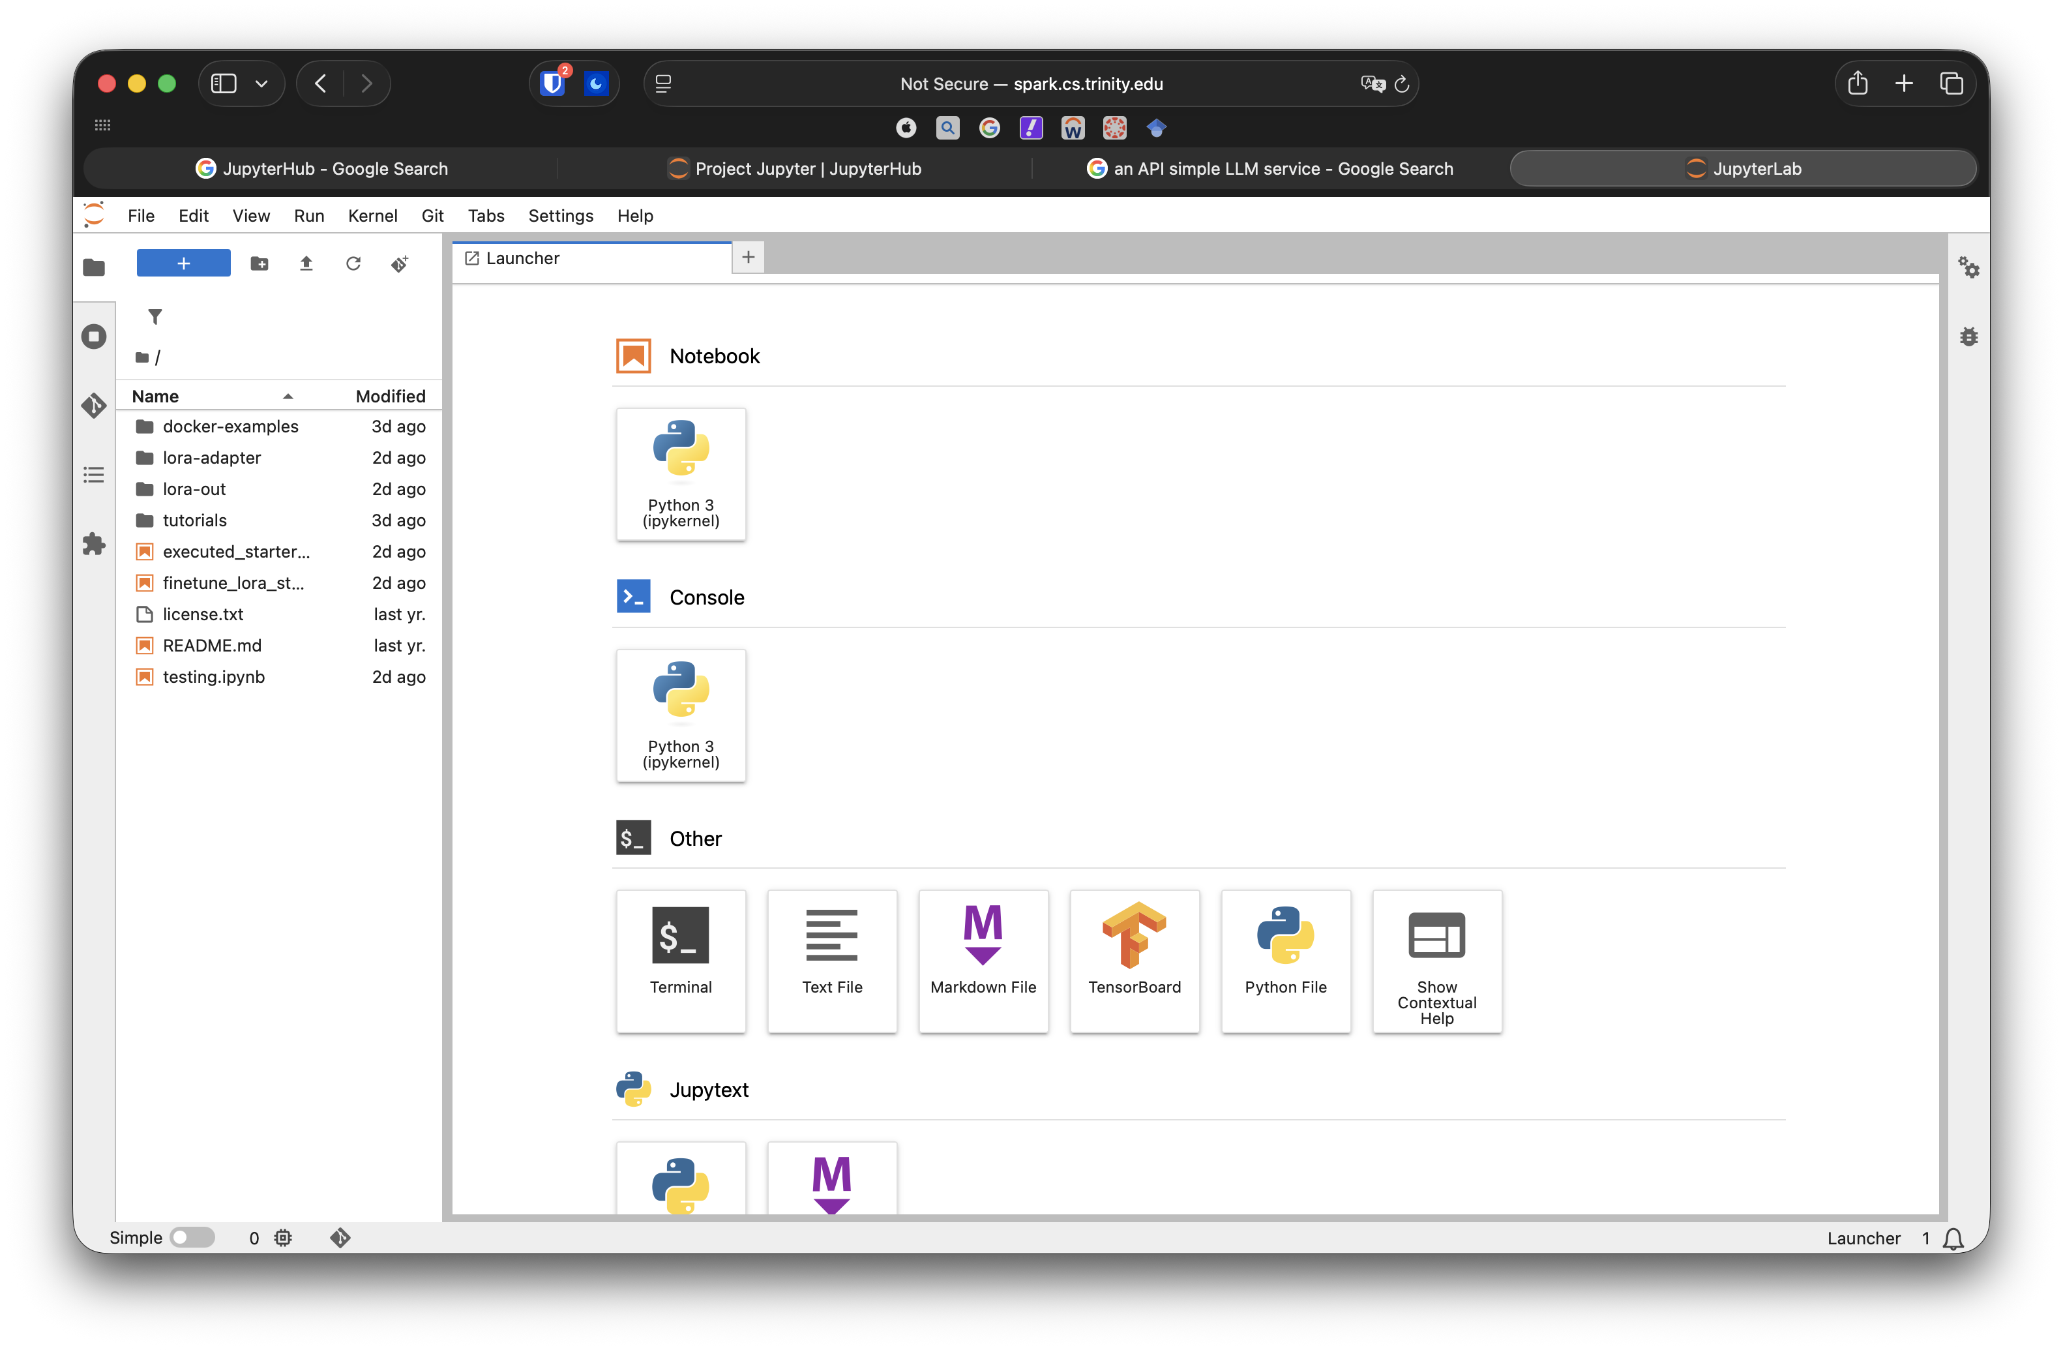
JupyterHub in Spark
URL: spark.cs.trinity.edu:71/jupyter
Test using your provide login credentials.
Test credentials:
teststudent@trinity.edu
fYEEENmiRUmsGcnW

Slide 6
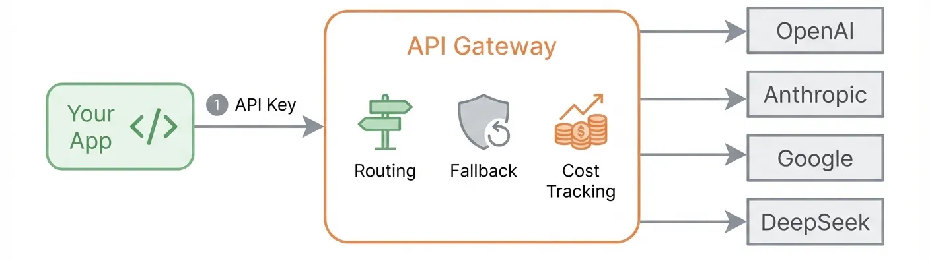
LLM API
URL: spark.cs.trinity.edu:71/v1
Test API key:
sk-trin-TUcfv022BapUHhXeGOkDfSPWj2PGUA8H

Slide 7
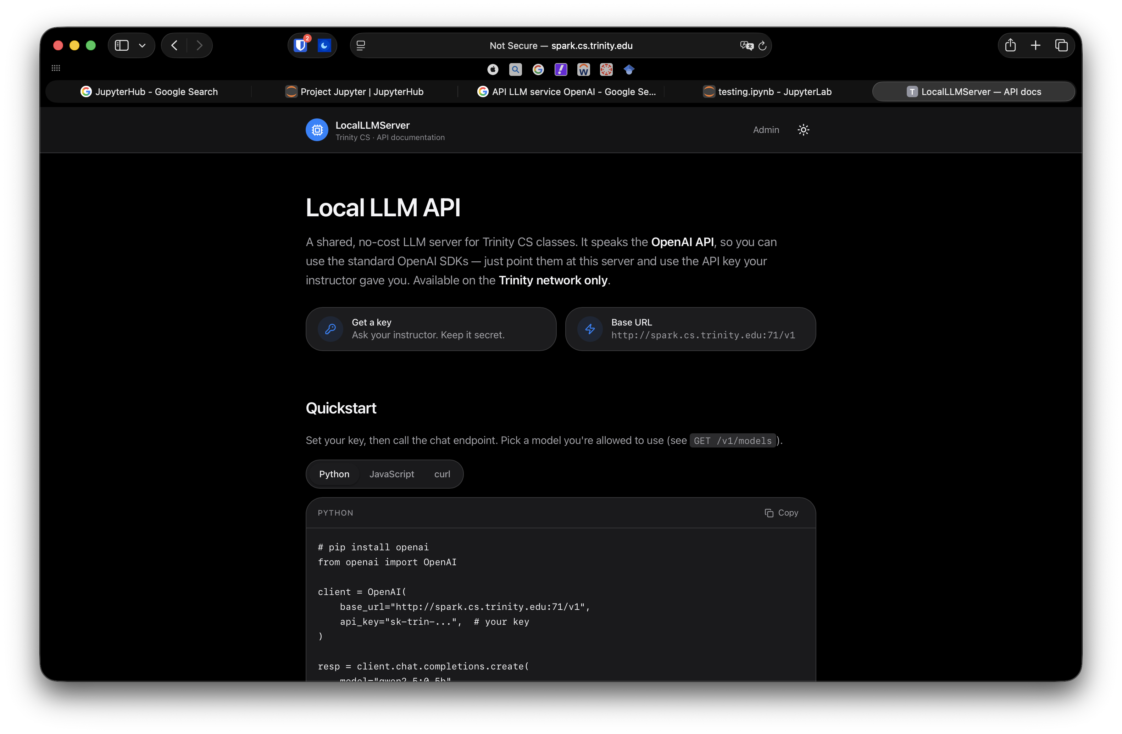
LLM API: OpenAI SDK
Access the docs at: http://spark.cs.trinity.edu:71/docs
Try sending a request via Python
# pip install openai
from openai import OpenAI
client = OpenAI(
base_url="http://spark.cs.trinity.edu:71/v1",
api_key="sk-trin-...", # your key
)
resp = client.chat.completions.create(
model="qwen2.5:0.5b",
messages=[{"role": "user", "content": "Explain Big-O in one sentence."}],
)
print(resp.choices[0].message.content)

Slide 8
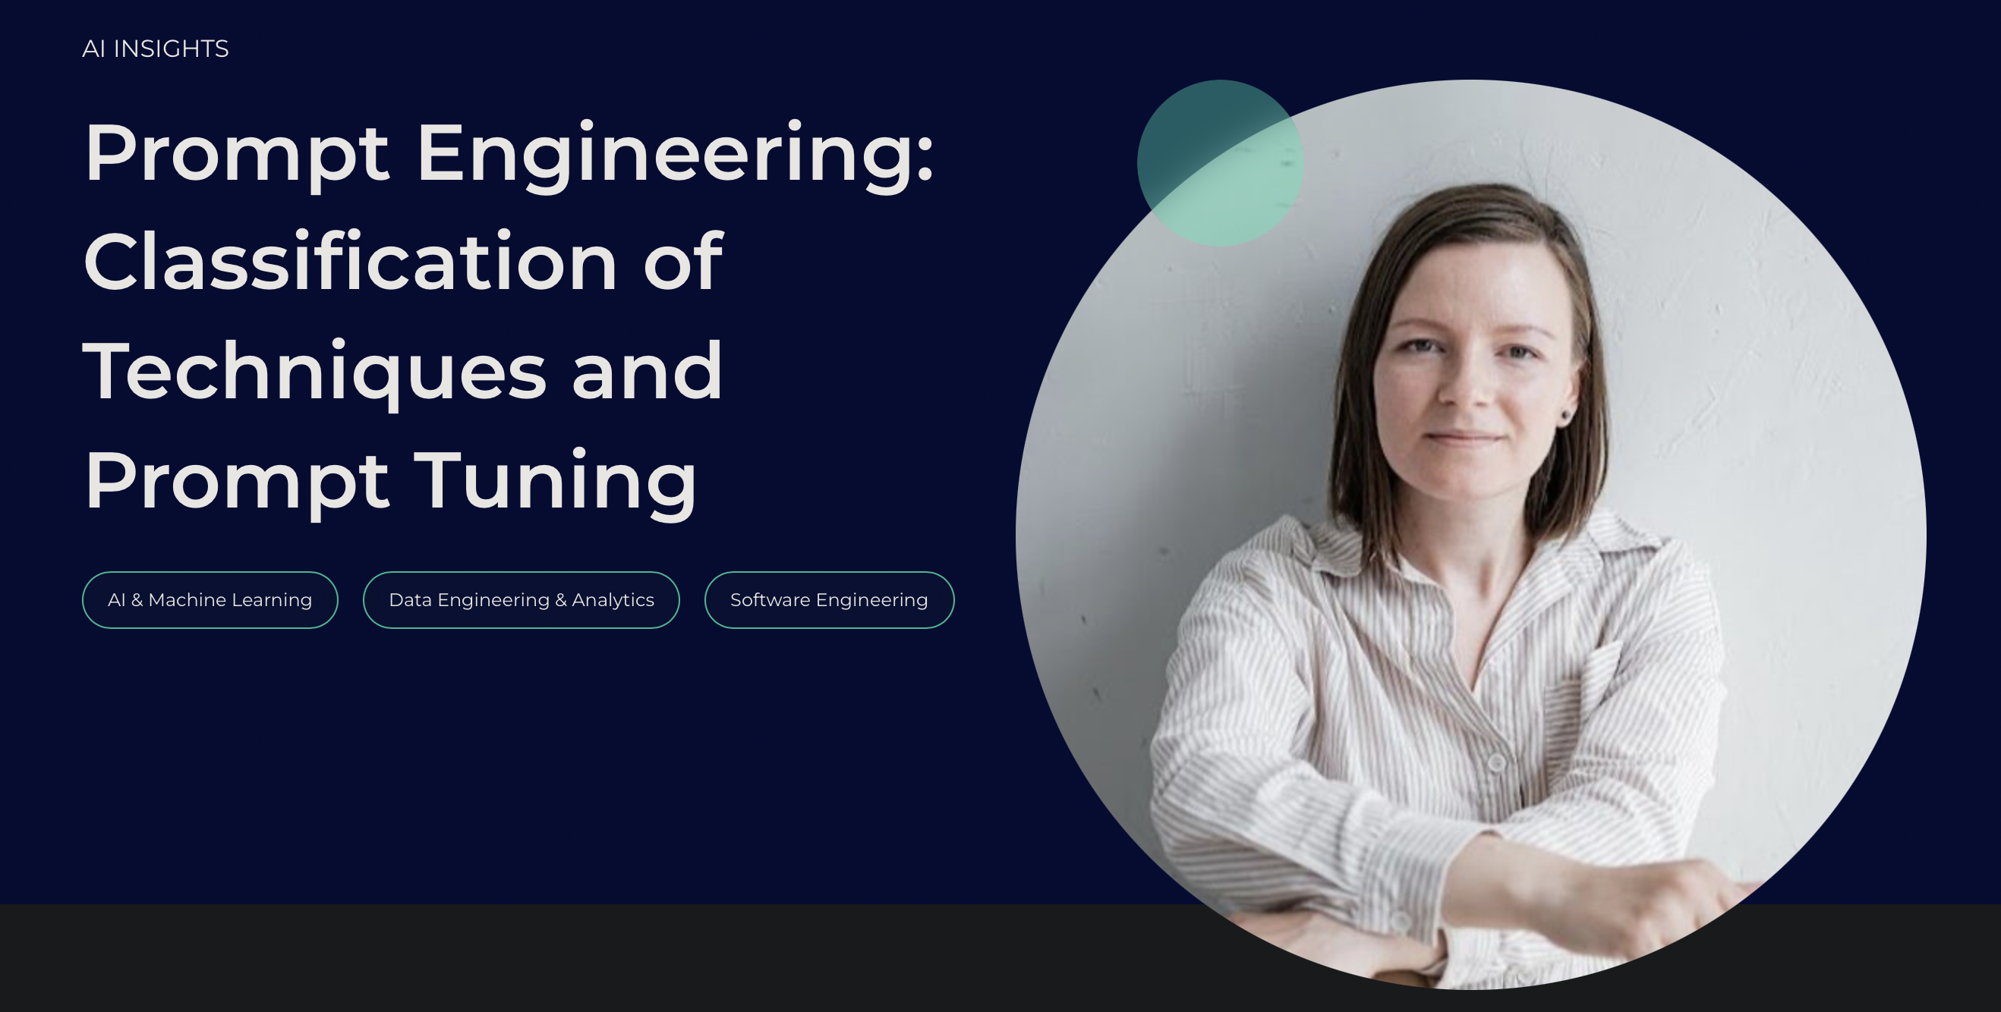
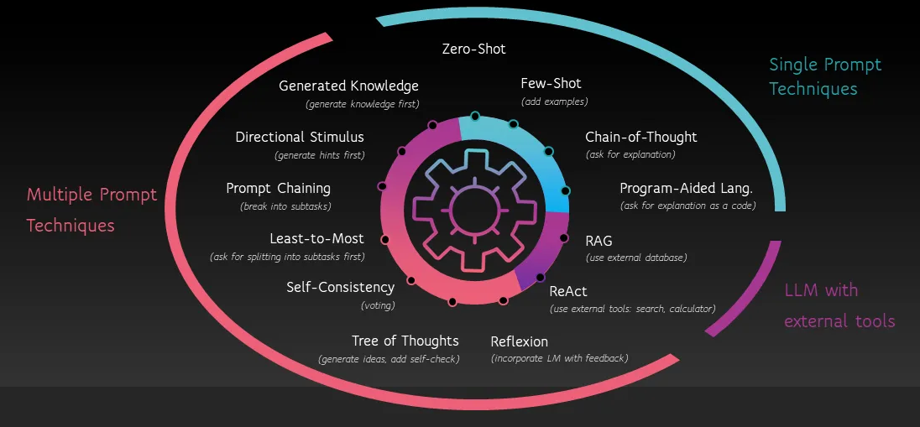
Fundamentals of Prompt Engineering

Slide 9
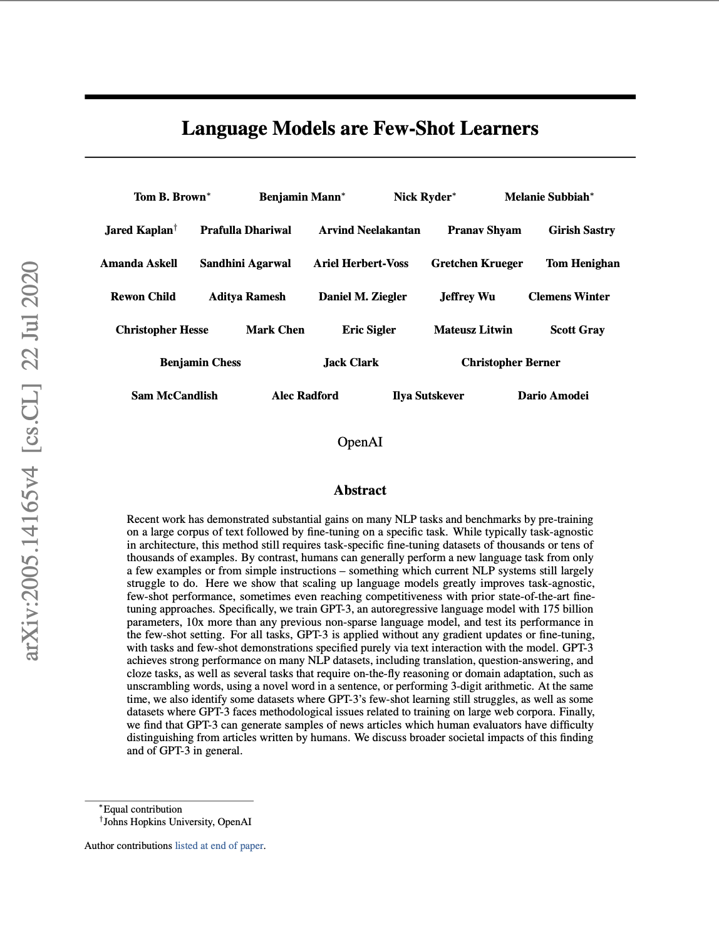
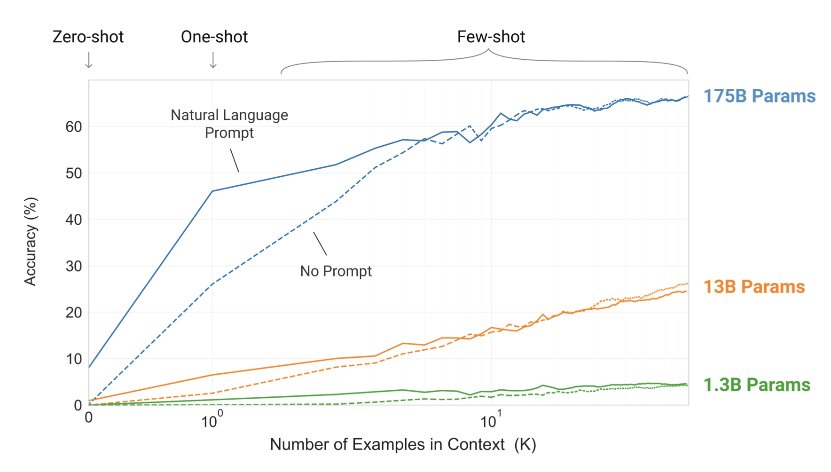
GPT-3: In-Context Learning
GPT-3 Paper: “Larger models make increasingly efficient use of in-context information.”

Slide 10
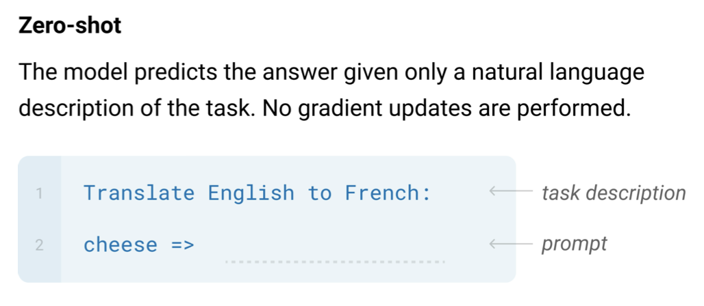
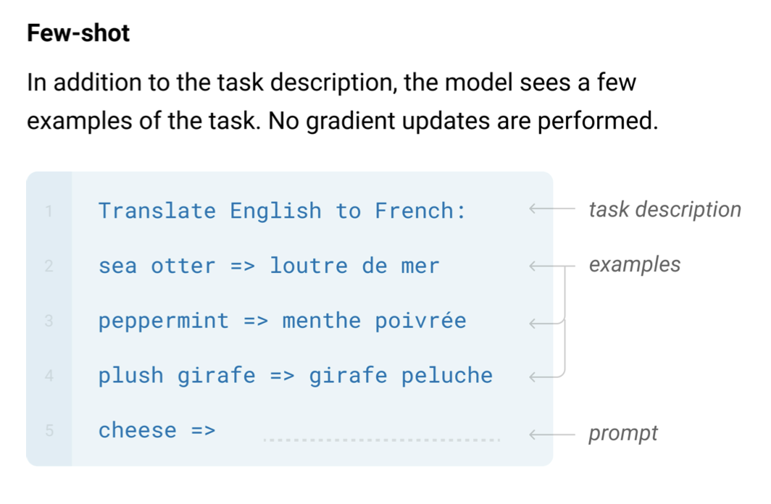
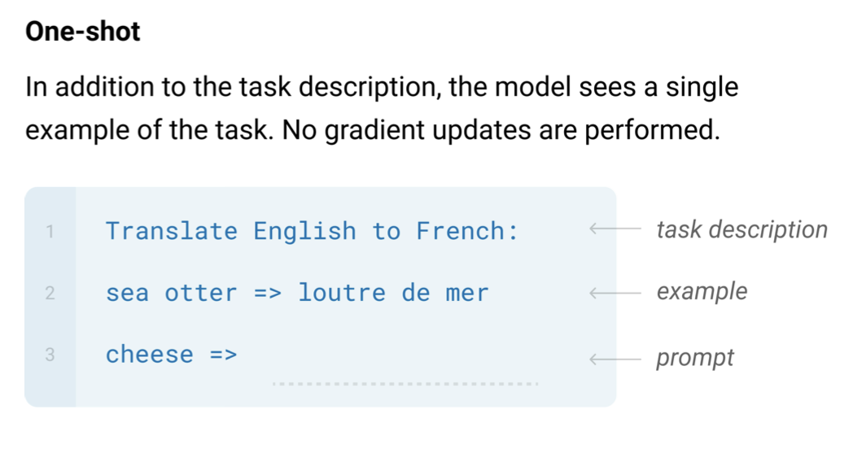
Zero and Few-Shot Learning

Slide 11

Let’s code it!

Slide 12

Break
Source: original figure

Slide 13

Proposal Worktime

