Slide 1
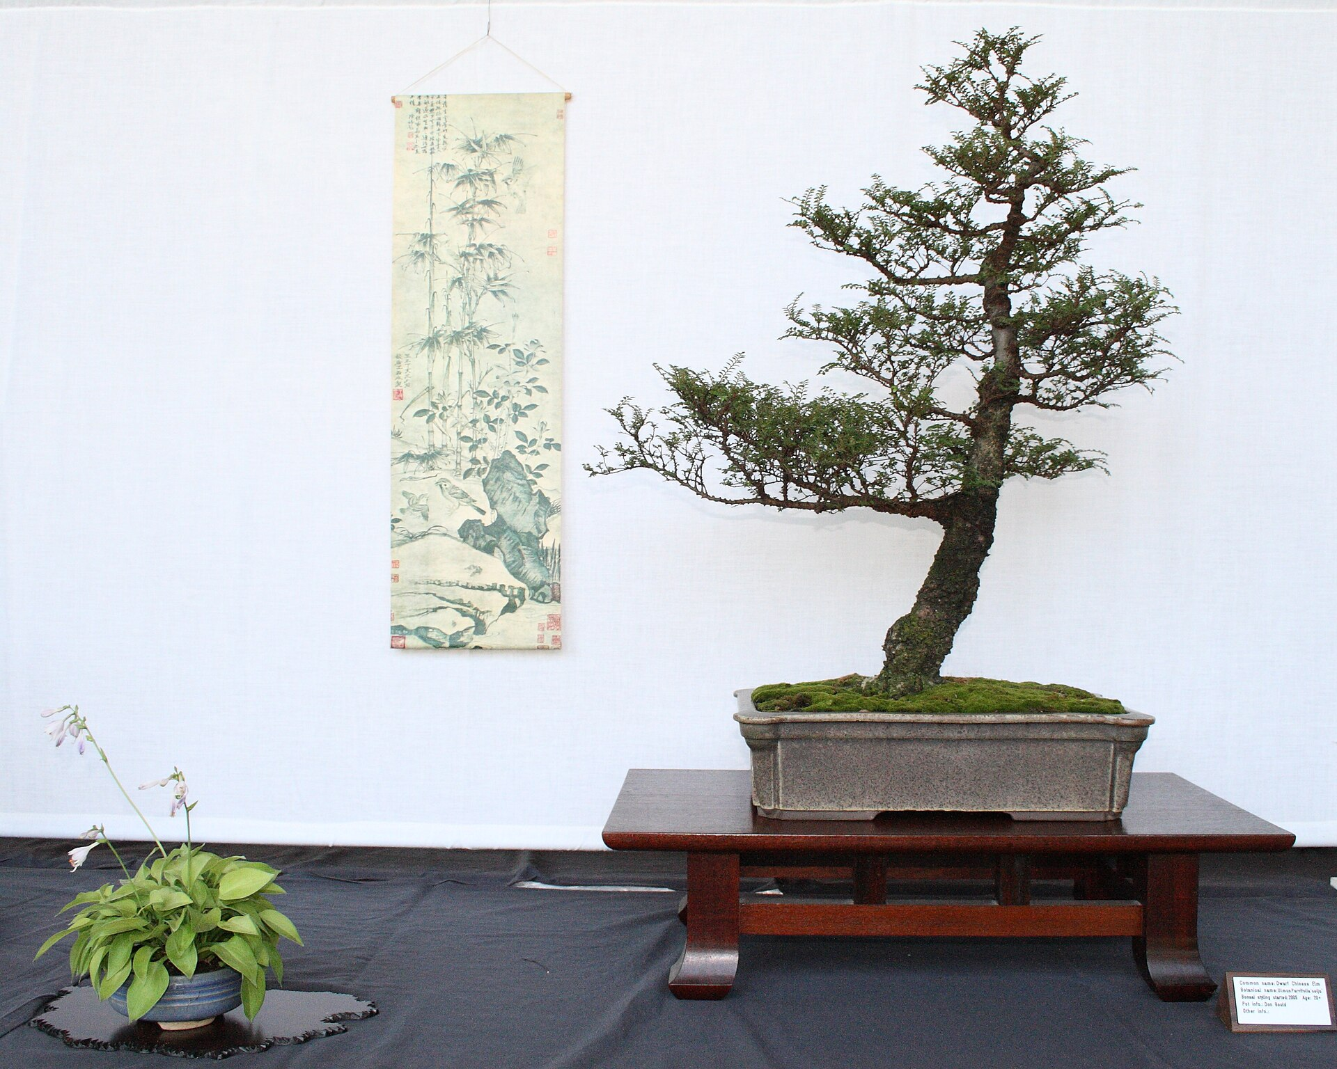
CSCI 3495
Efficient LLMs: LoRA, PEFT & Quantization
Natural Language Processing & Large Language Models
Week 11, Class 1 · Mon Nov 2, 2026
Source: Sage Ross, Wikimedia Commons, CC BY-SA 3.0
Notes:
A bonsai is a full tree, deliberately kept tiny. Ask the class: what would you prune from a 7B-parameter model, and what must survive?

Slide 2
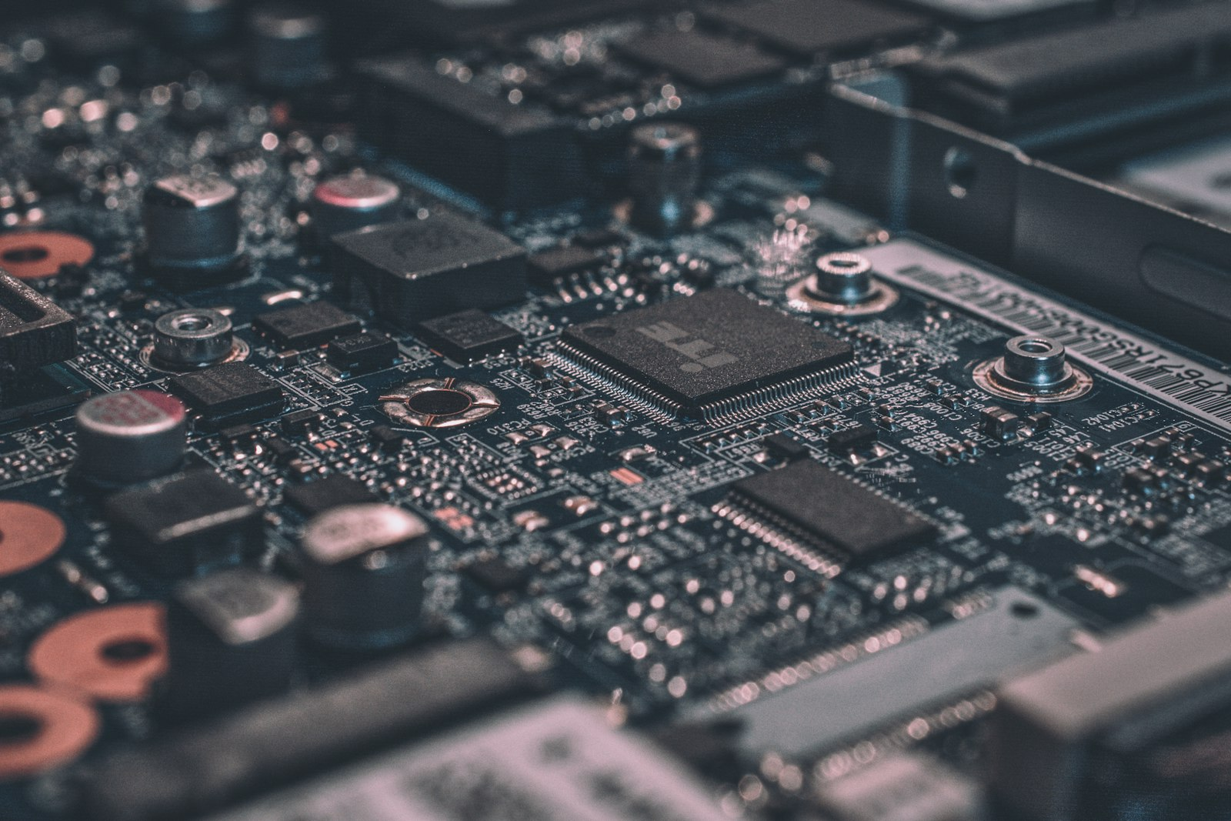
Billions of weights, one laptop
Source: Unsplash License, https://images.unsplash.com/photo-1518770660439-4636190af475
Notes:
A 7B model is billions of numbers. The whole game today is making those numbers fit and move on modest hardware.

Slide 3
Why full fine-tuning doesn't scale
One 7B model with Adam, peak memory in GB
Source: original figure; Adam memory rule-of-thumb
Notes:
The weights are the cheap part. Adam keeps the weights, the gradients and two moments per parameter, so a 7B model needs roughly a hundred gigabytes of peak training memory. Nobody has that in a laptop, and you pay it again for every task. 1 copy / task7B weights saved again for every customer, product or language you fine-tune for. And it repeats. Every new task you adapt to needs its own full copy of the model. Infeasible on a laptop, wasteful even on a cluster.

Slide 4
Parameter-Efficient Fine-Tuning
METHOD | WHAT YOU TRAIN | WHERE IT SITS
Adapters | small bottleneck layers | inserted inside each block
Prefix tuning | a few virtual tokens | prepended to the input
LoRA | two thin matrices | beside each weight matrix
THE MODEL ITSELF
Billions of parameters, frozen, never updated. Everything above is what gets added.
Source: original figure
Notes:
The base model never moves. Everything here bolts a small trainable piece onto a frozen model, and the three approaches differ mainly in where that piece sits.

Slide 5
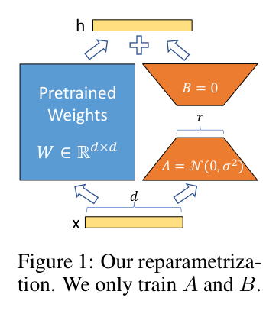
LoRA, visually
Source: Hu et al. 2021 (arXiv:2106.09685), Fig. 1
Notes:
B starts at zero, so training begins exactly at the pretrained model; after training, B times A merges back into W, so inference costs nothing extra. B starts at 0; after training, B and A merge back into W: no extra inference latency.

Slide 6
LoRA: the core idea
A DENSE UPDATE
d x d entries
Every one of them a gradient to keep.
B TIMES A
2 x d x r entries
Orders of magnitude fewer when r is small. W is assumed to be low rank.
Source: after Hu et al., 2021, arxiv.org/abs/2106.09685
Notes:
Freeze W and learn the update instead, factored into two thin matrices. The bet is that the update has low intrinsic rank, and empirically it does. That is how the trainable parameter count drops by four orders of magnitude.

Slide 7
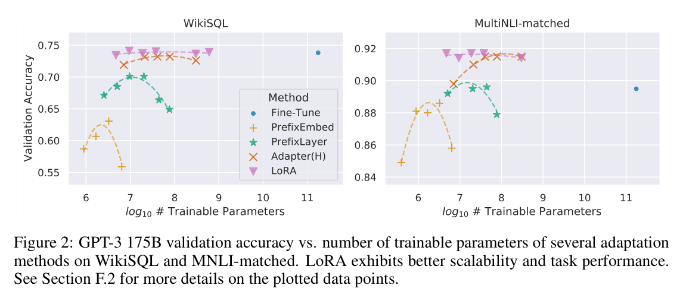
Why LoRA is a big deal
Source: Hu et al. 2021 (arXiv:2106.09685), Fig. 2
Notes:
The lone blue dot is full fine-tuning of GPT-3 175B. LoRA (pink) holds that accuracy with about 10,000x fewer trainable parameters, while prefix methods degrade as they grow. Blue dot = full fine-tuning of GPT-3 175B; LoRA (pink) matches it with ~10,000x fewer params.

Slide 8
Quantization: fewer bits per weight
PRECISION | LEVELS | SIZE
16-bit float | continuous | full | the usual storage
8-bit int | 256 | 2x smaller | half the bytes moved
4-bit int | 16 | 4x smaller | where QLoRA lives
Source: original figure
Notes:
This is why a 7B model runs on a laptop at all. Post-training quantization needs no retraining, just map ranges of floats to integer buckets, losing surprisingly little accuracy.

Slide 9
How quantization works
CONTINUOUS FLOATS
0.31 0.62 0.85
ROUNDED TO A GRID
2 4 6
Find a block's min and max, round each weight to the nearest level, and keep one scale factor per block. The gap is the rounding error.
Source: original figure
Notes:
Find the min and max of a block, lay a small grid of integer levels across it, and round every weight to the nearest one. Store the levels plus a single scale factor per block. The precision you lose is mostly precision you were not using.

Slide 10
QLoRA: the combination
BASE MODEL, 4-BIT
frozen, quantized
Tiny footprint. No gradient ever reaches it.
LORA ADAPTERS, 16-BIT
trainable
Gradients reach only these. That is what fits a large model on one consumer GPU.
Source: after Dettmers et al., 2023, arxiv.org/abs/2305.14314
Notes:
Quantize the frozen base down to four bits and train only the adapters in sixteen. Gradients never touch the base, so its precision does not matter as much as you would think. This is what puts fine-tuning a large model on one consumer GPU.

Slide 11

Could you fine-tune a model on your laptop tonight?
With QLoRA, the honest answer is yes. Hold that thought for the exercise.
Source: Unsplash License, https://images.unsplash.com/photo-1498050108023-c5249f4df085
Notes:
The honest answer is yes, and they are about to. Hold it until the lab.

Slide 12
Running models locally with Ollama
$ ollama pull qwen2.5:0.5b
pulling manifest ... verifying sha256 digest ... success
$ ollama list
NAME SIZE
qwen2.5:0.5b 398 MB
$ ollama run qwen2.5:0.5b "Why is the sky blue?"
Sunlight scatters off air molecules, and blue scatters most ...
three commands, no API key, nothing leaves the machine
Source: original figure; model size from ollama.com/library/qwen2.5
Notes:
No API key, no network, no per-token bill: the model file sits on your disk, and a Modelfile can set the system prompt, sampling params, and even LoRA adapters.

Slide 13
The efficiency toolbox
LEVER | SAVES | COSTS
LoRA / PEFT | training memory and storage | slightly less flexible
Quantization | model size and bandwidth | small accuracy loss
QLoRA | both at once | setup complexity
Distillation | inference cost | you must train a student
Source: original figure
Notes:
Four levers and the price of each. Nothing here is free, and the point is knowing which cost you can afford for a given job. In practice, most local deployments stack these two together: a 4-bit base on disk, a few megabytes of adapters per task.

Slide 14

Break
Source: original figure

Slide 15
Quantization bake-off
1
Implement LoRALinear and quantize in lora_lab.py. Train the adapter, freeze the base
2
Run the sweep at 8, 4 and 2 bits. Record the error and the size each time
3
Smallest model that still works wins. About thirty minutes
Source: original figure
Notes:
Build the LoRA layer and the quantizer, train the adapter with the base frozen, then bake off. The smallest model that still works wins, which forces them to find the accuracy cliff rather than just reading about it.

Slide 16
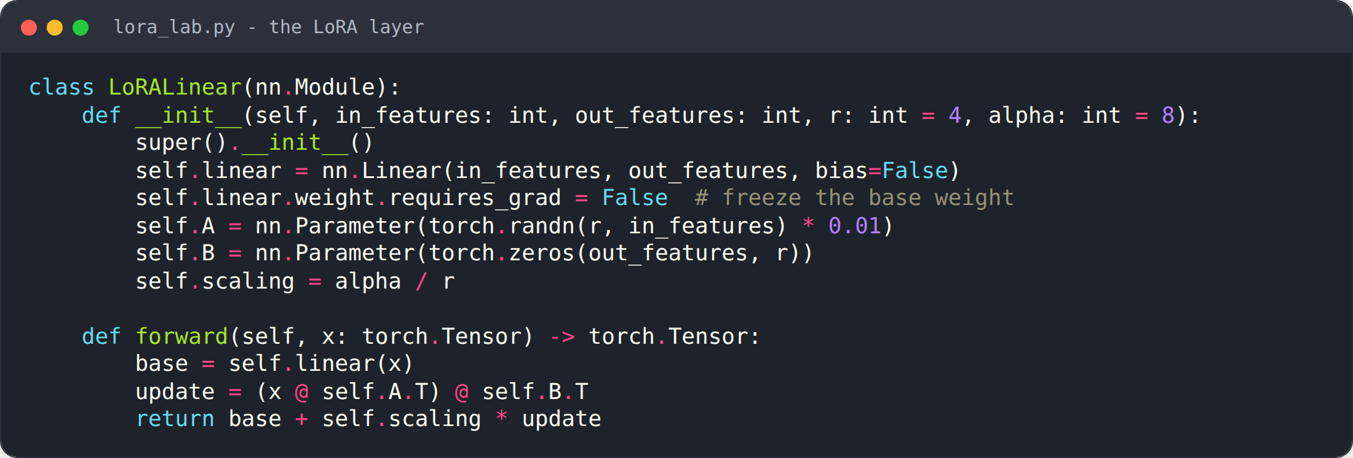
Build a LoRA layer
Source: weeks/week-11/class-01/exercise/lora_lab.py
Notes:
Freeze the base weight; train only A and B. Then run a quantization bake-off at 8/4/2 bits.

Slide 17
What you should see
$ python lora_lab.py
LoRA loss: 9.744 -> 0.000
Trainable params: 48 Frozen params: 32
Quantization bake-off (mean abs error vs original):
8-bit: error = 0.0072
4-bit: error = 0.1316
2-bit: error = 0.7530
Source: example run in the course Docker image (seed=0)
Notes:
Loss collapses; only 48 trainable params; error grows as bits drop.

Slide 18
Project work and feedback
1
What is your question, in one sentence?
2
What baseline already runs end to end?
3
What is the single biggest thing blocking you?
4
Every team gets a turn. Leave with a next action you can finish this week
Source: project/README.md milestones
Notes:
Last 15 minutes: work with your team while I come around. Checkpoint presentations are next week.

