Slide 1
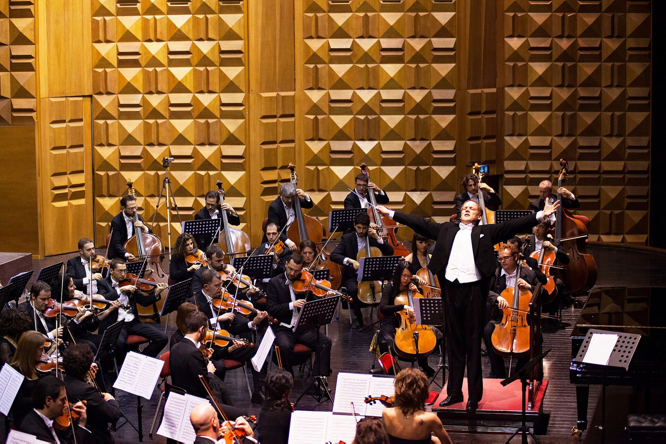
CSCI 3495
Agentic Workflows & Orchestration
Natural Language Processing & Large Language Models
Week 14, Class 2 · Wed Dec 2, 2026
Source: Photo: AnnaLesniewski, Wikimedia Commons, CC0
Notes:
A conductor plays no instrument, yet the whole orchestra depends on one. What plays that role in a system of LLM calls?

Slide 2
From one call to a system
WHERE WE STARTED
one LLM call
A single prompt. Simple, and brittle for anything complex.
WHERE WE ARE GOING
a system of calls
Small reliable steps wired together. Software design, with LLMs as components.
Source: original figure
Notes:
The skill shifts from prompting to systems design.

Slide 3

A team of specialists, not one genius
Source: Unsplash License, https://images.unsplash.com/photo-1522071820081-009f0129c71c
Notes:
Like a project team, a good LLM system splits work into focused roles that each do one job well.

Slide 4
A grounding source
Find the simplest solution possible, and only add complexity when it is needed.
Source: Anthropic, "Building Effective Agents" (2024)
Notes:
An engineering guide, not a paper. Most agent projects fail by being over-engineered.

Slide 5
Workflow or agent?
 | WORKFLOW | AGENT
path | fixed before the run | decided by the LLM
control | code decides | the LLM decides
predictable | high | low
cost | bounded | open-ended
use when | it decomposes cleanly | it does not
Source: Anthropic, "Building Effective Agents" (2024)
Notes:
Most production needs are workflows, not full agents.

Slide 6
The building block: the augmented LLM
RETRIEVAL
pull context on demand
A knowledge base, queried per question.
TOOLS
call functions and APIs
Search, run code, act on the world.
MEMORY
carry state across turns
What happened earlier, available later.
Source: Anthropic, "Building Effective Agents" (2024)
Notes:
Everything today is made of this one unit: a model with retrieval, tools and memory attached. Retrieval was Week 13, tools were Week 13. Nothing new here, just named so we can compose it.

Slide 7
The five patterns at a glance
PROMPT CHAINING
fixed sequential steps
Each call works on the prior output, with a gate between them.
ROUTING
classify, then dispatch
Cheap work to cheap models.
PARALLELIZATION
sectioning, or voting
Split and merge, or run N times and count.
ORCHESTRATOR-WORKERS
the split is decided at runtime
Use when you cannot predict the decomposition.
Source: Anthropic, "Building Effective Agents" (2024)
Notes:
Today: patterns 1 to 4; evaluator-optimizer next class.

Slide 8
Pattern 1: prompt chaining
OUTLINE
draft the structure
DRAFT
write from the outline
POLISH
fix grammar and tone
a programmatic gate between steps catches an error before it propagates
Source: original figure; Anthropic, "Building Effective Agents" (2024)
Notes:
A fixed sequence, with a gate between steps. Outline, draft, polish, and a programmatic check that can send a step back. Fixed in advance, which is what makes it a workflow and not an agent.

Slide 9
Pattern 2: routing
QUERY
whatever came in
ROUTER
a cheap classifier
SPECIALIST
the right path
cheap work to cheap models, strong models kept for the hard cases
Source: original figure; Anthropic, "Building Effective Agents" (2024)
Notes:
One cheap classifier, then dispatch to a specialist. This is where most of the cost savings in real systems come from: the strong model only sees the queries that need it.

Slide 10
Pattern 3: parallelization
SECTIONING
different subtasks, at once
Split, run in parallel, merge. Faster wall-clock.
VOTING
the same task, N times
Aggregate by majority. Higher confidence, N times the cost.
Source: original figure; Anthropic, "Building Effective Agents" (2024)
Notes:
Two flavours. Sectioning splits a task into independent pieces and merges them, which buys wall-clock time. Voting runs the same task several times and aggregates, which buys reliability.

Slide 11
Pattern 4: orchestrator and workers
ORCHESTRATOR
plans, and splits
WORKERS
one per subtask
SYNTHESISE
one answer back
unlike parallelization, the number and shape of subtasks is decided at runtime
Source: original figure; Anthropic, "Building Effective Agents" (2024)
Notes:
The difference from parallelization is that the number and shape of the subtasks is decided at runtime, by the model, not written down in advance. That is the first pattern on this slide with any real autonomy in it.

Slide 12

What is the simplest design that could possibly work?
Ask this before adding a single agent loop. Complexity is a cost, not a feature.
Source: Unsplash License, https://images.unsplash.com/photo-1518770660439-4636190af475
Notes:
Ask it before adding a single agent loop. Every extra step is another place to fail, and complexity is a cost you pay forever.

Slide 13
Routing in depth (our exercise)
RAW REPLY
" Translate "
NORMALISE
strip, lowercase
VALIDATE
is it in LABELS?
WORKER
translate
a router that trusts the raw reply breaks on a capital letter
Source: original figure
Notes:
Make the router deterministic and testable.

Slide 14
Why structure beats one mega-prompt
 | ONE MEGA-PROMPT | A STRUCTURED PIPELINE
failure | silent, one wrong token | loud, at the step that failed
visibility | none, inside one call | inspect every stage
cost | top price for every subtask | cheap models for cheap steps
Source: original figure
Notes:
Software engineering with stochastic parts.

Slide 15
Multi-agent systems: a caution
2 AGENTS
1 channel to keep in sync
4 AGENTS
6 channels
N(N-1)/2. Every pair is one more place to disagree, and errors compound. Prefer the least agentic design that works.
Source: original figure; Anthropic, "Building Effective Agents" (2024)
Notes:
Often a workflow is simpler and more reliable.

Slide 16
Designing good tool and step interfaces
def search(q):
"searches stuff" # the model guesses, and gets prose back
def search_flights(origin, dest, date):
"""Nonstop flights. IATA codes, YYYY-MM-DD.
Returns JSON: {"flights": [{"depart": ..., "price": ...}]}"""
a vague tool returns prose the next step cannot parse
Source: Anthropic, "Building Effective Agents" (2024)
Notes:
The model is only as good as its interface. Prompt-engineer your tools as carefully as your prompts.

Slide 17

Break
Source: original figure

Slide 18
Router and workers
ROUTE
classify a query into exactly one of LABELS, defensively
WORKER_SUMMARIZE
summarize the text in one sentence
RUN_WORKFLOW
route, then return a structured Result
Already written: worker_translate, worker_extract, worker_fallback, make_ollama_llm.
Source: weeks/week-14/class-02/exercise/workflow.py
Notes:
Three functions: route classifies the query defensively, worker_summarize is one specialist, and run_workflow ties them into a structured Result. The other workers are written, so they have a pattern to copy.

Slide 19
What you should see
$ python -m pytest test_workflow.py -q
Q: Summarize the French Revolution.
-> [summarize] via worker_summarize: A sweeping 1789 upheaval
Q: Translate 'hello' for me.
-> [translate] via worker_translate: bonjour
........ 6 passed in 0.04s
Source: example run, mock LLM (deterministic tests)
Notes:
A query goes to the router, the router picks a worker, and a structured Result comes back. Point at the structure: the worker's output is parsed, not read.

Slide 20
Reading & next class
BEFORE NEXT CLASS
Building Effective Agents
Anthropic, 2024. Be ready for the four questions in readings.md.
NEXT CLASS
the quiz covers it
This, plus today's lecture.
Source: anthropic.com/research/building-effective-agents
Notes:
Next: reflection, evaluator and optimizer, when NOT to use agents. Project feedback session.

