Slide 1
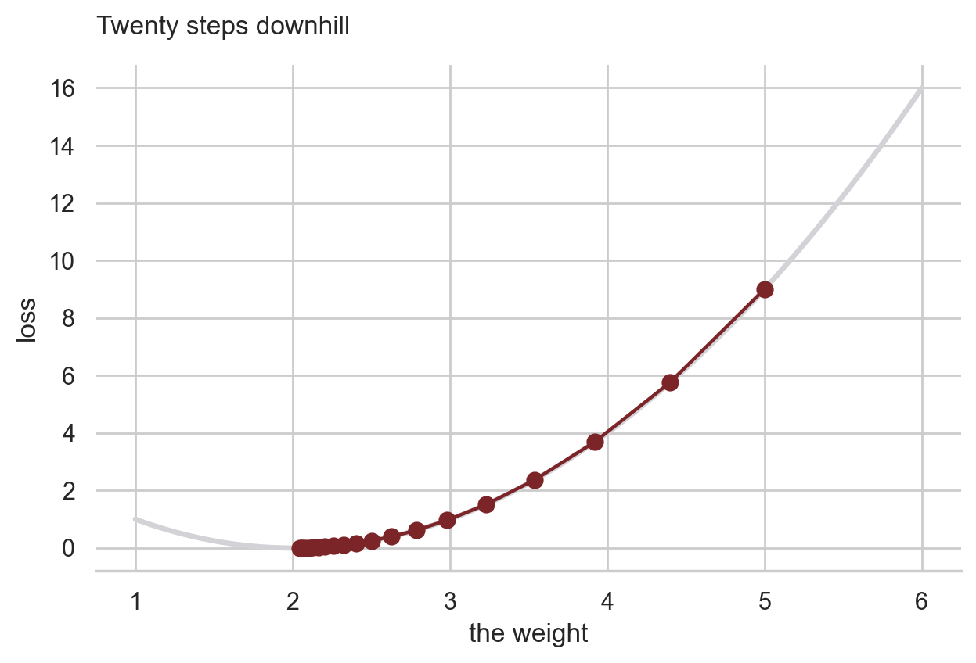
CSCI 3495
Probability, then PyTorch
Natural Language Processing & Large Language Models
Week 3, Class 2 · Mon Sep 14, 2026
Source: original figure, produced by the notebook's own descent loop
Notes:
Two halves today. The first is counting: every probability in this course is a count divided by another count. The second is the machinery that finds numbers by rolling downhill instead of counting, and we point it at the simplest model there is, a straight line. Whiteboards and markers out for the first thirty minutes; laptops stay shut.

Slide 2
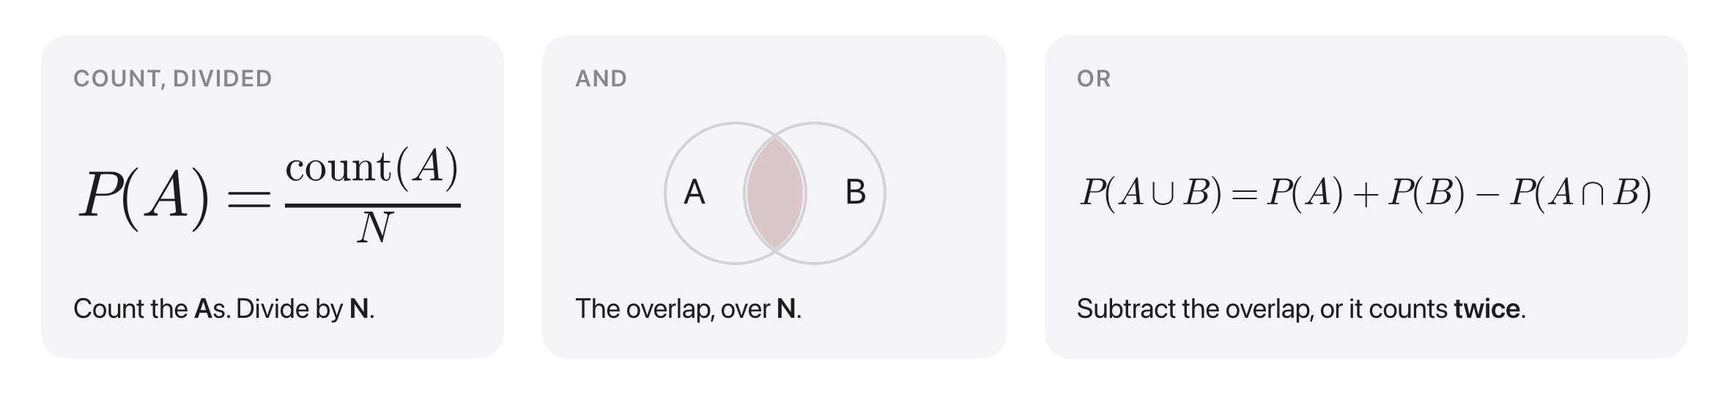
A probability is a count, divided
Source: original figure
Notes:
Three rules, and the first is the only definition you need: count the items that are A and divide by N. And is the overlap, or is the two added with the overlap subtracted once, because otherwise you have counted it twice. Draw the Venn on the board as you say it. Everything in the second half of the course rests on these three lines.

Slide 3
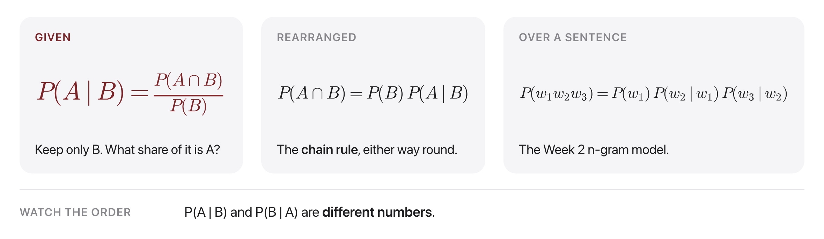
Given: shrink the world
Source: original figure
Notes:
A conditional shrinks the universe to B and asks what fraction of the survivors are also A. Rearranged, it is the chain rule, and stretched over a sentence it is exactly an n-gram language model. Spend the most time on the bottom line: P(A given B) and P(B given A) are different numbers, and swapping them is the mistake that will cost the most marks this semester.

Slide 4
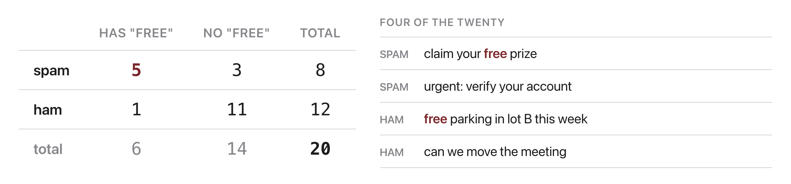
Twenty messages, counted
Source: original figure
Notes:
This table is the data for the next four problems, so leave it up or write it on the board. Twenty messages, eight of them spam, six containing the word "free", five of those both. Every number the teams need is in the four inner cells.

Slide 5
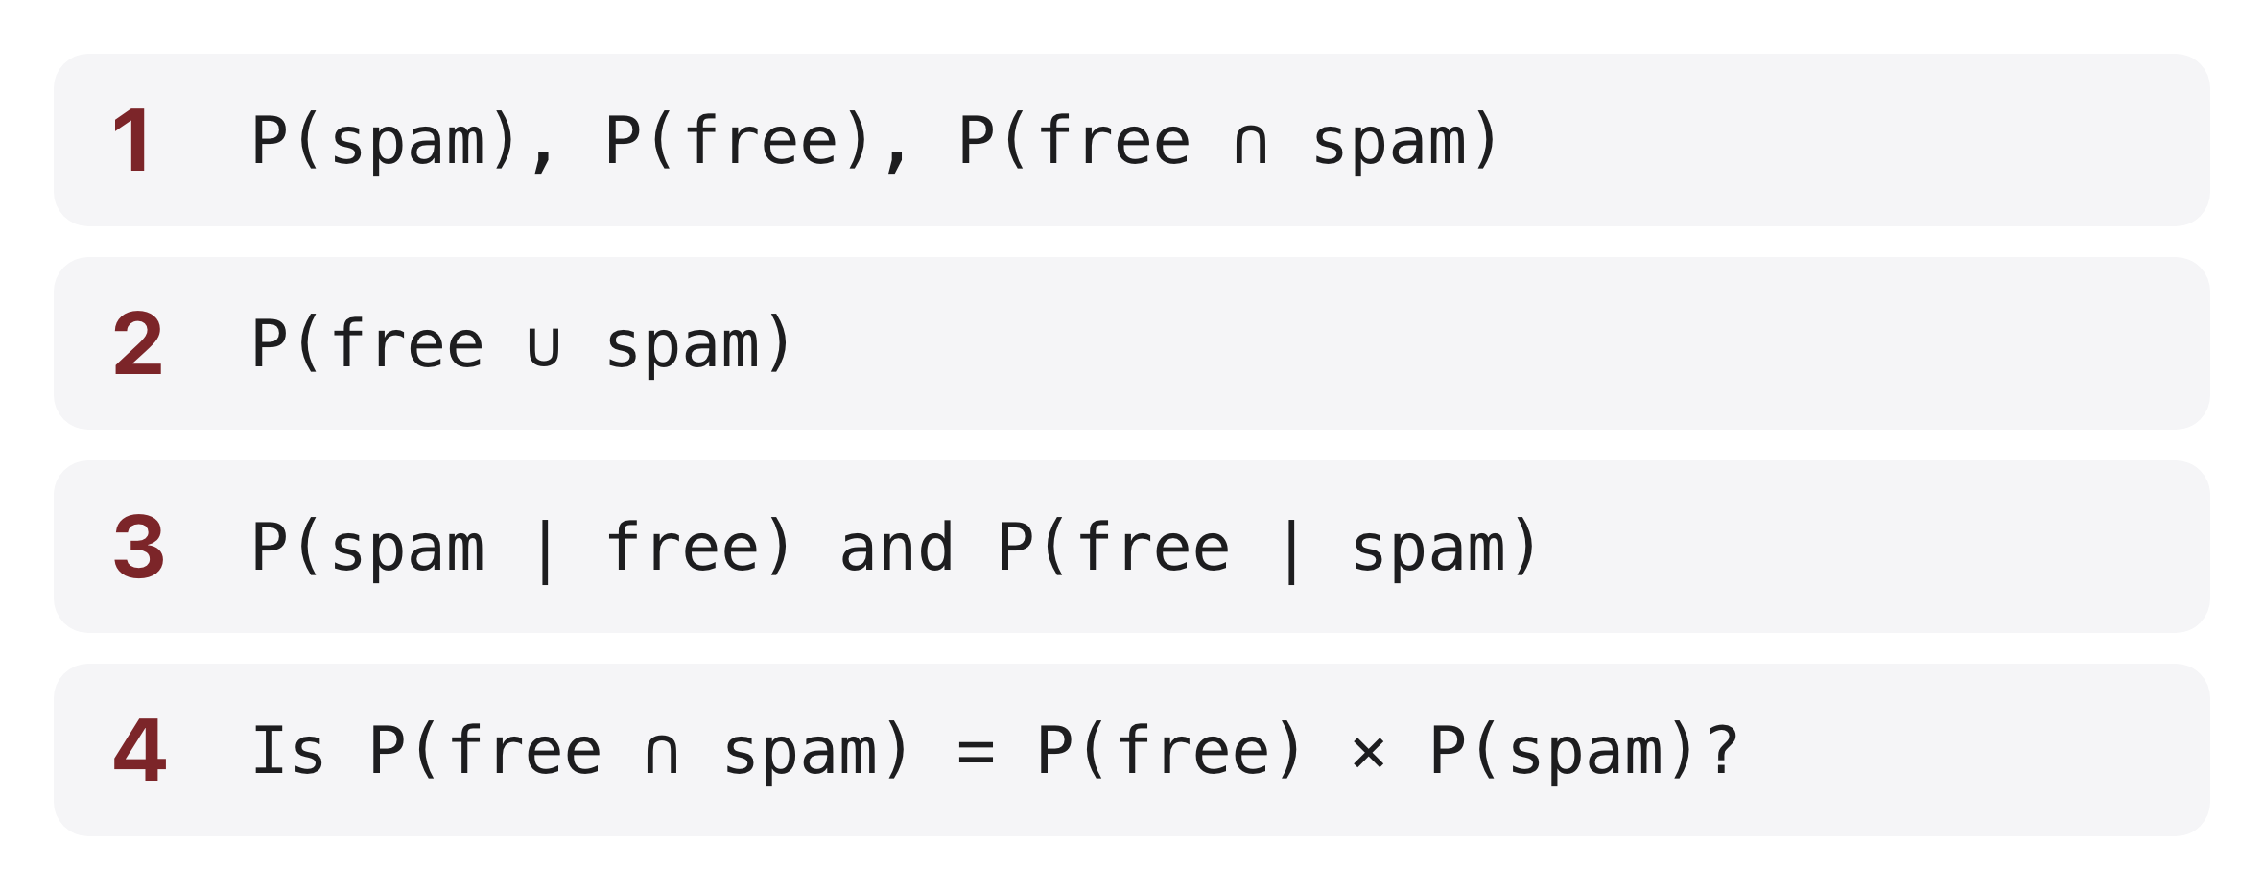
Four problems, in teams
Source: original figure
Notes:
Teams of three or four, one board each, markers out. Twenty minutes. Work the room rather than watching; the answers are in the instructor notes. Problem 4 is the one to bring back together at the end, because the answer, that "free" and spam are very much NOT independent, is exactly the assumption Naive Bayes makes anyway and gets away with.

Slide 6
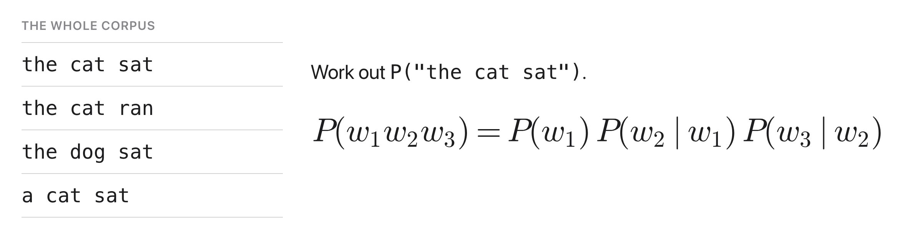
If you finish early
Source: original figure
Notes:
A four-sentence corpus and the chain rule with each word conditioned on the previous one. The answer is three quarters times two thirds times two thirds, which is exactly one third. This is a bigram language model computed by hand, so if a team gets here they have built Week 2 from scratch.

Slide 7

Break
Source: course-standard break figure

Slide 8
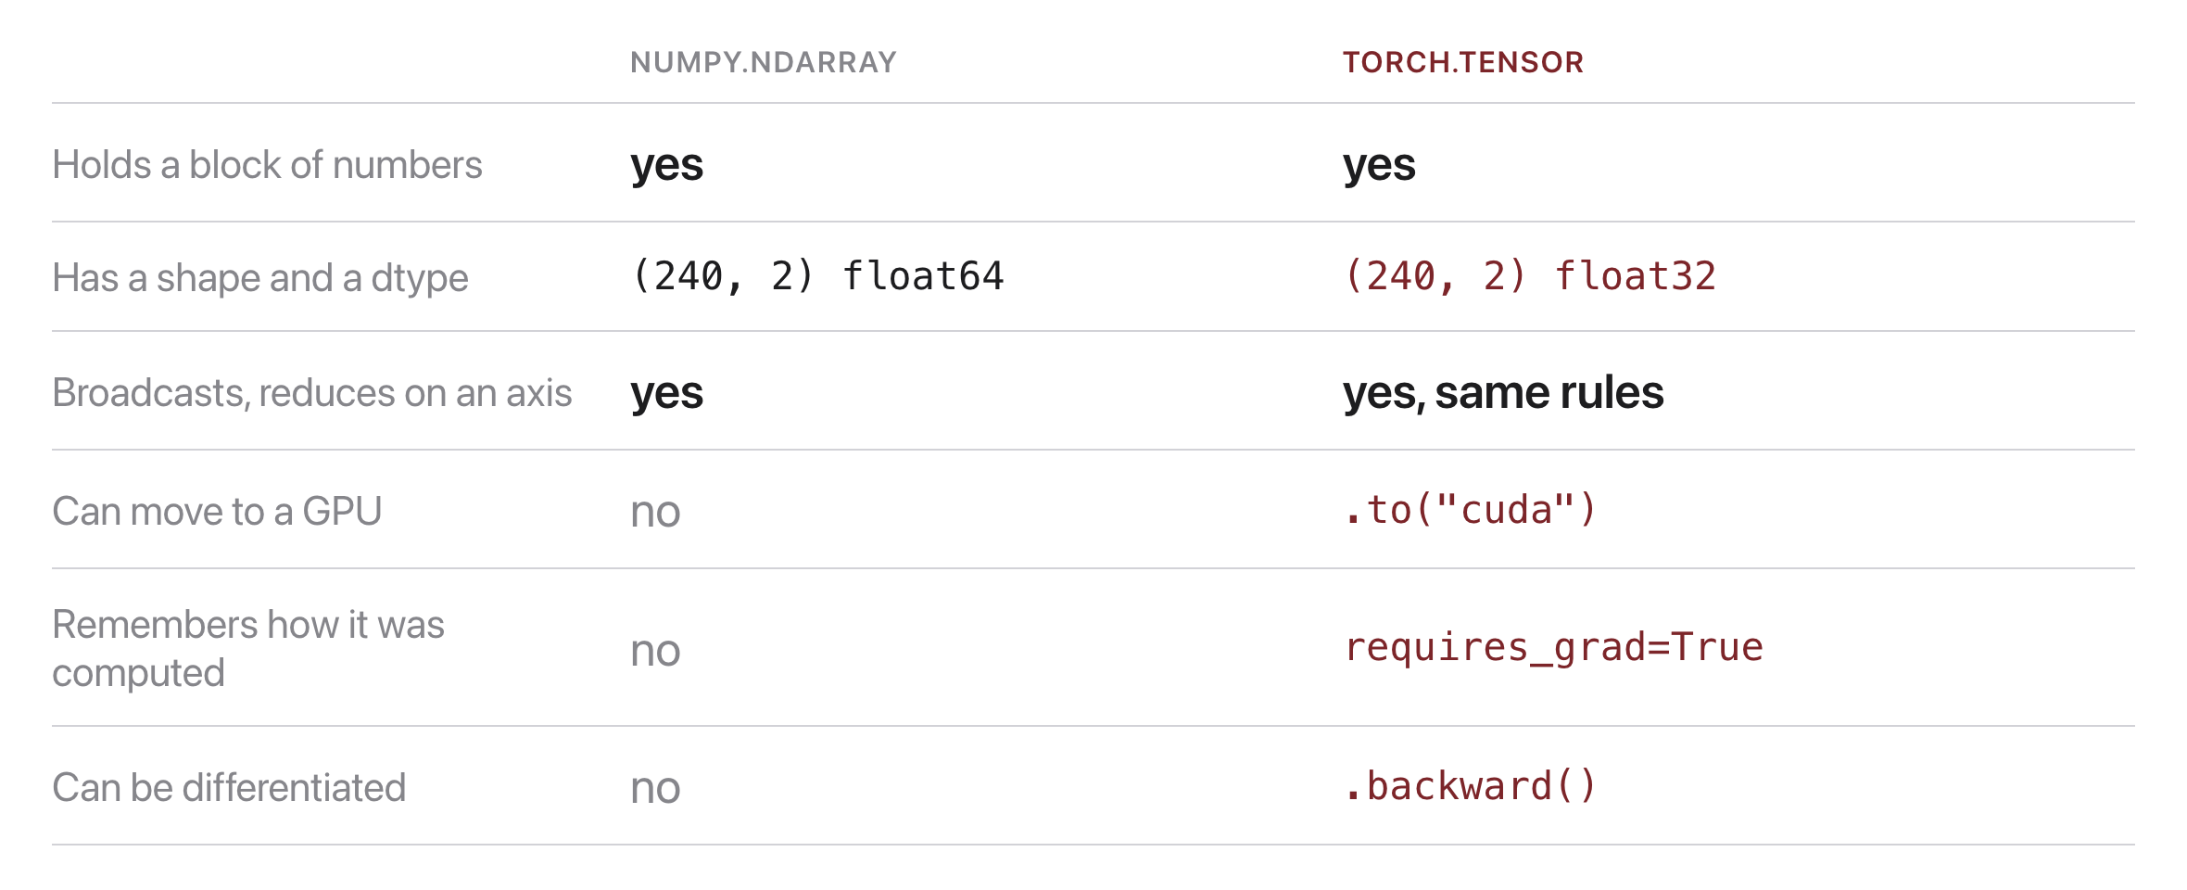
A tensor is an array that remembers
Source: original figure; NumPy 2.5, PyTorch 2.12
Notes:
Everything about a NumPy array transfers: shape, dtype, broadcasting, axis reductions, all identical. The two rows that matter are the last ones. A tensor can record the operations performed on it, and that recording is what makes it differentiable. Also flag dtype: networks want float32 and labels stay int64, and that mismatch is the first error most people hit.

Slide 9
Let's walk through Part 1 in the notebook
Tensors, dtype, reshape, and @.
Notes:
Everyone into today's lab.ipynb. Same repository, the same 240 movie reviews. The TRY IT at the end of the part is the reshape they will need again in Part 3.

Slide 10
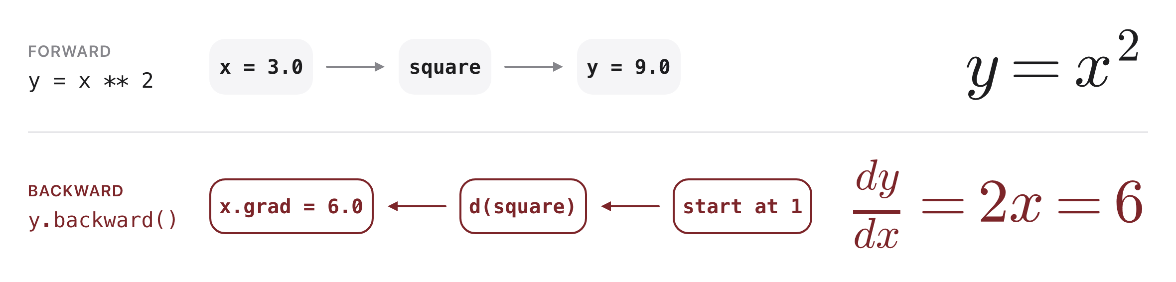
Record forwards, replay backwards
Source: original figure
Notes:
Set requires_grad and PyTorch keeps a note of every operation. Calling backward walks that note in reverse, applying the chain rule, the same chain rule they used on the whiteboard half an hour ago, and leaves the slope in x.grad. Here the answer is 6, which is 2x at x equal to 3, and checking it by hand is what stops it feeling like magic.

Slide 11
Let's walk through Part 2 in the notebook
One gradient, then twenty steps downhill.
Notes:
The loss curve at the end of this part is the cover slide. Ask them to predict what a bigger step size would do before the task shows them.

Slide 12
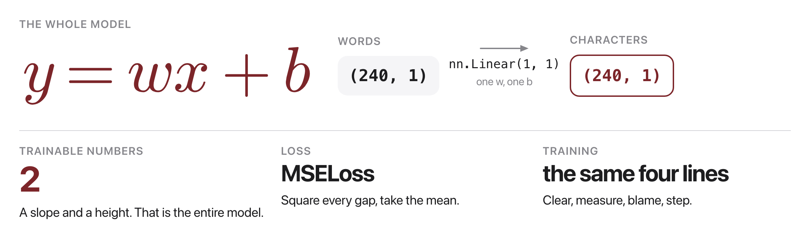
A line has two numbers
Source: original figure; the model built in today's notebook
Notes:
The simplest model there is: one slope, one height, two trainable numbers, and you can hold both in your head. The loss is mean squared error, which squares every vertical gap between the line and a point and averages them. Squaring is what makes a big miss hurt much more than a small one, and it is why the line ends up in the middle of the cloud rather than through the easiest points.

Slide 13
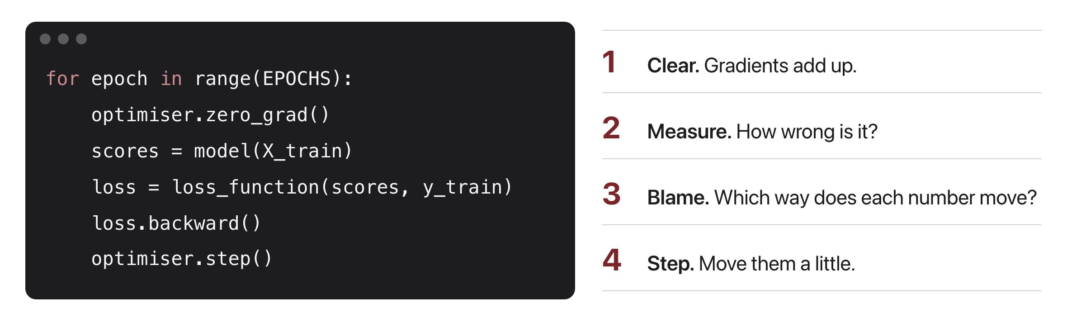
Four lines train everything
Source: original figure
Notes:
Clear, measure, blame, step. That loop is the same whether there is one weight or a hundred billion; only the time per pass changes. The optimiser is bookkeeping: it holds the list of parameters so you do not update each one by hand.

Slide 14
Let's walk through Part 3 in the notebook
The scatter, the model, then two thousand steps.
Notes:
The same 240 reviews, now as two numeric columns: how many words a review has, and how many characters. Scatter them first and let someone say out loud that there is obviously a line in there.

Slide 15
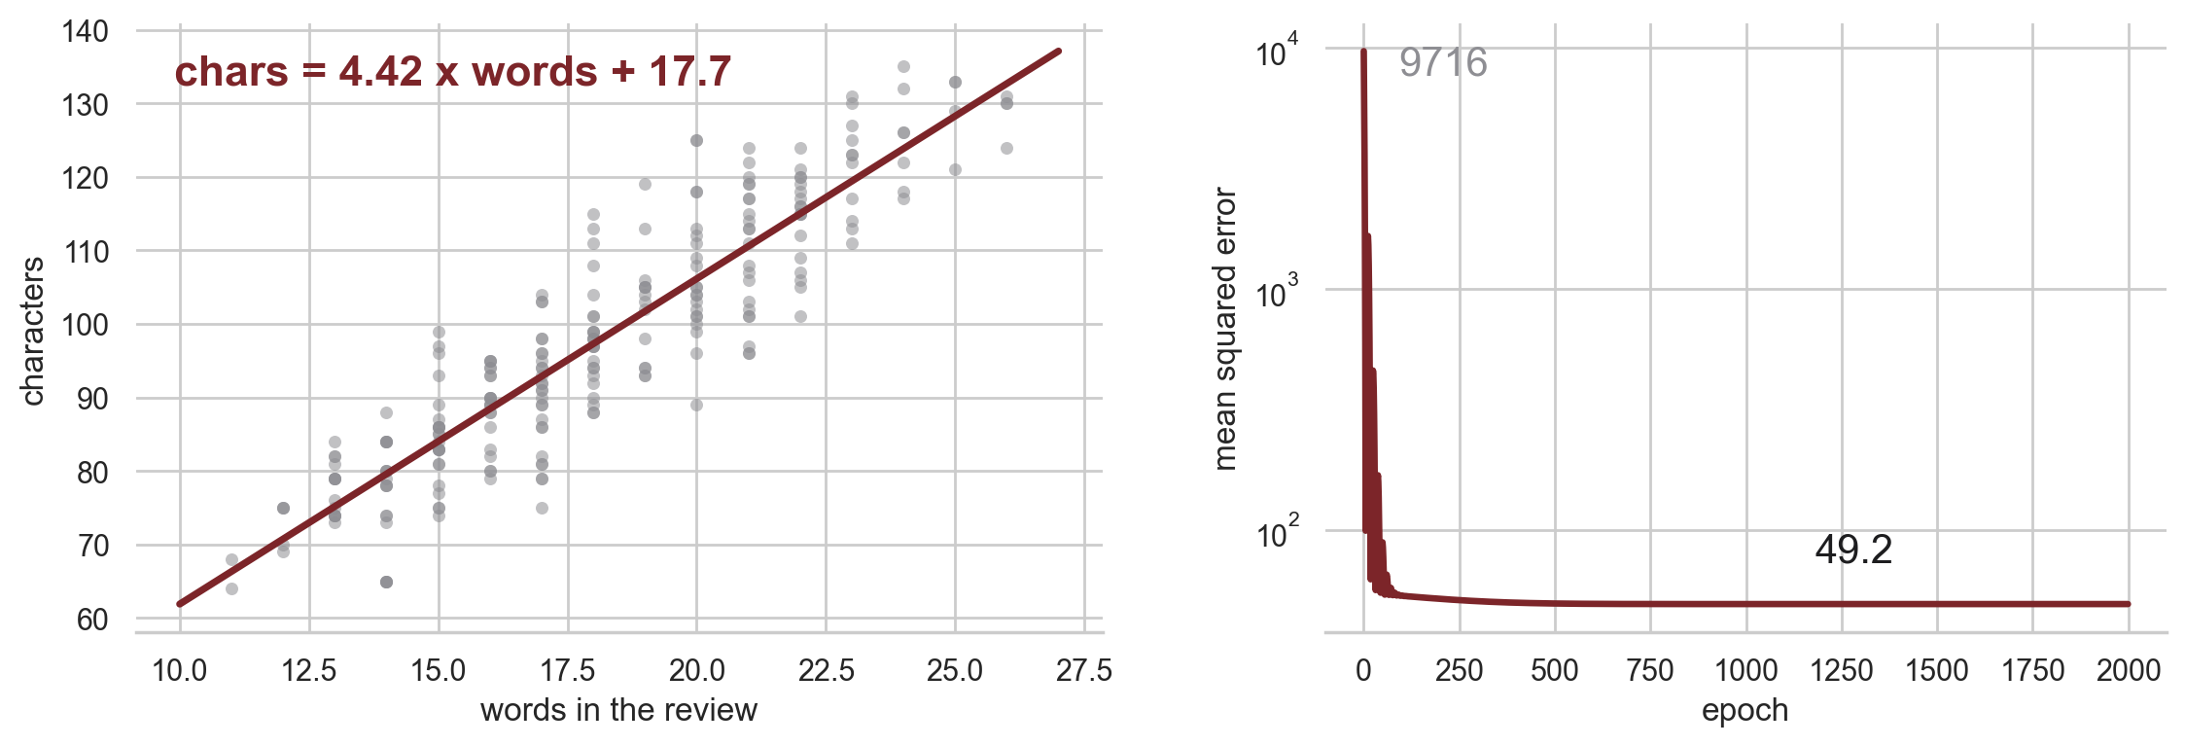
It found the line algebra would have given you
Source: original figure, from the 2000-epoch run in today's notebook
Notes:
Two thousand steps take the error from 9716 to 49.2, and the numbers it lands on, 4.42 and 17.7, are exactly what the least-squares formula gives. That is the point of the slide: for a straight line you never needed gradient descent, because algebra hands you the answer. Every model after this week has no formula, and the loop is all there is. Also flag the intercept: 17.7 characters for a review of no words is nonsense, and nobody should read a fitted parameter as a measurement.

Slide 16
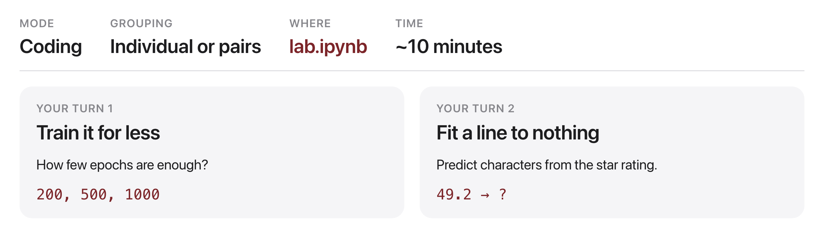
Your turn
Source: original figure
Notes:
The first task asks how few epochs are enough, and the answer is interesting: the slope settles by 500 and the intercept crawls for another 1500. The second fits a line to two columns with almost nothing between them, and the loss barely beats predicting the average. Make them say what that means before they leave: a fitted line is not evidence of a relationship.

