Slide 1
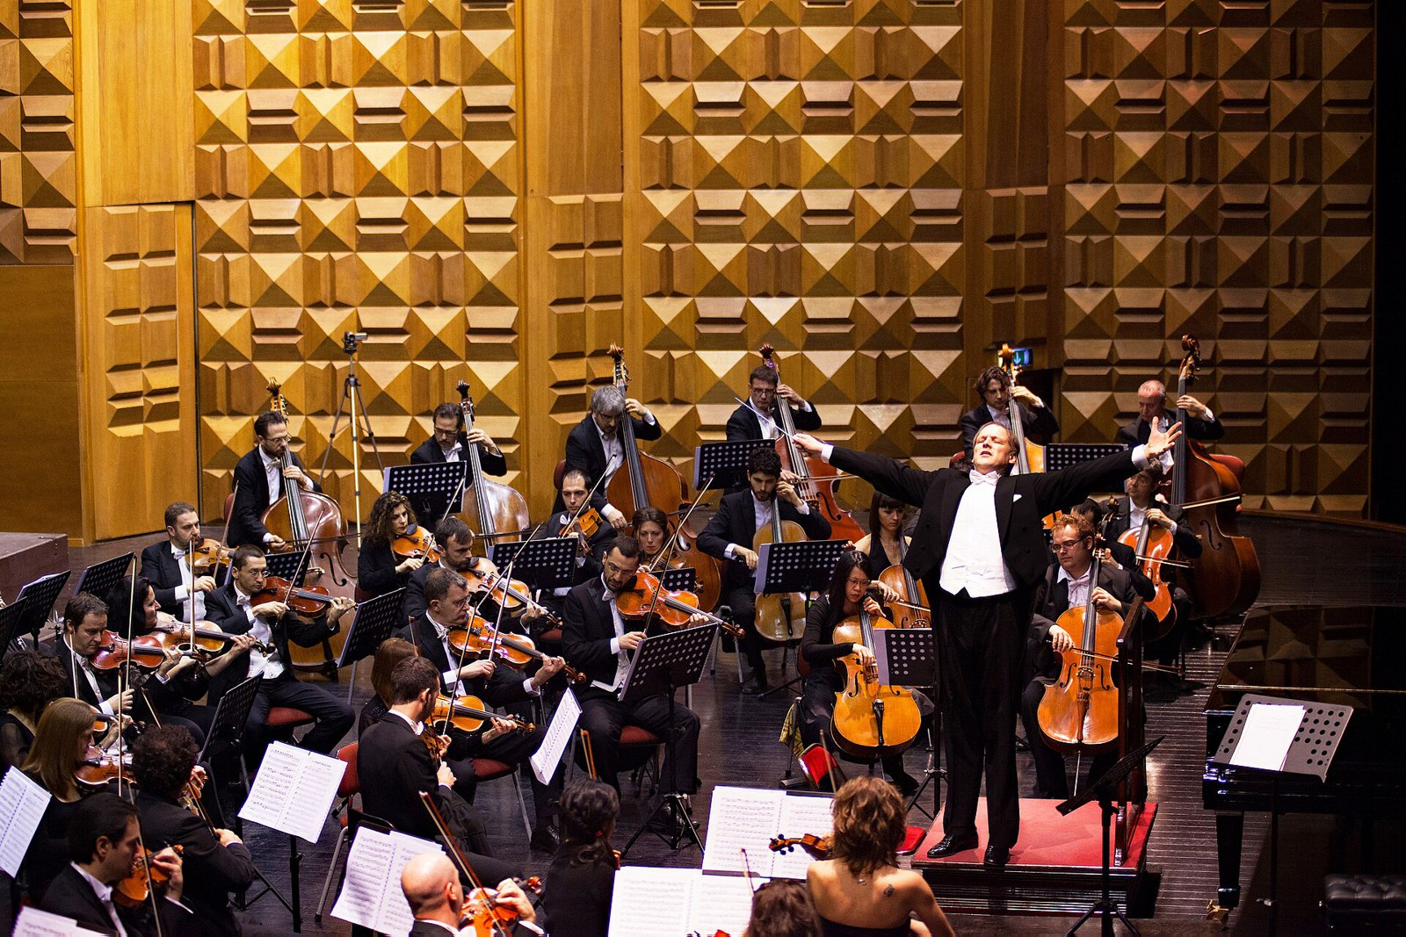
CSCI 3495
Agentic Workflows & Orchestration
Natural Language Processing & Large Language Models
Week 14, Class 1 · Mon Nov 30, 2026
Source: Photo: AnnaLesniewski, Wikimedia Commons, CC0
Notes:
A conductor plays no instrument, yet the whole orchestra depends on one. What plays that role in a system of LLM calls?

Slide 2
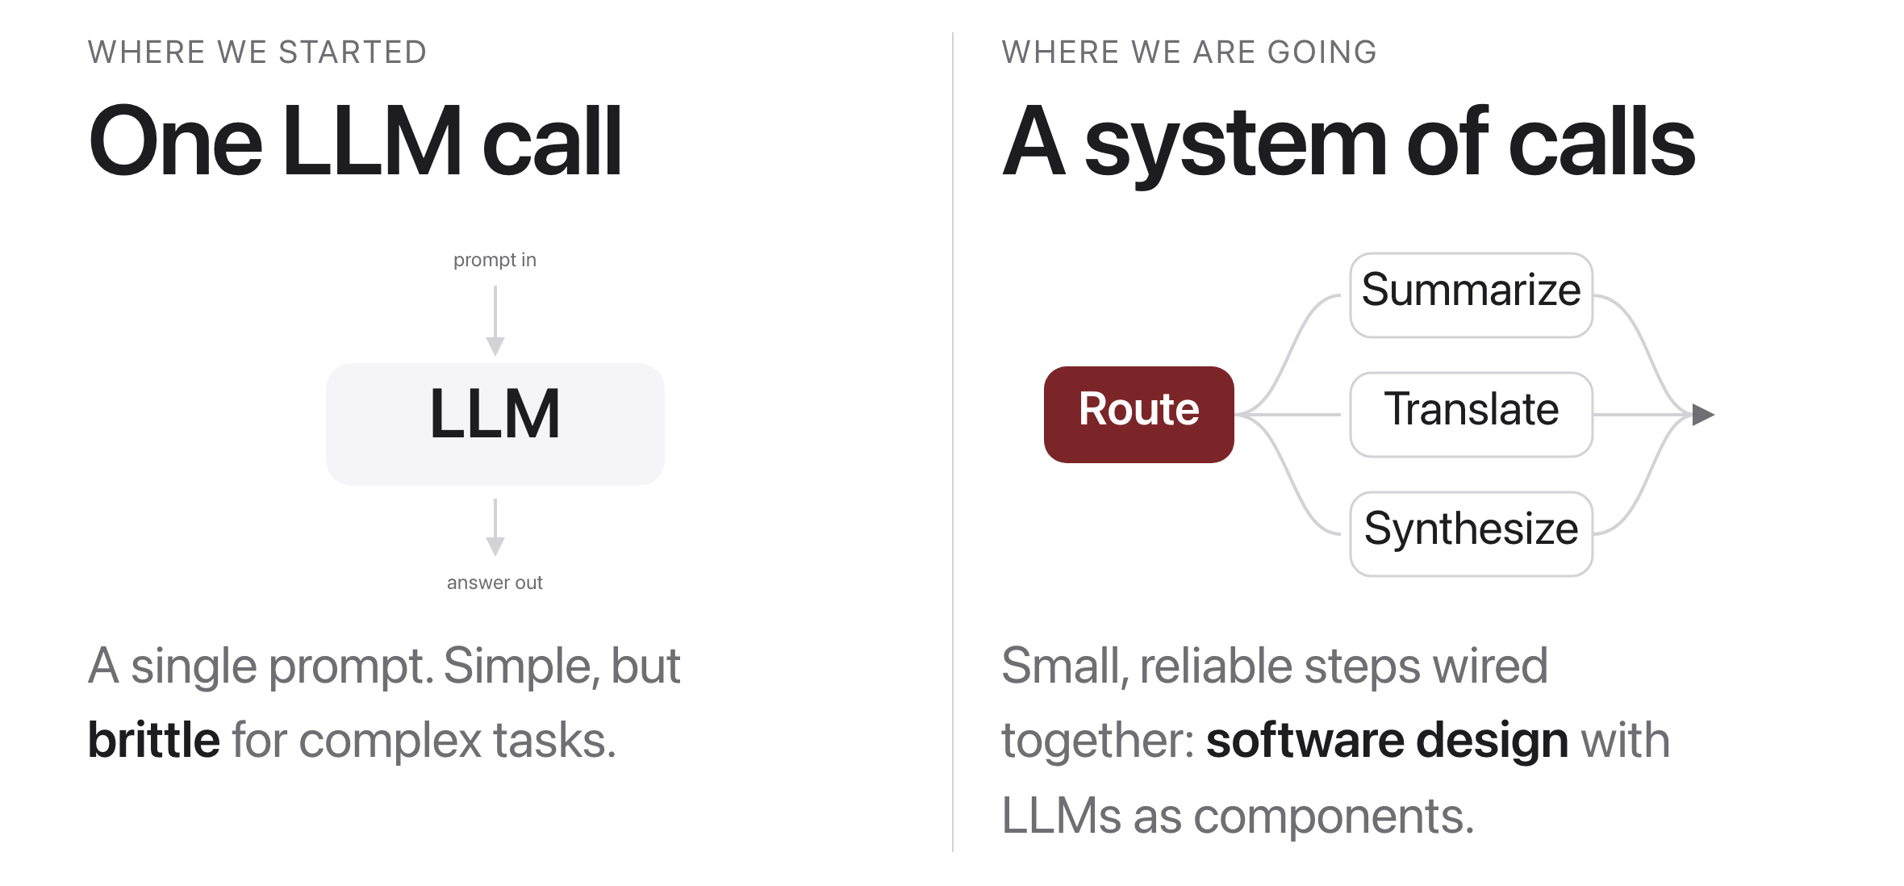
From one call to a system
Source: original figure
Notes:
The skill shifts from prompting to systems design.

Slide 3

A team of specialists, not one genius
Source: Unsplash License, https://images.unsplash.com/photo-1522071820081-009f0129c71c
Notes:
Like a project team, a good LLM system splits work into focused roles that each do one job well.

Slide 4
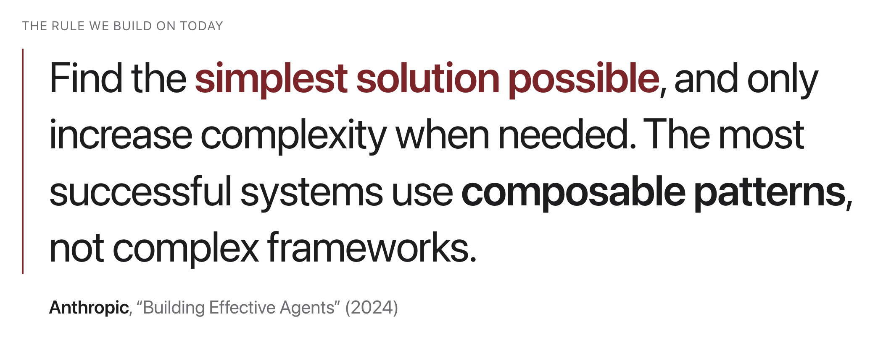
A grounding source
Source: Anthropic, "Building Effective Agents" (2024)
Notes:
An engineering guide, not a paper. Most agent projects fail by being over-engineered.

Slide 5
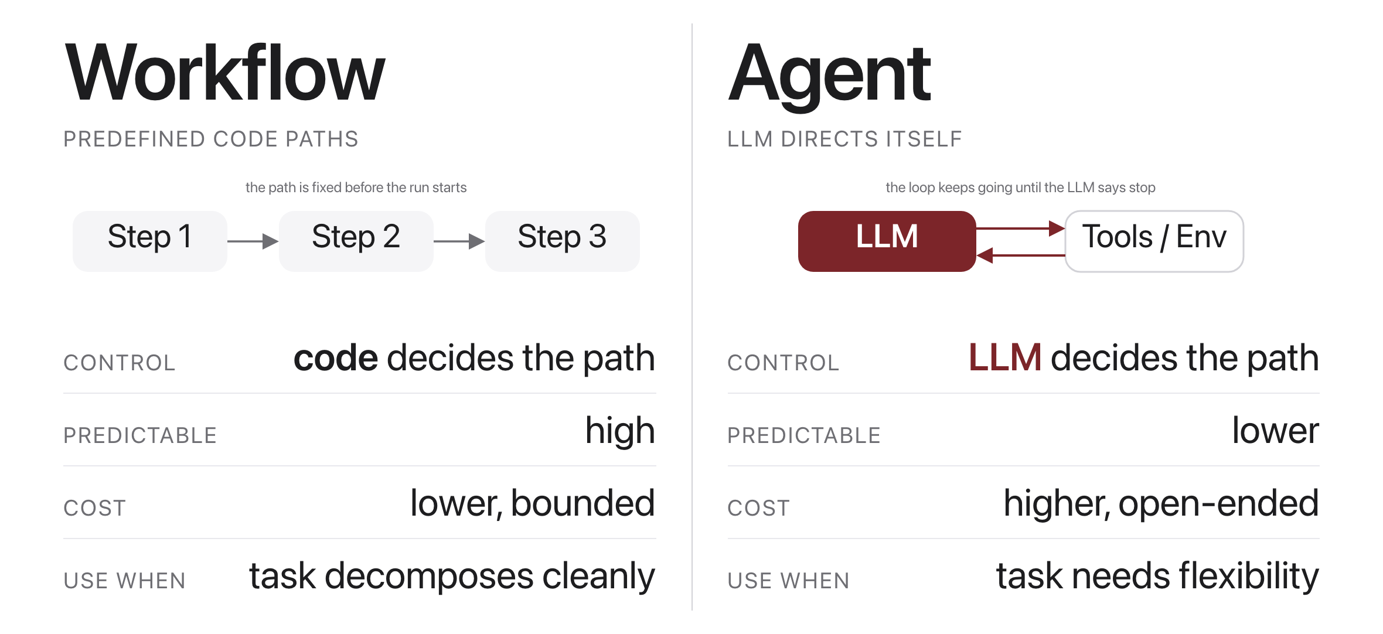
Workflow or agent?
Source: Anthropic, "Building Effective Agents" (2024)
Notes:
Most production needs are workflows, not full agents.

Slide 6
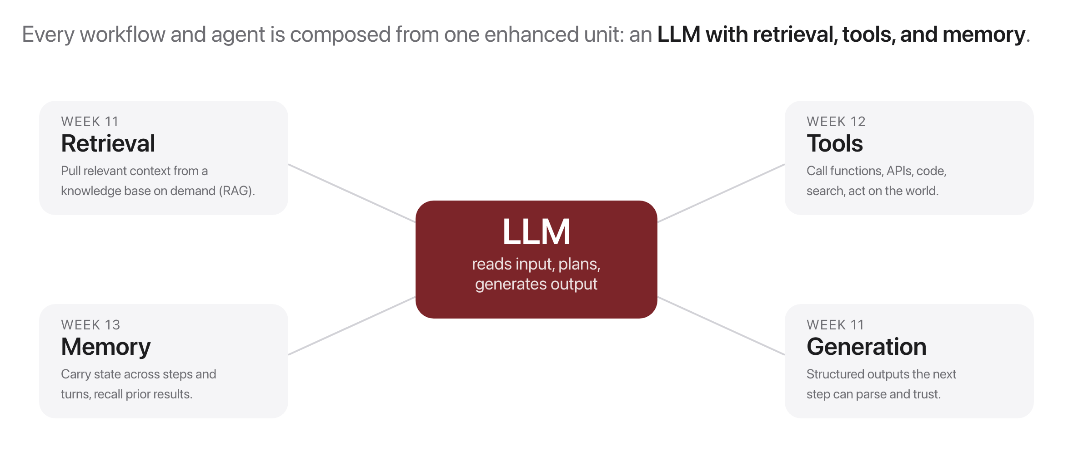
The building block: the augmented LLM
Source: Anthropic, "Building Effective Agents" (2024)
Notes:
Everything today is made of this one unit: a model with retrieval, tools and memory attached. Retrieval was Week 12, tools were Week 12. Nothing new here, just named so we can compose it.

Slide 7
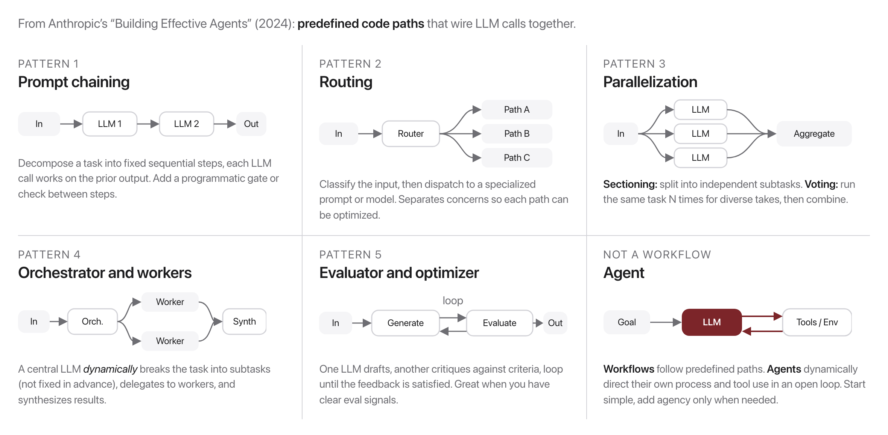
The five patterns at a glance
Source: Anthropic, "Building Effective Agents" (2024)
Notes:
Today: patterns 1 to 4; evaluator-optimizer next class.

Slide 8
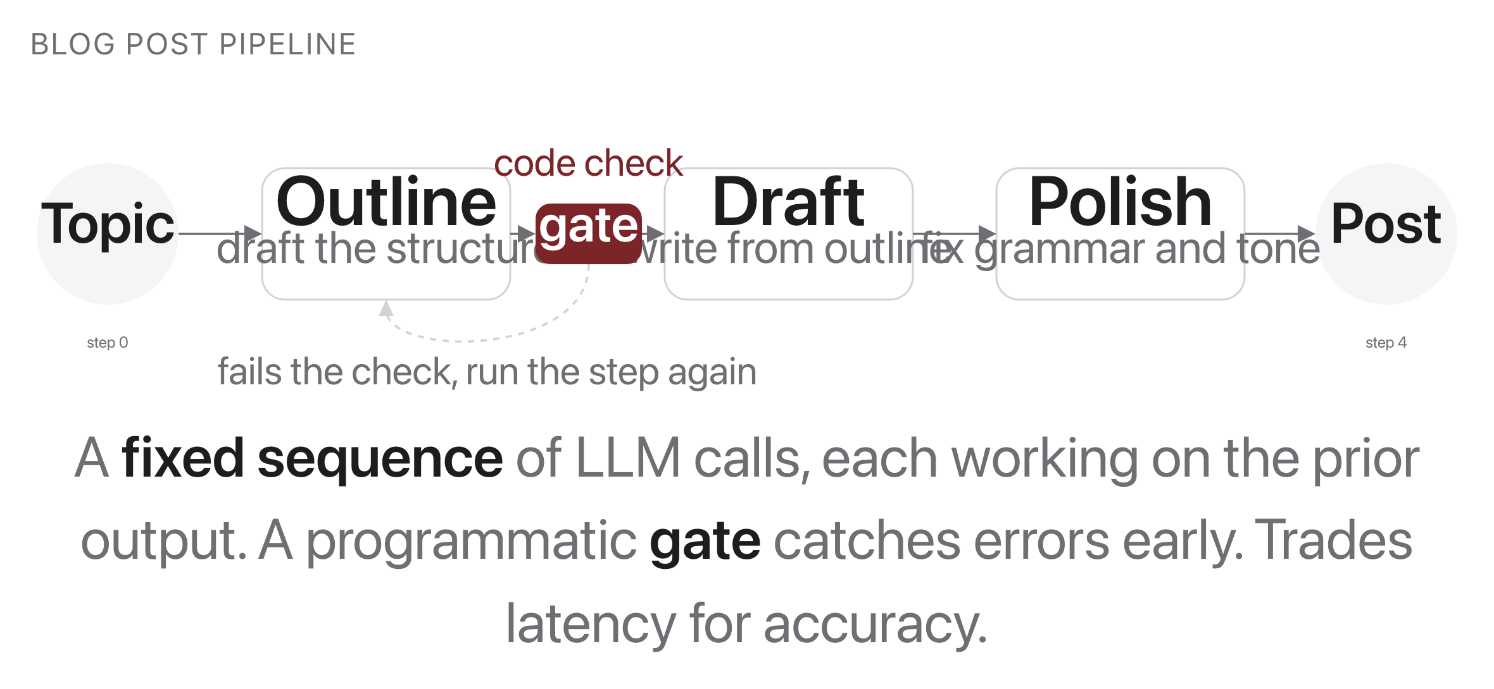
Pattern 1: prompt chaining
Source: original figure; Anthropic, "Building Effective Agents" (2024)
Notes:
A fixed sequence, with a gate between steps. Outline, draft, polish, and a programmatic check that can send a step back. Fixed in advance, which is what makes it a workflow and not an agent.

Slide 9
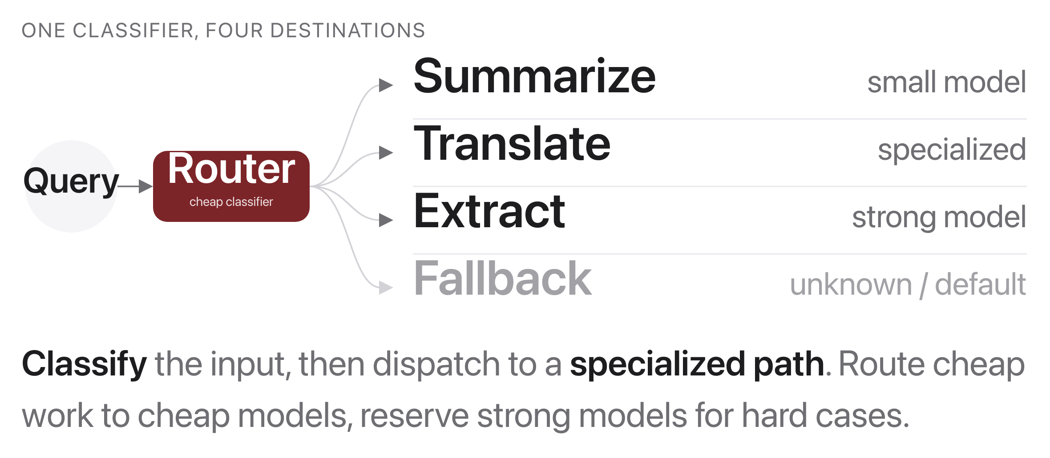
Pattern 2: routing
Source: original figure; Anthropic, "Building Effective Agents" (2024)
Notes:
One cheap classifier, then dispatch to a specialist. This is where most of the cost savings in real systems come from: the strong model only sees the queries that need it.

Slide 10
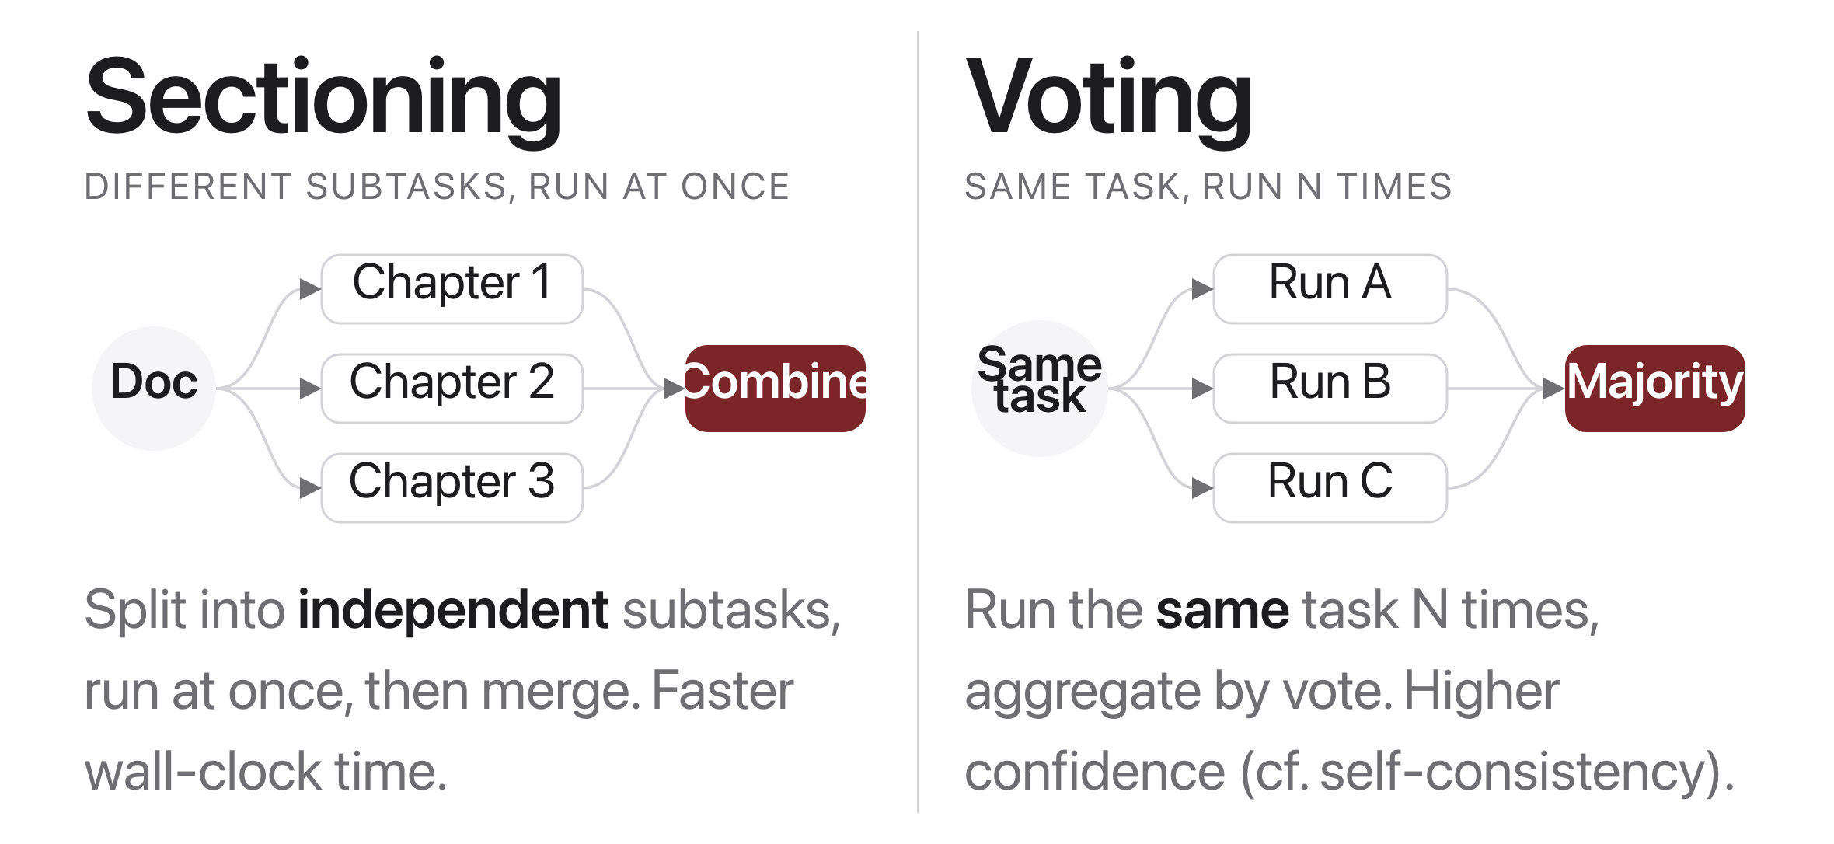
Pattern 3: parallelization
Source: original figure; Anthropic, "Building Effective Agents" (2024)
Notes:
Two flavours. Sectioning splits a task into independent pieces and merges them, which buys wall-clock time. Voting runs the same task several times and aggregates, which buys reliability.

Slide 11
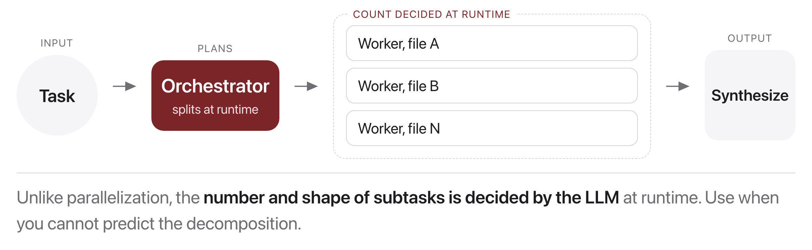
Pattern 4: orchestrator and workers
Source: original figure; Anthropic, "Building Effective Agents" (2024)
Notes:
The difference from parallelization is that the number and shape of the subtasks is decided at runtime, by the model, not written down in advance. That is the first pattern on this slide with any real autonomy in it.

Slide 12

What is the simplest design that could possibly work?
Ask this before adding a single agent loop. Complexity is a cost, not a feature.
Source: Unsplash License, https://images.unsplash.com/photo-1518770660439-4636190af475
Notes:
Ask it before adding a single agent loop. Every extra step is another place to fail, and complexity is a cost you pay forever.

Slide 13
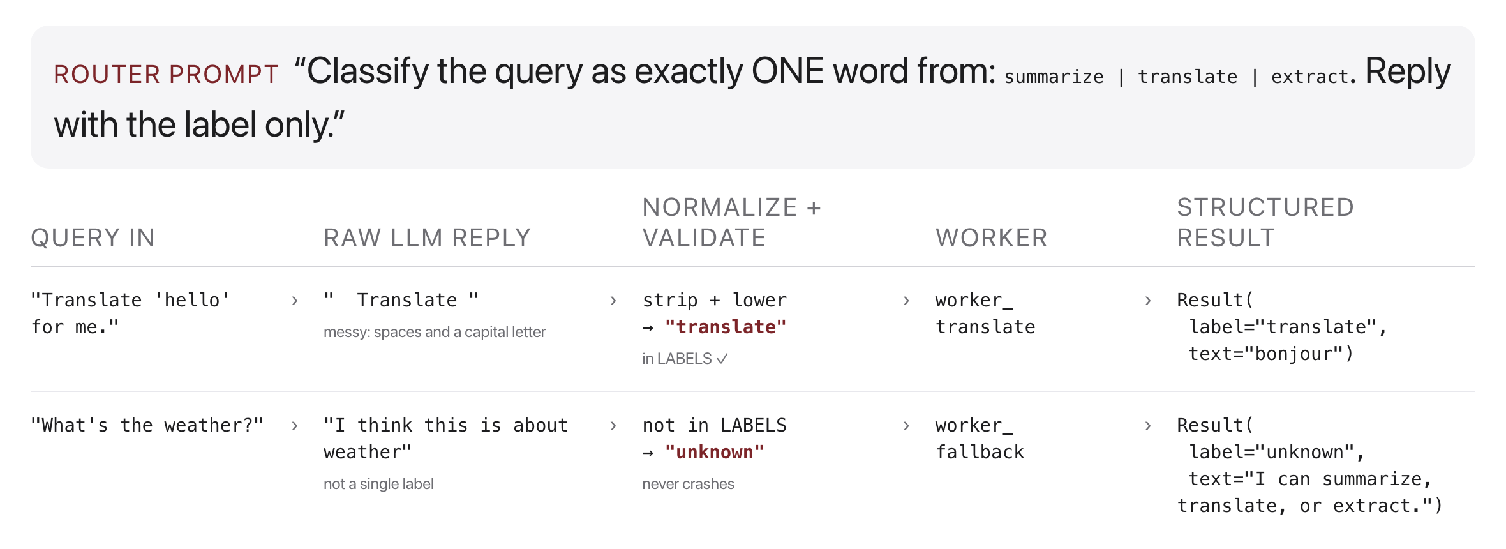
Routing in depth (our exercise)
Source: original figure
Notes:
Make the router deterministic and testable.

Slide 14
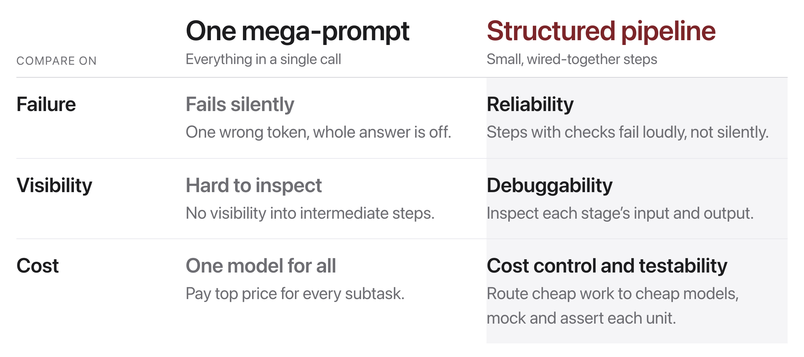
Why structure beats one mega-prompt
Source: original figure
Notes:
Software engineering with stochastic parts.

Slide 15
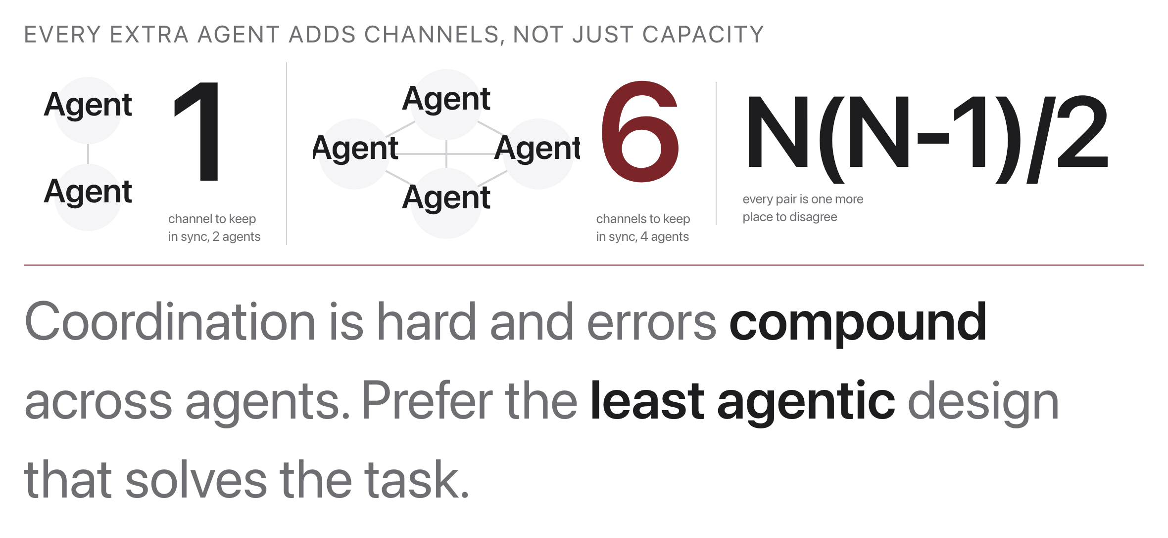
Multi-agent systems: a caution
Source: original figure; Anthropic, "Building Effective Agents" (2024)
Notes:
Often a workflow is simpler and more reliable.

Slide 16
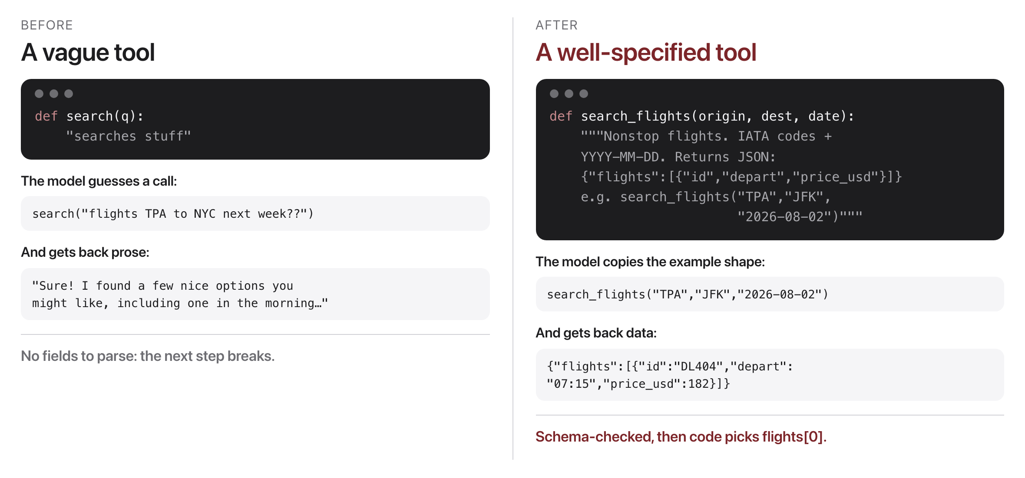
Designing good tool and step interfaces
Source: Anthropic, "Building Effective Agents" (2024)
Notes:
The model is only as good as its interface. Prompt-engineer your tools as carefully as your prompts.

Slide 17

Break
Source: original figure

Slide 18
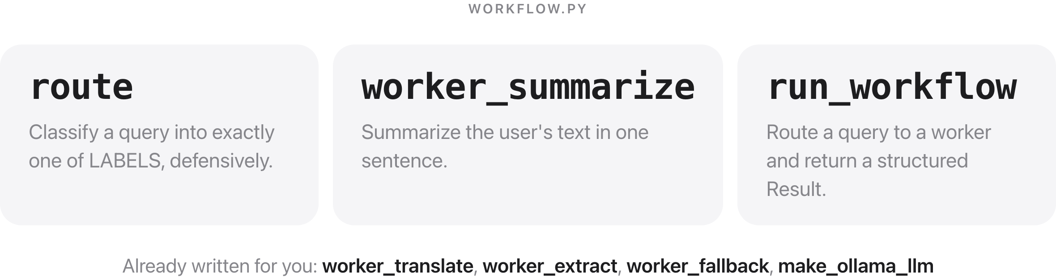
Router and workers
Source: weeks/week-14/class-01/exercise/workflow.py
Notes:
Three functions: route classifies the query defensively, worker_summarize is one specialist, and run_workflow ties them into a structured Result. The other workers are written, so they have a pattern to copy.

Slide 19
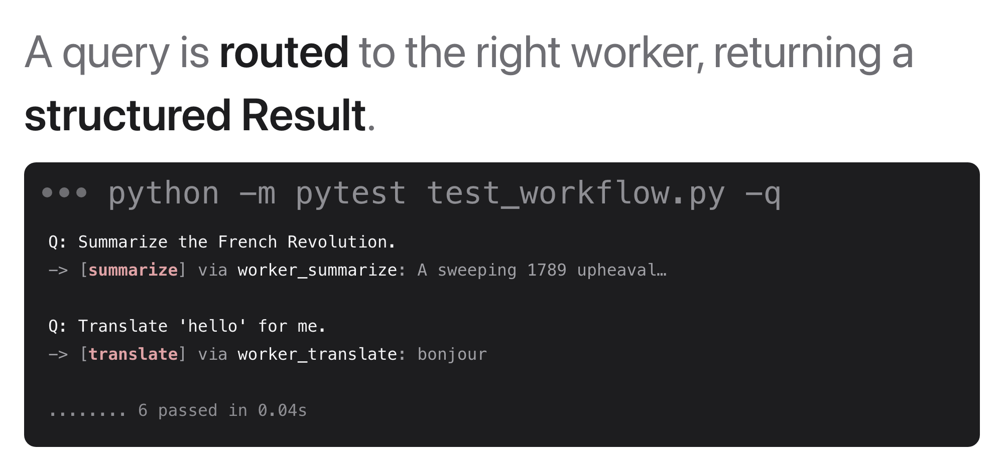
What you should see
Source: example run, mock LLM (deterministic tests)
Notes:
A query goes to the router, the router picks a worker, and a structured Result comes back. Point at the structure: the worker's output is parsed, not read.

Slide 20
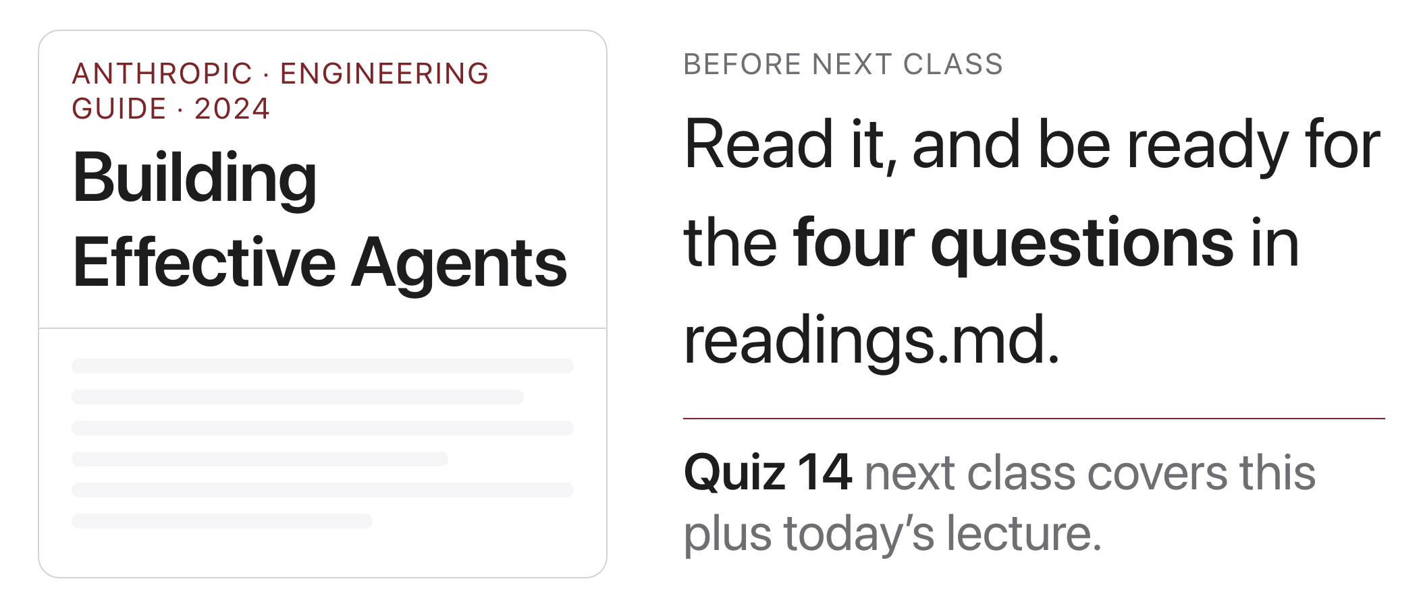
Reading & next class
Source: anthropic.com/research/building-effective-agents
Notes:
Next: reflection, evaluator and optimizer, when NOT to use agents. Quiz 14 plus project feedback session.

