Slide 1

CSCI 3495
Welcome & The Big Picture
Natural Language Processing & Large Language Models
Week 1, Class 1 · Mon Aug 24, 2026
Source: photo: Unsplash License

Slide 2
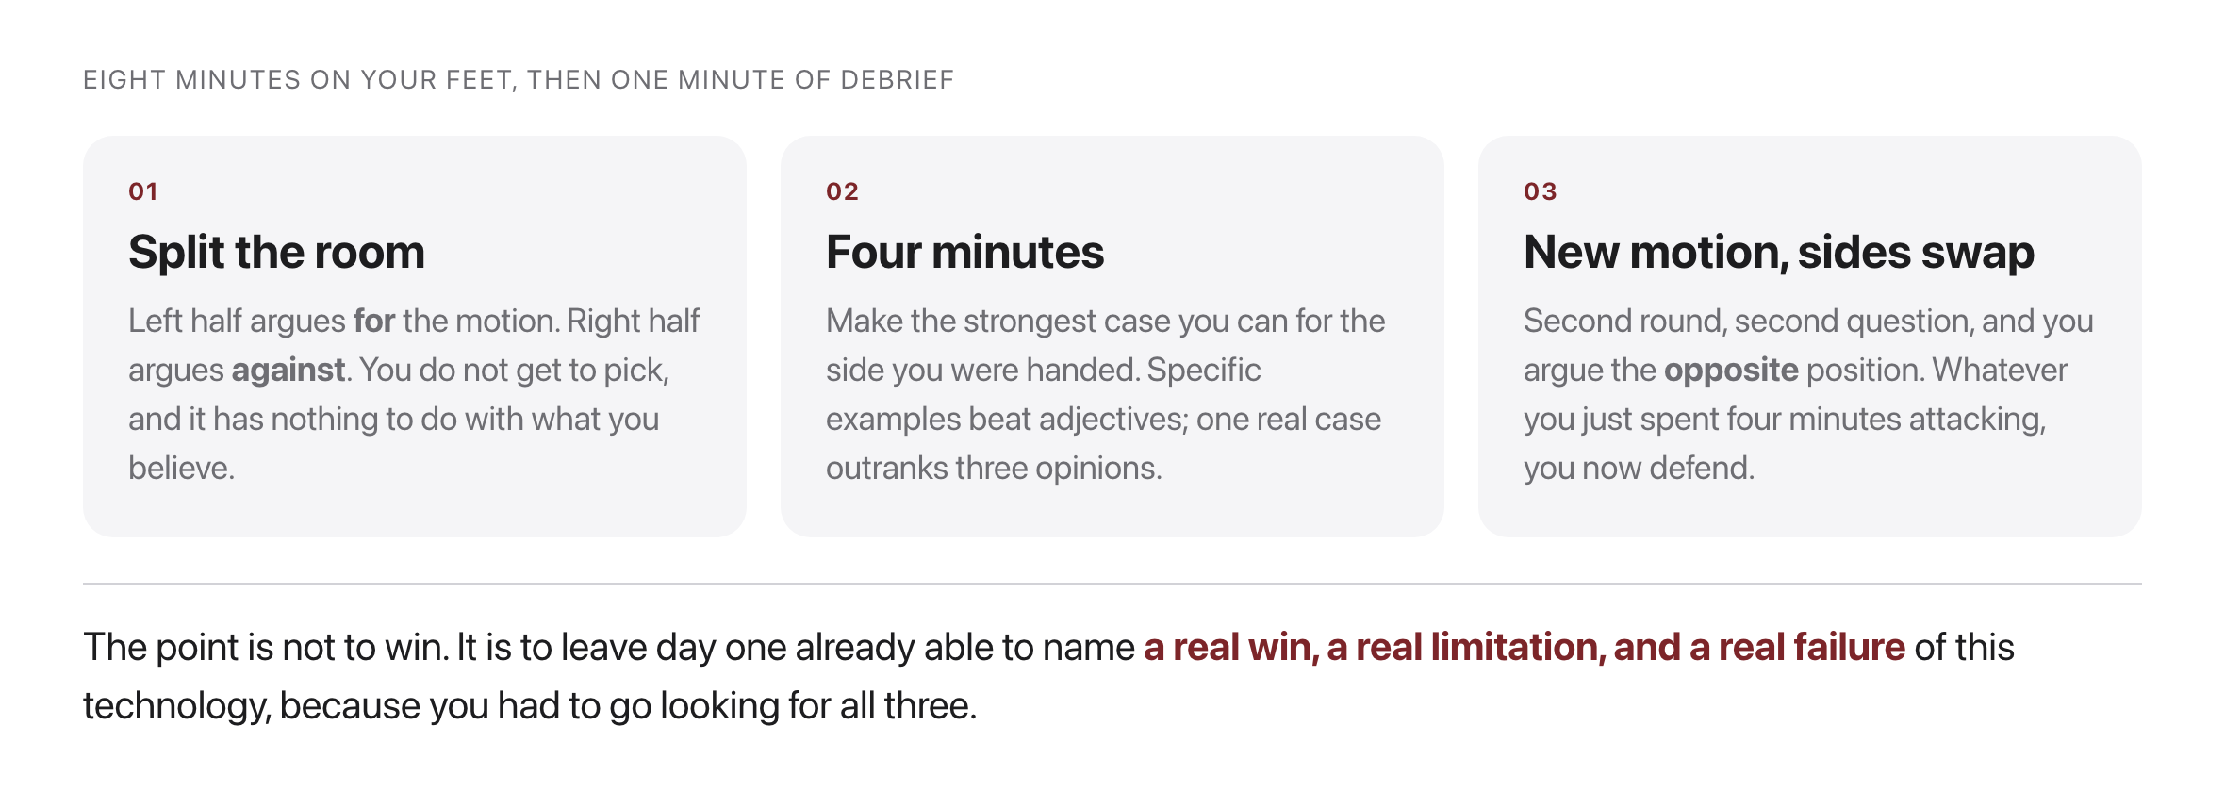
Ice breaker: you will argue both sides
Source: original figure

Slide 3
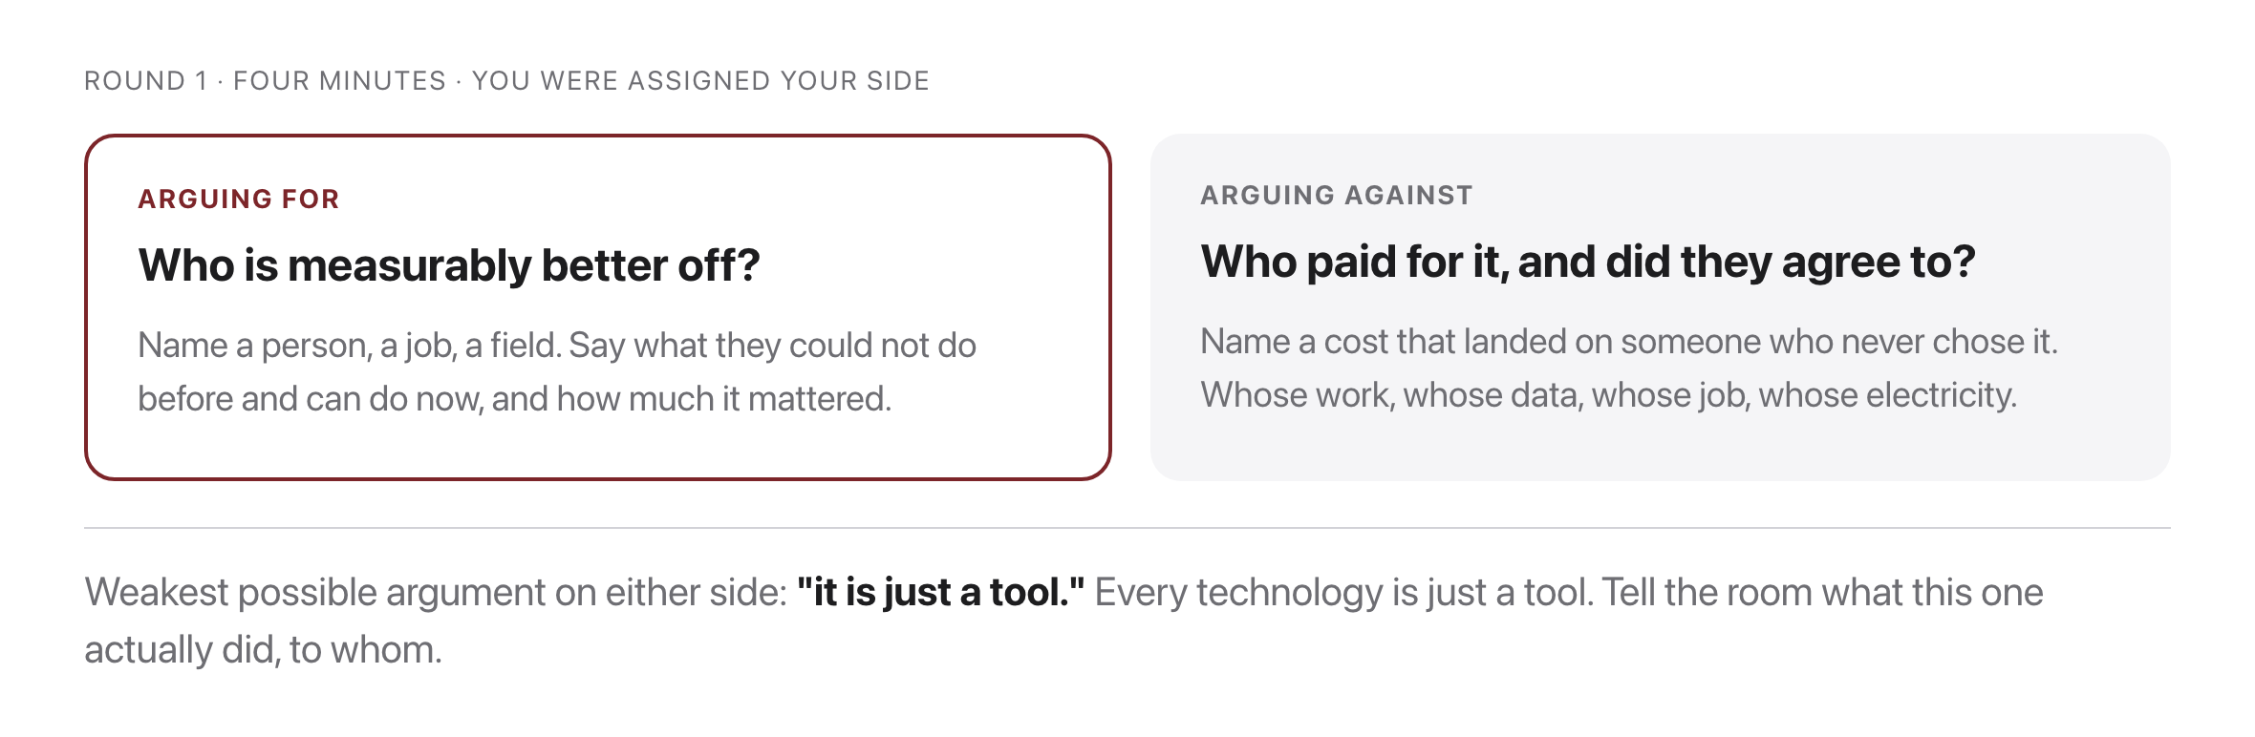
Round 1: on balance, AI and LLMs have made society better
Source: original figure

Slide 4
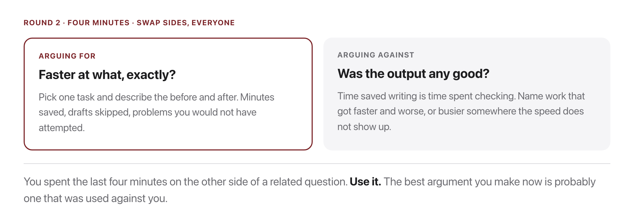
Round 2: AI and LLMs have made us measurably more productive
Source: original figure

Slide 5
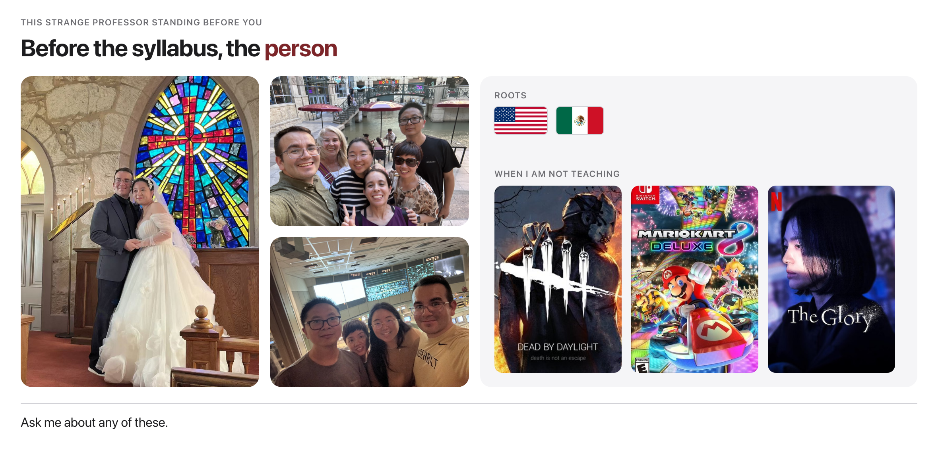
Who am I?
Source: personal photos; game and series cover art copyright their publishers

Slide 6
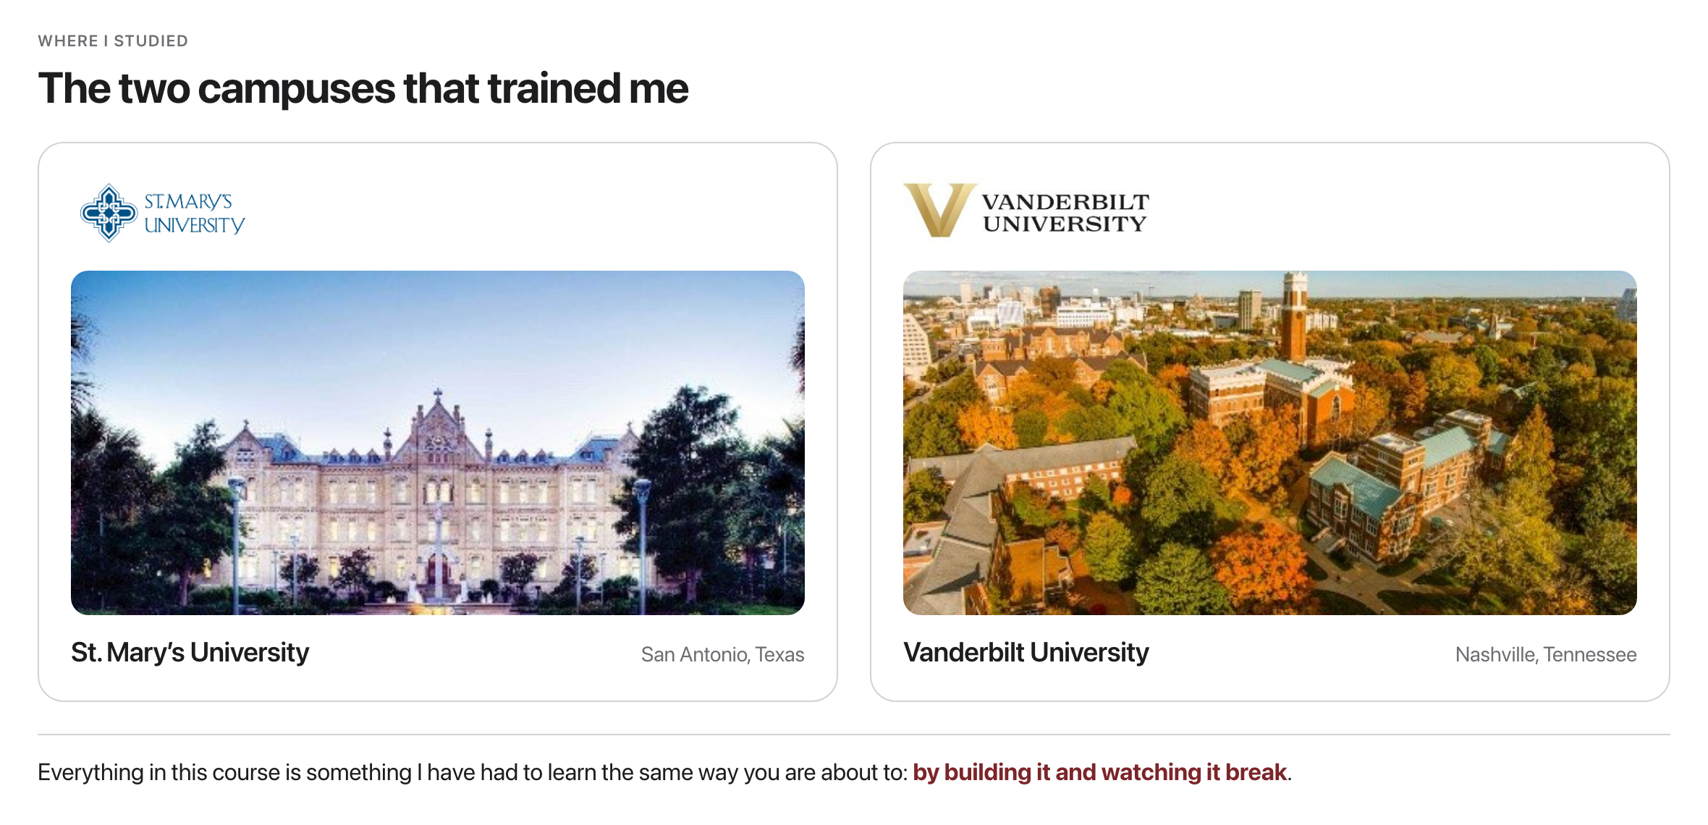
My background
Source: campus photos and marks copyright the respective universities

Slide 7
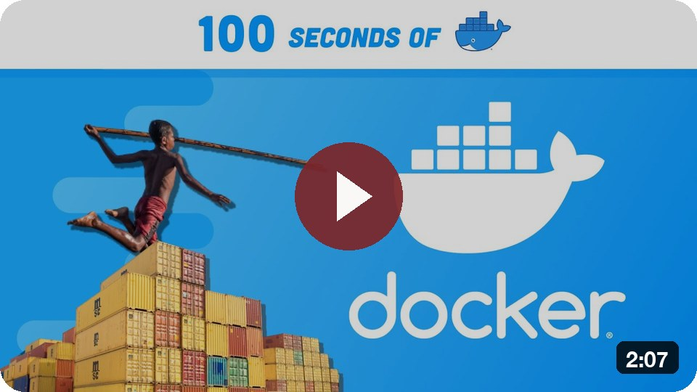
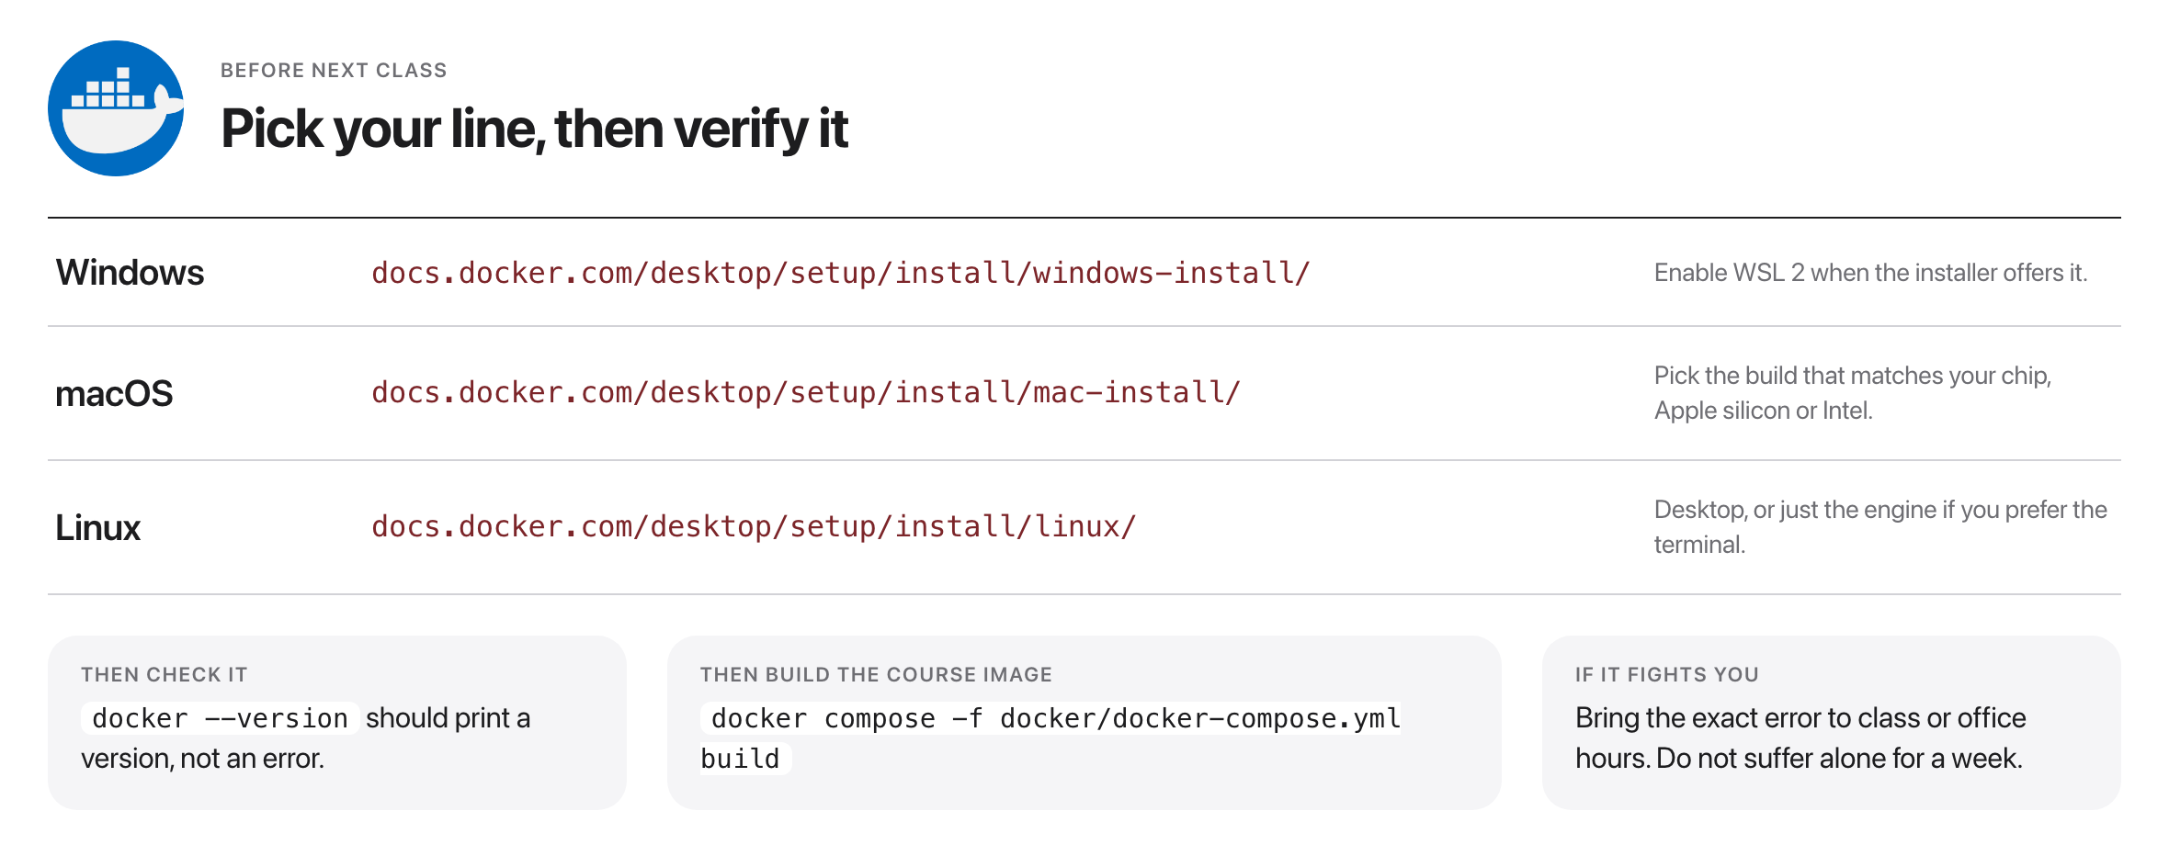
Installing Docker
Windows · macOS · Linux
Docker in 100 Seconds
Source: docs.docker.com/desktop/setup/install/

Slide 8
What is Natural Language Processing (NLP)?
Take thirty seconds. Say it in your own words before I say it in mine.
Source: reaction GIF

Slide 9
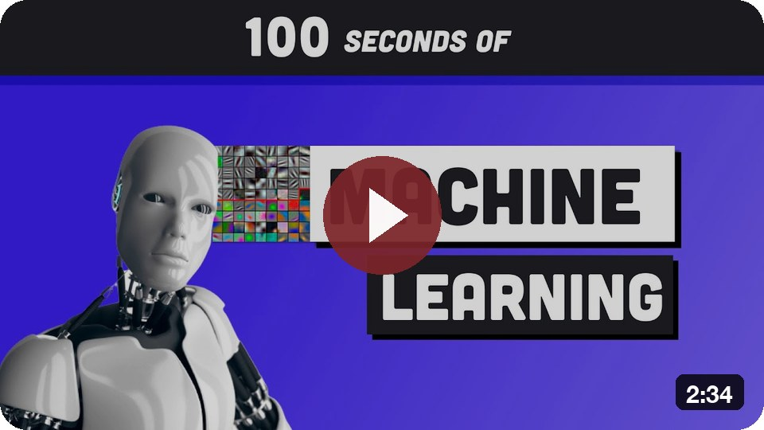
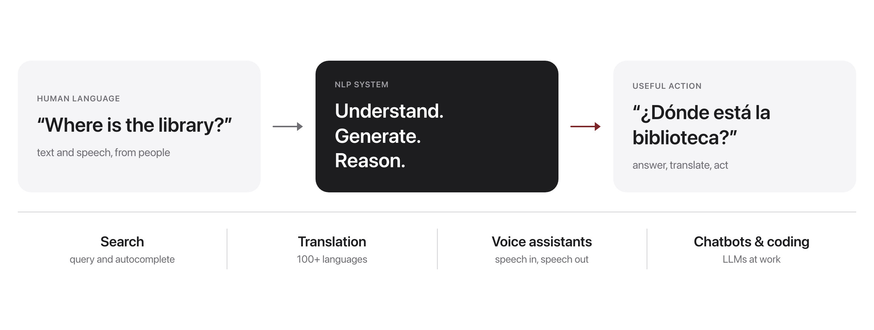
Language in, action out
ML in 100 Seconds
Source: original figure

Slide 10

Language is everywhere
Source: original figure; photo: Unsplash License, https://images.unsplash.com/photo-1517245386807-bb43f82c33c4

Slide 11
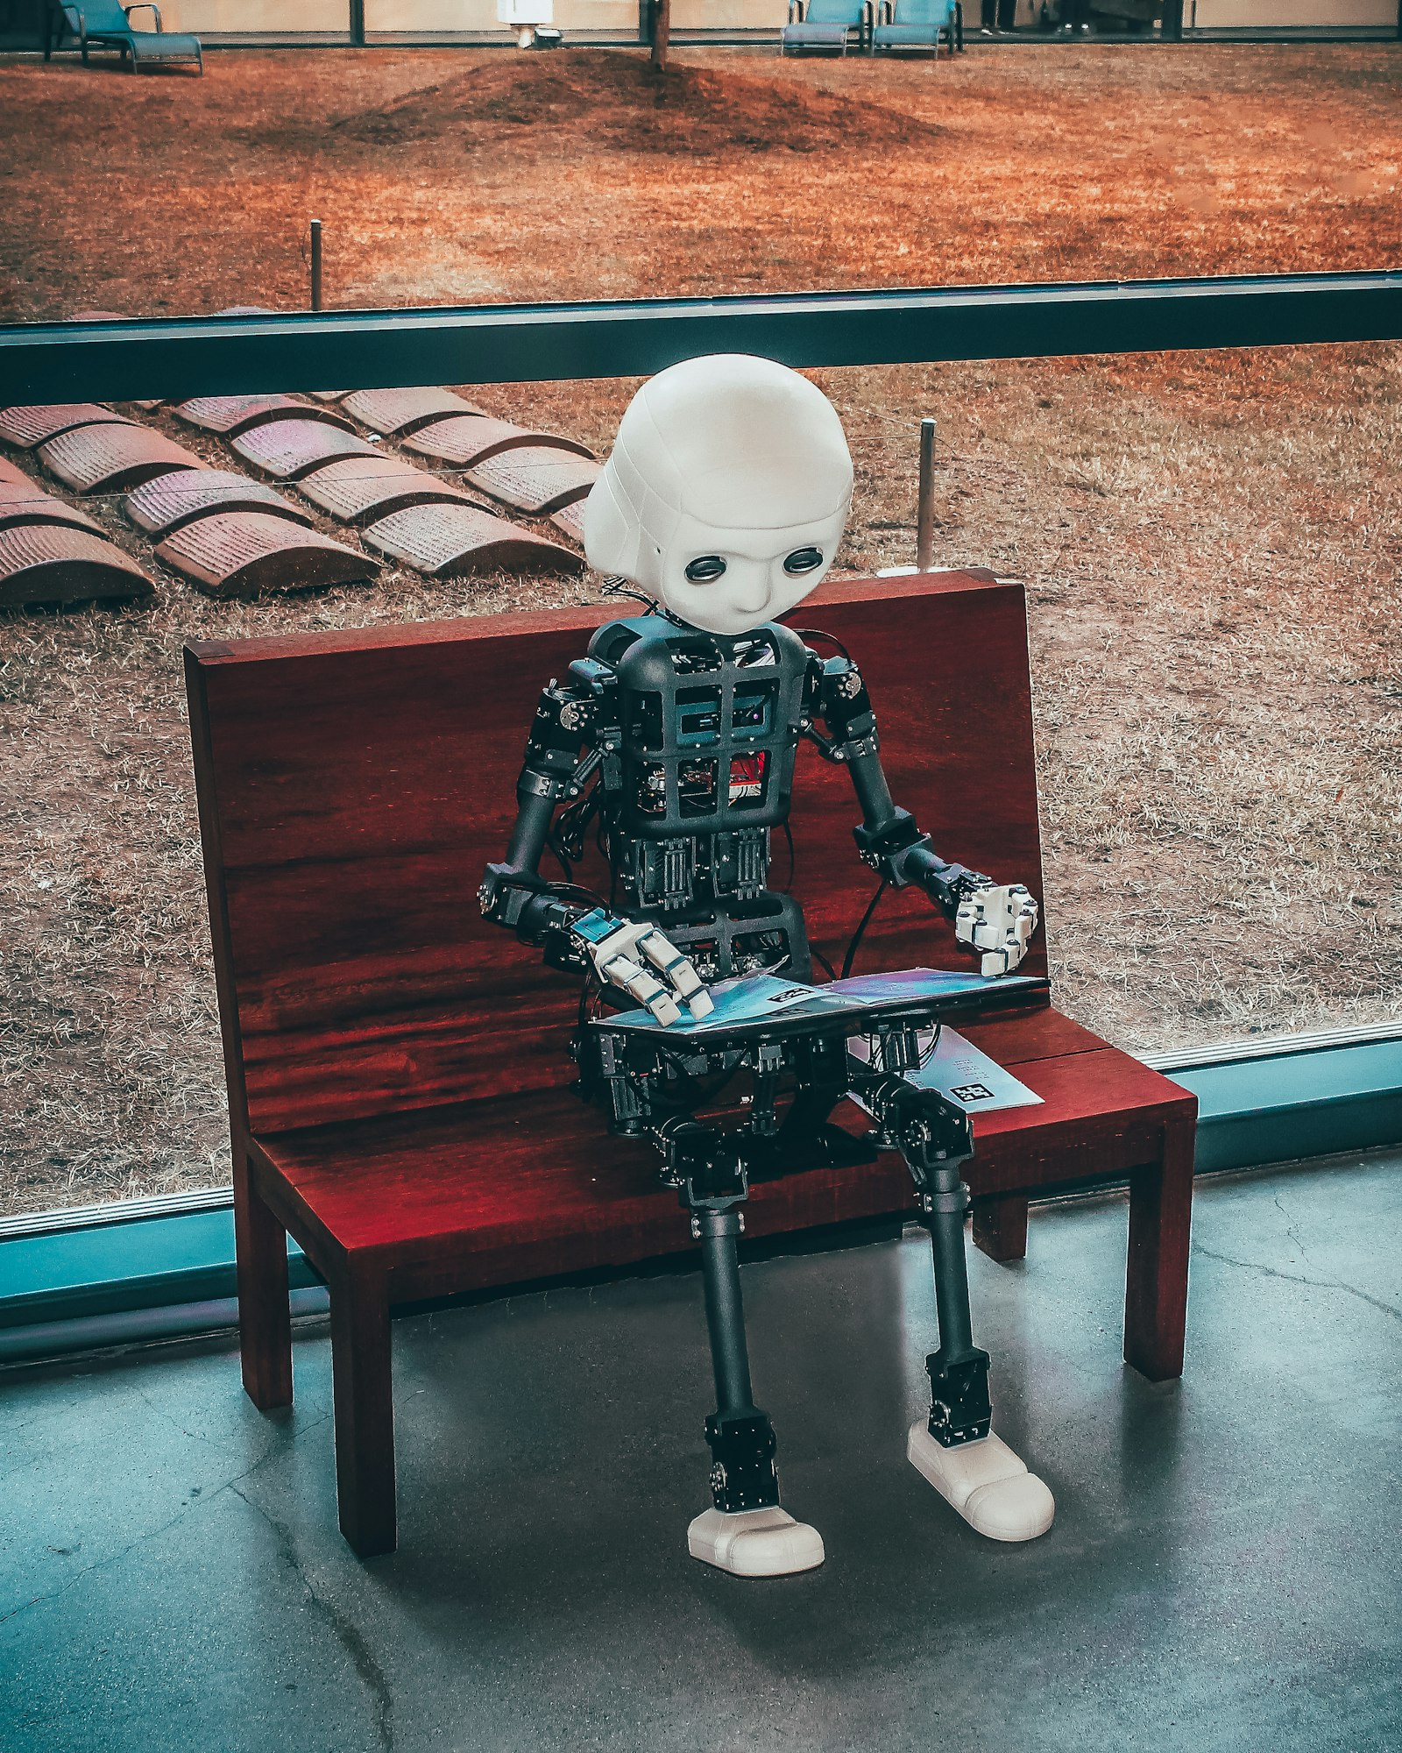
If a computer can finish your sentence, does it understand you?
Hold that question. We will keep asking it all semester.
Source: Unsplash License, https://images.unsplash.com/photo-1620712943543-bcc4688e7485

Slide 12
Predicting the next word
Source: original animation (qwen2.5:0.5b style)

Slide 13
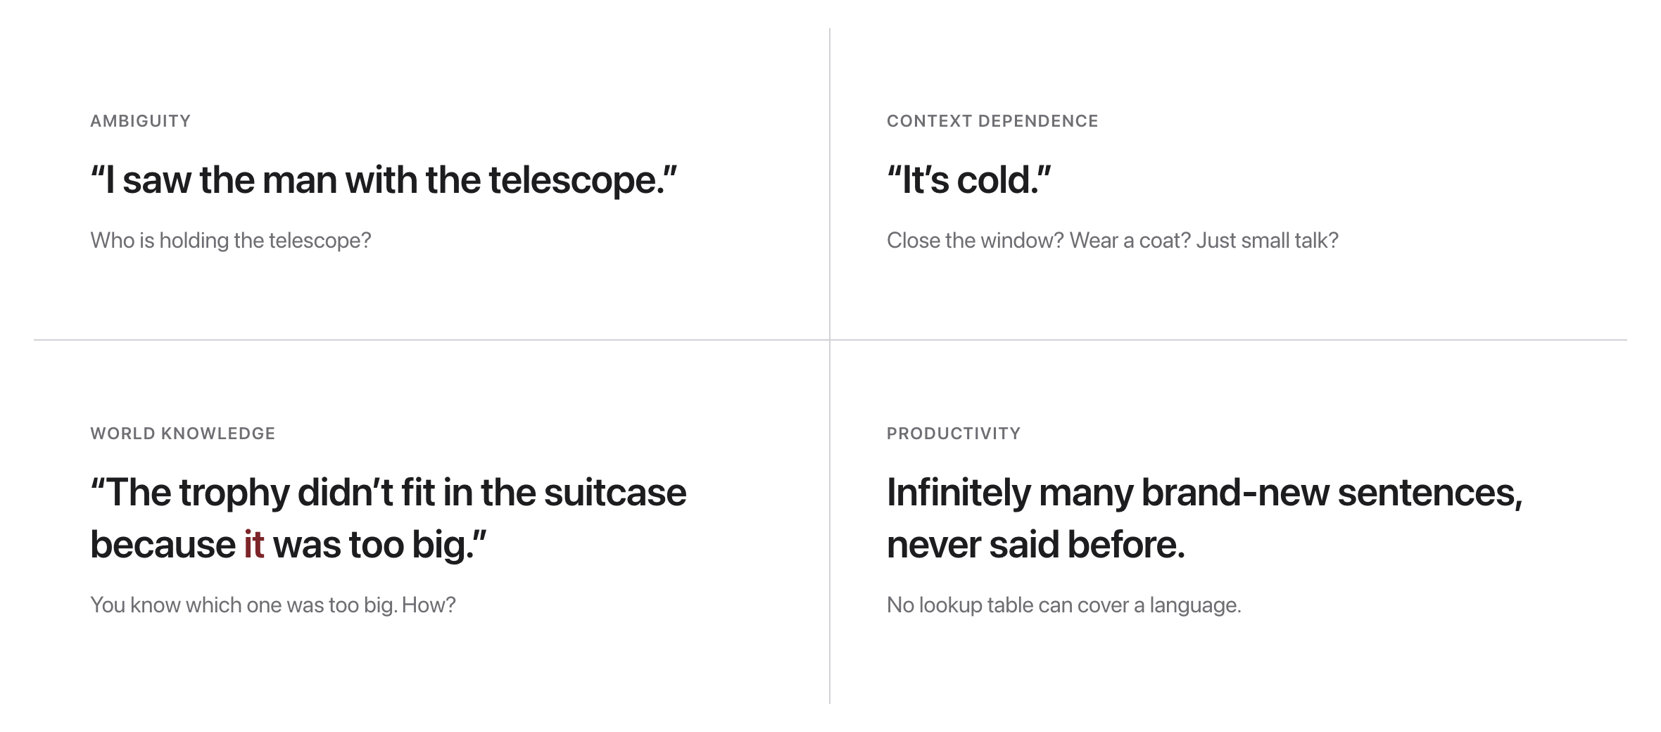
Why is language hard?
Source: original figure; Winograd schema example, Levesque et al. 2012

Slide 14
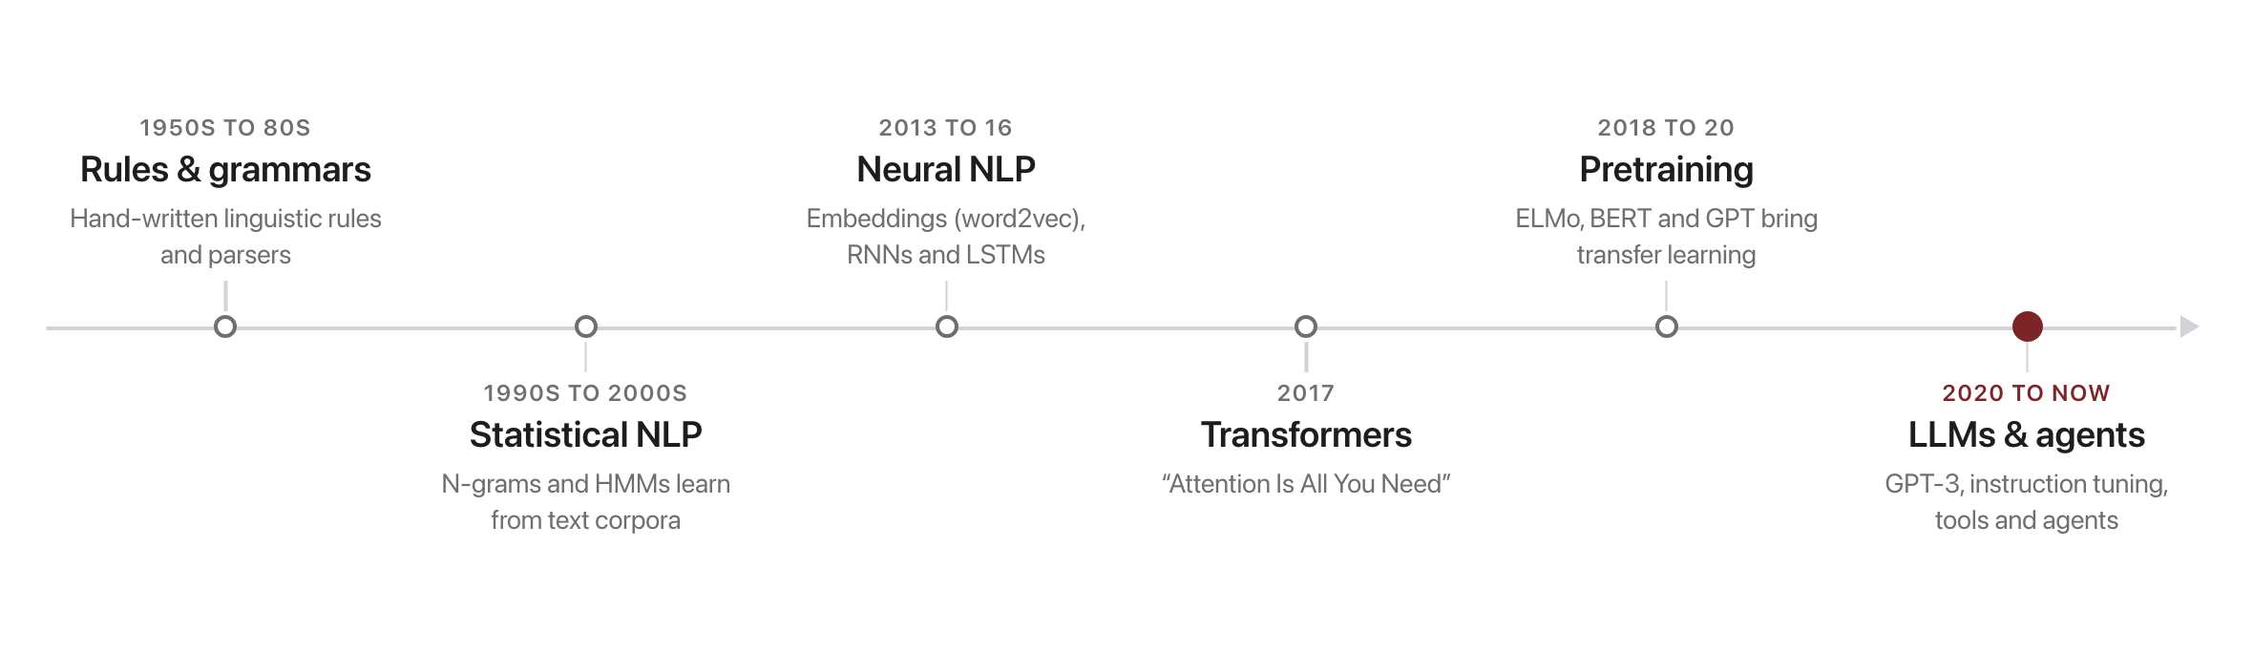
A very short history
Source: original figure

Slide 15
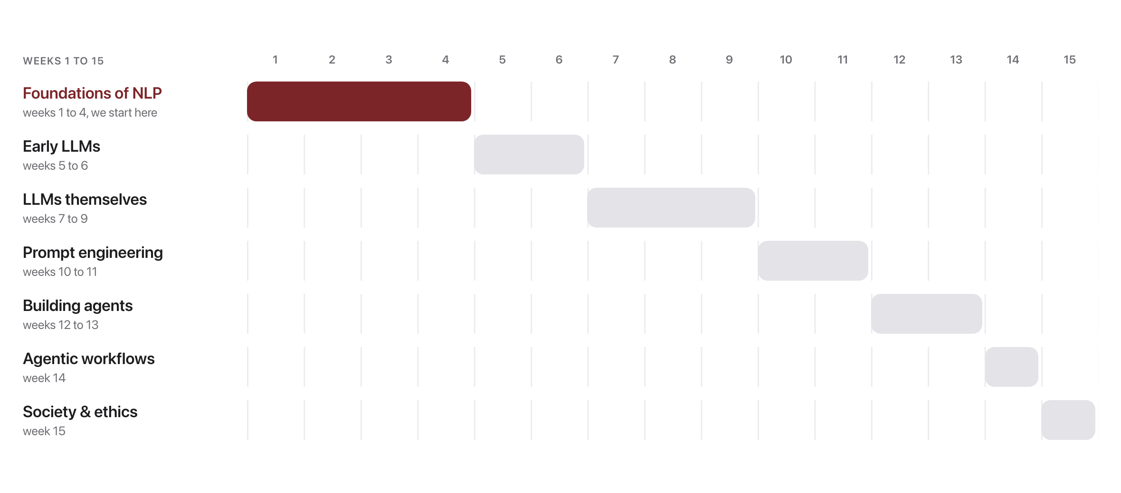
This course in one diagram
Source: original figure; see schedule/SCHEDULE.md

Slide 16
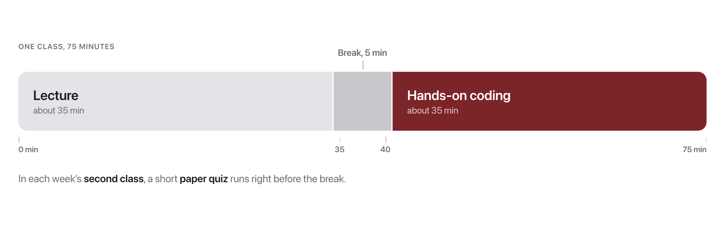
How class works (every session)
Source: original figure

Slide 17
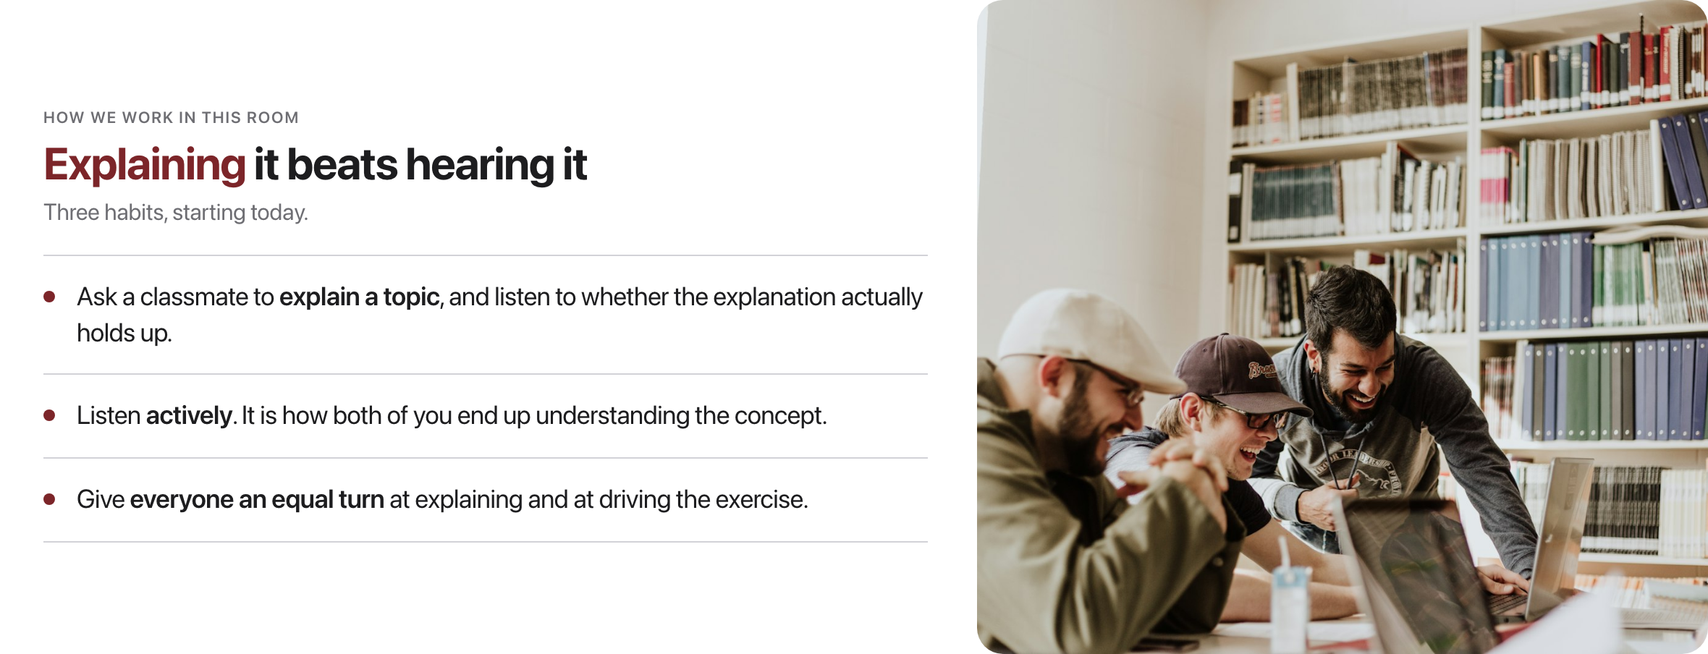
Learning together
Source: original figure; photo: Unsplash License, https://images.unsplash.com/photo-1523240795612-9a054b0db644

Slide 18
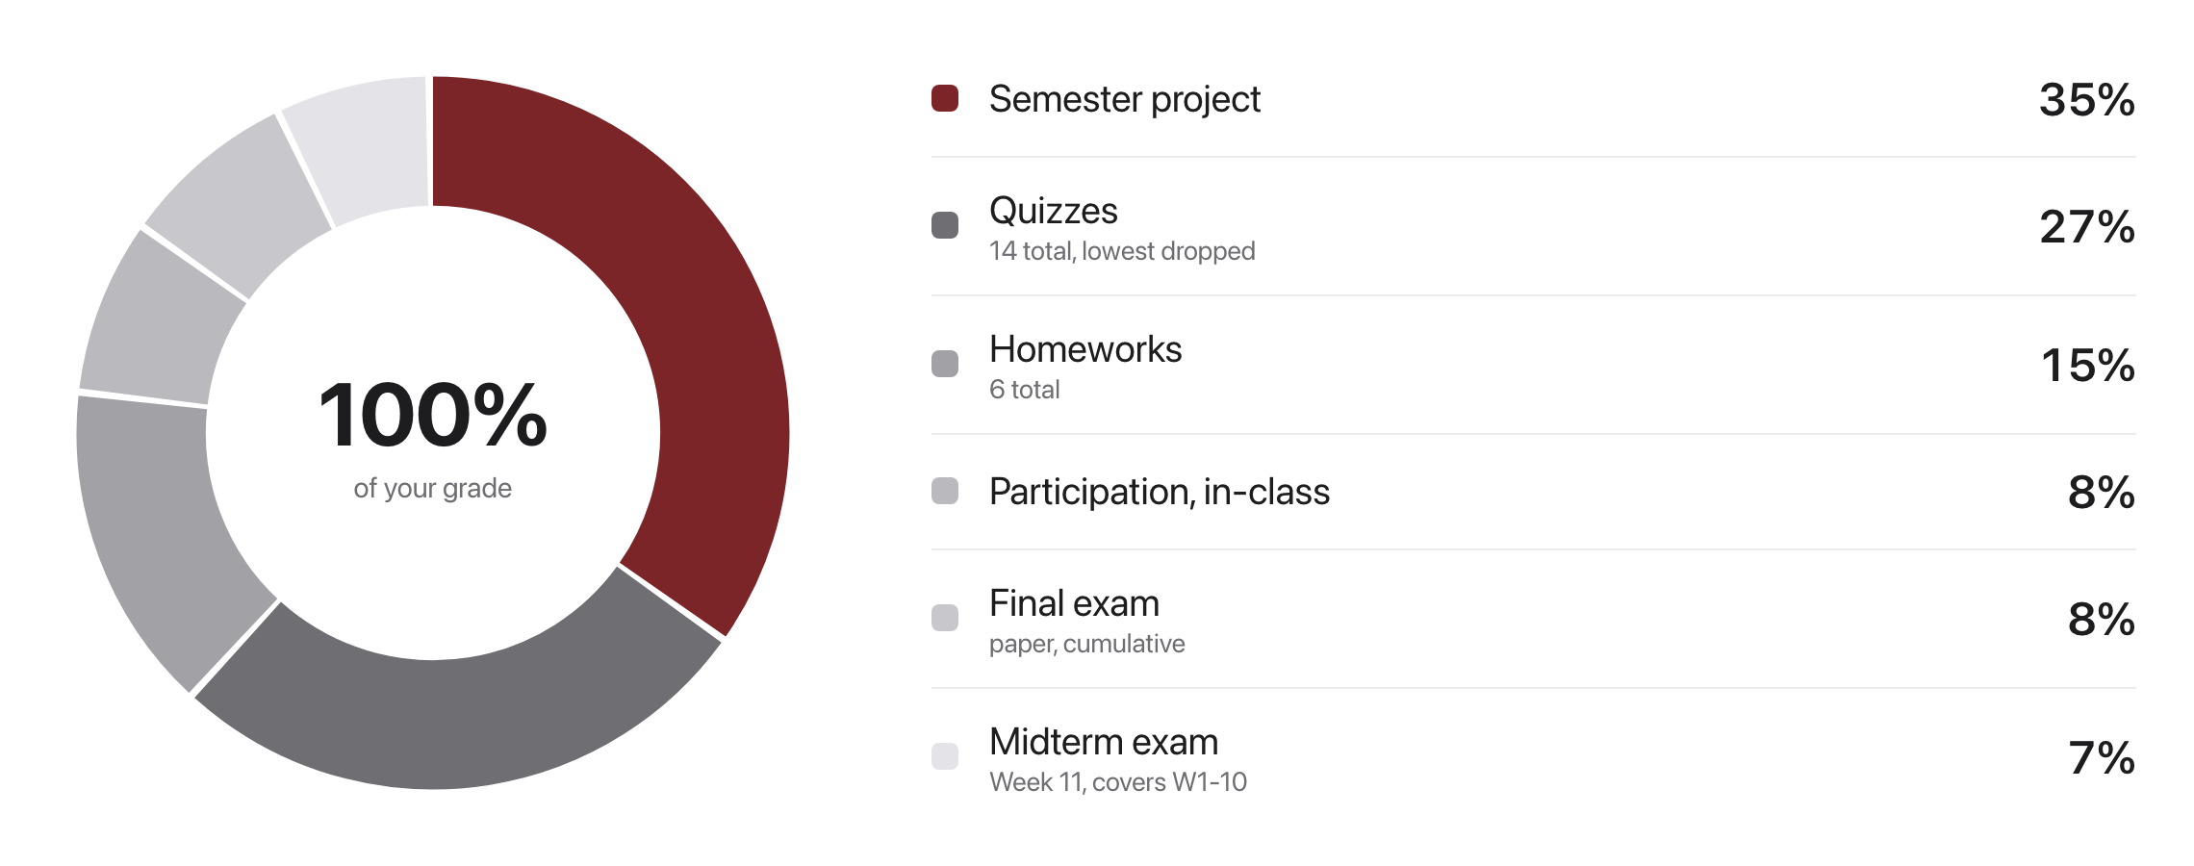
Grade breakdown
Source: syllabus/SYLLABUS.md

Slide 19
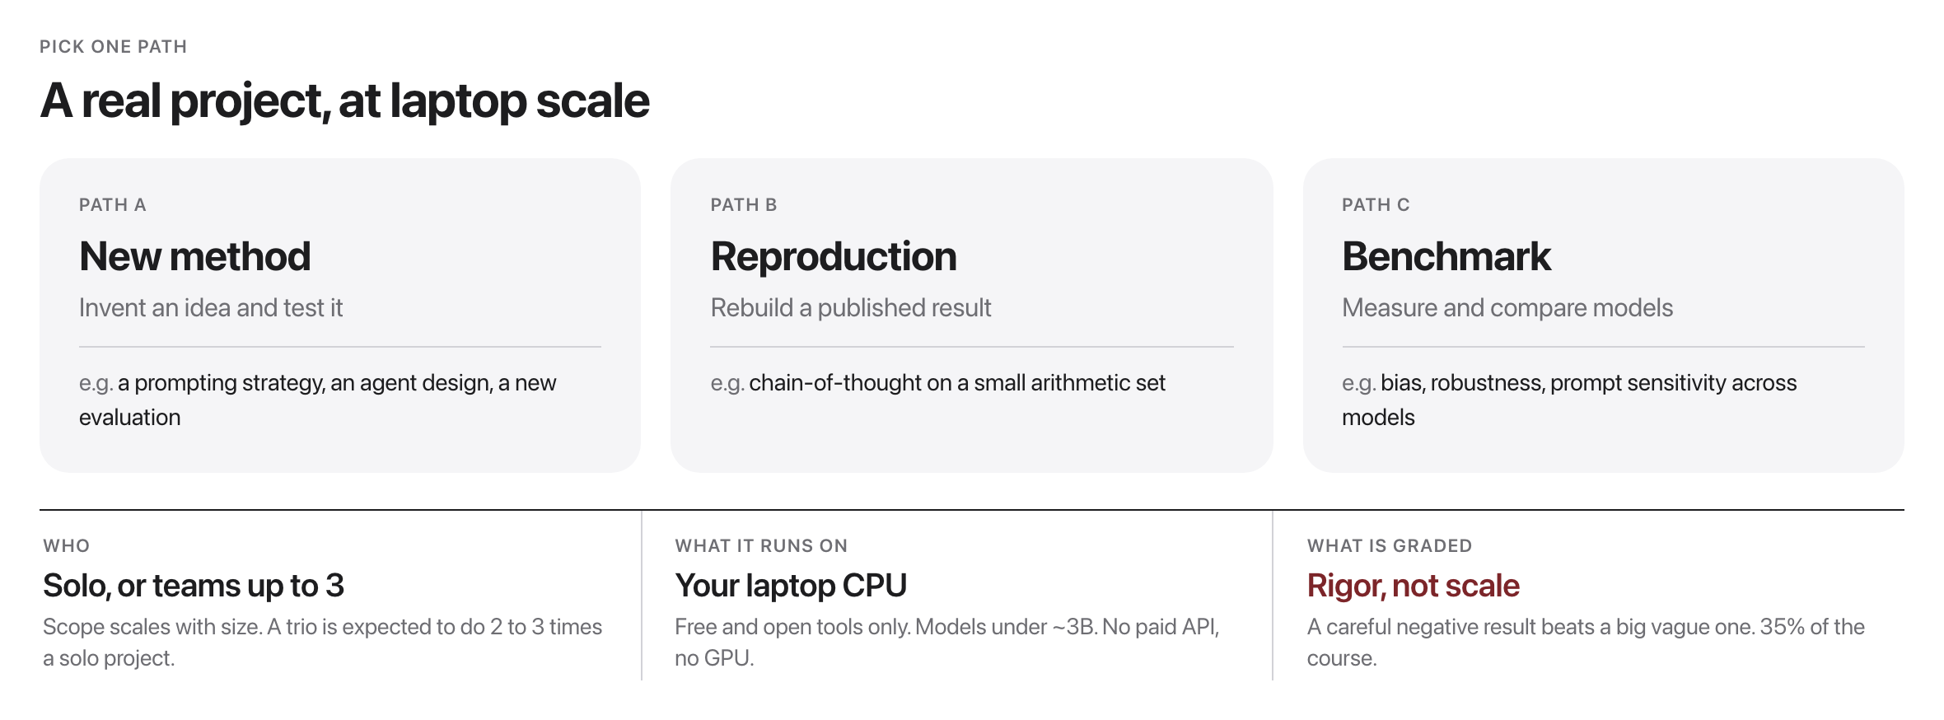
The semester project
Source: project/README.md

Slide 20
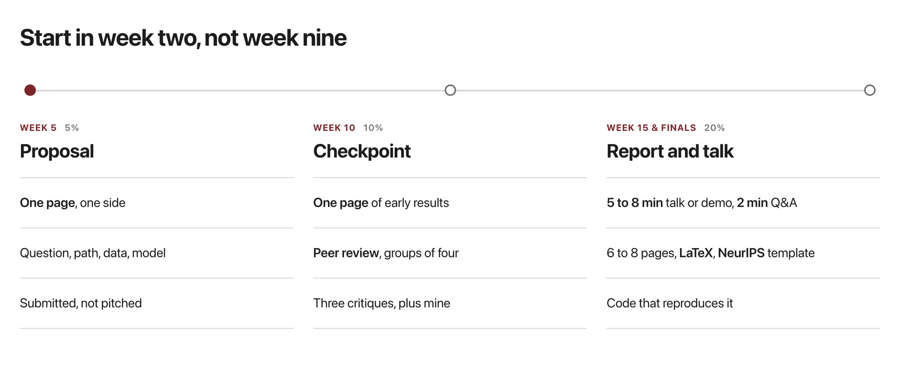
Three milestones
NeurIPS LaTeX template (Overleaf)
Source: project/README.md; project/RUBRICS.md

Slide 21
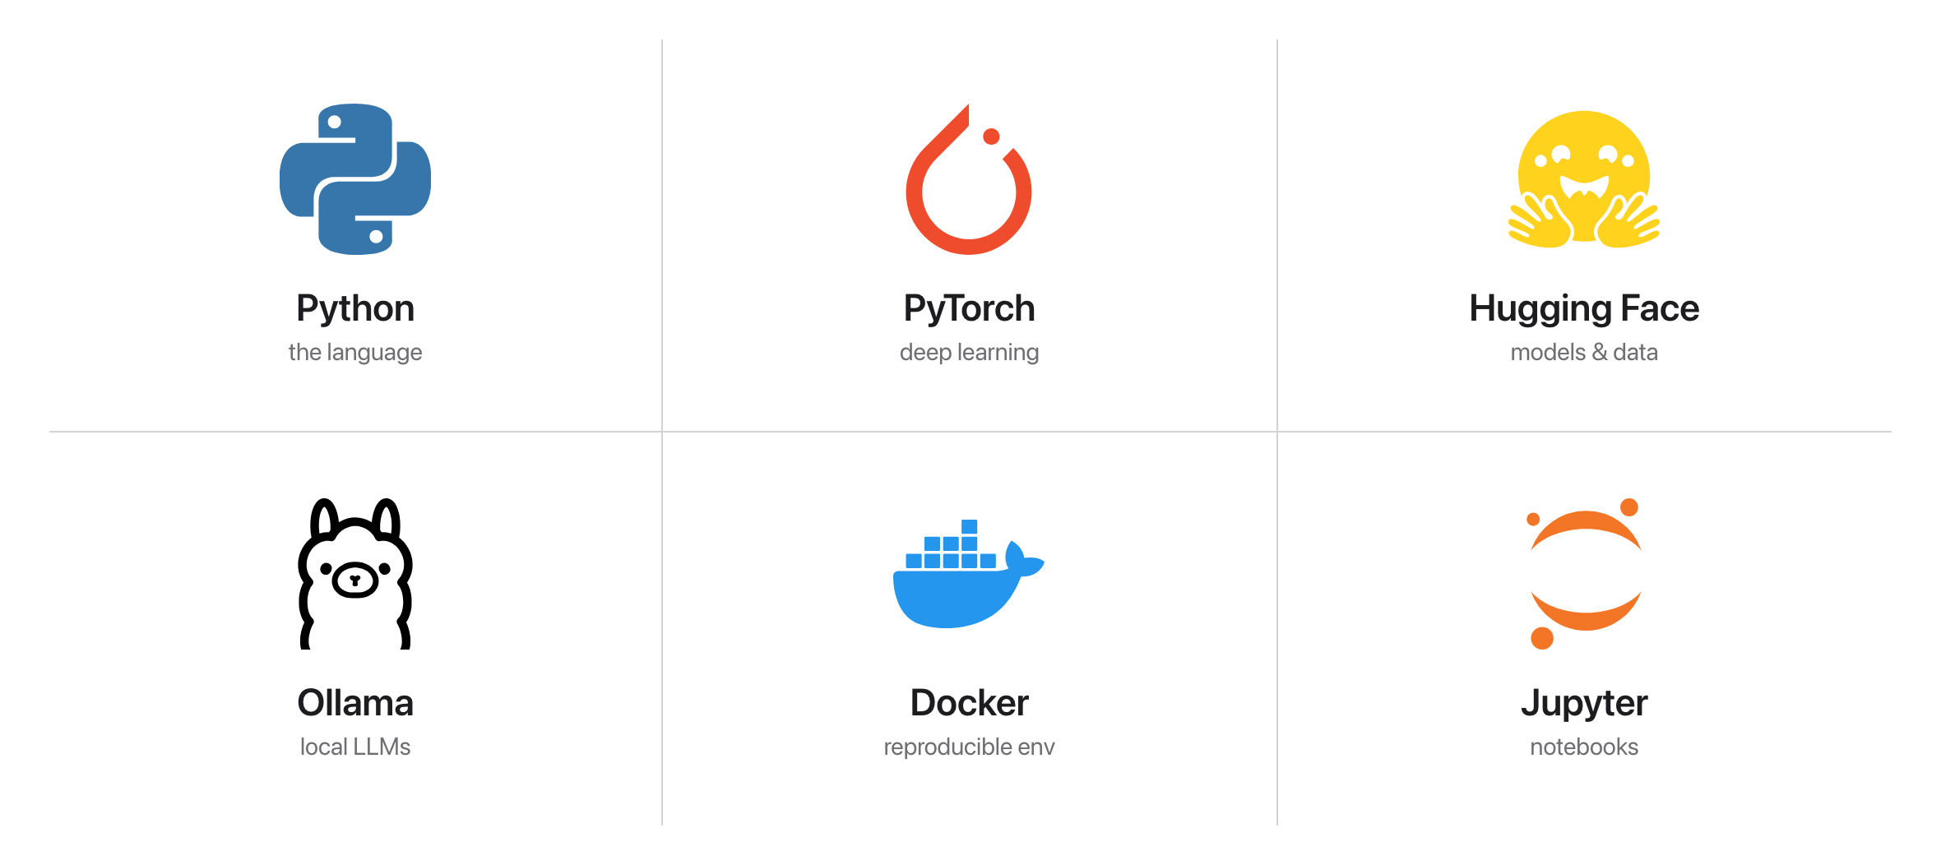
Tools: free & open-source
Source: logos copyright their projects (Simple Icons, CC0)

Slide 22
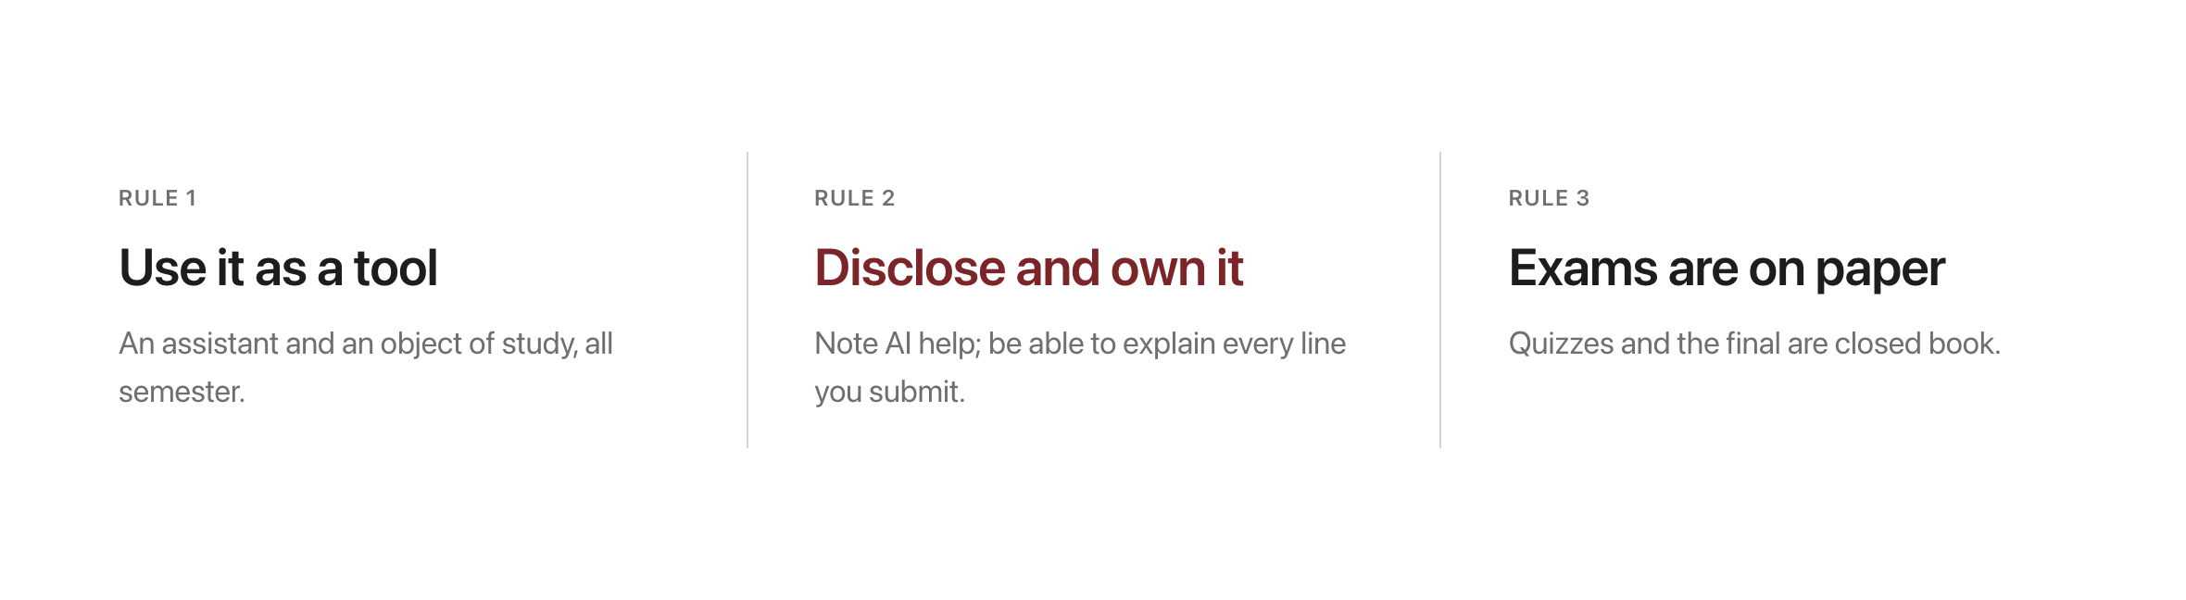
AI-use policy (important)
Source: syllabus/SYLLABUS.md

Slide 23
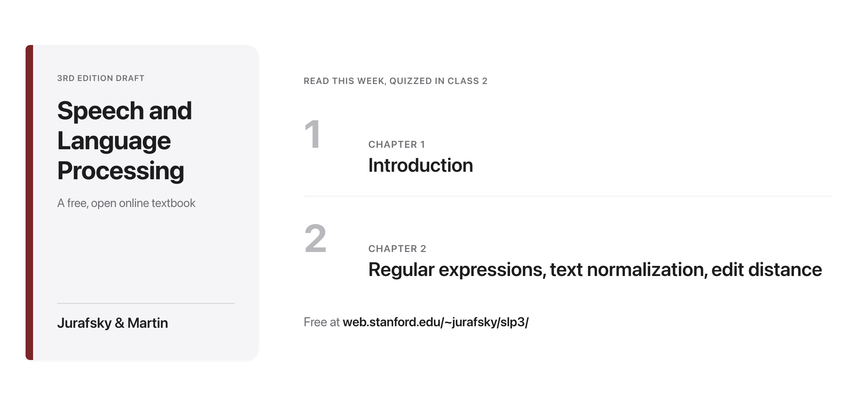
Assigned reading this week
Source: web.stanford.edu/~jurafsky/slp3/

Slide 24

Break
Source: original figure

Slide 25
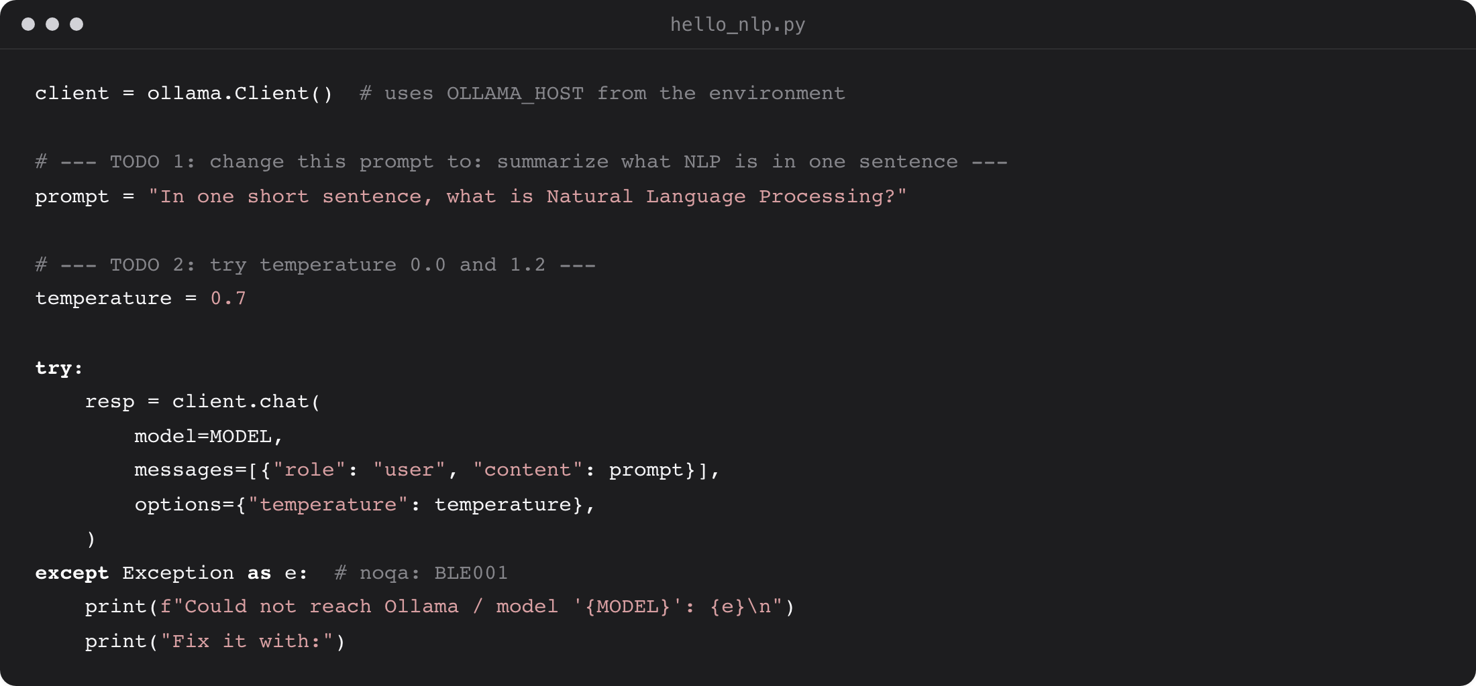
Exercise: your first local LLM prompt
Edit the prompt, then try temperature 0.0 vs 1.2
Run it and read the model's answer
Source: weeks/week-01/class-01/exercise/hello_nlp.py

Slide 26
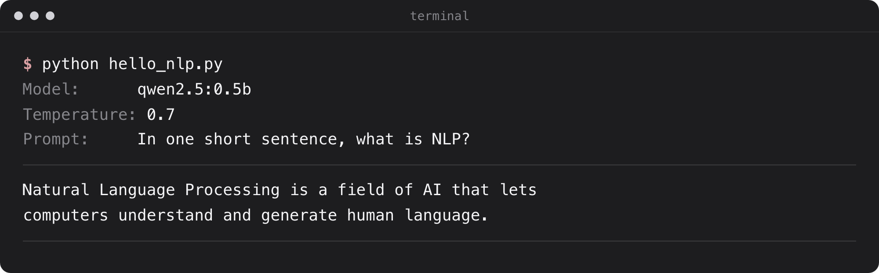
What you should see
A real LLM, running locally on your laptop CPU
Source: example run, qwen2.5:0.5b via Ollama

Slide 27
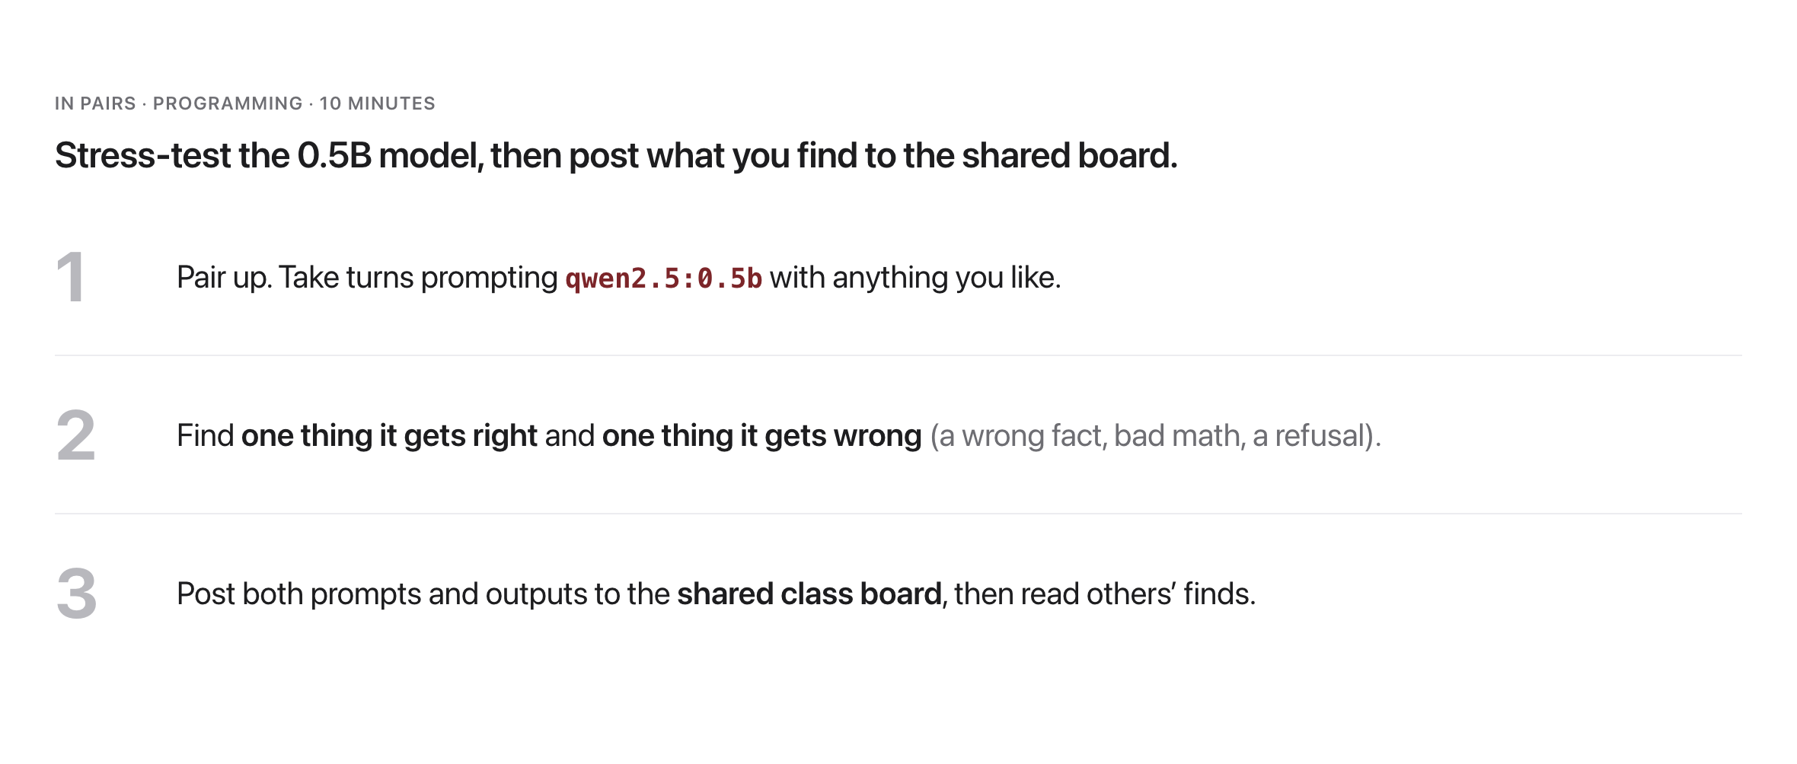
Activity: First-Prompt Scavenger Hunt
Source: weeks/week-01/class-01/exercise/hello_nlp.py

