Slide 1
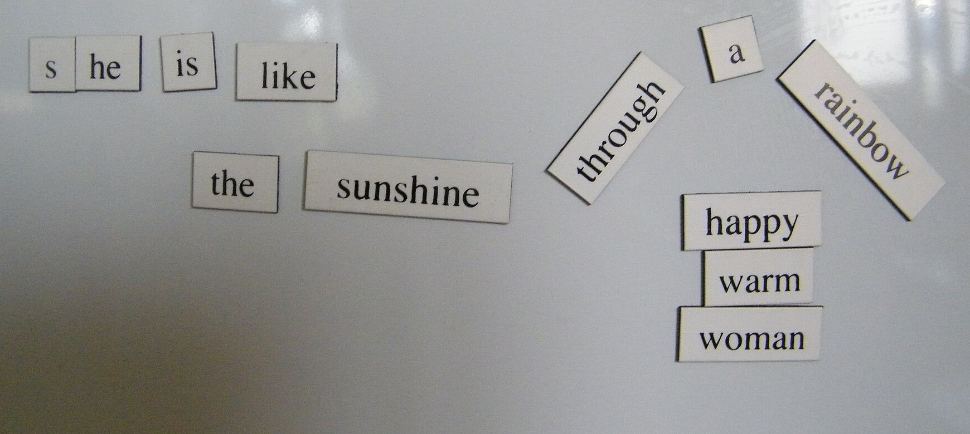
CSCI 3495
N-gram Language Models
Natural Language Processing & Large Language Models
Week 2, Class 1 · Mon Aug 31, 2026
Source: Michael Zimmer, Wikimedia Commons, CC BY-SA 2.0

Slide 2

You use a language model every day
Source: Unsplash License, https://images.unsplash.com/photo-1512941937669-90a1b58e7e9c

Slide 3
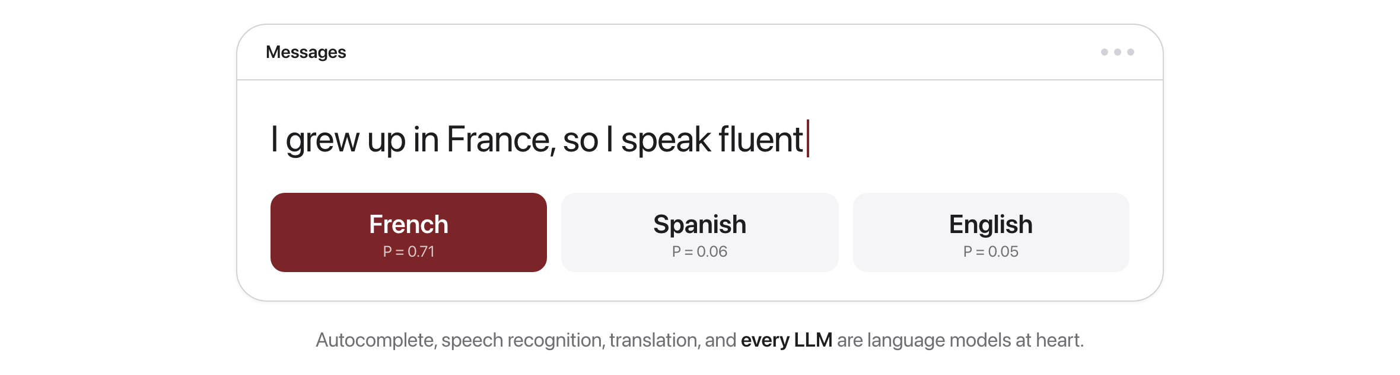
What is a language model?
It scores a whole sentence, or predicts the next word from the ones so far
Source: original figure

Slide 4
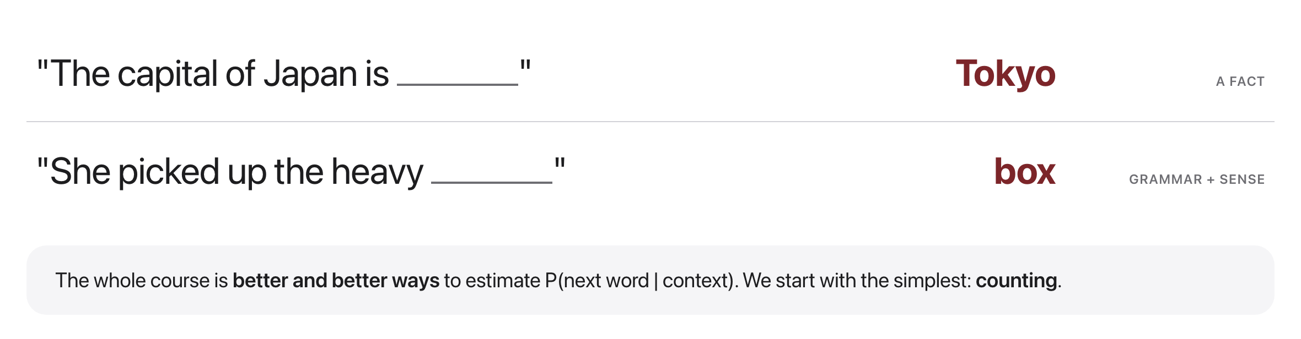
Why next-word prediction is central
Source: original figure

Slide 5
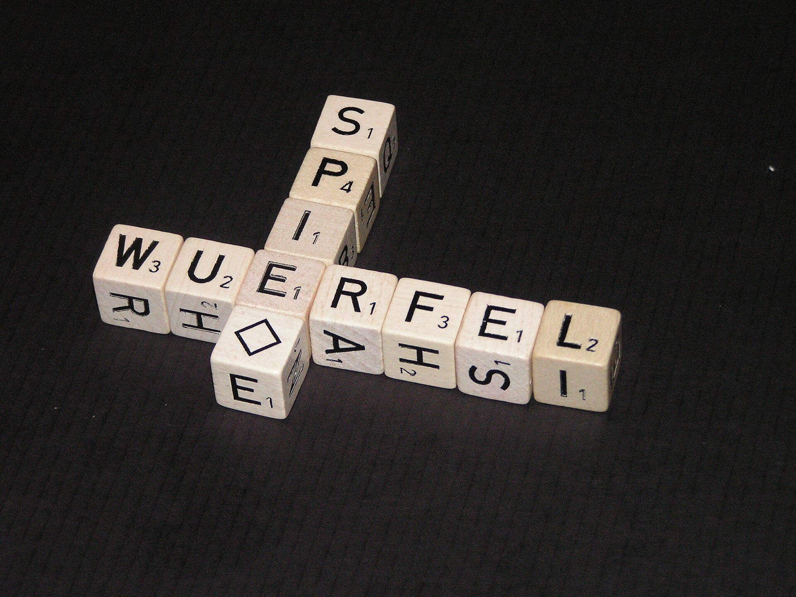
If you can guess the next word, how much have you really learned?
Grammar, facts, and style all hide inside next-word prediction.
Source: Wikimedia Commons, public domain, commons.wikimedia.org/wiki/File:Letra_Mix.JPG

Slide 6
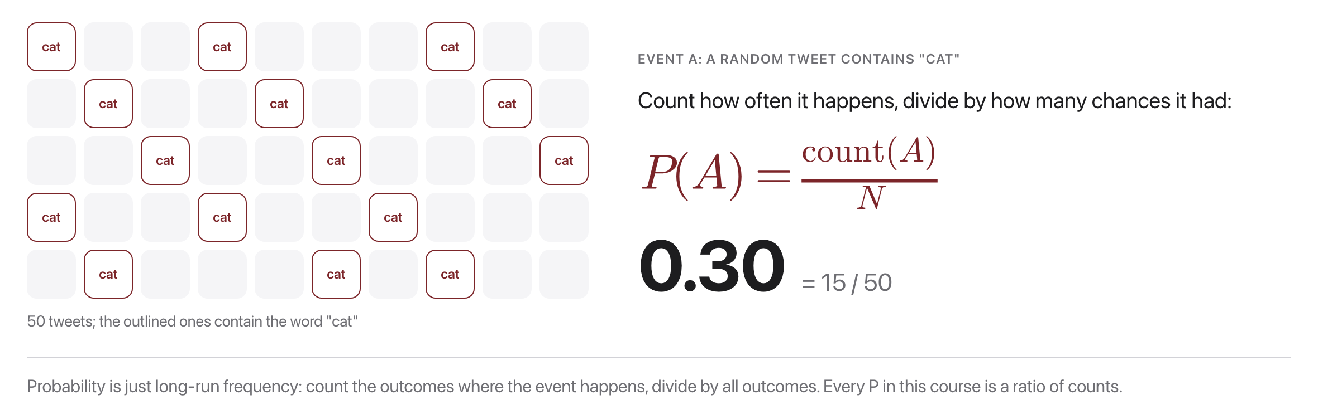
Probability is just counting
Source: original figure

Slide 7
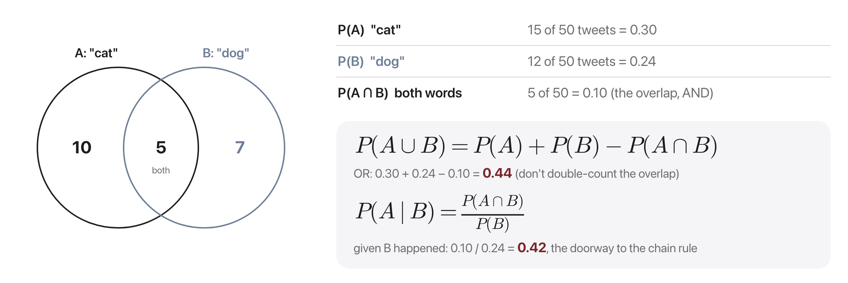
Two events: AND, OR, and "given"
P(A and B) = P(B) x P(A given B): apply this over and over and you get the chain rule
Source: original figure

Slide 8
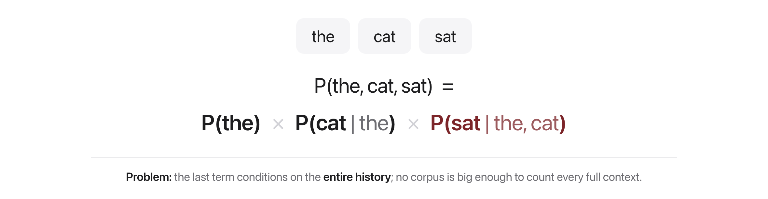
The chain rule of probability
Source: original figure

Slide 9
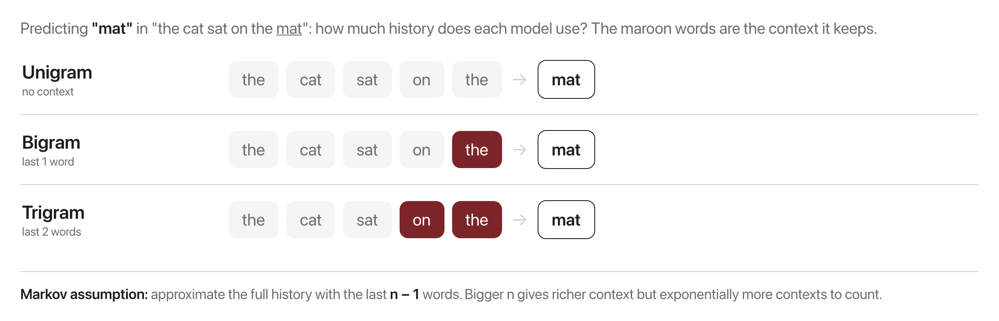
The Markov assumption
This simplification is what makes counting feasible
Source: original figure

Slide 10

A corpus is just text we count
Source: Unsplash License, https://images.unsplash.com/photo-1507842217343-583bb7270b66

Slide 11
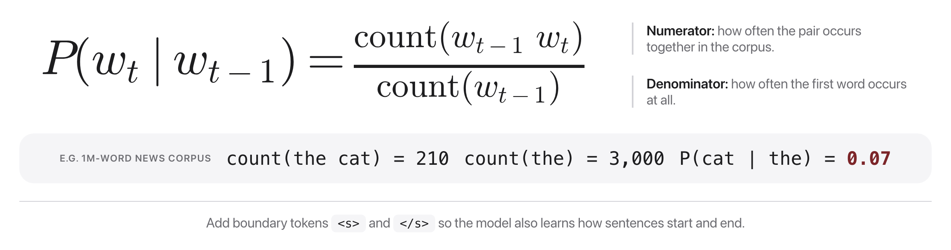
Estimating probabilities by counting
Source: original figure

Slide 12
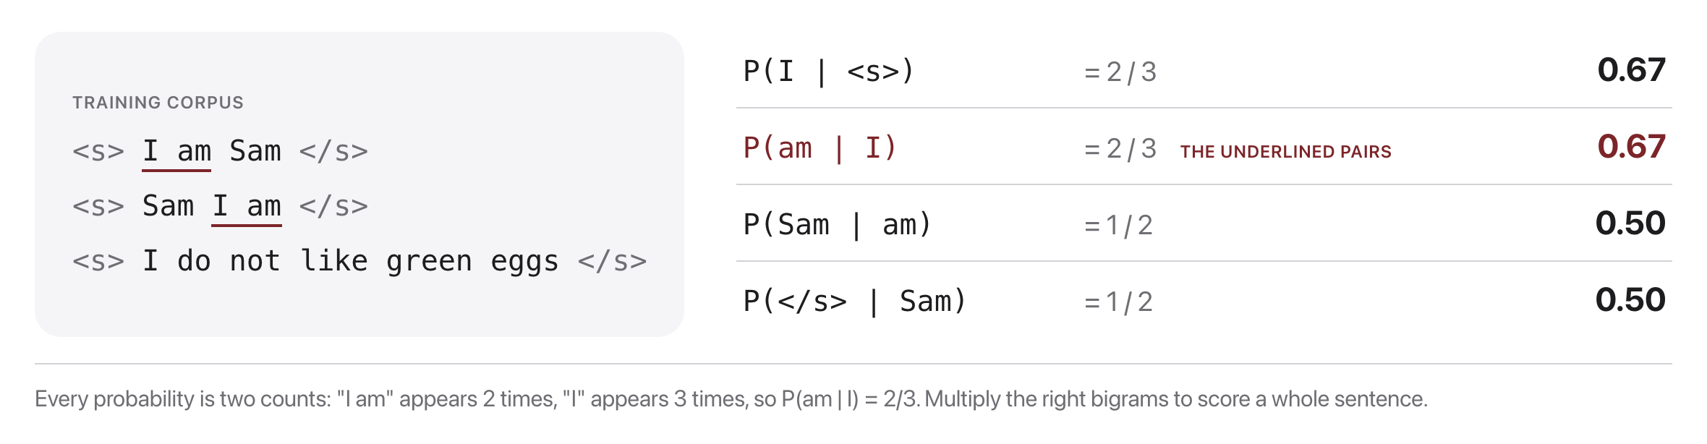
A tiny worked example
Multiply the right bigrams to score a whole sentence
Source: example after Jurafsky & Martin, SLP3 Ch. 3

Slide 13
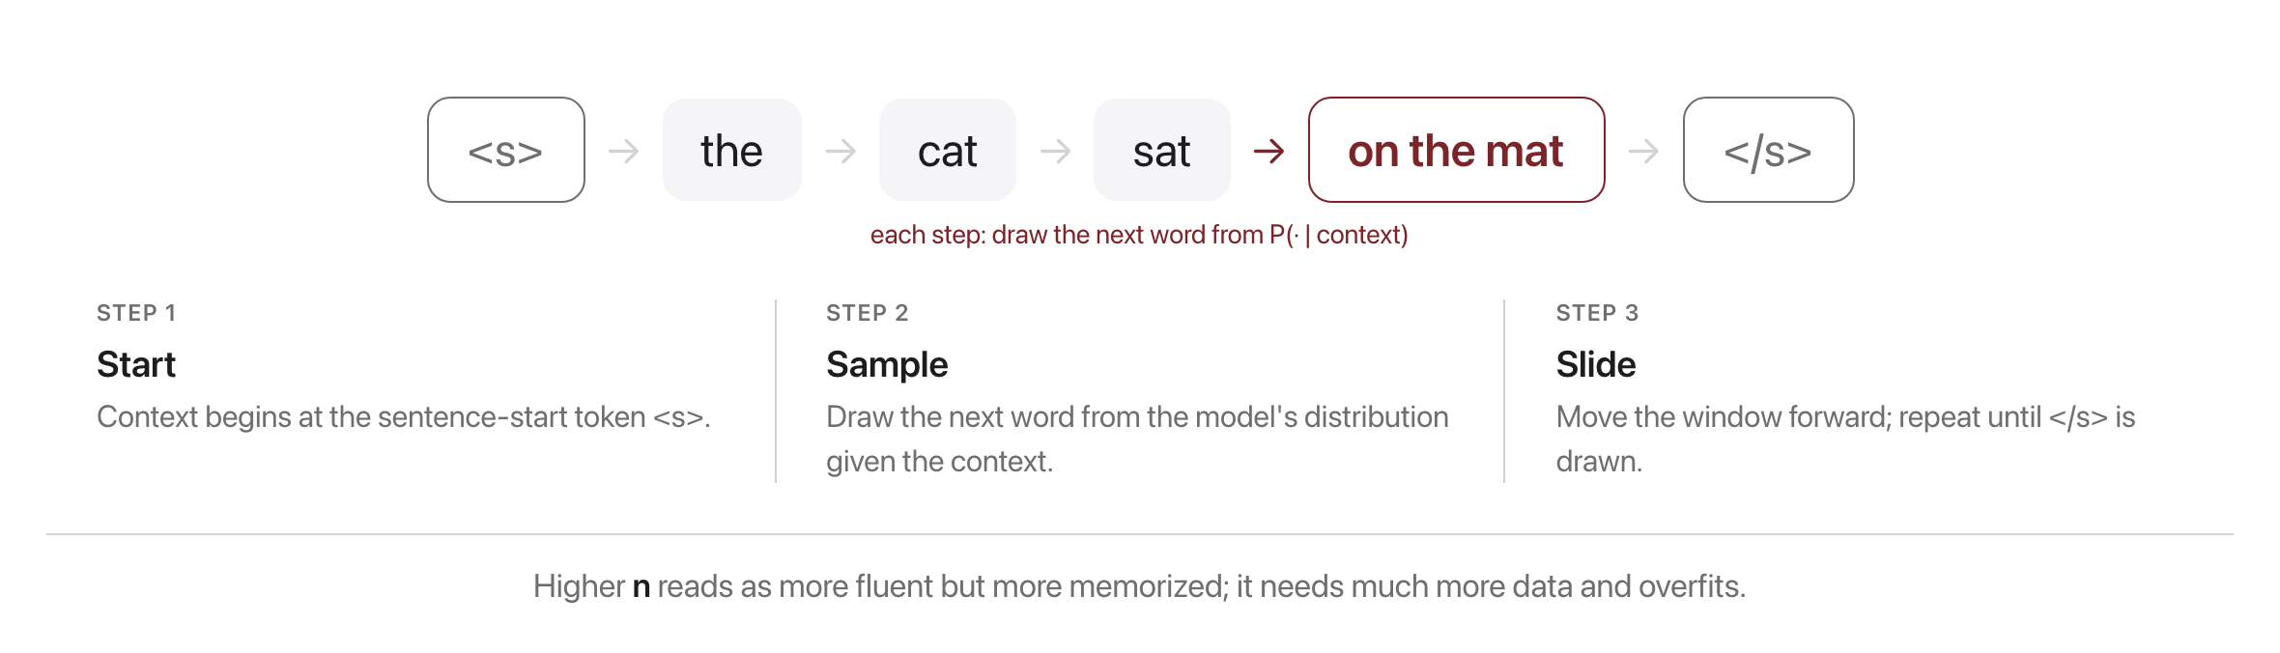
Generating text from an n-gram model
Source: original figure

Slide 14
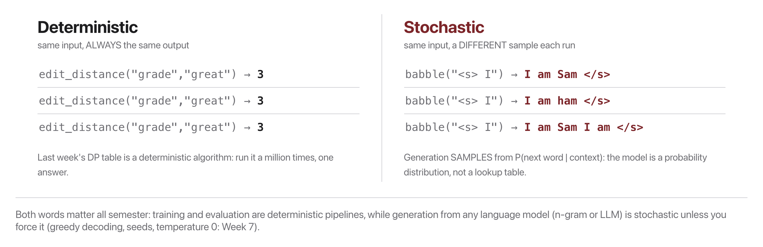
Two vocabulary words: deterministic vs. stochastic
Source: original figure

Slide 15
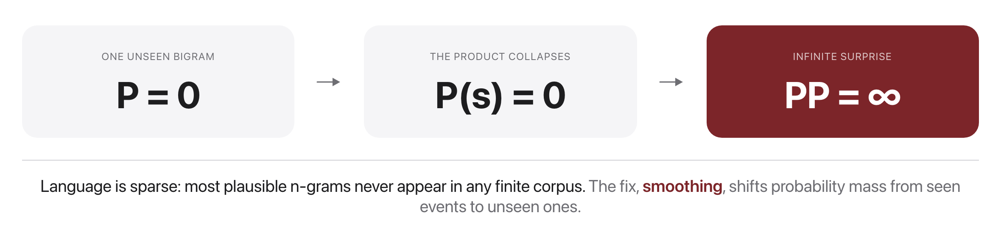
The zero-probability problem
Source: original figure

Slide 16
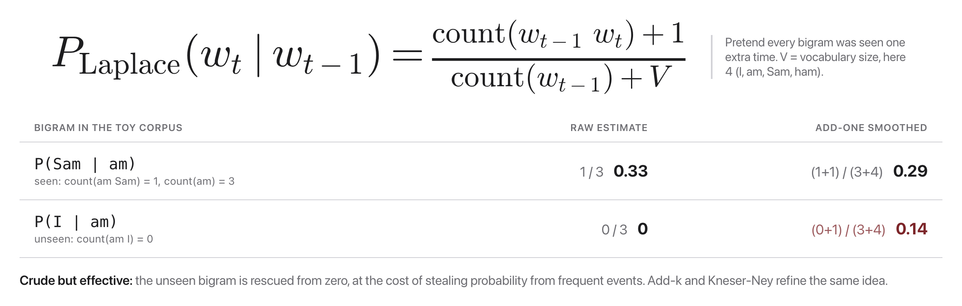
Add-one (Laplace) smoothing
Source: original figure

Slide 17
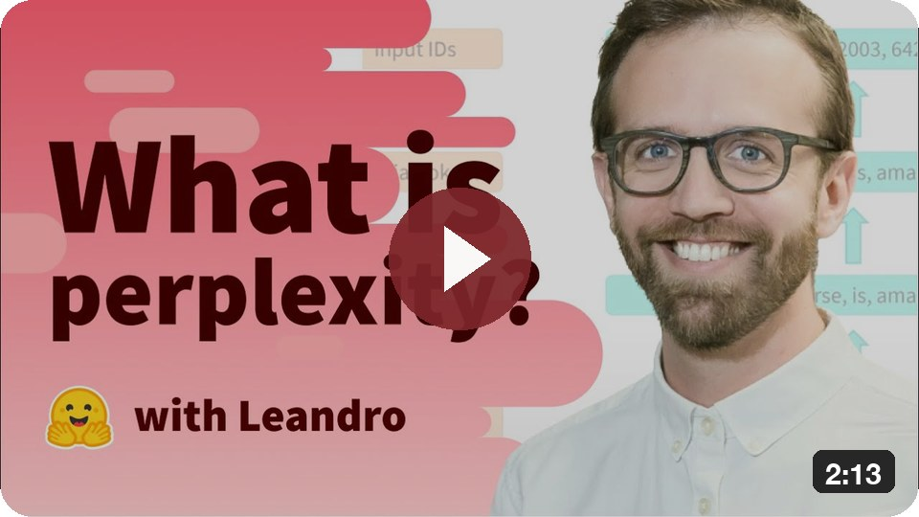
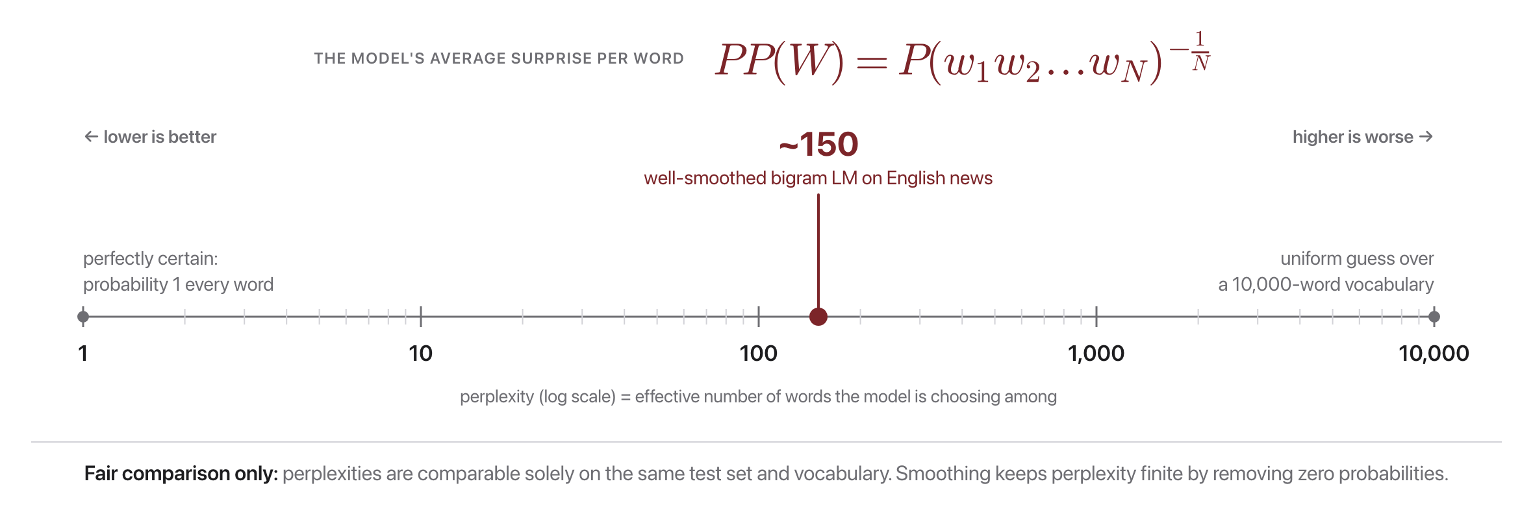
Perplexity: how good is the model?
What is perplexity?
Lower is better, like an effective branching factor
Source: original figure

Slide 18
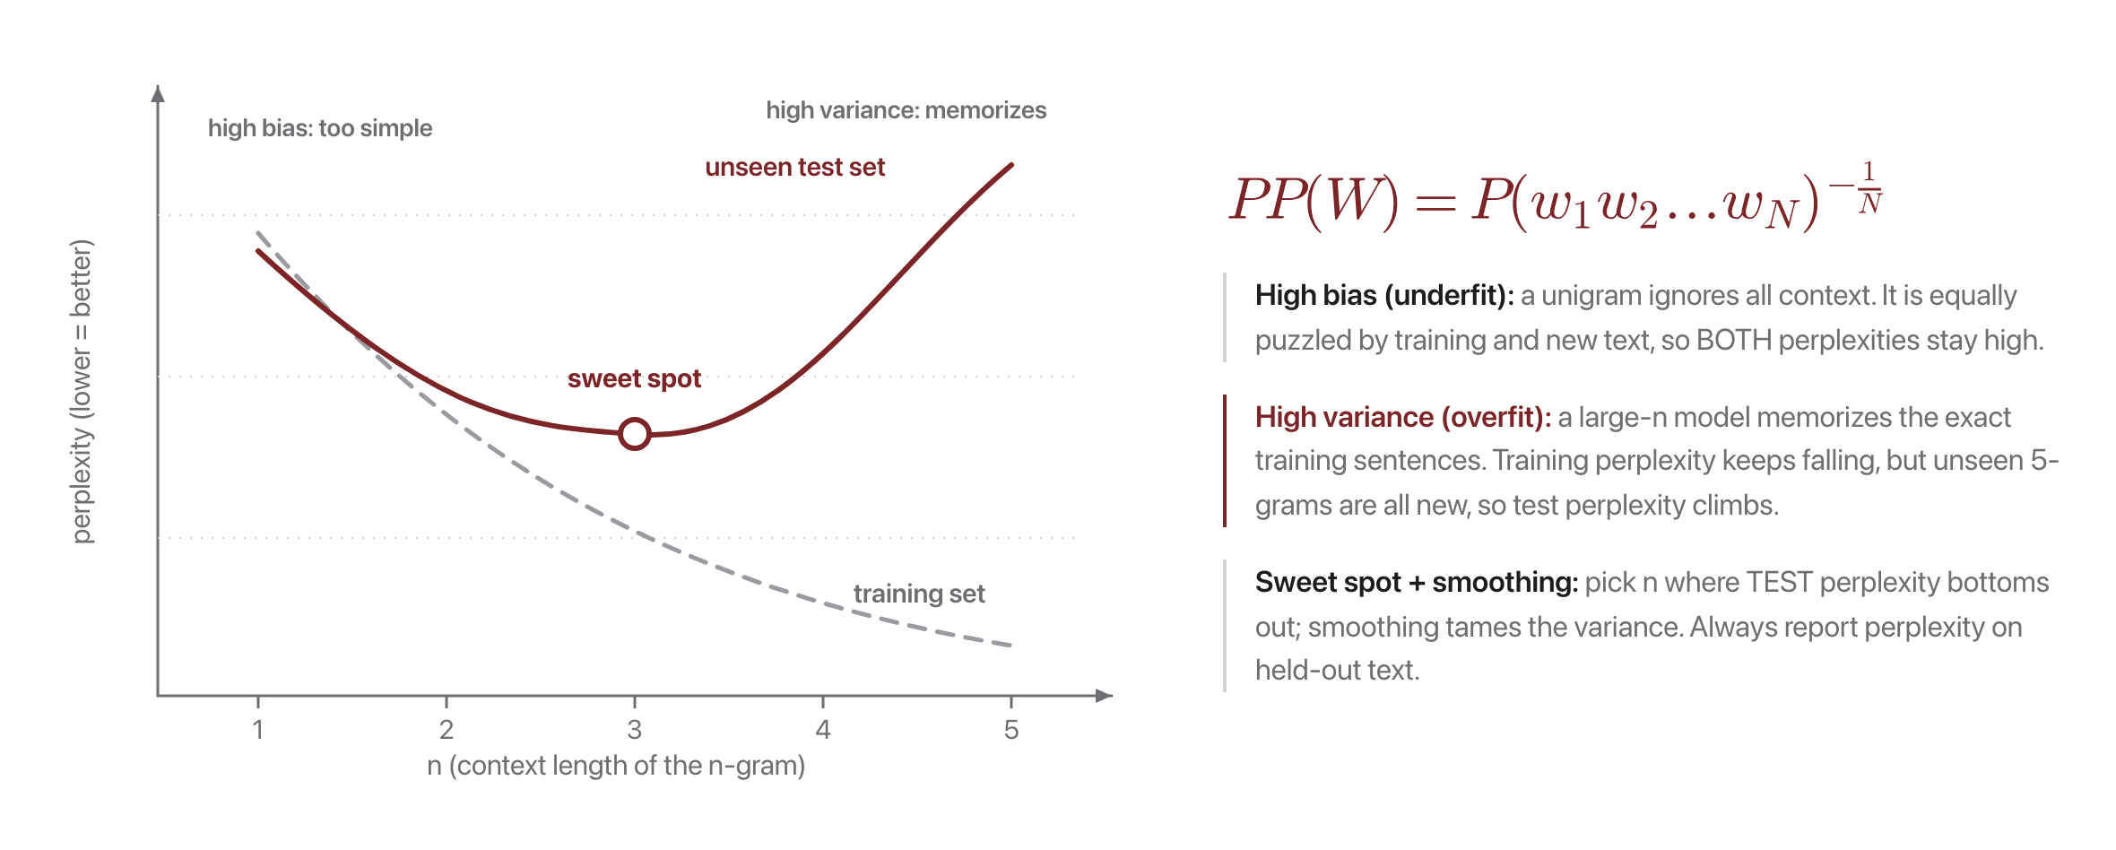
Perplexity meets bias and variance
Source: original figure

Slide 19
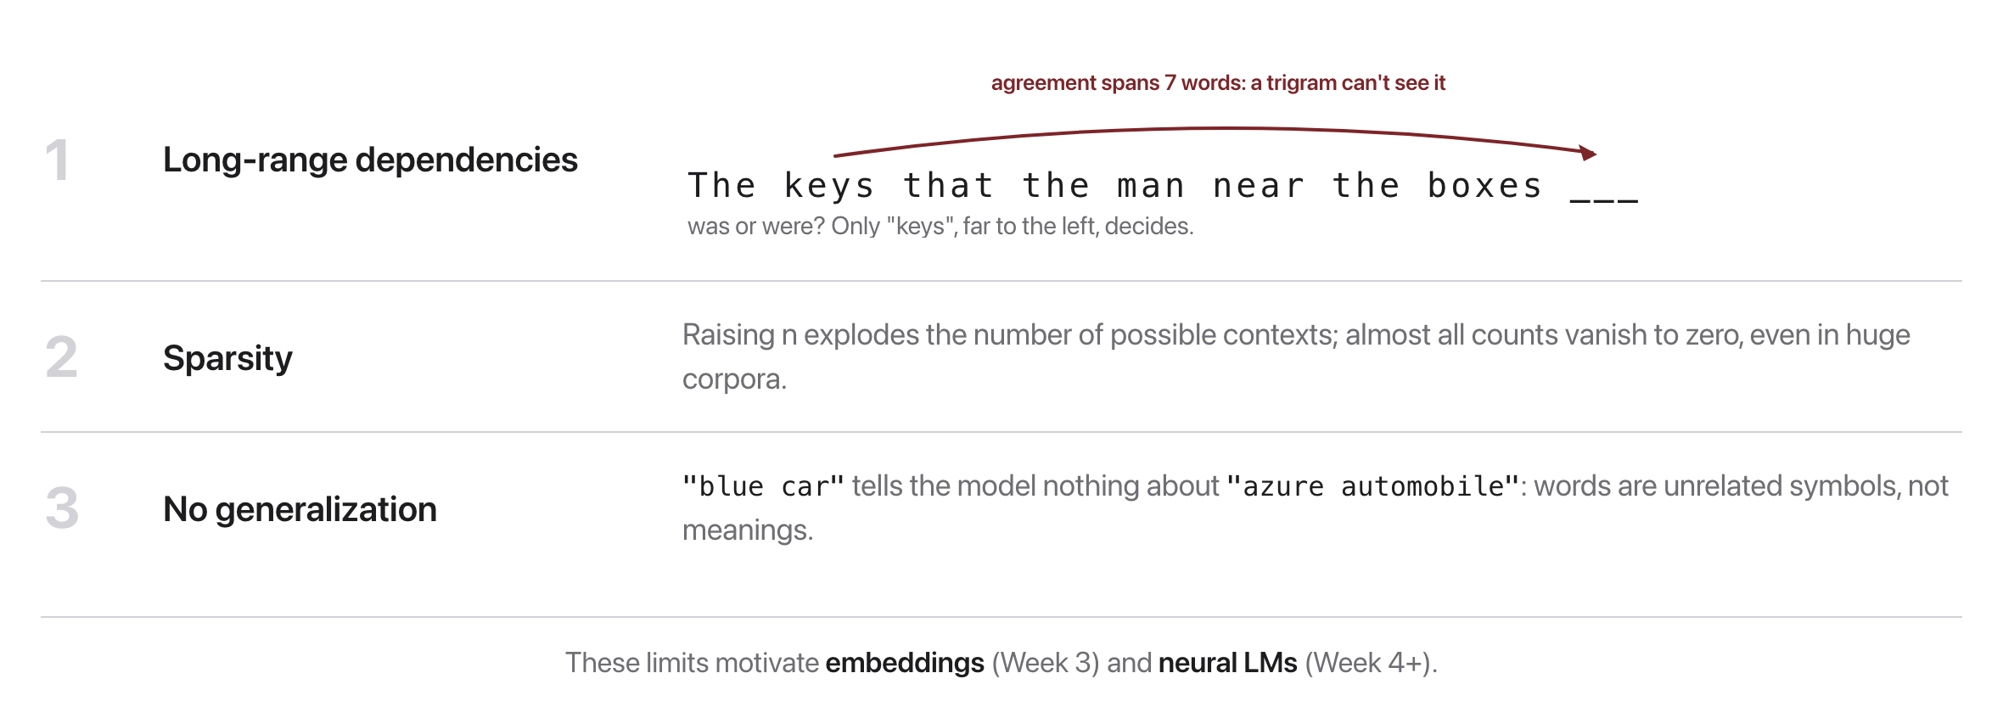
Where n-grams break down
Source: original figure

Slide 20

Break
Source: original figure

Slide 21
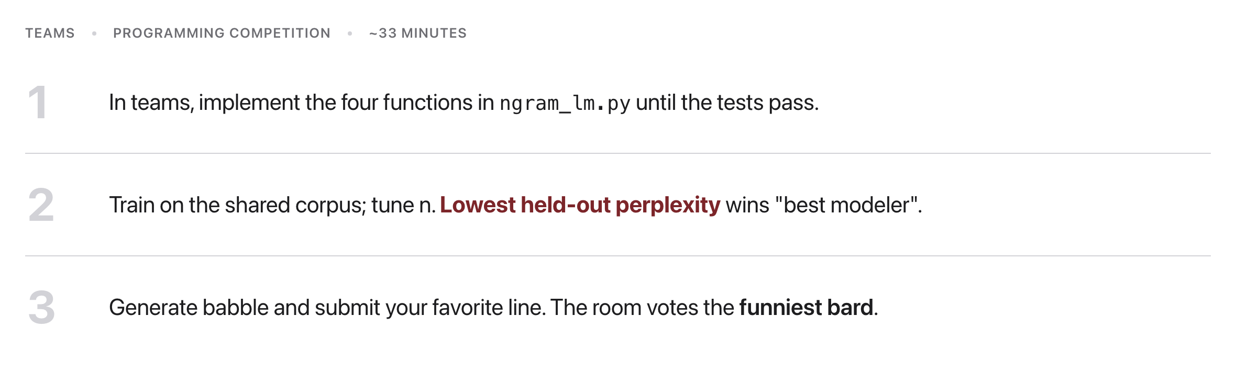
Activity: the Babble-Off
Source: weeks/week-02/class-01/exercise/ngram_lm.py

Slide 22
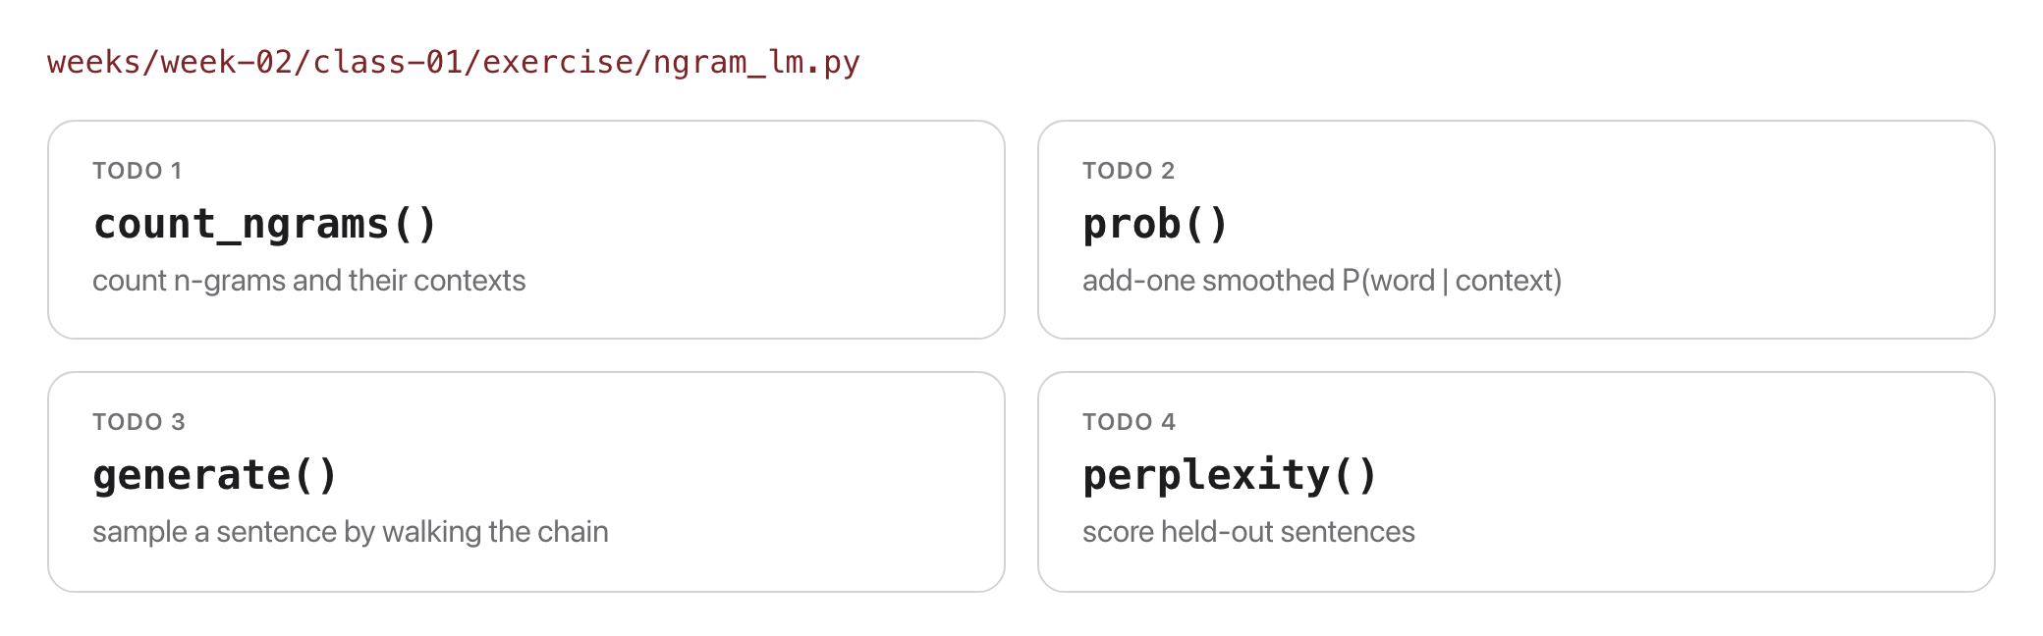
Exercise: build an N-gram Bard
Source: weeks/week-02/class-01/exercise/ngram_lm.py

Slide 23
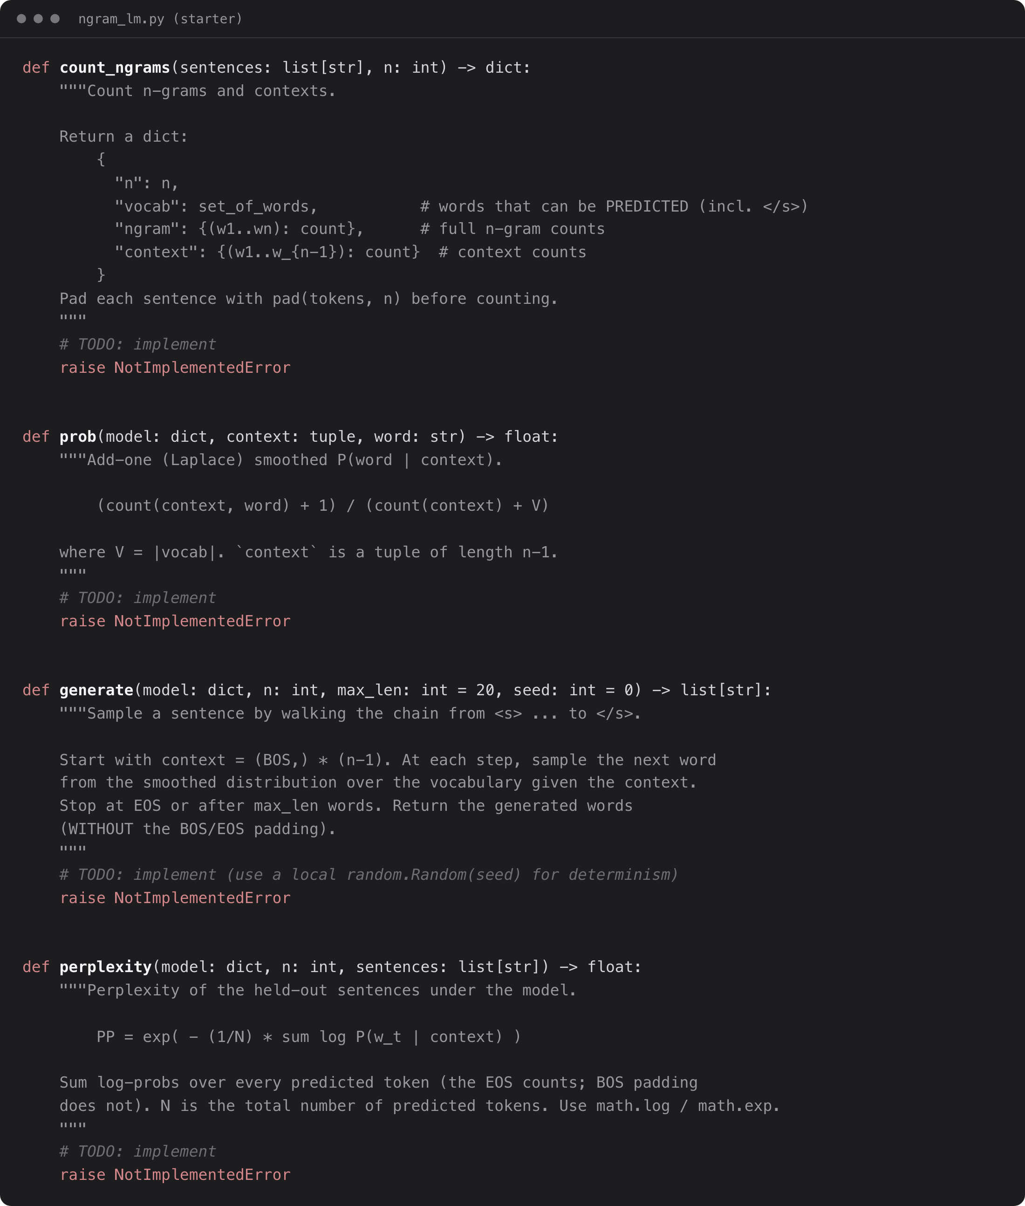
Exercise: the starter code
Run it, then pytest test_ngram_lm.py
Source: weeks/week-02/class-01/exercise/ngram_lm.py

Slide 24
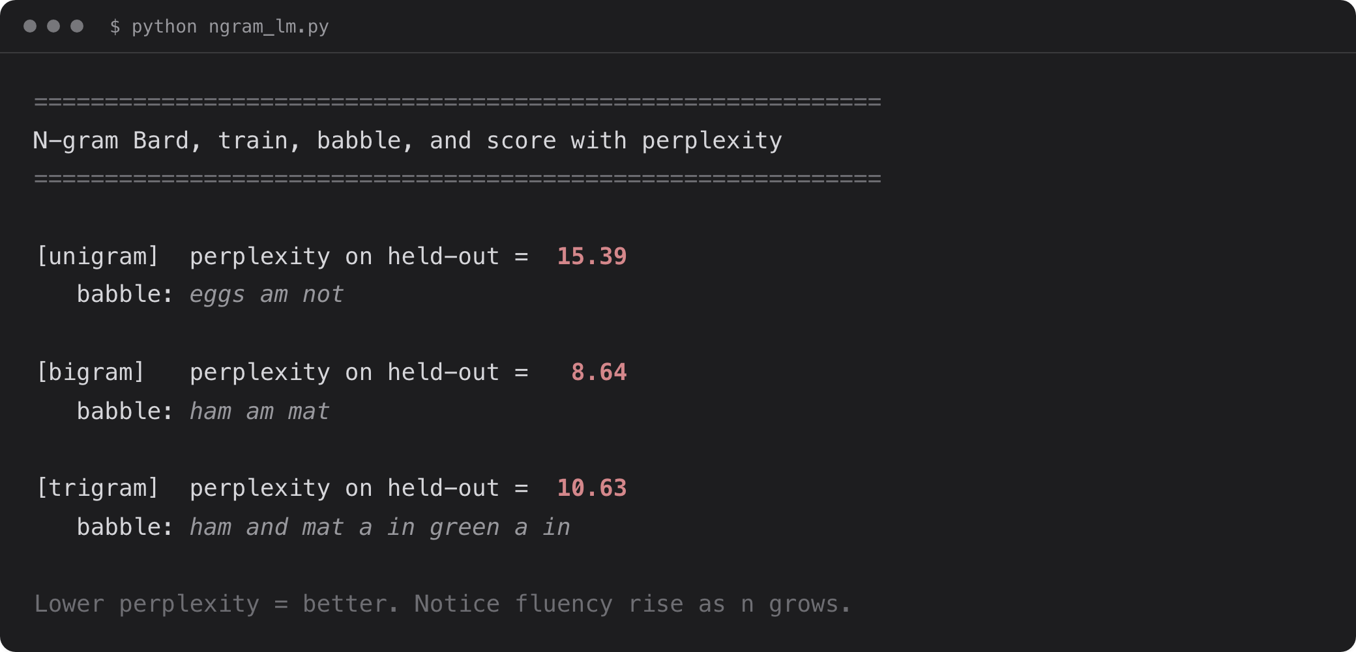
What you should see
Lower perplexity = better. HW1 is out today.
Source: example run, solutions/ngram_lm.py

