Slide 1
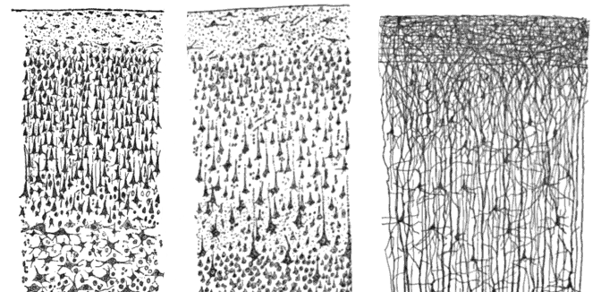
CSCI 3495
Neural Networks for NLP
Natural Language Processing & Large Language Models
Week 6, Class 1 · Mon Sep 28, 2026
Source: Santiago Ramon y Cajal (1899), detail, Wikimedia Commons, public domain
Notes:
Cajal drew the cortex by hand in 1899: layers of tiny units, all wired to each other. Ask the class what survives when we shrink one of those cells down to w·x + b.

Slide 2
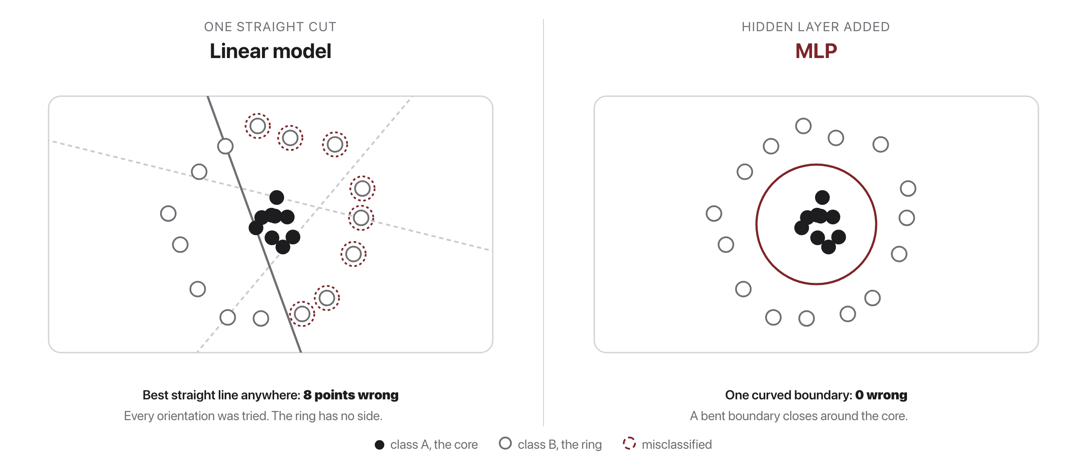
One straight cut is not enough
Source: original figure
Notes:
Logistic regression's boundary w·x + b = 0 is a single straight line, however you train it. Search every orientation and the best line still gets 8 of these 24 points wrong; one closed curve gets none. This is why a hidden layer exists. Stacking straight cuts buys you a boundary that bends.

Slide 3
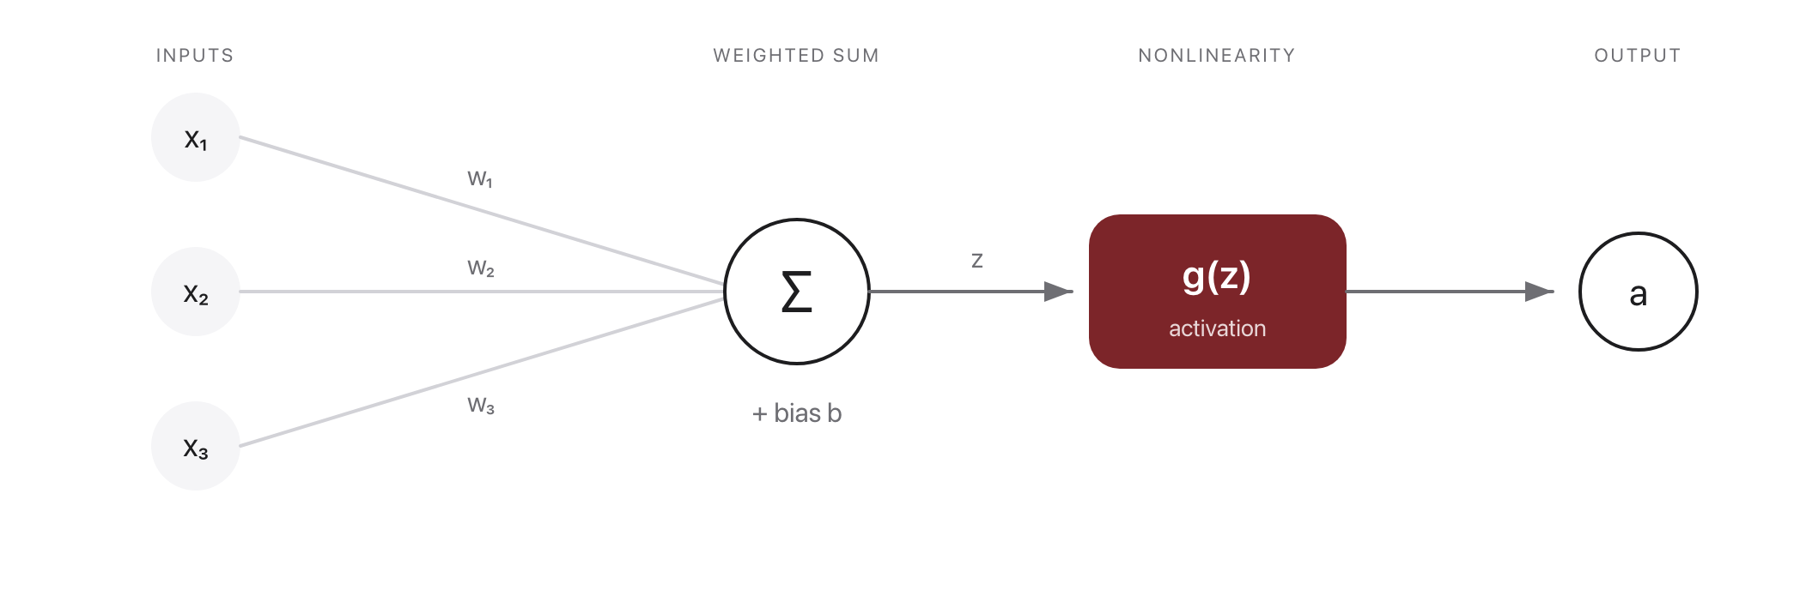
The neuron
Source: original figure
Notes:
A unit computes z = w·x + b, then a nonlinear activation a = g(z). Logistic regression is one neuron with g = sigmoid. X = input features (e.g. an averaged word embedding); w, b are learned; g = ReLU / tanh / sigmoid.

Slide 4
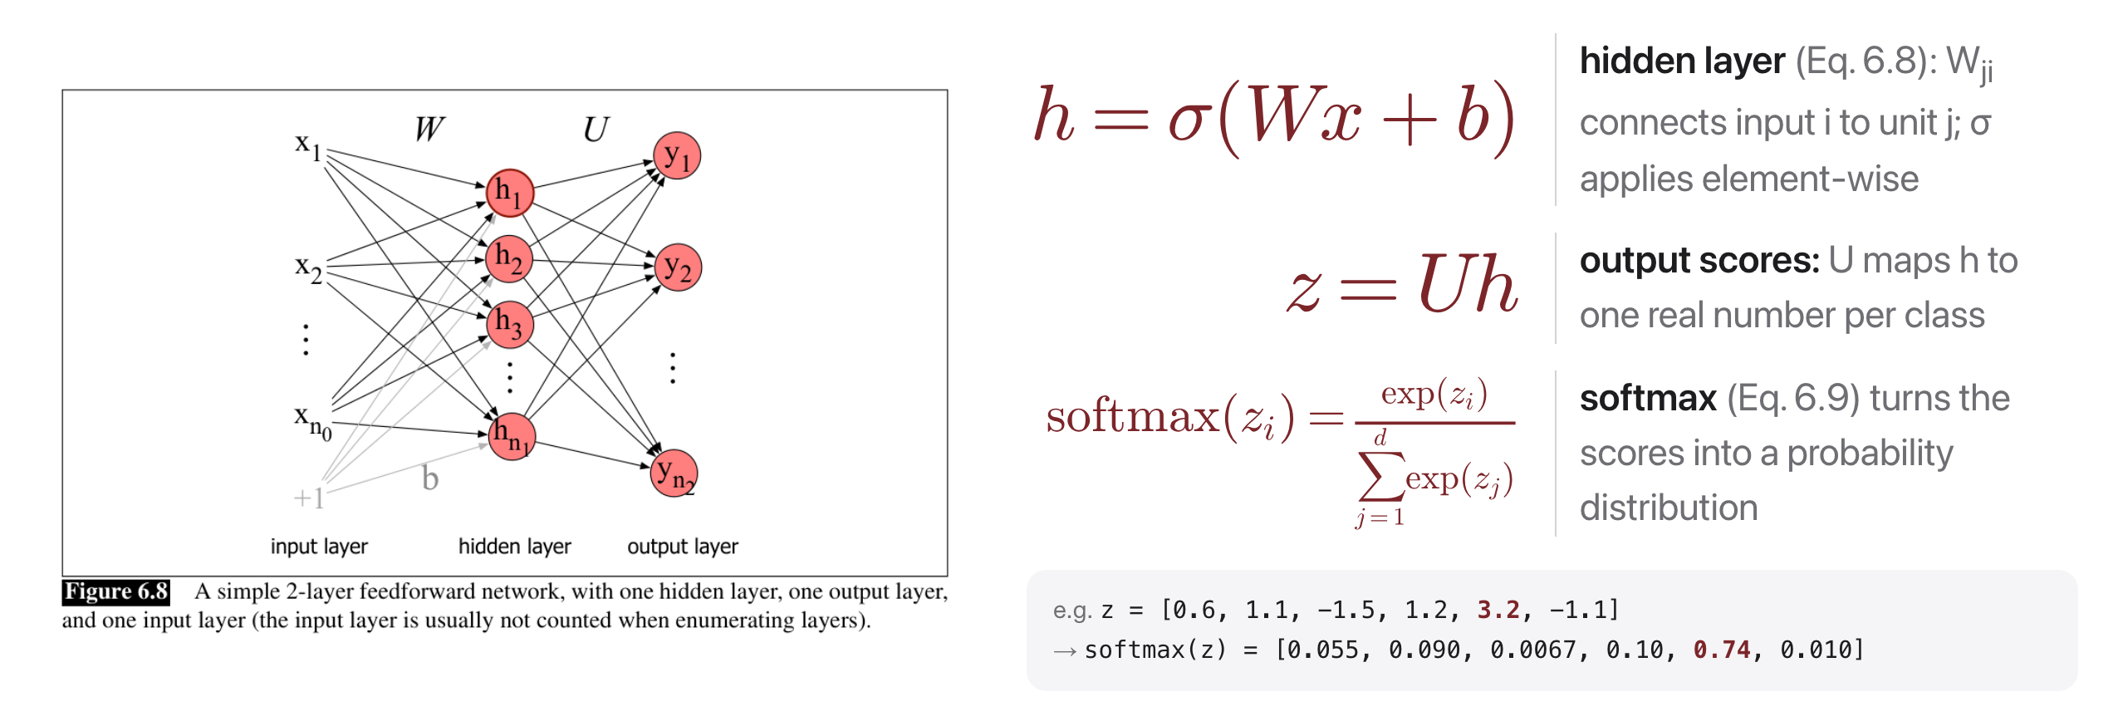
Stacking neurons into an MLP
Source: Jurafsky & Martin, SLP3 (Jan 2026 draft), Fig. 6.8, Eqs. 6.8-6.11
Notes:
A 2-layer feedforward net and its math, side by side: W and U are the weight matrices, the gray +1 node carries the biases b, and each layer is one line of algebra. The worked softmax shows score 3.2 grabbing 74% of the probability.

Slide 5
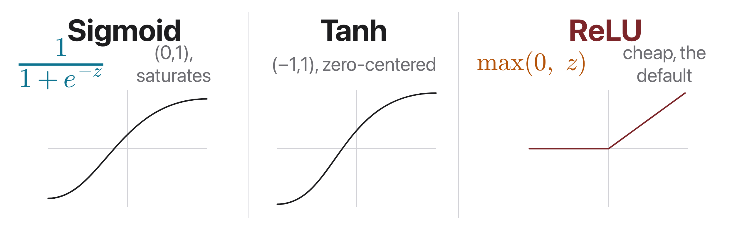
Activations: why nonlinearity matters
Source: original figure
Notes:
Sigmoid, tanh, and ReLU. Without a nonlinearity, stacked linear layers collapse to one linear layer. ReLU is the modern default: no saturation for z > 0 and trivially cheap to compute.

Slide 6
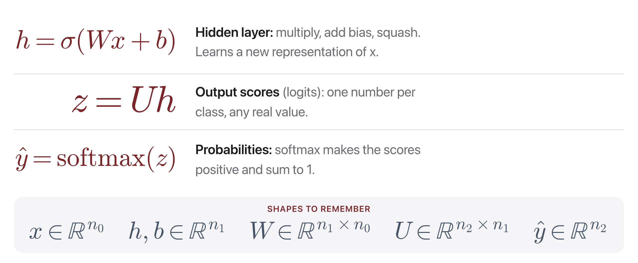
The whole network, in three equations
Source: Jurafsky & Martin, SLP3 (Jan 2026 draft), Eq. 6.12
Notes:
Bookmark this slide: every feedforward classifier this term is these three lines. The book writes sigma for ANY activation (sigmoid, tanh, ReLU).

Slide 7
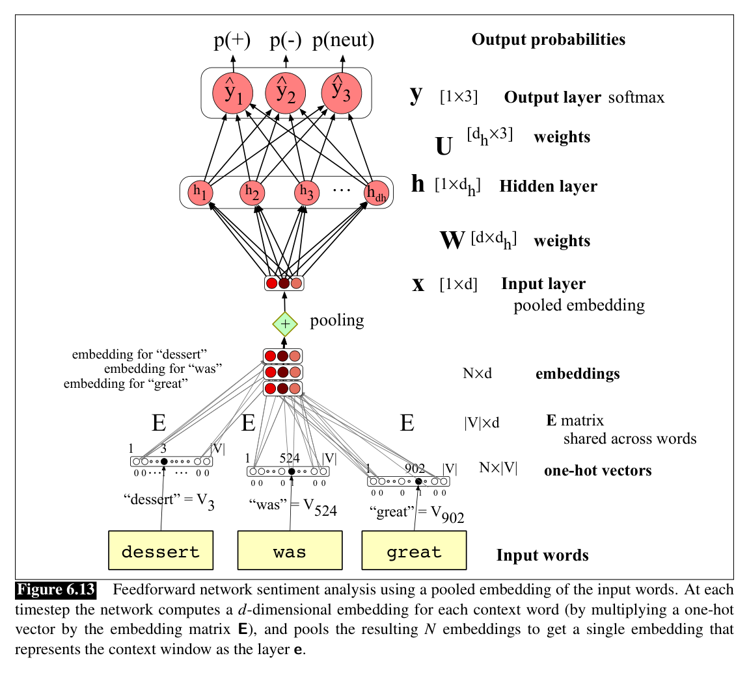
From text to a vector: pool the embeddings
Source: Jurafsky & Martin, SLP3 (Jan 2026 draft), Fig. 6.13
Notes:
Each word's one-hot picks its row of the shared embedding matrix E; pooling (mean or sum) squeezes the N embeddings into one input vector. Fast, cheap, and a surprisingly strong baseline (Iyyer et al. 2015).

Slide 8
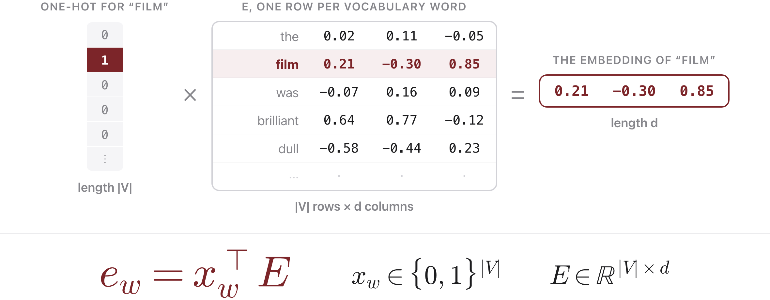
One word in, one row out
Source: original figure; Jurafsky & Martin, SLP3 (Jan 2026 draft), Ch. 6.8 notation
Notes:
The previous slide said each word's one-hot picks its row of E. This is that sentence as a picture, because it is the step students most often take on faith. E is the embedding table: one row per vocabulary word, so it is |V| rows by d columns, and in a real model that is something like 50,000 by 300. To embed the word film, write it as a one-hot vector of length |V|, all zeros except a 1 in film's position, and multiply. Every other row gets multiplied by zero and vanishes, so what comes out is exactly row film, and nothing else in E contributed. Two things follow, and they are the reason this slide exists. First, no framework actually does that multiply: it is a table lookup by index, which is what nn.Embedding is, and the one-hot is just the notation for it. Second, E is made of ordinary parameters, so backprop updates the rows of the words that appeared in the batch, which is what "learning the embeddings" means on the slide two ahead.

Slide 9
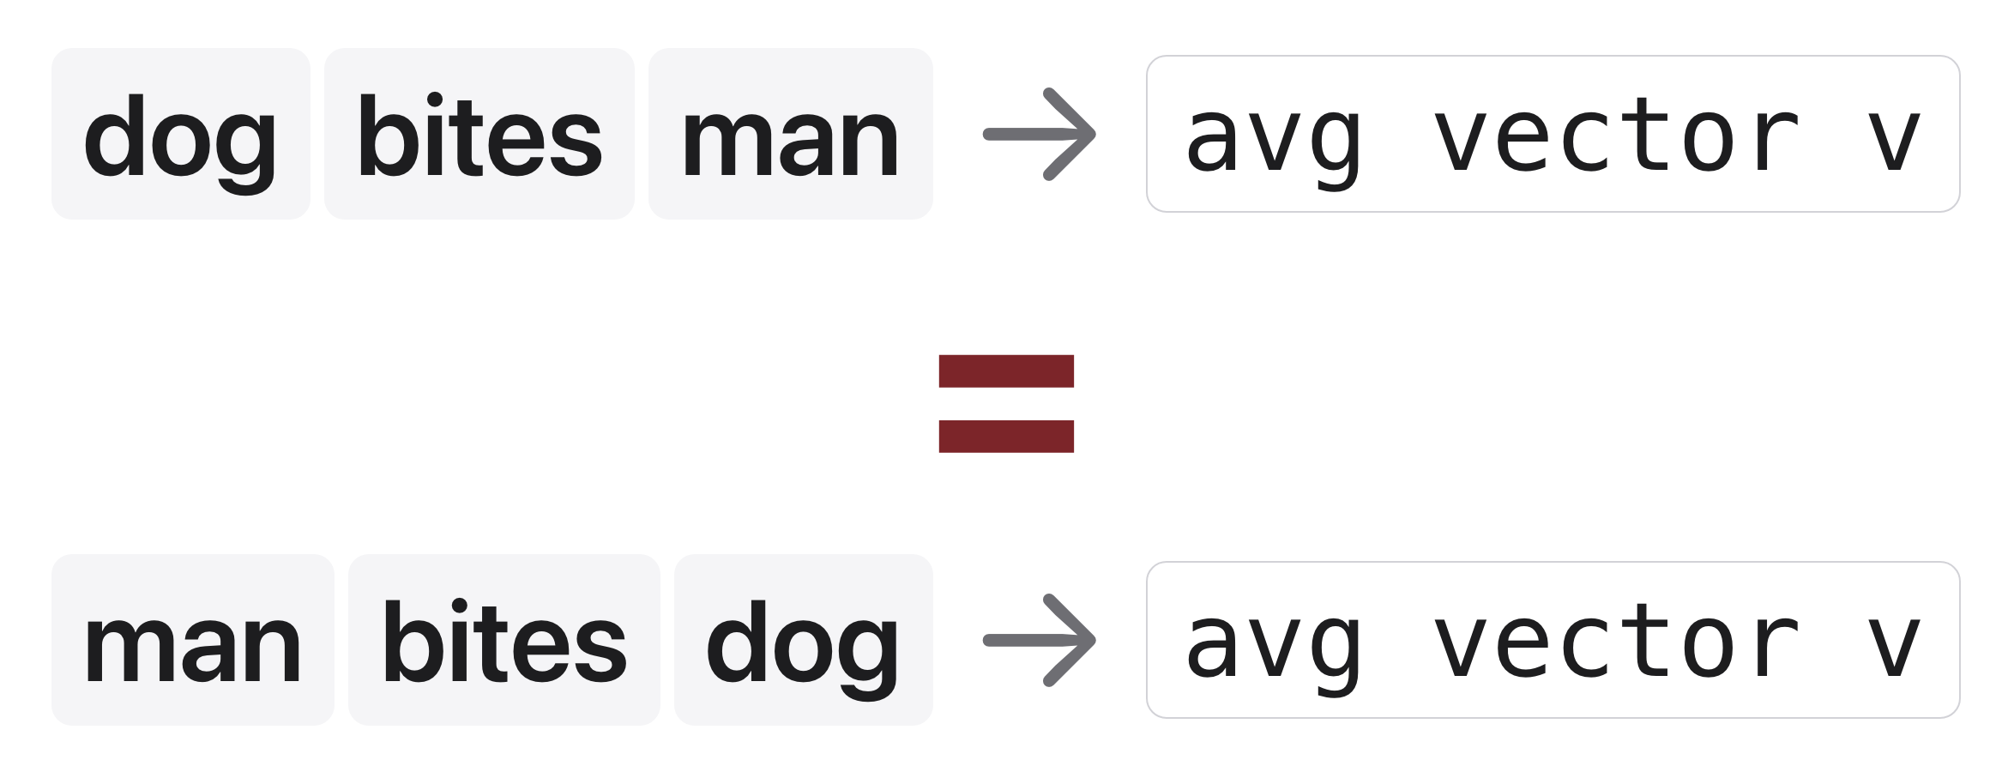
What pooling throws away
Source: original figure
Notes:
"dog bites man" and "man bites dog" give the same averaged vector, word order is lost. To capture order, negation scope and syntax you need a model that reads in sequence, which is where the course goes next. It is also a lever in the exercise: max pooling keeps the strongest signal instead of diluting it.

Slide 10
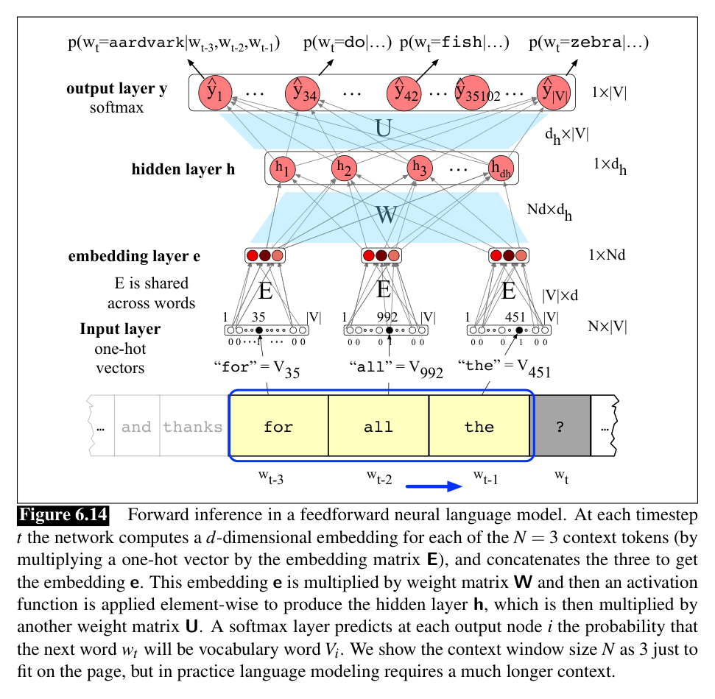
Keep the order: concatenate instead
Source: Jurafsky & Martin, SLP3 (Jan 2026 draft), Fig. 6.14
Notes:
A feedforward language model concatenates the context embeddings side by side, so each position keeps its identity, and predicts the next word. The catch: the window is stuck at N words.

Slide 11
Let's walk through Parts 1 and 2 in the notebook
A review becomes one vector, then a model to feed it to.
Notes:
Everyone into today's lab.ipynb. Two thousand real film reviews, and the first job is the one the last four slides described: look up a row per word, average the rows, and you have a fixed-size vector for a variable-length document. Part 2 builds the network and prints the shape at every step. Make them read the shapes out loud; (4, 150) becomes (4, 150, 8) becomes (4, 8) becomes (4, 2), and that is the whole architecture.

Slide 12
Gradient descent
Source: original animation, scripts/viz/make_nonconvex_gif.py
Notes:
First the mechanics, because the animation assumes them: the gradient points uphill, so you step the opposite way, and the learning rate sets how far. Steps shrink on their own as the slope flattens, which is why the balls slow down near the bottom. Now the point of the picture. Both runs are the same algorithm on the same surface, and they start a third of a unit apart. One ends in the deep well at loss -3.04, the other in the shallow one at -1.67 and cannot get out, because every direction out of it is uphill and uphill is the one direction gradient descent will not go. So the honest summary is that gradient descent finds A minimum, not THE minimum, and which one depends on where the weights happened to be initialised. Do add the caveat if it comes up, because the naive version of this scares people: in the millions of dimensions a real network has, bad local minima turn out to be rare, saddle points are the more common obstacle, and the minima that SGD actually reaches tend to have similar loss to one another. This two-dimensional picture is the right intuition for what the algorithm can and cannot do, not a warning that training is a lottery.

Slide 13
Let's walk through Part 3 in the notebook
Train it, score it, and find out it is bad.
Notes:
The same four lines they have written before, now over a real classifier, and then F1 rather than accuracy because a model that always guesses one class should score badly. It lands at 0.584 on validation. Then run the bag-of-words baseline in the next cell: logistic regression on word counts gets 0.852. Sit with that for a moment. The neural network loses to counting, and fixing that is the whole second half of the class.

Slide 14

Break
Source: original figure

Slide 15
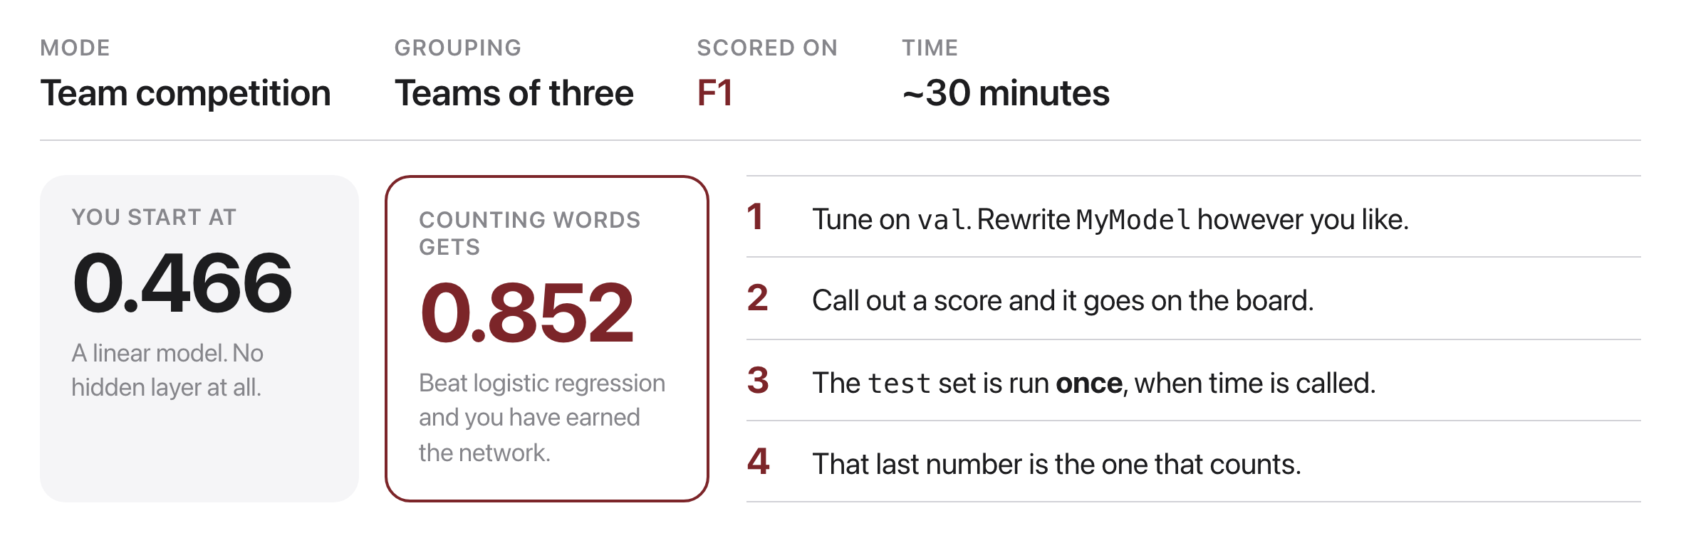
Beat the baseline
Source: original figure; scores measured on the notebook
Notes:
Teams of three, thirty minutes. Everything is one dictionary called CONFIG and every number in it is deliberately bad. Two rules that matter. Tune on validation, and the test set gets run once, at the end, together. Anyone who tunes against test has stopped measuring anything. Put a column on the board and write scores up as they are called; the leaderboard is most of the fun.

Slide 16
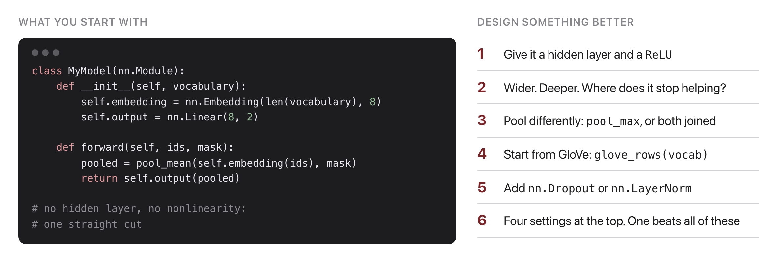
The model you start from has no hidden layer
Source: original figure; the starting model in today's notebook
Notes:
Show the starting model, name the one thing wrong with it, and get out of the way. It has no hidden layer, so it is the straight cut from the start of class, and putting one in is worth 0.17 on its own. Do not tell them what else matters. MAX_WORDS is the sleeper: it is worth almost nothing until the model has the capacity to use the extra text, so a team that tries it early, gets nothing and abandons it has found the best discussion point of the day.

Slide 17

Reading & homework
Source: resources/landmark-papers.md
Notes:
Required: seq2seq (Sutskever, Vinyals & Le, 2014), the only quizzed reading. J&M Ch. 6 & 13 are optional. HW2 is out today, due W7C1.

