Slide 1
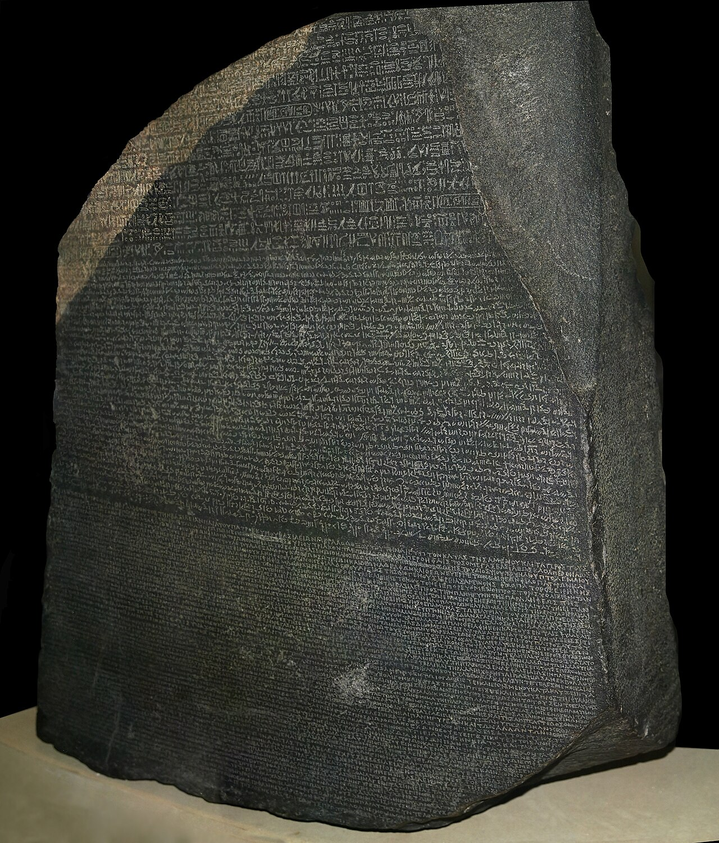
CSCI 3495
Attention and the Transformer
Natural Language Processing & Large Language Models
Week 7, Class 1 · Mon Oct 5, 2026
Source: Photo: Hans Hillewaert, Wikimedia Commons, CC BY-SA 4.0
Notes:
The Rosetta Stone: one decree, three scripts. Reading any line meant constantly glancing back at the others. That glance is the whole idea today, and by the end of class we go from one glance to the architecture everything since 2017 is built on. After the break they take a real one apart with their hands.

Slide 2
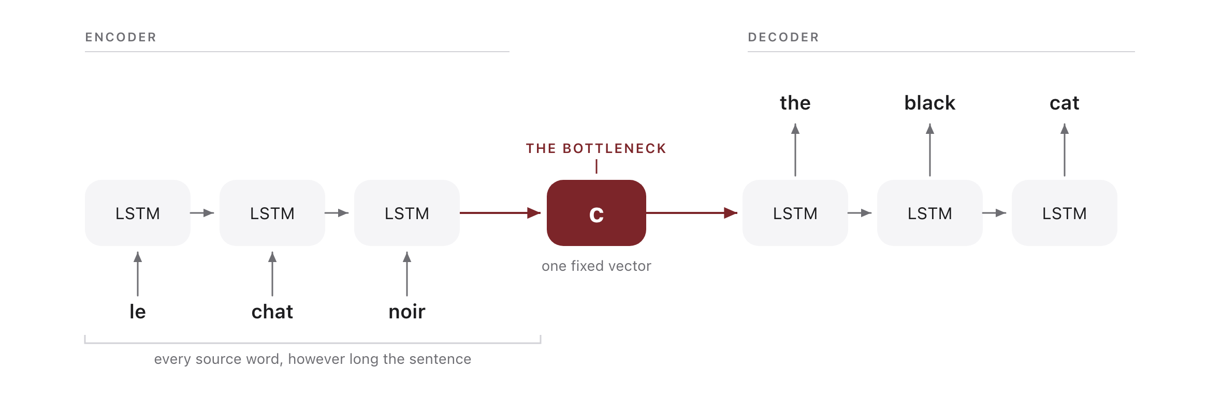
One vector has to carry the whole sentence
Source: original figure; the architecture of Sutskever, Vinyals & Le 2014
Notes:
This is the machine translation system that worked before attention, and the shape of it is the problem. The encoder reads the source one word at a time and hands the decoder a single fixed vector, c. Everything the decoder will ever know about the source has to be in there: every word, every ending, every bit of word order, whether the sentence was three words or forty. Ask the room what happens as the sentence gets longer, and let somebody say it out loud. The vector does not get bigger. Performance falls off a cliff past about twenty words, and the fix on the next slide is almost embarrassingly simple: stop insisting on one vector, and let the decoder look back at all of them.

Slide 3
Attention in three steps
Source: original animation; original figure
Notes:
Every output word re-weights the whole input. Watch the peak jump backwards when "chat noir" comes out reversed.

Slide 4
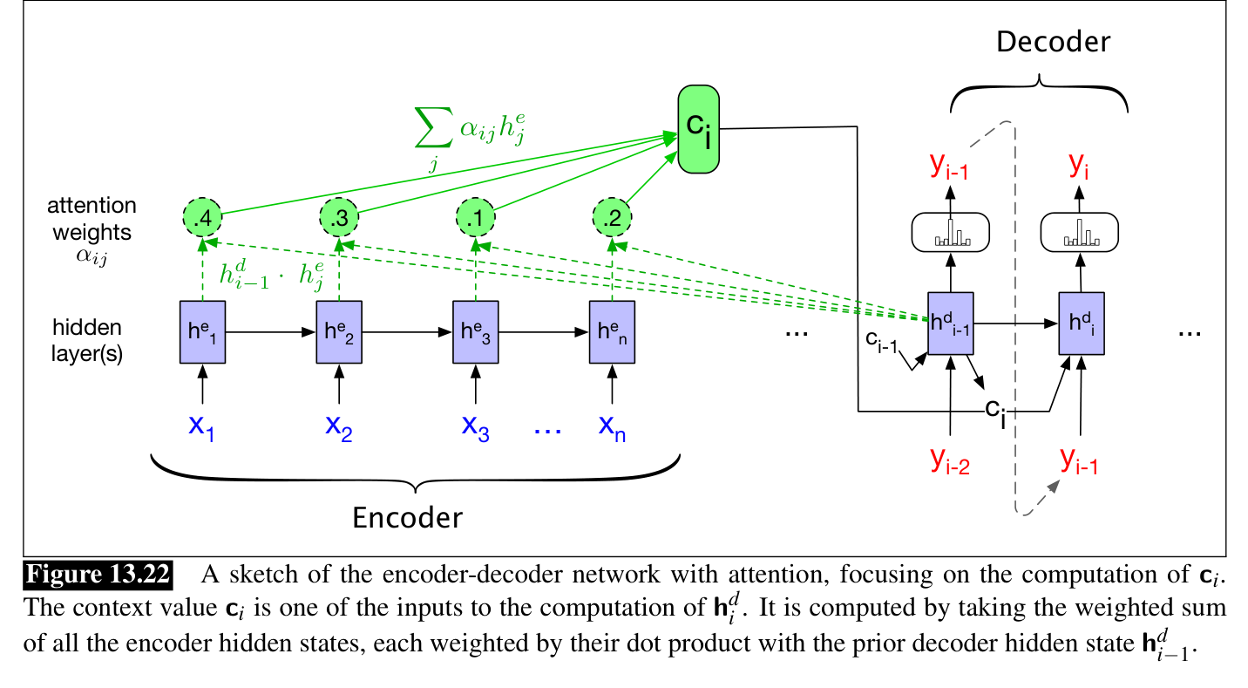
The whole computation, drawn
Source: Jurafsky & Martin, SLP3 (Jan 2026 draft), Fig. 13.22
Notes:
One decoding step: every encoder state gets a weight (here .4, .3, .1, .2 from dot products with the previous decoder state), and their weighted sum becomes c_i, an input to the next decoder state. Repeat fresh for every output word.

Slide 5
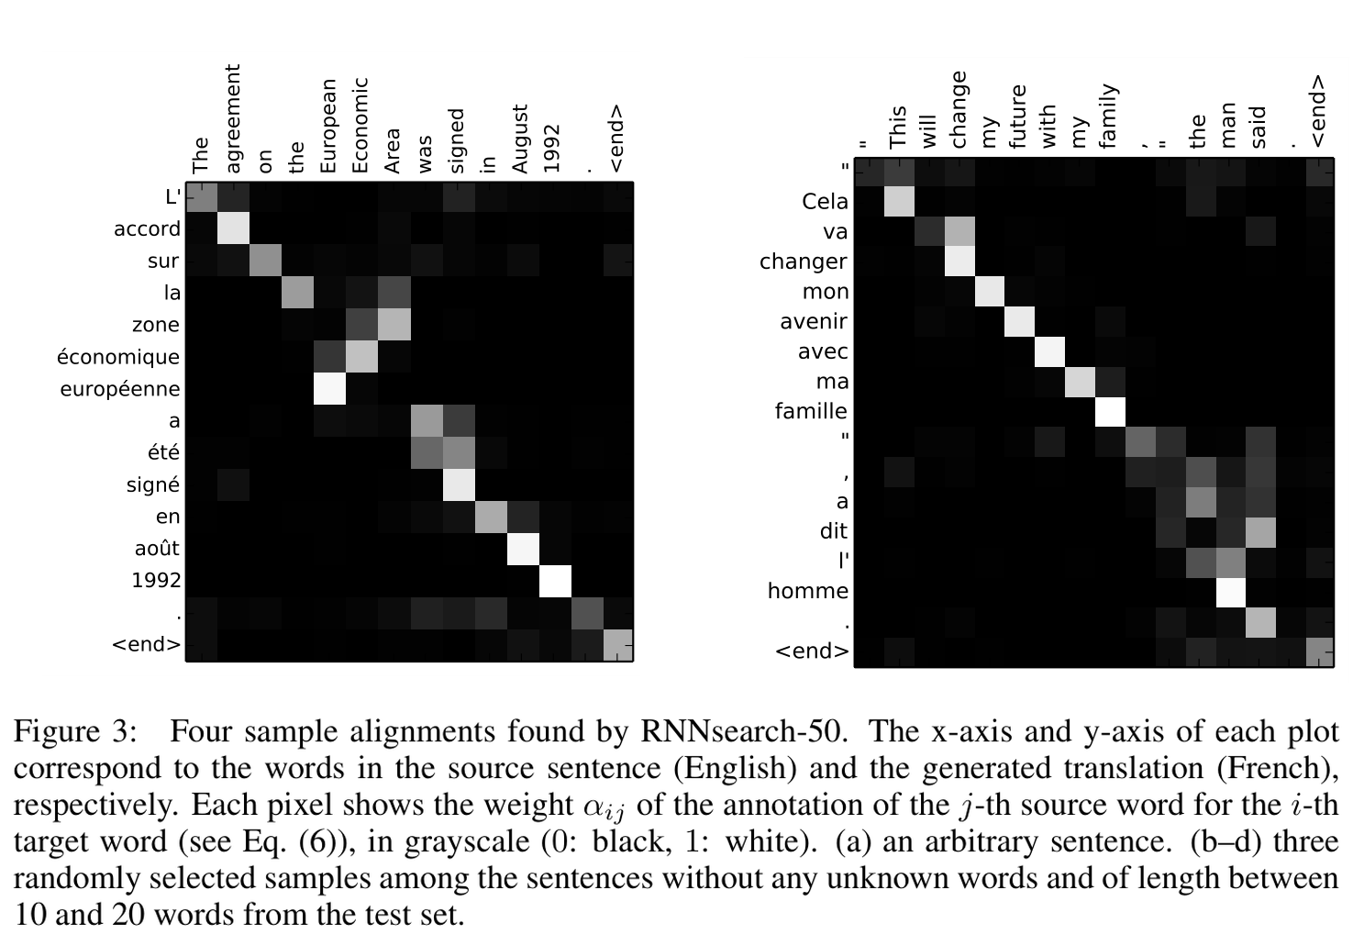
Reading attention as alignment
Source: Bahdanau, Cho & Bengio 2014 (arXiv:1409.0473), Fig. 3 (a, d)
Notes:
Real learned weights, two examples: rows are French output words, columns the English source, white means high alpha. Left: "zone economique europeenne" reverses "European Economic Area". Right: French says "a dit l'homme" (said the man), and the weights jump backwards to "the man said". Nobody labeled any of this.

Slide 6
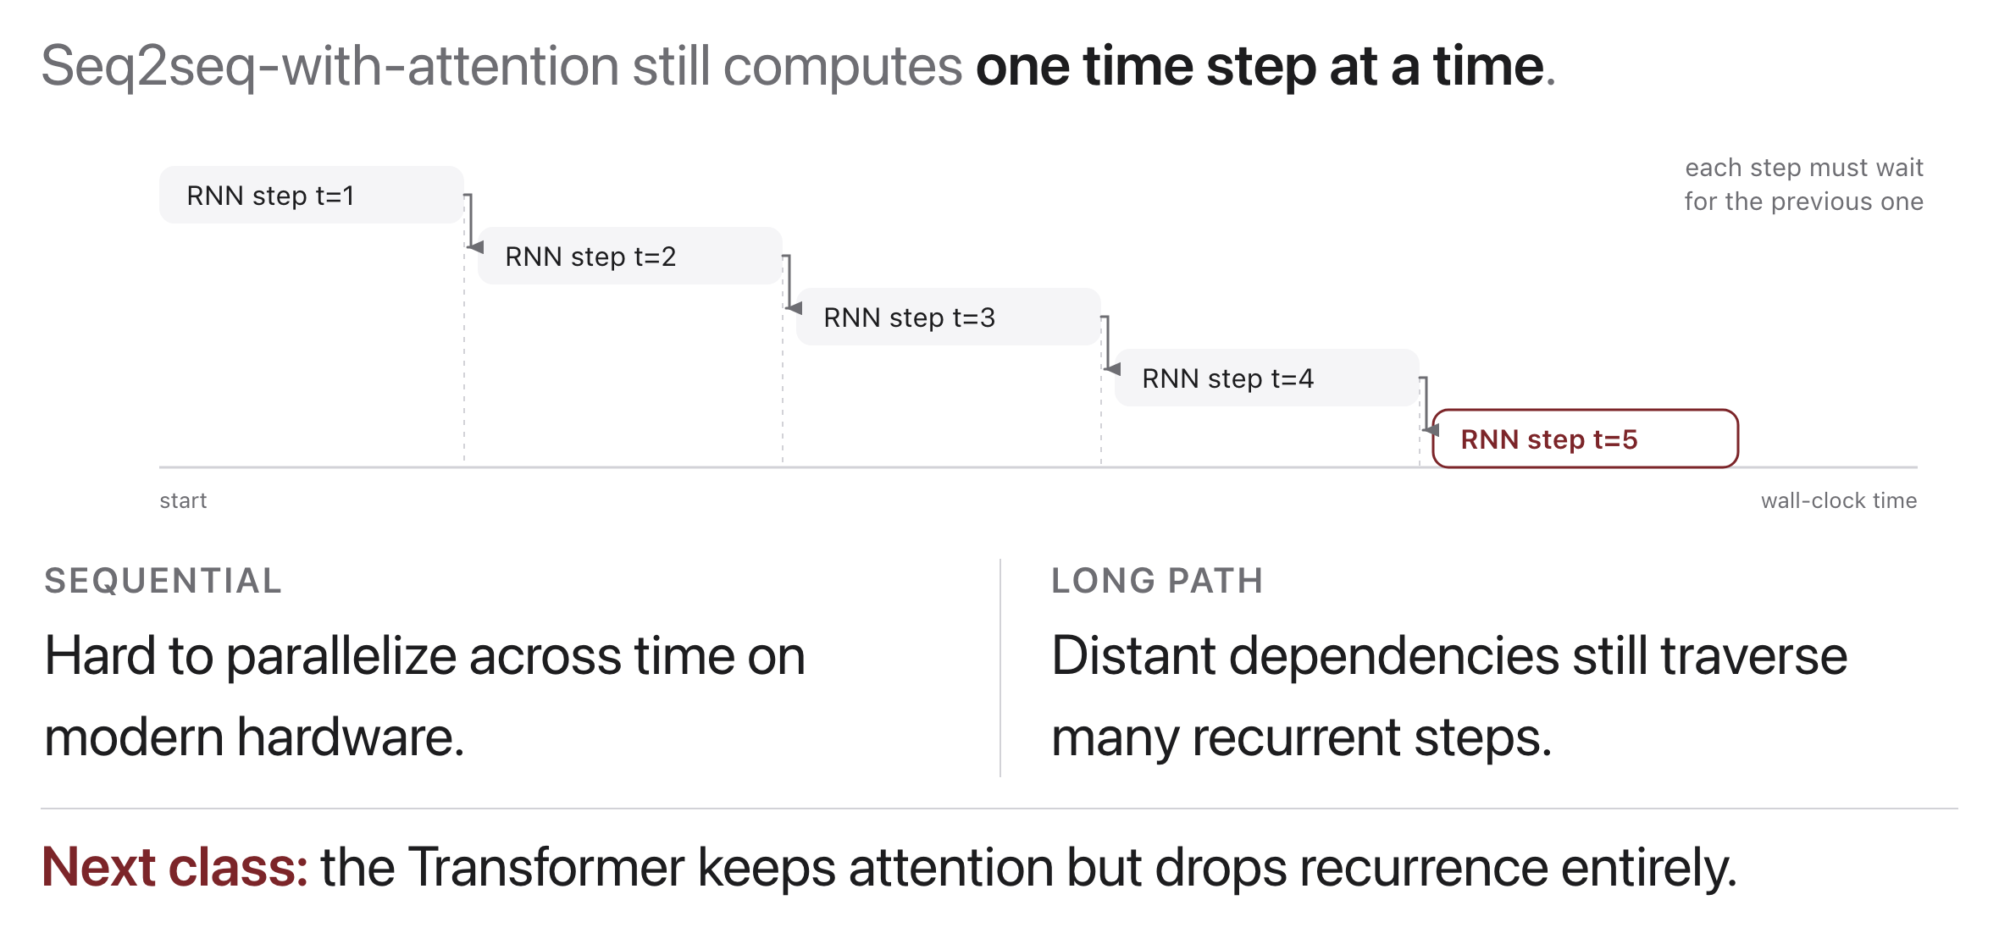
Limitations that motivate the Transformer
Source: original figure
Notes:
Attention fixed the bottleneck but not the clock. Step five still cannot start until step four finishes, so nothing parallelises across time, and a GPU sits mostly idle. That single constraint is what the Transformer removes next class.

Slide 7
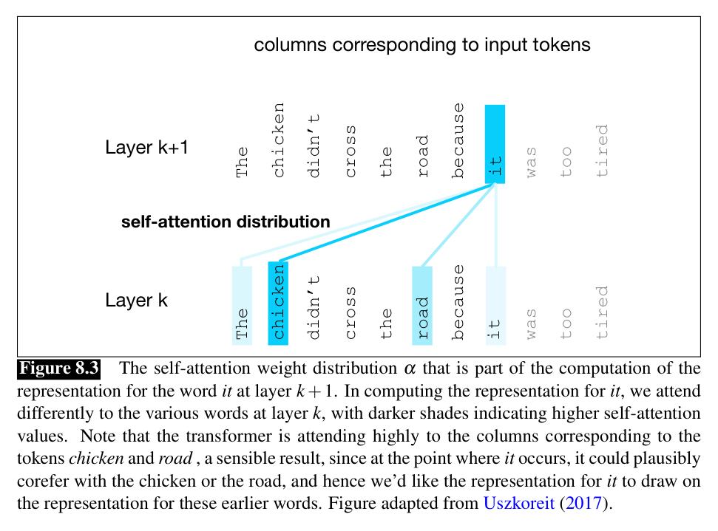
Self-attention: the core move
Source: Jurafsky & Martin, SLP3 (Jan 2026 draft), Fig. 8.3
Notes:
The book's example: building the representation of "it", the model attends hard to "chicken" and "road", the two things "it" could refer to. Every token does this over the whole context, at every layer.

Slide 8
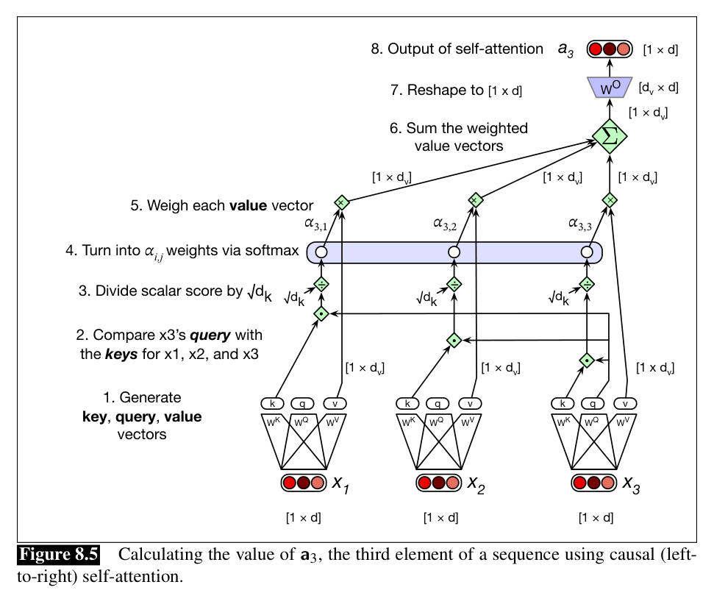
The same computation, drawn
Source: Jurafsky & Martin, SLP3 (Jan 2026 draft), Fig. 8.5
Notes:
Computing a_3, step by numbered step: generate k, q, v; compare q_3 to the keys; scale by sqrt(d_k); softmax; weigh the values; sum; reshape with W^O. Match each arrow to an equation on the previous slide.

Slide 9
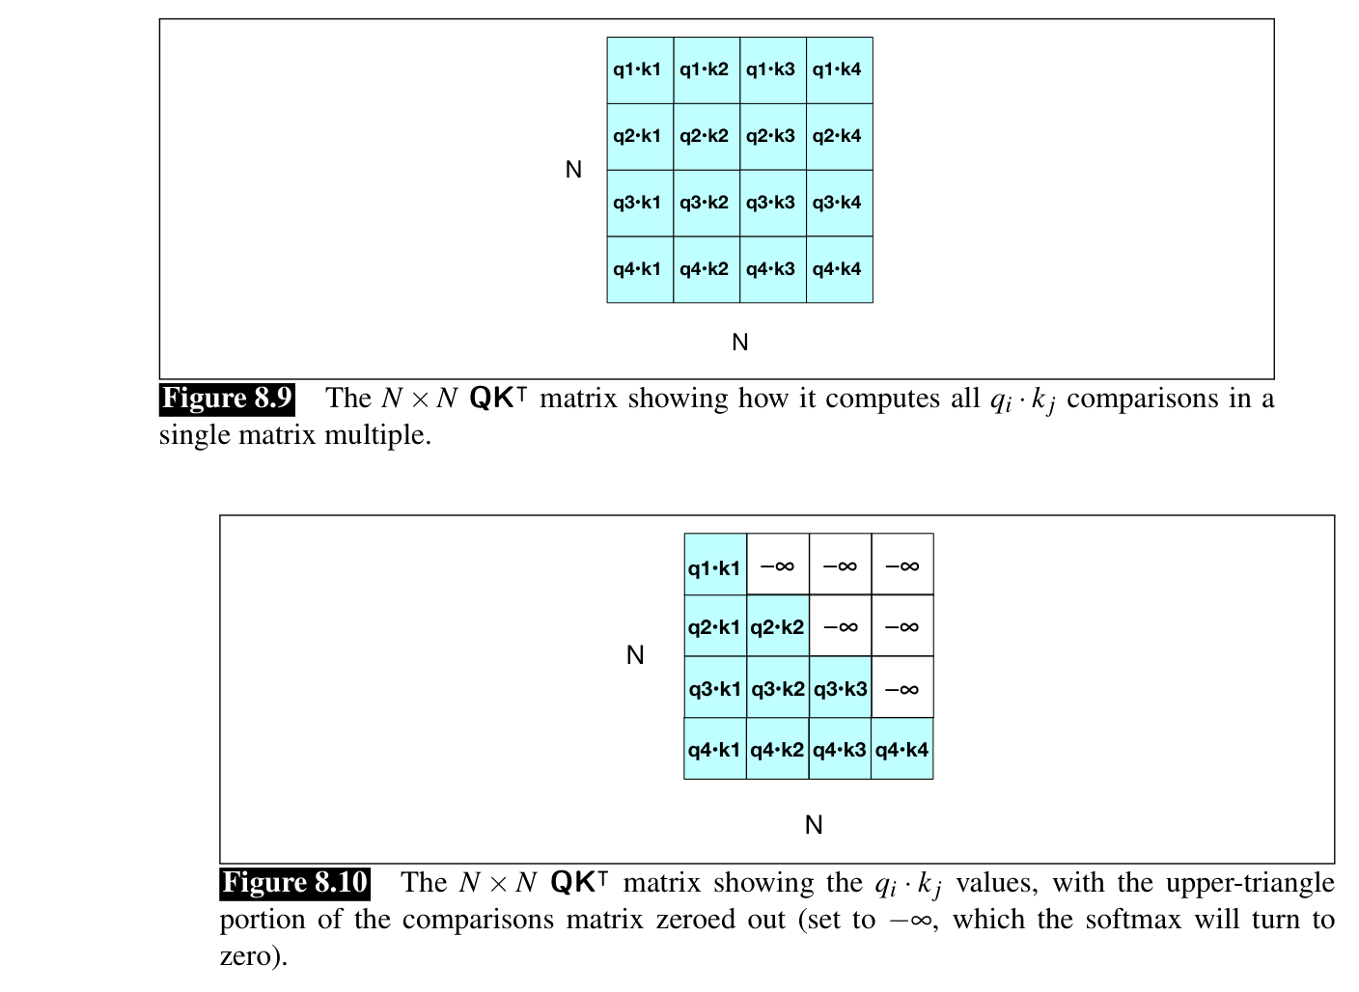
All pairs at once, and the causal mask
Source: Jurafsky & Martin, SLP3 (Jan 2026 draft), Figs. 8.9-8.10
Notes:
In practice one matrix multiply QK^T scores every pair at once (top), but the upper triangle is the FUTURE. The mask sets those cells to -infinity, so after softmax they get exactly zero weight (bottom): no information leaks backwards from tokens the model has not generated yet.

Slide 10
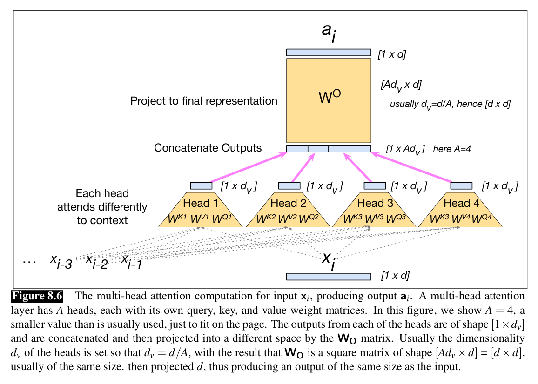
Multi-head, concretely
Source: Jurafsky & Martin, SLP3 (Jan 2026 draft), Fig. 8.6
Notes:
The book's version with A = 4 heads: each head has its own W^Q, W^K, W^V, their outputs are concatenated and W^O projects back to model size. Same picture as the paper's, with the shapes written on every wire.

Slide 11
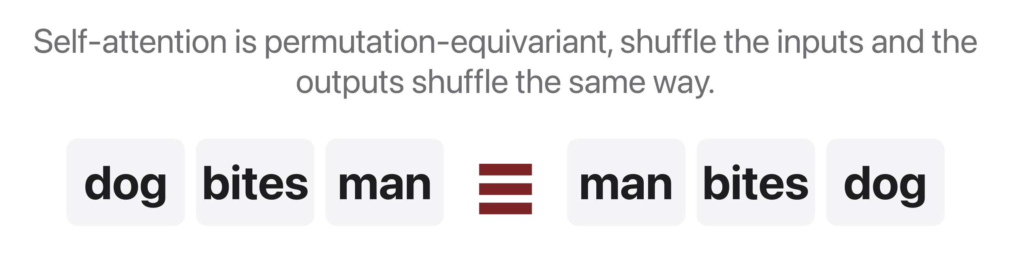
But attention has no sense of order
Source: original figure
Notes:
To bare attention these look identical, we must inject position explicitly.

Slide 12
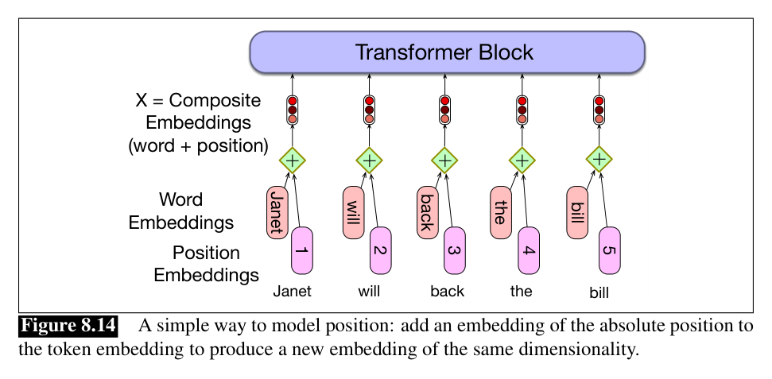
The simple fix: add position embeddings
Source: Jurafsky & Martin, SLP3 (Jan 2026 draft), Fig. 8.14
Notes:
Give every position its own embedding and just ADD it to the token embedding; now "bites" at position 2 and "bites" at position 4 enter the stack as different vectors.

Slide 13
Let's walk through Parts 1, 2 and 3 in the notebook
A real transformer.
Notes:
Everyone into today's lab.ipynb. We are not implementing any of the last six slides; we are loading a trained transformer and looking at what it does. Part 1 turns a sentence into one vector per token, all positions at once. Part 2 pulls the attention weights out and draws them, which is the heatmap from the alignment slide except this model taught itself. Part 3 is the one to slow down on: the same word in two different sentences comes out as two different vectors, which is the thing a fixed embedding table could never do.

Slide 14
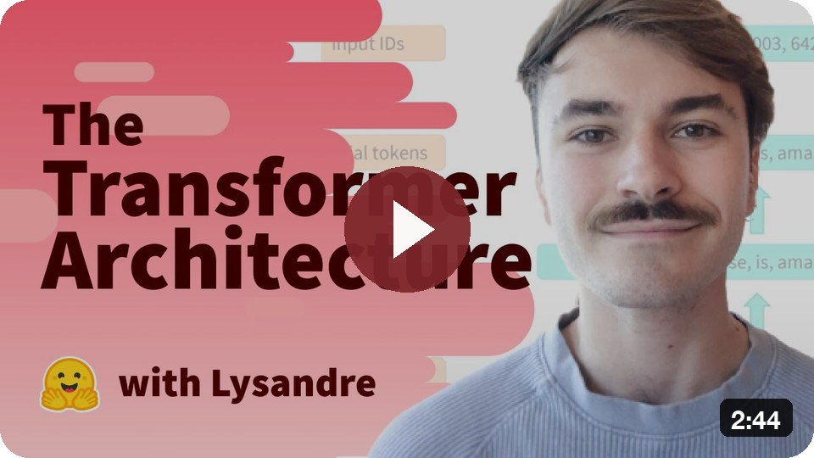
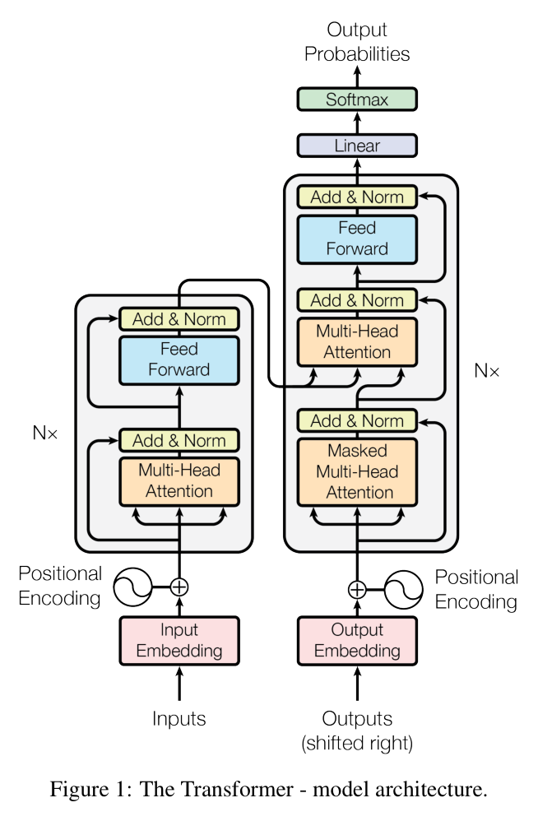
The full Transformer, assembled
The Transformer (HF)
Source: Vaswani et al. 2017 (arXiv:1706.03762), Fig. 1
Notes:
The most reproduced figure in modern NLP. Every piece you have met is here: embeddings plus positional encoding, multi-head attention, feed-forward, residual Add & Norm, stacked N=6 times per side. The decoder adds masked self-attention and cross-attention into the encoder.

Slide 15
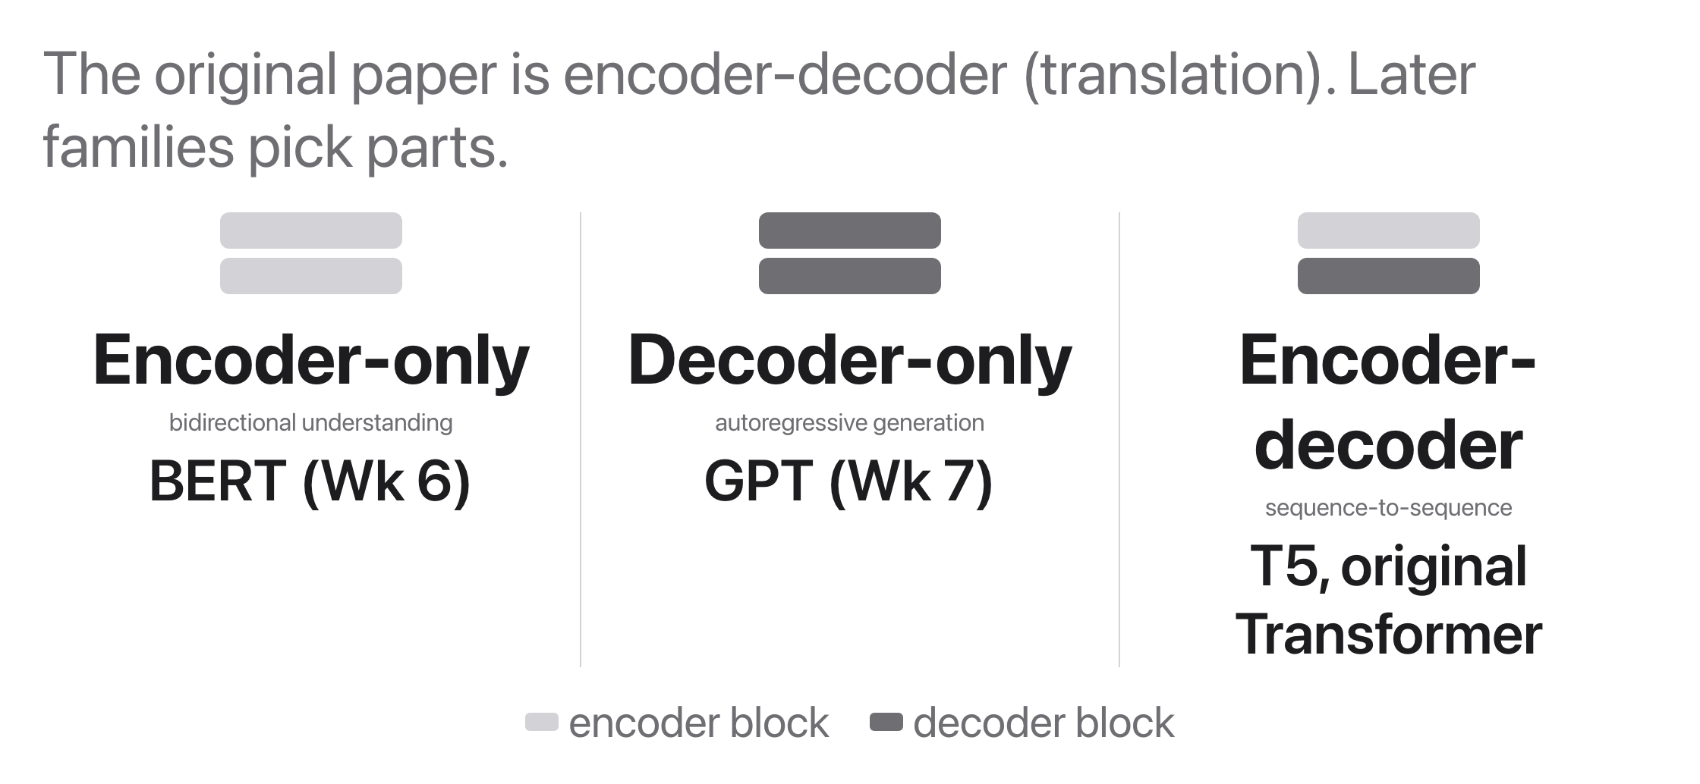
Encoder, decoder, or both?
Source: original figure
Notes:
The attention machinery is the same, the masking and wiring differ.

Slide 16
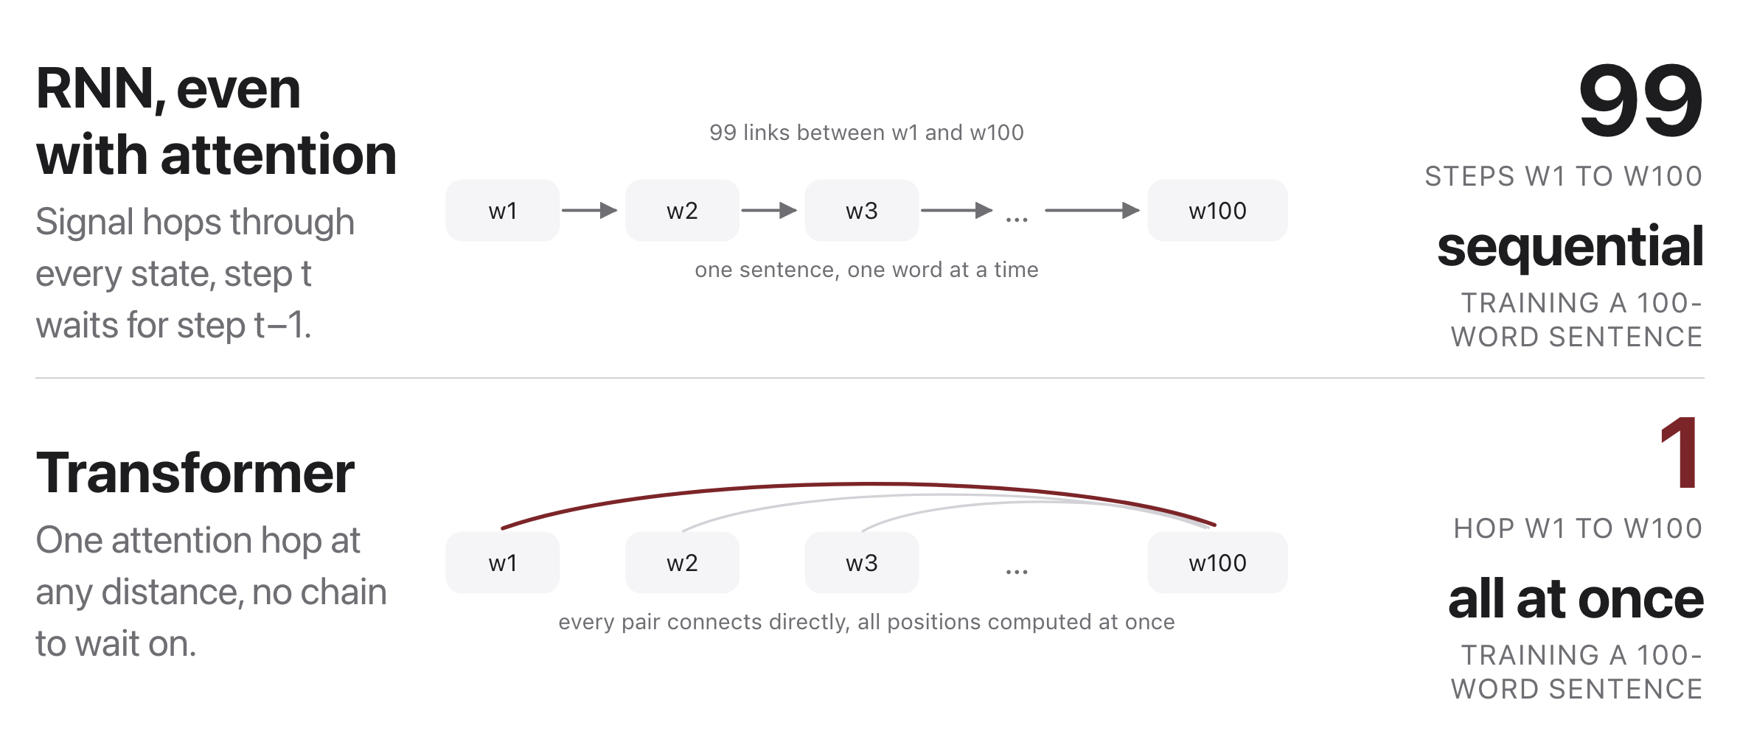
Why the Transformer won
Source: original figure
Notes:
The result: the backbone of every modern LLM, from BERT and GPT onward. Short paths plus parallel training made scaling pay off (Weeks 8-9). Trade-off: comparing all pairs costs O(n ) in sequence length n.

Slide 17

Break
Source: original figure

Slide 18
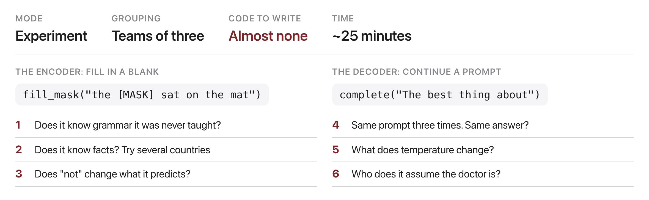
Experiment on a language model
Source: original figure; distilbert-base-uncased and distilgpt2 in today's notebook
Notes:
Teams of three, about twenty-five minutes, and almost no code: two helper functions are given and everything else is choosing sentences. The encoder fills in a blank, the decoder continues a prompt, and the job is to find out what each one does and does not know. Six starting questions are on the slide and teams should invent their own. Insist on evidence: a claim about the model has to come with the prompt that produced it and the numbers it returned. Last ten minutes, each team reports the single most surprising thing they found.

