Slide 1
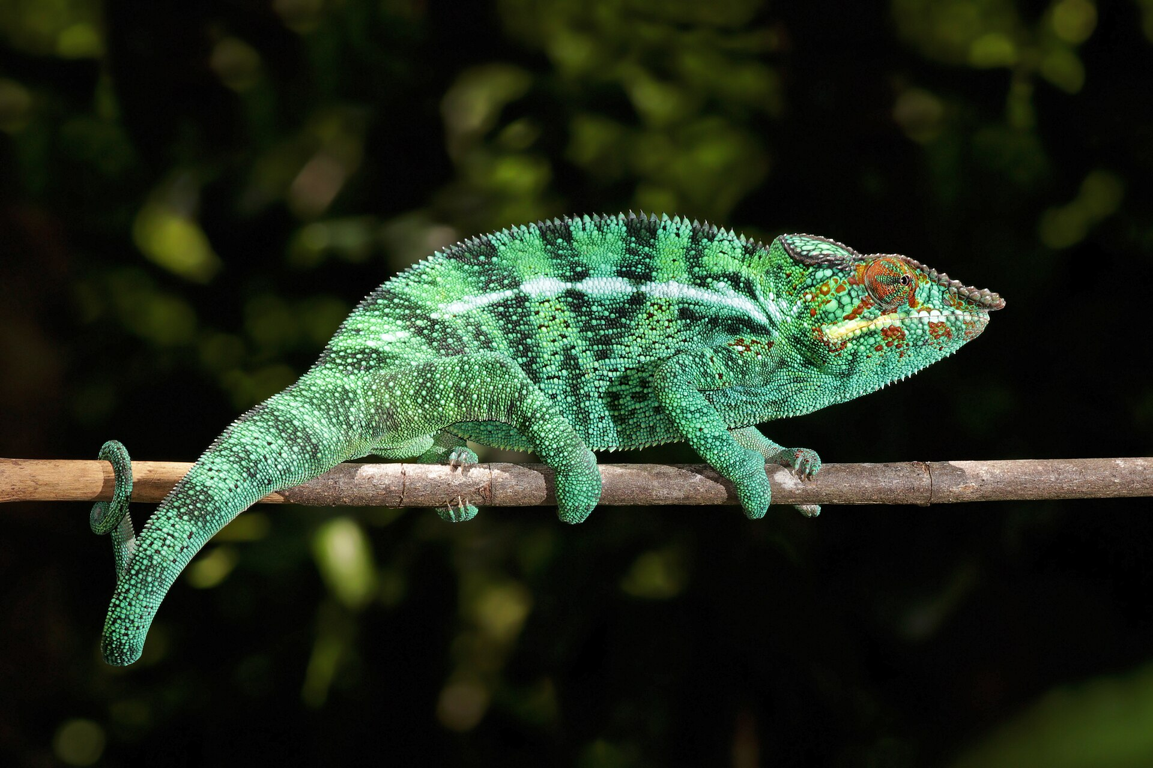
CSCI 3495
BERT on paper
Natural Language Processing & Large Language Models
Week 8, Class 1 · Mon Oct 12, 2026
Source: Charles J. Sharp, Wikimedia Commons, CC BY-SA 4.0
Notes:
A chameleon takes its color from its surroundings, and so does every word in this room. Say the shape of the day out loud: the first half is six slides that put the whole model and every formula on the board, the second half is markers and arithmetic in teams. No laptops today, and no lab; the code comes next session. Everything the problems need will be on the slides they can still see.

Slide 2
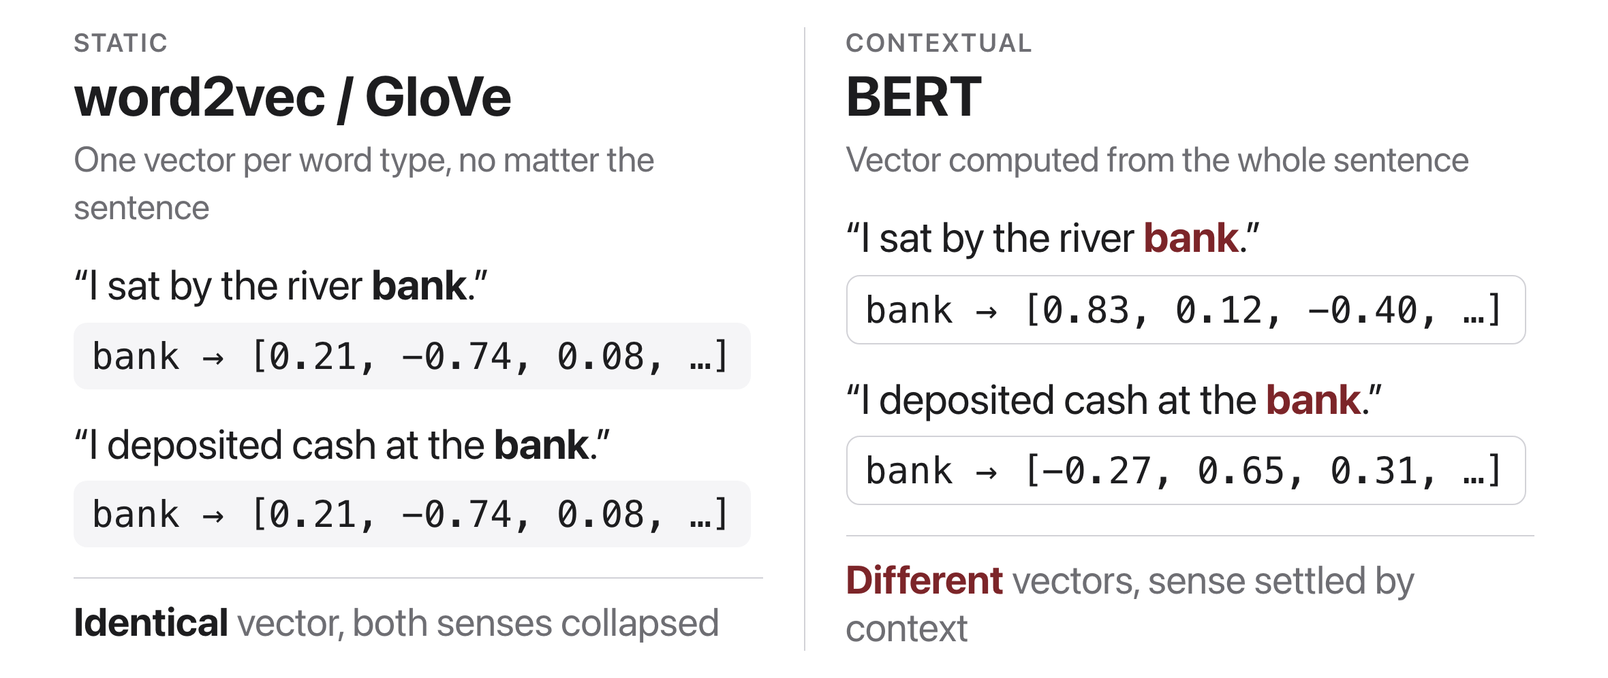
One vector per word, no matter the sentence
Source: original figure
Notes:
A lookup table hands back the same row for bank in both of these sentences, so the two senses are averaged into one point and nothing downstream can separate them. Take one or two more examples from the room: bat, spring, lead, light. The fix is to stop looking a word up and start computing it from the sentence it is sitting in, which is what every model for the rest of the course does.

Slide 3
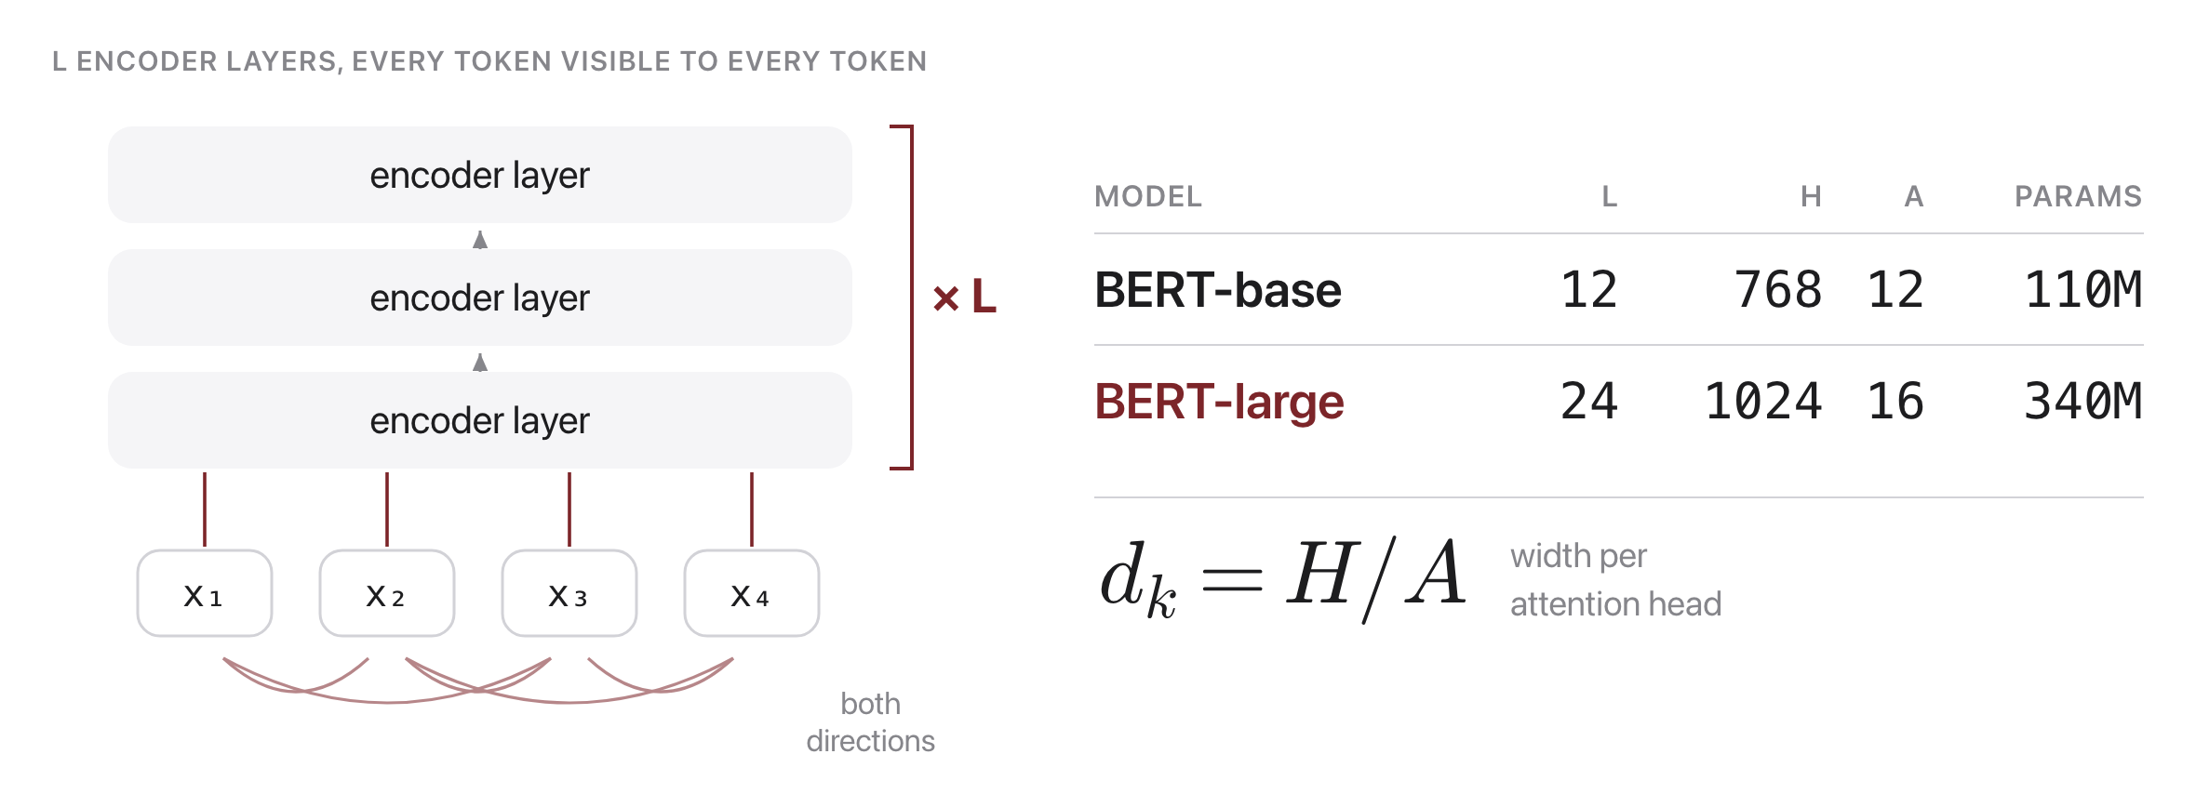
A stack of encoder layers, no direction
Source: Devlin et al. 2019, arXiv:1810.04805
Notes:
BERT is a transformer encoder stack and nothing more: L identical layers, each of width H, each with A attention heads. The one design decision worth naming is what is missing, the causal mask, so every token attends to every token in both directions at every layer. Leave the table up. L, H and A are the three numbers the problems ask about, and d_k = H over A is the only formula on this slide.

Slide 4
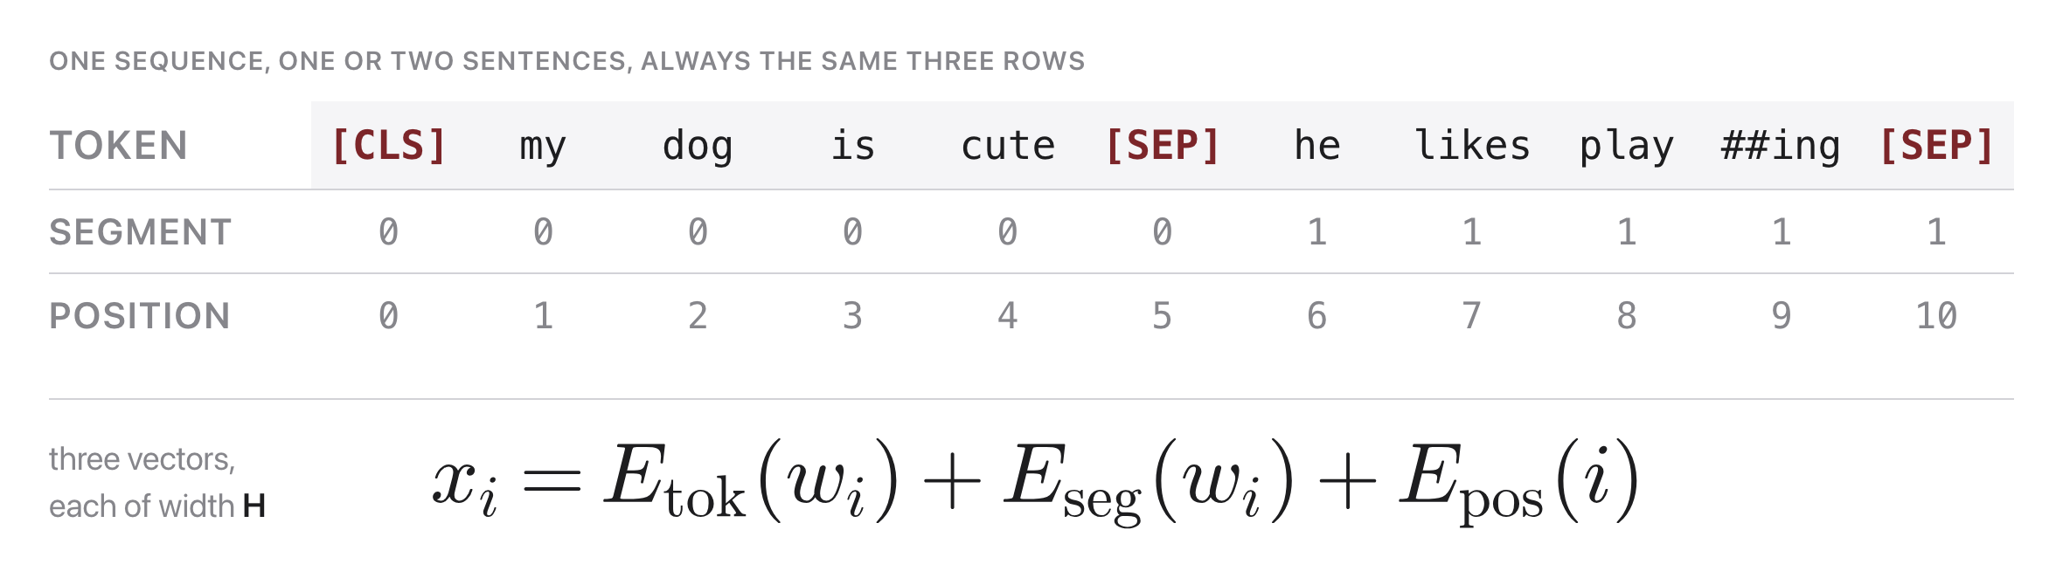
Every input is three embeddings added
Source: Devlin et al. 2019, arXiv:1810.04805
Notes:
A token vector says which word, a segment vector says which of the two sentences, a position vector says where. All three are width H and they are summed before the first layer runs. Two tokens belong to no word: [CLS] opens every sequence and [SEP] closes each sentence, which is what lets a single encoder take a pair. Point at play and ##ing: WordPiece splits rare words into pieces, so token count and word count are not the same thing.

Slide 5
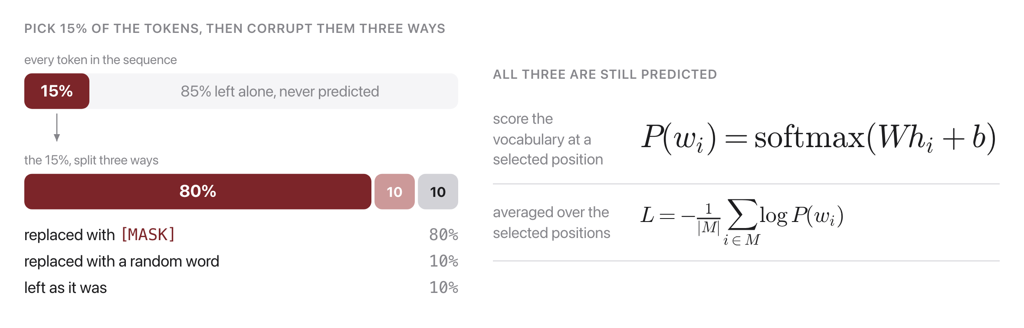
Pretraining: hide words, then predict them
Source: Devlin et al. 2019, arXiv:1810.04805
Notes:
Fifteen per cent of the tokens are selected, and of those, eighty per cent become [MASK], ten per cent become a random word and ten per cent are left exactly as they were. All three groups are still predicted, and only those positions contribute to the loss. Why corrupt at all? Because with attention in both directions the answer is sitting in the input, so the task would be free. Why not always [MASK]? Because [MASK] never appears once the model is being used, and the mixture keeps pretraining and use from drifting apart.

Slide 6
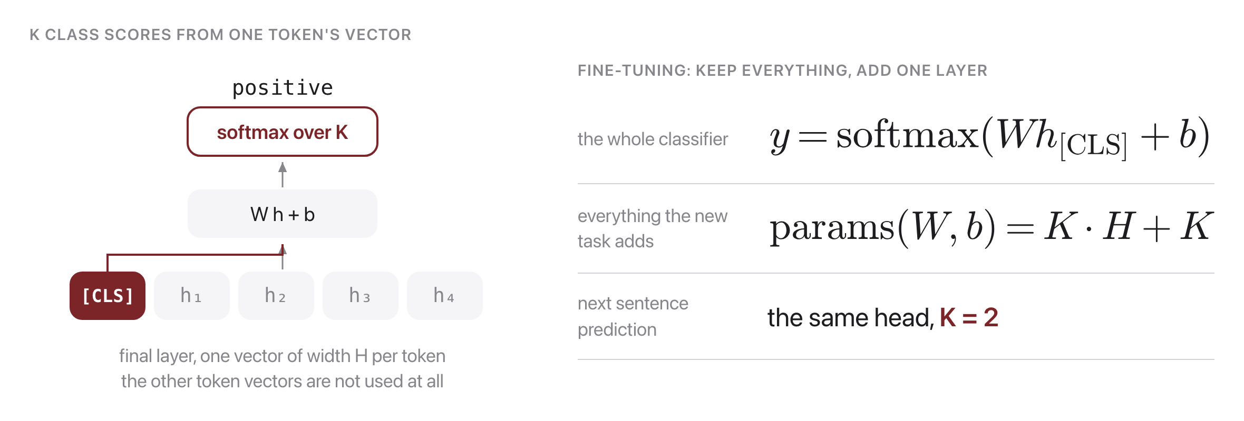
One extra layer turns it into a classifier
Source: Devlin et al. 2019, arXiv:1810.04805
Notes:
Take the final vector at [CLS], multiply by one weight matrix, softmax, and you have a sentence classifier. Everything below that layer is the pretrained model, unchanged, so a new task costs one matrix of K by H plus K biases. That is the whole transfer story: the expensive part was paid once by somebody else, on unlabeled text. Next sentence prediction is exactly this head with K equal to two, and it is what gives [CLS] something to mean in the first place.

Slide 7
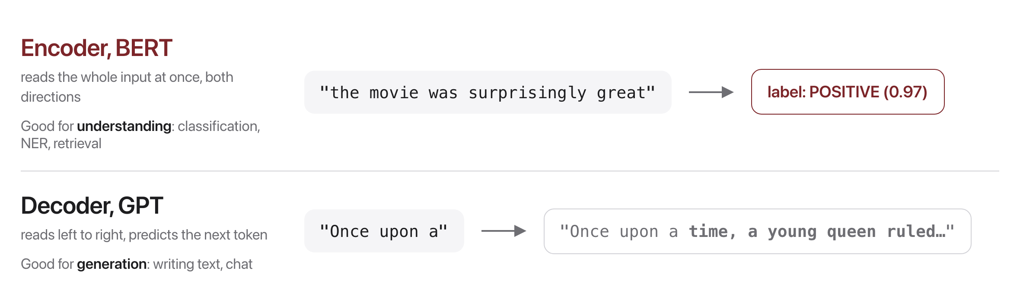
Encoder or decoder, understanding or writing
Source: original figure
Notes:
The mask is the whole difference. Delete it and you get a model that reads everything at once and is very good at judging text, but cannot generate a sentence, because it has no notion of what comes next. Keep it and you get GPT. Neither is the better architecture; they are answers to different questions, and both are the same encoder block underneath.

Slide 8

Break
Source: original figure

Slide 9
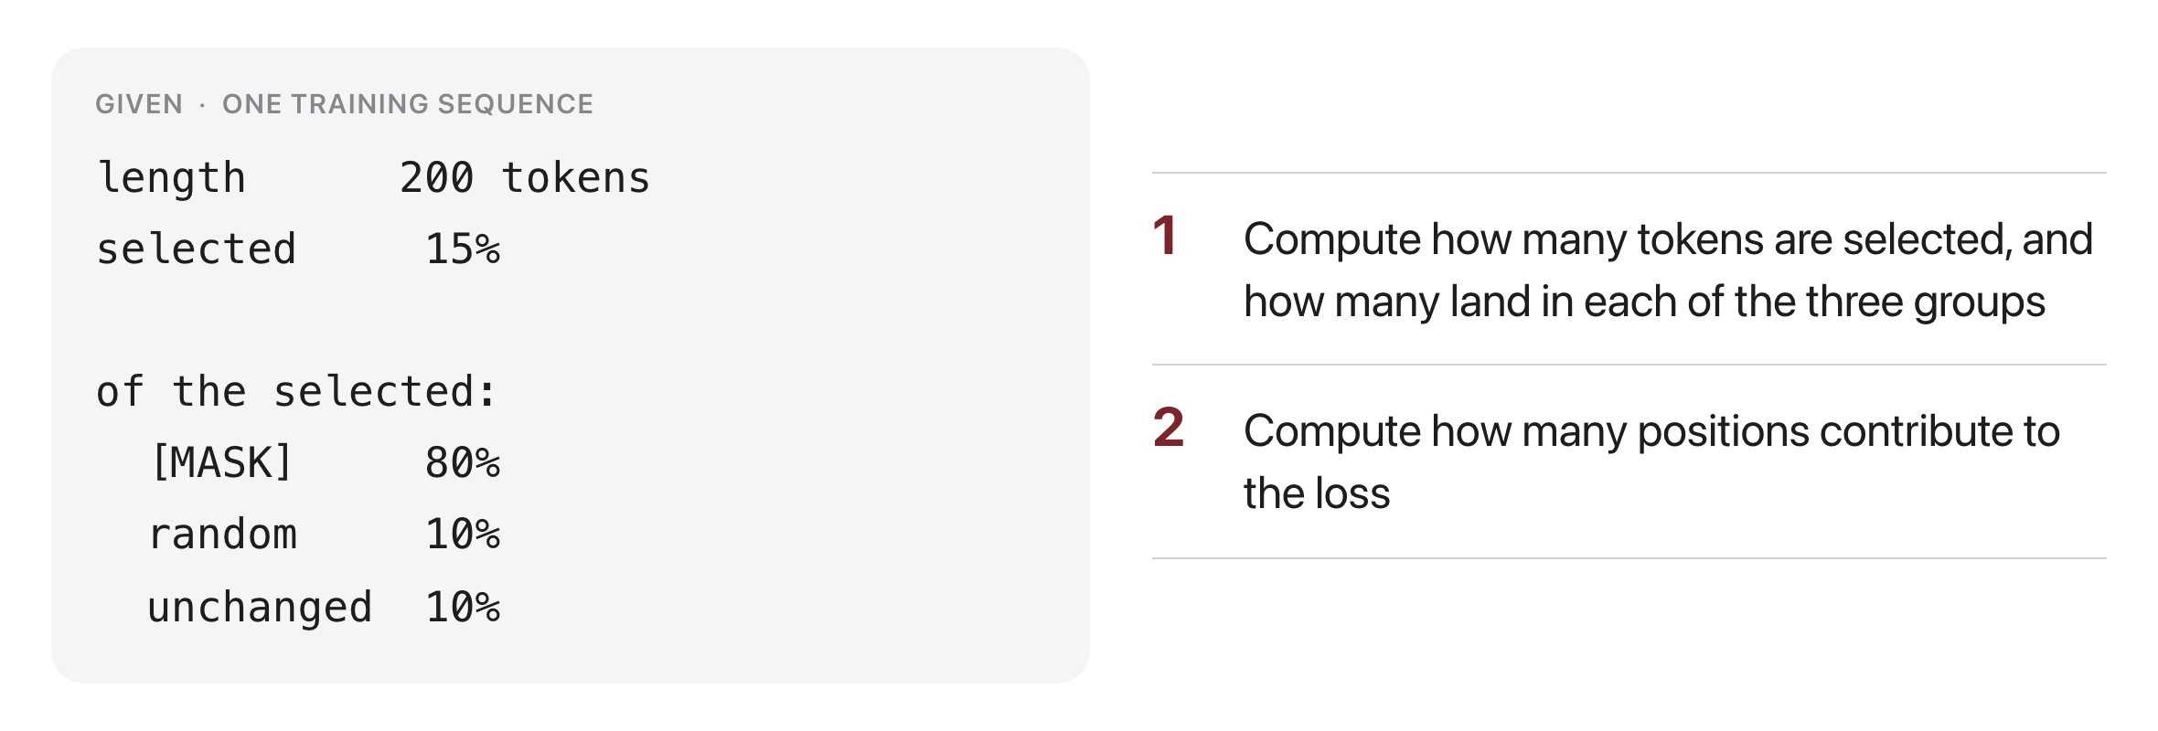
Problem 1: the masking budget
Source: original figure
Notes:
The warm-up, and everyone should finish it. Thirty tokens selected, of which twenty four become [MASK], three become a random word and three are untouched. Question two is the one to draw out: all thirty contribute to the loss, including the three that were never changed, which is exactly why the model cannot simply learn to answer wherever it sees [MASK].

Slide 10
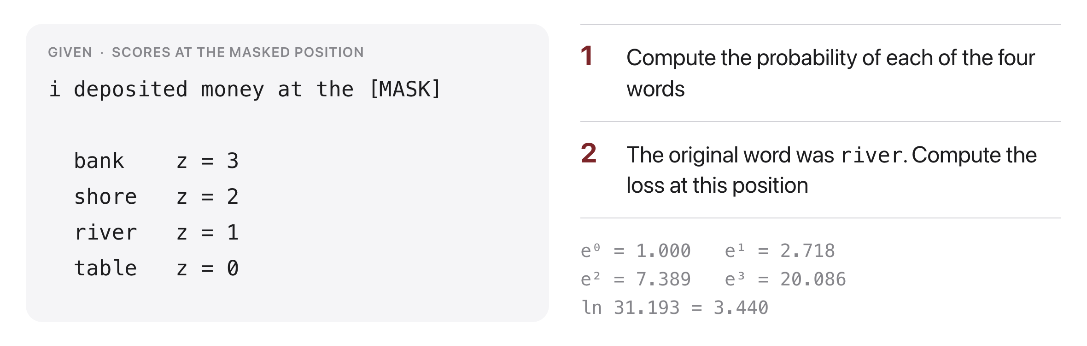
Problem 2: filling the blank
Source: original figure
Notes:
Exponentials sum to 31.193, so the probabilities are 0.644, 0.237, 0.087 and 0.032. The loss is minus the log of the probability of the word that was actually there, 3.440 minus 1, so 2.440. Ask what the model would need to change to drive that loss down, and let someone notice it can only be done by raising river's score relative to bank's, which is the entire training signal in one sentence.

Slide 11
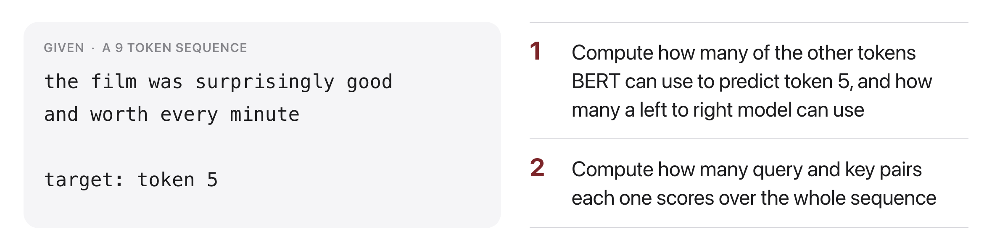
Problem 3: how much context
Source: original figure
Notes:
Eight against four. BERT sees every other token; a left to right model has only the four before it and is blind to worth, every and minute, which are the words that settle whether good is praise. Question two: 81 pairs against 45, the full square against the lower triangle. The extra context is not free, and that is the trade.

Slide 12
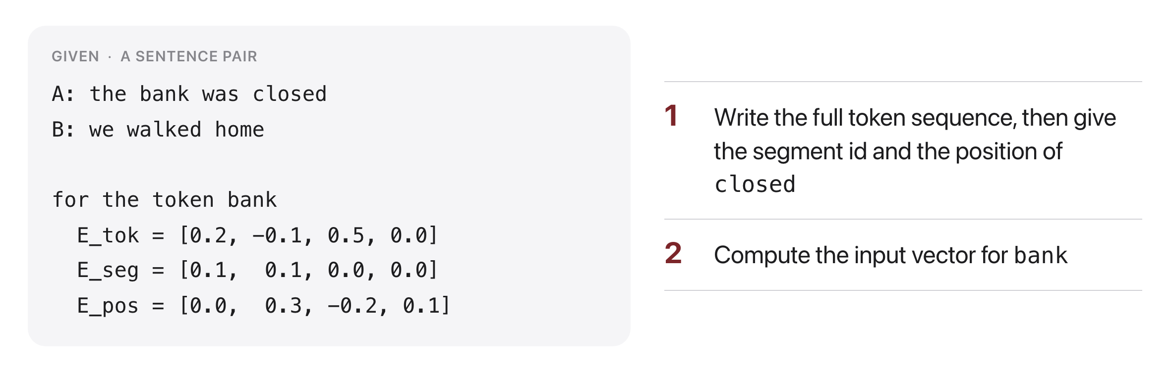
Problem 4: assembling the input
Source: original figure
Notes:
Ten tokens: [CLS], four words, [SEP], three words, [SEP]. closed is segment 0 at position 4, and the most common slip is forgetting that [CLS] takes position 0 and that the first [SEP] still belongs to segment 0. The sum is 0.3, 0.3, 0.3, 0.1. Worth saying: nothing here is learned by the student, it is just addition, and it is genuinely all that happens before layer one.

Slide 13
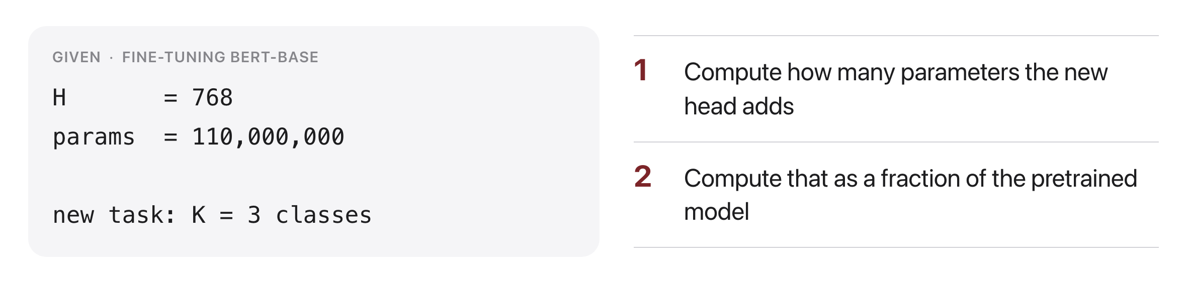
Problem 5: the price of a new task
Source: original figure
Notes:
Three times 768 plus 3, so 2,307 parameters, about two thousandths of one per cent of the model. Ask for a guess before they compute it; people say a few million. That ratio is why fine-tuning took over: the labeled data buys one small matrix, and the hundred million parameters underneath came free from raw text.

Slide 14
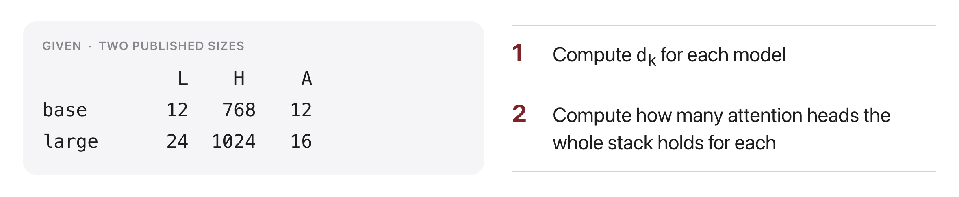
Problem 6: base against large
Source: original figure
Notes:
d_k is 64 for both, which is the point: 768 over 12 and 1024 over 16 land on the same number, so scaling up added heads and layers rather than widening each head. The stacks hold 144 and 384 heads. Close on that. Nobody tuned the head width between the two models, and the same 64 shows up again in the next generation of models too.

