Slide 1
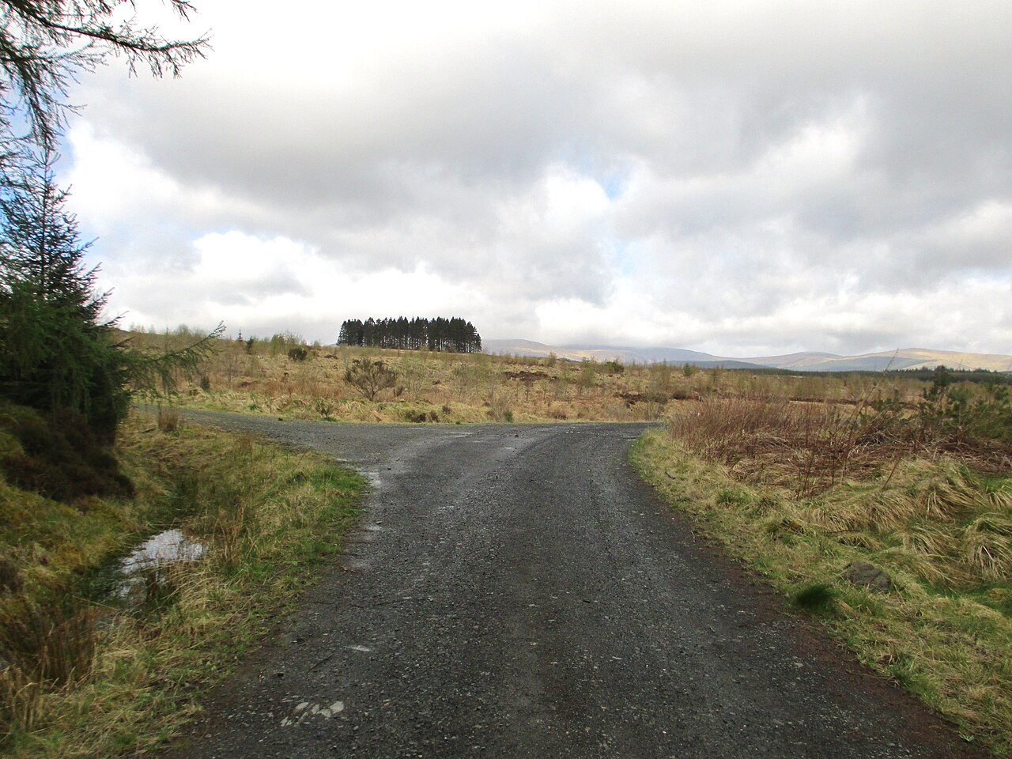
CSCI 3495
Decoding Strategies: How a Model Picks the Next Word
Natural Language Processing & Large Language Models
Week 9, Class 1 · Mon Oct 19, 2026
Source: Ann Cook, geograph.org.uk via Wikimedia Commons, CC BY-SA 2.0
Notes:
Two roads diverged in a wood. A language model hits a fork like this at EVERY word, with fifty thousand branches. Who picks? That is the whole session, and we answer it half in slides and half in the notebook.

Slide 2
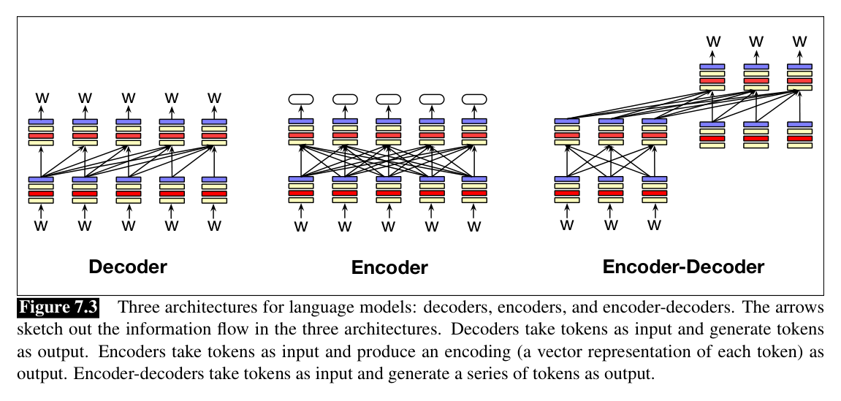
Three ways to wire a Transformer
Source: Jurafsky & Martin, SLP3 (Jan 2026 draft), Fig. 7.3
Notes:
Decoders attend only leftward and generate tokens; encoders attend in both directions and output representations; encoder-decoders encode a full input, then a decoder generates from it. Everything today lives in the left column, because only a decoder has a next token to choose.

Slide 3
What is autoregressive generation?
Feed the whole context in, get one distribution out, pick one token, append it, run again.
Notes:
Ask it cold and wait. Someone will say "it predicts the next word", and the follow-up is the one that matters: what does it do with the word it just predicted? It puts it back in the input. Take two or three answers before clicking the reveal.

Slide 4
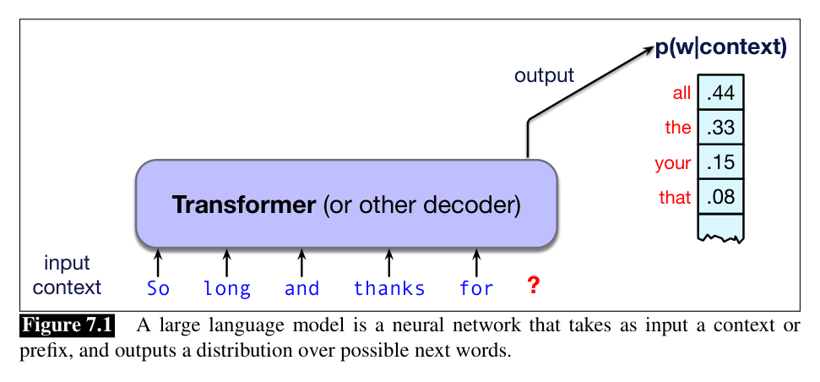
The engine under generation
Source: Jurafsky & Martin, SLP3 (Jan 2026 draft), Fig. 7.1
Notes:
The model reads the context and outputs a probability for every word in its vocabulary. Pick one, append it, run the model again: that loop IS autoregressive generation. Notice what the model never does: it never picks. It scores.

Slide 5
Let's walk through Part 1 in the notebook
One prompt, fifty thousand scores.
Notes:
Everyone into lab.ipynb now, kernel selected, run from the top. Part 1 loads distilgpt2 and prints the full distribution over the next word for one prompt. The TRY IT at the end asks what the probabilities sum to, and why that matters.

Slide 6
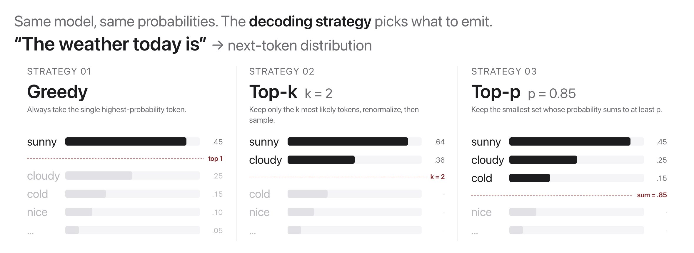
The decoding problem
Source: original figure
Notes:
Every step hands you a distribution over tens of thousands of tokens. How do you choose? That choice is not the model, it is a decoding strategy you picked, and the rest of the period is the four of them.

Slide 7
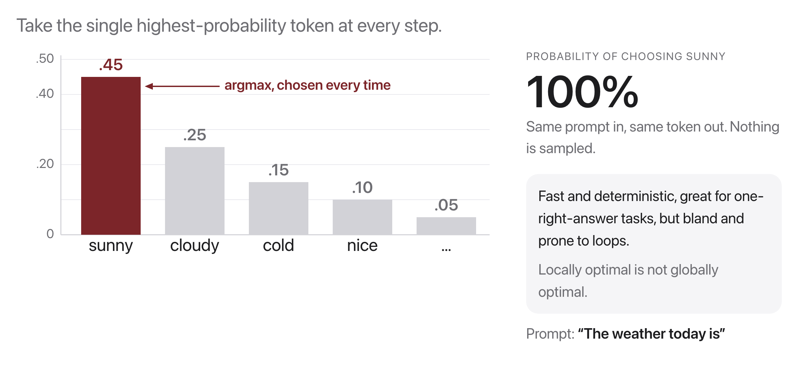
Greedy decoding
Source: original figure
Notes:
Always take the argmax. Same prompt in, same token out, nothing sampled. Fast and safe for code or a factual answer, and, as we will see after the break, the reason generated prose goes flat and starts repeating.

Slide 8
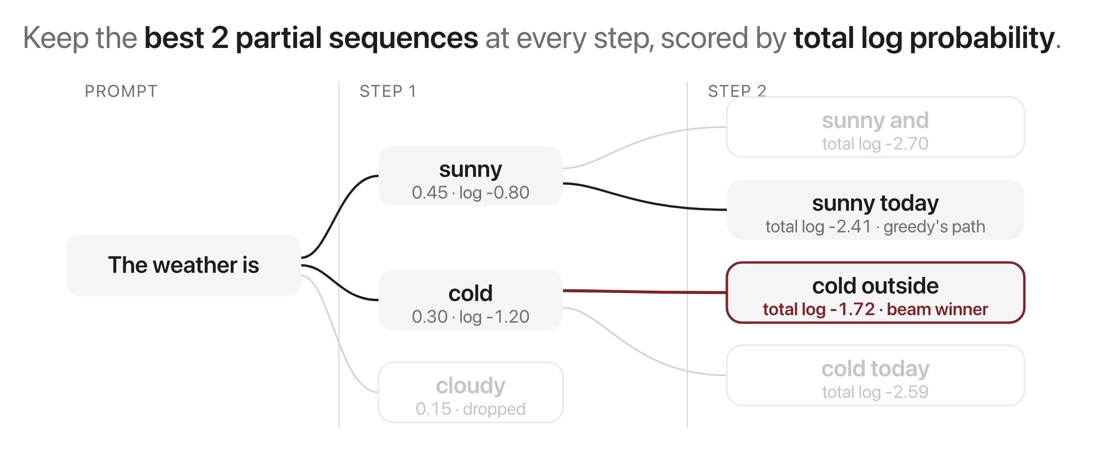
Beam search
Source: original figure
Notes:
Width 2, with real cumulative log probabilities. Walk the tree left to right and let them do the comparison out loud: greedy takes sunny because 0.45 beats 0.30, but the sequence starting from cold finishes at -1.72 against -2.41. The locally best first token was not on the globally best sequence.

Slide 9
Let's walk through Part 2 in the notebook
Greedy and beam, on a real model.
Notes:
Part 2 runs both strategies on distilgpt2 and prints the sequence score next to each. The TRY IT asks them to widen the beam and say what changes and what does not.

Slide 10
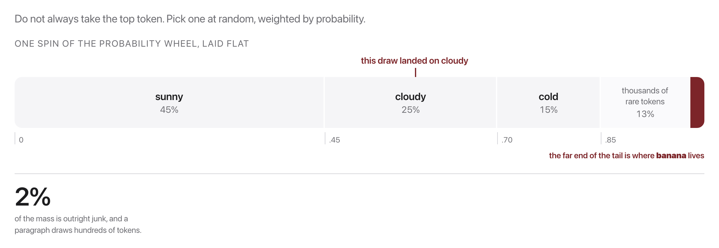
Sampling
Source: original figure
Notes:
Now the wheel spins. Sunny is the favourite but cloudy can win, and the long tail of thousands of rare tokens holds a real 13 percent between them. That tail is where both the creativity and the nonsense come from, so the next two slides are both about cutting it.

Slide 11
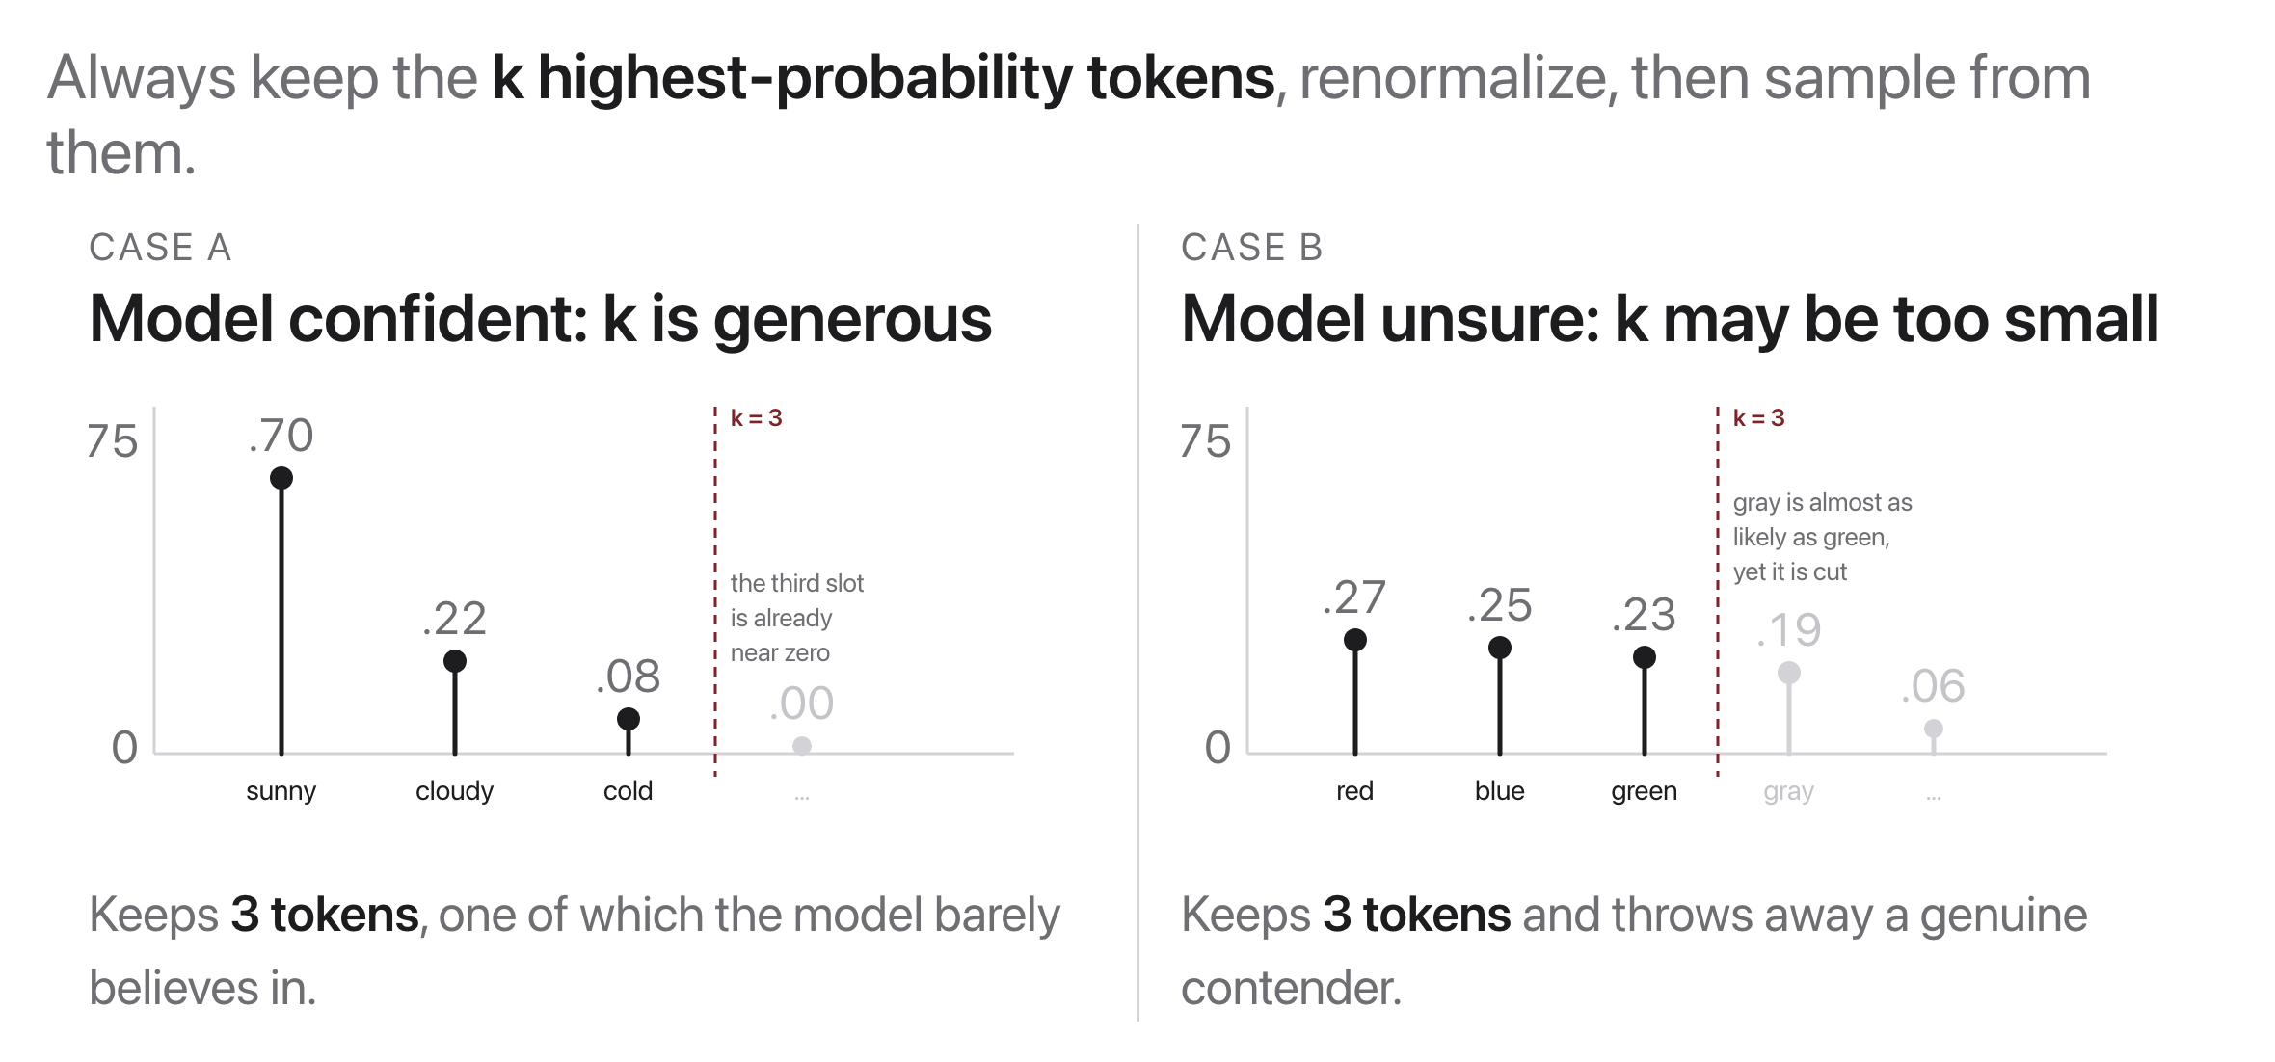
Top-k sampling
Source: original figure
Notes:
Keep the k highest tokens, renormalize, sample. Read the two panels side by side: the same k = 3 is too loose when the model is confident and too tight when it is unsure. K is a count, and a count cannot know how confident the model is.

Slide 12
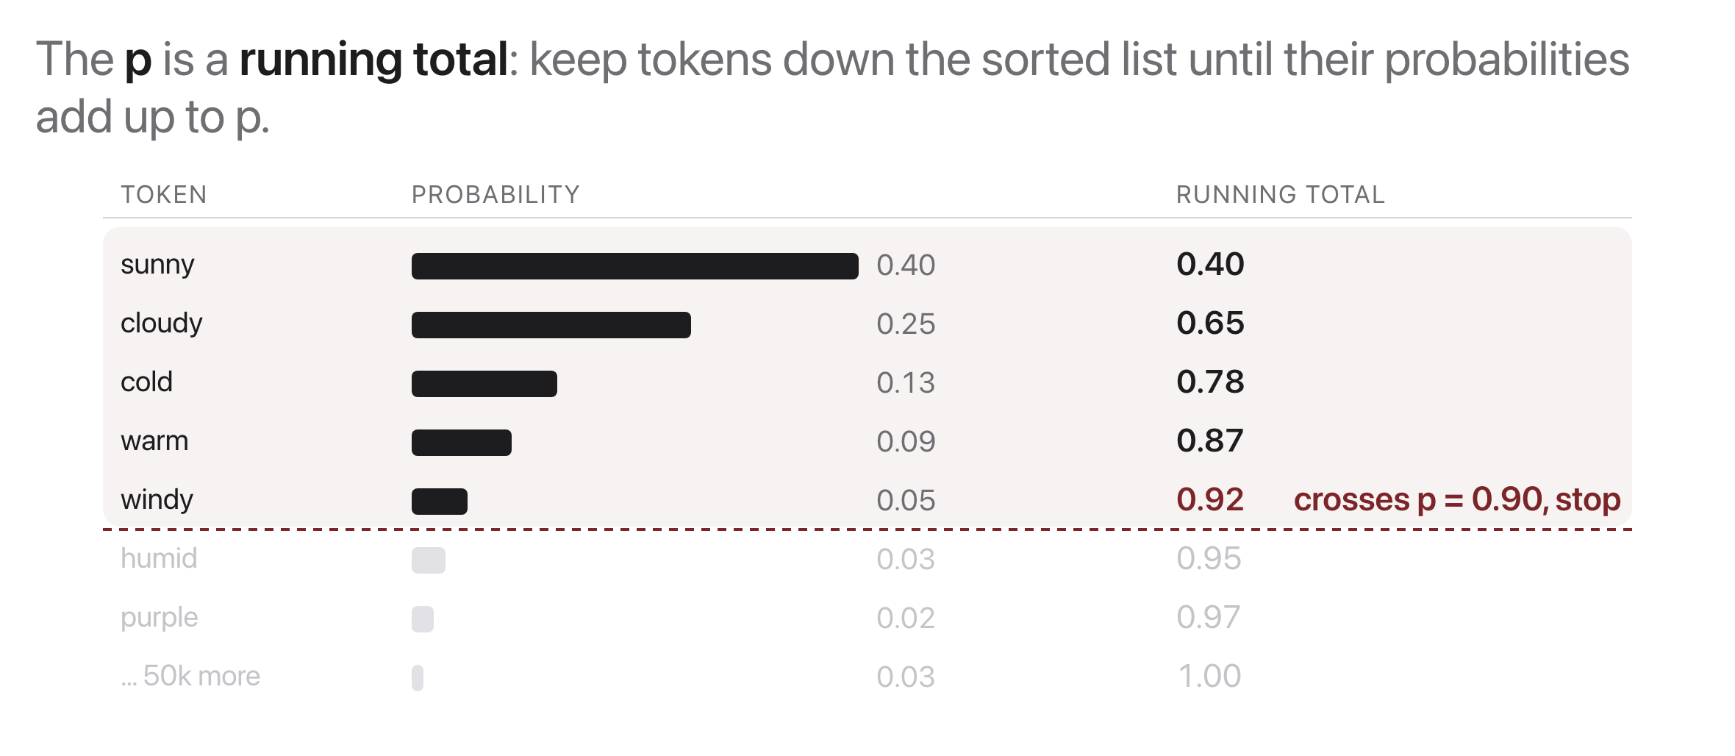
Top-p (nucleus) sampling
Source: original figure; nucleus sampling, Holtzman et al. 2020
Notes:
Read the running-total column out loud: 0.40, 0.65, 0.78, 0.87, 0.92, and stop, because 0.92 has passed 0.90. The p is not a count of tokens, it is how much probability mass you are willing to sample from. Five tokens here; on a confident step the same 0.90 might keep two.

Slide 13
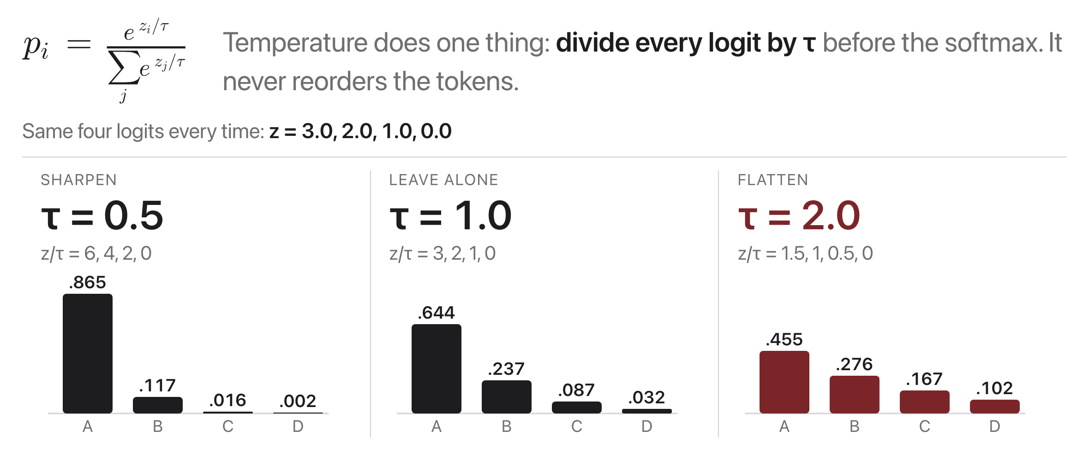
Temperature
Source: original figure
Notes:
Temperature is not a fifth strategy, it is a dial that reshapes the distribution before any of the others run. Divide every logit by tau, then softmax. Small tau spreads the logits apart and the top token takes almost everything; large tau squeezes them together and the tail gets a real chance. The order never changes, only how much the ranking matters.

Slide 14
Let's walk through Part 3 in the notebook
One distribution, four settings, side by side.
Notes:
Part 3 puts temperature, top-k and top-p on the same prompt and draws what survives under each. The TRY IT asks how many tokens top-p keeps at 0.5 against 0.99, which is the adaptivity claim from the slide, measured.

Slide 15

Break
Source: original figure
Notes:
Five minutes. After it, Part 4: greedy loops, and they have to stop it.

Slide 16
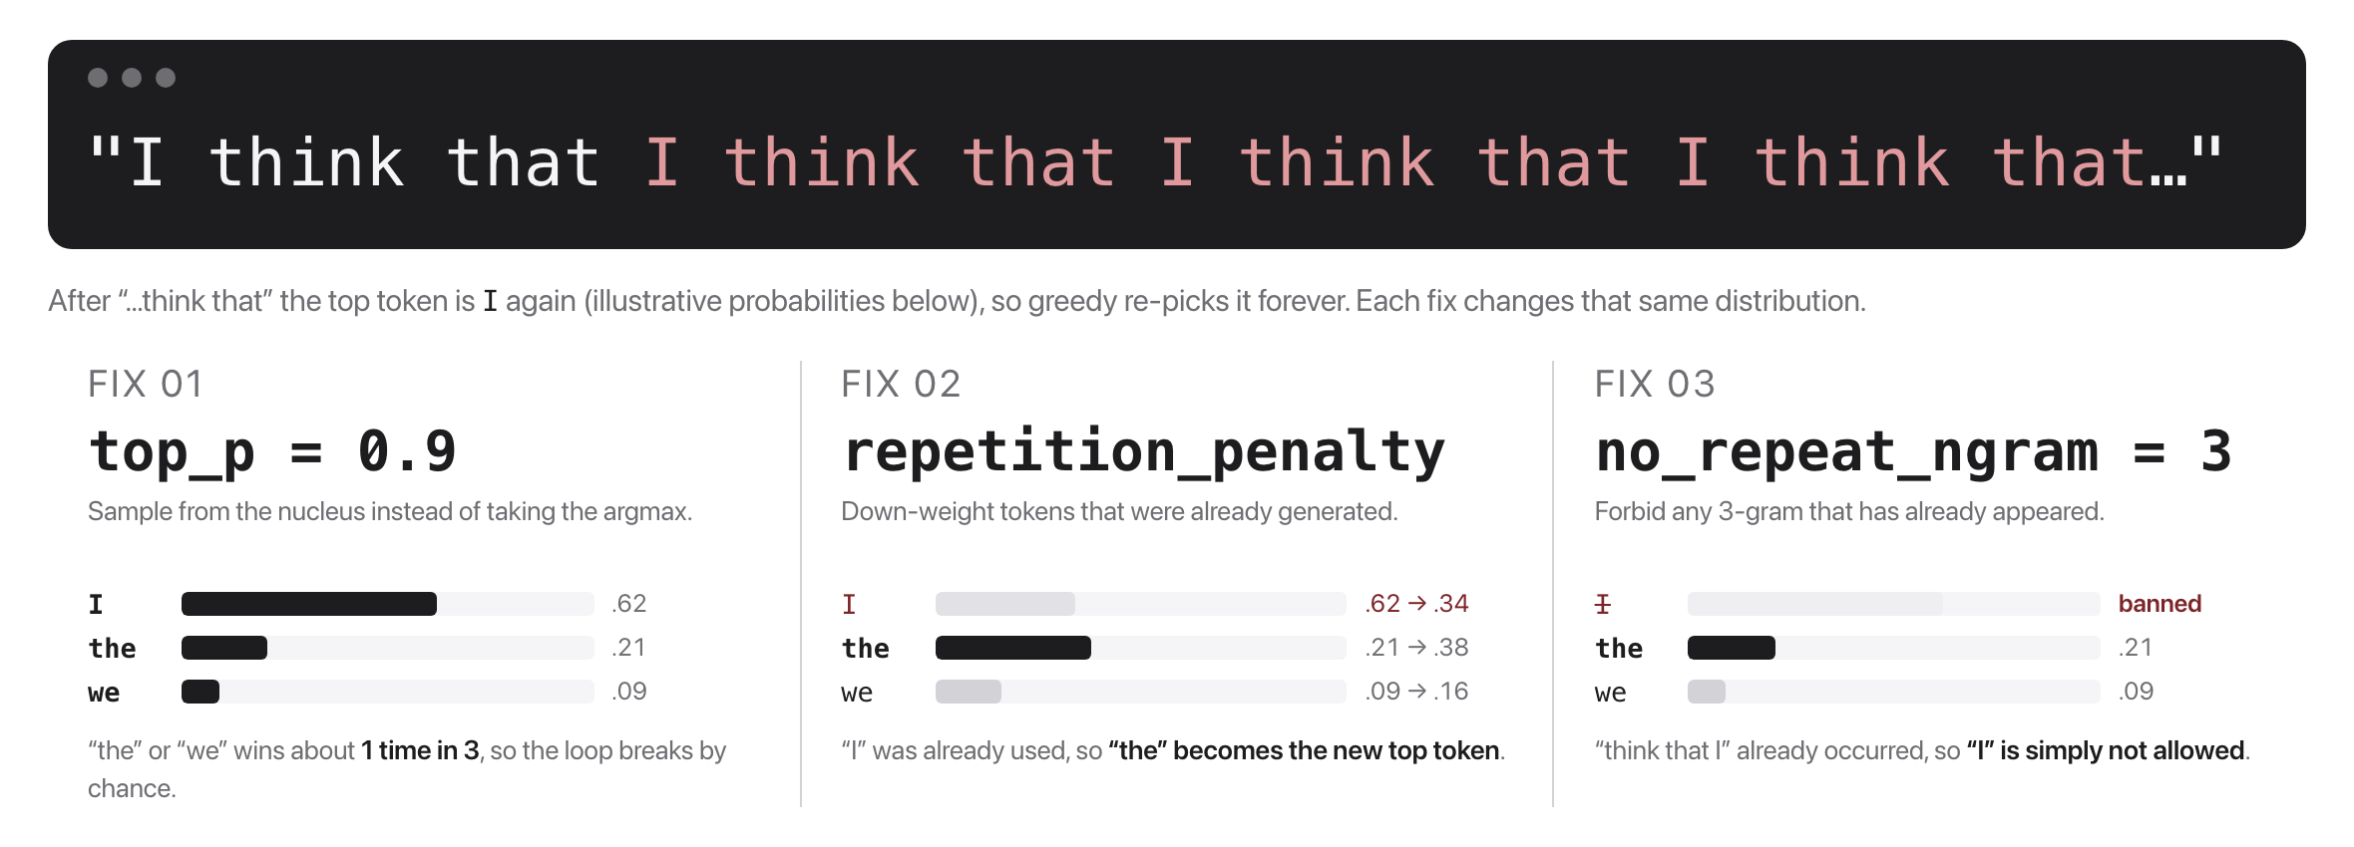
The repetition problem
Source: original figure
Notes:
Read the loop out loud, it lands better. After "think that", the top token is "I" again, so greedy re-picks it forever. The argmax has become a fixed point. Every fix works the same way: reshape the distribution so the argmax stops being a fixed point. Do not name the fixes here, that is their job.

Slide 17
Your turn: make it stop
Part 4 in the notebook. Greedy is looping. Change one thing at a time and get it under 5 repeats.
Notes:
Individually or in pairs, twenty-five minutes. The cell prints a repeat count so they have a number to beat, and every knob from the last hour is available: temperature, top-k, top-p, and the repetition penalty they have not seen yet. Insist they change ONE thing per run and write the number down, because the fastest team will be the one that measured rather than guessed. Last five minutes: two pairs read their settings out and we compare counts.

