Slide 1
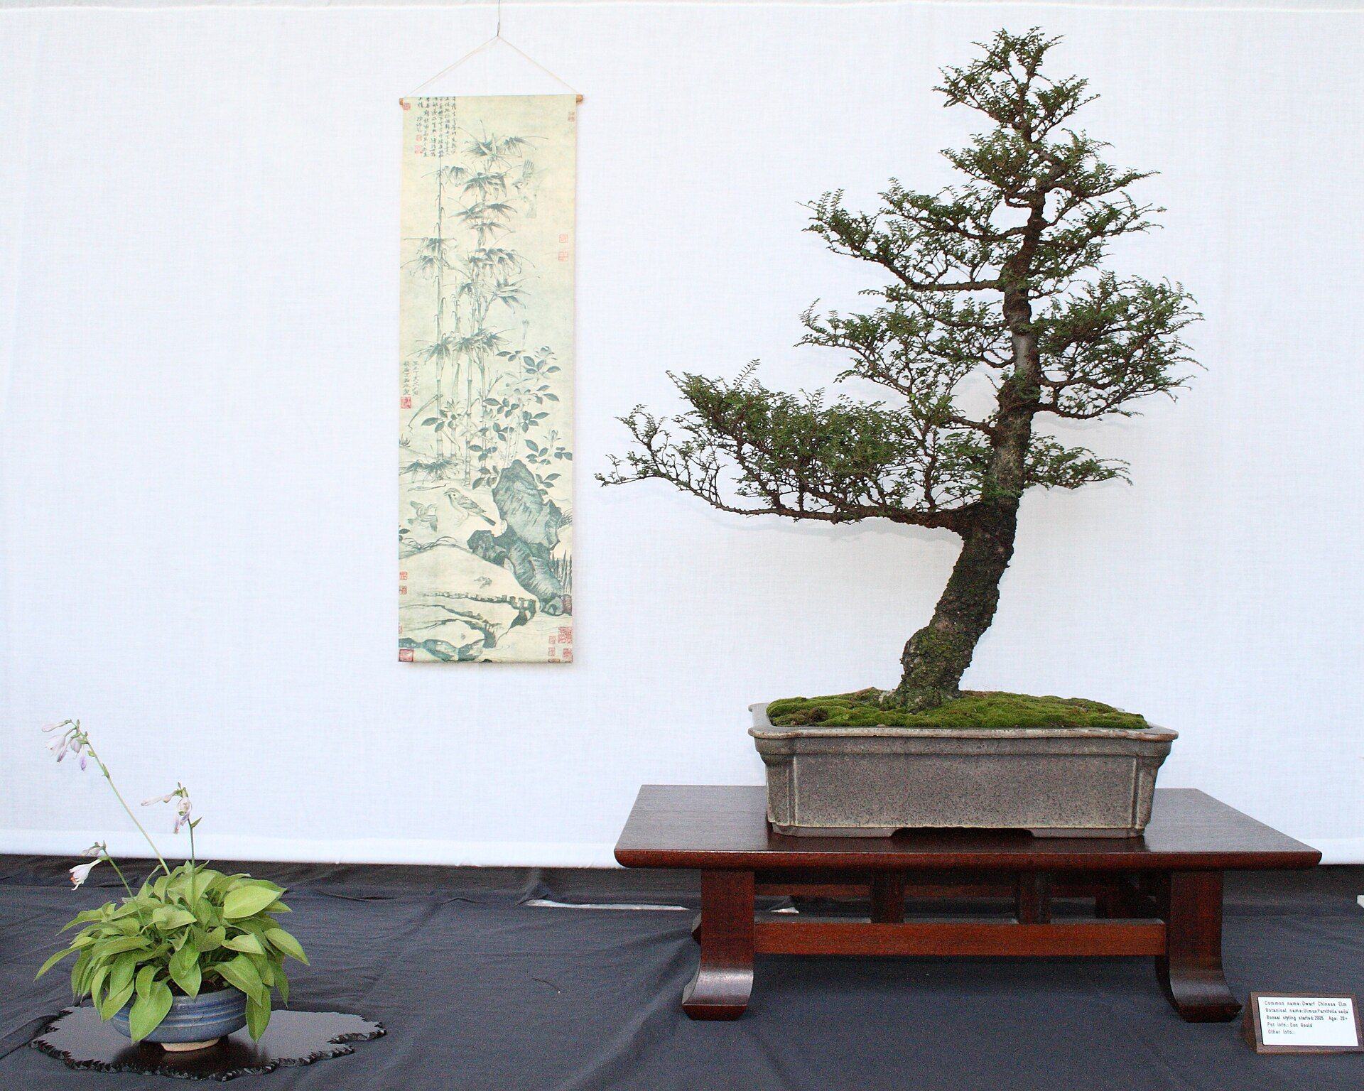
CSCI 3495
Efficient LLMs: LoRA, PEFT & Quantization
Natural Language Processing & Large Language Models
Week 11, Class 1 · Mon Nov 2, 2026
Source: Sage Ross, Wikimedia Commons, CC BY-SA 3.0
Notes:
A bonsai is a full tree, deliberately kept tiny. Ask the class: what would you prune from a 7B-parameter model, and what must survive?

Slide 2
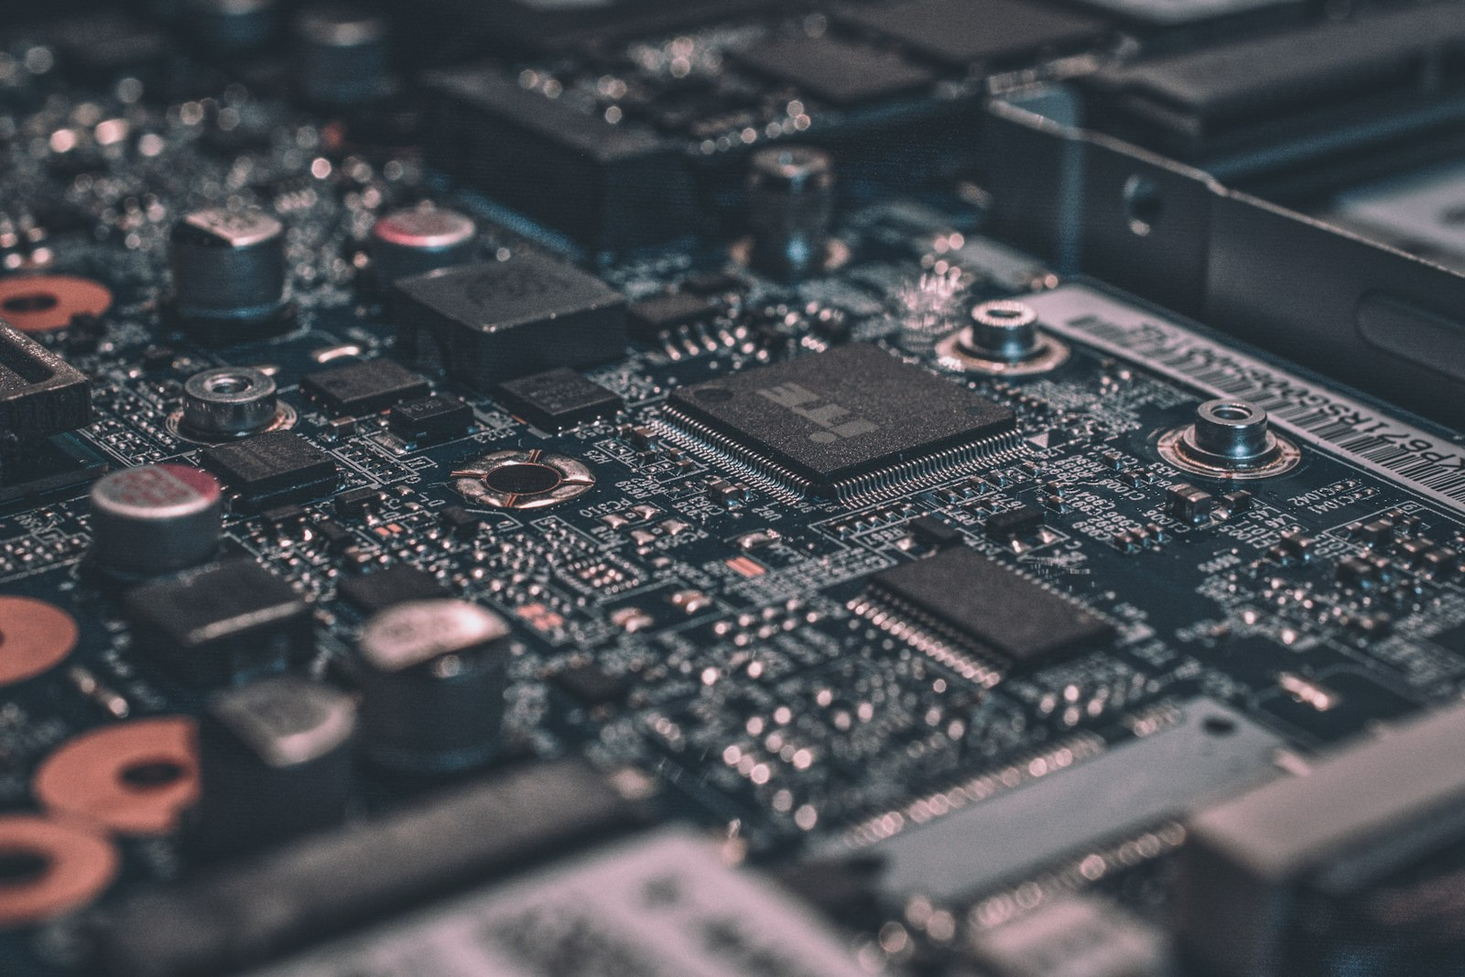
Billions of weights, one laptop
Source: Unsplash License, https://images.unsplash.com/photo-1518770660439-4636190af475
Notes:
A 7B model is billions of numbers. The whole game today is making those numbers fit and move on modest hardware.

Slide 3
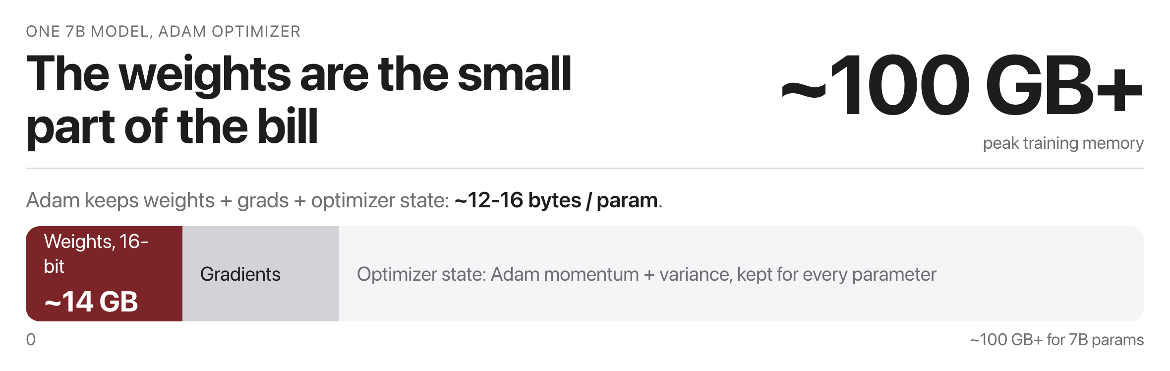
Why full fine-tuning doesn't scale
Source: original figure; Adam memory rule-of-thumb
Notes:
The weights are the cheap part. Adam keeps the weights, the gradients and two moments per parameter, so a 7B model needs roughly a hundred gigabytes of peak training memory. Nobody has that in a laptop, and you pay it again for every task. 1 copy / task7B weights saved again for every customer, product or language you fine-tune for. And it repeats. Every new task you adapt to needs its own full copy of the model. Infeasible on a laptop, wasteful even on a cluster.

Slide 4
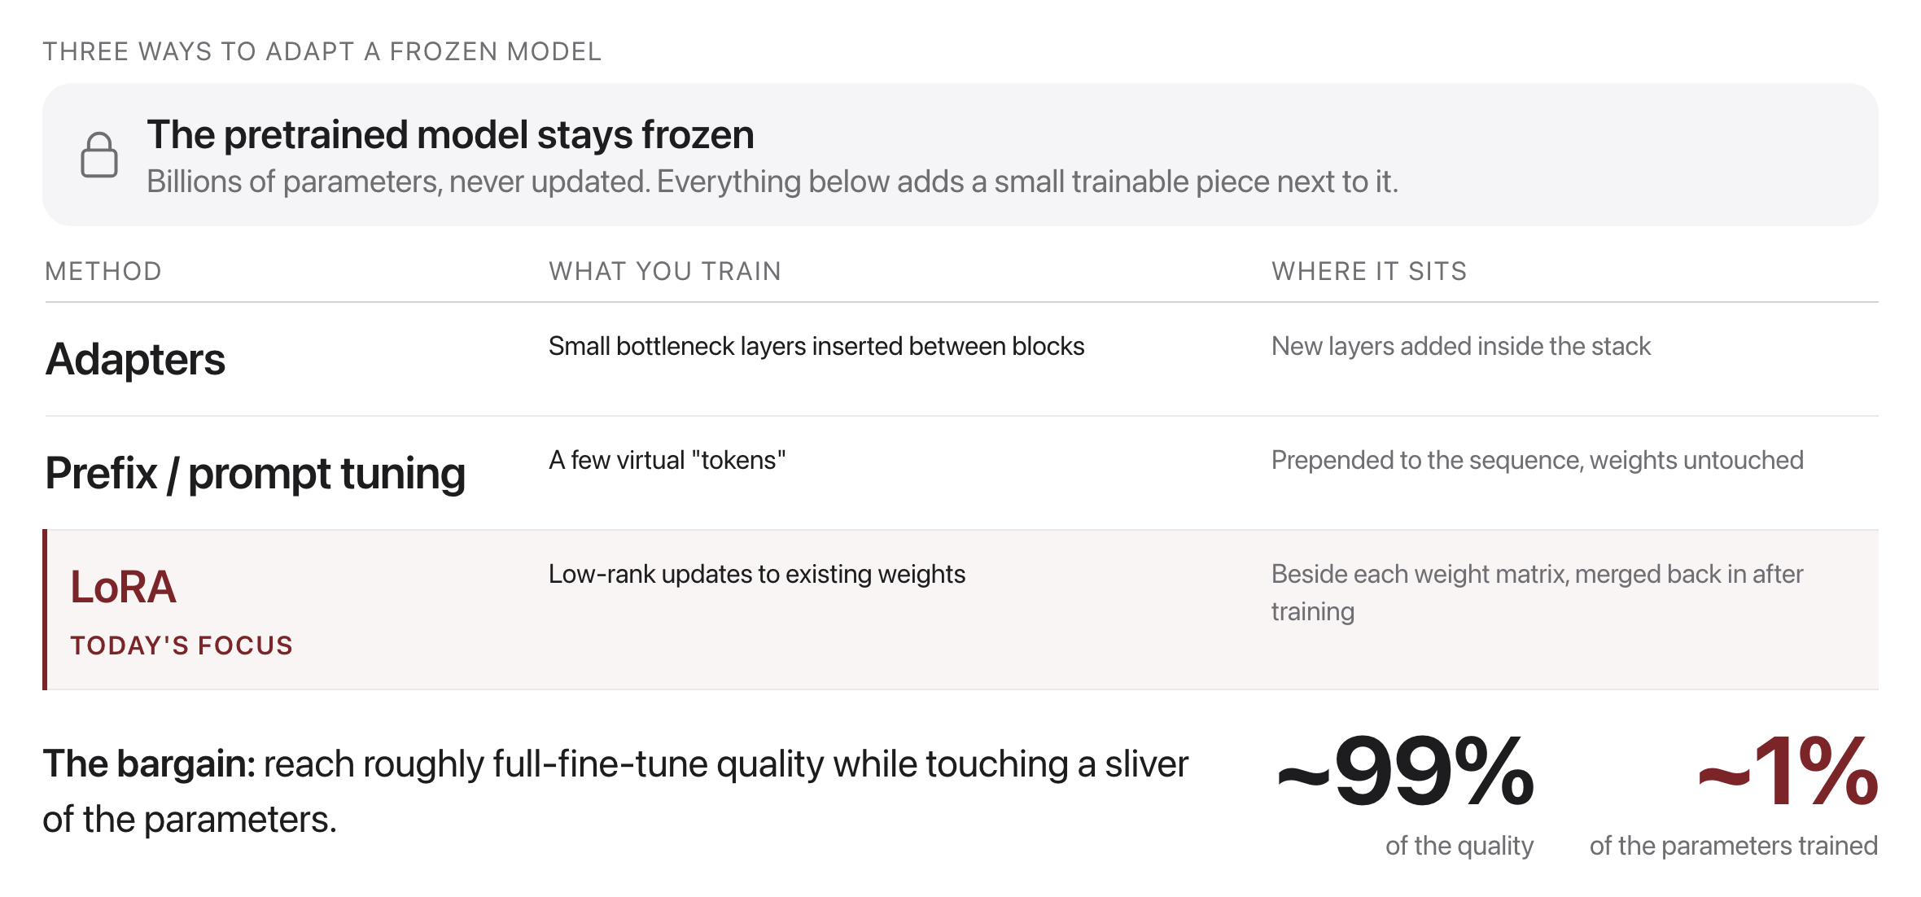
Parameter-Efficient Fine-Tuning
Source: original figure
Notes:
The base model never moves. Everything here bolts a small trainable piece onto a frozen model, and the three approaches differ mainly in where that piece sits.

Slide 5
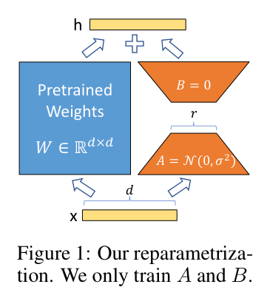
LoRA, visually
Source: Hu et al. 2021 (arXiv:2106.09685), Fig. 1
Notes:
B starts at zero, so training begins exactly at the pretrained model; after training, B times A merges back into W, so inference costs nothing extra. B starts at 0; after training, B and A merge back into W: no extra inference latency.

Slide 6
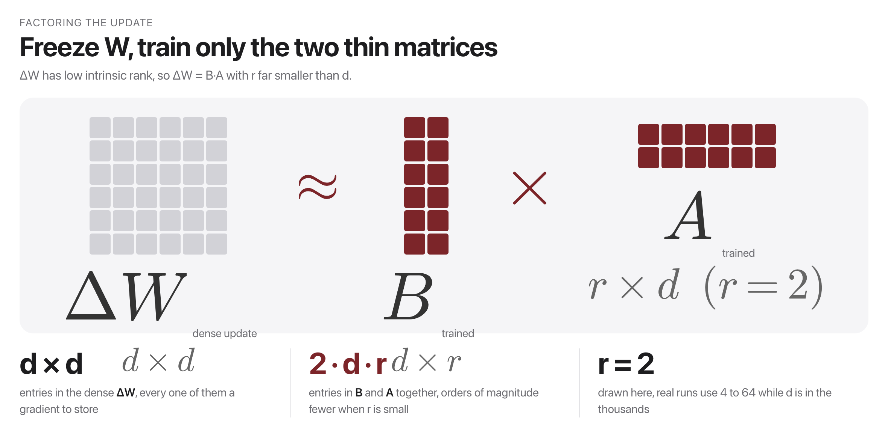
LoRA: the core idea
Source: after Hu et al., 2021, arxiv.org/abs/2106.09685
Notes:
Freeze W and learn the update instead, factored into two thin matrices. The bet is that the update has low intrinsic rank, and empirically it does. That is how the trainable parameter count drops by four orders of magnitude.

Slide 7
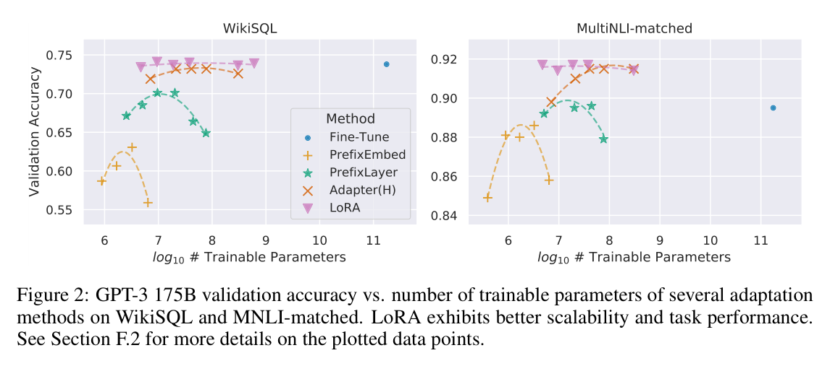
Why LoRA is a big deal
Source: Hu et al. 2021 (arXiv:2106.09685), Fig. 2
Notes:
The lone blue dot is full fine-tuning of GPT-3 175B. LoRA (pink) holds that accuracy with about 10,000x fewer trainable parameters, while prefix methods degrade as they grow. Blue dot = full fine-tuning of GPT-3 175B; LoRA (pink) matches it with ~10,000x fewer params.

Slide 8
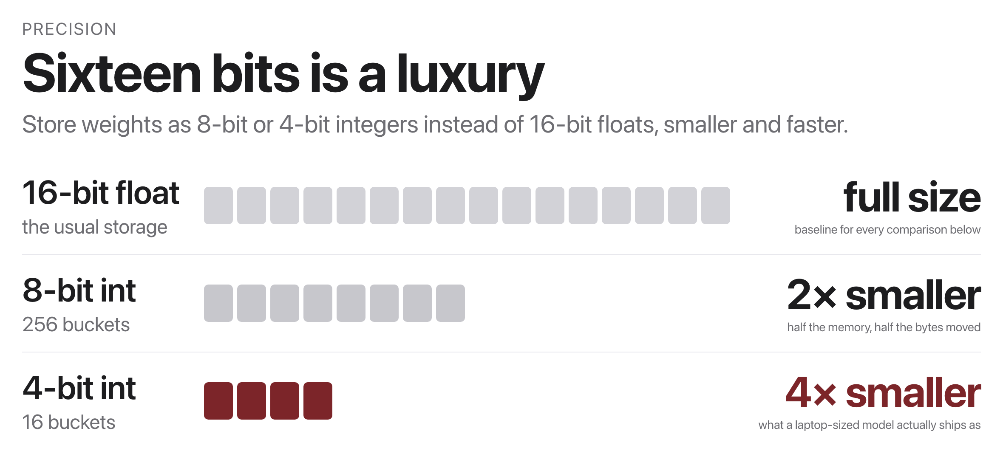
Quantization: fewer bits per weight
Source: original figure
Notes:
This is why a 7B model runs on a laptop at all. Post-training quantization needs no retraining, just map ranges of floats to integer buckets, losing surprisingly little accuracy.

Slide 9
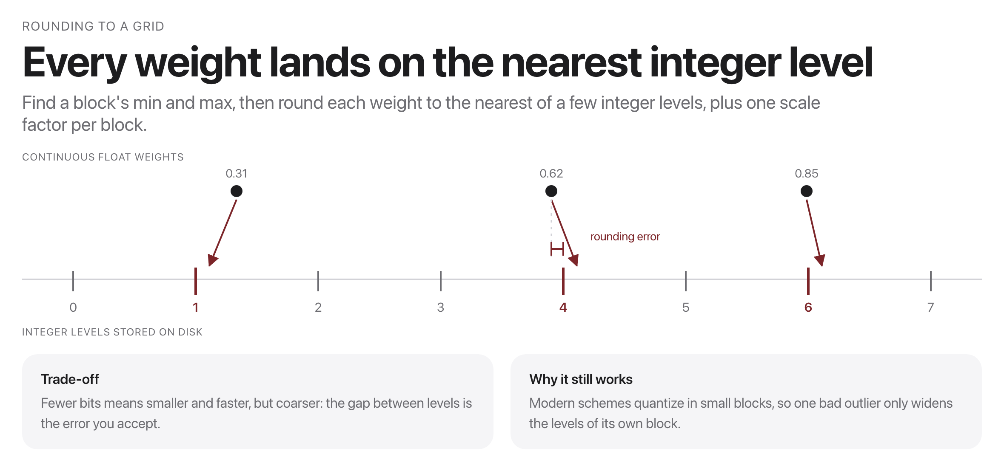
How quantization works
Source: original figure
Notes:
Find the min and max of a block, lay a small grid of integer levels across it, and round every weight to the nearest one. Store the levels plus a single scale factor per block. The precision you lose is mostly precision you were not using.

Slide 10
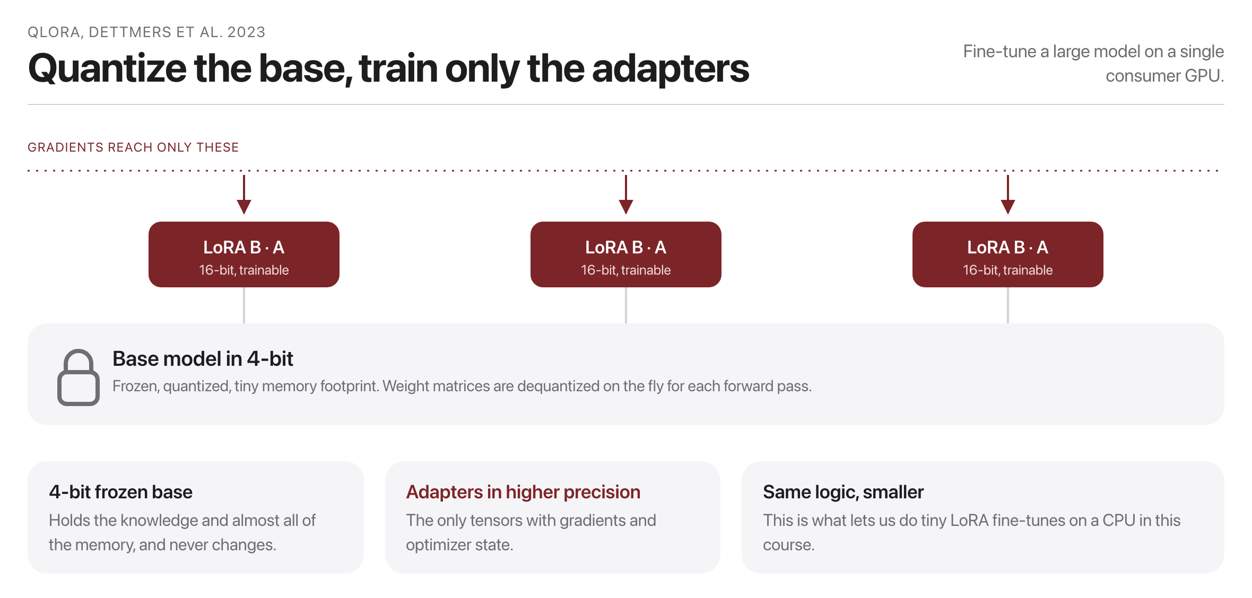
QLoRA: the combination
Source: after Dettmers et al., 2023, arxiv.org/abs/2305.14314
Notes:
Quantize the frozen base down to four bits and train only the adapters in sixteen. Gradients never touch the base, so its precision does not matter as much as you would think. This is what puts fine-tuning a large model on one consumer GPU.

Slide 11

Could you fine-tune a model on your laptop tonight?
With QLoRA, the honest answer is yes. Hold that thought for the exercise.
Source: Unsplash License, https://images.unsplash.com/photo-1498050108023-c5249f4df085
Notes:
The honest answer is yes, and they are about to. Hold it until the lab.

Slide 12
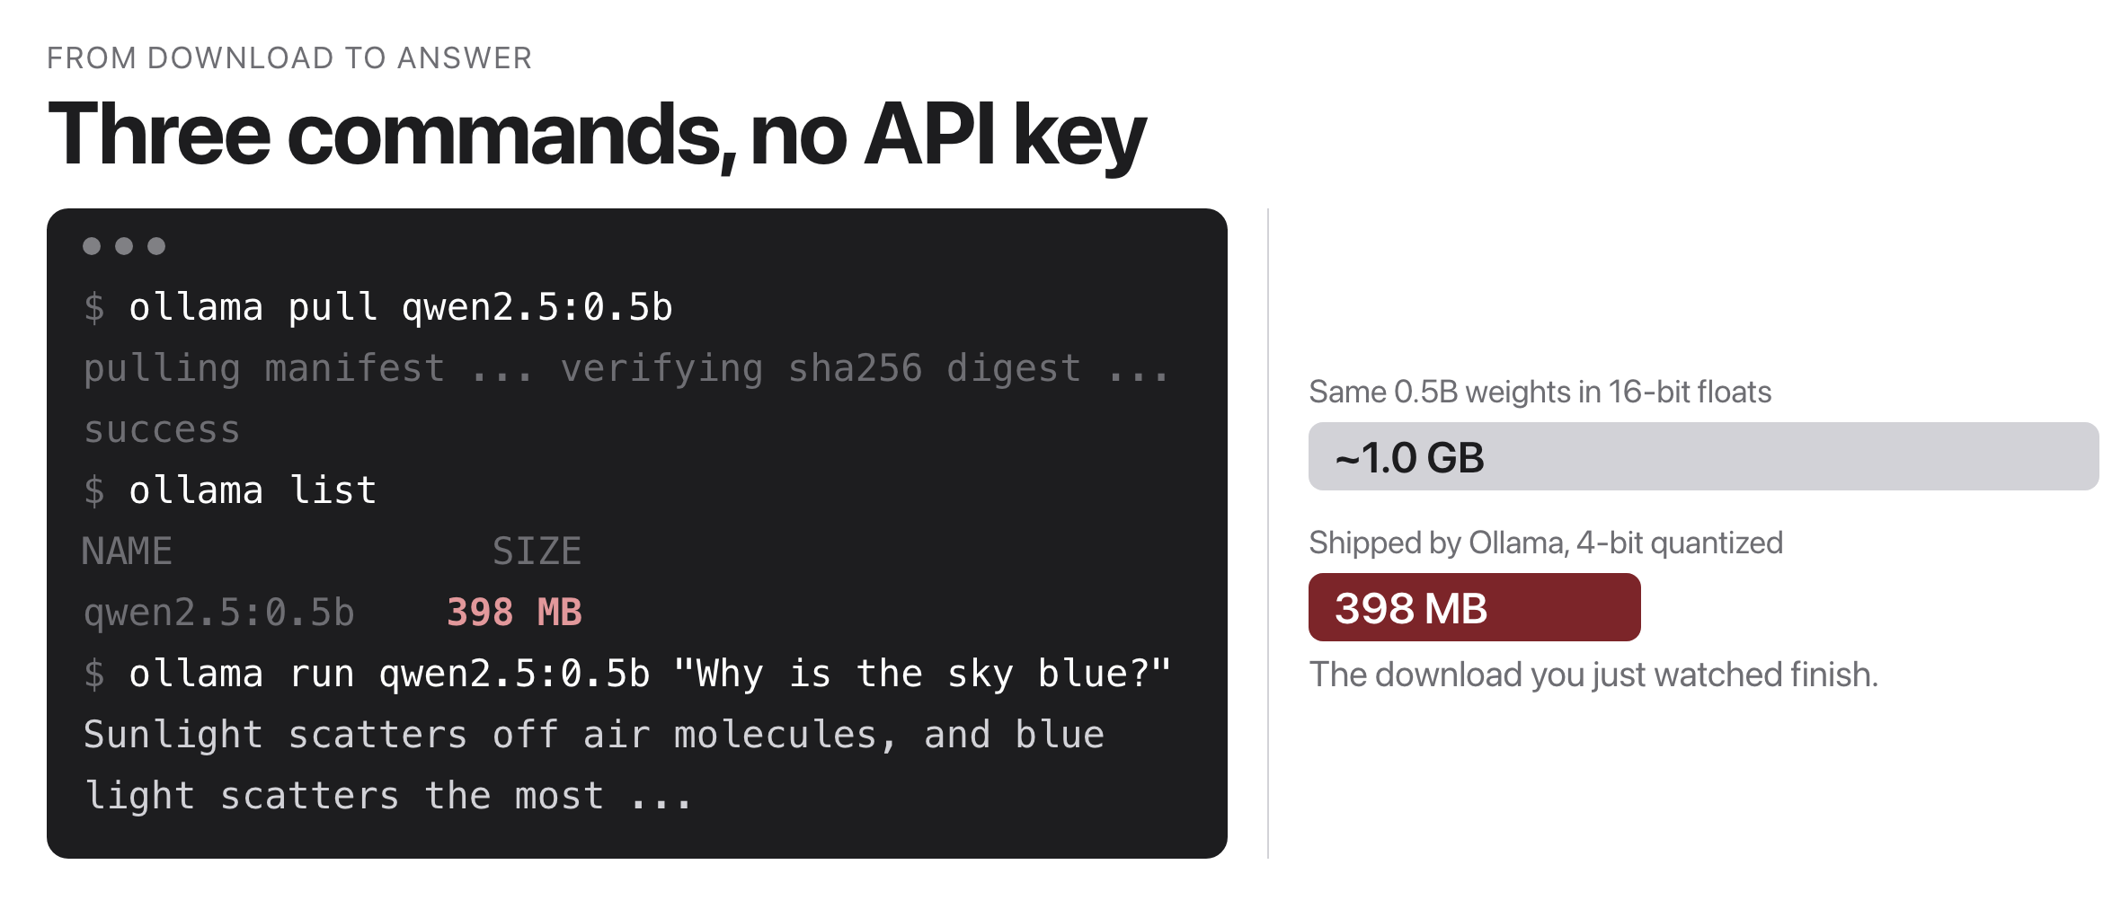
Running models locally with Ollama
Source: original figure; model size from ollama.com/library/qwen2.5
Notes:
No API key, no network, no per-token bill: the model file sits on your disk, and a Modelfile can set the system prompt, sampling params, and even LoRA adapters.

Slide 13
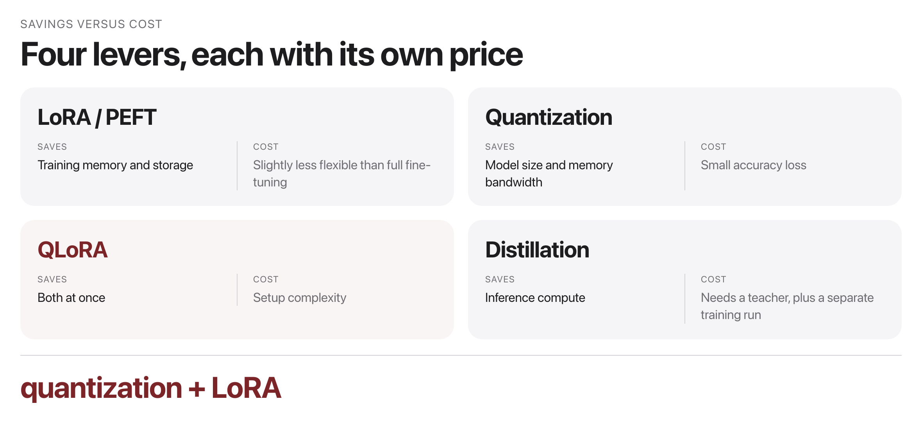
The efficiency toolbox
Source: original figure
Notes:
Four levers and the price of each. Nothing here is free, and the point is knowing which cost you can afford for a given job. In practice, most local deployments stack these two together: a 4-bit base on disk, a few megabytes of adapters per task.

Slide 14

Break
Source: original figure

Slide 15
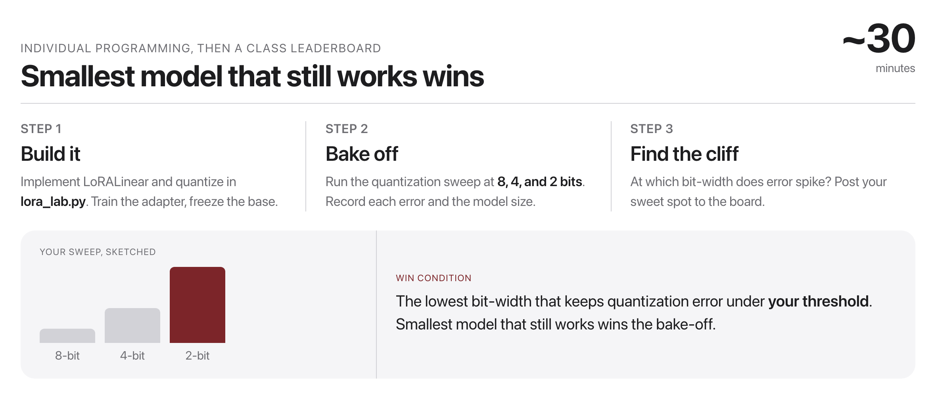
Quantization bake-off
Source: original figure
Notes:
Build the LoRA layer and the quantizer, train the adapter with the base frozen, then bake off. The smallest model that still works wins, which forces them to find the accuracy cliff rather than just reading about it.

Slide 16
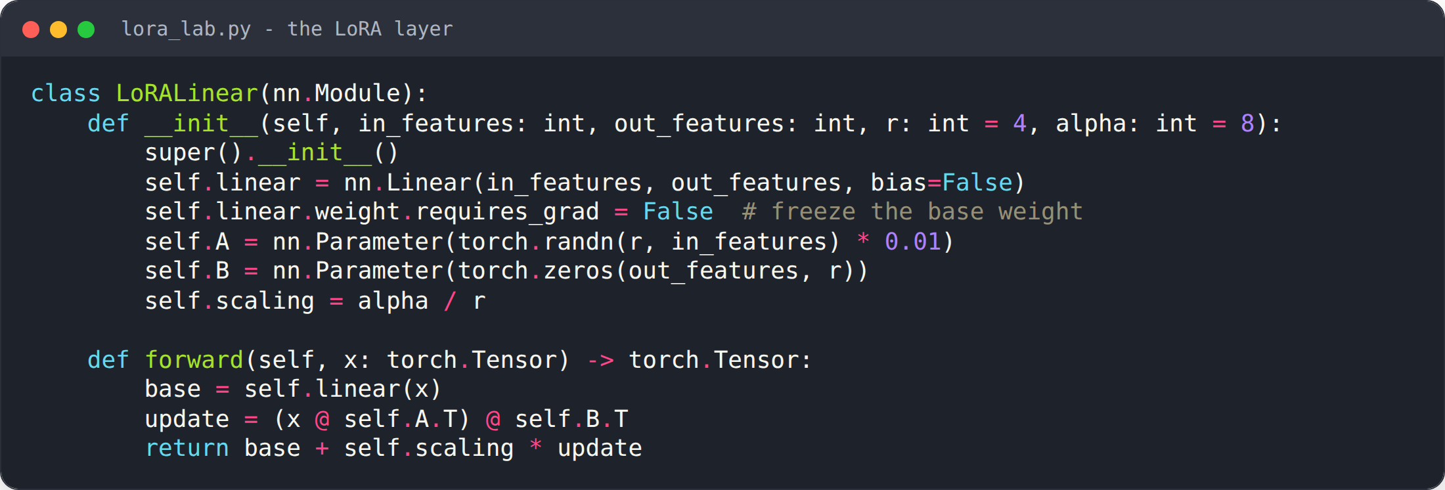
Build a LoRA layer
Source: weeks/week-11/class-01/exercise/lora_lab.py
Notes:
Freeze the base weight; train only A and B. Then run a quantization bake-off at 8/4/2 bits.

Slide 17
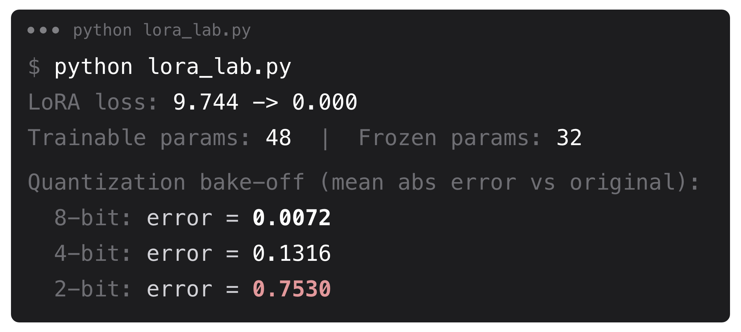
What you should see
Source: example run in the course Docker image (seed=0)
Notes:
Loss collapses; only 48 trainable params; error grows as bits drop.

Slide 18
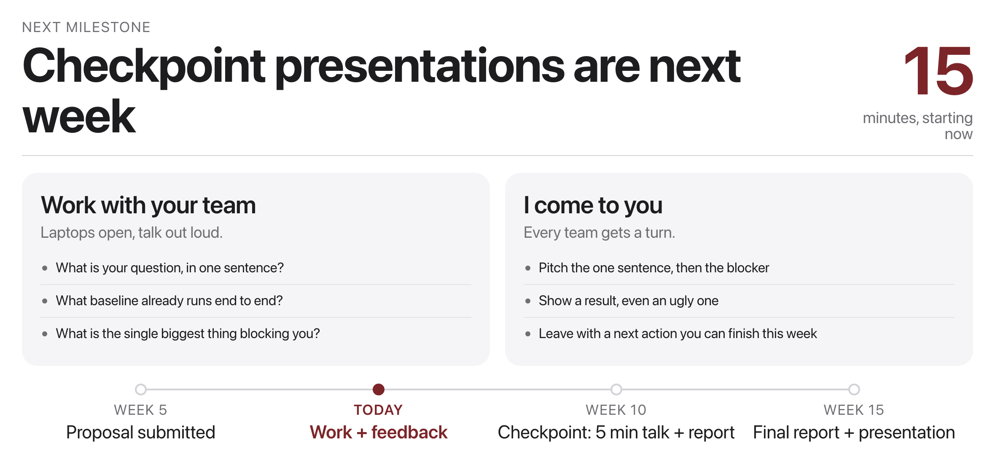
Project work and feedback
Source: project/README.md milestones
Notes:
Last 15 minutes: work with your team while I come around. Checkpoint presentations are next week.

