Slide 1
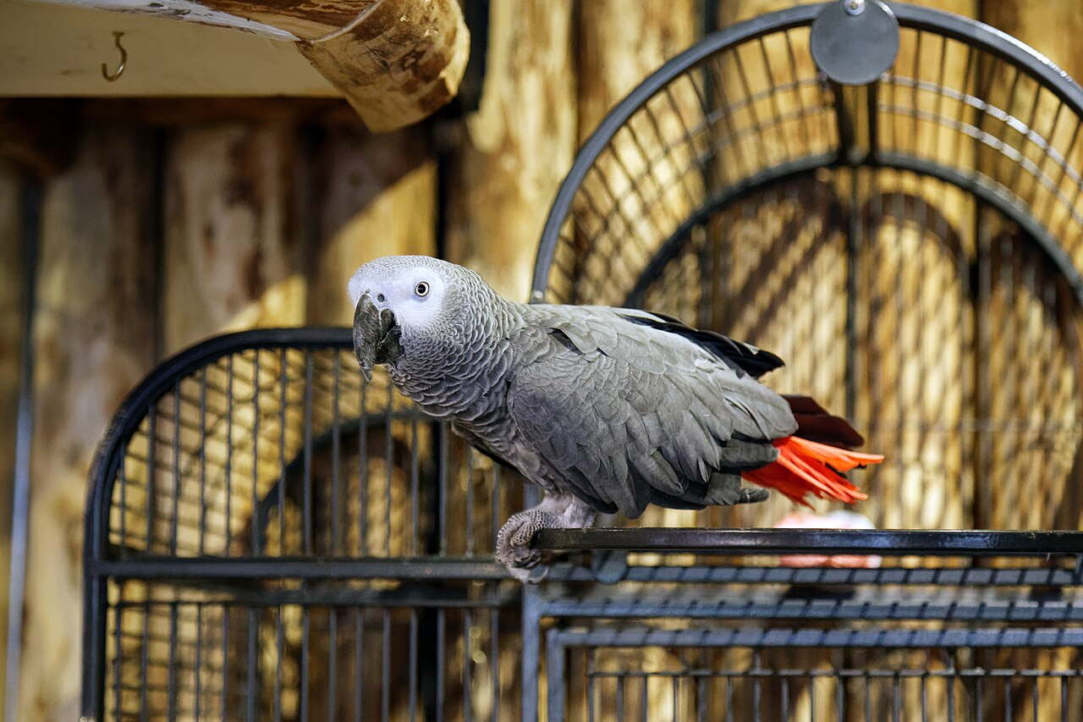
CSCI 3495
Ethics & Society: The Stakes of Language Technology
Natural Language Processing & Large Language Models
Week 15, Class 1 · Mon Dec 7, 2026
Source: photo: Acabashi, Wikimedia Commons, CC BY-SA 4.0
Notes:
Meet the original language model. An African grey can repeat thousands of phrases it has heard. What, if anything, does it understand?

Slide 2
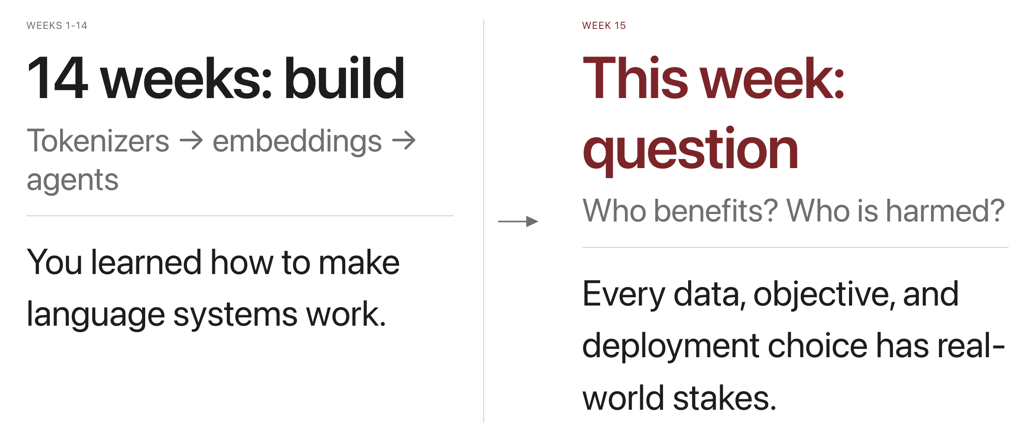
Why this, why now
Source: original figure
Notes:
Every modeling choice is also an ethical choice.

Slide 3
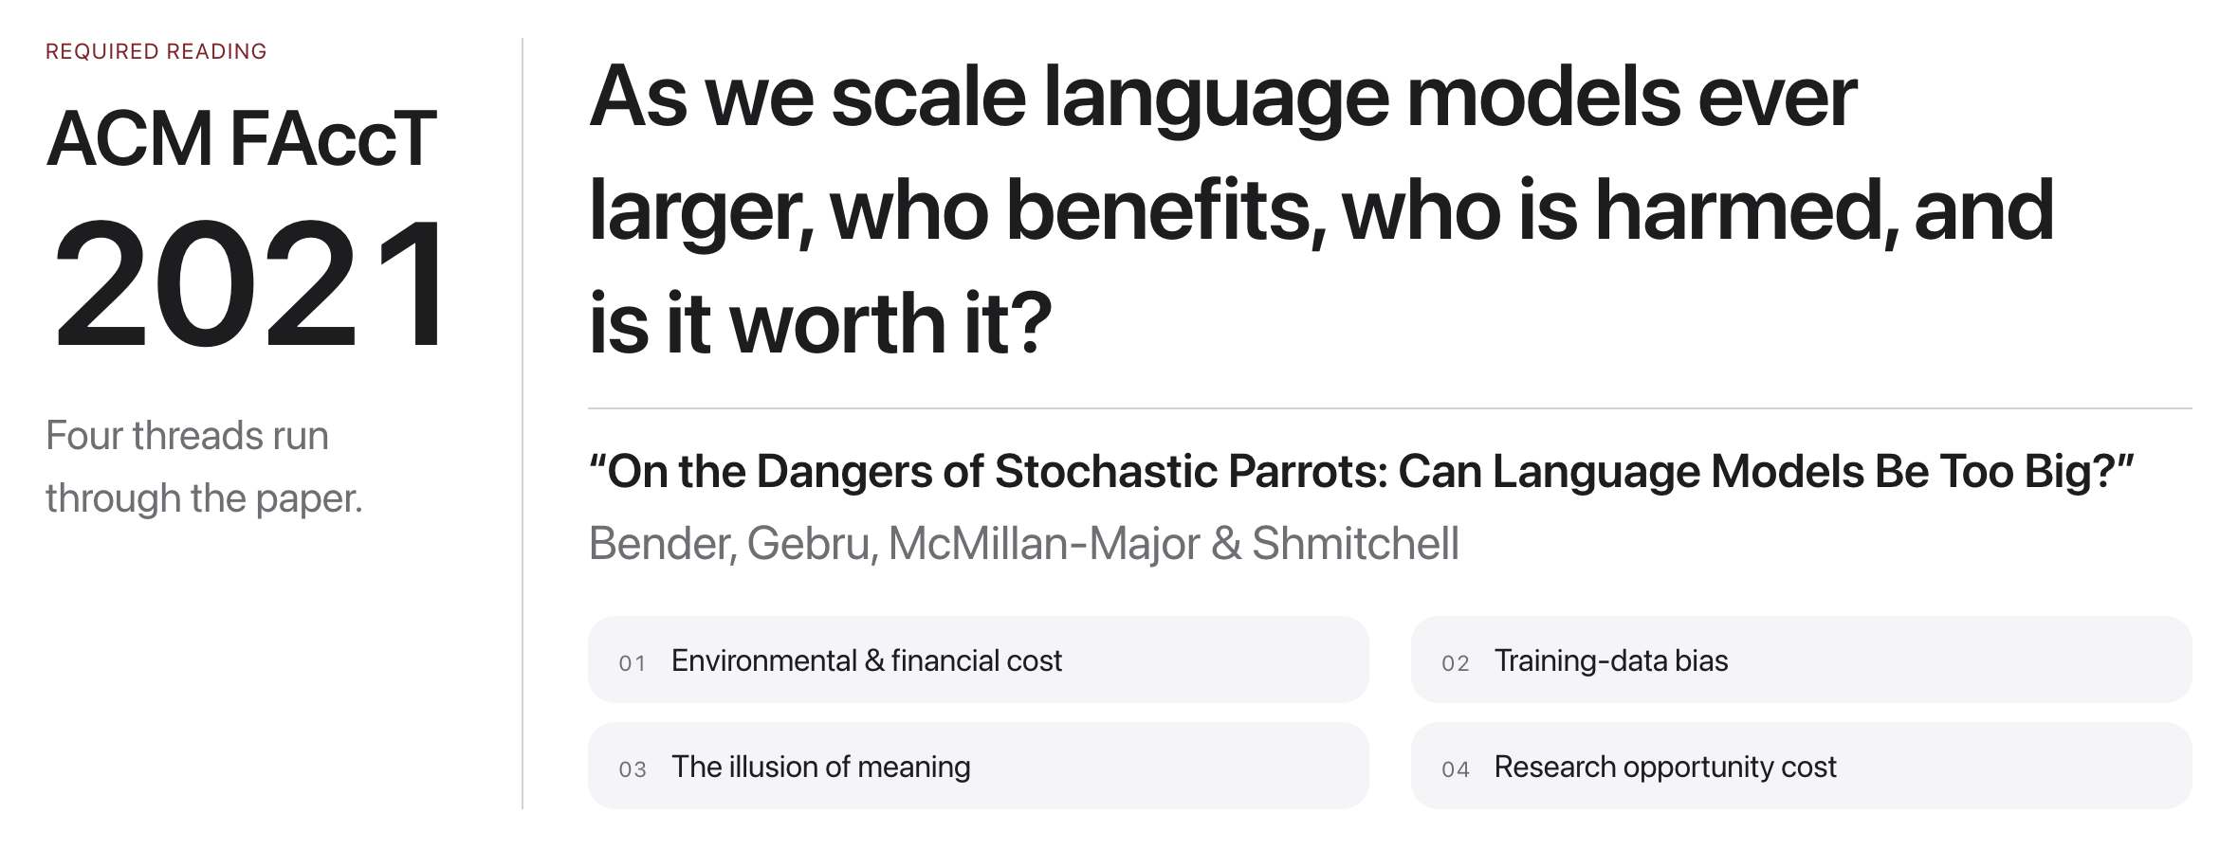
"Stochastic Parrots" (Bender et al., 2021)
Source: Bender et al., FAccT 2021, dl.acm.org/doi/10.1145/3442188.3445922
Notes:
This week's required reading; it supplies today's method and appears on the final exam.

Slide 4
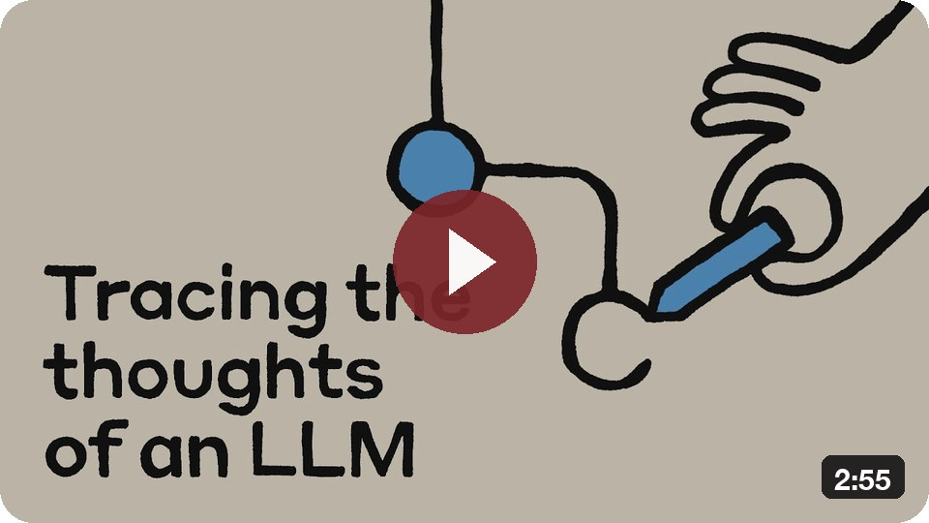
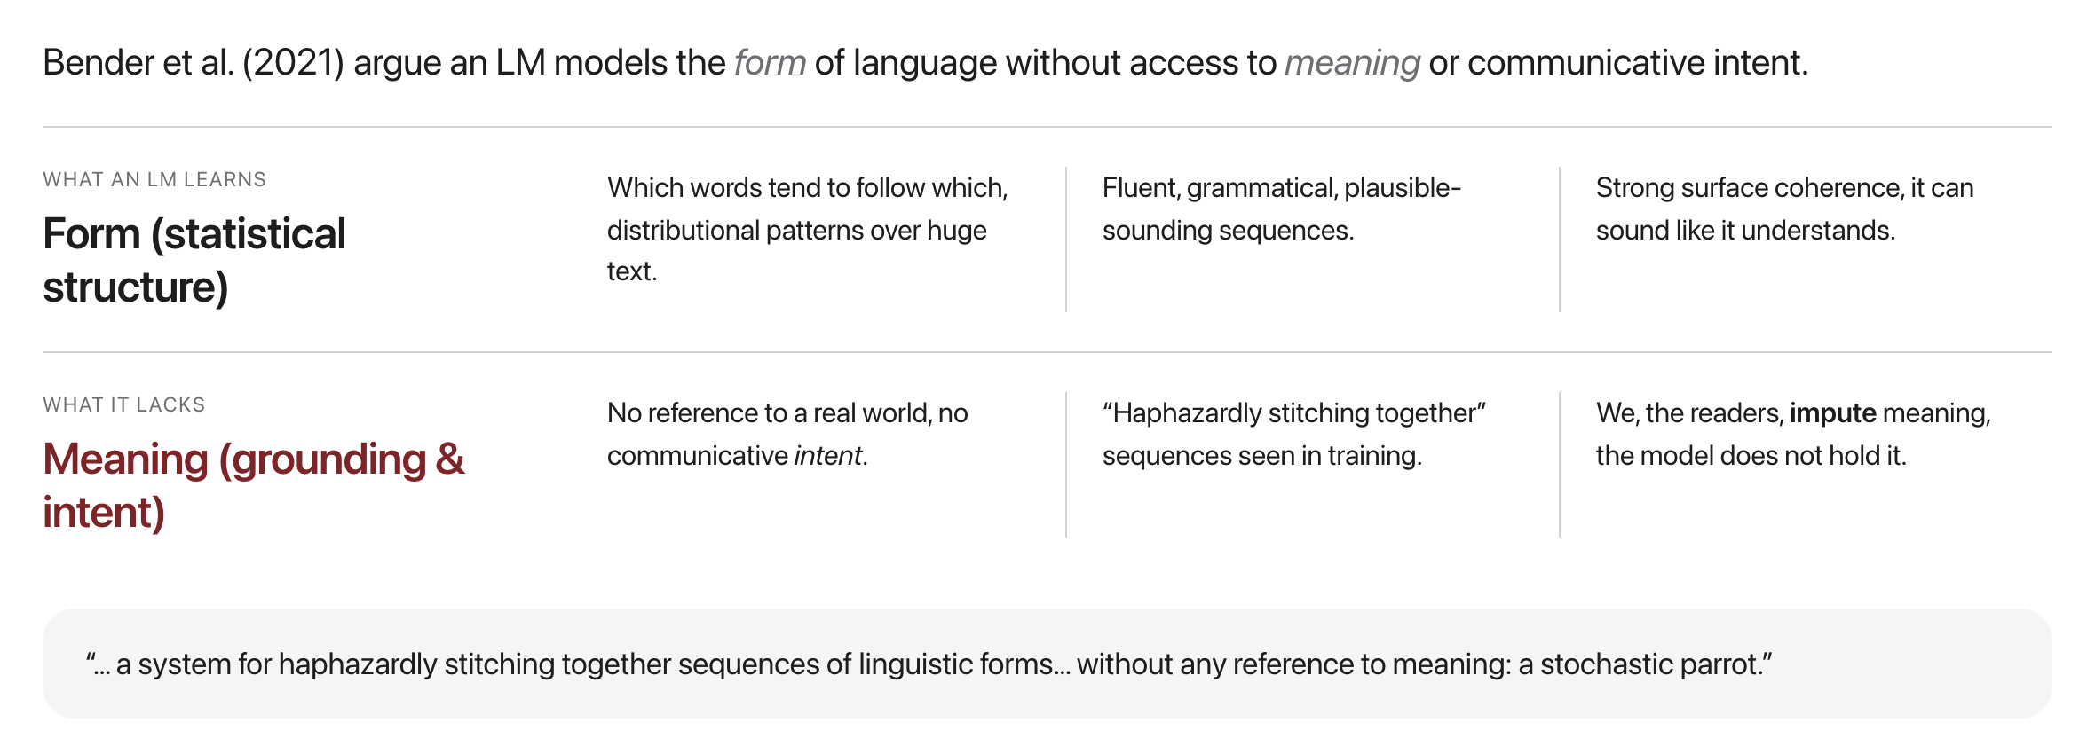
Form vs. meaning
Tracing an LLM's thoughts
Source: Bender et al., FAccT 2021
Notes:
A cited critique, not a settled fact; what LLMs "understand" is still an open debate.

Slide 5
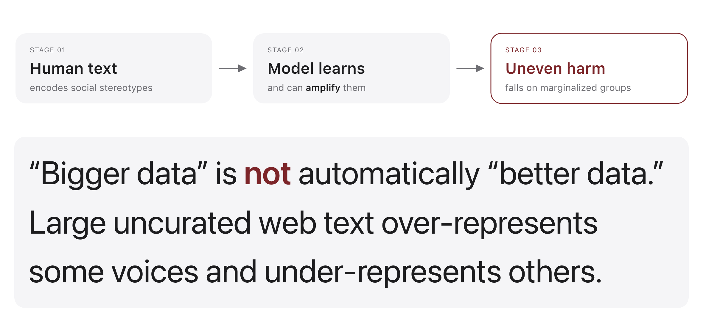
Fault line 1: Bias & fairness
Source: Bender et al., FAccT 2021
Notes:
You will measure exactly this pipeline in the take-home bias probe.

Slide 6
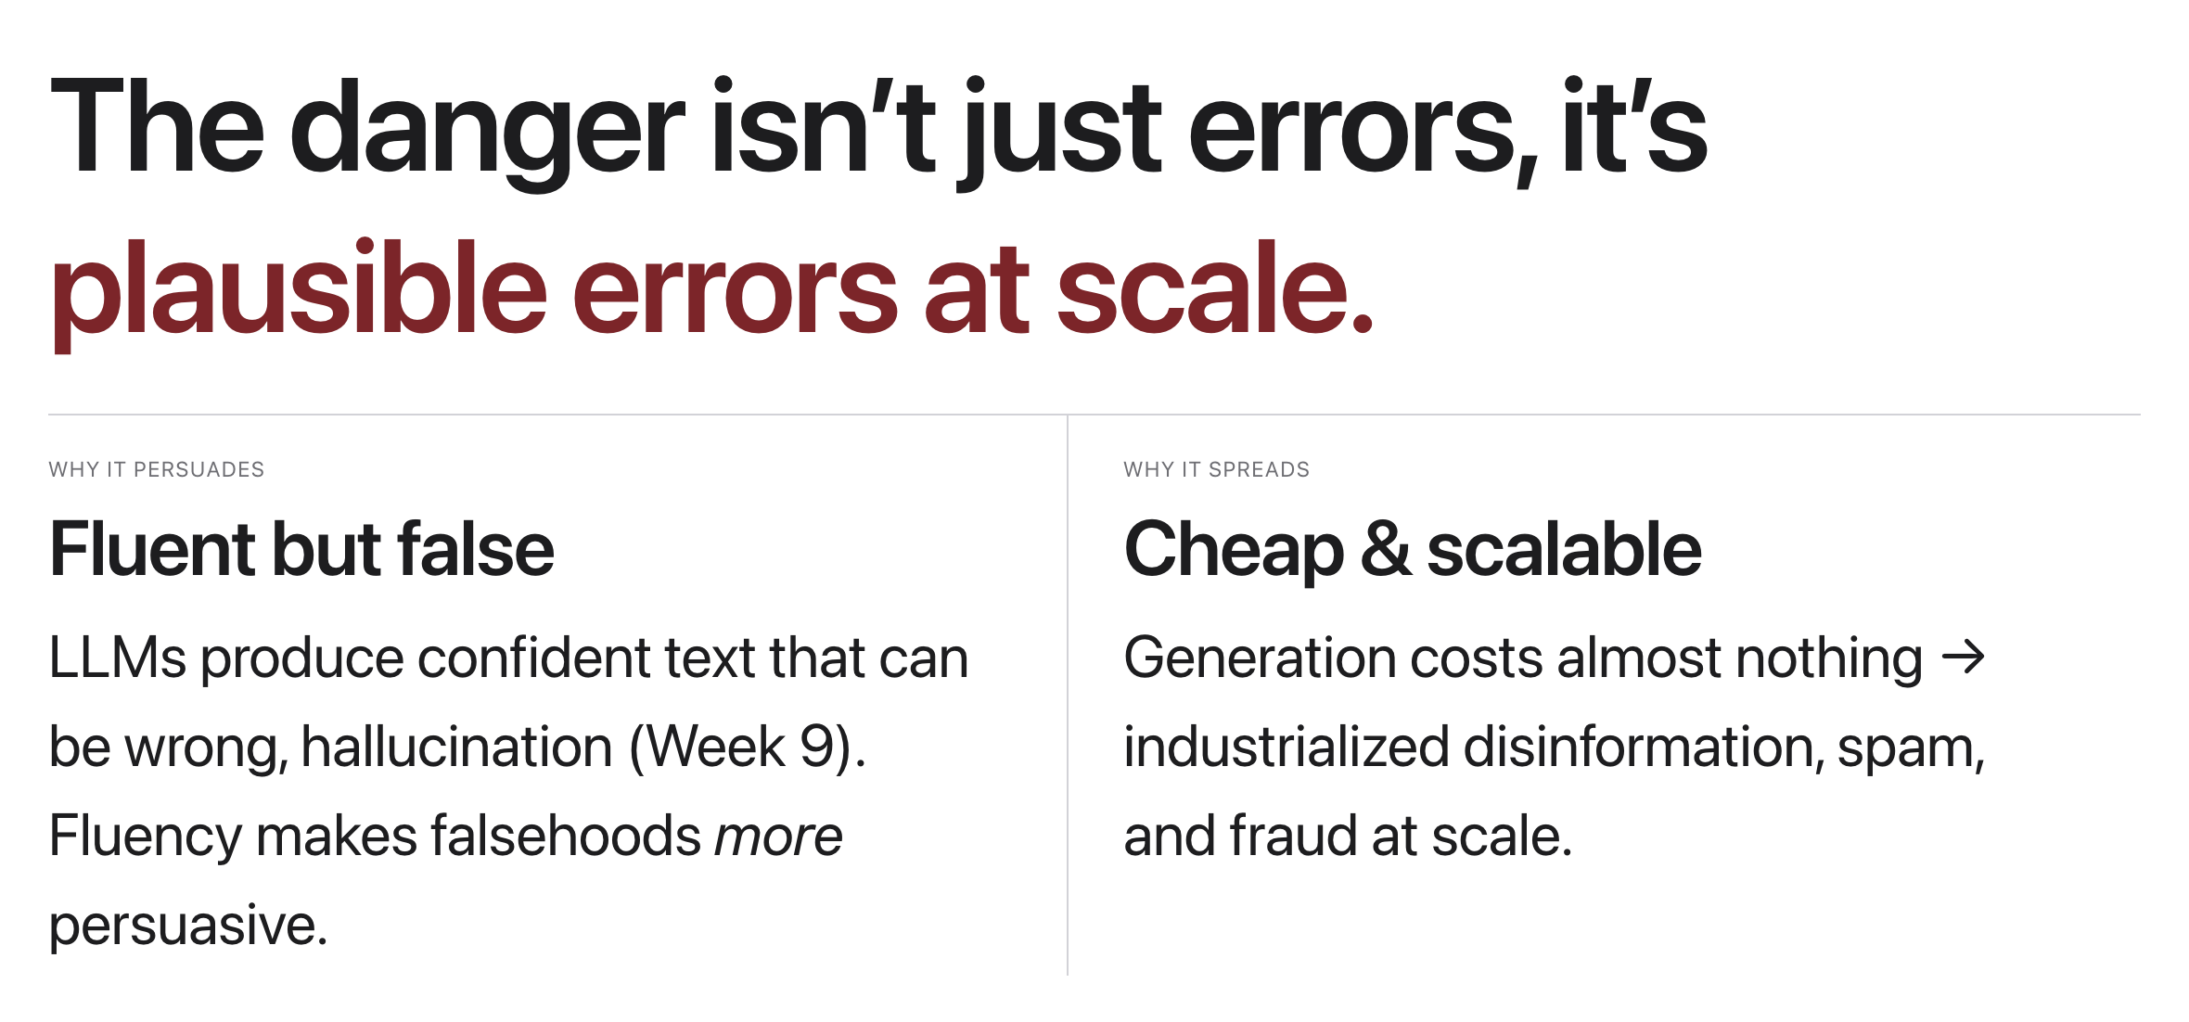
Fault line 2: Misinformation
Source: original figure; hallucination (Week 11)
Notes:
The hallucination problem from Week 11, industrialized.

Slide 7
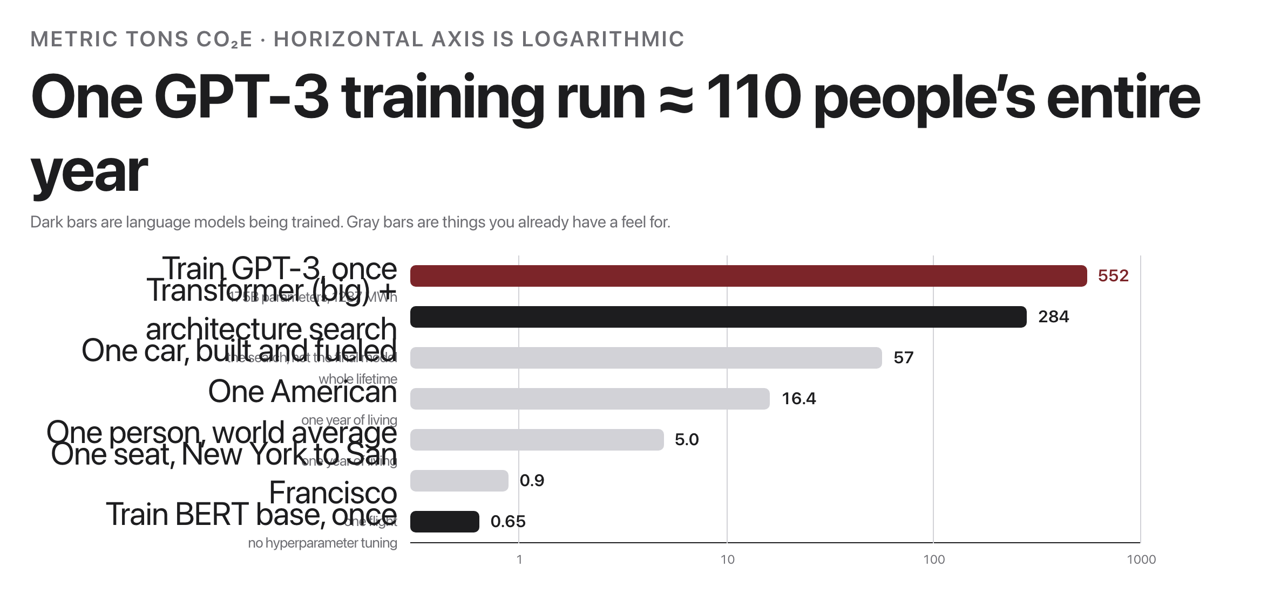
Fault line 3: Environmental cost
Source: Strubell et al. 2019 Table 1; Bender et al. 2021 section 3; Patterson et al. 2021
Notes:
The bill is real, unequally paid, and mostly spent on runs you never see. Sources: Strubell et al. 2019 (Table 1, converted from lbs); Bender et al. 2021 3; Patterson et al. 2021 (GPT-3: 552 tCO e, 1287 MWh). Both dark bars are training a language model. They are 437 apart. What separates them is not the model you ship, it is everything you burned to find it.

Slide 8
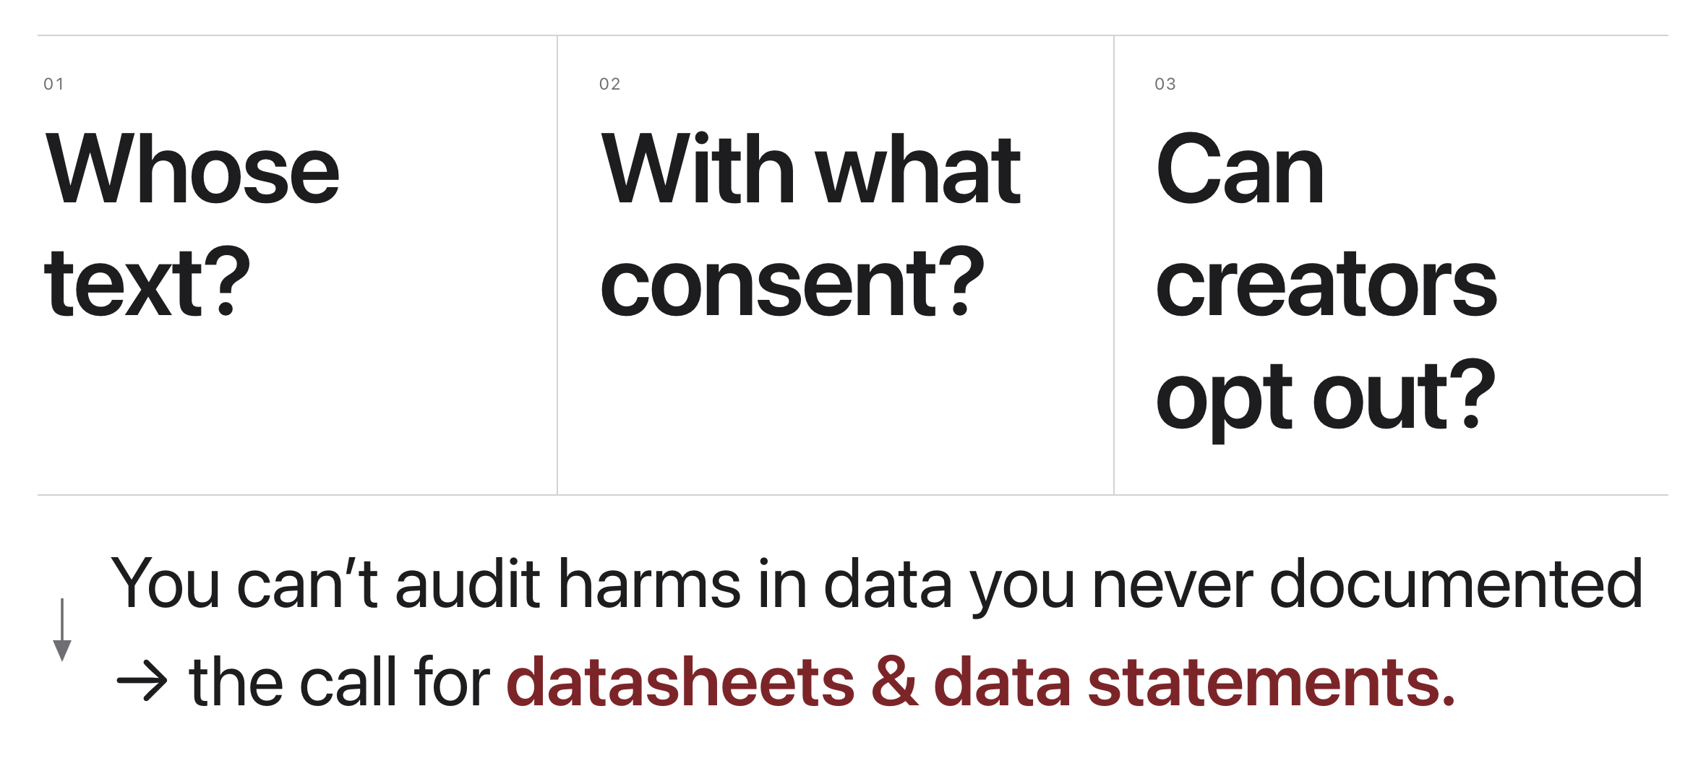
Fault line 4: Copyright & data provenance
Source: original figure; datasheets/data statements
Notes:
Courts are testing these questions right now.

Slide 9
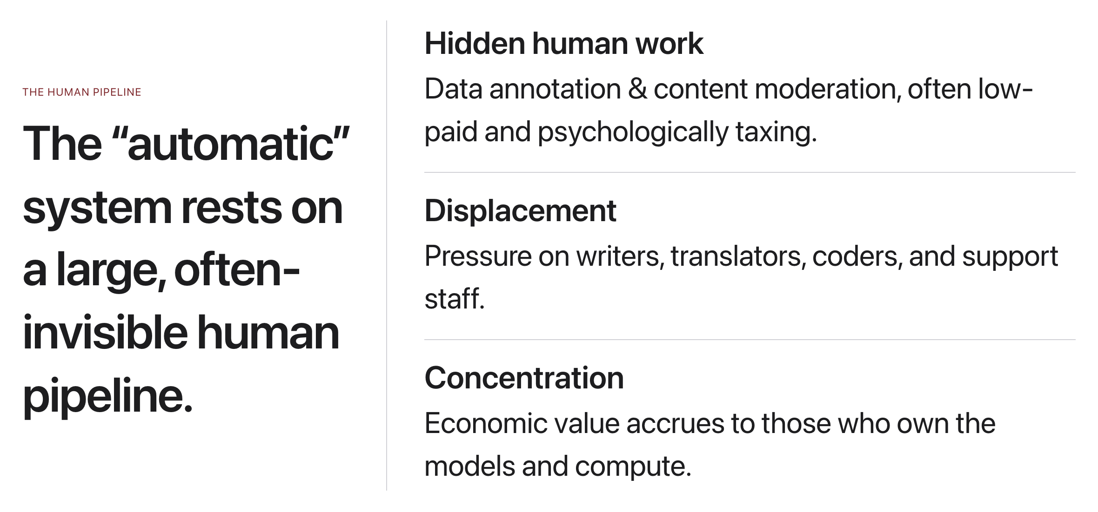
Fault line 5: Labor
Source: original figure
Notes:
Ask who does the work, and who captures the value.

Slide 10
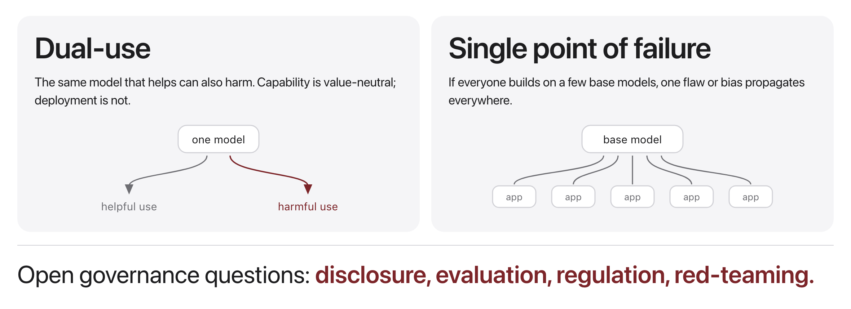
Fault line 6: Safety & policy
Source: original figure
Notes:
No consensus answers yet; this is a live policy debate.

Slide 11
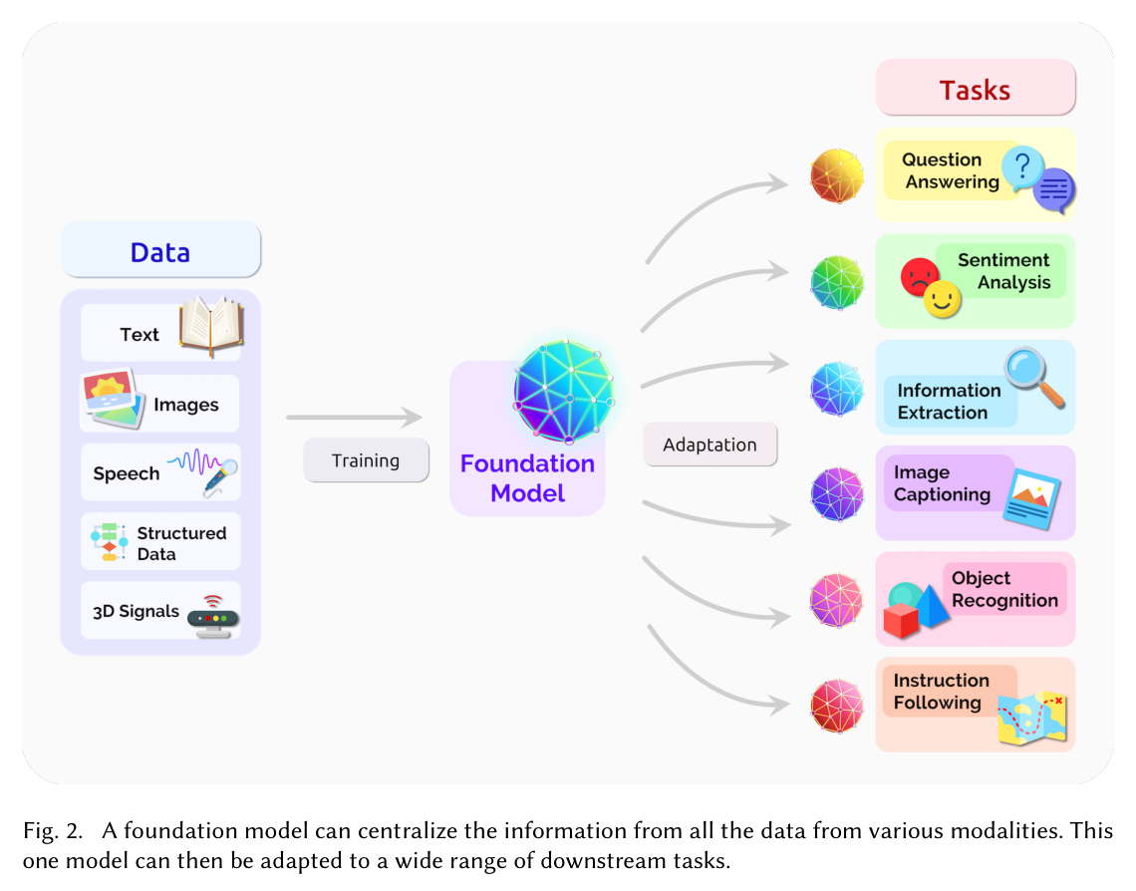
One model beneath everything
Source: Bommasani et al. 2021 (arXiv:2108.07258), Fig. 2
Notes:
The Stanford report's own diagram, from the paper that coined "foundation model". Optional reading, never quizzed. The ethics hook is homogenization: one shared model means its flaws reach every adapted task at once.

Slide 12
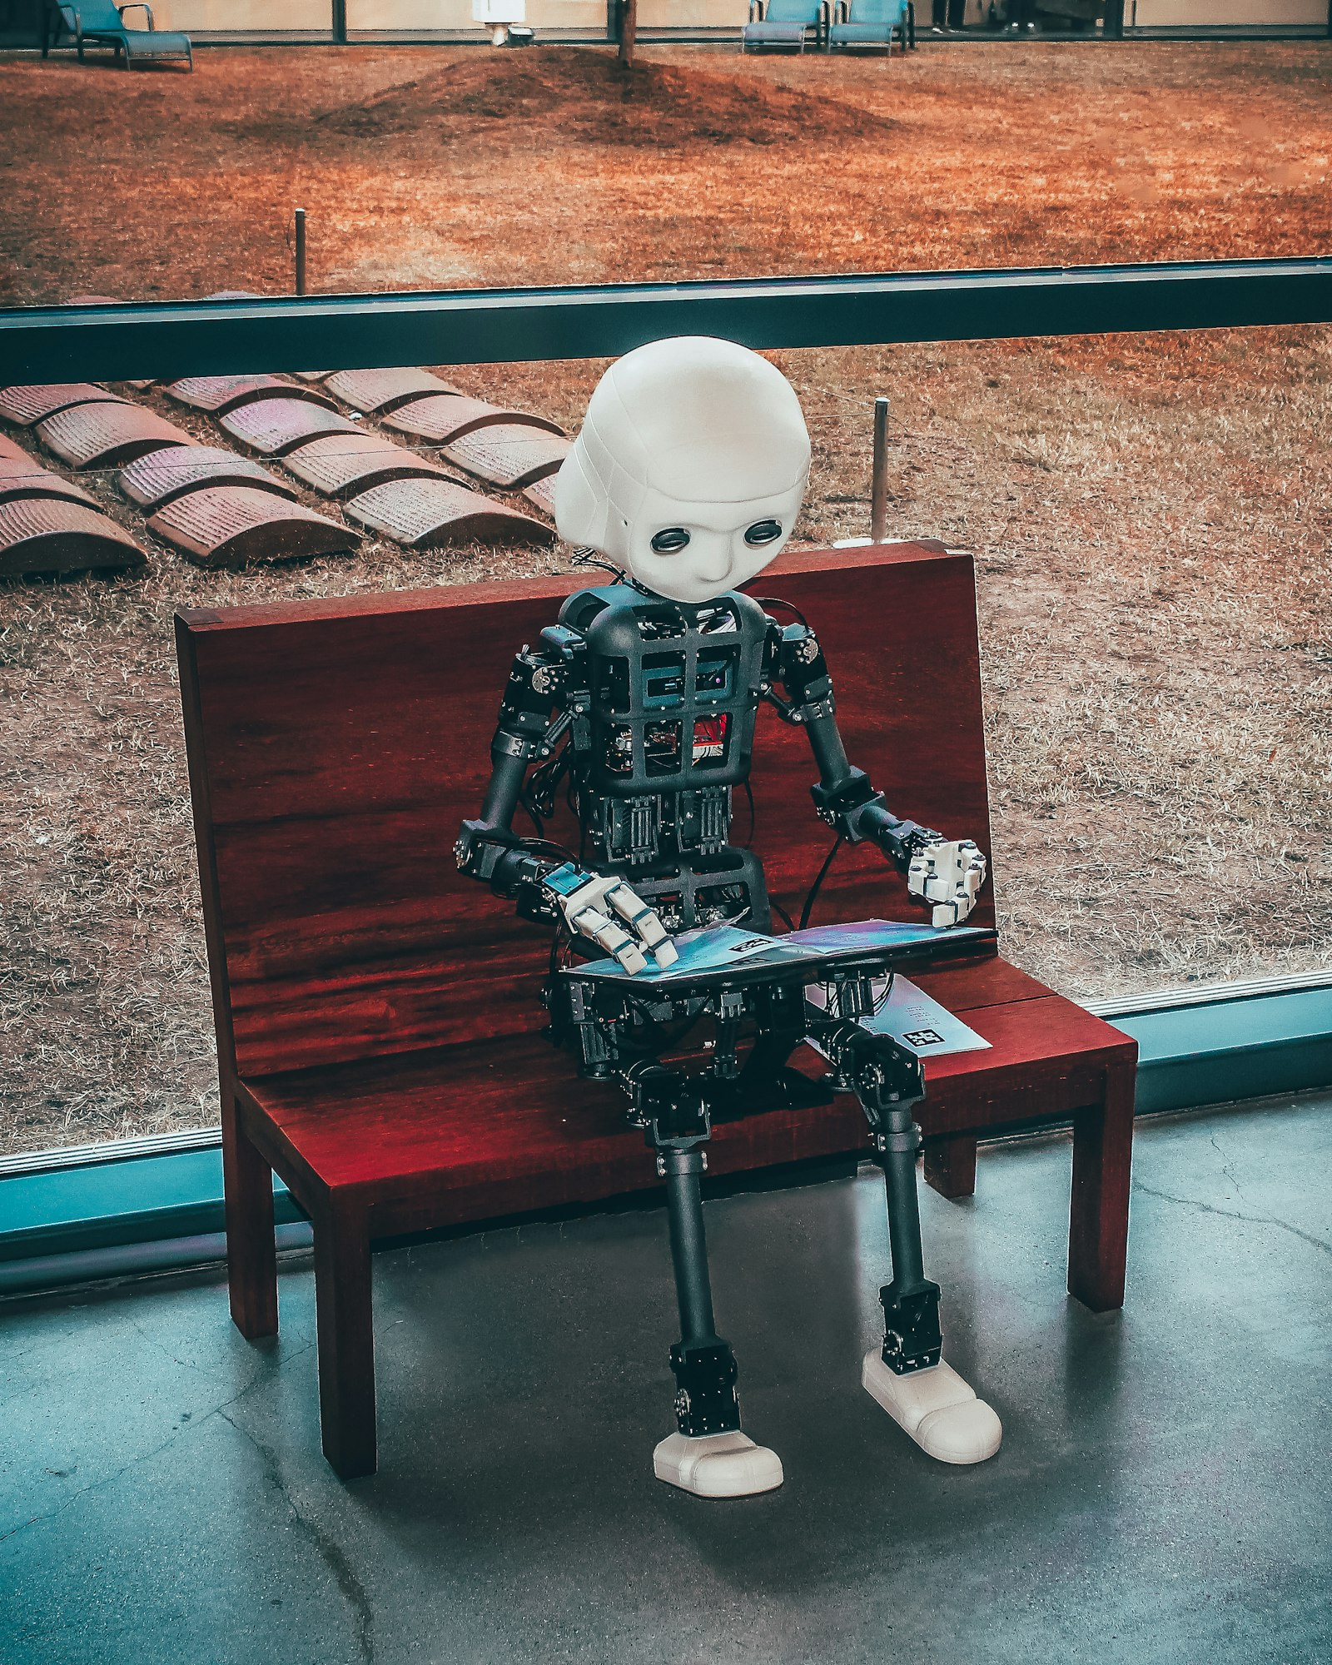
If it reads every book, does it owe the authors anything?
Sit with this one. The hardest questions in this field are not technical.
Source: Unsplash License, https://unsplash.com/photos/black-and-white-robot-toy-on-red-wooden-table-zwd435-ewb4
Notes:
Do not resolve this one. Let a few people argue it. The point of the last week is that the hardest questions left in this field are not technical, and they will be the ones answering them.

Slide 13
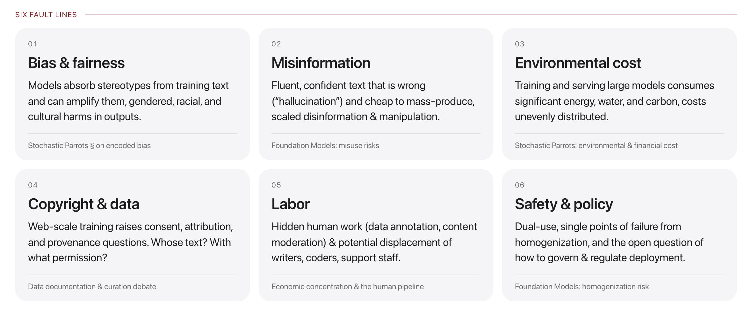
The landscape, at a glance
Source: original figure; Bender et al. 2021 & Bommasani et al. 2021
Notes:
Six interacting fault lines, technical and social at once. You can't fix them with code alone, nor ignore them while writing code.

Slide 14
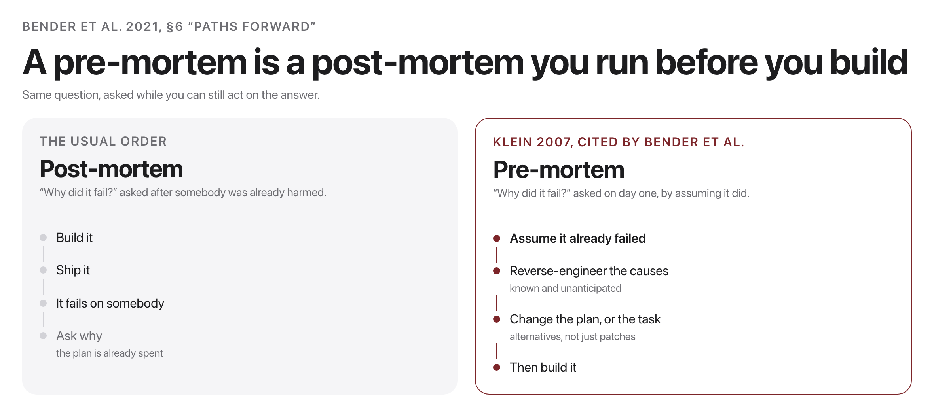
Planning is the mitigation
Source: Bender et al., FAccT 2021, section 6; Klein, Harvard Business Review, 2007
Notes:
Bender et al. do not end with a filter to apply. They end with a step you run before the thing exists. Bender, Gebru, McMillan-Major & Shmitchell, FAccT 2021, 6. Pre-mortem technique: Gary Klein, Performing a Project Premortem, Harvard Business Review, 2007. Bender et al. want three more things decided up front: weigh the financial and environmental cost before choosing a direction, curate and document the data instead of ingesting whatever scrapes easily, and evaluate the worst case, not just the average and the cherry-picked one.

Slide 15
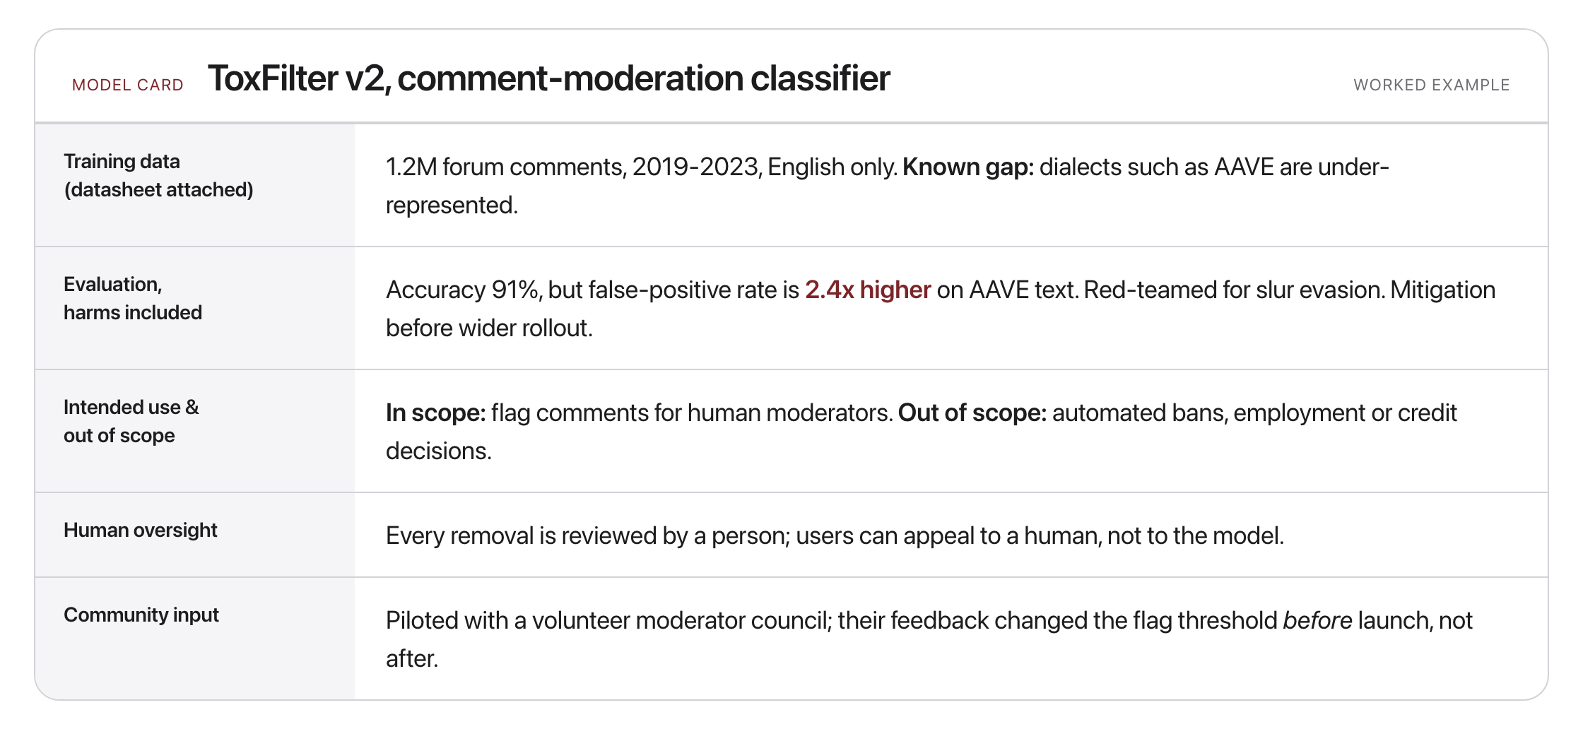
What responsible builders can do
Source: original figure (worked example); model cards (Mitchell et al., 2019); datasheets (Gebru et al., 2018)
Notes:
One artifact, five habits: a model card for a fictional moderation classifier.

Slide 16

Break
Source: original figure

Slide 17
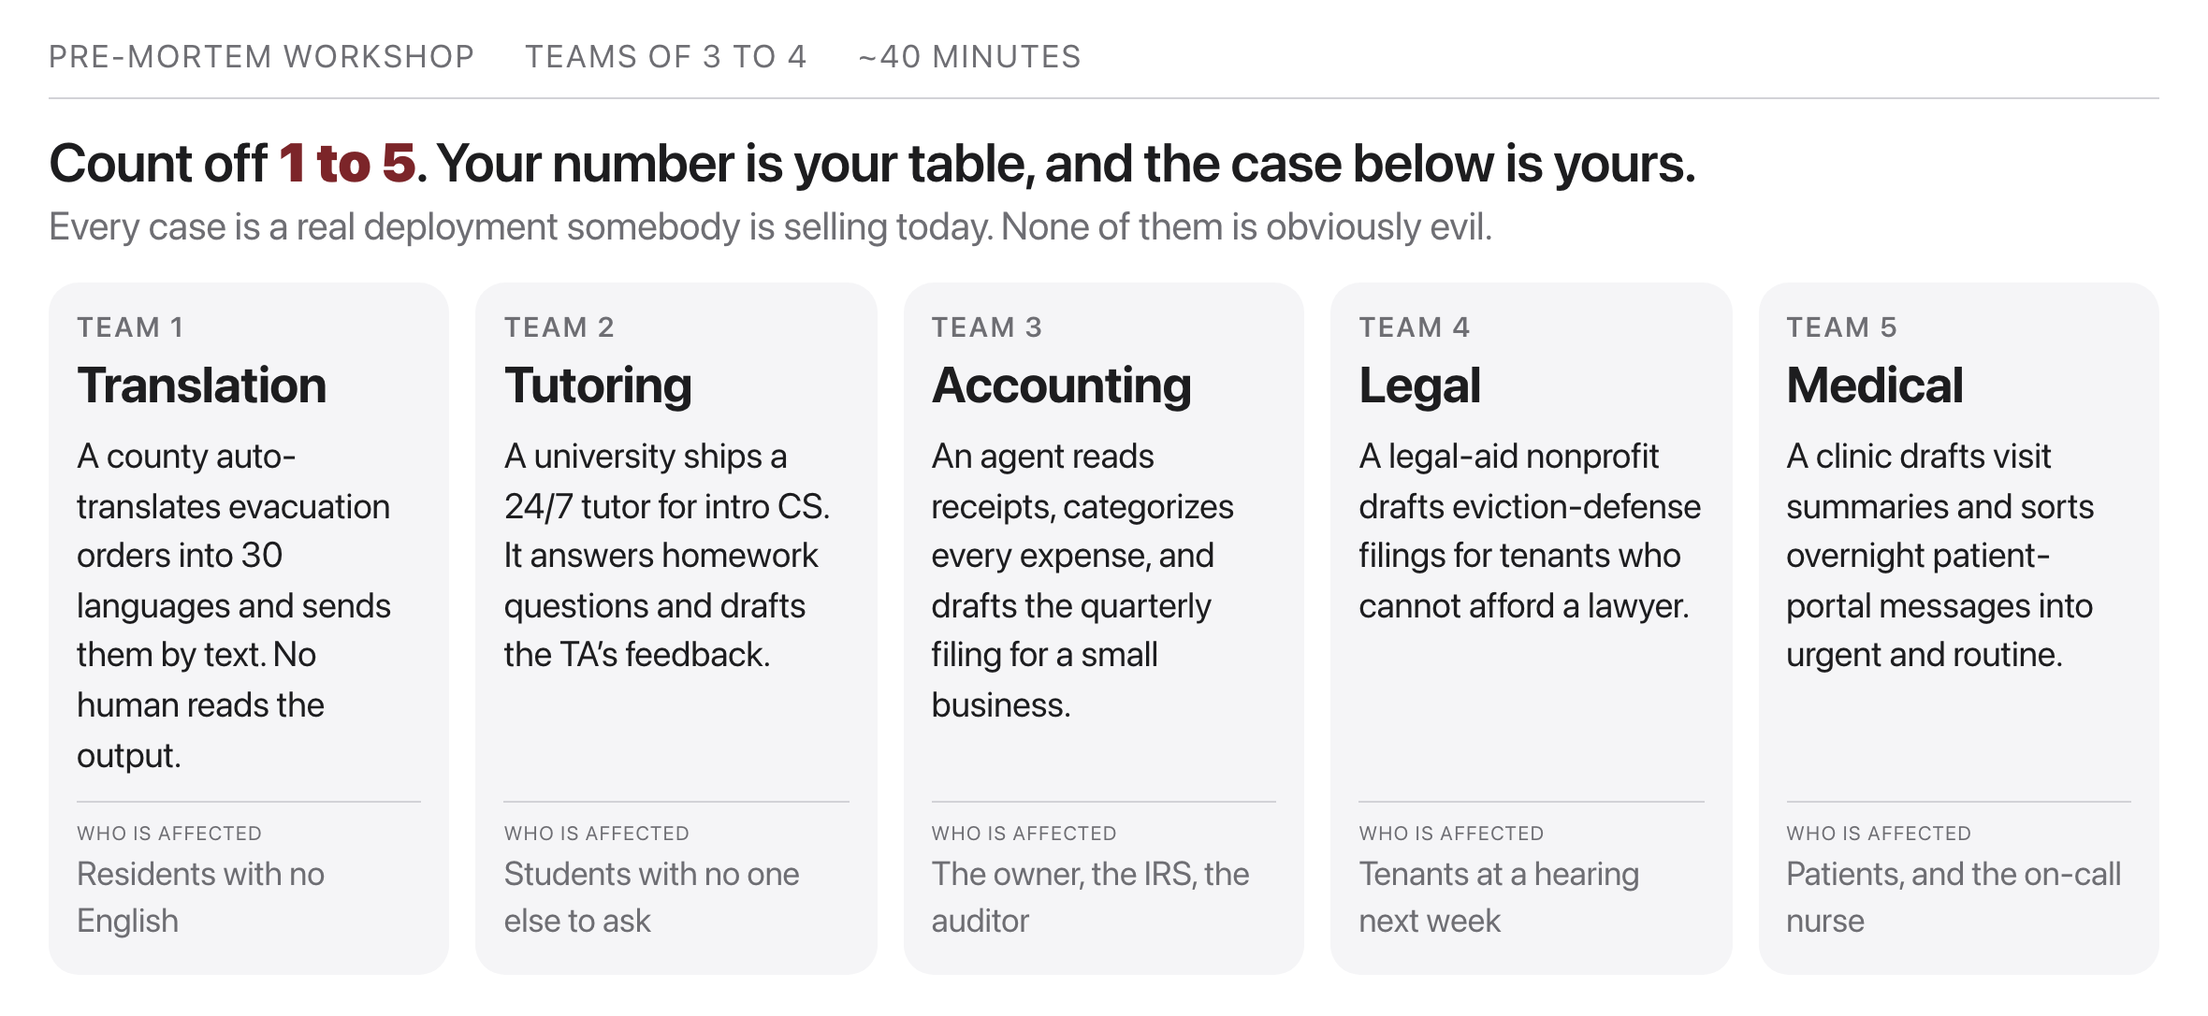
Pre-mortem a real deployment (teams)
Source: exercise/premortem-guide.md
Notes:
Five teams, five cases. Nobody defends a position today; every team is on the build side. First thing at your table, out loud, in one minute: who uses this directly, and who gets affected by it without ever touching it? The second group is where the pre-mortem earns its keep.

Slide 18
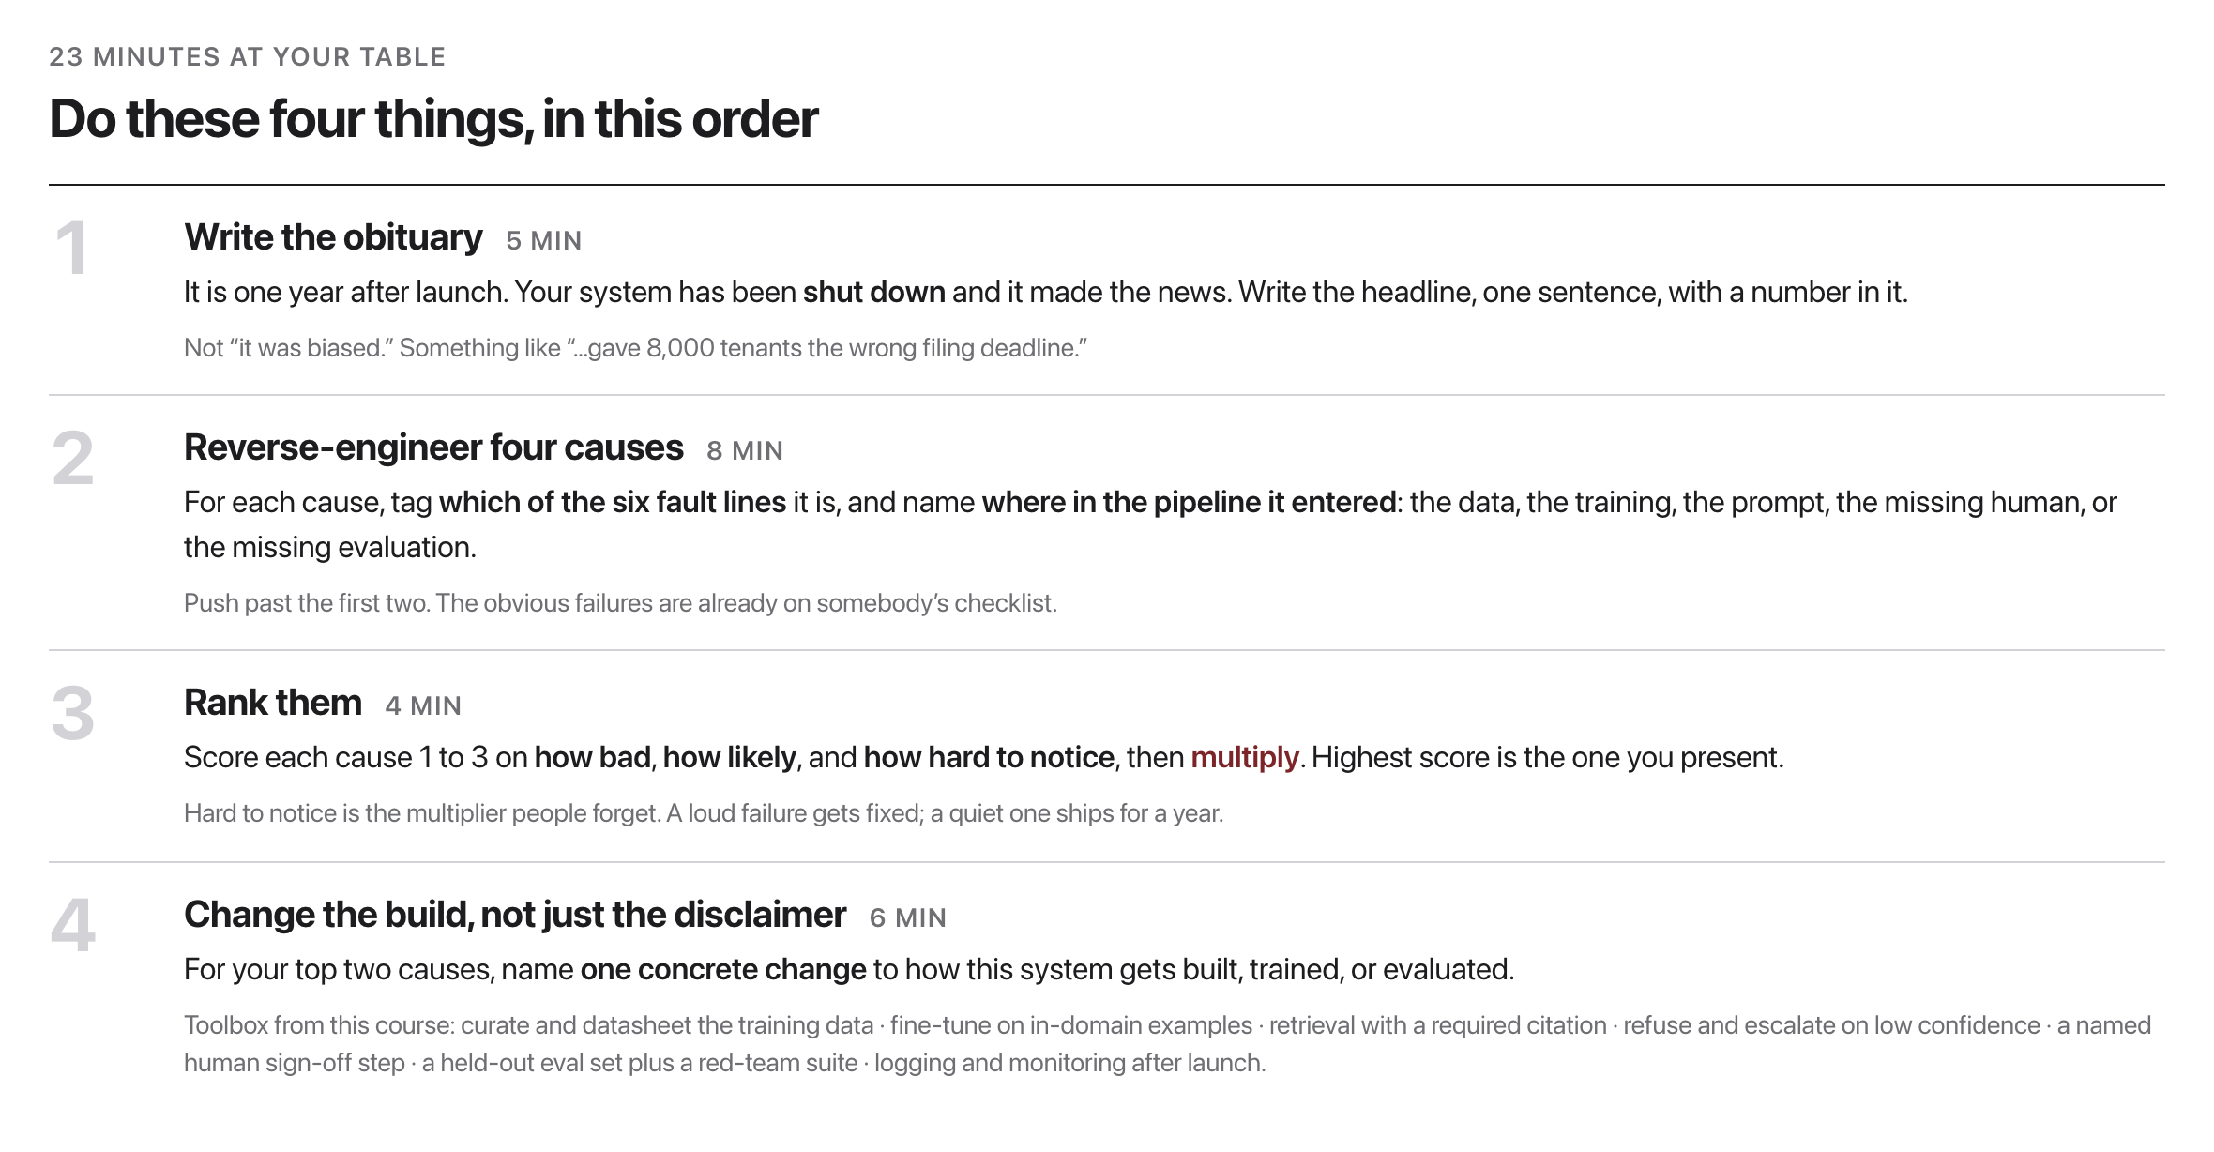
Running the pre-mortem
Source: method: Klein 2007, via Bender et al. 2021 section 6
Notes:
Four steps, 23 minutes. Keep an eye on the clock yourselves. Then two minutes at the board. You are not presenting your case, you are presenting one failure and the change that prevents it.

Slide 19
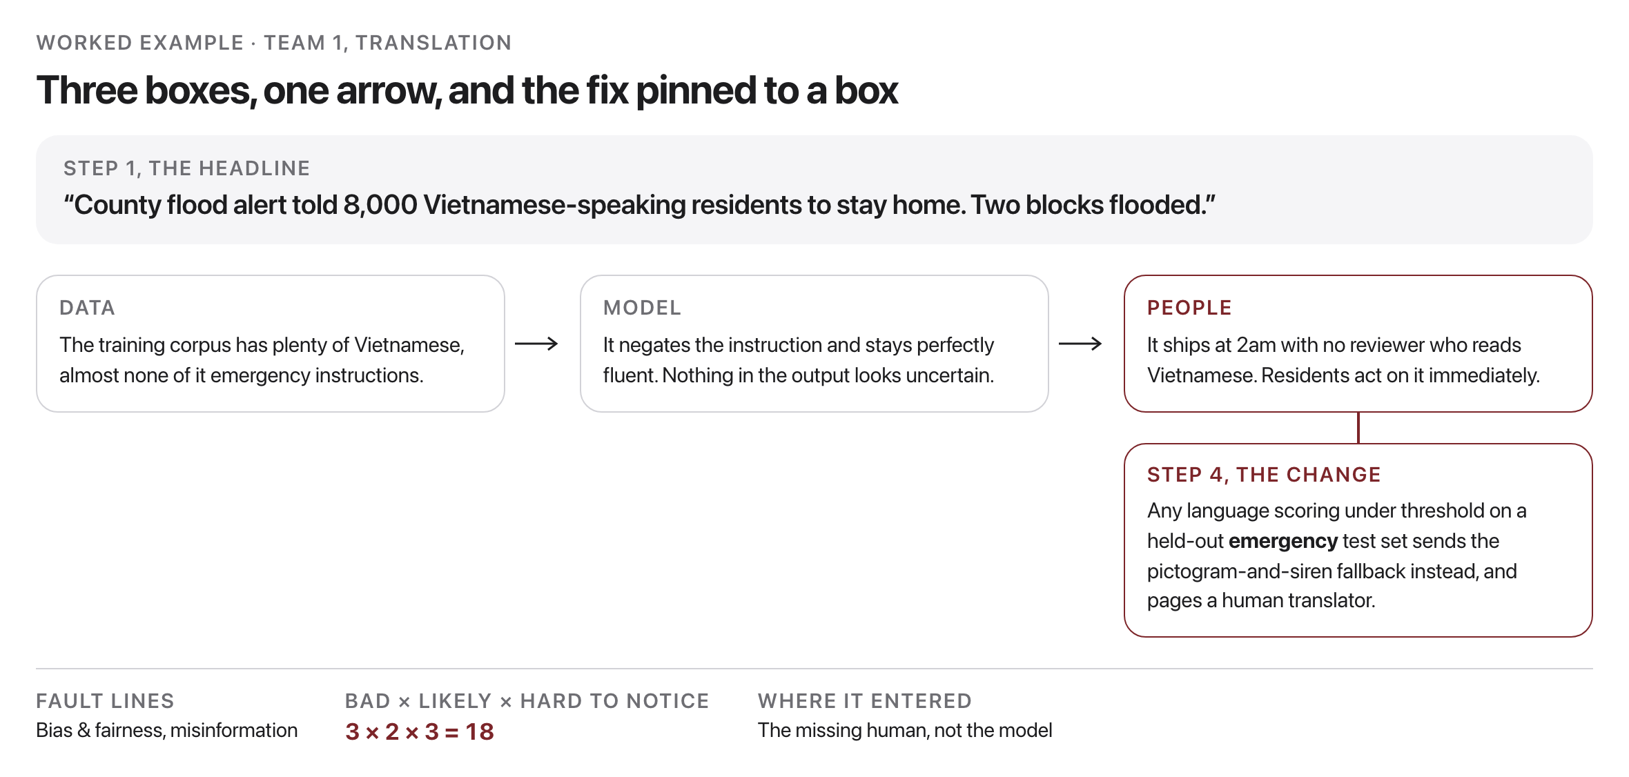
What your whiteboard should look like
Source: worked example, exercise/premortem-guide.md
Notes:
Two minutes per team at the board. Draw this shape, fill in your own case.

Slide 20
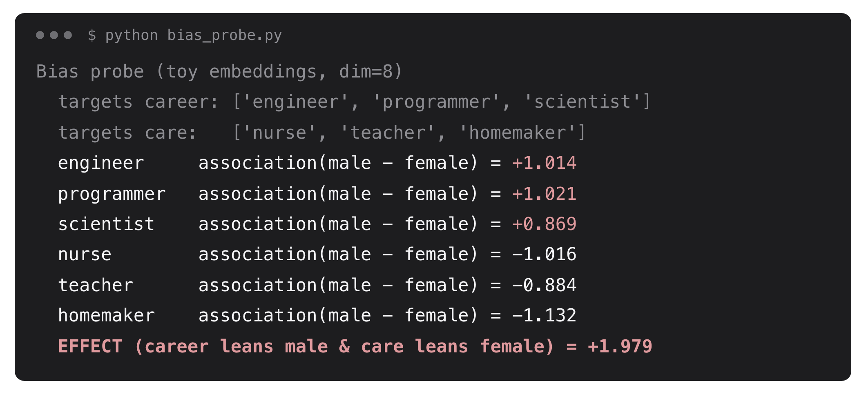
Take-home demo: measure the bias
Source: example run, weeks/week-15/class-01/exercise/bias_probe.py
Notes:
A measure-first WEAT-style probe on toy embeddings, fully offline. Optional take-home lab; the point is to arrive with a number, not an opinion.

Slide 21
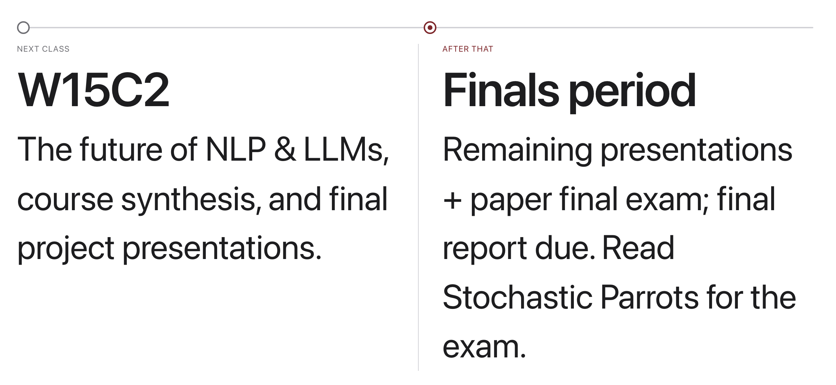
Looking ahead
Source: schedule/SCHEDULE.md; readings.md
Notes:
One class left. Presentations start next time, come with your demo ready to run.

