Slide 1

CSCI 3495
The Future of NLP & LLMs · Course Synthesis · Final Presentations
Natural Language Processing & Large Language Models
Week 15, Class 2 · Mon Dec 7, 2026
Source: photo: Balise42, Wikimedia Commons, CC BY-SA 4.0
Notes:
A crystal ball shows the city sharp but upside down. Every prediction about this field comes with the same warning.

Slide 2
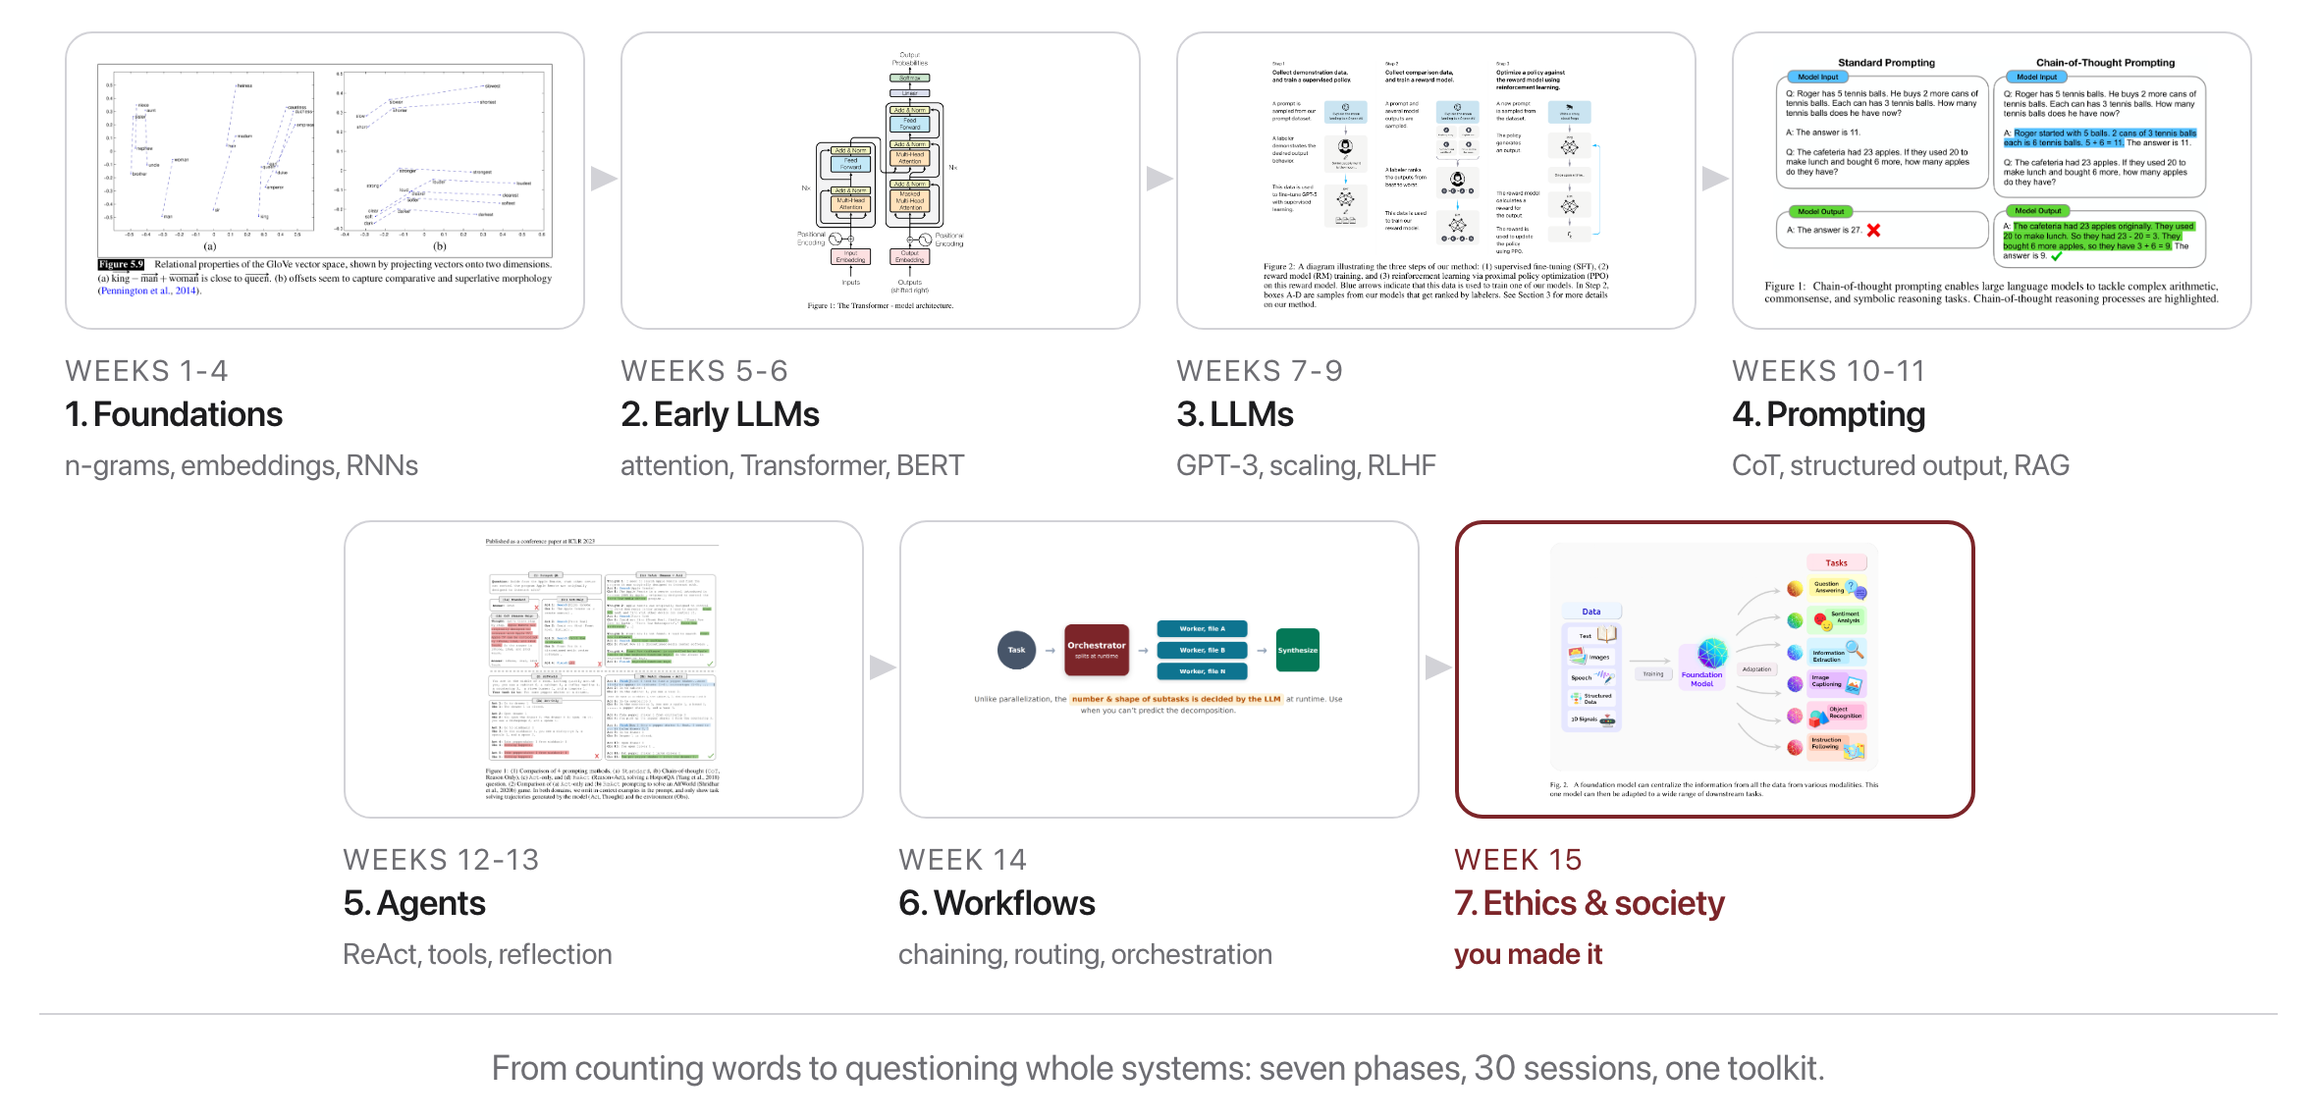
The whole arc
Source: SLP3 Fig. 5.9; Vaswani et al. 2017 Fig. 1; Ouyang et al. 2022 Fig. 2; Wei et al. 2022 Fig. 1; Yao et al. 2023 Fig. 1; Bommasani et al. 2021 Fig. 2; course figure (W14)
Notes:
Seven phases, 15 weeks. You built a piece of each, tokenizers to agents, and learned to question all of it.

Slide 3
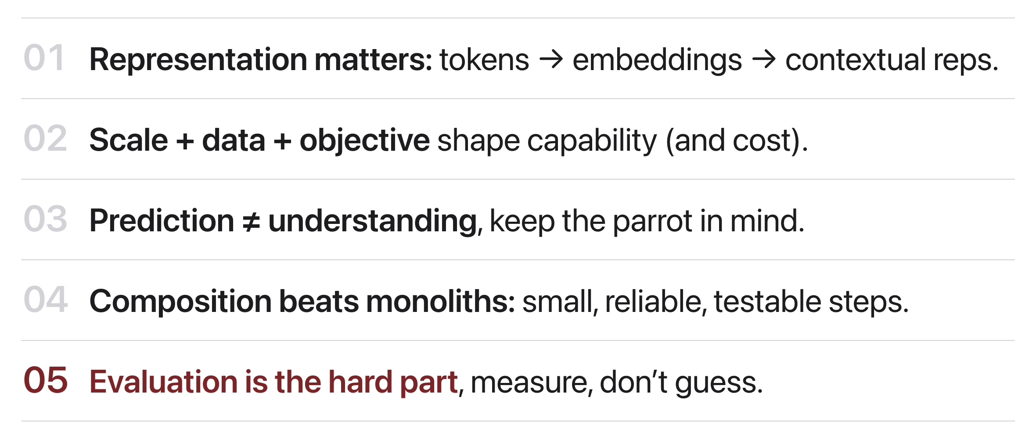
What stays true
Source: original figure
Notes:
Five ideas that will outlast any specific model.

Slide 4
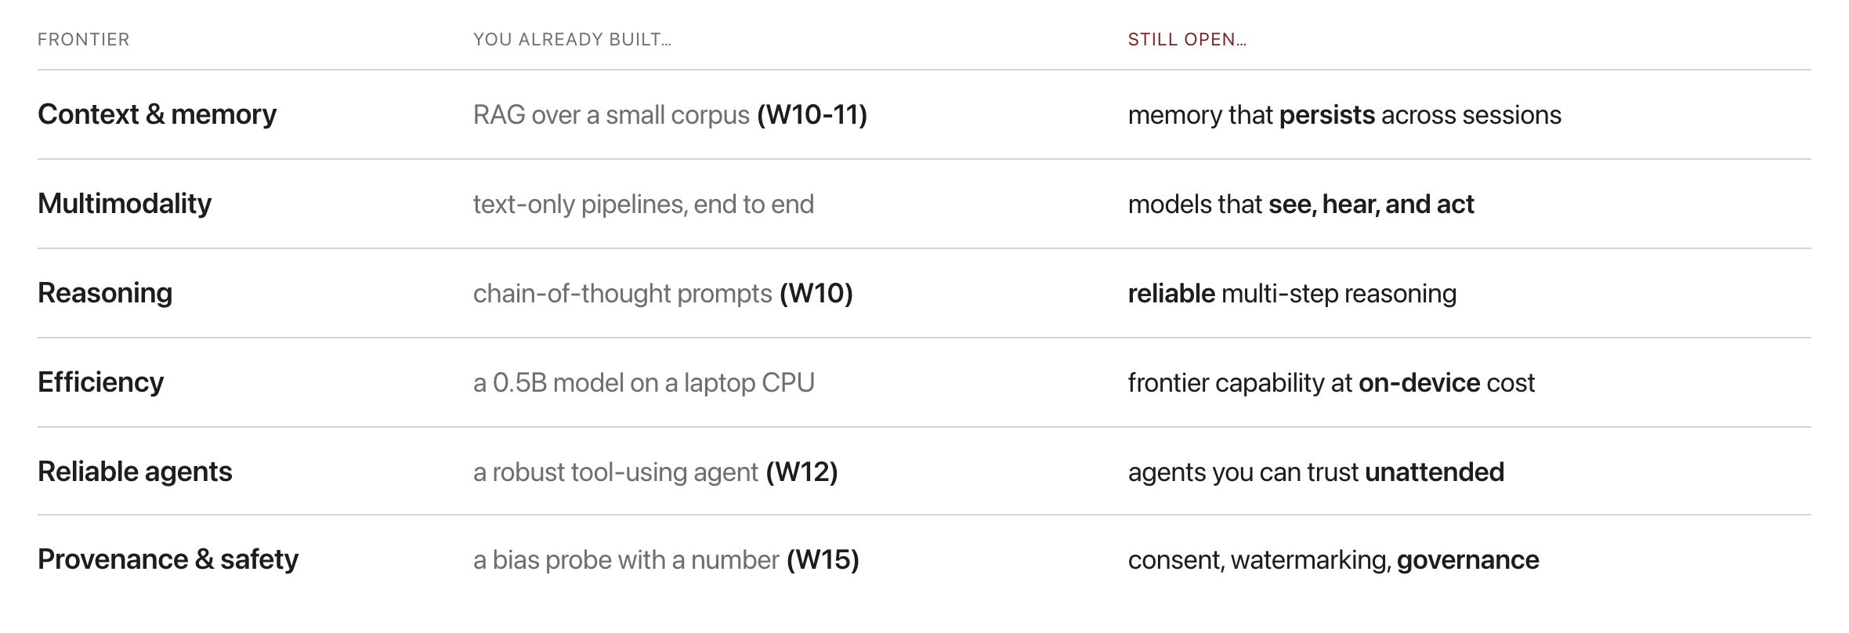
Open frontiers
Source: original figure; course arc, schedule/SCHEDULE.md
Notes:
Every "still open" cell is a thesis topic or a startup waiting to happen.

Slide 5
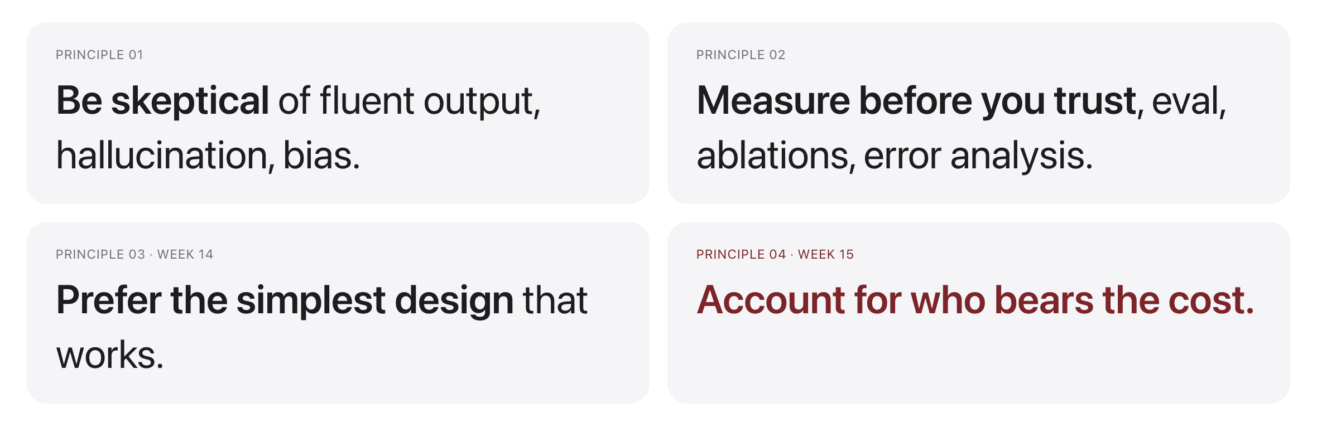
Predictions are hard: principles aren't
Source: original figure
Notes:
Models will change fast. These habits won't.

Slide 6

How to keep learning
Source: photo: Unsplash License, https://images.unsplash.com/photo-1481627834876-b7833e8f5570
Notes:
Read the source, reproduce results, build small, stay critical. You already have the toolkit and the habits.

Slide 7
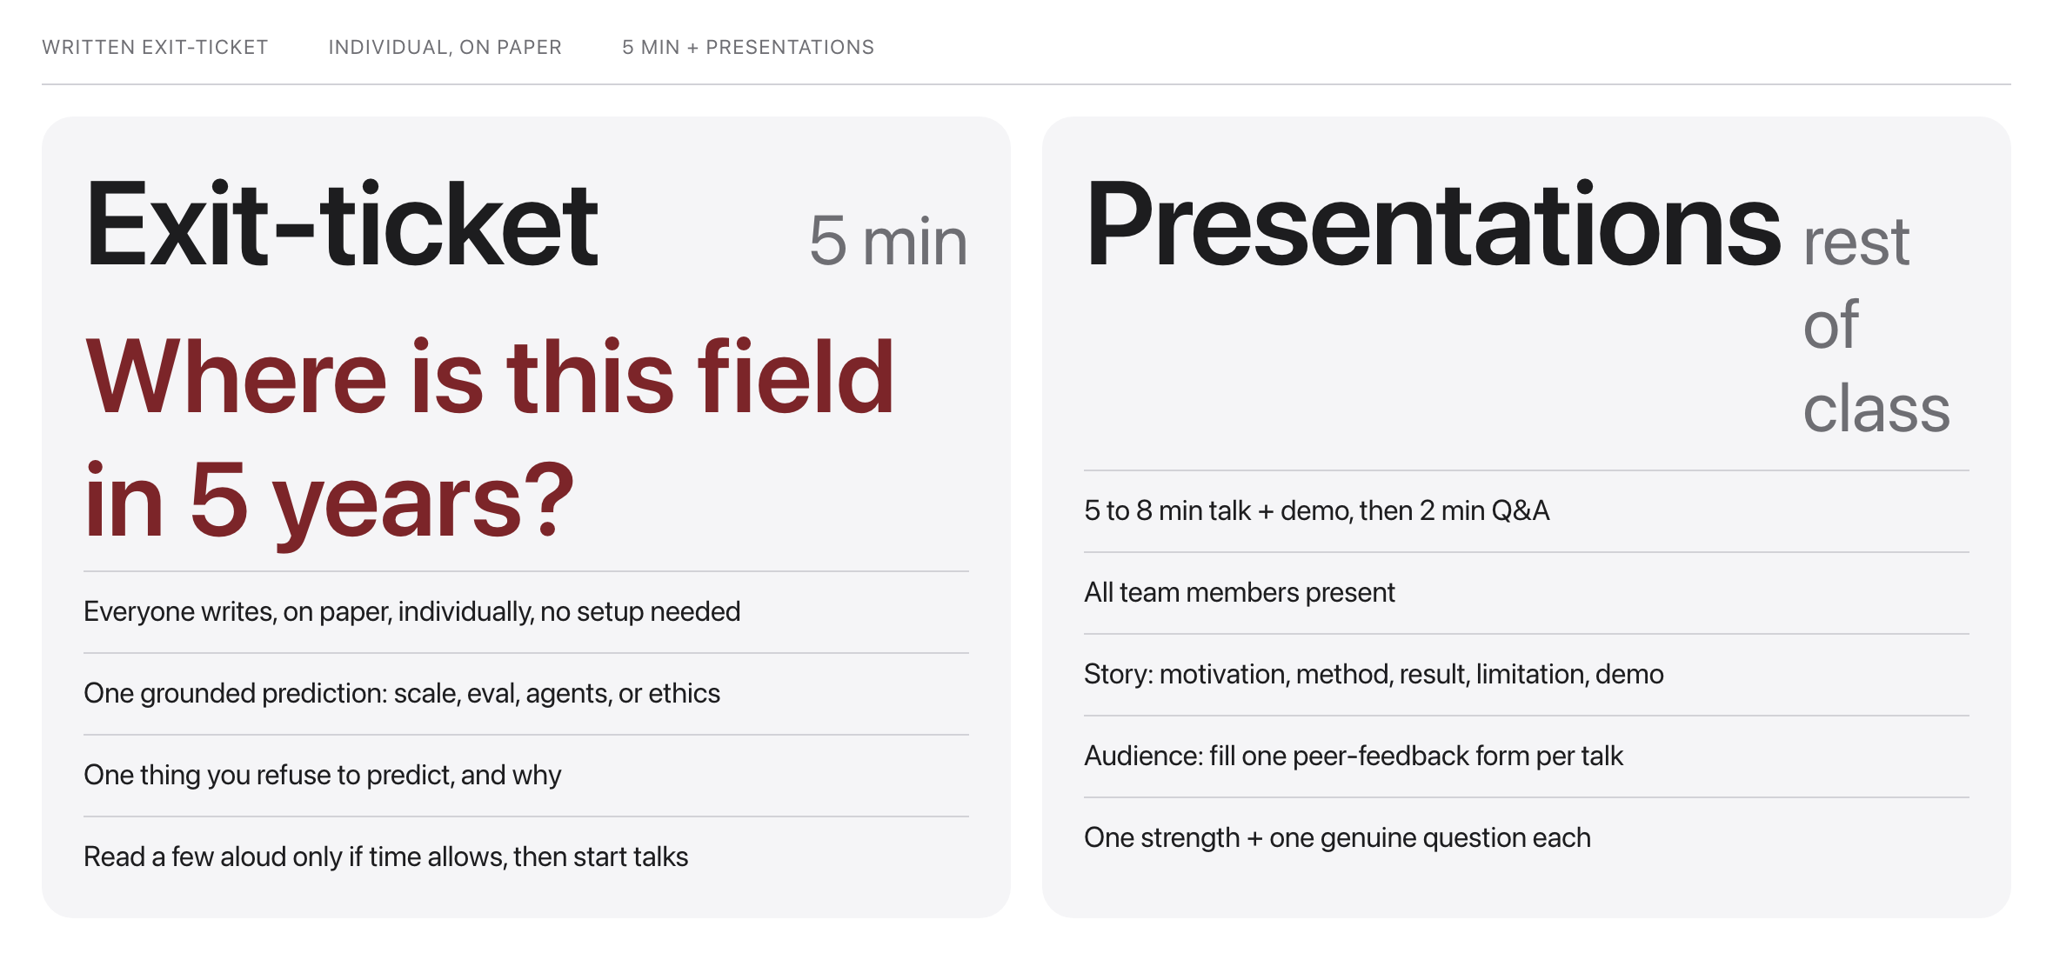
Exit-ticket synthesis, then presentations
Source: weeks/week-15/class-02/exercise/presentation-guide.md
Notes:
Five minutes, on paper, individually, no setup. One grounded prediction about where the field goes, and one thing they refuse to predict. Then straight into the talks.

Slide 8

Exit-ticket: one prediction, one thing you refuse to predict
Five minutes, on paper: write one grounded prediction about the field and one thing you refuse to predict, and why. Read a few aloud if time allows, then straight into the talks.
Source: Unsplash License, https://images.unsplash.com/photo-1543269865-cbf427effbad
Notes:
Read two or three aloud if the clock allows. The refusals are usually more interesting than the predictions.

Slide 9
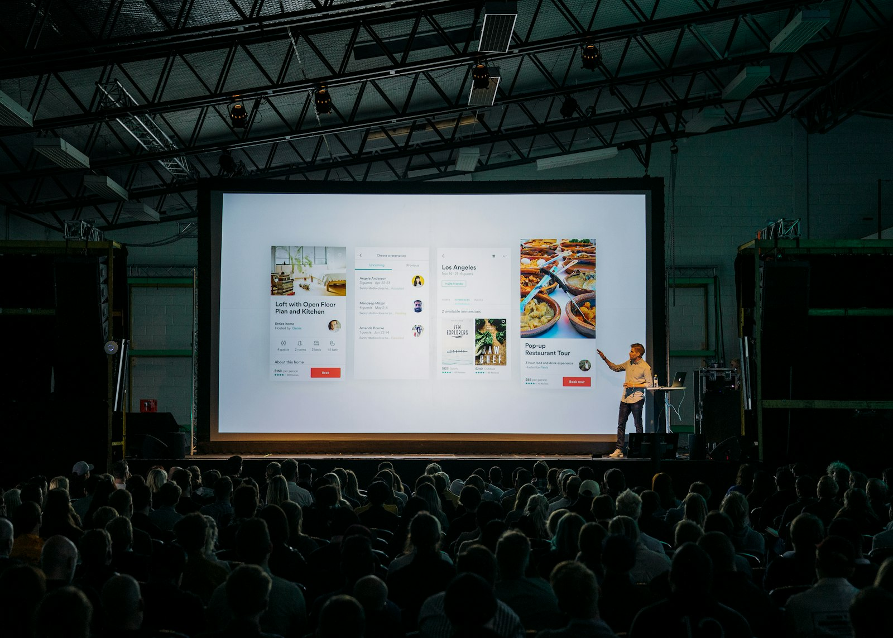
Your moment: show what you built
Source: Unsplash License, https://images.unsplash.com/photo-1505373877841-8d25f7d46678
Notes:
A real talk to a real audience. Tell the story of your project, then show it running.

Slide 10
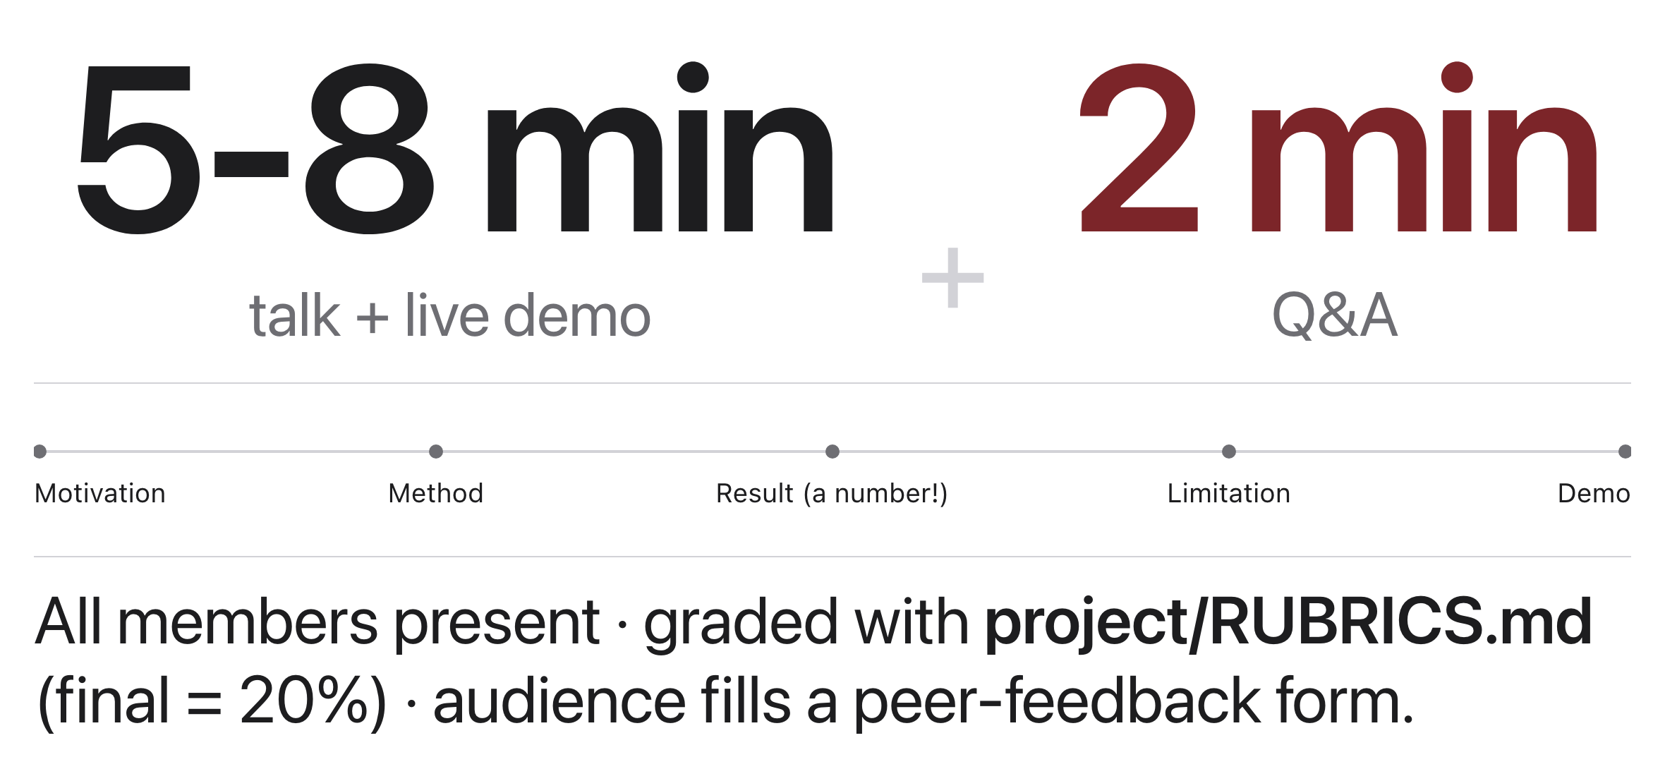
The format
Source: project/RUBRICS.md; exercise/peer-feedback-form.md
Notes:
Practice your timing beforehand; eight minutes goes faster than you think.

Slide 11
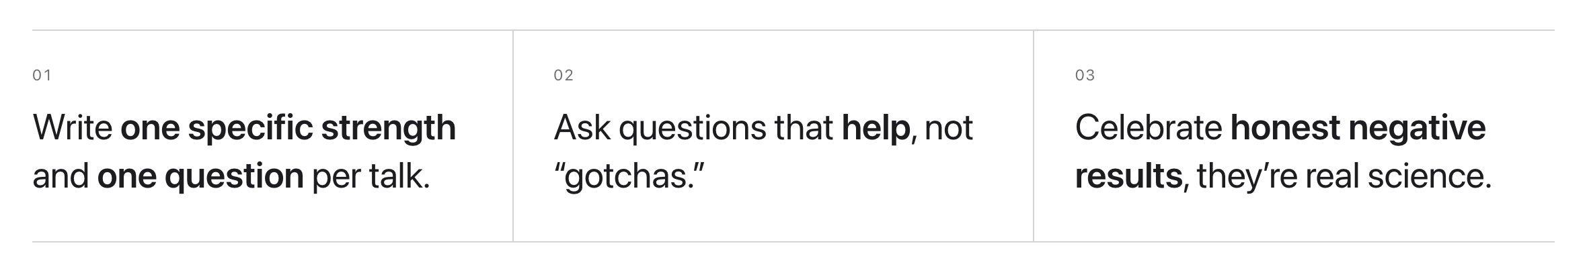
Be a good audience
Source: exercise/peer-feedback-form.md
Notes:
One peer-feedback form per talk. Your feedback is part of your participation grade.

Slide 12
What will you build that the world actually needs?
You have the tools and the judgment. Now go decide what is worth building.
Source: original prompt
Notes:
Last slide of the course. They have the tools and, after last week, some of the judgment. The question is the assignment.

Slide 13
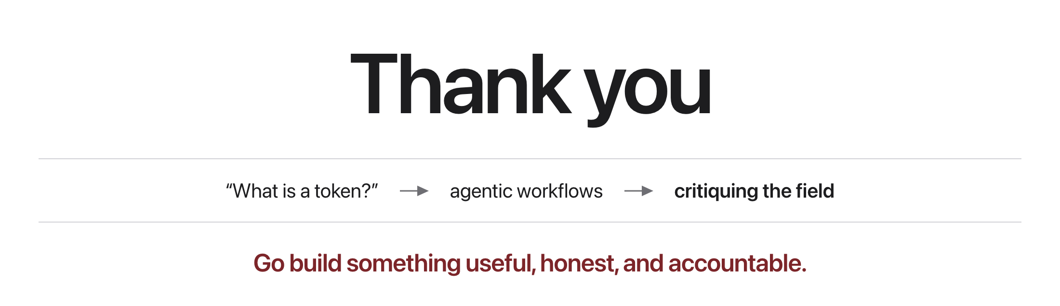
Course wrap-up
Source: original figure
Notes:
Remaining presentations and the paper final exam happen in the finals period.

