Slide 1
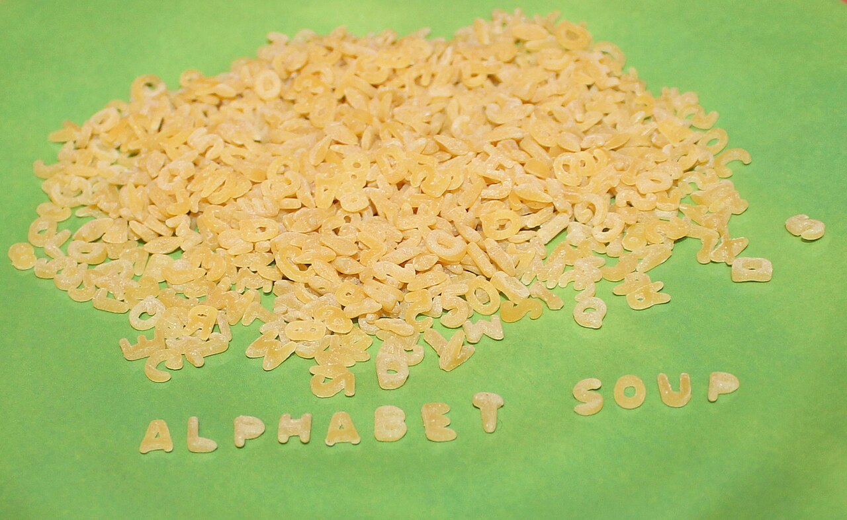
CSCI 3495
Text Processing: Tokenization, Regex & Edit Distance
Natural Language Processing & Large Language Models
Week 1, Class 2 · Wed Aug 26, 2026
Source: Thriving Vegetarian, CC BY 2.0, via Wikimedia Commons

Slide 2

It all starts with raw text
Source: Unsplash License, https://images.unsplash.com/photo-1455390582262-044cdead277a

Slide 3
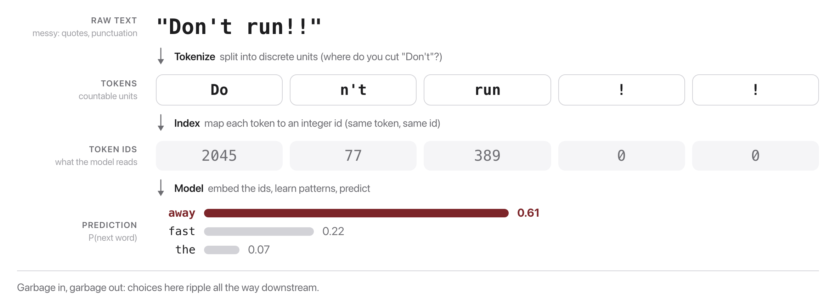
Why text processing?
Source: original figure

Slide 4

How would YOU split a sentence into "words"?
Is "don't" one token or two? What about "New York" or a hashtag? Hold that thought.
Source: Unsplash License, https://images.unsplash.com/photo-1457369804613-52c61a468e7d

Slide 5
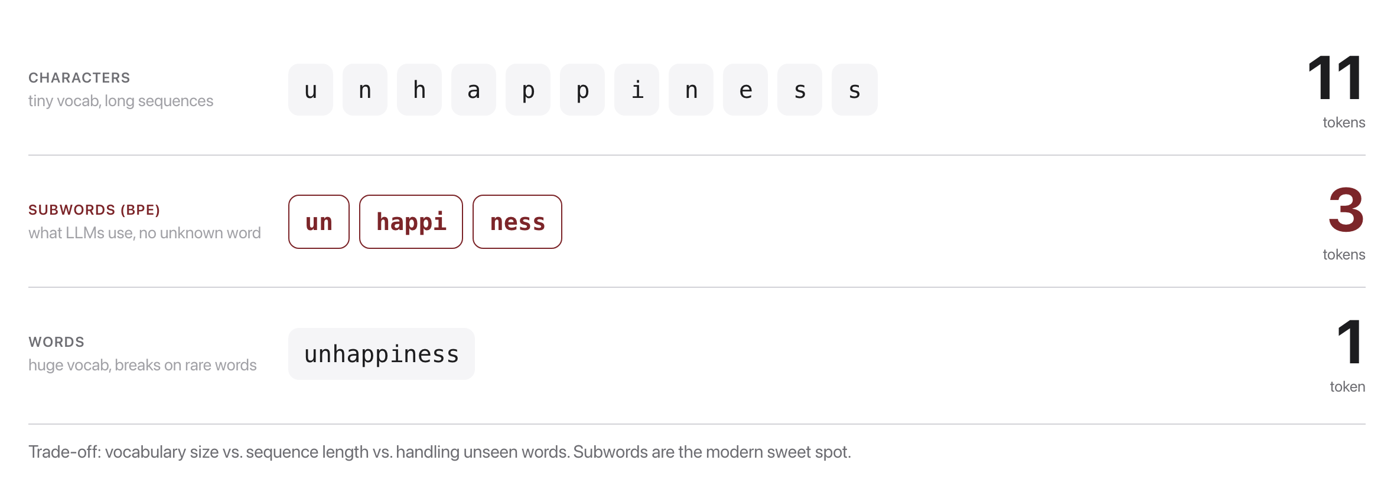
One word, three tokenizations
Source: original figure

Slide 6
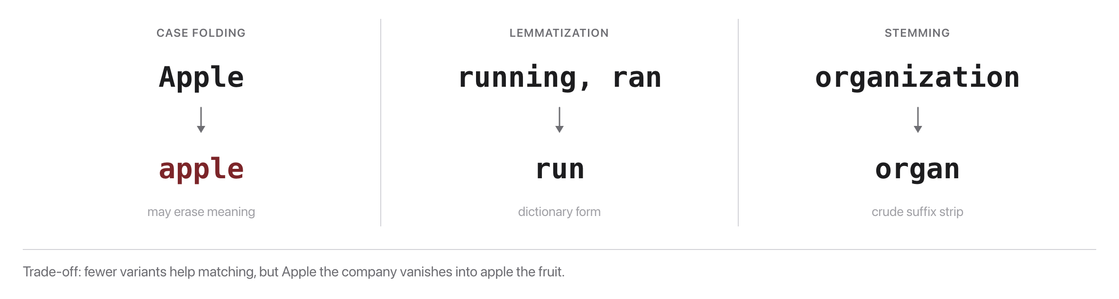
Normalization
Source: original figure

Slide 7
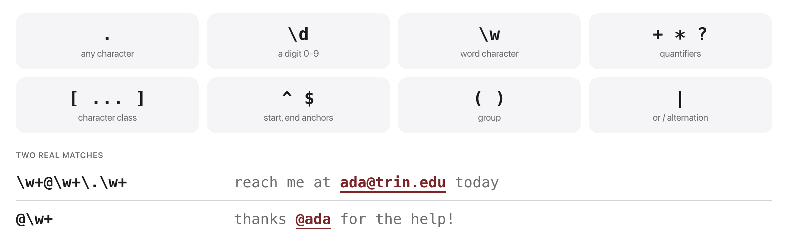
Regular expressions
Source: original figure

Slide 8

Did you mean...?
Source: Unsplash License, https://images.unsplash.com/photo-1456513080510-7bf3a84b82f8

Slide 9
Minimum edit distance
Uses: spell-check, fuzzy matching, word-error-rate, diffing
Source: original animation (Levenshtein; J&M SLP3 Ch. 2)

Slide 10
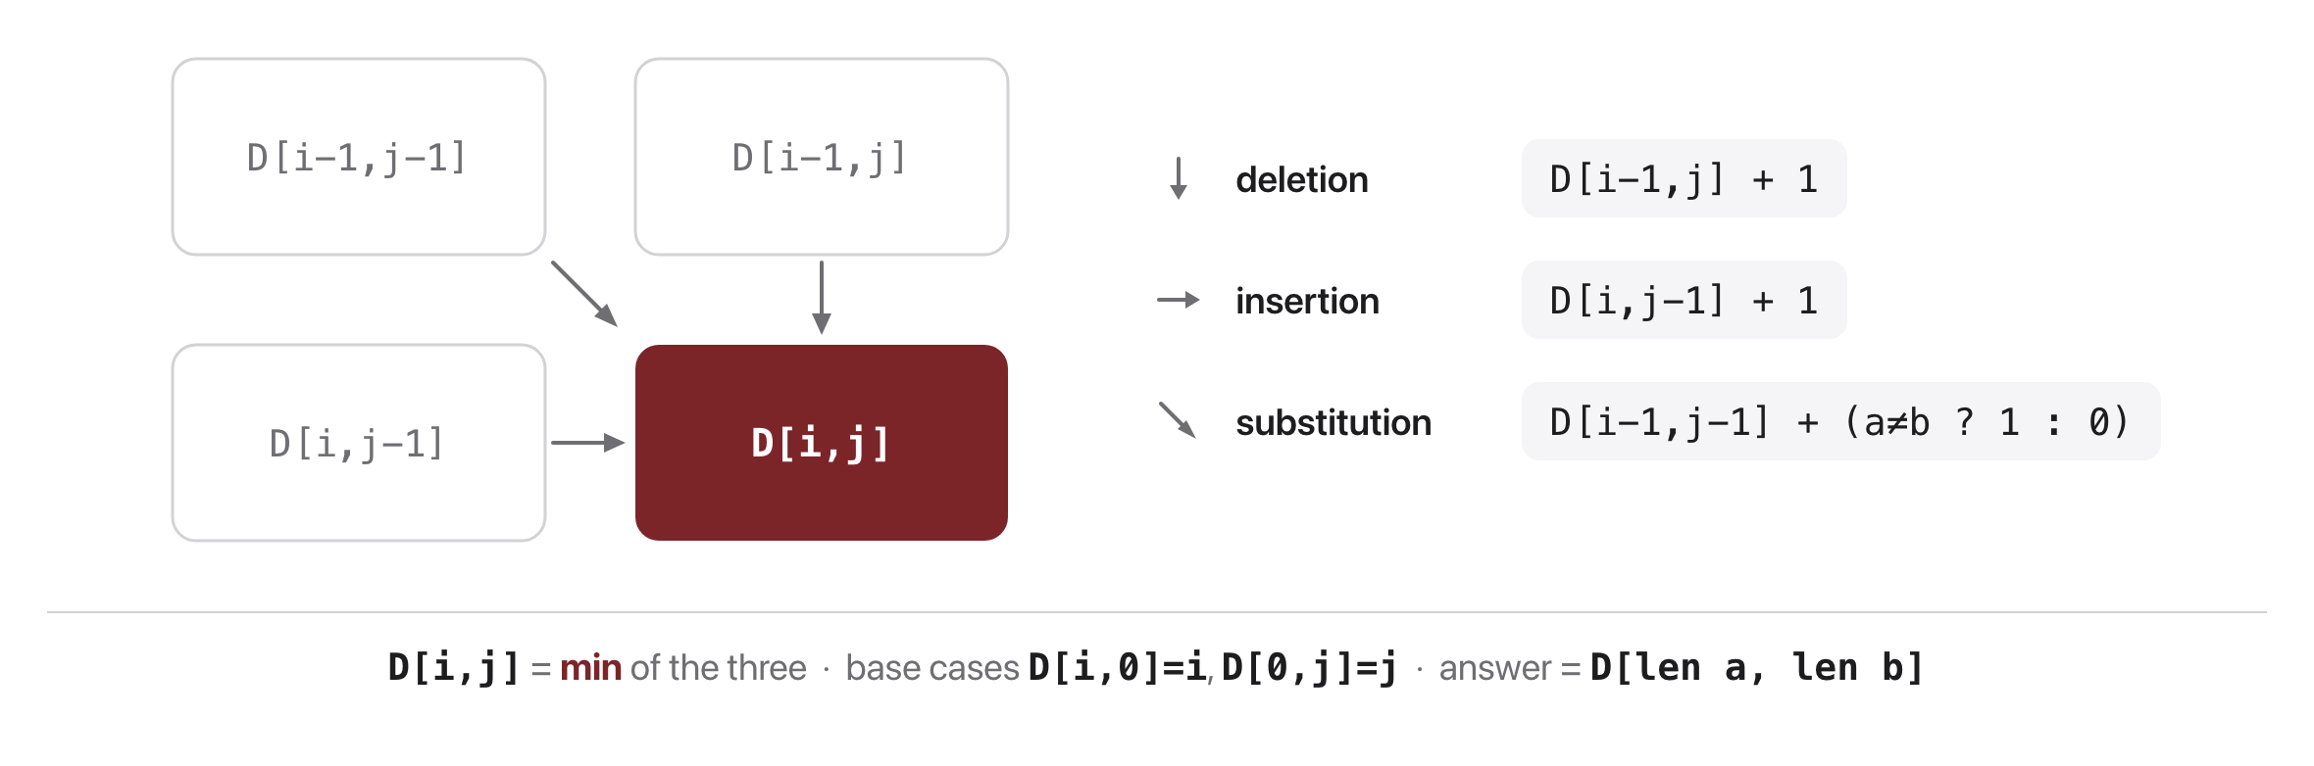
Edit distance: the recurrence
Source: original figure

Slide 11
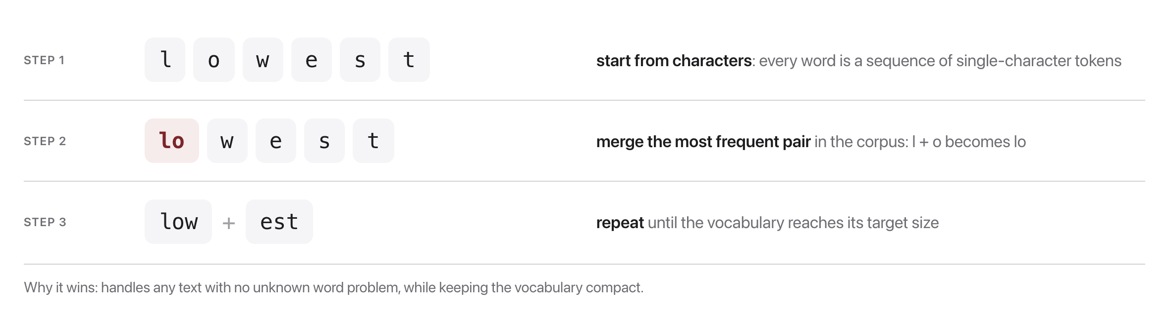
A peek ahead: Byte-Pair Encoding
We build our own BPE tokenizer in Week 10
Source: original figure (BPE: Sennrich et al., 2016)

Slide 12
Watch BPE merge, step by step
Source: original animation (BPE: Sennrich et al., 2016)

Slide 13
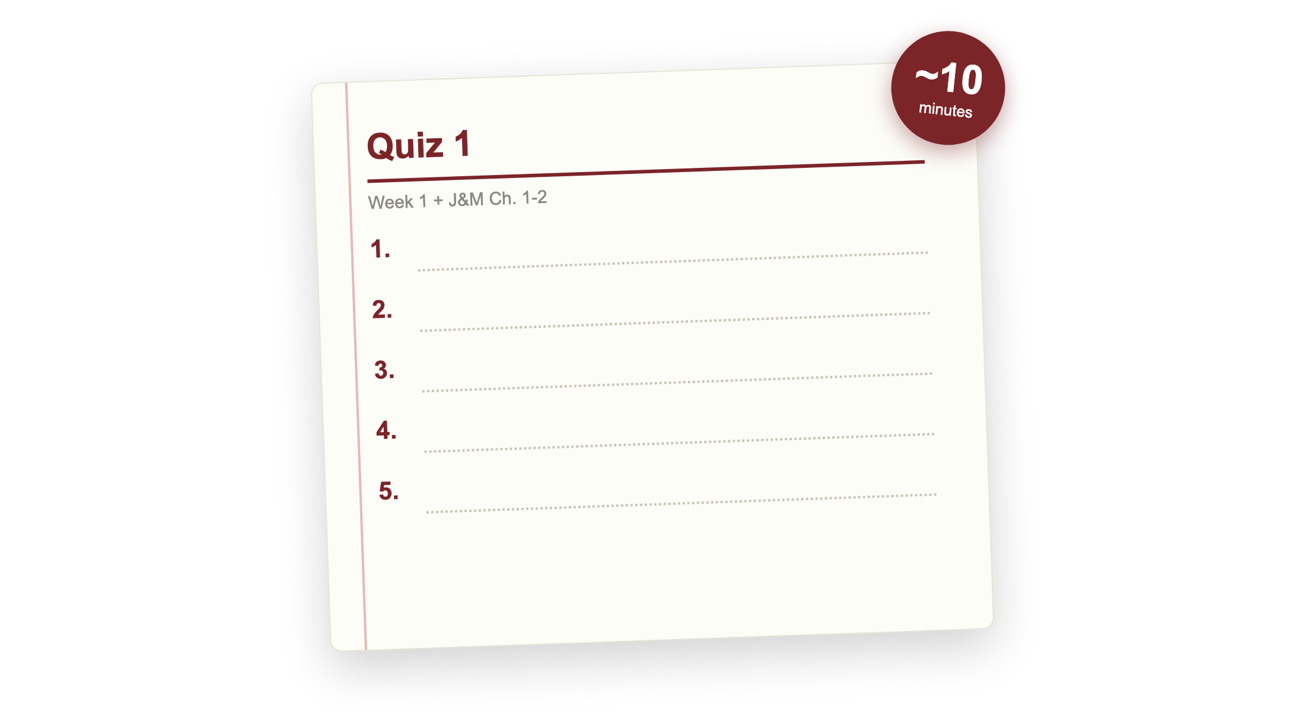
Quiz 1 (paper)
Covers Week 1 lecture and J&M Ch. 1 to 2
Closed book; finish early and your break starts early, need more time and it comes out of the break
Source: original figure

Slide 14

Break
Source: original figure

Slide 15
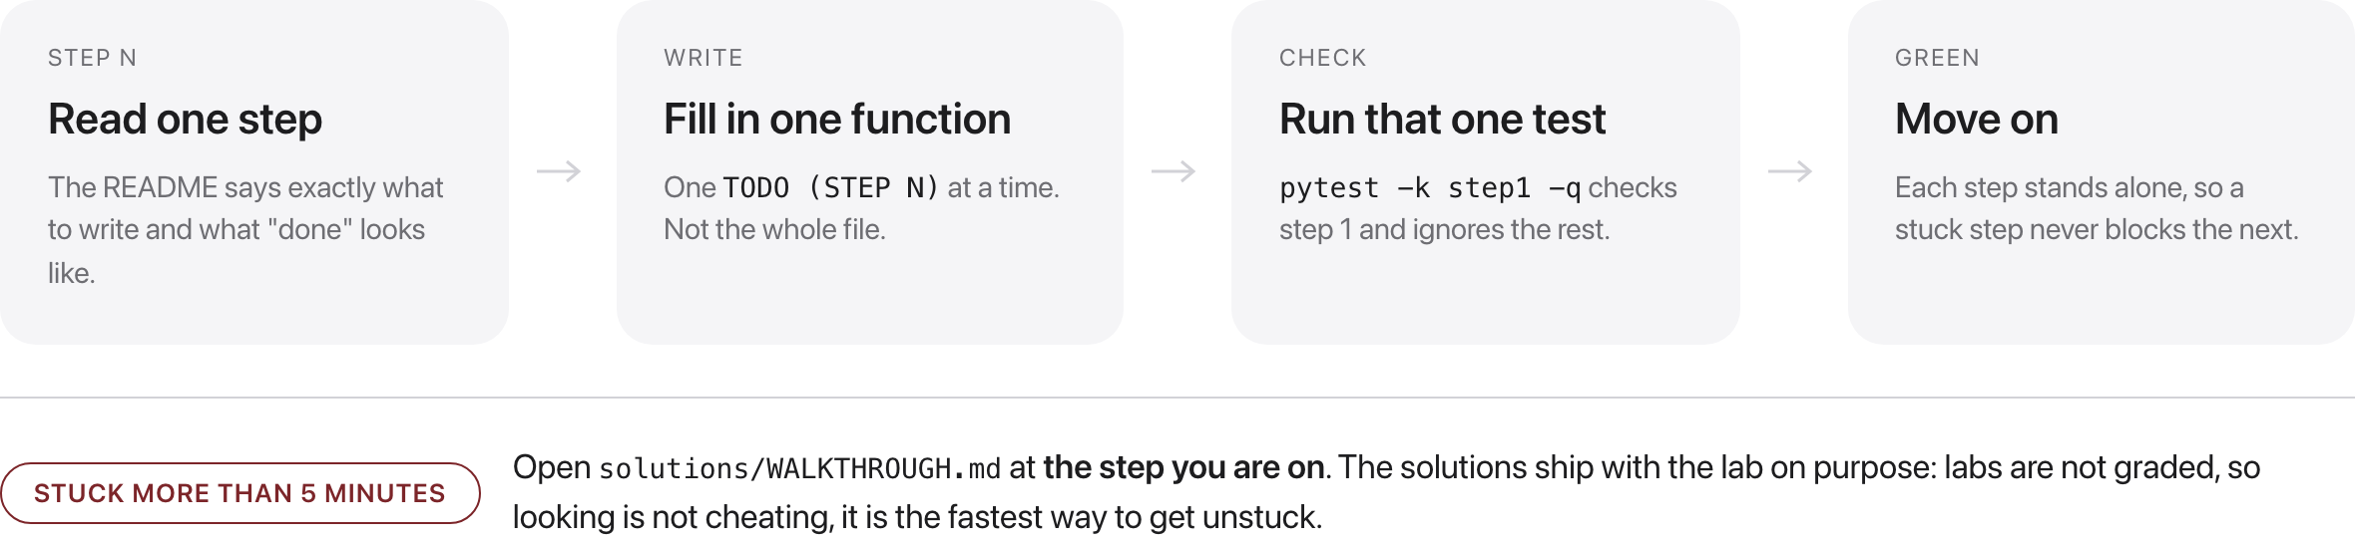
How every lab in this course works
Source: original figure

Slide 16
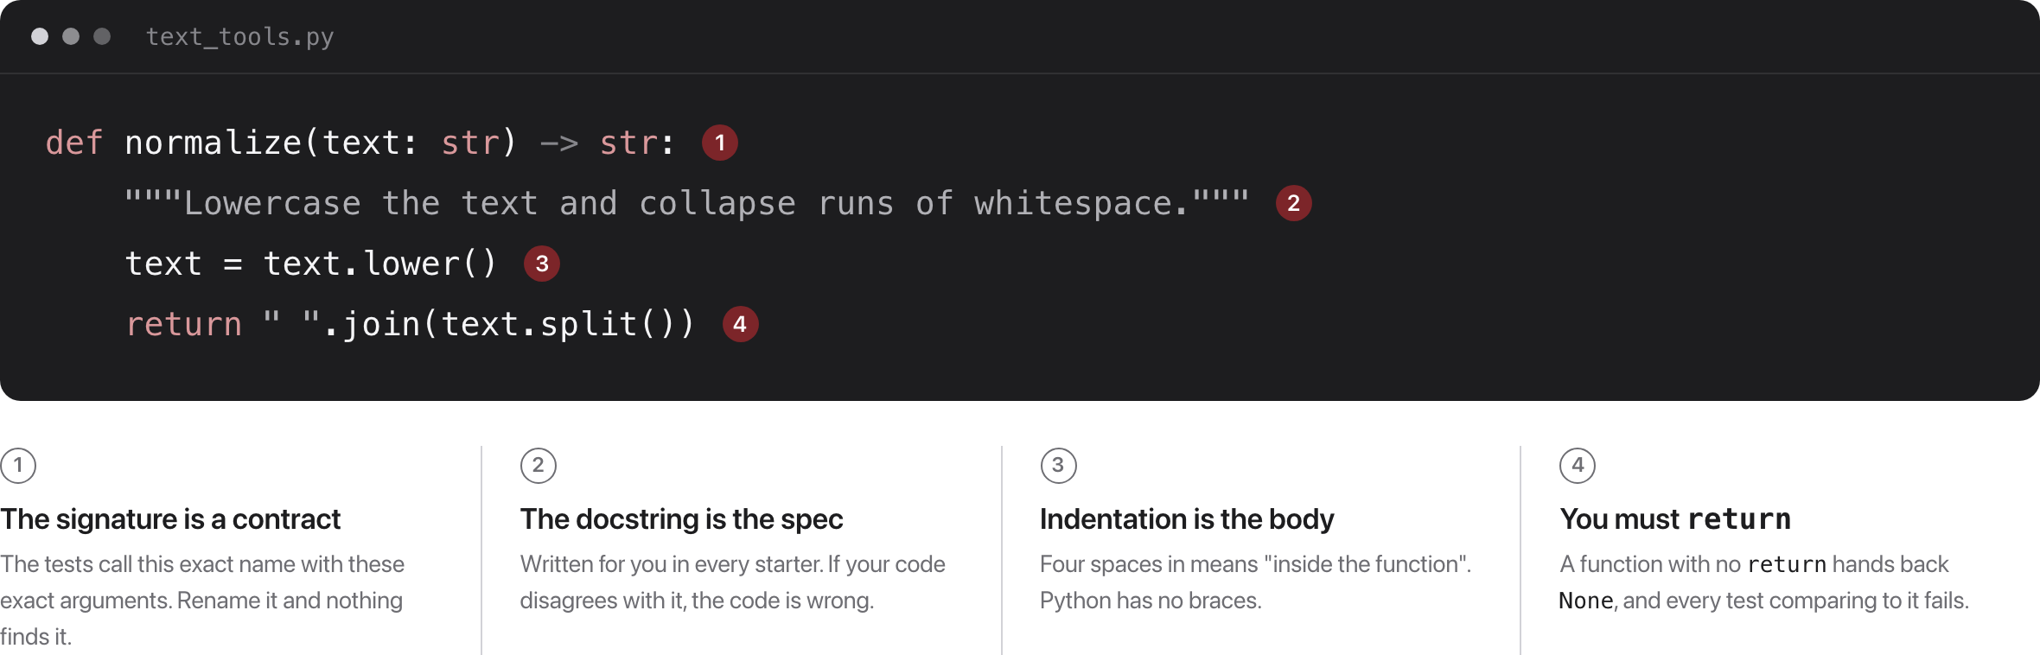
Enough Python for today
The starter gives you the signature and the docstring; you write the body
Source: weeks/week-01/class-02/exercise/text_tools.py

Slide 17
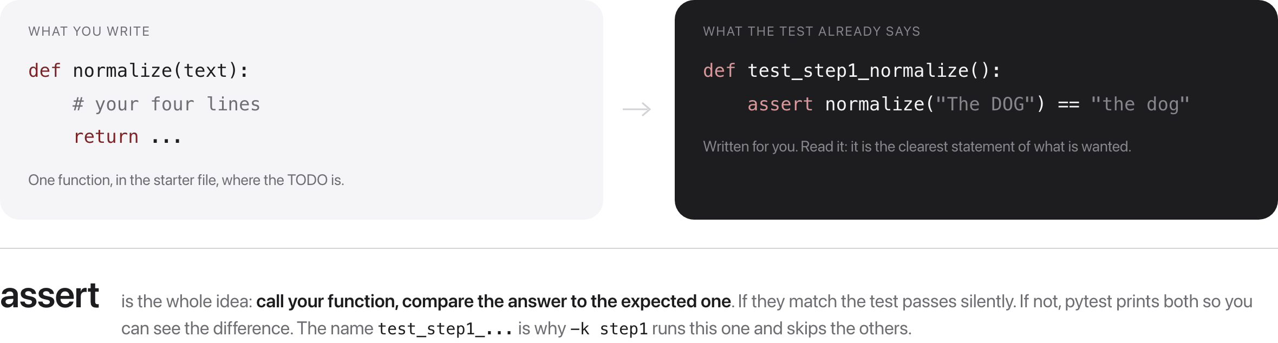
What is a test?
Code that calls your function and checks the answer the step promised
Source: weeks/week-01/class-02/exercise/test_text_tools.py

Slide 18
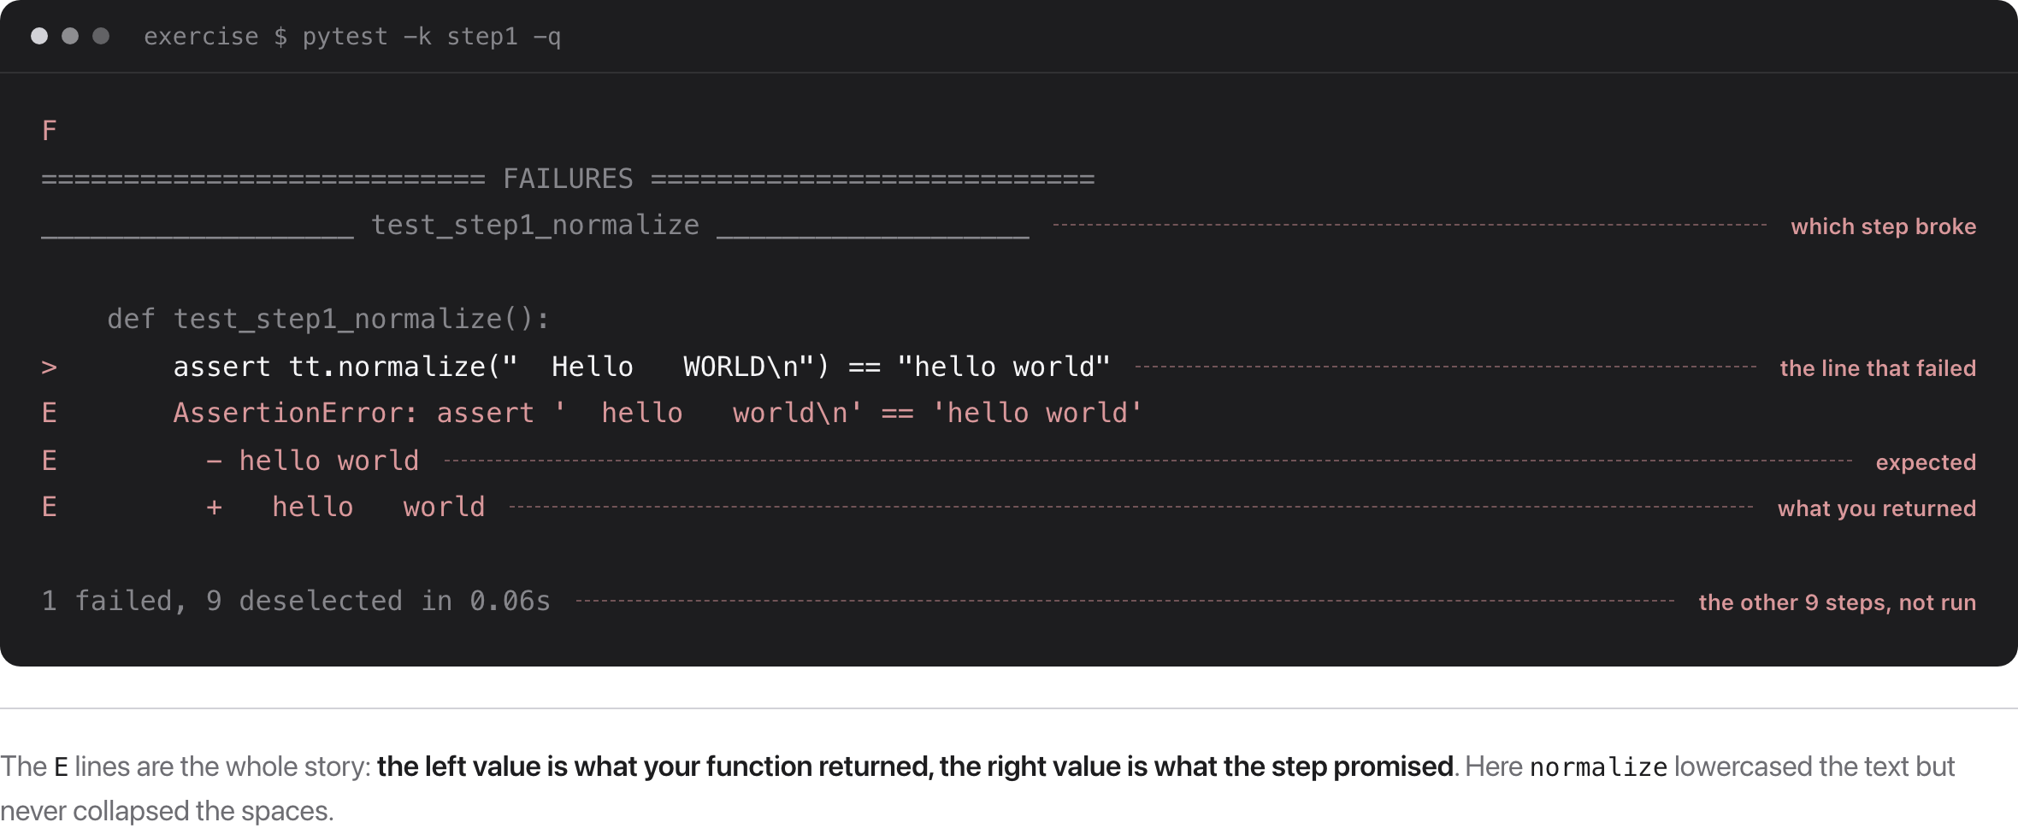
Green is not the goal, the message is
Source: pytest output, week 1 class 2 starter

Slide 19
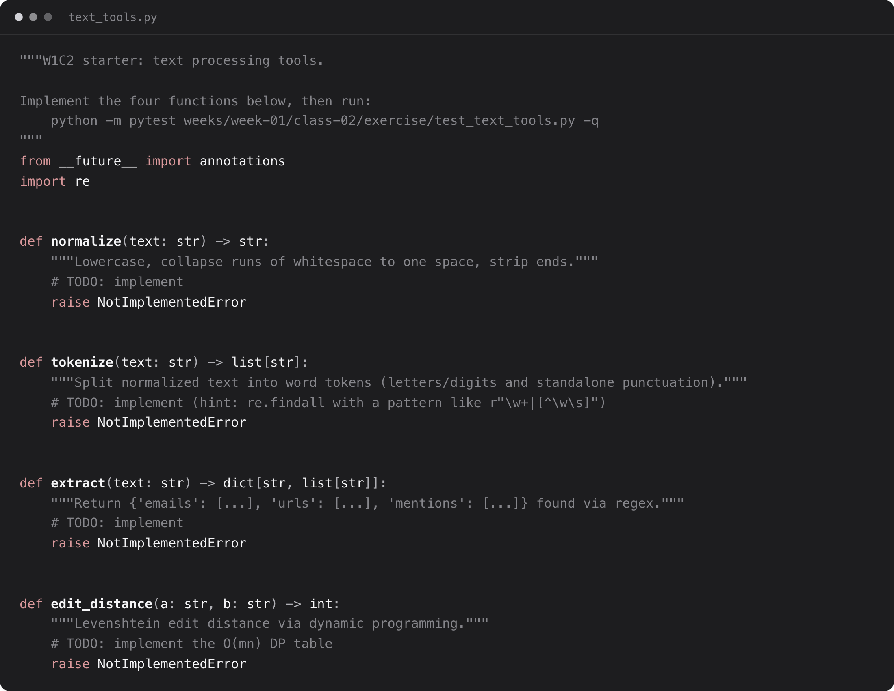
Exercise: build the text tools
Two functions to write: tokenize and edit_distance
normalize and extract are written for you, to read and copy the pattern
Source: weeks/week-01/class-02/exercise/text_tools.py

Slide 20
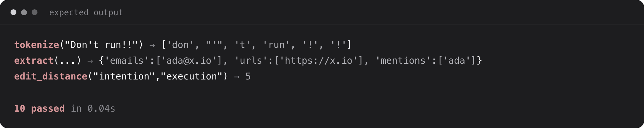
What you should see
All 10 tests green when your four functions are correct
Source: weeks/week-01/class-02/exercise/test_text_tools.py

