Slide 1
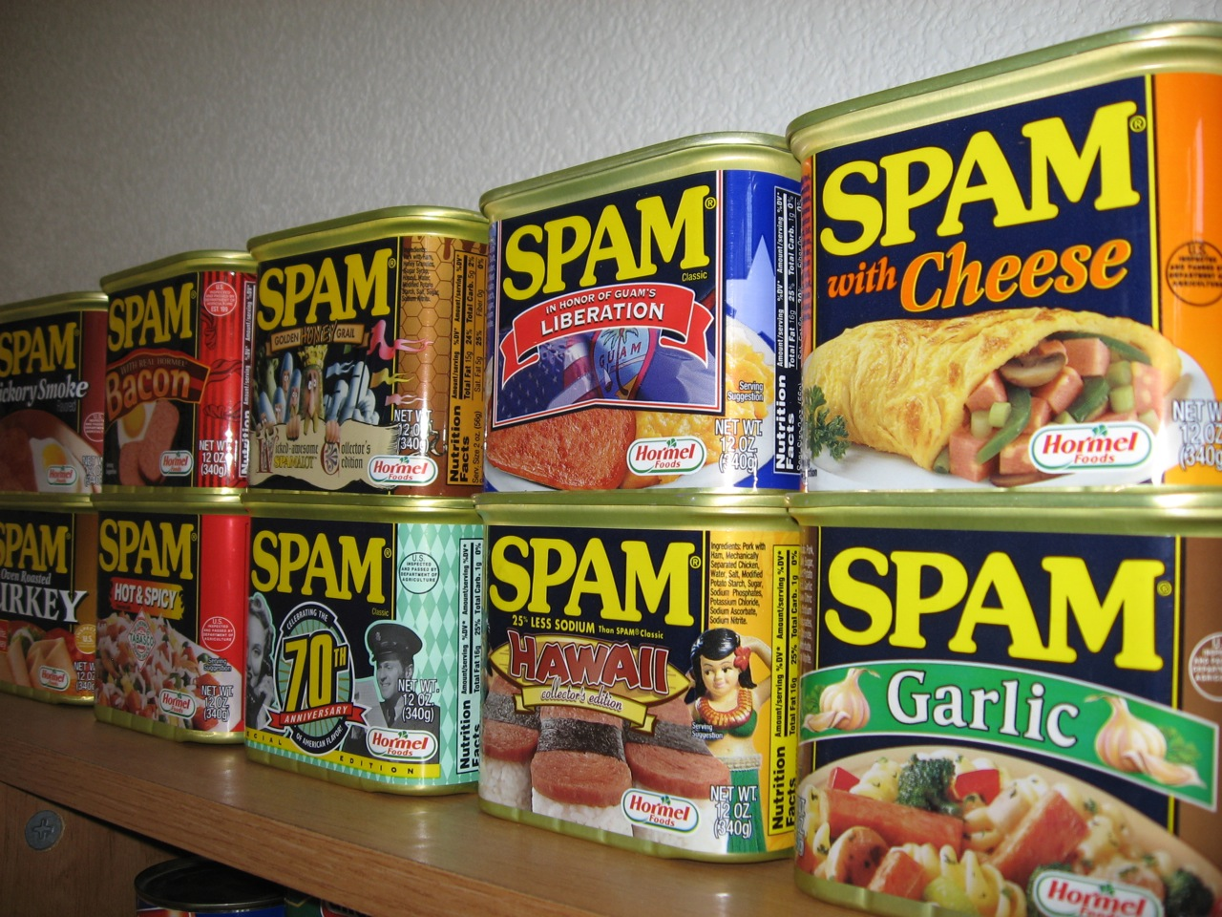
CSCI 3495
Text Classification
Natural Language Processing & Large Language Models
Week 2, Class 2 · Wed Sep 2, 2026
Source: Arnold Gatilao, CC BY 2.0, Wikimedia Commons (SPAM Shrine.jpg)
Notes:
Why is junk email called "spam"? By the end of class you can build the classifier that catches it.

Slide 2

Every inbox is a classifier at work
Source: Unsplash License, https://images.unsplash.com/photo-1450101499163-c8848c66ca85
Notes:
Spam filters, support routing, and review tagging all map a document to a label.

Slide 3
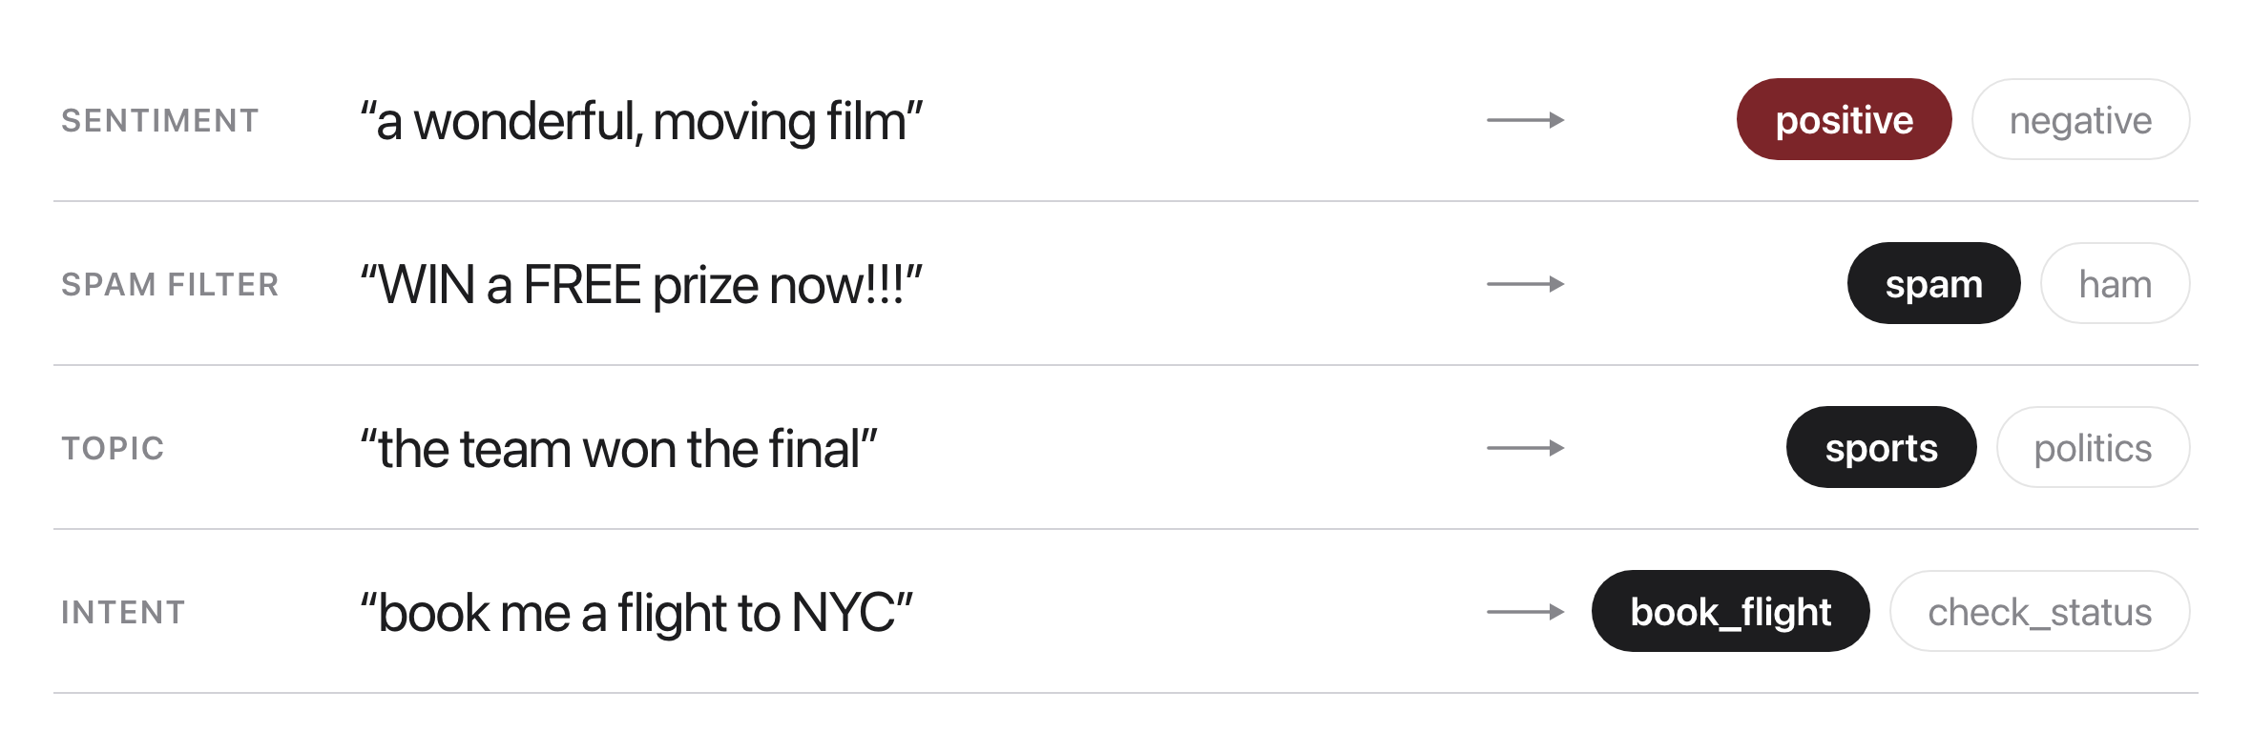
The task
Source: original figure
Notes:
Map a document to one label from a fixed set: sentiment, spam, topic, intent. Supervised: learn from labeled examples, predict on new text Every one of these is the same shape: a document in, one label out.

Slide 4
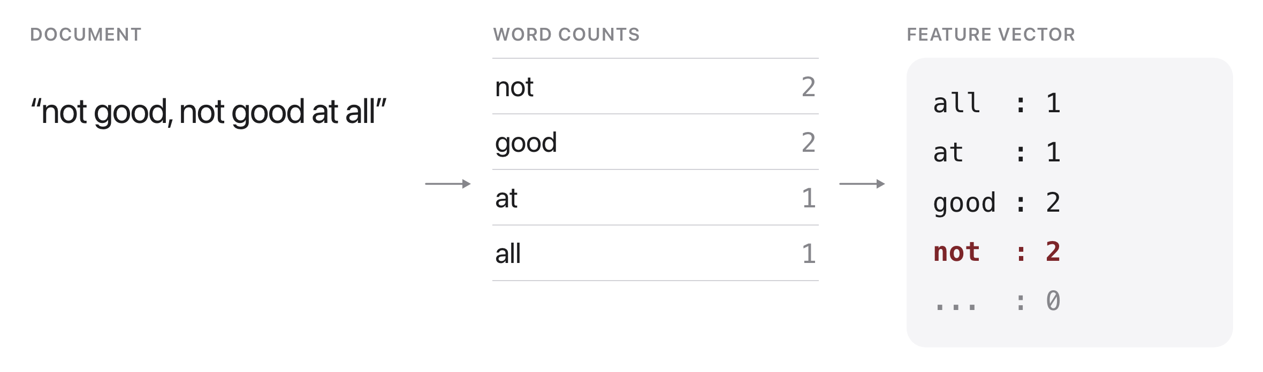
Features: bag-of-words
Source: original figure
Notes:
A document becomes counts of its words; order is thrown away. Cheap and strong, but blind to word order. "good not bad" and "bad not good" map to the same bag. Sequence models in Week 6 and Transformers in Week 7 fix this.

Slide 5

Is this review positive or negative?
Source: Pexels License, https://images.pexels.com/photos/3850250/pexels-photo-3850250.jpeg
Notes:
"It was not bad at all." Decide for yourself, then watch a machine try.

Slide 6
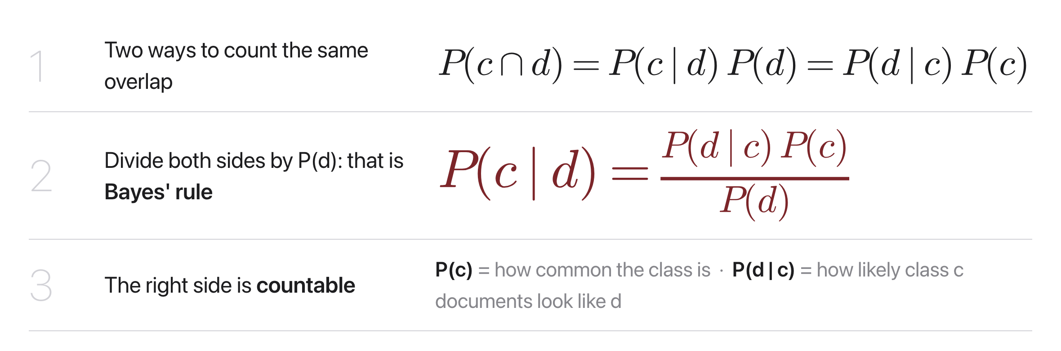
Bayes' rule, from counting
Source: original figure
Notes:
Bayes' rule flips an impossible count into countable pieces. We cannot count P(spam | "win a free cruise") directly. Bayes' rule flips it into two things we can count: how common spam is, and how spam-like those words are.

Slide 7
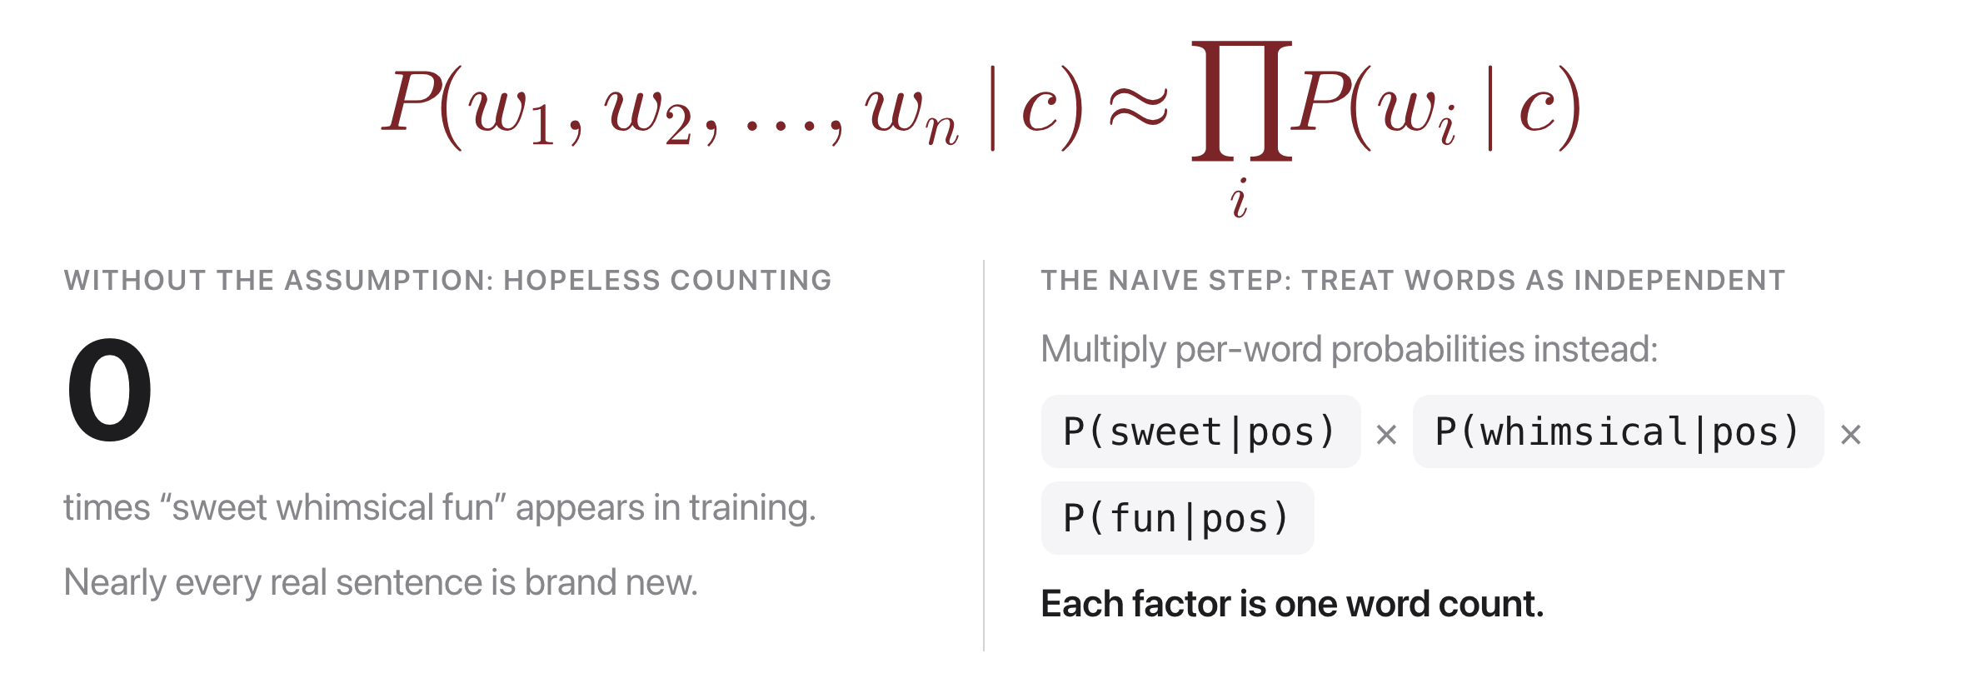
The naive assumption, laid out
Source: original figure
Notes:
Exact sentences never repeat. Treat words as independent and multiply. Naive means pretending each word appears independently given the class, ignoring position and neighbours. That is false for language, and the classifier still works remarkably well.

Slide 8
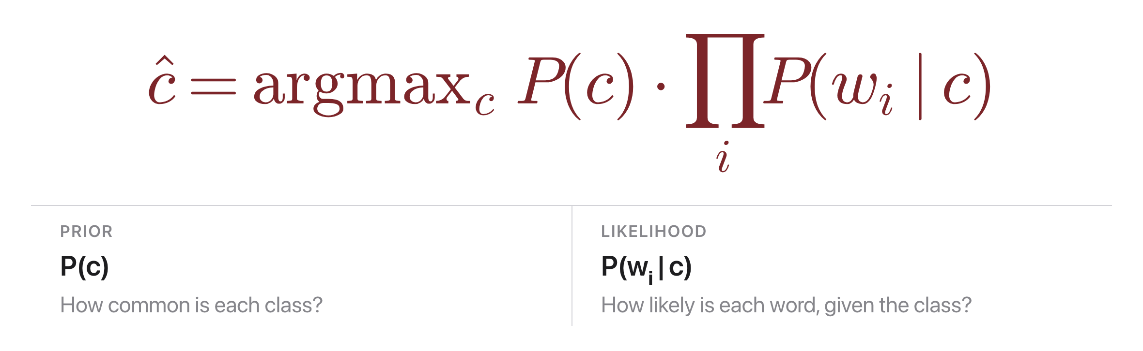
Naive Bayes: the idea
Source: original figure
Notes:
A generative classifier picks the class that best explains the words (Bayes' rule). Naive here means we assume the words are conditionally independent given the class.

Slide 9
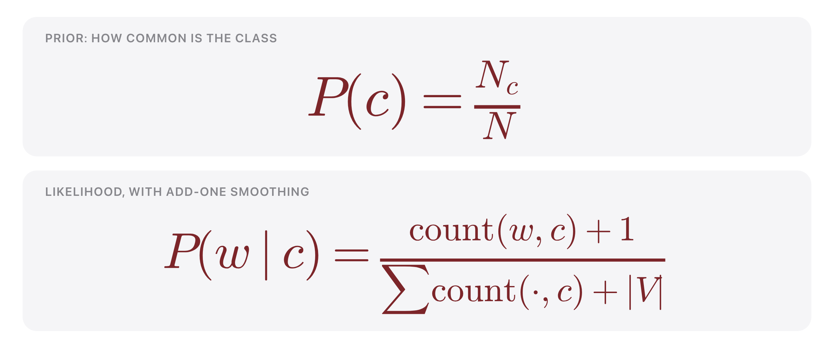
Training Naive Bayes
Source: original figure
Notes:
Just count, with add-one smoothing, the same trick as our language model. No gradient descent needed; training is a single counting pass Work in log space to avoid underflow. Training is one counting pass, which makes this a fast and strong baseline.

Slide 10

The independence assumption
Source: original figure
Notes:
Words aren't really independent ("San" then "Francisco"), yet NB still works well. The assumption is wrong, but Naive Bayes only needs the right class to score highest, not perfectly calibrated probabilities.

Slide 11
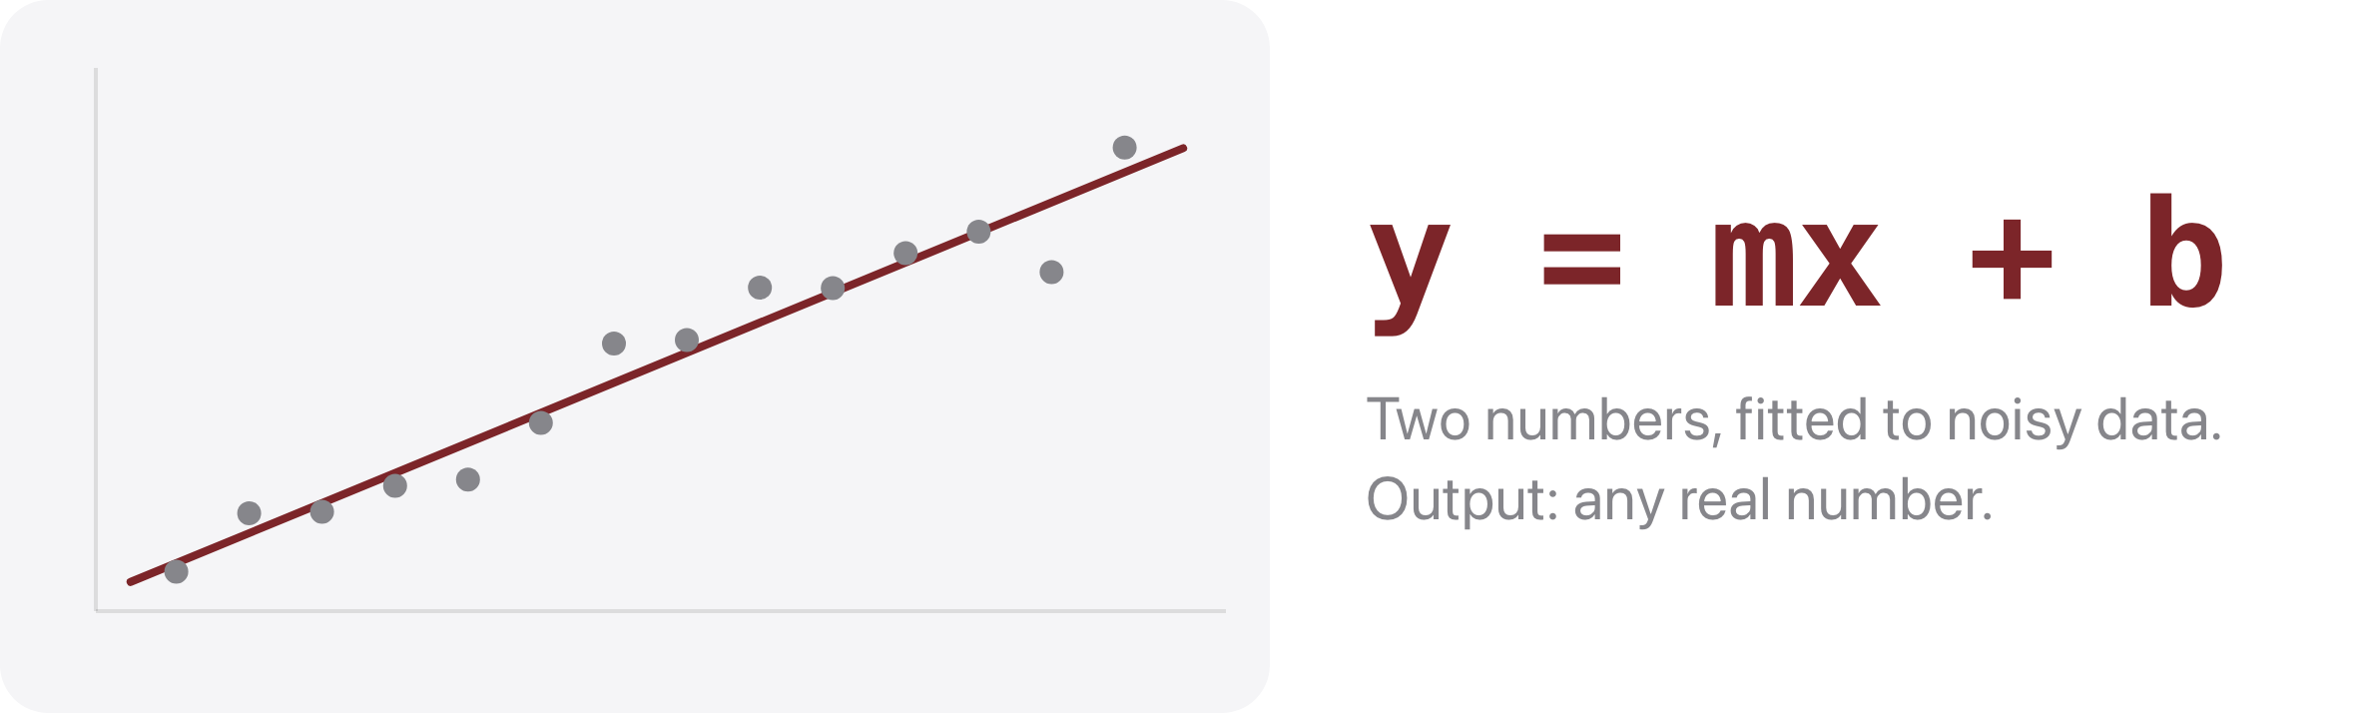
First, the shape you already know
Source: original figure
Notes:
Linear regression fits a straight line through noisy data: pick m and b so the line sits as close to the points as possible. The output is any real number, which is fine when you are predicting a price or a temperature. For classification we need a probability, so it has to land between 0 and 1. Logistic regression does exactly the same fitting, then squashes the answer into that range with the sigmoid. Same w and b, same gradient descent, different output range.

Slide 12
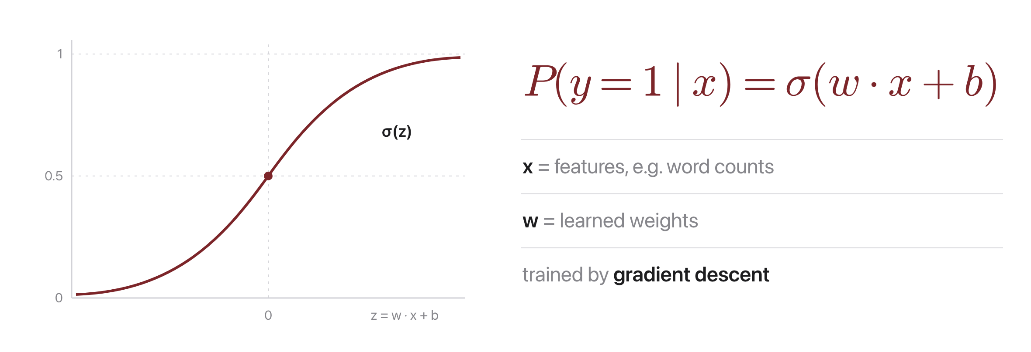
Logistic regression: the idea
Source: original figure
Notes:
A discriminative classifier models P(c | document) directly with the sigmoid. x is the feature vector, w the learned weights; a positive weight pushes toward class 1. Trained by gradient descent on the cross-entropy loss.

Slide 13
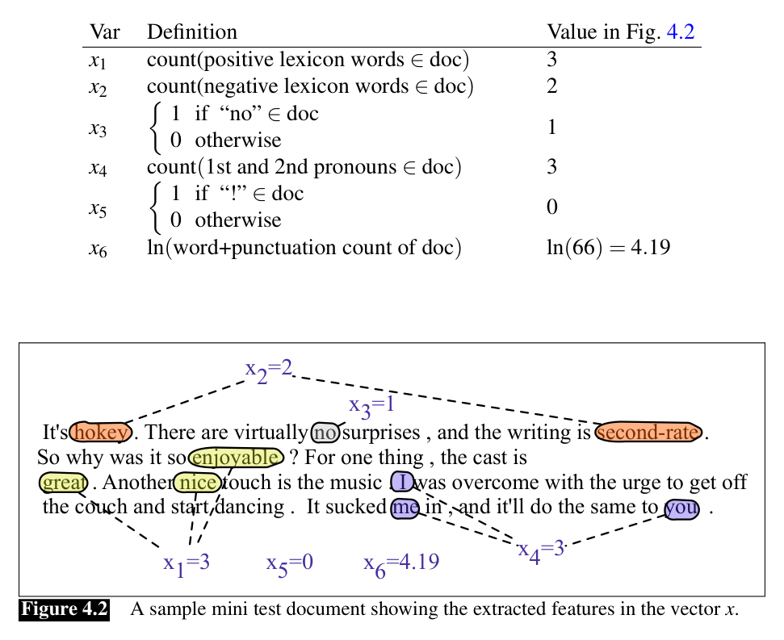
What the model sees: a feature vector x
Source: Jurafsky & Martin, SLP3 (Jan 2026 draft), Fig. 4.2
Notes:
The whole review becomes one vector. That is all the model sees.

Slide 14
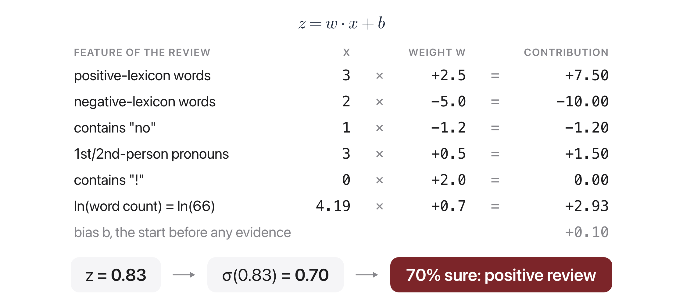
The entire model: multiply, add, squash
Source: Jurafsky & Martin, SLP3 (Jan 2026 draft), Ch. 4.3.1 worked example
Notes:
Each weight votes for a class. The bias is the score before any evidence. Each weight says how strongly its feature votes and for which class. The bias is the starting score before any evidence.

Slide 15
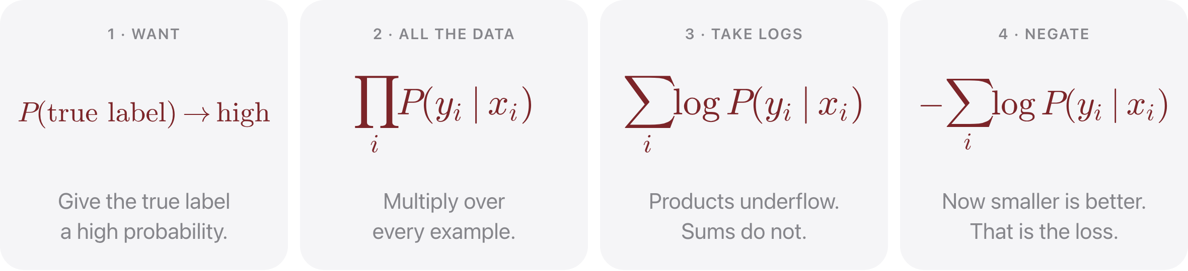
Where does the loss come from?
Source: original figure
Notes:
Start from what you actually want: the model should give the TRUE label a high probability. Across the whole dataset that means multiplying those probabilities together, which is the likelihood. Multiplying thousands of small numbers underflows, so take logs and it becomes a sum. Finally negate it, because optimisers minimise. That is cross-entropy: it is not an arbitrary formula, it is the likelihood written so a computer can descend it.

Slide 16
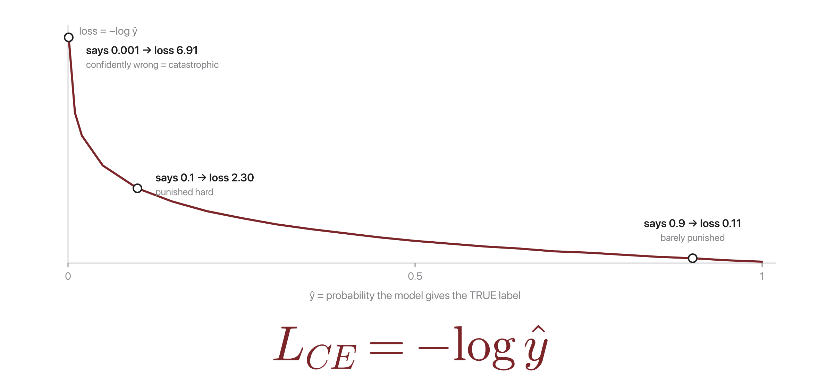
One example, one number
Source: Jurafsky & Martin, SLP3 (Jan 2026 draft), Ch. 4.5, cross-entropy loss
Notes:
For a single example the loss is minus the log of the probability you gave the true label. Read the curve: give the truth 0.9 and you pay almost nothing. Give it 0.1 and you pay 2.3. Give it 0.001 and you pay 6.9. Being confidently wrong is punished enormously, and being confidently right is nearly free. That asymmetry is what pushes the weights.

Slide 17
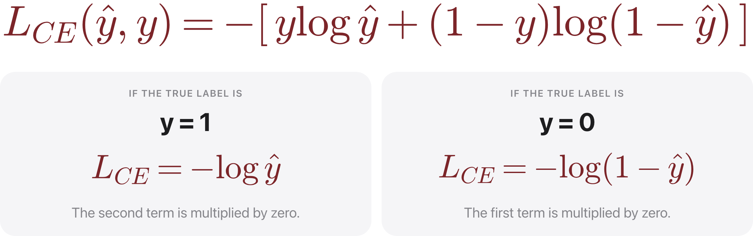
The two-class form
Source: original figure
Notes:
With two classes we write it as one line, and the y and one-minus-y are just a switch. When the true label is 1 the second term vanishes and the loss is minus log y-hat. When the true label is 0 the first term vanishes and the loss is minus log of one minus y-hat. It is the same single-example loss from the previous slide, written so it covers both cases at once.

Slide 18
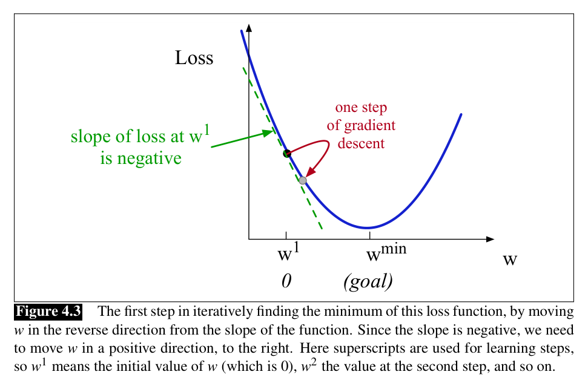
Learning = rolling downhill on the loss
Source: Jurafsky & Martin, SLP3 (Jan 2026 draft), Fig. 4.3
Notes:
The slope says which way is uphill. Step the other way. Repeat. The gradient is the slope, for every weight at once

Slide 19
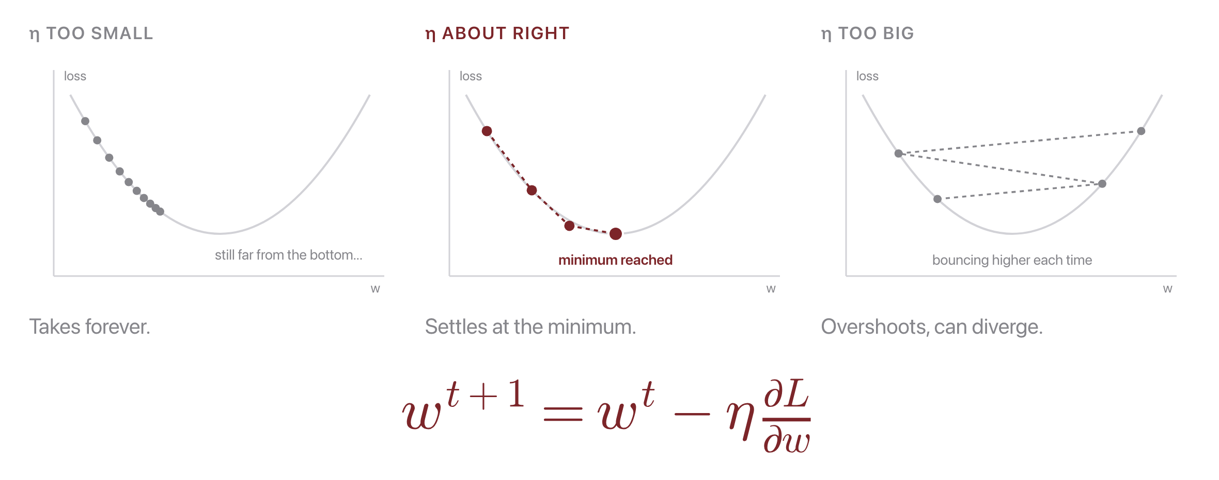
The learning rate sets the step size
Source: original figure; Jurafsky & Martin, SLP3 (Jan 2026 draft), Ch. 4.6
Notes:
The learning rate is yours to choose, not something the model learns. Same valley, three step sizes. The learning rate scales every gradient step, and it is a hyperparameter you choose.

Slide 20
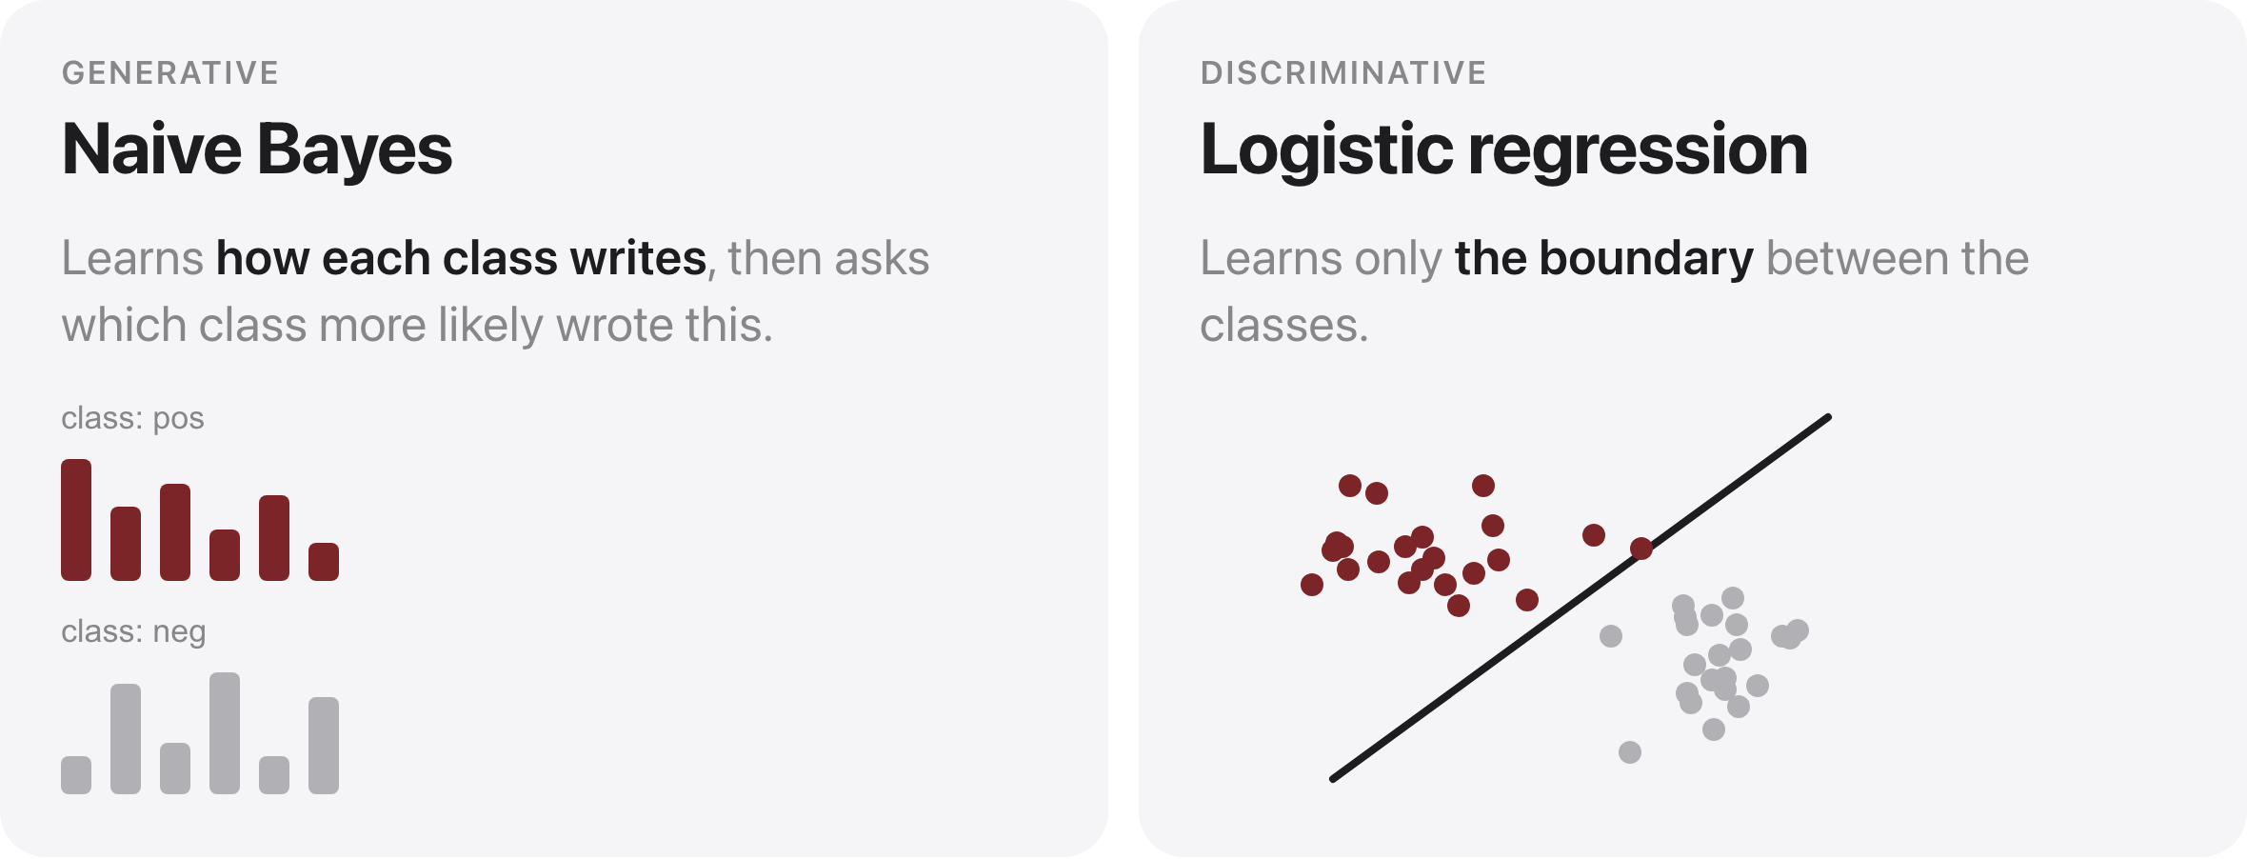
NB vs. logistic regression
Source: original figure
Notes:
Both are linear over bag-of-words; they differ in what they model and how they train. Naive Bayes is generative and wins on small data. Logistic regression is discriminative, handles correlated features, and needs more data.

Slide 21
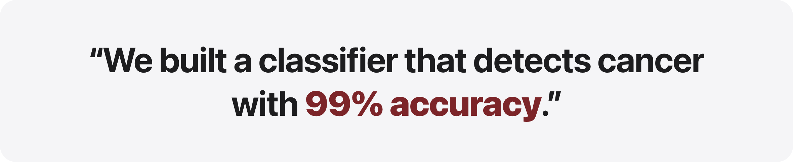
What is wrong with this sentence?
Source: original figure
Notes:
Let them sit with it. Do not answer yet. Take two or three guesses from the room. The claim is not false, it is just uninformative, and almost nobody spots why on the first read. Prompt if needed: what would happen if the classifier never said "cancer" at all?

Slide 22
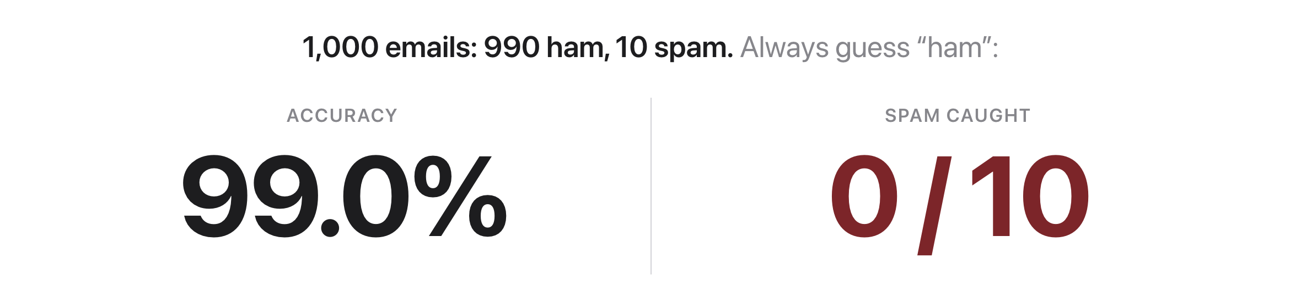
Accuracy hid the only case that mattered
Source: original figure
Notes:
Accuracy alone misleads on imbalanced data; look at which kind of error happens. 990 of 1,000 correct looks great on a report, and it is a total failure on the one class we care about.

Slide 23
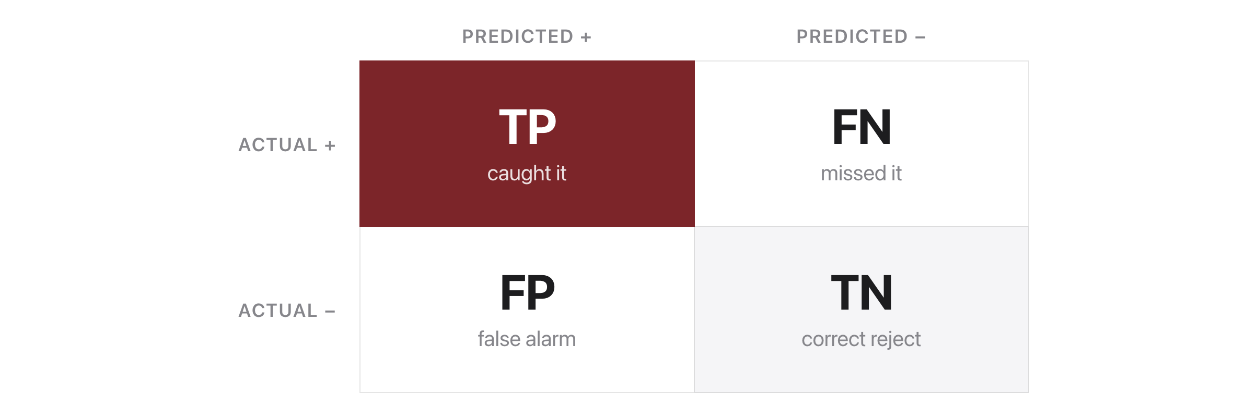
The confusion matrix
Source: original figure
Notes:
Four outcomes for a target class: TP, FN, FP, TN. TP and TN are correct, FP is a false alarm, FN is a miss.

Slide 24
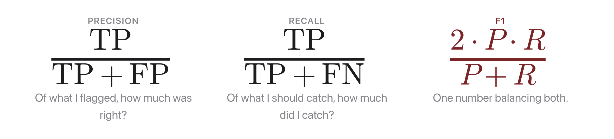
Precision, recall, F1
Source: original figure
Notes:
Precision avoids false alarms; recall avoids misses; F1 is their harmonic mean. There is a real trade-off: pushing recall up usually drags precision down, and the other way round.

Slide 25
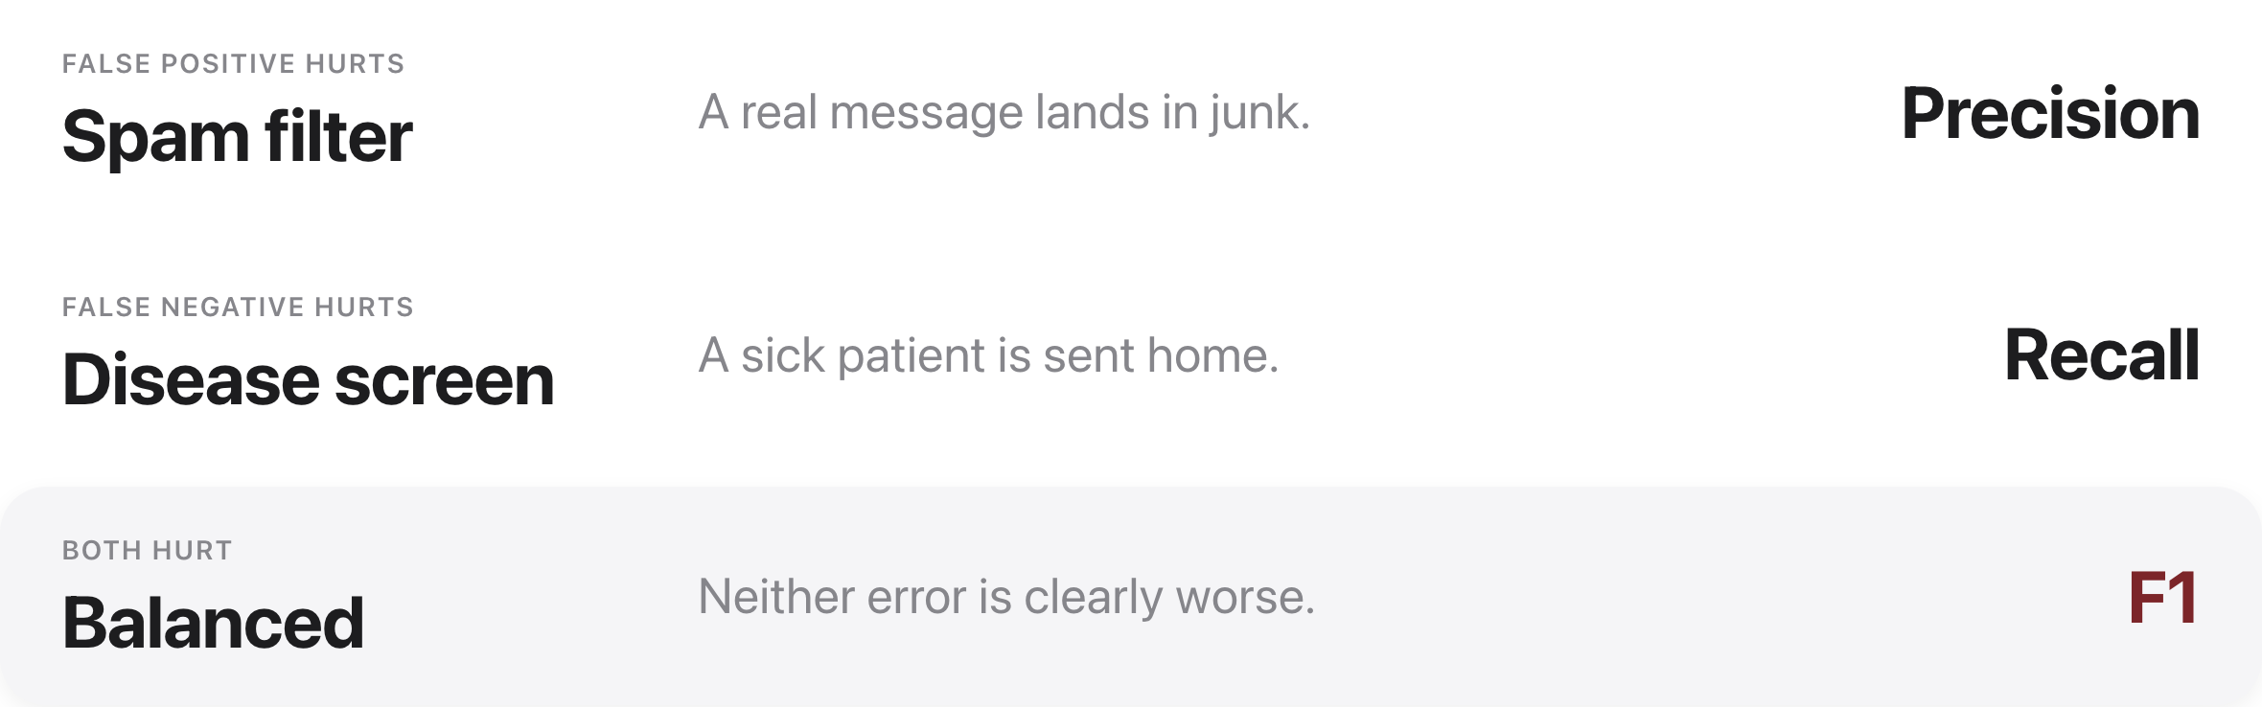
Which metric matters?
Source: original figure
Notes:
Match the metric to the cost of errors, and always use a held-out test set. Match the metric to what the mistake costs you.

Slide 26

Quiz 2 (paper)
Source: original figure
Notes:
Covers the Week 2 lecture plus the reading. Clear your desk. Finish early and your break starts early; need more time and it comes out of the break.

Slide 27

Break
Source: original figure

Slide 28
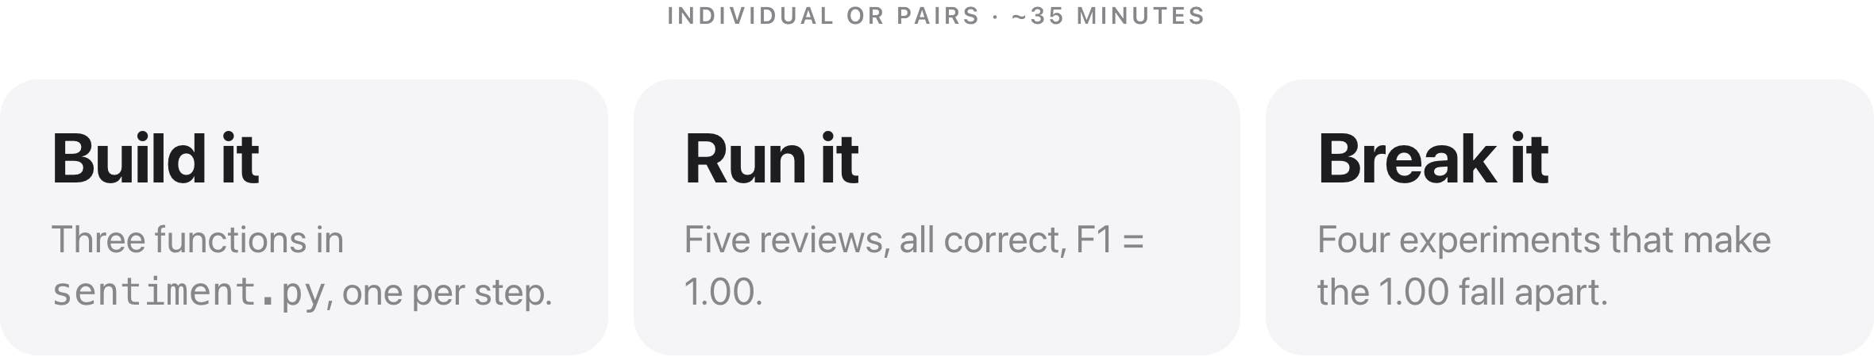
Sentiment Showdown
Source: weeks/week-02/class-02/exercise/sentiment.py
Notes:
Three functions, then run it, then break it. The 1.00 they get is not evidence of anything, and the last third of the period is spent finding out what it hides.

Slide 29
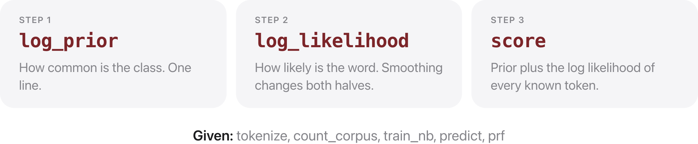
Three functions to write
Source: weeks/week-02/class-02/exercise/sentiment.py
Notes:
log_prior and log_likelihood are one line each. score is the one that matters: prior plus the log likelihood of every token the model has seen, skipping the rest, adding logs rather than multiplying probabilities. Everything else in the file is written for them.

Slide 30
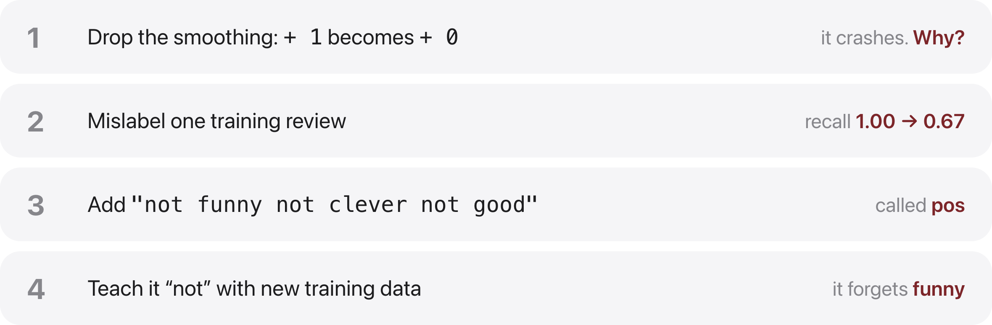
Then break it
Source: weeks/week-02/class-02/exercise/sentiment.py
Notes:
Four experiments, all one-line edits. Dropping the smoothing crashes on a zero probability. Mislabelling one review moves recall but not precision, and asking why is the point. The negation review shows what a bag of words cannot represent. And the fix, teaching it 'not' with new data, costs it the word 'funny', which is the lesson: fixing one failure with data can break another.

Slide 31
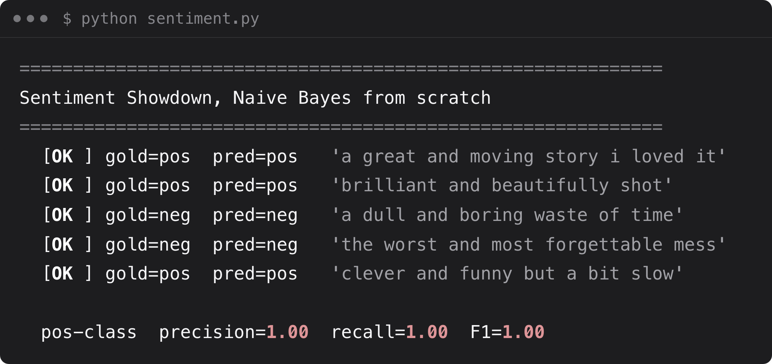
What you should see
Source: example run, solutions/sentiment.py
Notes:
All five test reviews classified correctly; precision, recall, and F1 all 1.00. Then break it: add a tricky review and watch the metrics move

