Slide 1
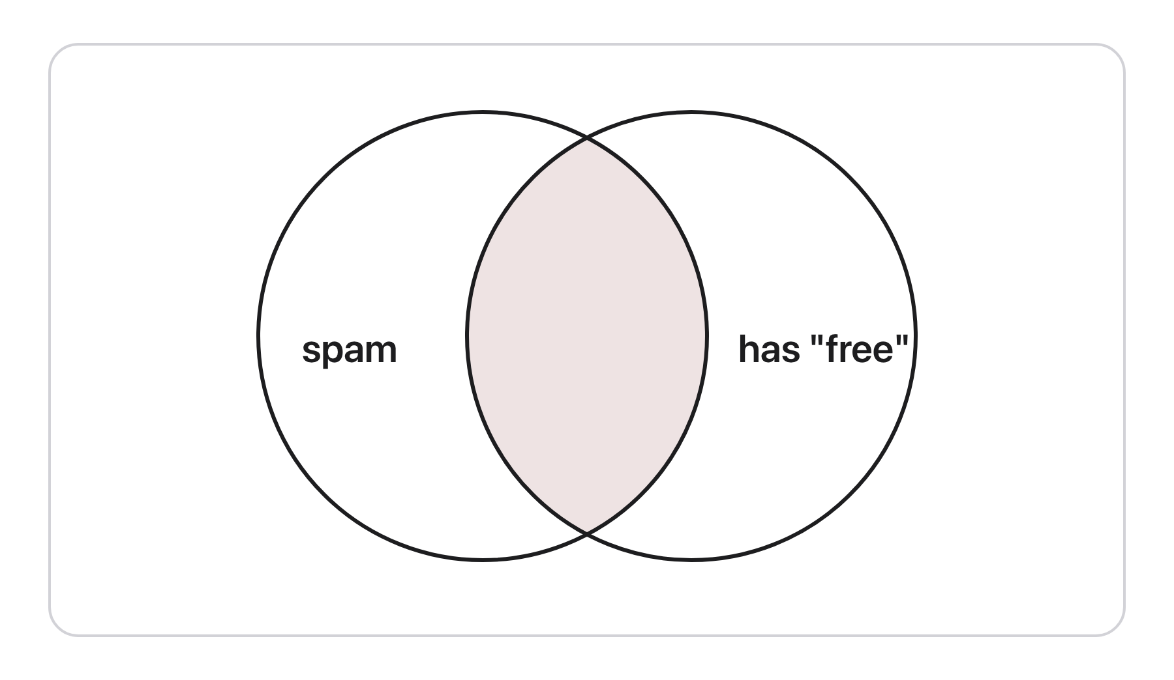
CSCI 3495
Probability for NLP
Natural Language Processing & Large Language Models
Week 4, Class 1 · Mon Sep 14, 2026
Source: original figure
Notes:
Whiteboards and markers today, laptops shut the whole period. Every probability in this course is a count divided by another count, and by the end of the hour they will have computed a bigram language model by hand without being told that is what they are doing. The rules go up once, all eight together, and then we read every one of them off a single table of twenty reviews.

Slide 2
What is Probability?

Slide 3
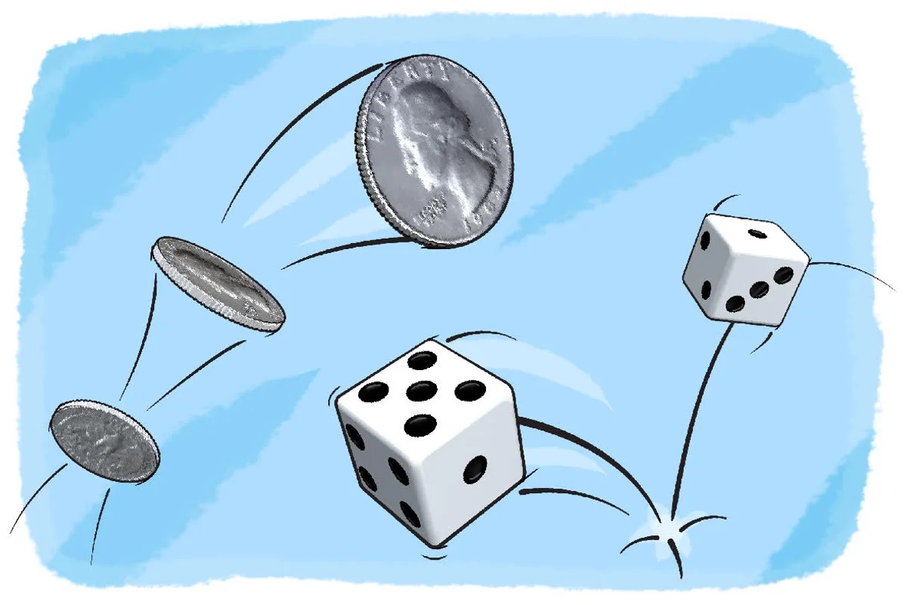

Slide 4


Slide 5
Every one of these is a count, divided
PROBABILITY
P(A) = count(A) / N
AND
P(A ∩ B)
OR
P(A ∪ B) = P(A) + P(B) - P(A ∩ B)
GIVEN
P(A | B) = P(A ∩ B) / P(B)
CHAIN RULE
P(A ∩ B) = P(A | B) P(B)
INDEPENDENCE
P(A ∩ B) = P(A) P(B)
BAYES'S RULE
P(A | B) = P(B | A) P(A) / P(B)
TOTAL PROBABILITY
P(B) = P(B|A) P(A) + P(B|¬A) P(¬A)
Source: original figure
Notes:
Eight lines, and the first one is the only definition: count the items that are A, divide by N. Everything under it is that definition rearranged. Draw the Venn on the board as you say "or", because subtracting the overlap is the step they skip. Say the two that matter most out loud: P(A given B) and P(B given A) are different numbers, and Bayes is the rearrangement that gets you from the one you can count to the one you want. The last line is the one teams forget an hour from now, so read it rather than letting it sit there.

Slide 6
Twenty app reviews, counted
 | HAS "CRASHES" | NO "CRASHES" | TOTAL
1 star | 7 | 3 | 10
4-5 star | 1 | 9 | 10
total | 8 | 12 | 20
FOUR OF THE TWENTY
1 STAR crashes every time I open it
1 STAR unusable since the update
4 STAR much faster since the update
5 STAR fast, and it never crashes
Source: original figure
Notes:
Twenty reviews, half of them one star, and the word "crashes" in eight of them. Every number on the next slide comes out of those four inner cells. Read the last review out loud: "never crashes" is a five star review that contains the word, which is the honest reason a count of words is only ever an approximation.

Slide 7
How would you compute each of these?
1
P(1 star), P(crashes), P(crashes ∩ 1 star)
2
P(crashes ∪ 1 star)
3
P(1 star | crashes) and P(crashes | 1 star)
4
Is P(crashes ∩ 1 star) = P(crashes) × P(1 star)?
5
"update" is in 10, five of them 1 star. Same question.
6
Flagger catches 80% of 1 star, 20% of the rest. P(1 star | flagged)?
Source: original figure
Notes:
Do not solve these on the slide. Take them one at a time, ask the room which two counts go on top and underneath, and write only the fraction on the board before anyone reaches for a calculator. The answers are in the instructor notes. Four and five are the pair worth the most time: same test, opposite answers, and that is what makes one word a useful feature and the other one dead weight. Six is the only one that needs the last line of the rules slide.

Slide 8

Break
Source: course-standard break figure

Slide 9
Twenty messages, counted
 | HAS "FREE" | NO "FREE" | TOTAL
spam | 5 | 3 | 8
ham | 1 | 11 | 12
total | 6 | 14 | 20
FOUR OF THE TWENTY
SPAM claim your free prize
SPAM urgent: verify your account
HAM free parking in lot B this week
HAM can we move the meeting
Source: original figure
Notes:
A second corpus, and this one they work themselves. Twenty messages, eight of them spam, six containing the word "free", five of those both. Leave this up for the rest of the period, or copy it onto a side board, because problems one to five are all read off these four inner cells.

Slide 10
Six problems, in teams
1
P(spam), P(free), P(free ∩ spam)
2
P(free ∪ spam)
3
P(spam | free) and P(free | spam)
4
Is P(free ∩ spam) = P(free) × P(spam)?
5
"meeting" is in 5, two of them spam. Same question.
6
Filter flags 90% of spam, 10% of ham. P(spam | flagged)?
Source: original figure
Notes:
Teams of three or four, one board each, markers out, thirty minutes. Hand out one and two first, then three and four once most boards have something. They have seen this shape once already on the review corpus, so do not re-explain it; work the room instead. The most useful thing you can say to a stuck team is "point at the messages you are counting", which fixes almost every wrong number.

Slide 11
If you finish early
THE WHOLE CORPUS
the cat sat
the cat ran
the dog sat
a cat sat
WORK OUT
P(the cat sat)
= P(w1) × P(w2 | w1) × P(w3 | w2)
Source: original figure
Notes:
A four-sentence corpus and the chain rule with each word conditioned on the one before it. The answer is three quarters times two thirds times two thirds, which is exactly one third. A team that gets here has computed a bigram language model by hand, and telling them so afterwards is the best two minutes of the period.

