Slide 1
CSCI 3495
How scary is it? Boo!
Natural Language Processing & Large Language Models
Week 4, Class 2 · Wed Sep 16, 2026
Source: original figure, the loss from the run we do in class
Notes:
Laptops open, notebook open, and the first half of it empty on purpose. One problem today, start to finish: a hundred and twenty horror films, a pile of audience reviews for each, and an audience scariness score out of ten. We have the words, we want the number. That curve is the loss from the model we are about to build, falling as it learns. Say the rule once and mean it: if I am typing, you are typing.

Slide 2


Slide 3


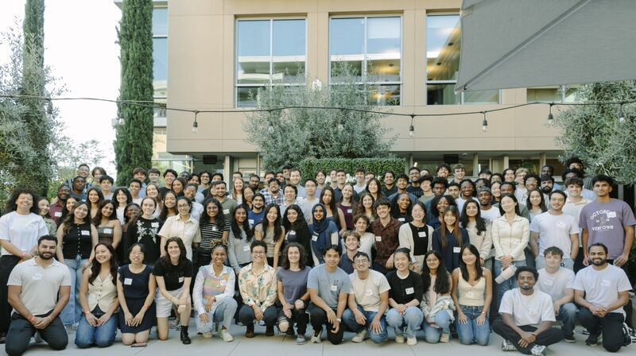


🎊
🎉
🎉
🎉

Slide 4

Ohh No!!!!
Netflix users are filing lawsuits cause Netflix is recommending too scary movies.

Slide 5

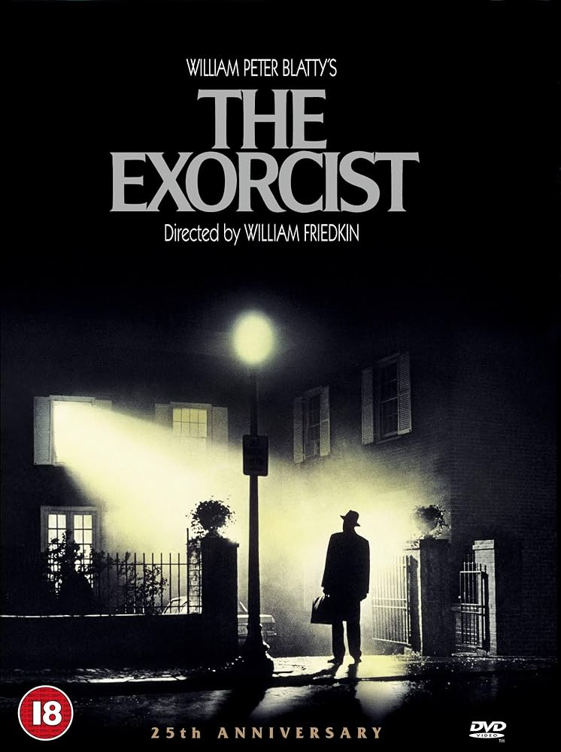

Your first assignment:
Detect the scariness of movies based on move reviews

Slide 6
Example Reviews
LOW SIGNAL, 2012
"The score is chilling and never lets up. That long hallway shot is unsettling. I found the whole thing terrifying. The sound design alone is ominous. The third act is gory."
9.6 out of 10
SALT CHAPEL, 2015
"It gets silly once the twist lands. A tame retread of better films. Every beat is predictable. The third act is brutal. Ninety minutes, no padding."
1.6 out of 10
Source: two films from the course corpus
Notes:
Read both reviews out loud and then cover the numbers. Ask the room which film scored higher, and everybody gets it right instantly, which is the point: the answer is sitting in the words and every one of us can see it. Now the hard part. The score is a number and the review is a string, and nothing in PyTorch can multiply a string. So the whole job today is the arrow between those two things, and we are going to build it with something embarrassingly simple.

Slide 7
A list of adjectives is a feature extractor
"The score is chilling and never lets up. That long hallway shot is unsettling. I found the whole thing terrifying. The sound design alone is ominous. The third act is gory."
FEAR
terrifying chilling eerie creepy unsettling haunting ominous sinister
4 found
GORE
gory bloody gruesome brutal grisly
1 found
DULL
boring predictable tedious silly tame
0 found
Source: the three word lists we use all session
Notes:
Three lists, written by hand by us, with no learning involved anywhere. Count how many words from each list appear in the reviews and a film becomes three numbers. That is a rule-based feature extractor, and it is what people actually built before anything was learned from data. Say what it throws away, because it throws away nearly everything: word order, who said it, whether the sentence was negated. Not remotely terrifying counts as one fear word. Keep that objection in your pocket; it is what the rest of the course is for.

Slide 8
Data Pipeline
REVIEWS
120 films
COUNTS
fear gore dull
TENSOR
120 x 3
SCARINESS
w . x + b
the loss blames w and b, and backward() works out by how much
Source: original
Notes:
Trace the grey arrows left to right: text becomes three counts, the counts become a tensor, and the tensor meets four numbers, three weights and a bias. That is the entire model and you can hold it in your head. Then trace the maroon arrow back, and slow right down, because this is the misconception everybody arrives with. backward fills in .grad and moves nothing at all; the moving is a line you write yourself. One more thing while it is on screen: gradients add up by default, so a loop that forgets to clear them is training on a running total, and everyone writes that bug exactly once.

Slide 9
Linear Regression learns Dull Words
what one more word of each kind is worth
120 films, none of them held back
Source: the 200-step run in today's notebook
Notes:
Read the left panel as three sentences. A fear word is worth about one and a quarter points of scariness; a gore word is worth a quarter of that, because blood is not fear and the model worked that out by itself; and a dull word takes six tenths of a point away, which is the clearest evidence that it is reading words rather than just counting them. The right panel is how well it did, and the honest caveat goes with it: nothing was held back, so this is the model marking its own homework. Every point above the grey line is a film we called scarier than the audience did.

Slide 10

Break
Source: course-standard break figure

Slide 11
Your turn
THE TASK
comedy_reviews.csv
140 films, predict funniness.
THE RULE
funny.txt crude.txt flat.txt
Loss near 0.80. Judge it against 3.135.
Source: original
Notes:
Individually or in pairs, about twenty minutes, in a notebook they create themselves, and this time with no template at all. Everything they need is on the slide: comedy_reviews.csv for the data, and the three word lists for the rule, all in the same data folder they have been reading from all session. The task is the seven steps you just walked through, on a different genre. The solutions folder is a rescue hatch, not a starting point; tell them to read the one step they are stuck on and close it. Say the warning before they start or you will say it one desk at a time: the loss lands near 0.80 rather than 0.21, and that is the data and not their code, because the comedy ratings carry twice the noise of the horror ones. Two sentences to collect at the end. Four times better than guessing the average is how you judge a model; four times worse than the horror model is a fact about the data, not about the method.

