Slide 1
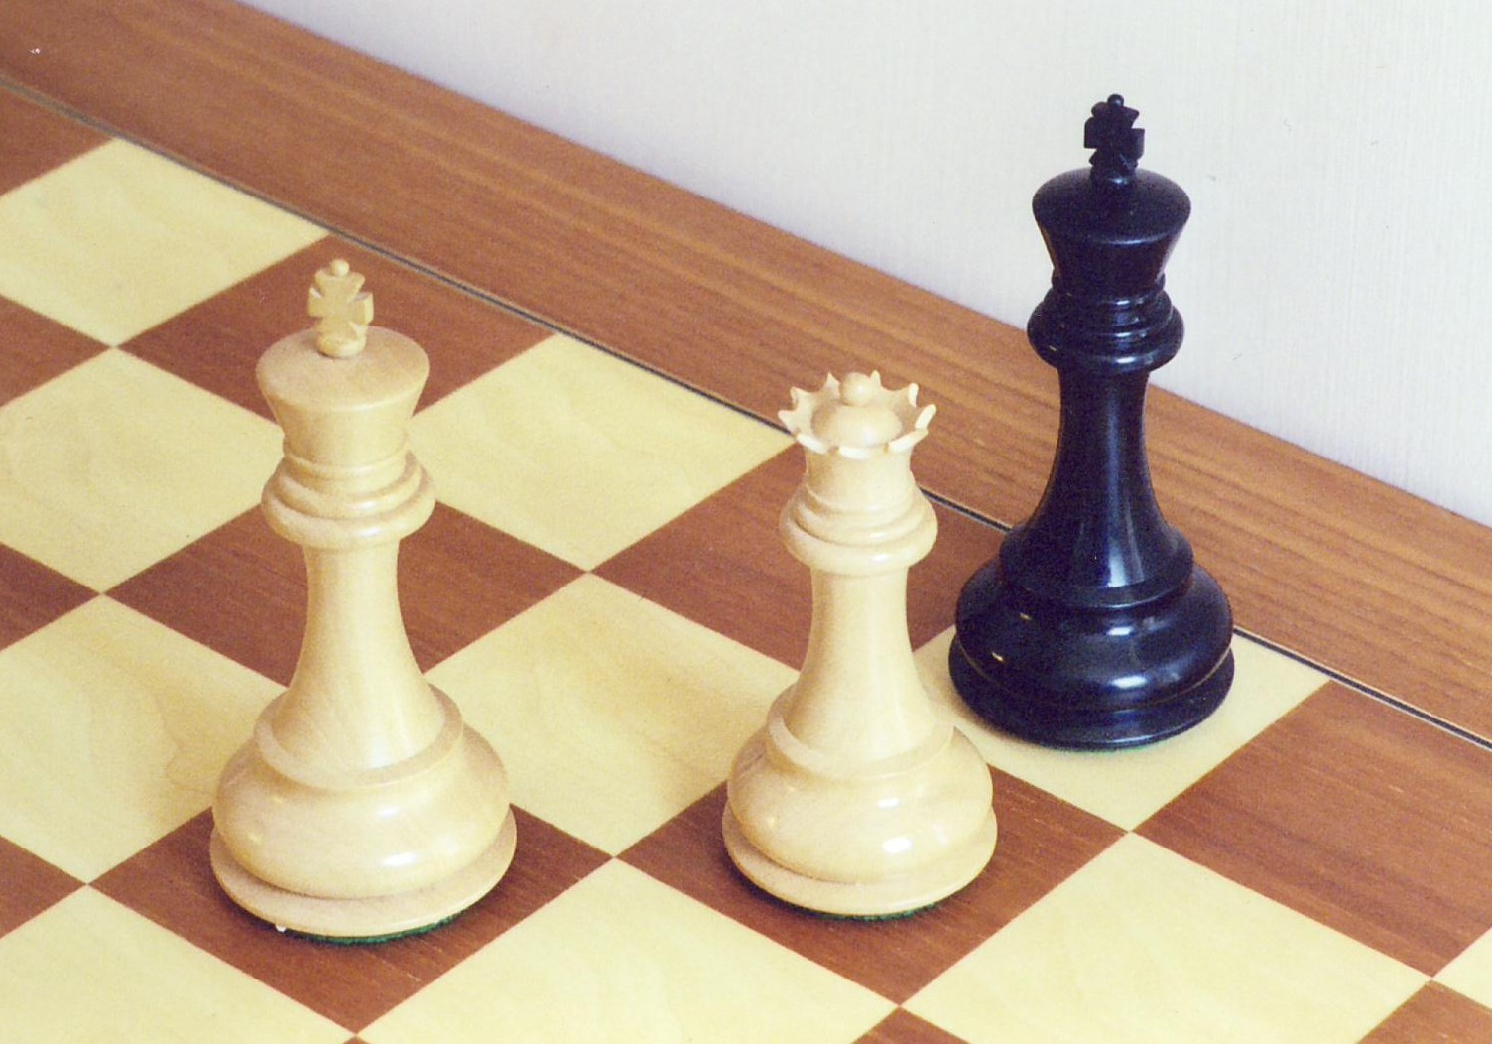
CSCI 3495
Word Embeddings
Natural Language Processing & Large Language Models
Week 5, Class 2 · Wed Sep 23, 2026
Source: Bubba73 (Jud McCranie), Wikimedia Commons, CC BY-SA 3.0
Notes:
King minus man plus woman equals queen. Today they do that arithmetic themselves, on real vectors, and then they run the same line with doctor in it and see what comes back. The second half of the class is what to do about it, on a budget.

Slide 2

Every word gets a place in one shared space
Embeddings scatter words like stars; nearby points share meaning.
Source: Unsplash License, https://unsplash.com/photos/Y20JJ_ddy9M (Vincentiu Solomon)
Notes:
Every dot is a word, and nearness is meaning. Nothing here was hand labelled: the positions came out of reading text. Ask them what would sit near coffee, then near Tuesday.

Slide 3
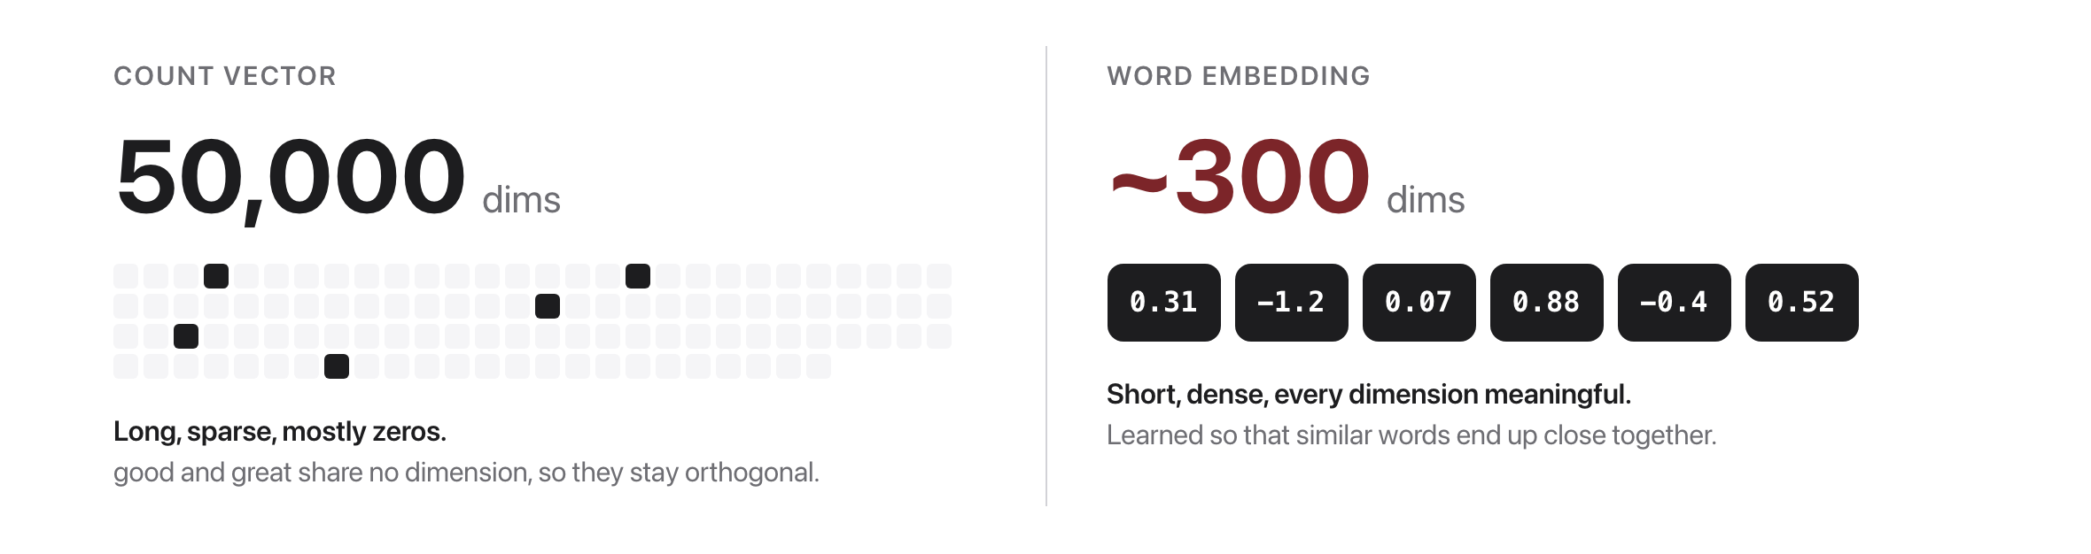
From sparse counts to dense vectors
Source: original figure
Notes:
In a sparse representation a word is a 50,000-long mostly-zero vector, and good and great share no dimension at all, so they are exactly as unrelated as good and asparagus. Today the vector is about 300 numbers, every one of them used, and it is learned rather than counted. That is the whole move.

Slide 4
Let's walk through Parts 1 and 2 in the notebook
Open a real embedding and look inside.
Notes:
Everyone into today's lab.ipynb. Twenty thousand real GloVe words, fifty numbers each, and none of the numbers were chosen by a person. Part 1 opens one vector, Part 2 finds a word's neighbours with cosine similarity. Pause on october: its five nearest words are the other months, all above 0.99, because months are used in near-identical sentences. Nobody told it what a month is.

Slide 5
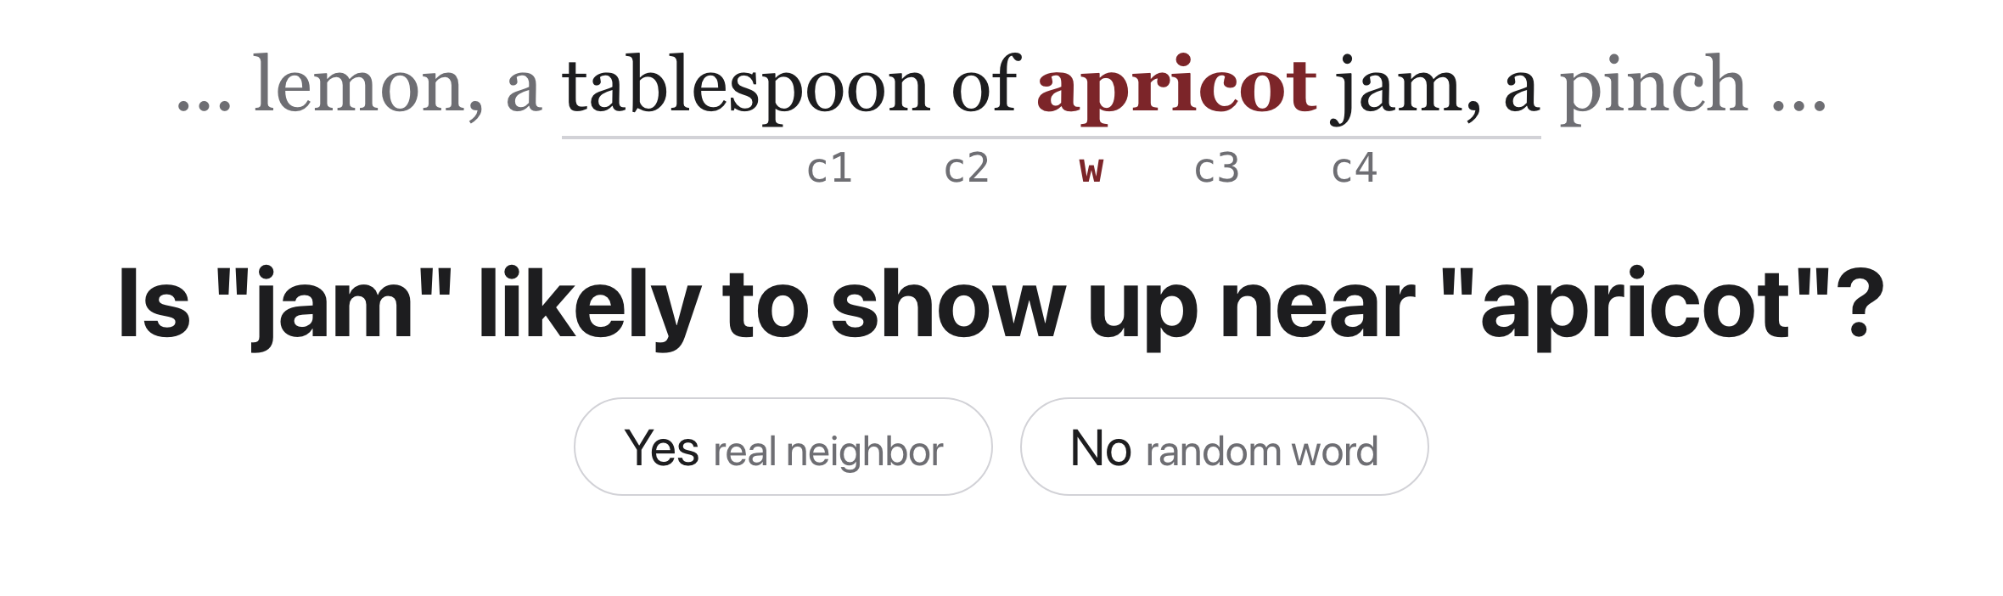
word2vec's trick: turn counting into a quiz
Source: Jurafsky & Martin, SLP3 (Jan 2026 draft), Ch. 5.5 running example
Notes:
Instead of counting neighbors, train a yes/no classifier on a fake task. The quiz is a means to an end. We never actually use this classifier. We train it, throw it away, and keep its learned weights: those are the embeddings.

Slide 6
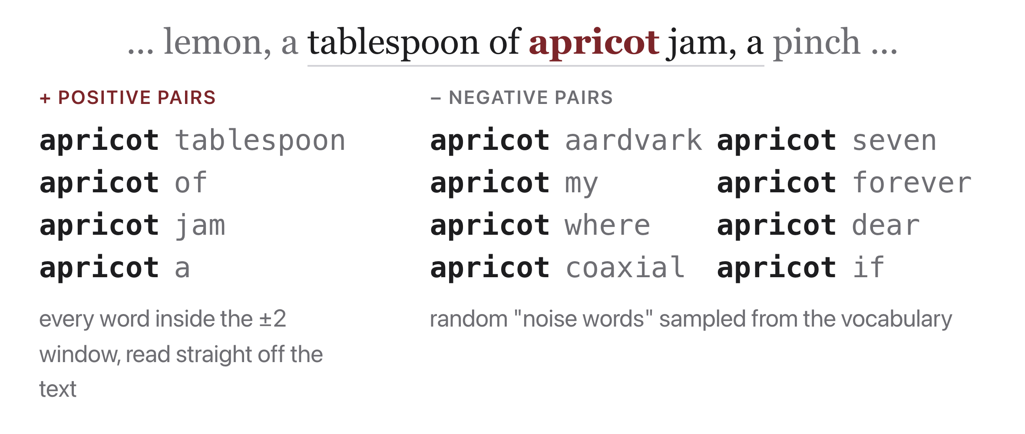
The labels are free: self-supervision
Source: Jurafsky & Martin, SLP3 (Jan 2026 draft), Ch. 5.5.2 training example
Notes:
One window of running text hands us 4 positive pairs; k random noise words per real pair supply the negatives. This is skip-gram with negative sampling (SGNS). K = 2 noise words per real pair , no human labeled anything.

Slide 7
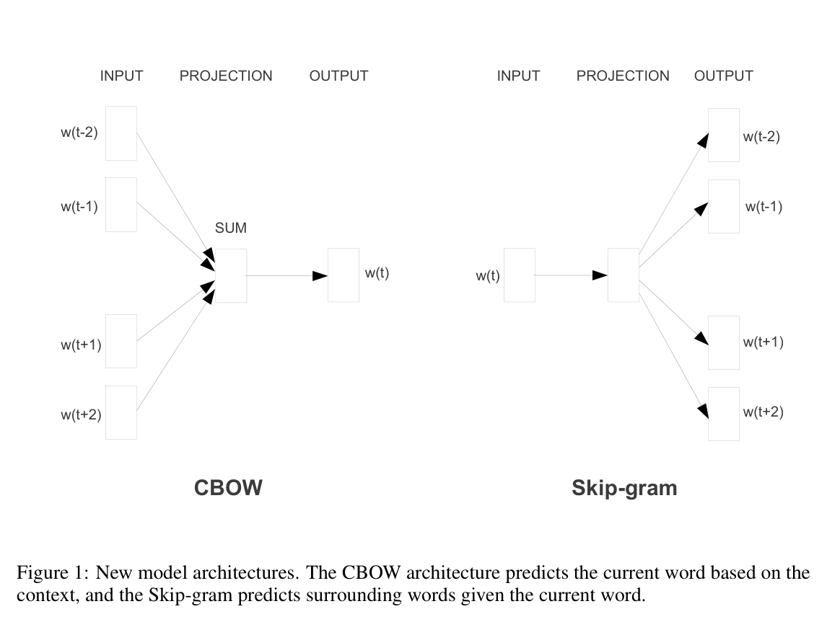
The word2vec family: skip-gram and CBOW
Source: Mikolov et al. 2013 (arXiv:1301.3781), Fig. 1
Notes:
What we just built is skip-gram (right): the center word predicts each neighbor. CBOW (left) flips the arrows. The trained projection weights ARE the word vectors.

Slide 8
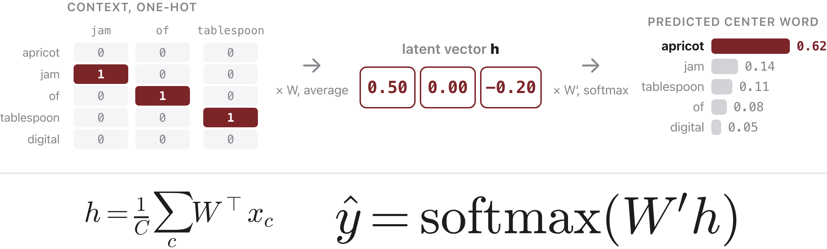
Train a network, then keep only its first layer
Source: original figure; Mikolov et al. 2013 (arXiv:1301.3781), CBOW
Notes:
Walk this left to right with CBOW, which is the easier direction: the context predicts the missing middle word. Three context words come in as one-hot vectors over a five-word vocabulary, so each is a column of zeros with a single one. Multiplying a one-hot by W does not compute anything, it selects a row, so this step is a lookup. CBOW then averages the three rows, and that average is h, the latent vector, the actual numbers on the slide. Then W-prime and a softmax turn h into a probability over the vocabulary, and apricot wins with 0.62. Two things to say out loud. First, there are no biases anywhere in this network and no activation function on the hidden layer, which is unusual for a neural net and is a large part of why it trains on billions of words so cheaply. Second, and this is the punchline: we do not want the prediction. We train the whole thing, throw away W-prime and the softmax, and keep W. Every row of W is one word's embedding. Skip-gram is the same picture with the arrows reversed, and the sigmoid version from three slides ago is skip-gram with negative sampling, which replaces this softmax over the whole vocabulary with k plus one yes-or-no decisions.

Slide 9
The famous result: analogies
Source: original animation; Mikolov et al., 2013
Notes:
The offset between man and woman is the same vector that joins king to queen. A 2D schematic.

Slide 10
Let's walk through Part 3 in the notebook
One line of arithmetic, and then the ones that fail.
Notes:
They write the analogy line themselves: target equals vector b minus vector a plus vector c. King minus man plus woman gives queen at 0.861, clear of daughter at 0.768. Then run the three that do not work, because that is the half nobody shows: brother minus man plus woman gives daughter, and washington minus usa plus france gives Chirac. The famous example is real and it is also cherry-picked.

Slide 11
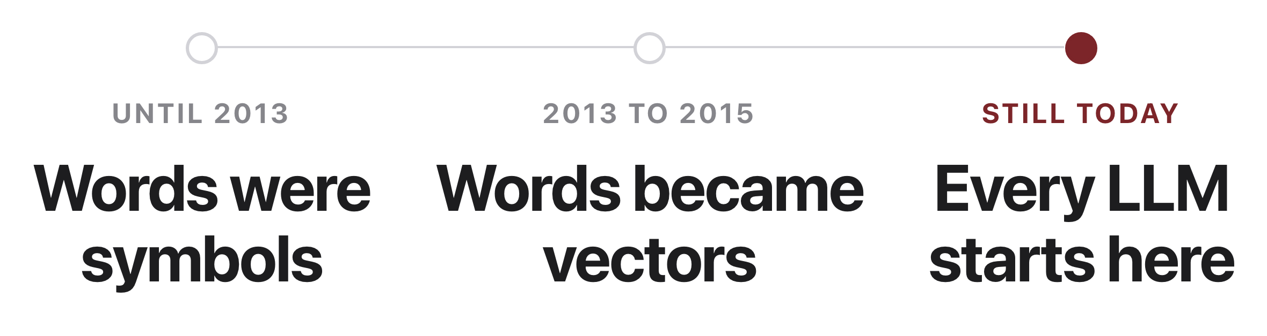
The turn that made modern NLP possible
Source: original figure
Notes:
Three beats, and the slide only shows the shape, so this is the talking. Before 2013, a word was an index into a vocabulary. Everything a model knew about language came from tf-idf over tens of thousands of sparse dimensions plus feature templates a person wrote by hand and rebuilt for every new task, and good and great shared no dimension at all, so they were as unrelated as good and asparagus. Then word2vec in 2013 and GloVe in 2014 made it practical to learn meaning once from raw unlabeled text and hand it to any model as geometry, something you can add, subtract and measure. That is the shift from counting to representation, and it is why the field pivoted to neural networks between roughly 2013 and 2015. Be fair about the history if anyone asks: the idea was not new, Bengio's neural language model in 2003 and Collobert and Weston in 2008 both learned word vectors. What changed was the cost, from a research project to a free download you could train over a weekend. Ubiquity, not novelty. And it never went away. Every LLM in this course still begins with an embedding matrix, just over subword tokens rather than whole words, and it is the same row-of-a-matrix lookup we drew seven slides ago. Week 8 makes those vectors depend on context, Week 13 uses them for retrieval.

Slide 12

Should a machine learn that "programmer" means a man?
Embeddings learn whatever the text assumes, including who belongs where.
Source: Unsplash License, https://unsplash.com/photos/iFgRcqHznqg (Helena Lopes)
Notes:
Do not answer this one yet. The vectors are about to say something uncomfortable, and it is better if they see it in the numbers first.

Slide 13
Let's walk through Part 4 in the notebook
The same line, with doctor in it.
Notes:
Nothing changes except the words going in. Doctor minus man plus woman returns nurse at 0.842. Then they measure it properly against the she minus he direction and get a table: nurse plus 0.381 at the top, captain minus 0.316 at the bottom. Make them read the bottom of that table, because secretary lands at minus 0.216, the male end, and that is the opposite of the stereotype. These vectors are news text, and in news a secretary is a Secretary of State. The corpus decided, which is exactly the question they get next.

Slide 14
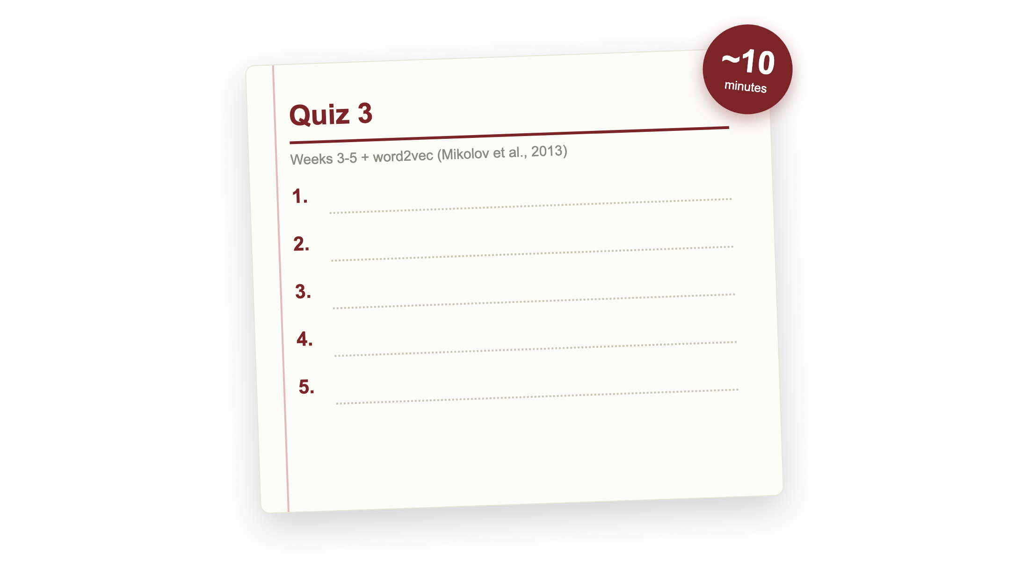
Quiz 3 (paper)
Source: quizzes/quiz-03.md
Notes:
Covers Weeks 3 to 5: NumPy and pandas, probability, PyTorch and the training loop, TF-IDF and cosine, and word2vec, plus the word2vec paper (Mikolov 2013). This is the first quiz since Week 2, so it reaches back further than the others. Clear your desk. Finish early and your break starts early; need more time and it comes out of the break.

Slide 15

Break
Source: original figure

Slide 16
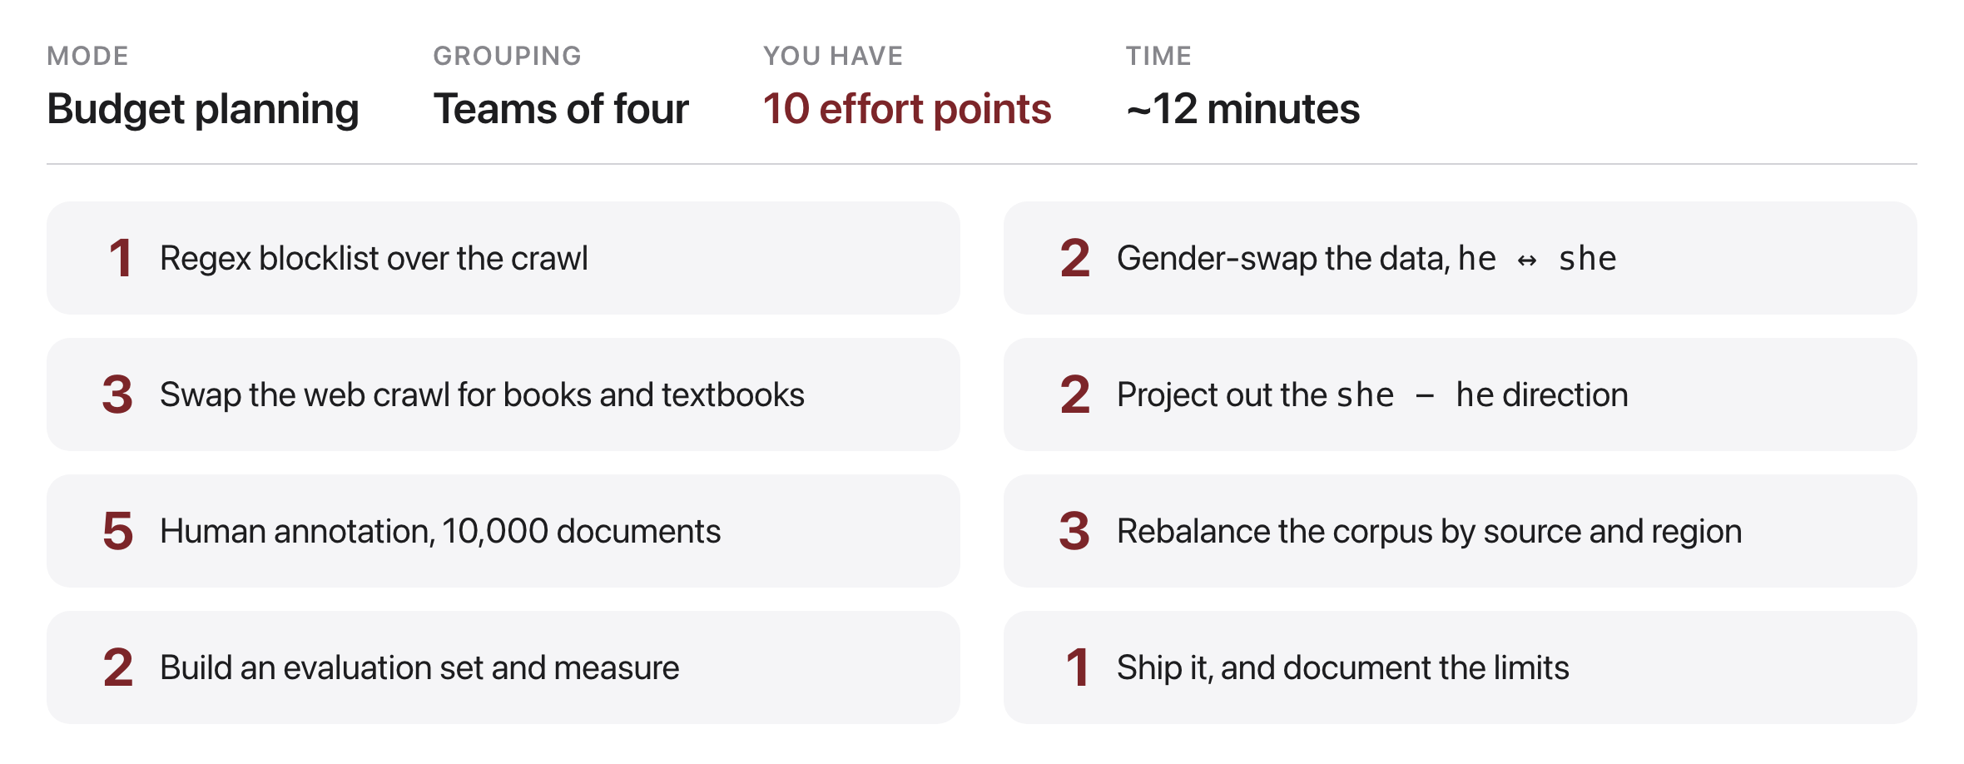
Ten points to spend
Source: original figure
Notes:
Teams of four, nine minutes to decide, then we compare. You are the team that has to ship the next version of these vectors. Every option is real and every one is something a lab has actually done. You cannot afford them all, so the budget is the point: say what you bought, and say what you gave up to buy it. Two rules, one sentence per choice on what it buys, and no team may spend more than ten.

Slide 17
One volunteer per team
What did you buy, and what did you give up?
Notes:
Round the room, one person per team, thirty seconds each. Budget on the board, then the sentence. Do not grade the answers; the useful move is to ask the next team whether they bought the same thing for a different reason. If a team bought the projection, ask what it changes and what it only hides. If a team never bought measurement, ask how they would know their other points worked.

