Slide 1
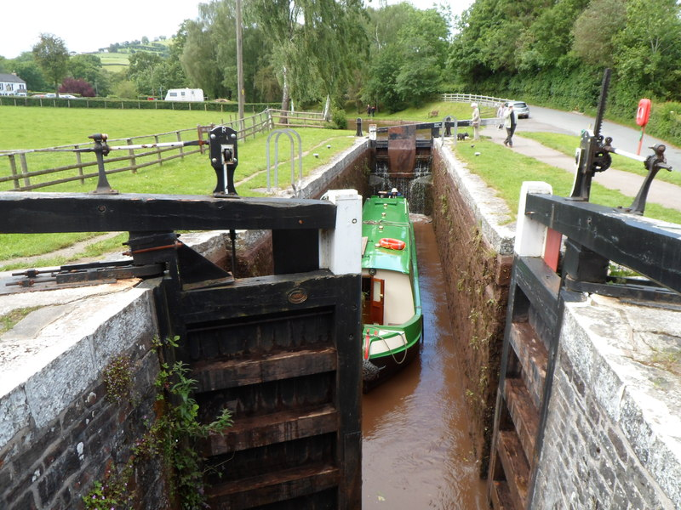
CSCI 3495
Sequence Models
Natural Language Processing & Large Language Models
Week 6, Class 2 · Wed Sep 30, 2026
Source: Jaggery, Geograph Britain and Ireland, CC BY-SA 2.0
Notes:
A canal lock moves a boat one gated chamber at a time, and each gate decides what flows through. Ask the class what plays the part of the water once we call this an LSTM.

Slide 2
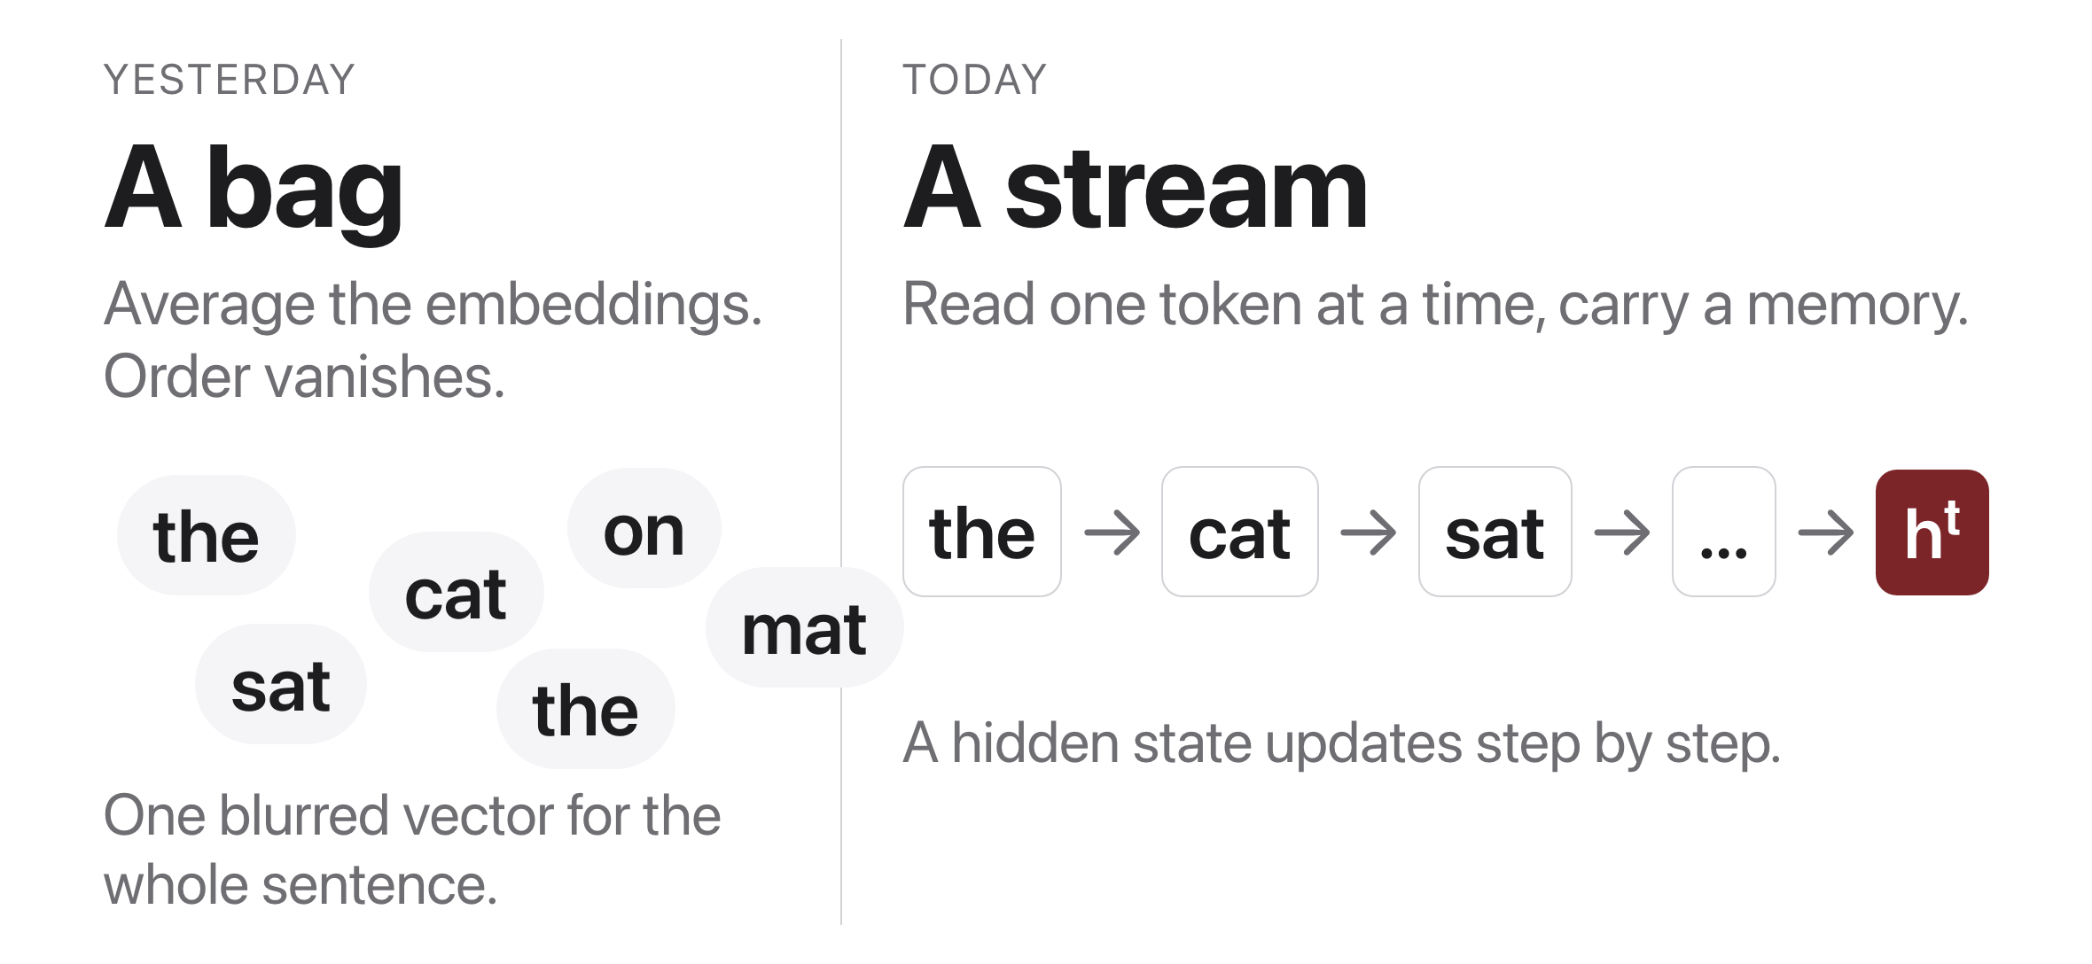
Averaging throws the order away
Source: original figure
Notes:
Same six tokens, and only the model on the right can tell who sat on what. A bag of words cannot represent the difference at all, which is the whole reason to read a sentence in order.

Slide 3
The recurrent idea
Source: original animation (visuals/_gen_rnn_gif.py)
Notes:
Watch one time step at a time: read the next character plus the incoming memory, update the memory, emit a prediction. Every box is the SAME network; the animation loops in slideshow mode.

Slide 4
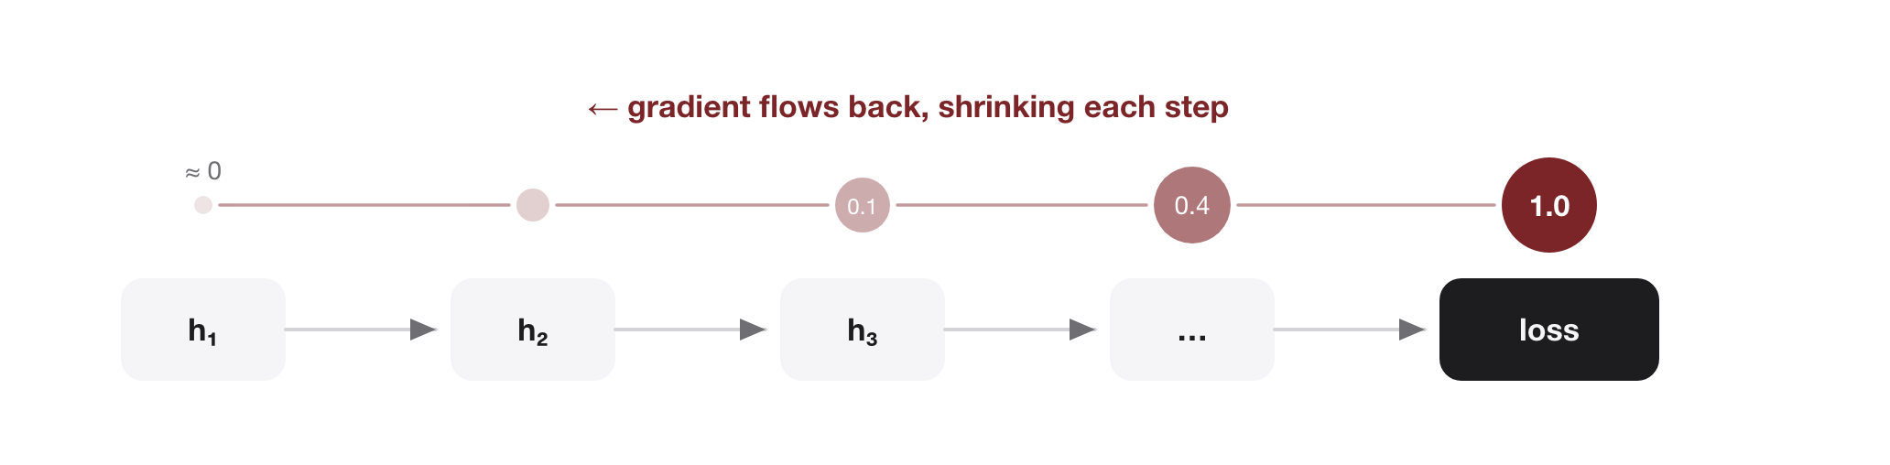
The vanishing gradient problem
Source: original figure
Notes:
Backprop through time multiplies many Jacobians; factors < 1 shrink the gradient to zero, > 1 explode it. Factors < 1 the gradient vanishes (no long-range learning); factors > 1 it explodes (unstable).

Slide 5
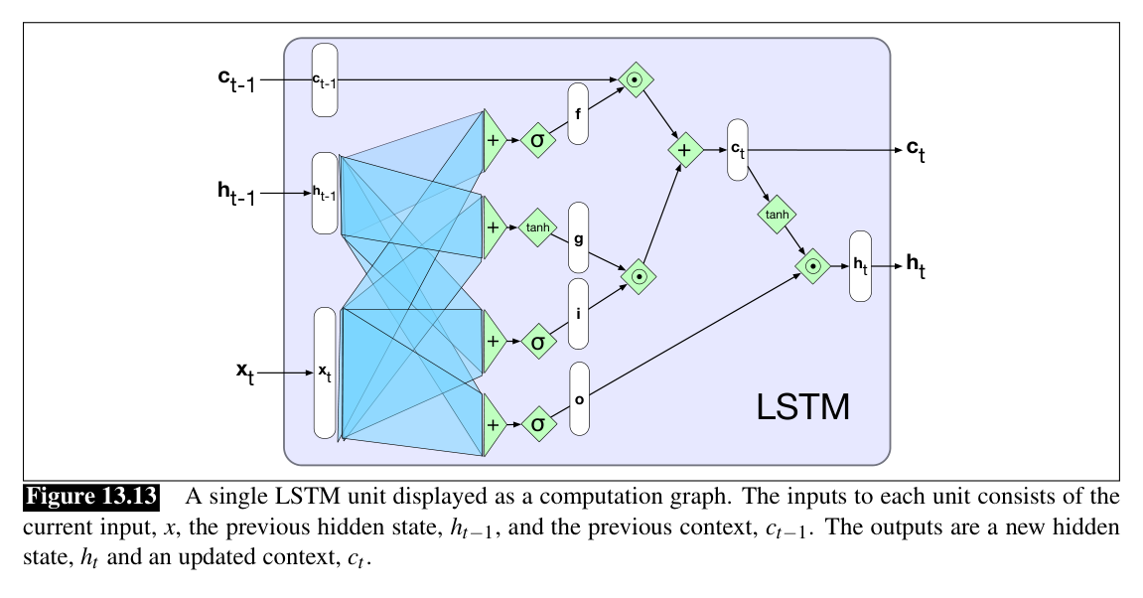
Inside the LSTM cell
Source: Jurafsky & Martin, SLP3 (Jan 2026 draft), Fig. 13.13
Notes:
The conveyor belt from the last slide is the top c path. Find the three sigmoid gates guarding it: f (forget old memory), i (admit the tanh candidate g), o (expose h_t).

Slide 6
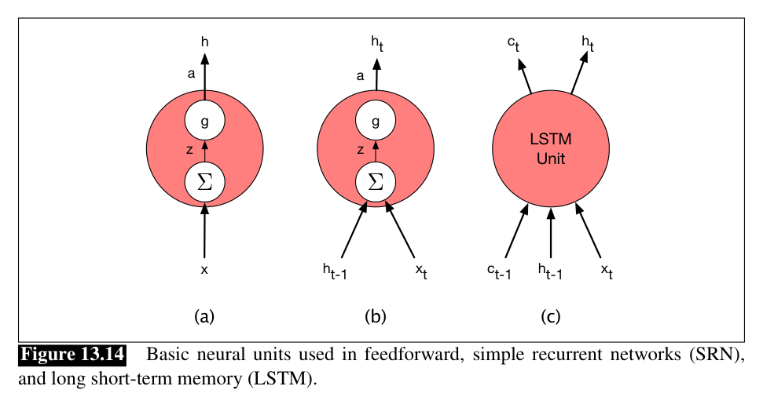
How different is an LSTM, really?
Source: Jurafsky & Martin, SLP3 (Jan 2026 draft), Fig. 13.14
Notes:
From the outside, barely at all: a feedforward unit (a) takes x, an RNN unit (b) adds h_t-1, an LSTM unit (c) just adds the context line c. Same socket, smarter unit; the rest of the network never notices.

Slide 7
Let's walk through Part 1 in the notebook
What nn.LSTM hands back, and what you do with it.
Notes:
Everyone into today's lab.ipynb. We are not building an LSTM, we are using one, so Part 1 is three lines and two shapes. Feed a batch of sequences in and you get back two things: one output per time step, shape (batch, time, hidden), and the final state, shape (1, batch, hidden). Those two return values ARE the three jobs. Per-step outputs give you generation and tagging; the final state alone gives you classification. Make them say that out loud before moving on.

Slide 8
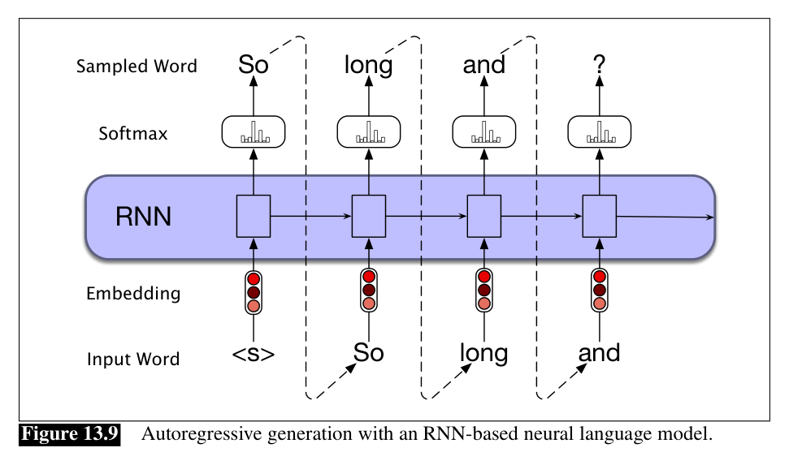
Job 1: language modeling and generation
Source: Jurafsky & Martin, SLP3 (Jan 2026 draft), Fig. 13.9
Notes:
Autoregressive generation: sample a word, feed it back in as the next input, repeat. Part 2 of the notebook does exactly this, one character at a time.

Slide 9
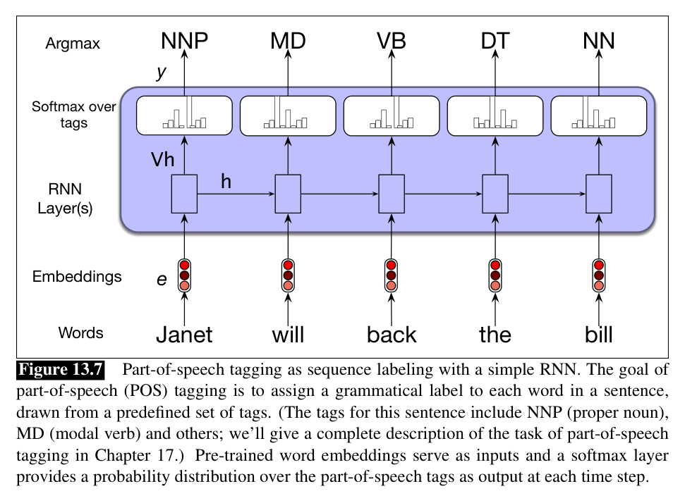
Job 2: label every token
Source: Jurafsky & Martin, SLP3 (Jan 2026 draft), Fig. 13.7
Notes:
Same loop, different head: emit one output PER time step and you get sequence labeling, here part-of-speech tags for "Janet will back the bill".

Slide 10
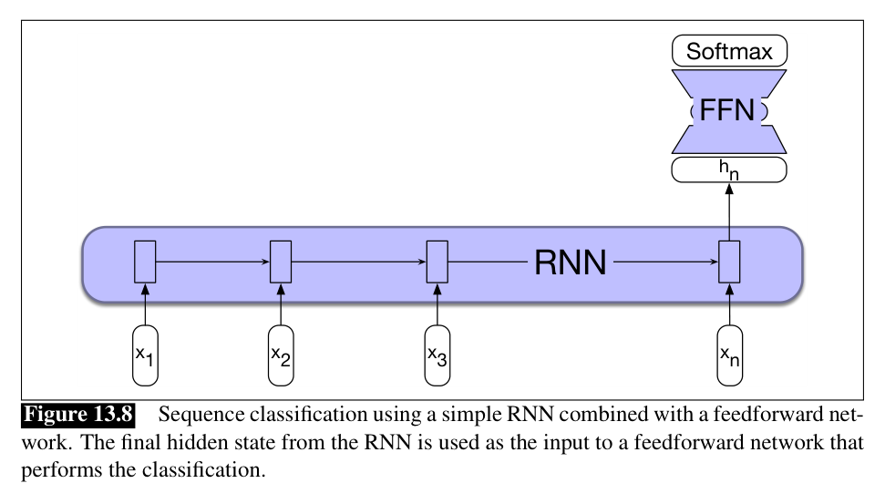
Job 3: classify the whole sequence
Source: Jurafsky & Martin, SLP3 (Jan 2026 draft), Fig. 13.8
Notes:
Or keep ONLY the last hidden state, which has read everything, and hand it to a feedforward classifier. Spam filter, sentiment, sarcasm: one sequence in, one label out. This is the job they build after the break.

Slide 11
Let's walk through Parts 2, 3 and 4 in the notebook
Three trained models. One line different between them.
Notes:
Three small LSTMs are already trained and waiting in data/, so nothing here takes more than a second to run. Part 2 generates headlines a character at a time, Part 3 tags a sentence, Part 4 says whether a headline is sarcastic. Put the three forward methods side by side at the end: head(outputs) for the two per-step jobs, head(last_hidden) for the classifier. That single line is the entire difference between the three architectures on the previous slides.

Slide 12
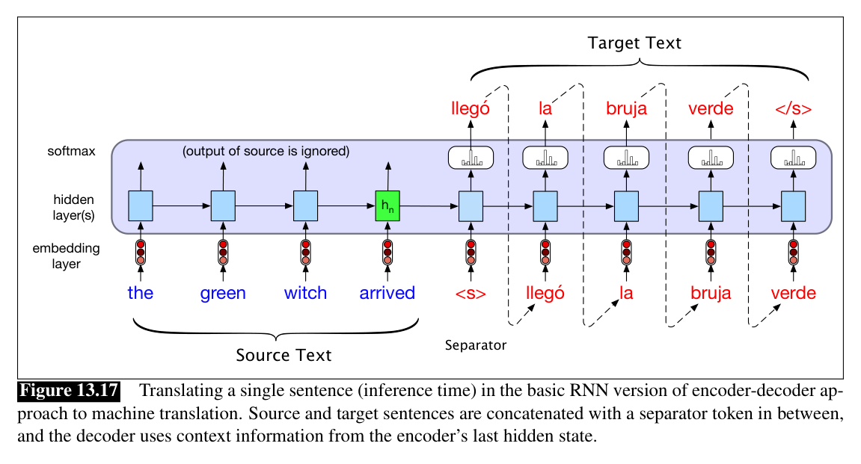
Why this matters: seq2seq
Source: Jurafsky & Martin, SLP3 (Jan 2026 draft), Fig. 13.17
Notes:
Fig 13.15's panel (d) with real words: read "the green witch arrived", hand over ONE hidden state (the green h_n), and unroll Spanish from it. Your reading (Sutskever et al. 2014) built exactly this with LSTMs; feeding the source reversed lifted BLEU from 25.9 to 30.6.

Slide 13

Break
Source: original figure

Slide 14
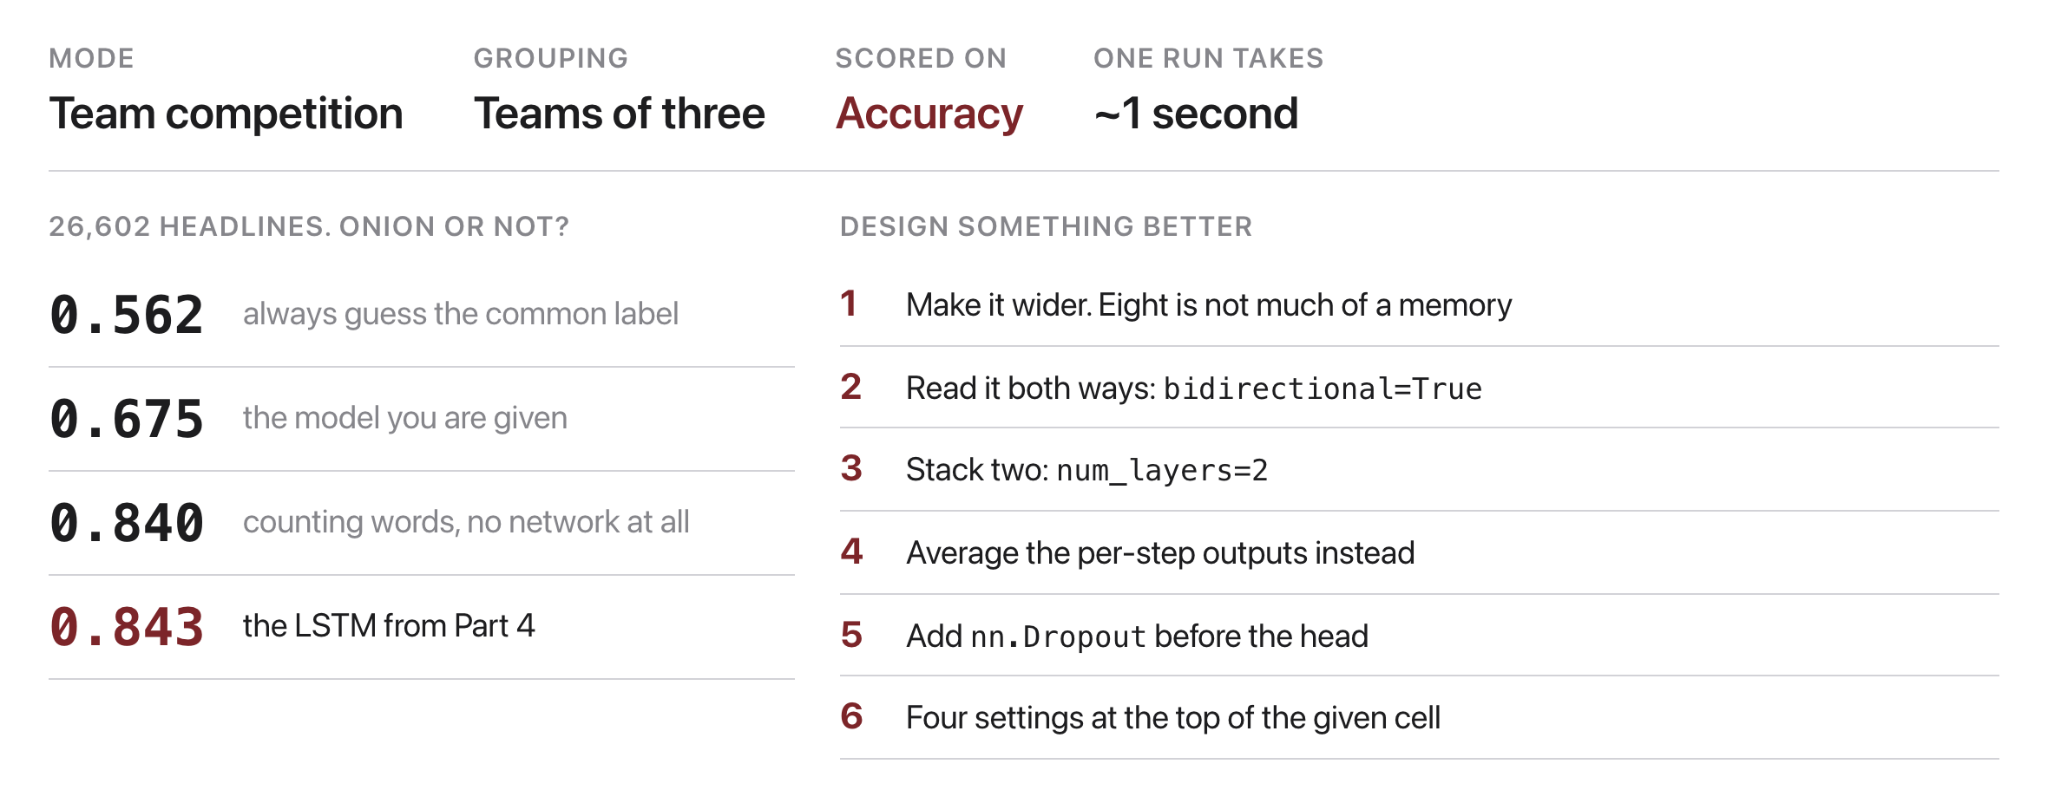
Train your own sarcasm detector
Source: original figure; the headline corpus in today's notebook
Notes:
Teams of three, about twenty-five minutes. Twenty-six thousand real headlines, half from The Onion and half from HuffPost, and the job is to tell them apart. They write the model themselves, and the starting point barely beats guessing. Counting words gets 0.840, so that is the number to chase. Read a few misclassified headlines at the end; the ones it gets wrong are usually the genuinely ambiguous ones, which is the honest finding.

