Slide 1
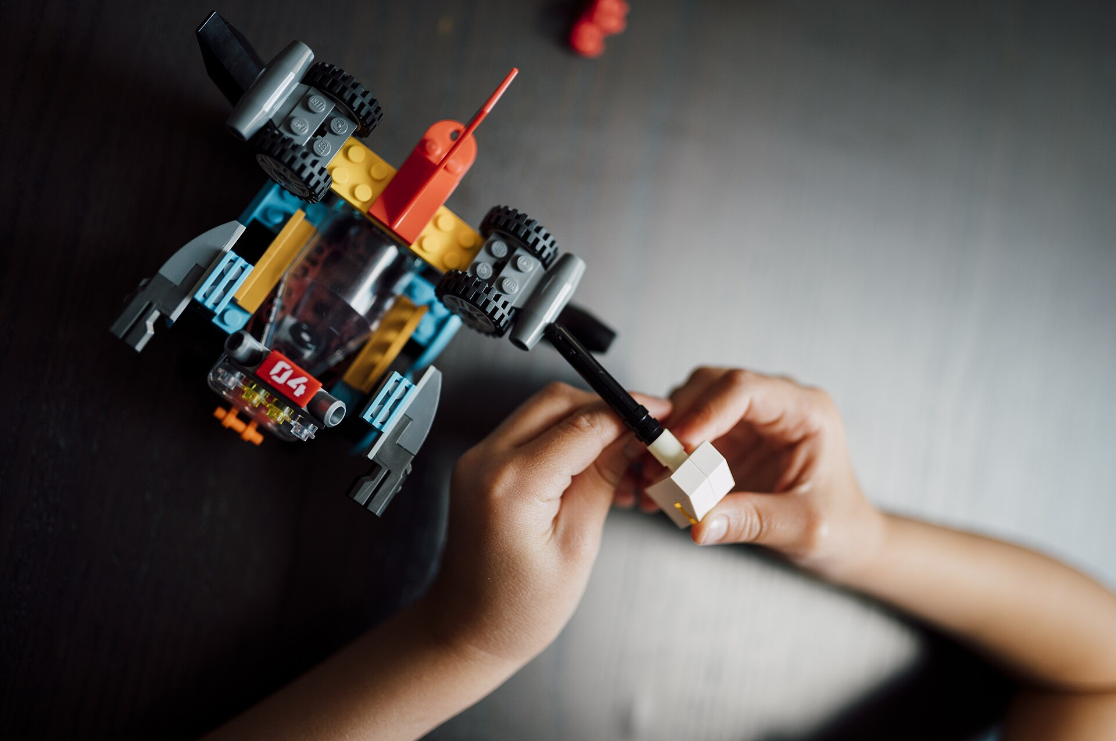
CSCI 3495
Transformers by hand, then your project
Natural Language Processing & Large Language Models
Week 7, Class 2 · Wed Oct 7, 2026
Source: Nenad Stojkovic, Wikimedia Commons, CC BY 2.0
Notes:
Two halves and a quiz between them. First thirty minutes: markers, no laptops, and six problems that take a transformer apart with arithmetic. Everything they need is on the slide, so nobody has to remember a formula. After the break the laptops come out but not for code: teams sit together and get the proposal into a state where it can be written down. Say both halves out loud at the start so nobody is waiting for a lab that is not coming.

Slide 2
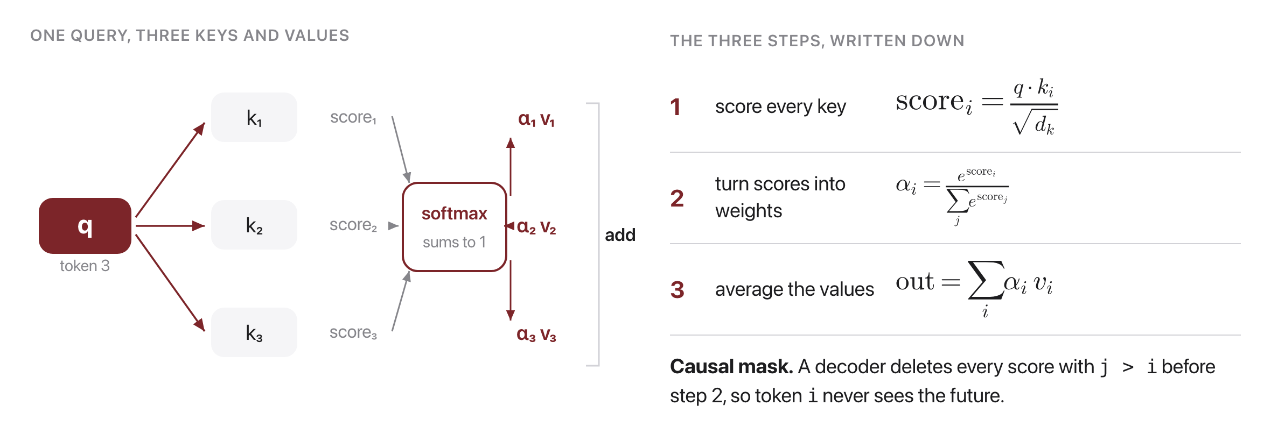
Refresher: what attention computes
Source: original figure
Notes:
Leave this up. Every formula the problems need is on this slide and the next, so nobody has to remember anything. Three steps: score each key against the query and divide by root d_k, softmax the scores into weights that sum to one, then average the values with those weights. The mask line at the bottom matters for problem 2: a decoder deletes the future scores BEFORE the softmax, not after, which is why the surviving weights still sum to one.

Slide 3
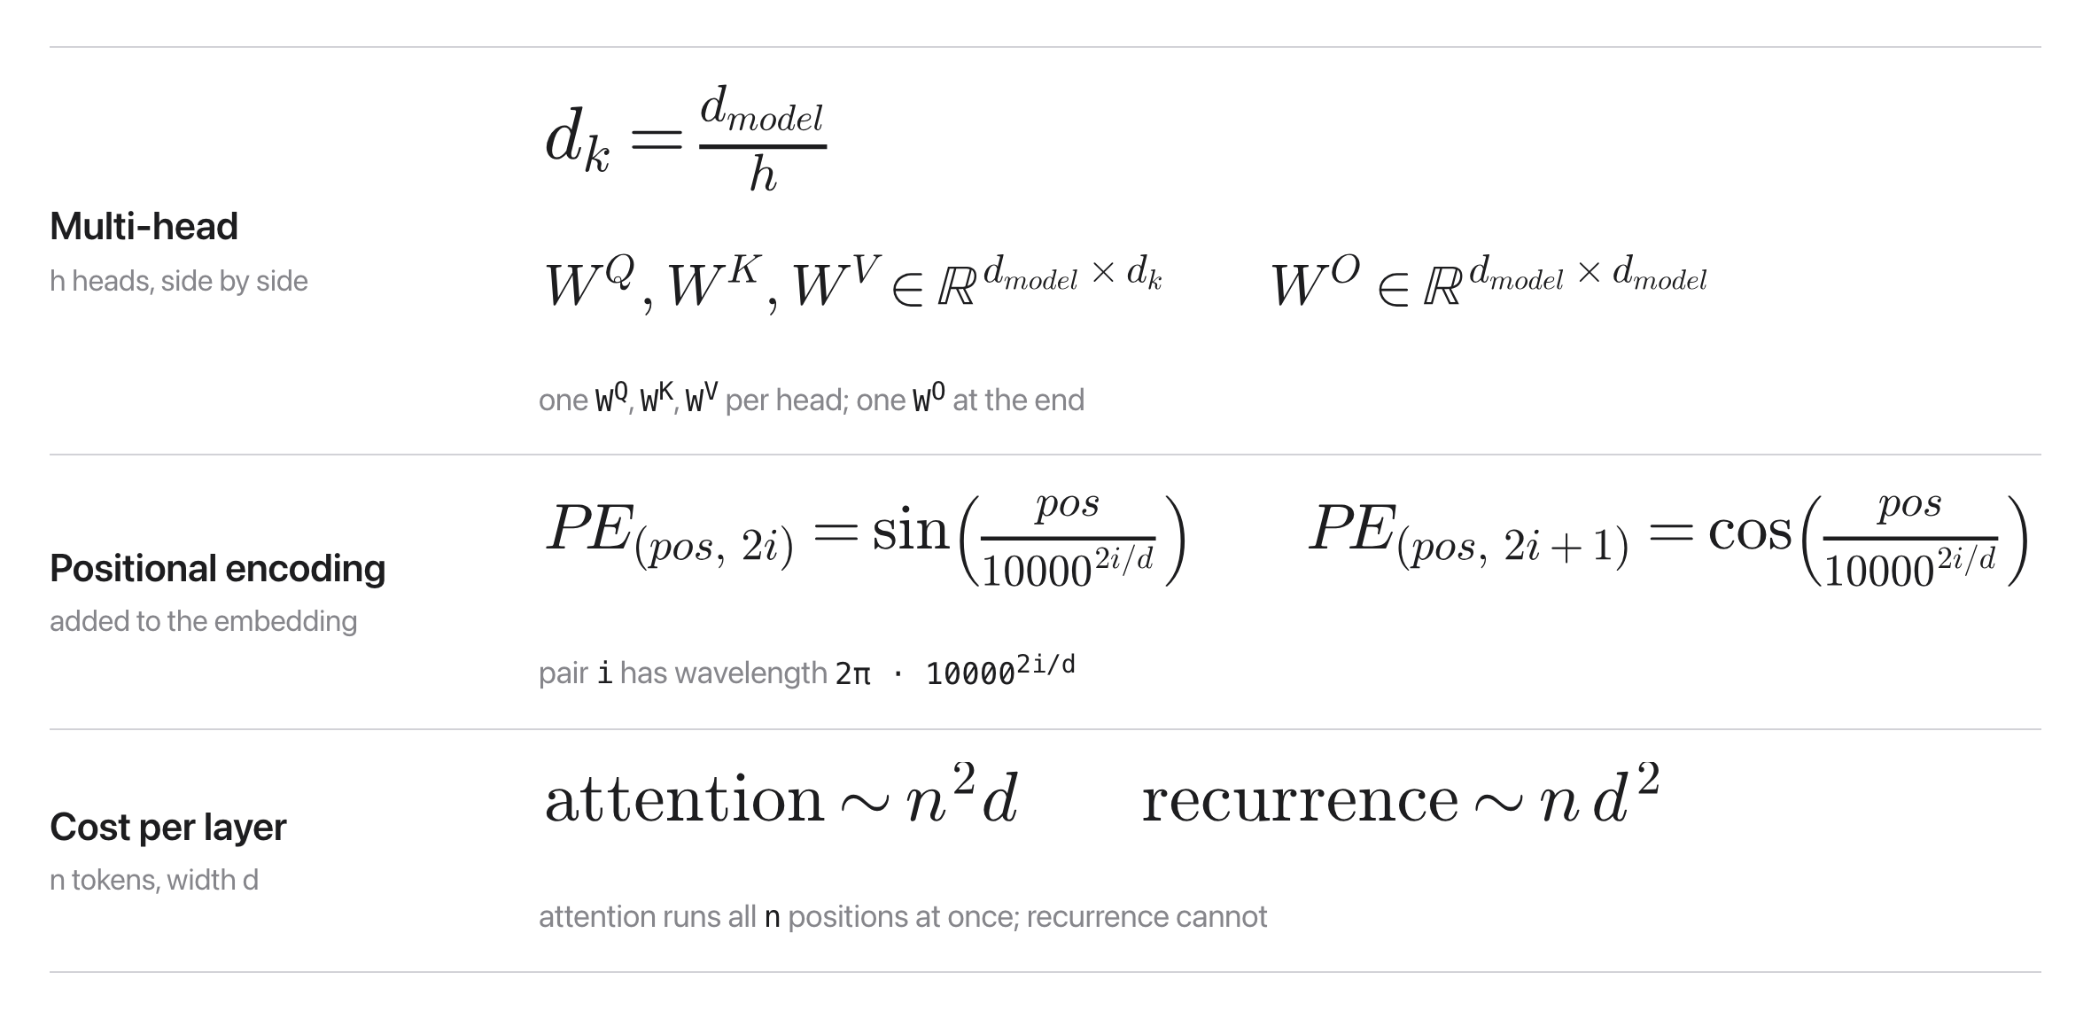
Refresher: heads, positions, and cost
Source: original figure
Notes:
The rest of the toolkit, and again it stays up for the whole half. Multi-head splits the width across h heads, so each head is narrower. Positional encodings are sines and cosines of the position, one pair per i, and the wavelength line is what problem 5 turns on. The cost line is problem 6. Do not explain any of these now; they are here to be referred to, and the problems are where they get understood.

Slide 4
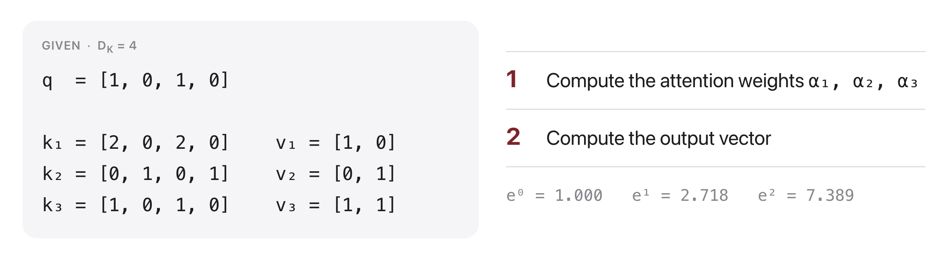
Problem 1: one attention step
Source: original figure
Notes:
Let them finish this one before anything else; it is the whole mechanism in one calculation. Scores 4, 0, 2, halved to 2, 0, 1, weights 0.665, 0.090, 0.245, output 0.910, 0.335. If a team is stuck, ask what the dot product is measuring. k1 points the same way as q and twice as far, which is why token 1 dominates, and k2 is orthogonal so it scores zero and STILL gets nine per cent, because softmax never returns a hard zero.

Slide 5
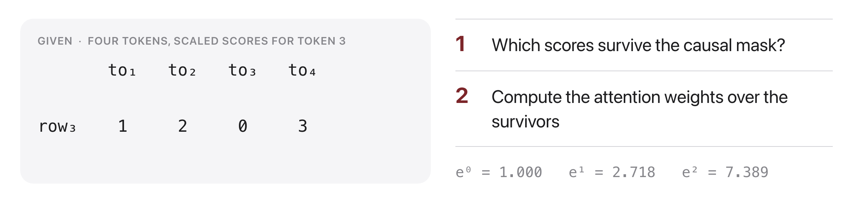
Problem 2: the causal mask
Source: original figure
Notes:
Short. Only the first three survive; token 4 is deleted. Softmax of 1, 2, 0 gives 0.245, 0.665, 0.090. The point to draw out is that token 4 had the HIGHEST score, 3, and it is still forbidden, because at generation time token 4 has not been produced yet. Train with it visible and the model learns to lean on something it will never have.

Slide 6
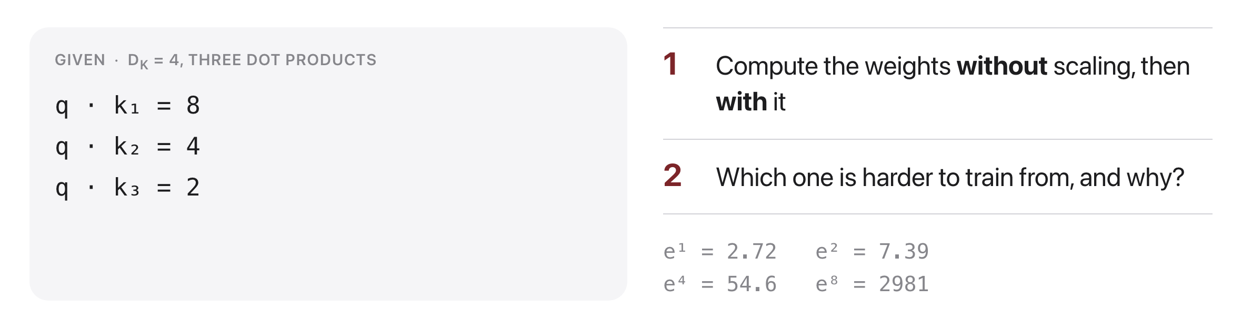
Problem 3: why the square root
Source: original figure
Notes:
Unscaled: 0.980, 0.018, 0.002. Scaled by 2: 0.844, 0.114, 0.042. The unscaled one is nearly a hard choice, and a saturated softmax has almost no gradient, so the layer stops learning. Add the part that makes it matter: dot products grow with d_k, so without the division the problem gets worse the wider you build.

Slide 7
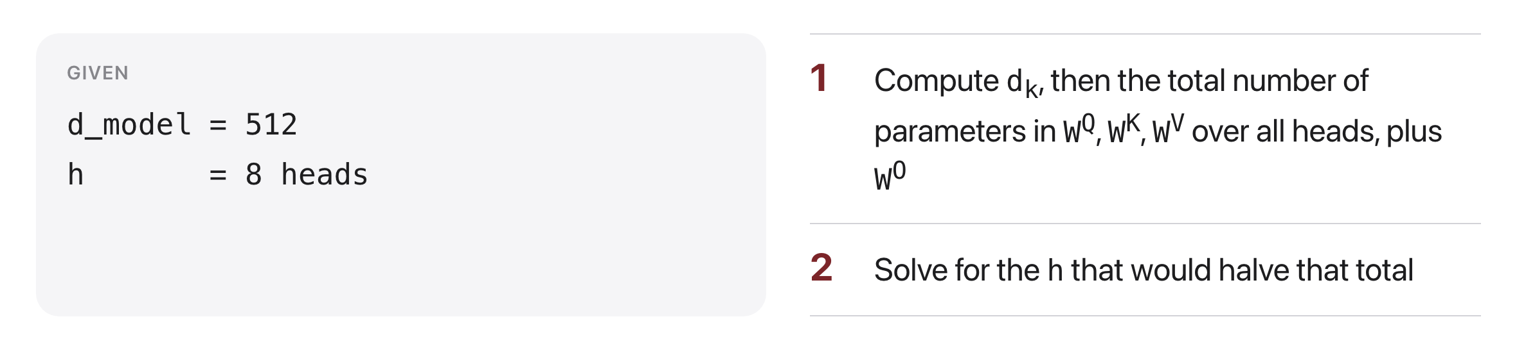
Problem 4: counting the parameters
Source: original figure
Notes:
d_k is 64. One W_Q is 512 by 64, so 32,768. Q, K and V over eight heads is 786,432, which is three d_model squared, plus W_O at 262,144, so 1,048,576 in total, four d_model squared. Question 2 is the good one: there is NO h that halves it, because h cancels. Eight heads cost exactly what one head of full width costs. Ask for a guess before they compute.

Slide 8
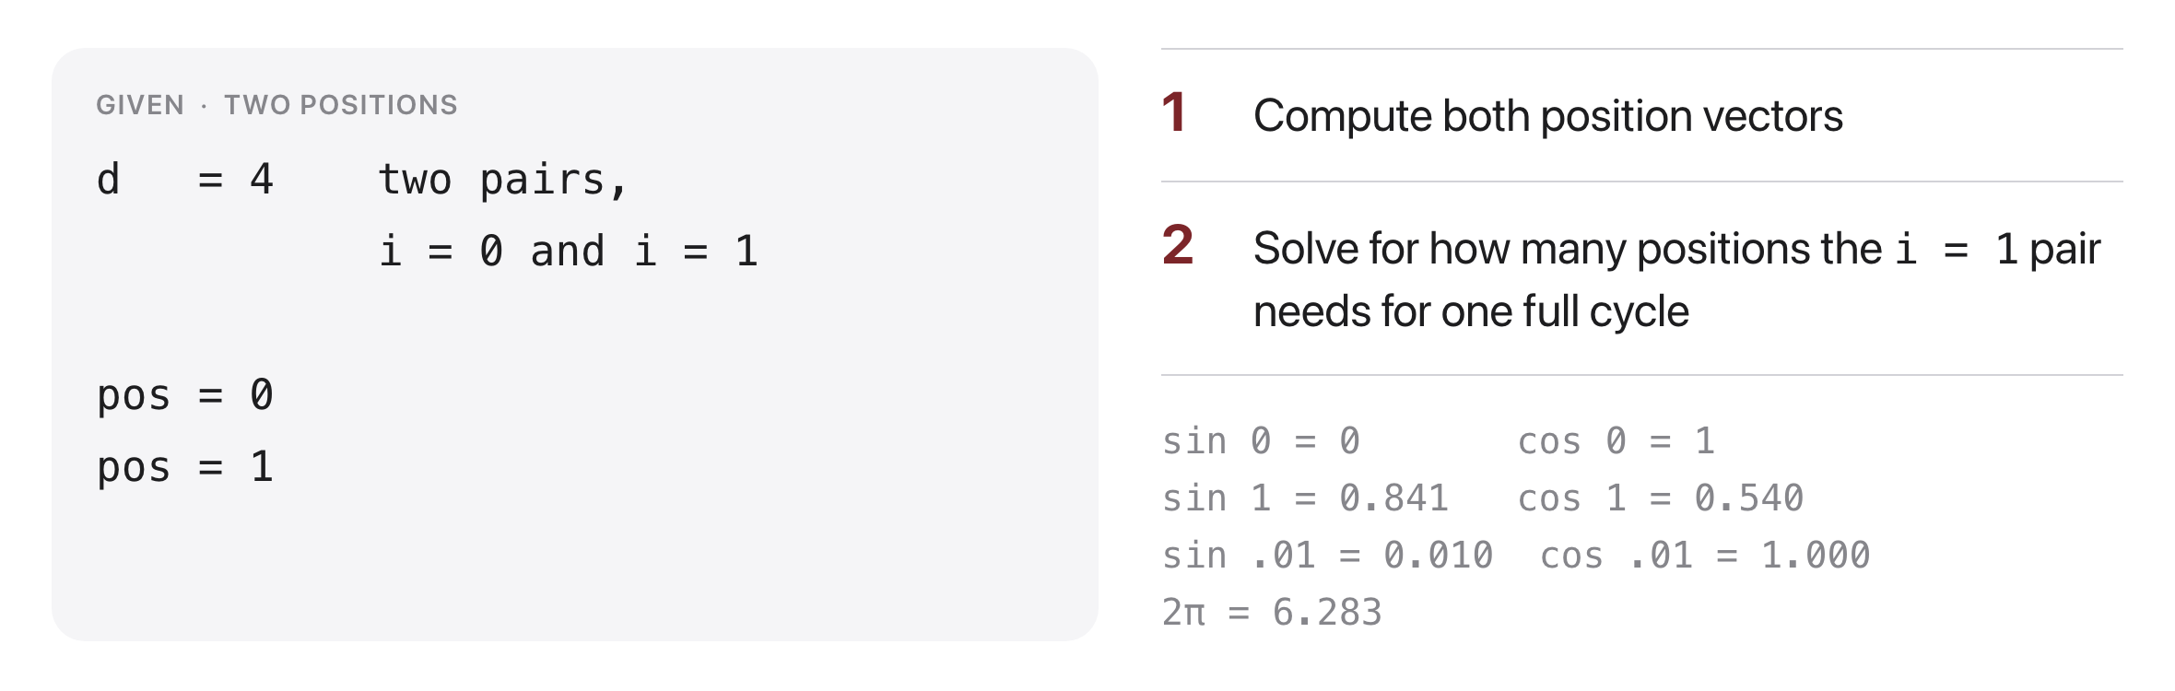
Problem 5: encoding position
Source: original figure
Notes:
pos 0 is 0, 1, 0, 1. pos 1 is 0.841, 0.540, 0.010, 1.000. The i=1 pair barely moved, and question 2 says why: its wavelength is 2 pi times 100, about 628 positions, against about 6 for the fast pair. Fast pairs separate neighbours, slow pairs separate position 5 from position 500. It is a counter written in sines.

Slide 9
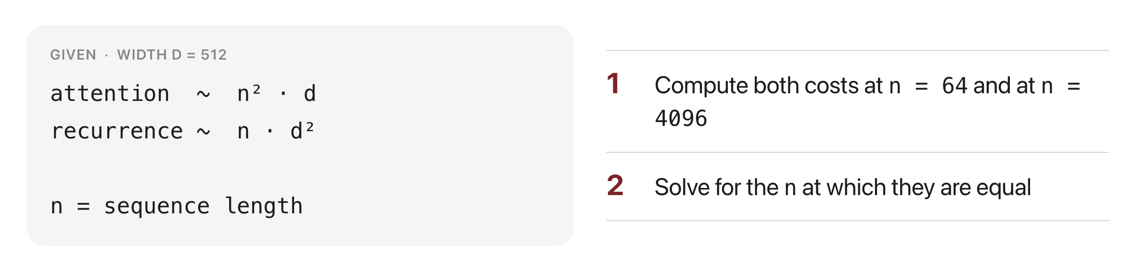
Problem 6: what attention costs
Source: original figure
Notes:
At n=64: attention about 2.1 million, recurrence about 16.8 million, so attention wins by eight times. At n=4096 it reverses exactly: 8.6 billion against 1.07 billion. They are equal at n = d = 512. Then the real answer to why attention won in 2017: sentences were short, so it was on the cheap side, AND every position computes at once while recurrence cannot. Parallelism is the reason; the arithmetic just does not stand in the way.

Slide 10
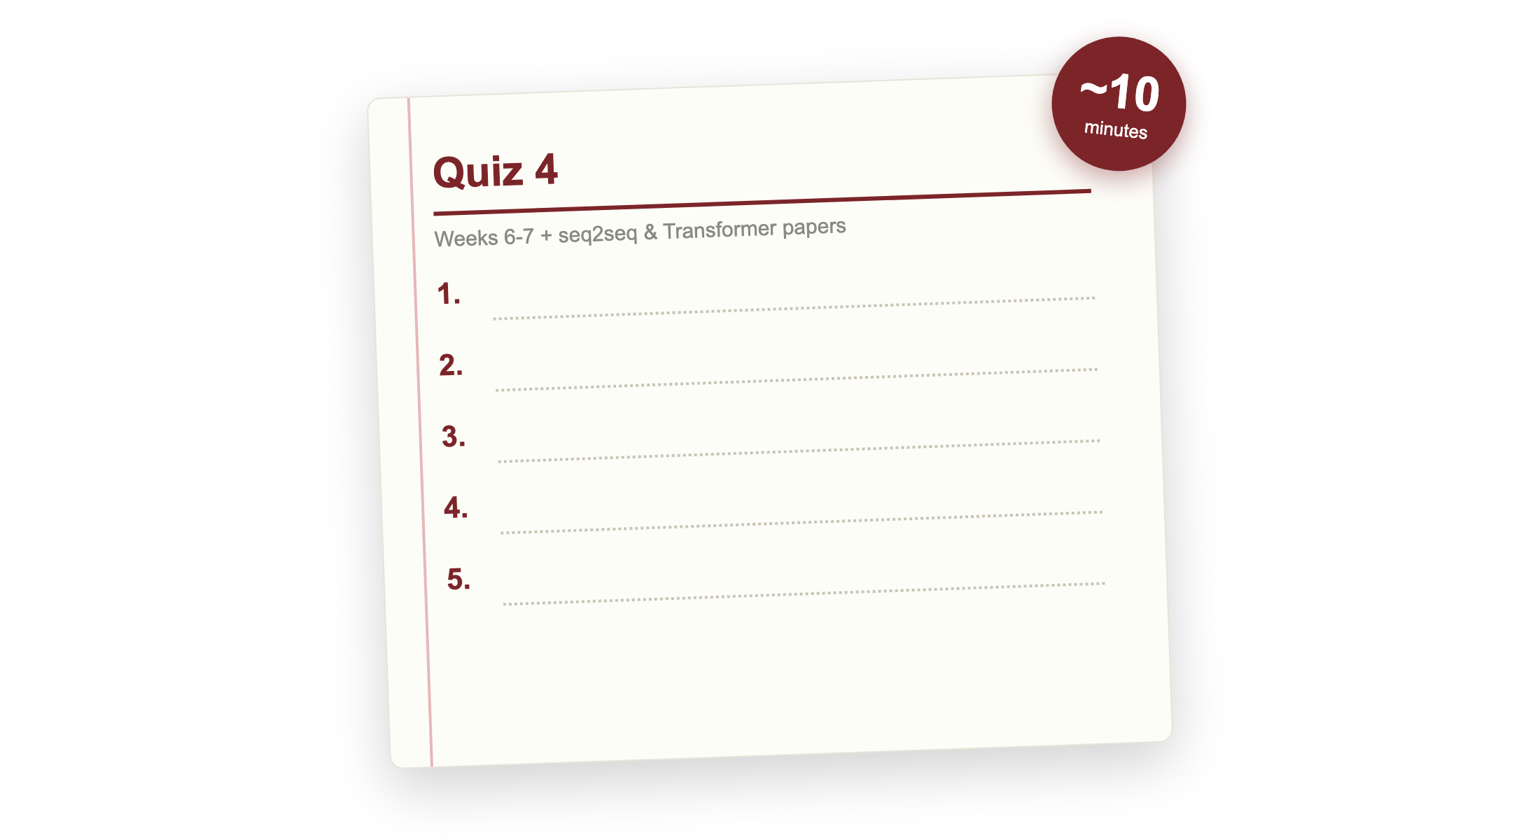
Quiz 4 (paper)
Source: quizzes/quiz-04.md
Notes:
Covers Weeks 6 and 7: neural nets, RNNs and LSTMs, attention and the Transformer, plus seq2seq (Sutskever 2014) and Attention Is All You Need (Vaswani 2017). Clear your desk. Finish early and your break starts early; need more time and it comes out of the break.

Slide 11

Break
Source: original figure

Slide 12
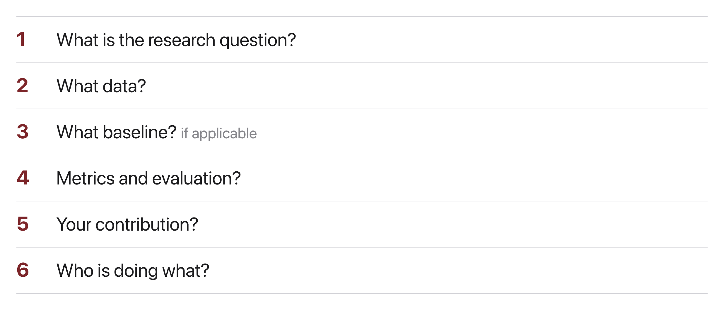
Six questions, on paper, before you write anything
Source: original figure; project/proposal/TEMPLATE.md
Notes:
Teams sit together. Answer these six out loud, in order, and write the answers down; the proposal is a one-page write-up of them. I am walking the room the whole time. The order matters: a team that cannot answer the first one in a single sentence with no method in it does not have a project yet. Push hardest on the baseline and on whether it runs on a laptop, because those two kill more projects than ambition does. Question five is the one people skip, and it is the one the rubric weighs most.

