Slide 1

CSCI 3495
BERT in code
Natural Language Processing & Large Language Models
Week 8, Class 2 · Wed Oct 14, 2026
Source: Unsplash License, https://images.unsplash.com/photo-1518770660439-4636190af475
Notes:
Laptops open today, all of it. Three parts before the break, then the second half is one build in pairs. Say up front that we are not implementing a transformer; we are loading a trained one and using it, which is what anyone actually does with these models. The first cell downloads about 260 MB, so start it running while you talk.

Slide 2
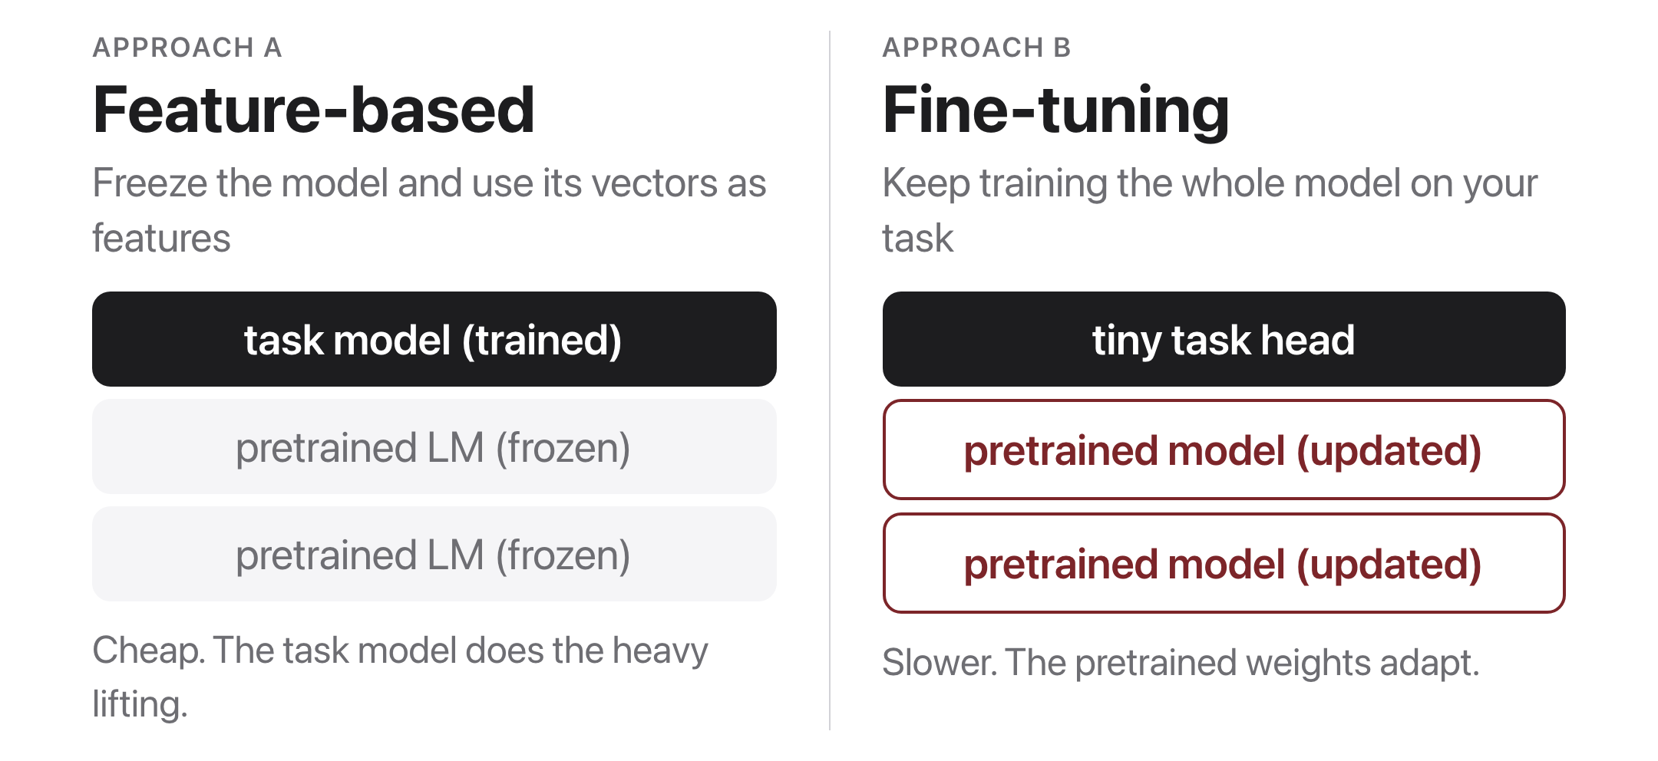
Two ways to use a pretrained model
Source: original figure
Notes:
The only decision you make when you pick up a pretrained model: do its weights move or not. Freeze it and it is a feature extractor, and whatever you put on top does all the learning. Unfreeze it and the representation itself reshapes around your task, which costs a great deal more compute and usually wins. The notebook does both today and puts the two numbers side by side, so do not settle the argument now.

Slide 3
Let's walk through Part 1 in the notebook
Three rows of numbers, and nothing else goes in.
Notes:
Everyone into today's lab.ipynb, run the setup cell first. Part 1 is the input, exactly as drawn on the board: token ids, the segment row that separates two sentences, and the attention mask that says which positions are padding. Slow down on the mask, because it is the one row that has nothing to do with meaning; it exists so a batch can hold sentences of different lengths. The TRY IT is the WordPiece one: an unusual word comes back in pieces.

Slide 4
Let's walk through Part 2 in the notebook
Its guess, and the number behind the guess.
Notes:
The pretraining objective, run live. We mask a word, take the logits at that one position, softmax them, and read the top five. Then the loss for a word we choose, which is the same cross entropy the model was trained with. Point out that the two sentences differ by a few words and the answer changes completely, because that is the whole difference from a lookup table. The TRY IT asks them to find a sentence the model gets wrong, and those are worth collecting out loud.

Slide 5
Let's walk through Part 3 in the notebook
One vector stands in for a whole sentence.
Notes:
The frozen half of the fine-tuning slide. Two thousand headlines go through the encoder once, we keep only the [CLS] vector from each, and a logistic regression on those vectors scores 0.827 on sarcasm. Say plainly what just happened: the encoder learned nothing about sarcasm, it has never seen this data set, and a linear model on its output is already most of the way there. That number is the baseline for the second half, so write it on the board.

Slide 6

Break
Source: original figure

Slide 7
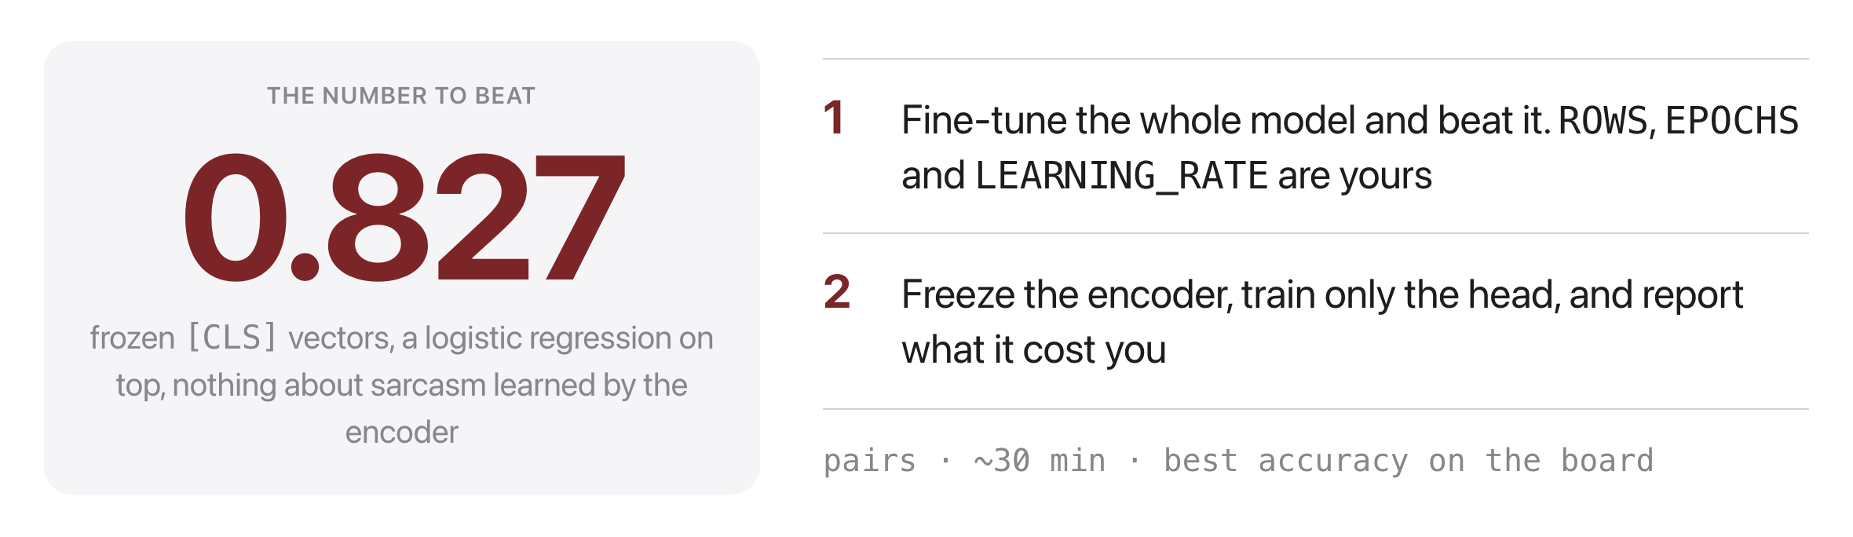
Beat the frozen baseline
Source: original figure; today's notebook
Notes:
Pairs, about thirty minutes, and the training loop is given so the work is choosing what to train on and for how long. The starting settings are deliberately bad and score below the baseline, which is the point: fine-tuning is not automatically better, it is better once it has enough data. The second task is the one to insist on, because freezing the encoder collapses the score, and that number is the honest answer to why anyone pays for fine-tuning at all. Last five minutes, collect the best accuracy from each pair and ask the winning pair what they changed.

